Slide 1
Why Did HMGB2 PROTACs Fail?
Target biology vs. PROTAC geometry
HMGB2 — The Target
The PROTAC Design Question
Nuclear chromatin-binding protein (Box A + Box B domains)
209 amino acids, 24 kDa, pI ~9.5 (highly basic)
20+ surface-accessible lysines — favorable for ubiquitination
Long, flexible, acidic C-terminal tail (186–209 aa)
Rapid dynamic exchange on/off chromatin (FRAP t½ ~seconds)
Involved in: inflammation, cancer, chromatin remodeling
Unregulated in multiple cancers (prognostic marker)
Warhead: Inflachromene (ICM) — known HMGB1/2 binder (Lee et al., 2014)
E3 ligases: VHL (AHPC) and CRBN (Thalidomide)
Linkers: C4, C6, C8 alkyl (3 lengths × 2 E3 = 6 PROTACs)
RESULT: All 6 PROTACs showed NO degradation
Core questions:
1. Is the ternary complex geometrically possible?
2. Is HMGB2 intrinsically non-degradable?
3. Which design parameter caused the failure?
This talk: Systematic computational diagnosis → Root cause identified → Rational redesign plan
1/11

Slide 2
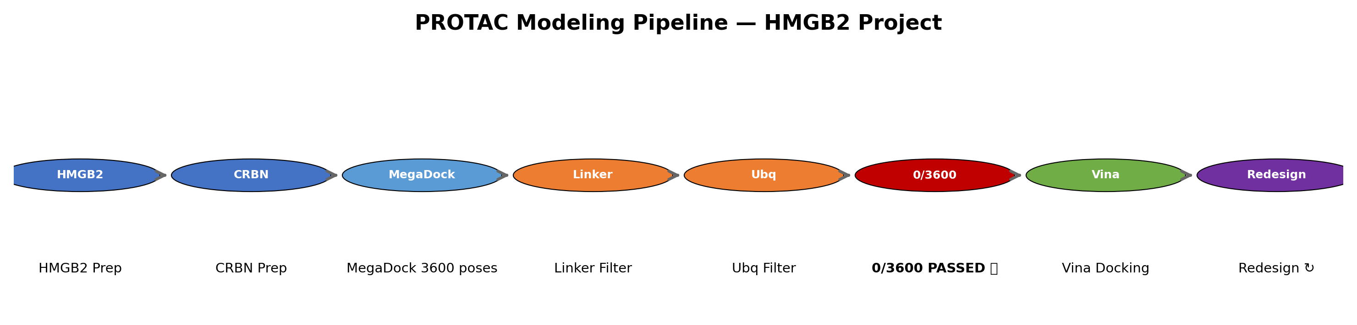
Computational Pipeline
HMGB2 modeling workflow — from structure to redesign
Pipeline Steps
1. HMGB2 + CRBN structure preparation (fix, minimize, protonate) → PDB prep
2. MegaDock: 3600 orientations of CRBN around HMGB2 → exhaustive sampling
3. PROTAC linker distance filter (auto-cutoff: 0.74 Å) → checks geometric feasibility
4. Ubiquitination filter (CRBN: 16 Å cutoff) → checks lysine-to-E2~Ub distance
5. Vina docking: 12 warheads against HMGB2 → score + rank alternatives
6. Root-cause diagnosis + redesign proposal → next cycle
2/11

Slide 3
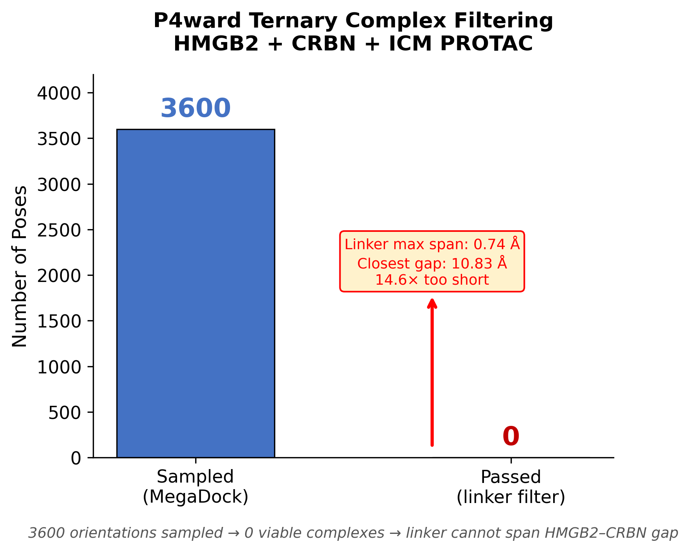
P4ward Ternary Complex Modeling — Primary Result
3600 orientations sampled → 0 viable ternary complexes
KEY RESULT
Total MegaDock orientations: 3,600
Passed linker distance filter: 0
Passed ubiquitination filter: 0
Closest exit-vector gap: 10.83 Å
Linker max conformational span: 0.74 Å
Gap vs. linker: 14.6× too large
Verification: P4ward log entry
"There are no poses which satisfy the
ligand distance filtering criteria.
Exiting now."
Method: Sharma et al., Sci Rep 15:21502, 2025
(PRosettaC/P4ward benchmark — best-in-class
for PROTAC ternary complex prediction)
DEFINITIVE RESULT: The C4-equivalent linker (CCCOCCC, 0.74 Å max span) cannot bridge HMGB2 and CRBN → no ternary complex possible
3/11

Slide 4
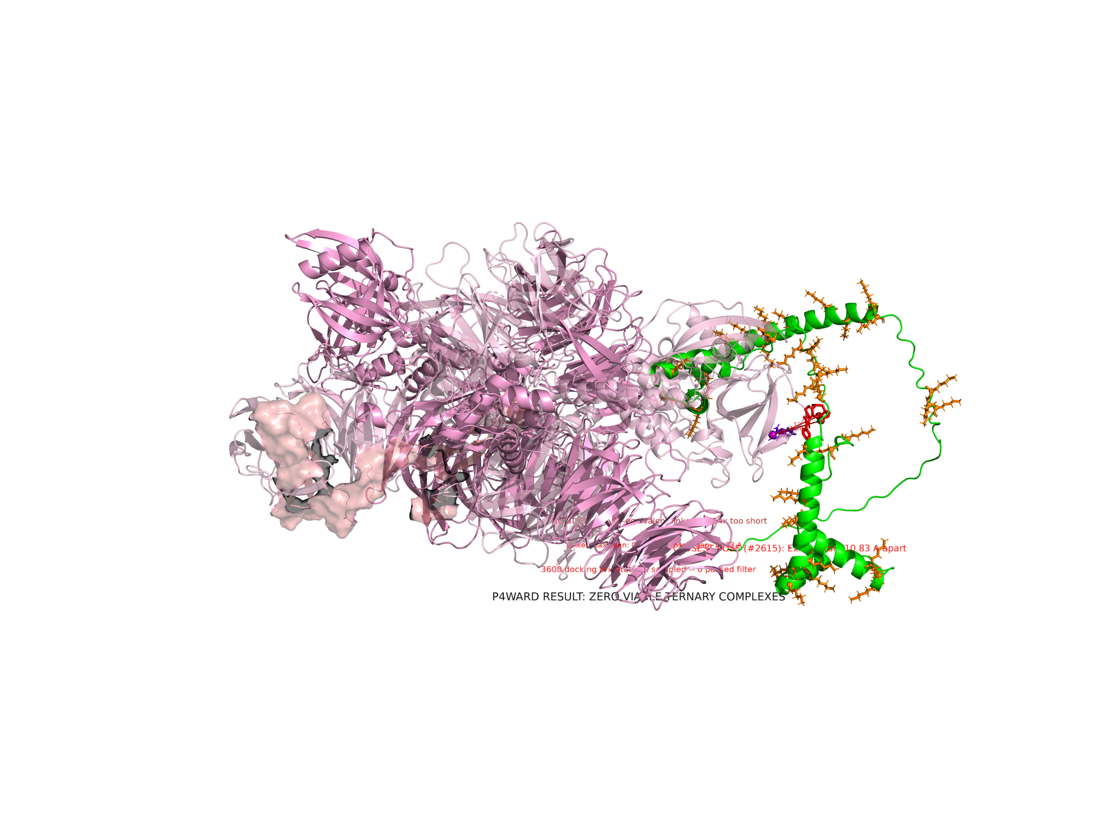
Closest Failed MegaDock/P4ward Pose (#2615)
Best of 3600 orientations — still no viable ternary complex
GREEN: HMGB2 (receptor, fixed position) | PINK: CRBN (ligase, rotated by MegaDock)
Exit vectors (red spheres on ICM, purple spheres on thalidomide) are still 10.83 Å apart
CCCOCCC linker can span at most 0.74 Å → this orientation cannot form a productive ternary complex
4/11

Slide 5
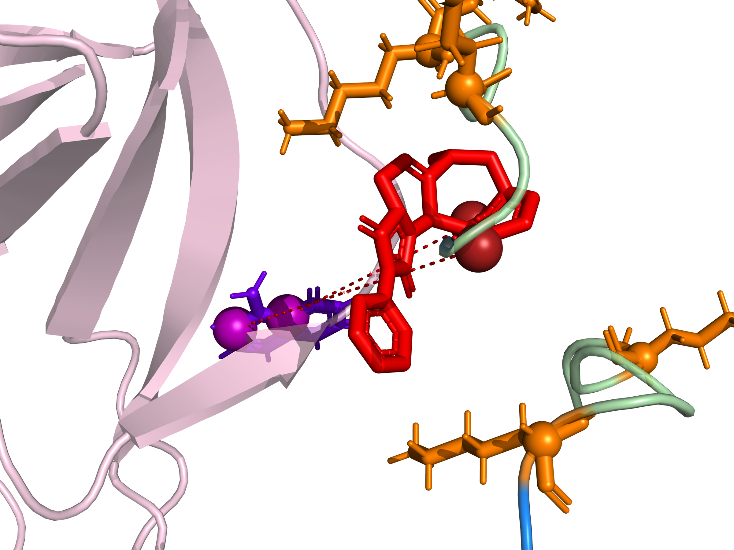
Exit Vector Gap — Zoom View
ICM warhead exit vectors vs. thalidomide exit vectors
GAP MEASUREMENT
ICM OH (exit vector 1)
↕ 10.83 Å
Thalidomide C (exit vec.)
vs.
Linker max span: 0.74 Å
Gap is 14.6× larger
than linker can span
→ Geometry impossible
→ All 3600 poses failed
5/11

Slide 6
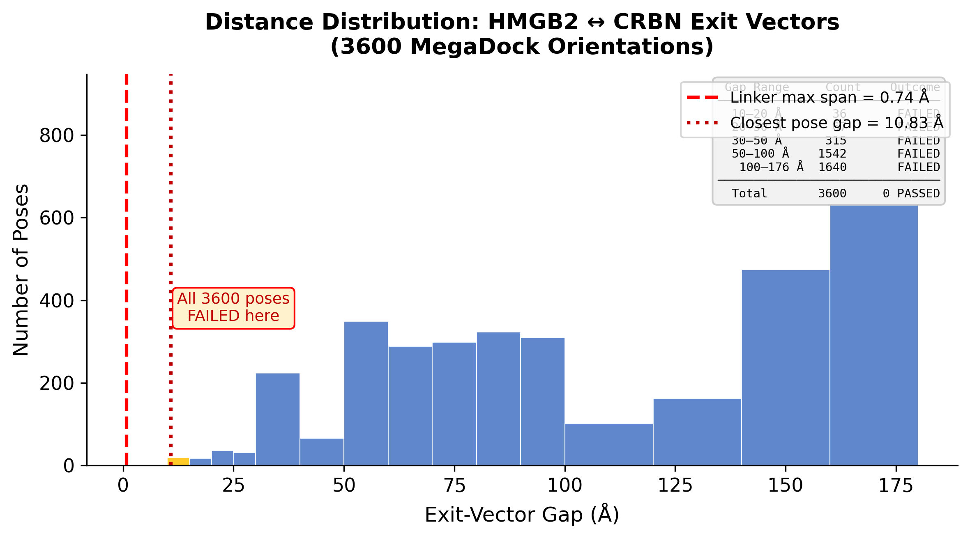
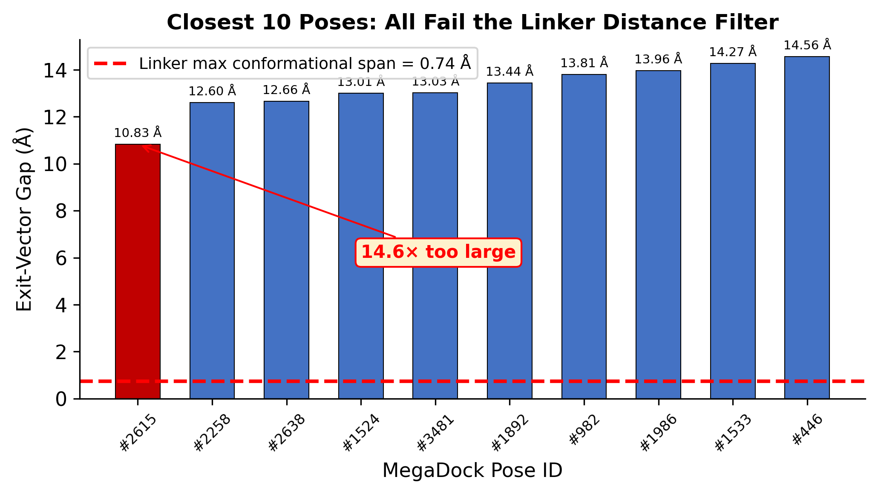
Distance Distribution — All 3600 MegaDock Poses
Exit-vector gaps range from 10.83 Å to 176.04 Å — none pass the filter
Gap Range Count Outcome
───────────────────────────────
10–20 Å 36 FAILED
20–30 Å 67 FAILED
30–50 Å 315 FAILED
50–100 Å 1,542 FAILED
100–176 Å 1,640 FAILED
───────────────────────────────
TOTAL 3,600 0 PASSED
Even the best 36 poses (top 1%) have exit-vector gaps of 10–20 Å — all far beyond the linker's 0.74 Å limit.
6/11

Slide 7
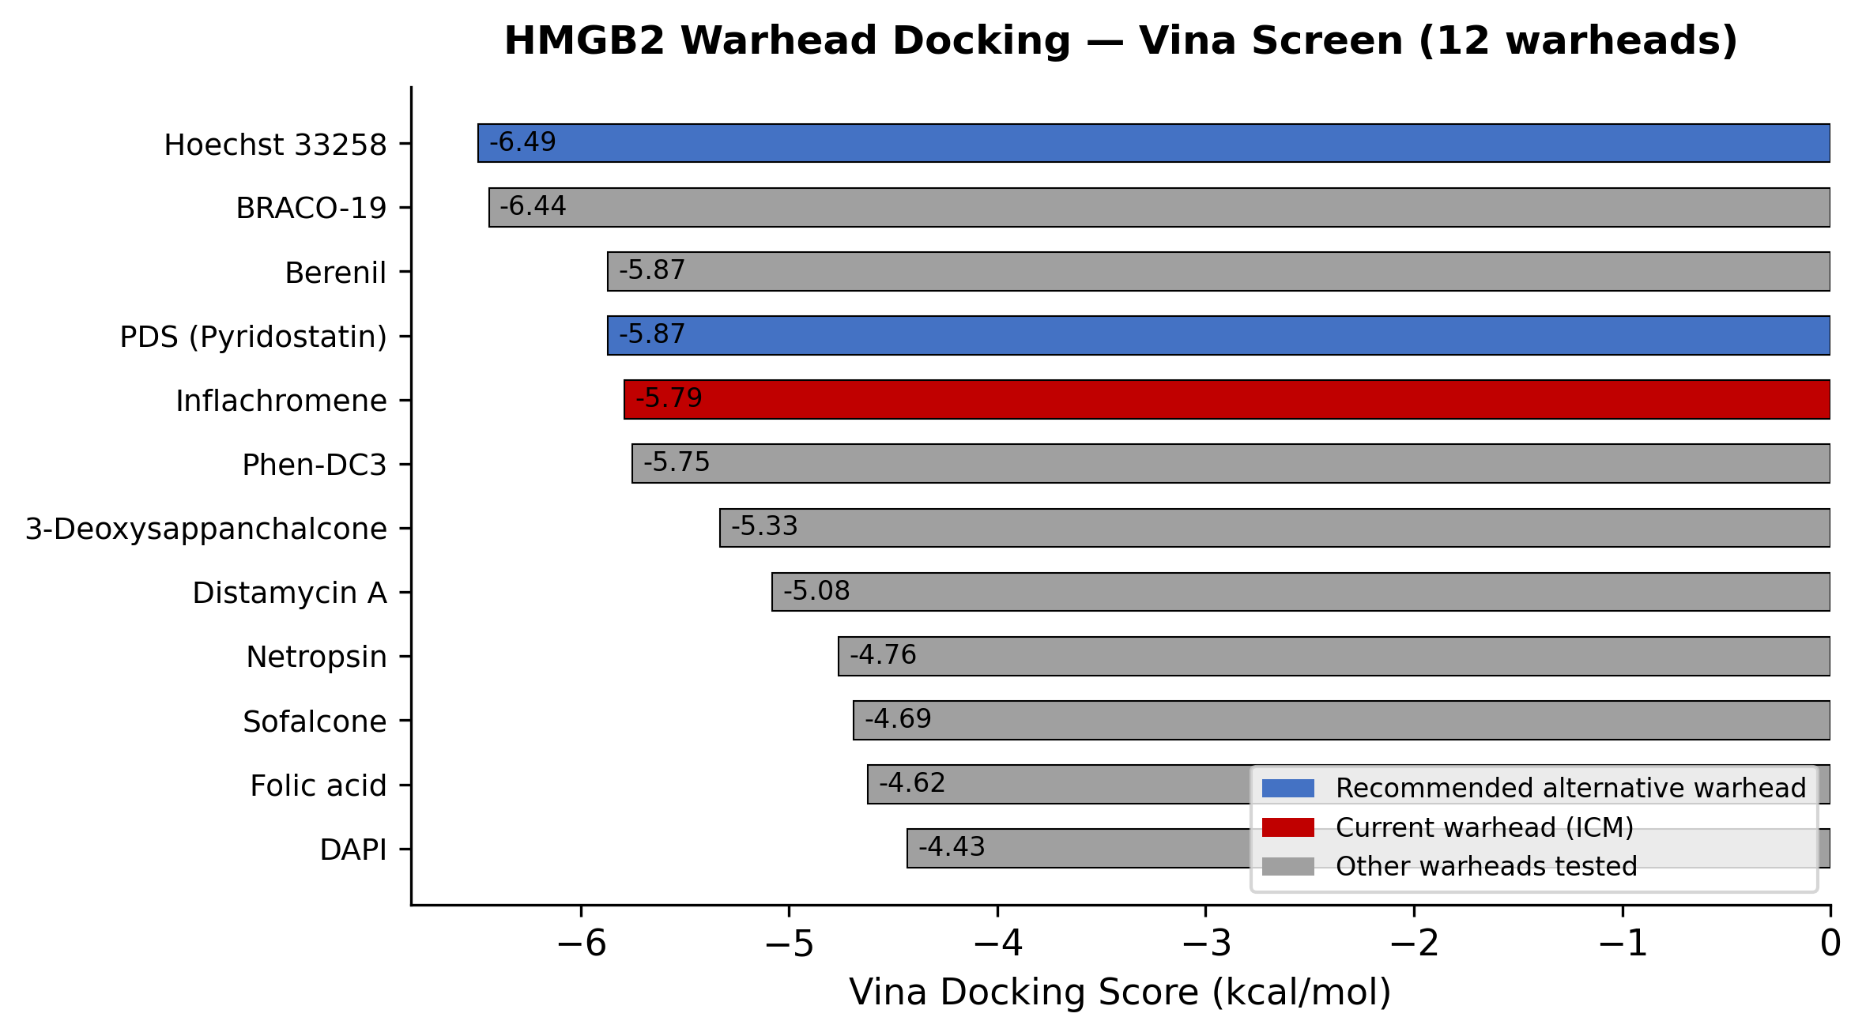
Warhead Selection — Vina Docking Screen (12 Warheads vs. HMGB2)
Identifying stronger alternatives to Inflachromene
Key Findings
Hoechst 33258: −6.49 kcal/mol (best)
→ DNA minor groove binder
→ Engages HMGB2's DNA-binding surface
PDS (Pyridostatin): −5.87 kcal/mol
→ G-quadruplex ligand
→ Alternative binding mode
Inflachromene: −5.79 kcal/mol (7th)
→ Only modest affinity
→ Binding site not resolved structurally
RECOMMENDATION:
Replace ICM with Hoechst 33258 or PDS
for stronger, validated HMGB2 engagement
7/11

Slide 8
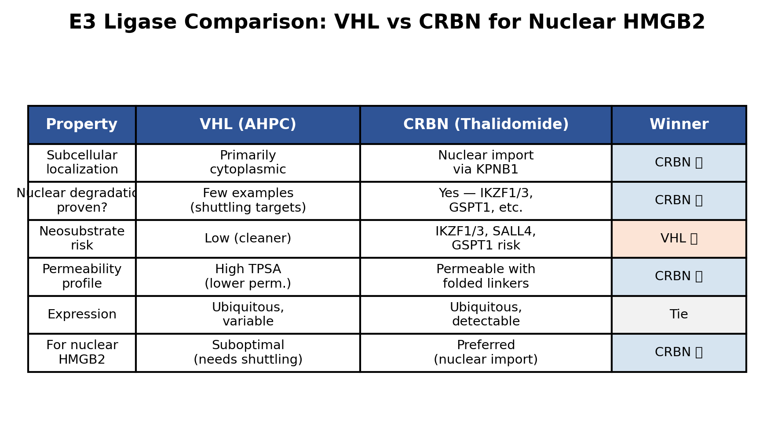
E3 Ligase Selection — VHL vs. CRBN for a Nuclear Target
Subcellular localization determines E3 accessibility to HMGB2
Decision for HMGB2
HMGB2 is NUCLEAR (chromatin-bound)
→ Requires E3 with nuclear access
CRBN (cereblon):
• Imported into nucleus via KPNB1
• Proven nuclear substrate degradation
(IKZF1, IKZF3, GSPT1)
• Intramolecular folding improves
permeability (Poongavanam 2025)
✅ RECOMMENDED
VHL (pVHL):
• Predominantly cytoplasmic
• Requires target to shuttle to cytoplasm
• Suboptimal for nuclear HMGB2
❌ Not recommended as primary E3
Preferred ligand: Pomalidomide > Lenalidomide
(better CRBN binding, different exit vector)
8/11

Slide 9
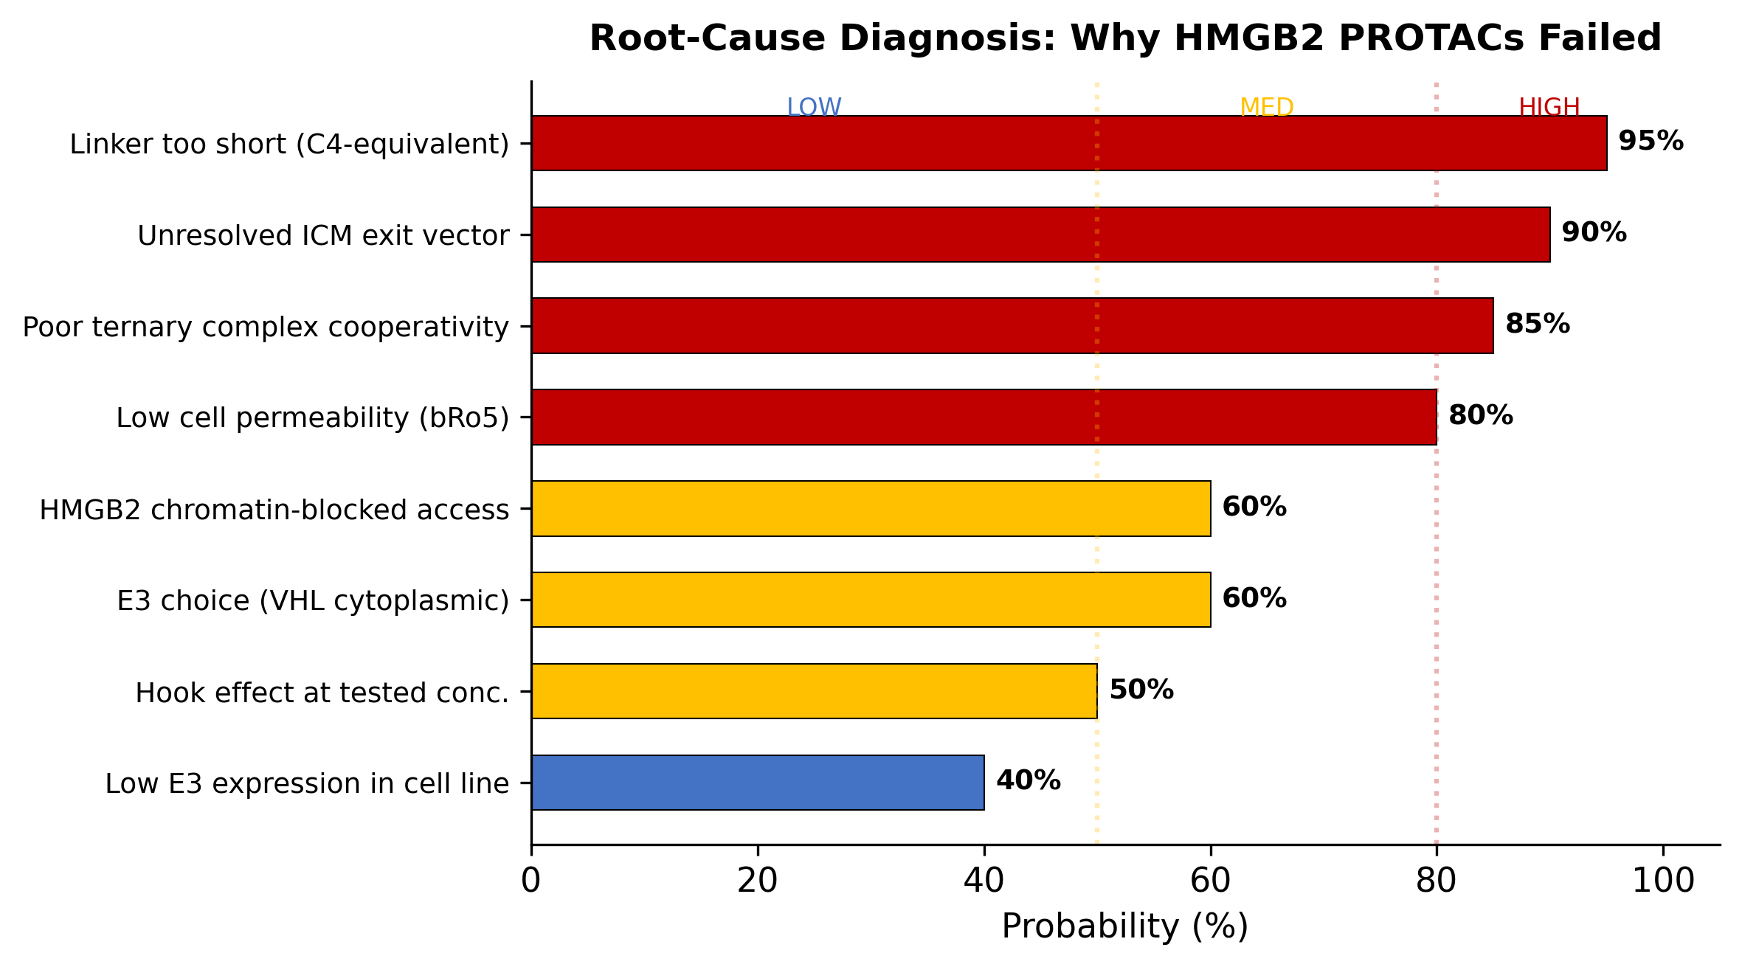
Root-Cause Diagnosis — Ranked by Probability
Why the current 6 PROTAC designs failed
Action Plan
🔴 HIGH (fix immediately):
1. Longer linkers (C10–C14, PEG-based)
2. Resolve ICM binding mode (dock + MD)
3. Design for ternary cooperativity
🟡 MEDIUM (address in parallel):
4. Measure cellular permeability
5. Check E3 expression in target line
6. Test wider concentration range
🟢 LOW (rule out last):
7. HMGB2 chromatin access
8. HMGB2 intrinsic degradability
Note: HMGB2 has 20+ surface lysines
and is small (24 kDa) → likely degradable
if the ternary complex can be formed.
9/11

Slide 10
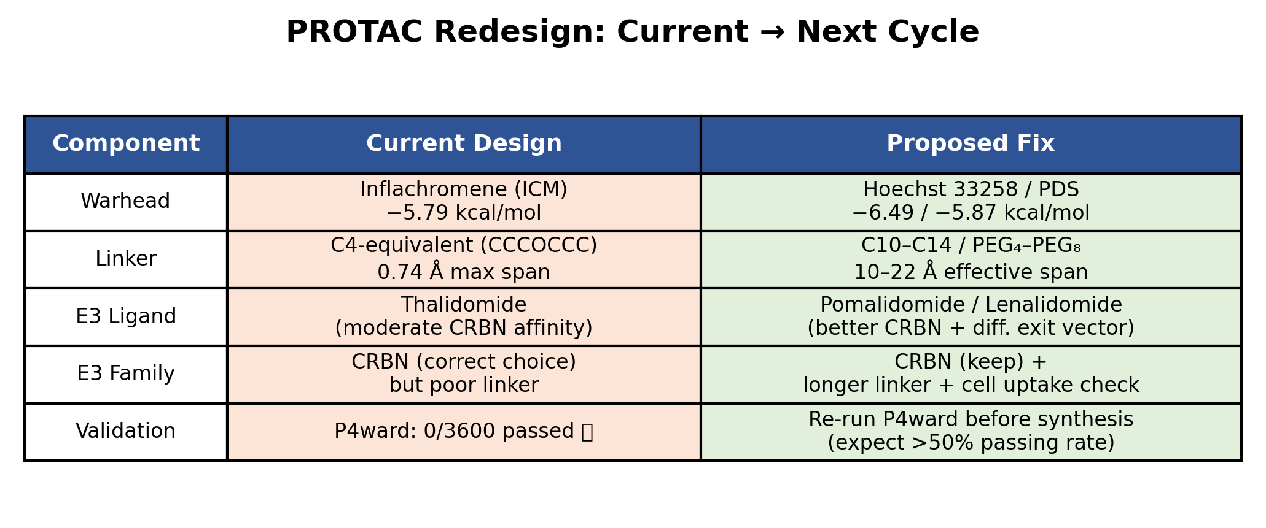
PROTAC Redesign — Next Cycle
Evidence-based design matrix: current → proposed fix
Linker Design Proposals
Validation Gates Before Synthesis
C10-PEG₄-amide: ~12 Å, PEG improves solubility
C12-alkyl-triazole: ~13 Å, semi-rigid + H-bond acceptor
C14-PEG₅: ~16 Å, maximum span test
C8-PEG₃-piperidine: conformational pre-organization
1. Re-run P4ward with new designs (C10–C14 + Pomalidomide)
2. MD simulation of top ternary complex (100+ ns)
3. Lysine-to-E2~Ub distance check for viable poses
4. Permeability prediction (bRo5 chameleonic behavior)
5. Only if ≥50% poses pass → proceed to synthesis
10/11

Slide 11
Conclusion
Current design failed by geometry — HMGB2 degradability is NOT ruled out
1. P4ward result is definitive: 0/3600 poses passed the linker distance filter.
→ The C4-equivalent linker (0.74 Å) cannot span the HMGB2–CRBN gap (min 10.83 Å).
2. HMGB2 is likely degradable — 20+ surface lysines, flexible C-tail, small size.
→ The target is not the problem. The PROTAC linker is the problem.
3. Clear redesign path exists: longer linkers (C10–C14), CRBN-based (pomalidomide),
alternative warheads (Hoechst 33258 / PDS), re-run P4ward before synthesis.
Immediate Next Steps
1. Extract reconstructed P4ward poses (hmgb2_pose_2615.pdb, crbn_pose_2615.pdb) for team inspection
2. Design C10–C14 PEG-linker PROTACs with pomalidomide (CRBN) and Hoechst 33258/PDS warheads
3. Re-run P4ward with new designs — target: >50% of poses passing the linker filter
4. MD simulation of top candidate(s) — 100+ ns to verify ternary complex stability
5. If computational validation passes → synthesize top 3–5 PROTACs, test in cellular degradation assay
Evidence package location: outputs/p4ward_evidence/ (all PDBs, MOL2s, logs, plots, PyMOL scripts)
Failure is diagnostic, not terminal — the geometry failure tells us exactly what to fix.
11/11

