Slide 1

Quantum Information and Computing
2021 - 2022
Saverio Monaco
28/11/2021
Solution of the Time Independent
Schrödinger Equation for
an armonic oscillator

Slide 2
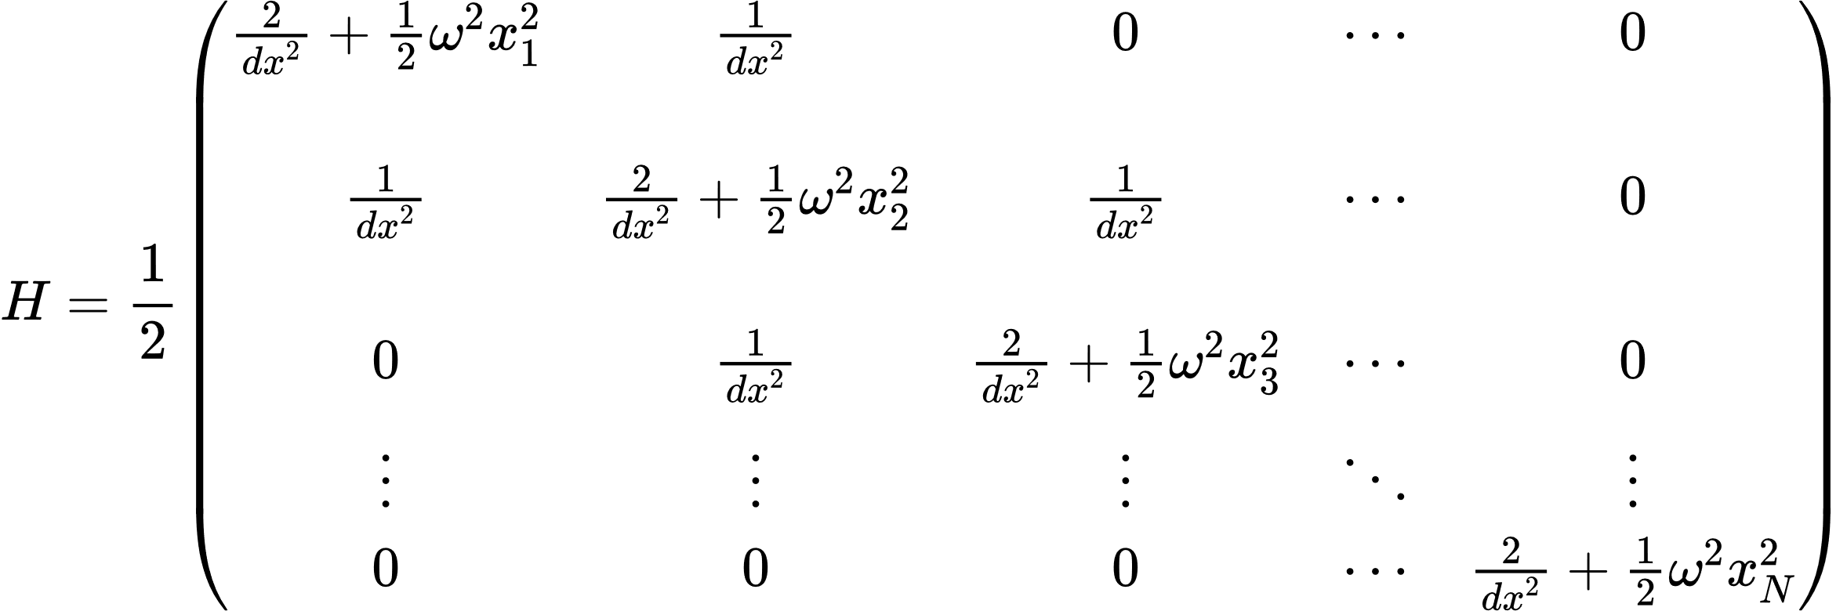
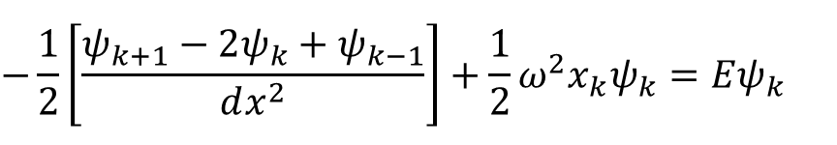
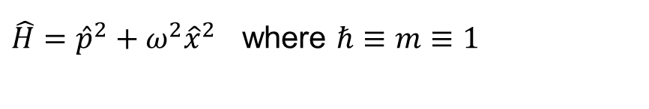
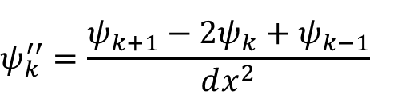

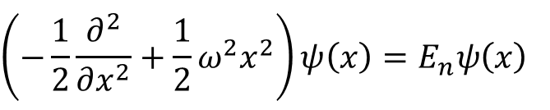
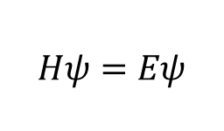
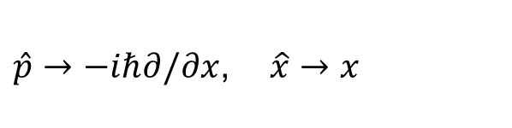
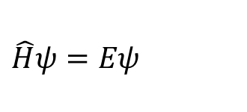
Theory
$\hat{H}={\hat{p}}^{2}+{ω^{2}\hat{x}}^{2}$ where $ℏ≡m≡1$
$$\left(−\frac{1}{2}\frac{∂^{2}}{∂x^{2}}+\frac{1}{2}ω^{2}x^{2}\right)ψ\left(x\right)=E_{n}ψ\left(x\right)$$
$$\hat{H}ψ=Eψ$$
$\hat{p}→−iℏ∂/∂x$, $\hat{x}→x$
$$ψ_{k}^{′′}=\frac{ψ_{k+1}−2ψ_{k}+ψ_{k−1}}{dx^{2}}$$
$$−\frac{1}{2}\left[\frac{ψ_{k+1}−2ψ_{k}+ψ_{k−1}}{dx^{2}}\right]+\frac{1}{2}ω^{2}x_{k}ψ_{k}=Eψ_{k}$$
$$≡$$
$$Hψ=Eψ$$
Notes:
Explain very briefly the theory you have based your solution on

Slide 3
Code Development
Notes:
Introduce strategies, tests, and report debugging problems, compilation options

Slide 4
Results
Notes:
Present data and explain your results

Slide 5
Bibliography
Notes:
Present data and explain your results

Slide 6
Thanks for the attention
___________________________

