Slide 1

Quantum Information and Computing
2021 - 2022
Saverio Monaco
Date
Exercise #

Slide 2
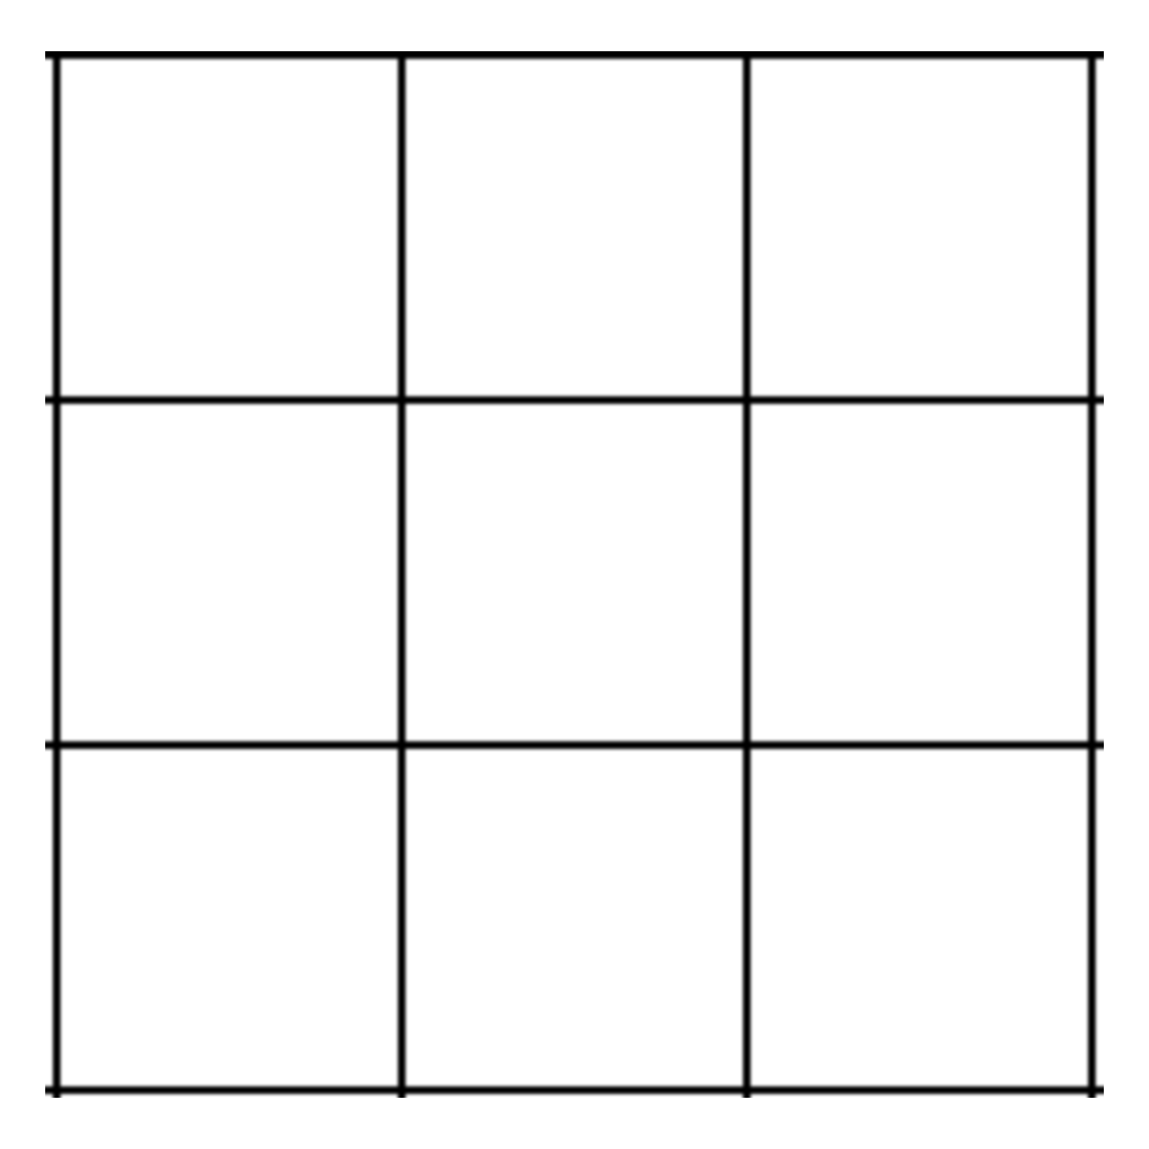


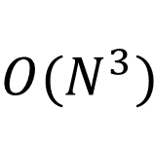

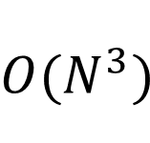


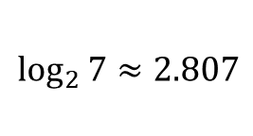
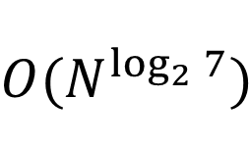
Scaling of the matrix-matrix multiplication
Loop method
Loop2 method
(not chache optimized)
matmul(A,B)
May use Strassen algorithm [1]
$$O(N^{3})$$
$$O(N^{3})$$
$$O(N^{\log_{2}{7}})$$
$$\log_{2}{7≈2.807}$$
Notes:
Explain very briefly the theory you have based your solution on

Slide 3
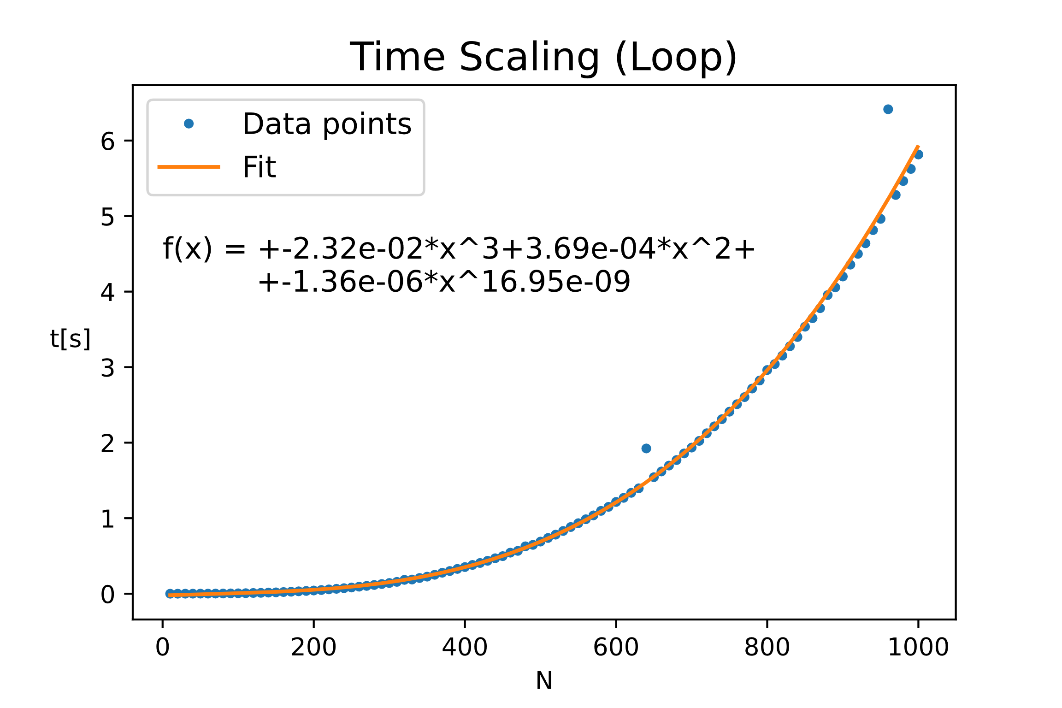
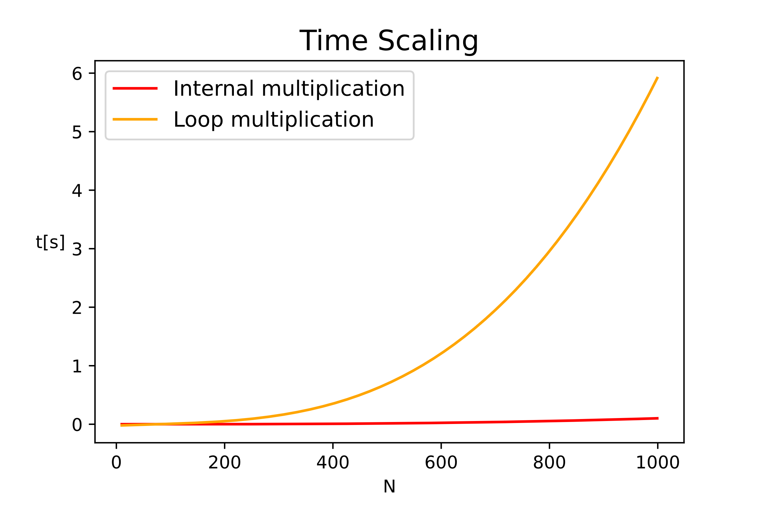
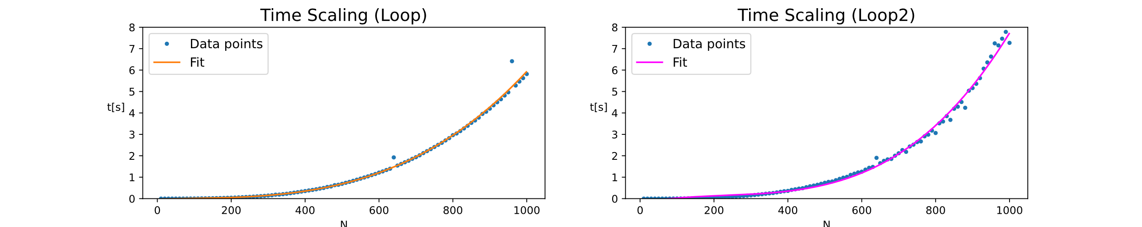
Scaling of the matrix-matrix multiplication
Notes:
Explain very briefly the theory you have based your solution on

Slide 4
Random Matrix Theory
Notes:
Introduce strategies, tests, and report debugging problems, compilation options

Slide 5
Bibliography
Notes:
Present data and explain your results

Slide 6
Thanks for the attention
___________________________

