Slide 1
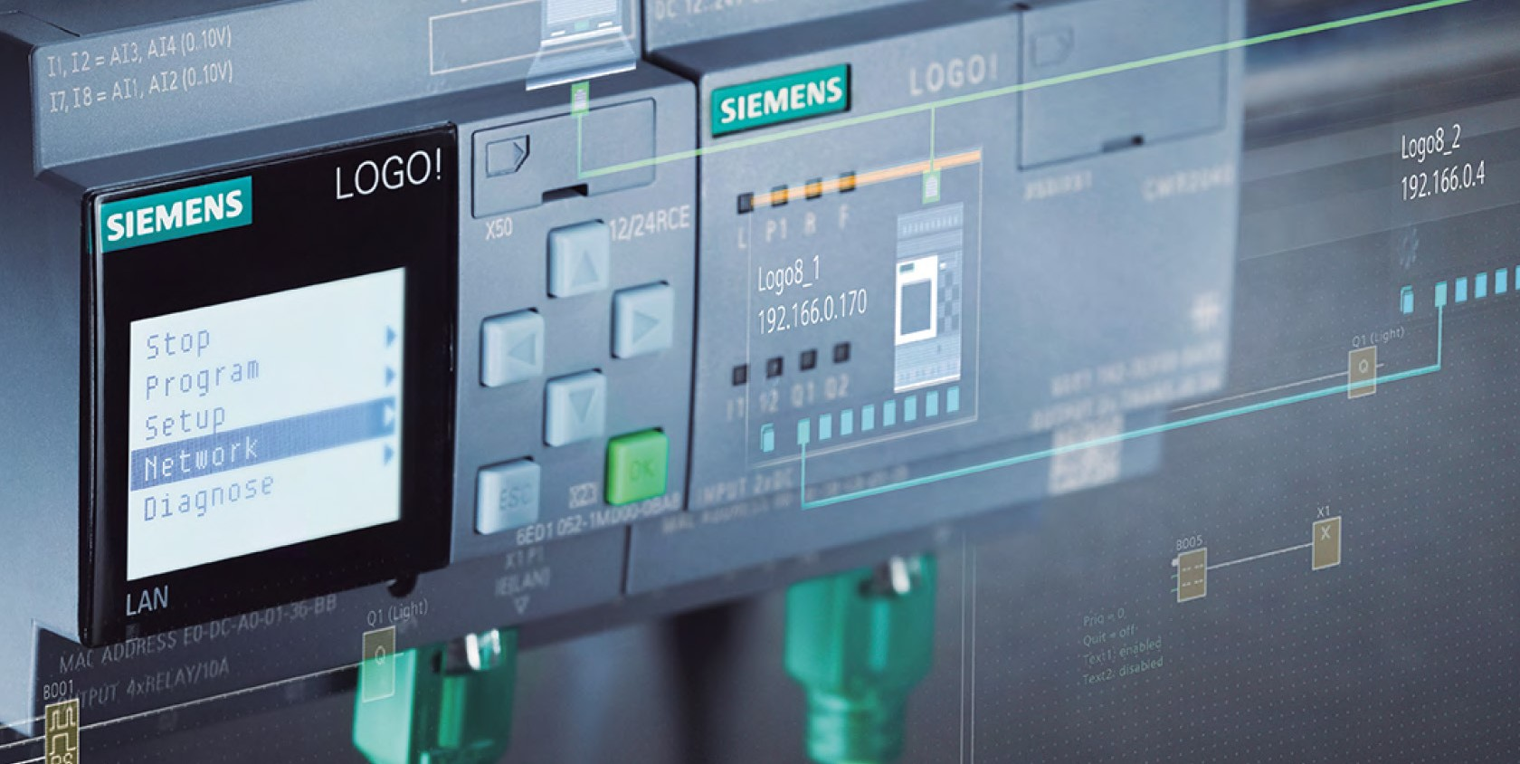
Conveyor belts automation
Course: Programmable controllers for Industrial Automation
Student: Savev David

Slide 2
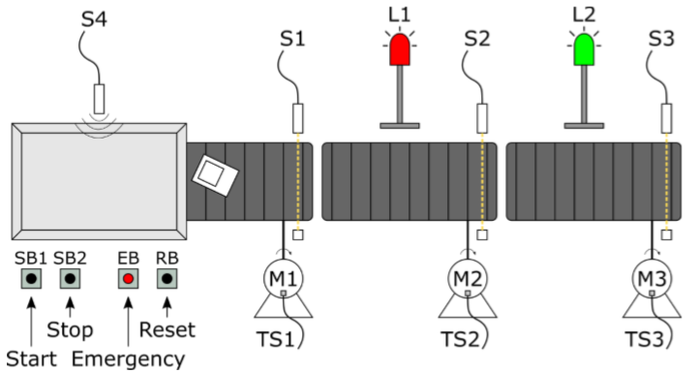
Assignment
Goal: “Automation of a conveyor belt system by using a Programmable controller”

Slide 3
I/O devices
Input devices:
Start, Stop, Reset button (N.O. pushbuttons);
Emerg. switch (N.C. switch);
Proximity sensor (N.O. of inductive type);
3 Photocells (Laser diode + phototransistor);
3 thermic contacts of the motors (N.O);
Output devices:
3 monophase motors with moto-reducers;
24V operation light (green) and emergency light (red).
TOTAL: 11 digital inputs, 5 digital outputs.

Slide 4
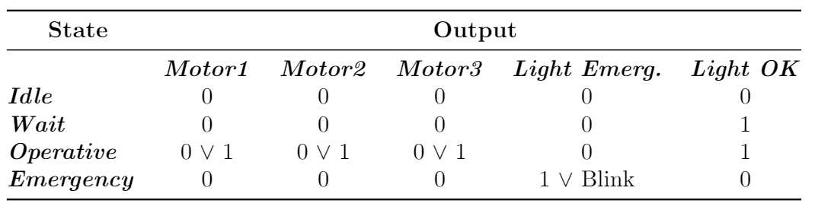
Operational states
We can extract the following states out of the system requirements: Idle, Wait, Operative, Emergency.
We can associate to the states the digital outputs of the system:

Slide 5
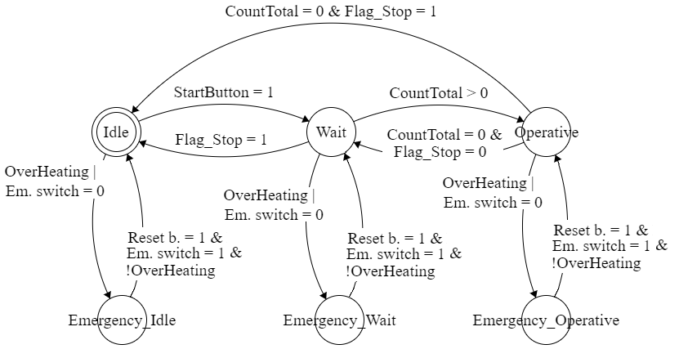
Main state machine
Developed in Ladder Diagram, sub-divided into two different blocks: ActiveStateMachine and ErrorStateMachine
Emergency status was split into 3 to maintain reference to previous state.

Slide 6
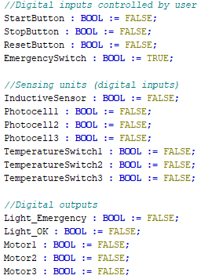
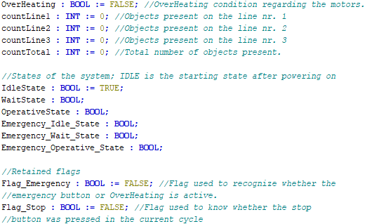
Variables
The following global variables were declared:
IOVars (1:1 mapping with the physical I/O devices);
GlobalVars (taking into account states and internal variables).

Slide 7
Functions and FB
Following functions and function blocks were declared to increase the maintainability, readability and re-usability of the code:
OverHeating (Function in ST): logical OR combination of the motor thermostats;
ObjectCounter (FB in ST): controls the number of objects on the conveyor belts by using 3 up-down counters, 3 global int linked to the belts (countLine1, countLine2, countLine3) and 1 other global int as result of the sum of the previous three (countTotal).;
Delay (FB in ST): delays the off switching of the motors by a ϑ constant through the usage of a TOFF timer;
Multivibrator (FB in ST): provides a PWM signal with a configurable duty cycle in order to manage the blinking of the red light.

Slide 8
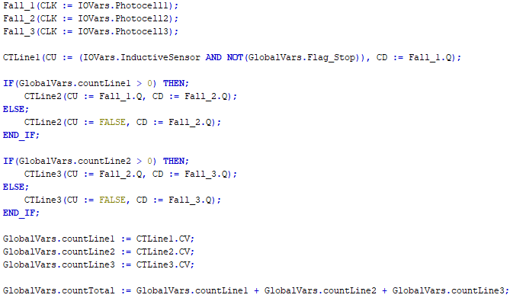
ObjectCounter

Slide 9
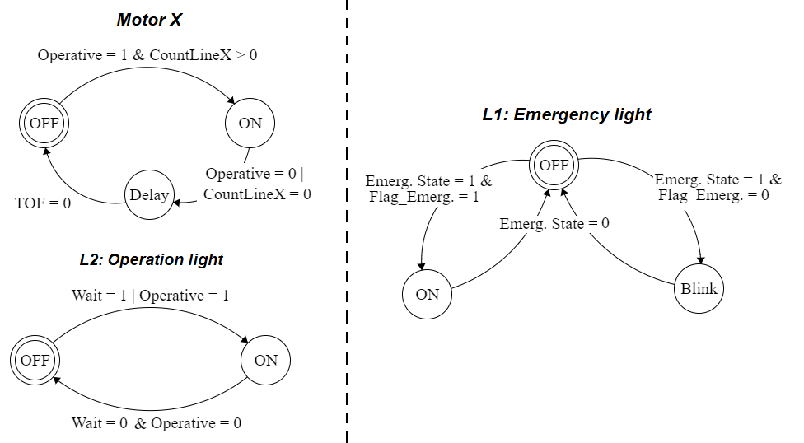
Output control
OutputActive and OutputEmergency were developed in Ladder Diagram in order to control the actuators (motors and lights); the high-level structure is the following:

Slide 10
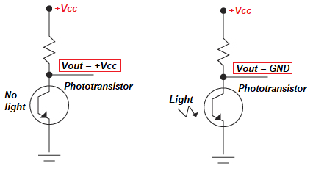
Hardware considerations
To standardize the working logic of the photocell receivers, it is more logical to have:
HIGH SIGNAL = BEAM INTERRUPTED = OBJECT DETECTION;
LOW SIGNAL = BEAM PRESENT = OBJECT ABSENCE.
I decided to use at the receiver side a pull-up configuration for the phototransistor:

Slide 11
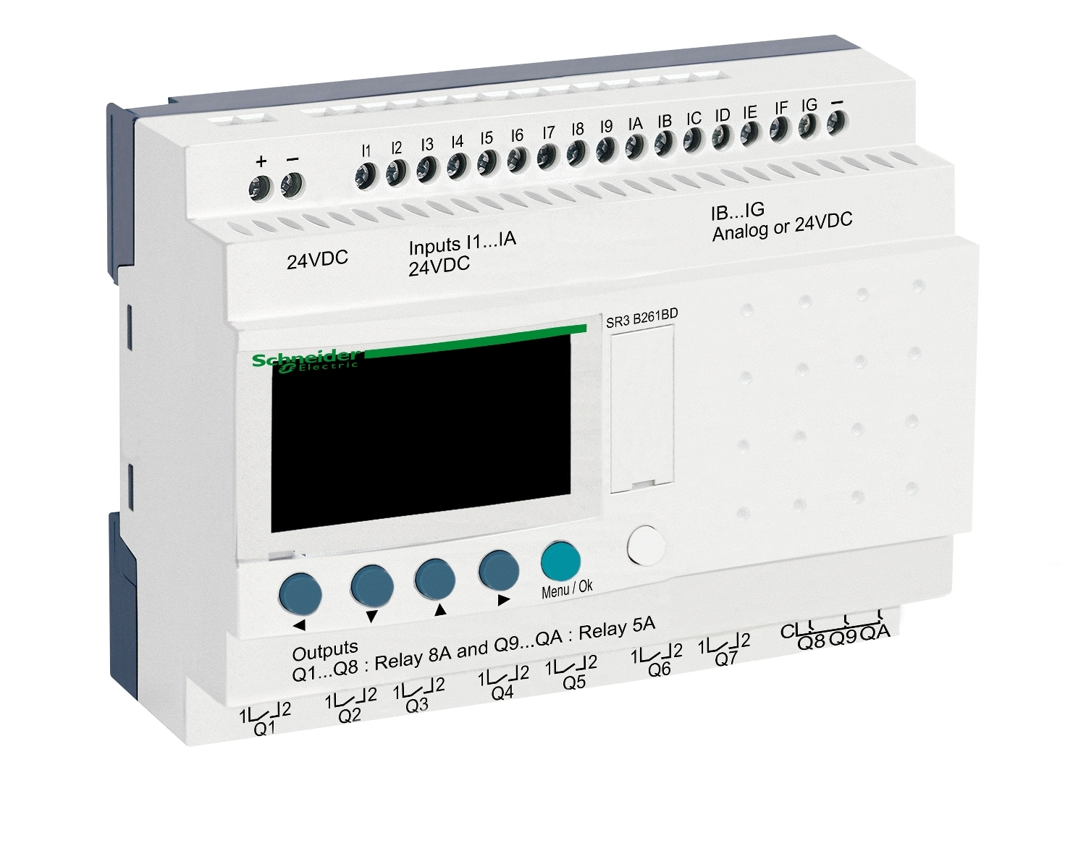
PLC selection
The Logic controller that was selected is the Zelio Logic Smart Relay SR3B261BD selled by Schneider electric.
Supply voltage: 24V DC;
16 input ports (10 digital and 6 analog/digital);
10 relay-based output ports supporting a quite large current (8A or 5A).
Chosen since it is the cheapest (232 euro) and since has enough input/output ports to control the system without the need of expansion modules.

Slide 12
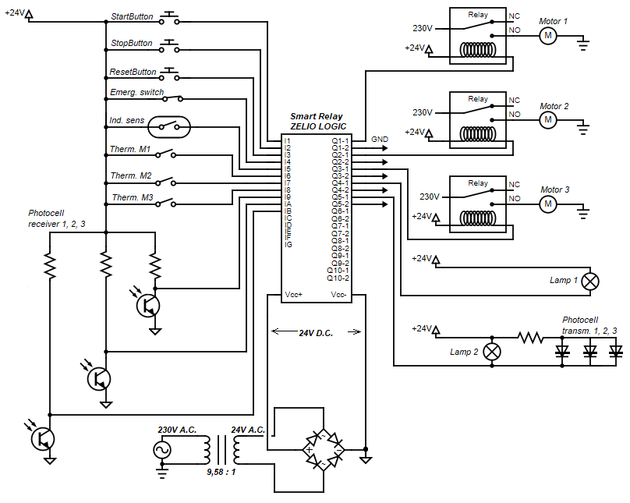
Electric circuit

Slide 13
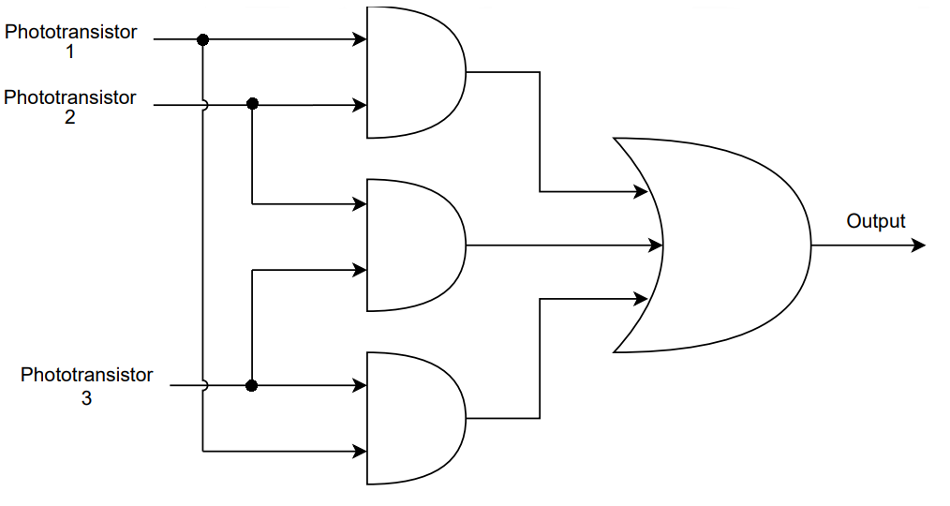
Final considerations
Optimization by using one single digital input for the motor thermostats by basically connecting them in a series configuration;
We are relying to much on the photocells. What if a phototransistor is faulty? Triple-Modular Redudancy circuit uses 3 blocks instead of one and in case of one faulty photocell can decide the correct output based on the working two.

