Slide 1

Emergency exit recognizer
Course: Multimedia Systems
Student: Savev David

Slide 2
Introduction
Goals:
Recognition of emergency exit shields within image frames (.png or .jpg);
Acoustically signal the direction to follow to leave the building.

Slide 3
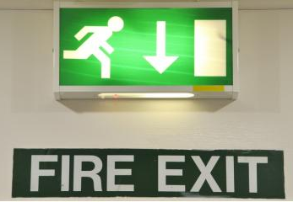
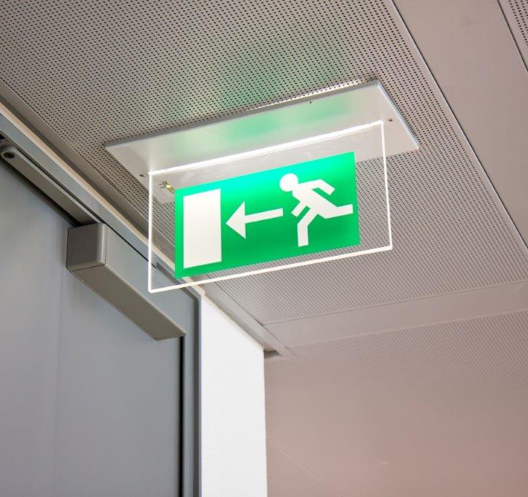
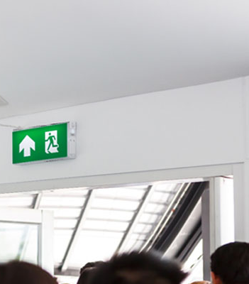
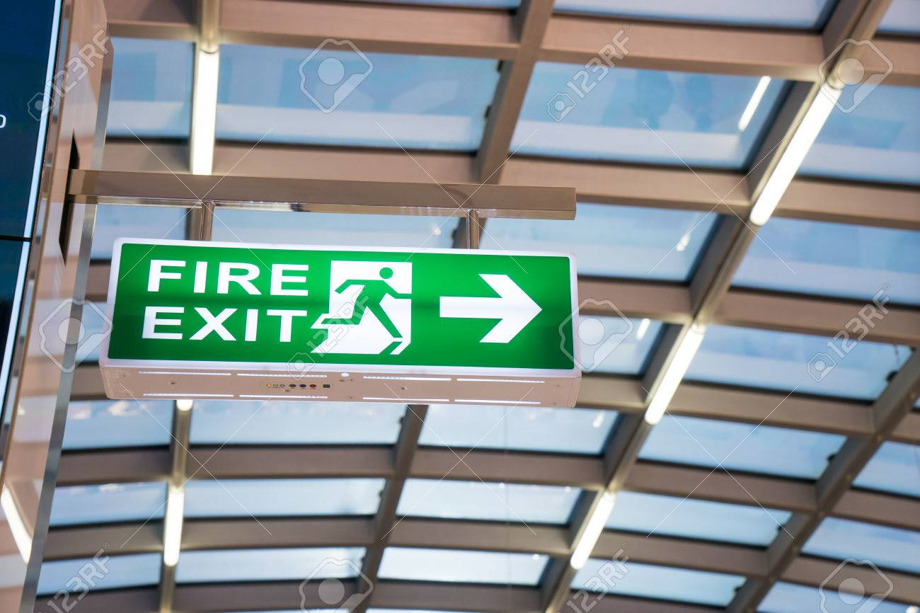
Analysis
Emergency exit shield = closed area predominantly with green pixels;
Green area = rectangular shape (convex polygon with 4 vertices);
Within the rectangle, the arrow color ≠ background color;
Arrow = concave polygon with 7 or 9 vertices.

Slide 4
OpenCV
Library used for computer vision, image and video processing operations.
Pros:
Well documented;
supported among several programming languages (Python, C++, Java);
widely adopted (community support, forums).

Slide 5
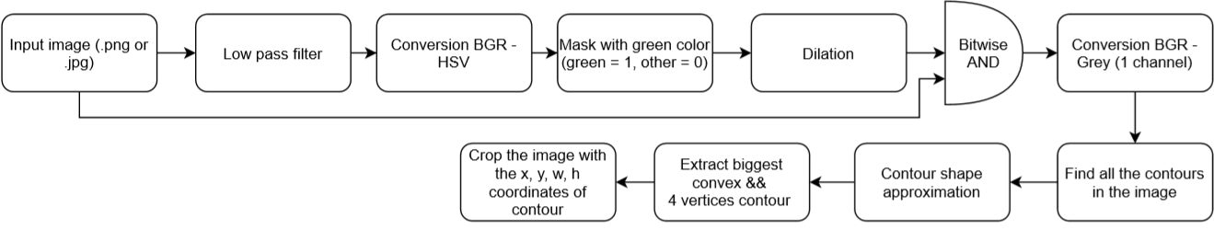
Image processing I
Recognition of emergency exit shield

Slide 6
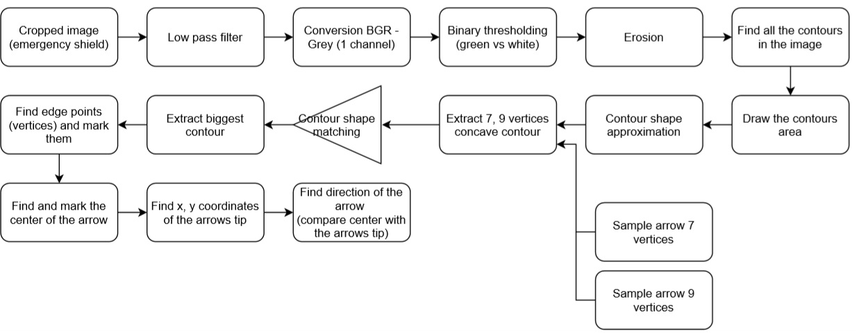
Image processing II
Arrow direction recognition

Slide 7
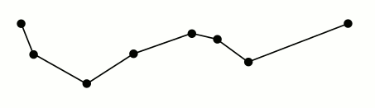

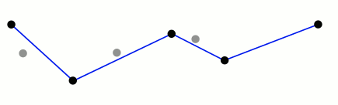
Contour approximation
Due to the blurring or image rotation, a wrong contour polygon may be extracted (hence → wrong number of vertices).
ApproxPolyDP(contour, ε) method permits the approximation of the contour, where ε parameters indicates the accuracy of the algorithm (distance from contour to its approximation).

Slide 8
Arrow tip
Which one is the tip of the arrow among 7 or 9 vertices? The tip is the point which has the biggest distance to the closest neighbour.
arr_dist = []
foreach vertex1 in vertices do:
min_dist = ∞
foreach vertex2 in vertices do:
dist_x = abs(vertex1.x - vertex2.x)
dist_y = abs(vertex1.y – vertex2.y)
res = dist_x + dist_y
if res not 0 and res < min_dist do:
min_dist = res
arr_dist.append(min_dist)
indx = index(max(arr_dist))
return vertices[indx]

Slide 9
Arrow direction
In order to compute the direction of the arrow, we need the x, y coordinates of the tip and the center of the arrow.
dist_x = abs(tip_x - center_x)
dist_y = abs(tip_y - center_y)
if dist_x > dist_y do:
if arrow_x - center_x < 0 do:
#Arrow pointing left
else do:
#Arrow pointing right
else do:
if arrow_y - center_y < 0 do:
#Arrow pointing up
else:
#Arrow pointing down

Slide 10
GUI
Developed with help of the tkinter library.
Main features:
Upload of .jpg or .png images;
Not processed image plotted on the left;
Processed image and all its features (contour, vertices, center) plotted on the right;
Possibility to plot intermediate steps of the processing.
In every case, an mp3 file indicating the direction to follow is played.

Slide 11
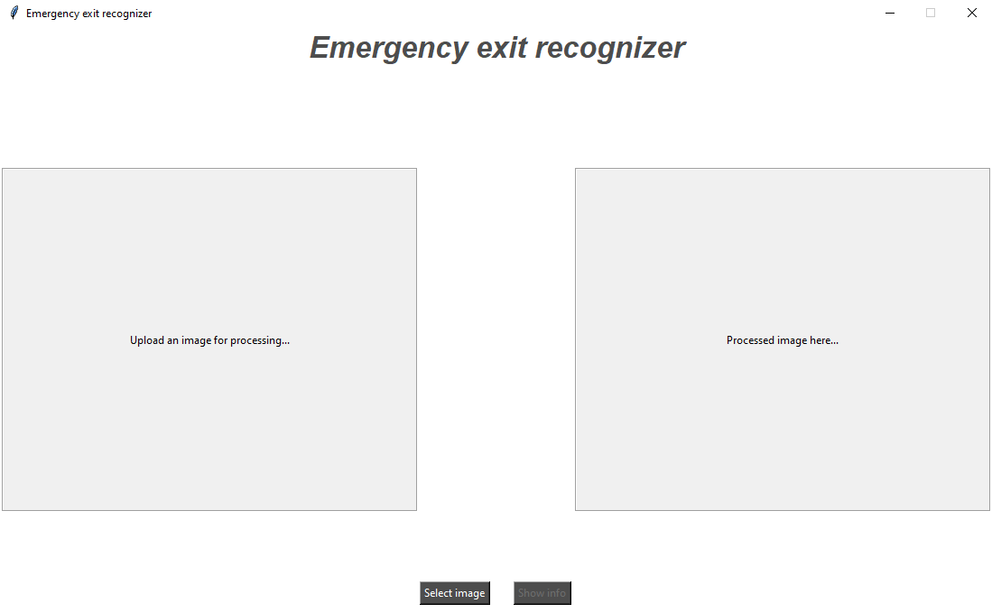
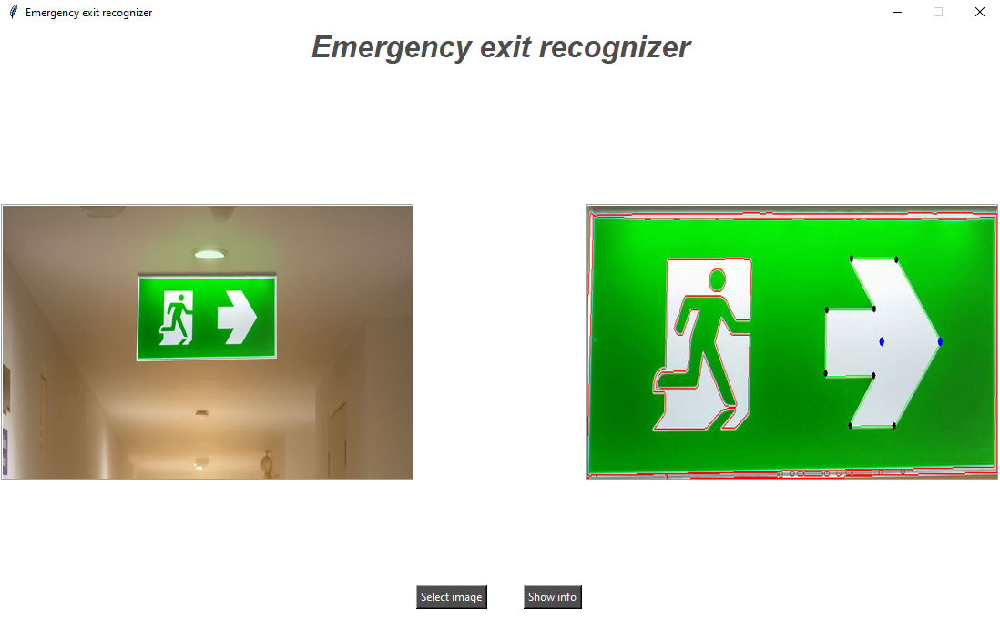
Images

Slide 12
Problems
Reconnaissance value ≅ 70-75% of the images that were collected as samples
20-25% of the cases, false positives and false negatives.
Error ε, due to:
Different conditions (image colors, image rotation, blurring);
Different tuning parameters (green color range, dimension of filtering matrixes, threshold, approximation of polygon vertices, upper bound of the shape matching between contours).

Slide 13
Conclusion
In order to increase the “Reconnaissance” percentage, further investigation, analysis, refinement and tuning is needed.
Since NO Machine Learning was used, a future implementation may take also these techniques into account and may be adapted to work also on video streams.

