Slide 1
Causal loop diagram as a network with identifiable nodes and edges: Urban malaria (Lecture note on system dynamics)
Koissi Savi (Ph.D.)
Dana Farber Cancer Institute - Harvard School of Medicine www.savikoissi.io

Slide 2
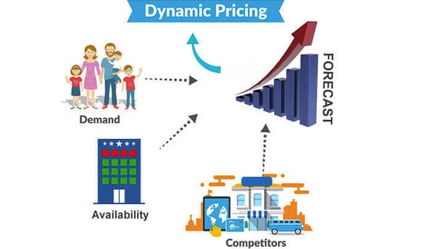
What is a dynamic system?
https://www.price2spy.com/blog/dynamic-pricing-vs-price-discrimination/
1- Dynamic system= system changing over time
Notes:
Originally developed in the 1950s to help corporate managers improve their understanding of industrial processes, SD is currently being used throughout the public and private sector for policy analysis and design

Slide 3

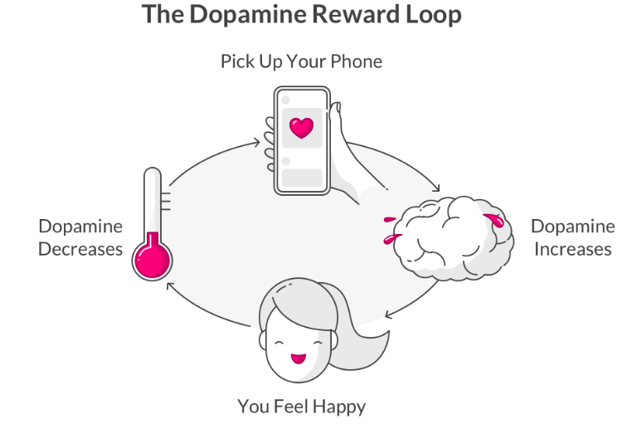
Notion of feedback loops
1- Reinforcing loops = encourages the system to continue in a given direction, reinforcing loop is undesirable, it can be referred to as a vicious cycle
2- Balancing loops will encourage the system to stay in balance

Slide 4
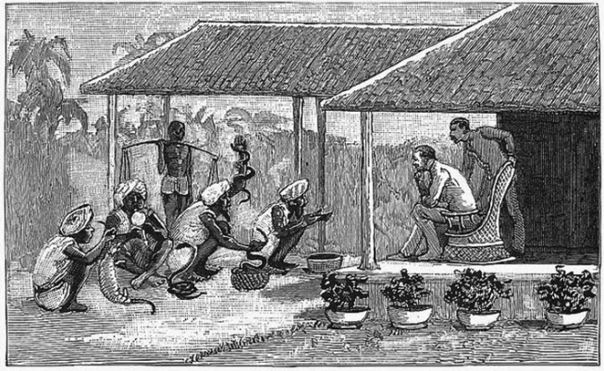
Policy resistance
https://annalogy.info/2020/09/15/incentivize-carefully/
1- The implementation of a policy can lead to unforeseen behavior of the population also called policy resistance
2- Feedback loops are basically chains of cause-and-effect relations that form a loop where its output routes back to the chain as an input.
Notes:
During 1930s there was British Raj in India.
the British government was facing lot of difficulties with the increasing population of venomous snakes.
The villagers dutifully started to bring the dead snakes to the British Raj and were getting rewarded.
The surprising fact was over the period of time the population of the snake increased
it was found that the reason for the increase in snake population was that the villagers started to breed snakes and kill it and bring it to the British Raj in order to get the incentive.

Slide 5
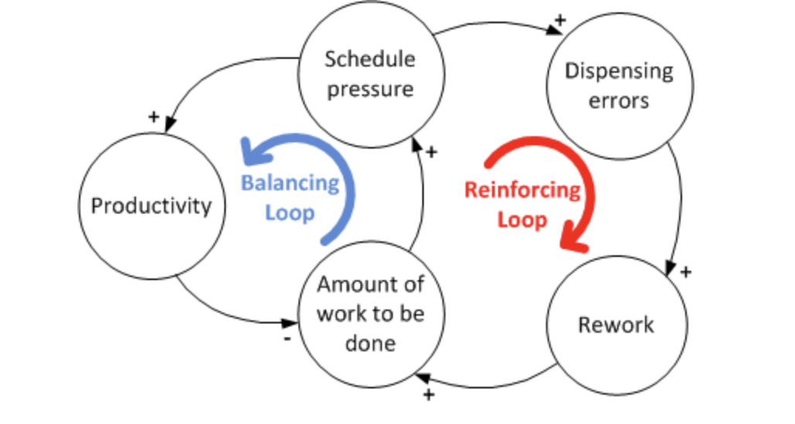
Causal loop diagrams
https://systemsthinkinglab.wordpress.com/causal-loop-diagram/
A causal loop diagram is a simple graphical representation of a system showing the nature of interaction between its components. The direction of the interactions can describe to a reinforcing or a balancing loop
Notes:
Causal loop diagram=simple map of a system with all its constituent components and their interactions
A causal link from one element (A) to another (B) is positive (+) when a change in A leads to change in B in the same direction; an increase in A leads to an increase to B and a decrease in A leads to a decrease in B.
Figure 1 describes dynamic factors affecting dispensing errors in a pharmacy setting
One reinforcing loop in red reveals that higher schedule pressure increases the number of dispensing errors, which leads to more rework to be done and schedule pressure eventually spirals up. On the other hand, a balancing loop on the left-hand side in blue reveals that schedule pressure can increase productivity, which then leads to less work to be done and decreased schedule pressure.

Slide 6
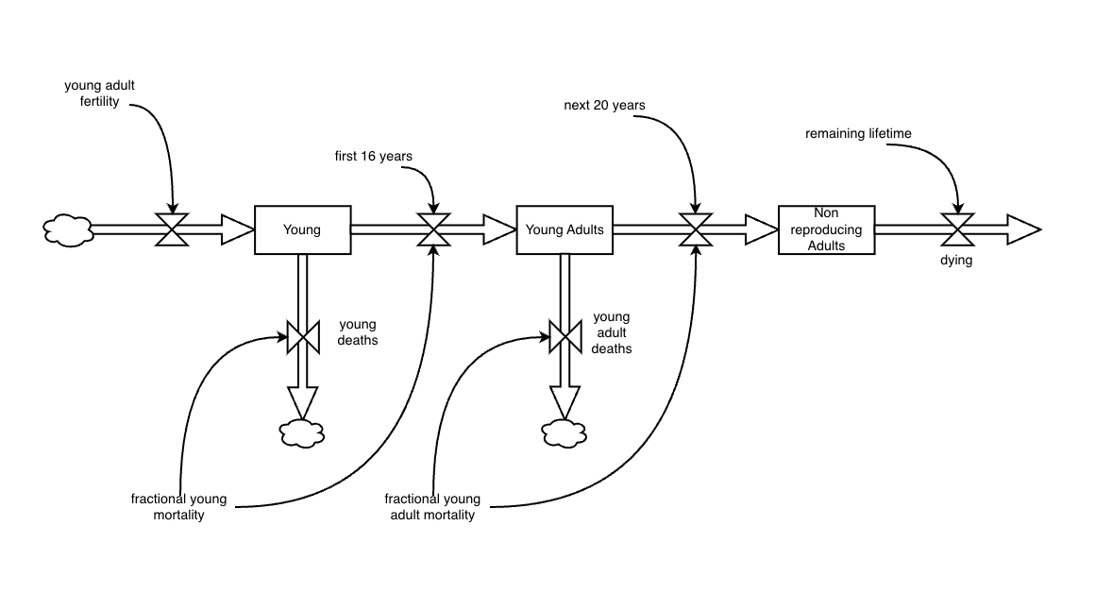
Other modeling tools
Stock and flow diagrams = a quantitative tool where a stock is a term for any entity that accumulates or depletes over time whereas a flow is the rate of change in a stock.
This last tool could be represented as a system of quantifiable ODEs

Slide 7
Step of system dynamics modeling
Define the problem boundary
Identify the most important stocks and flows that change these stock levels
Identify sources of information that impact the flows
Identify the main feedback loops
Draw a causal loop diagram that links the stocks, flows, and sources of information
Write the equations that determine the flows
Estimate the parameters and initial conditions.
Simulate the model and analyze results.

Slide 8

Urban malaria system dynamics

Slide 9



To exhibit the interplay between sources of heterogeneity
To identify the key sources of heterogeneity
Two experts’ workshops
Causal-loop diagram
Network analysis
Notes:
In two experts’ workshops, we sketched and refined the system, which was represented through a causal loop diagram, where the identification of leverage points was done using network analysis.
Where the functional importance of the determinants was captured via the calculation of six measures of centrality, i.e., degree ($K)$, in-degree ${(K}^{in})$, out-degree ${(K}^{out})$, PageRank$(x)$, closeness $(C)$, and betweenness $(B)$.

Slide 10
Caveat of mapping a SD using CLD
Identification of key experts and causal loop diagram elicitation
Problem definition and refinement
Definition of the variables of the model using five thematic clusters (vector, parasite, environment, human, and health care system)
Definition of the boundaries
Refinement of the model

Slide 11
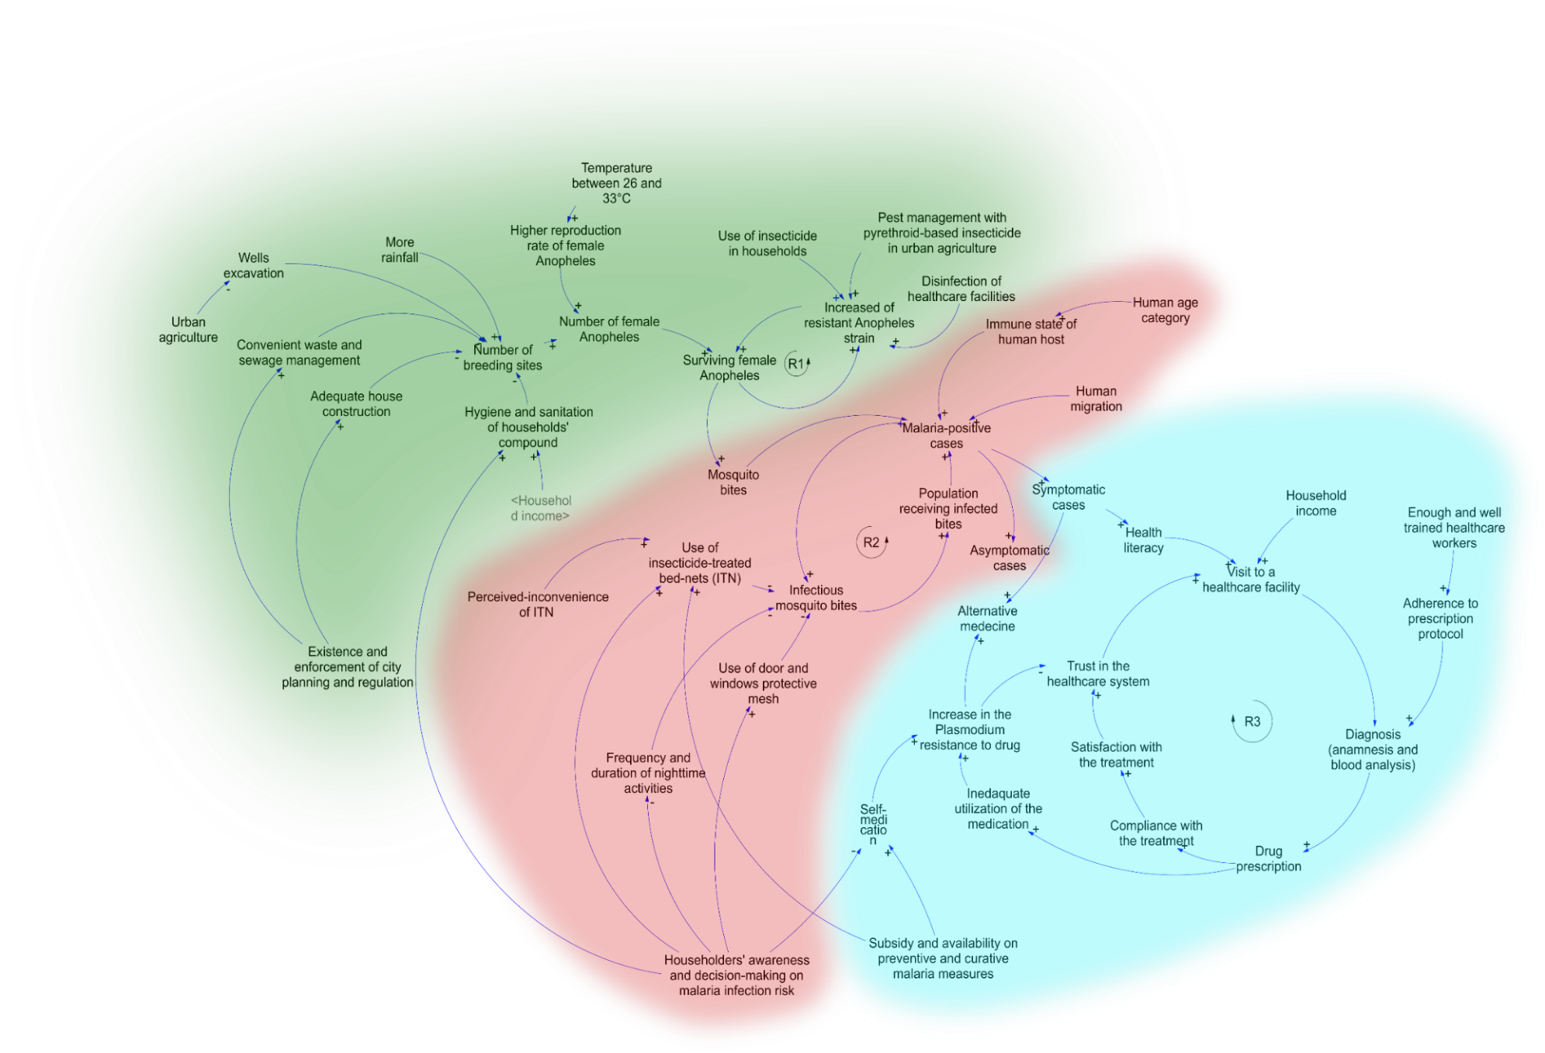
The network analysis showed that the number of breeding sites, the malaria-positive cases, or not, such as the drug prescription and householders’ awareness and decision-making on malaria infection risk are also important nodes
Notes:
This model shows three sub-models triggered each by a reinforcing loop, i.e., (i) the urbanization-related transmission and acquired resistance of Anopheles to insecticides (green), (ii) the human's infection-prone behavior (red), and (iii) the healthcare efficiency and Plasmodium resistance (blue)
The transmission and persistence of malaria in Accra are portrayed in a CLD of the complex system model, entailing 56 interactions among 45 determinants
Due to the time limit only the first loop will be explained
The deficient city planning and planning enforcement, inadequate housing conditions, and limited waste and sewage infrastructure lead to the proliferation of Anopheles breeding sites, which is worsened by the excavation of wells for urban and peri-urban agriculture and rainfall.
Besides, a temperature range between 26 and 33°C in Accra, contributes to the increase in the reproductive rate of Anopheles, their absolute numbers, and finally their survival, augmenting the risk of infection.
Furthermore, the preventive use of insecticides in households, agricultural sites, and healthcare facilities leaves residues that contribute to the development of insecticide resistance in local mosquito populations.
Thus, in the reinforcing loop one (R1, Fig1), we observe that the transmission of malaria depends not only on the environmental factors, such as temperature and rainfall but also on the lack of regulations to prevent and control the proliferation of mosquito breeding sites.
These effects are exacerbated by the widespread use of insecticides. Hence, this reinforcing loop portrayed the environment as a pathway of both, the infection and the development of resistance of mosquitoes to insecticides
Determinants participating directly in the infection process, such as the number of breeding sites, the malaria positive cases, or not, such as the drug prescription and householders' awareness and decision-making on malaria infection risk are also important leverage points (influential points in the system where a small change in these determinants can induce a big change in the whole system [46]) that can affect the system.

Slide 12

Conclusion
A web of determinants triggers and maintains the transmission of malaria in Ghana
The awareness of household dwellers was among the most important nodes of the system of transmission in Accra
Notes:
The proposed CLD contributed to illustrate the complexity of malaria transmission and persistence in our case study, Accra, Ghana. It showed that beyond the mere biological processes and the physical environment, the behavior of people plays a key role in malaria transmission and persistence.
The CLD embodies three major loops that trigger and maintain transmissions in urban environments.
Furthermore, the NA enabled the detection of emergent properties of the system and the identification of the key levering determinants.

Slide 13
Thanks
merveillekoissi.savi@gmail.com

