Slide 1
PYTHON PROJECT Peer-to-peer social media network
BY SAVI MOHAN
SMOH944

Slide 2
Overview of requirements
User can log into the system
User can send and receive messages and files (images, audio, video, PDF etc) from other users
User can view sent and received files and messages via the user interface
User can see who is currently online
User can view each online user’s profile including their own
User is also able to modify their own profile page.

Slide 3
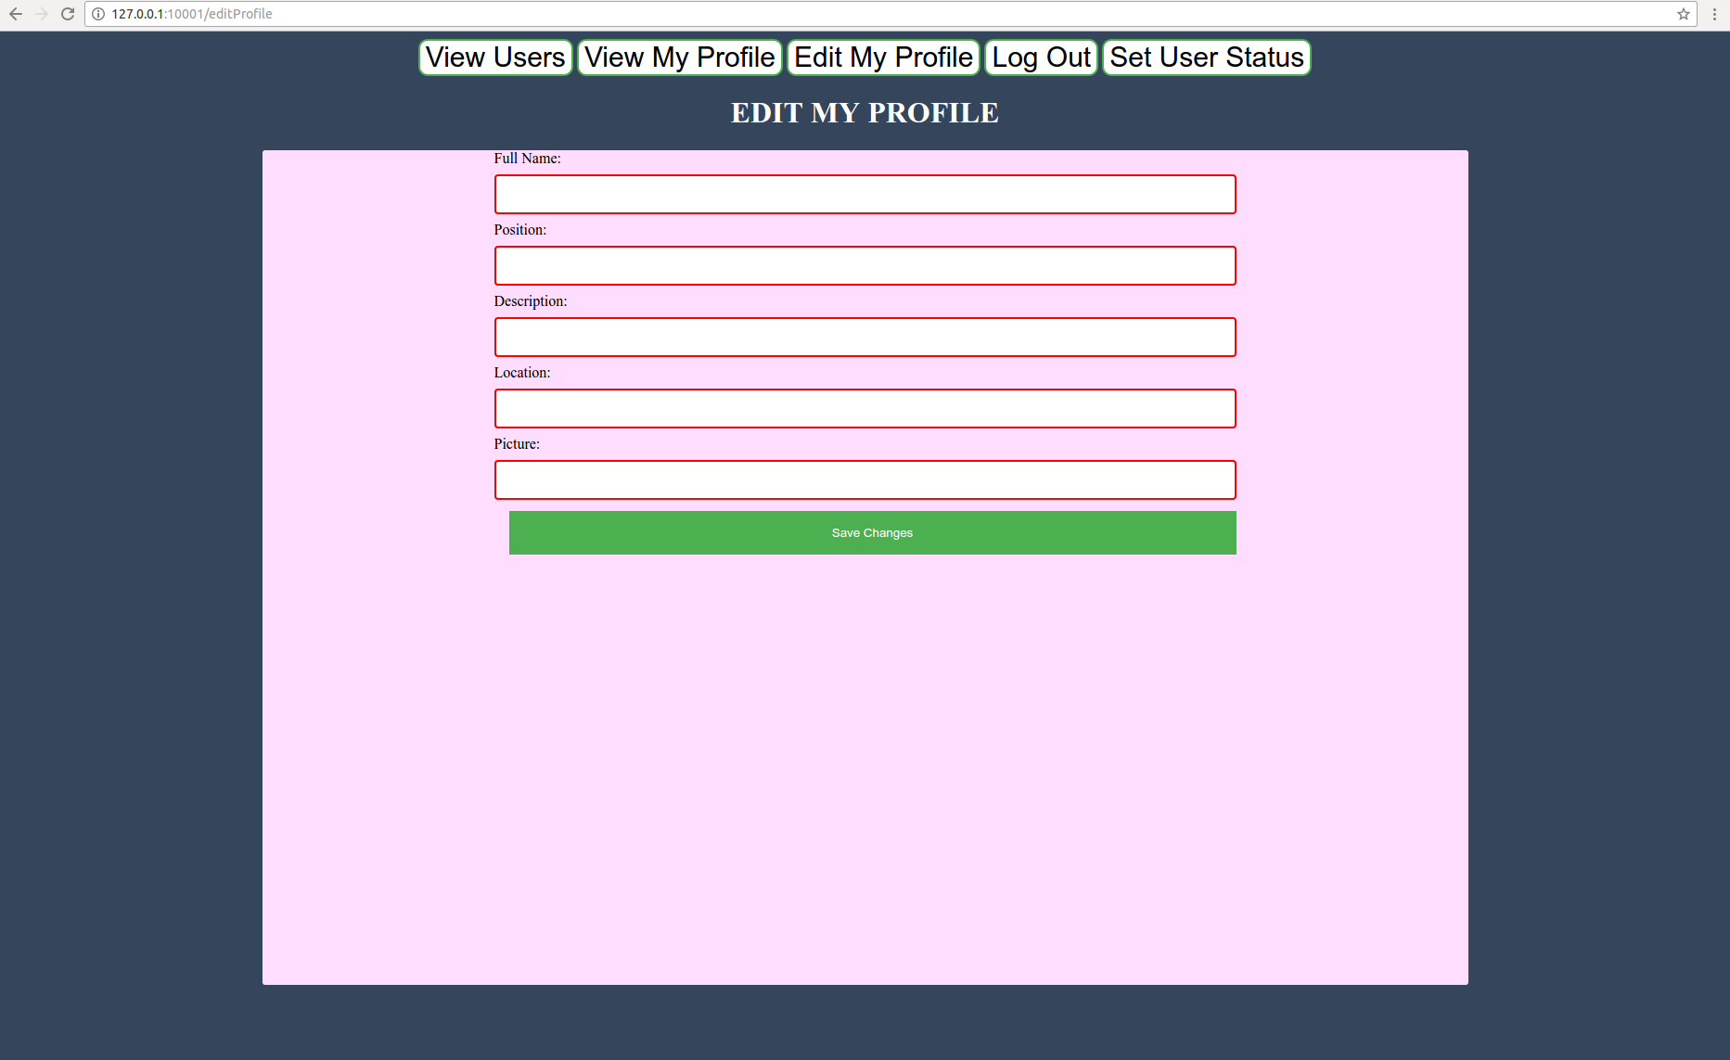
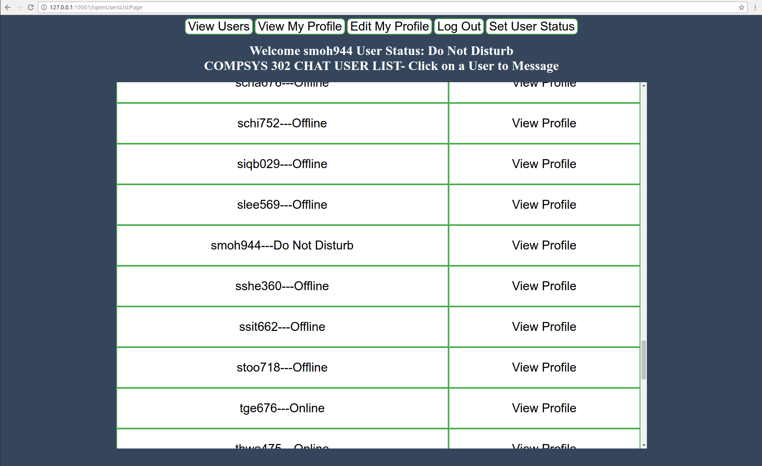
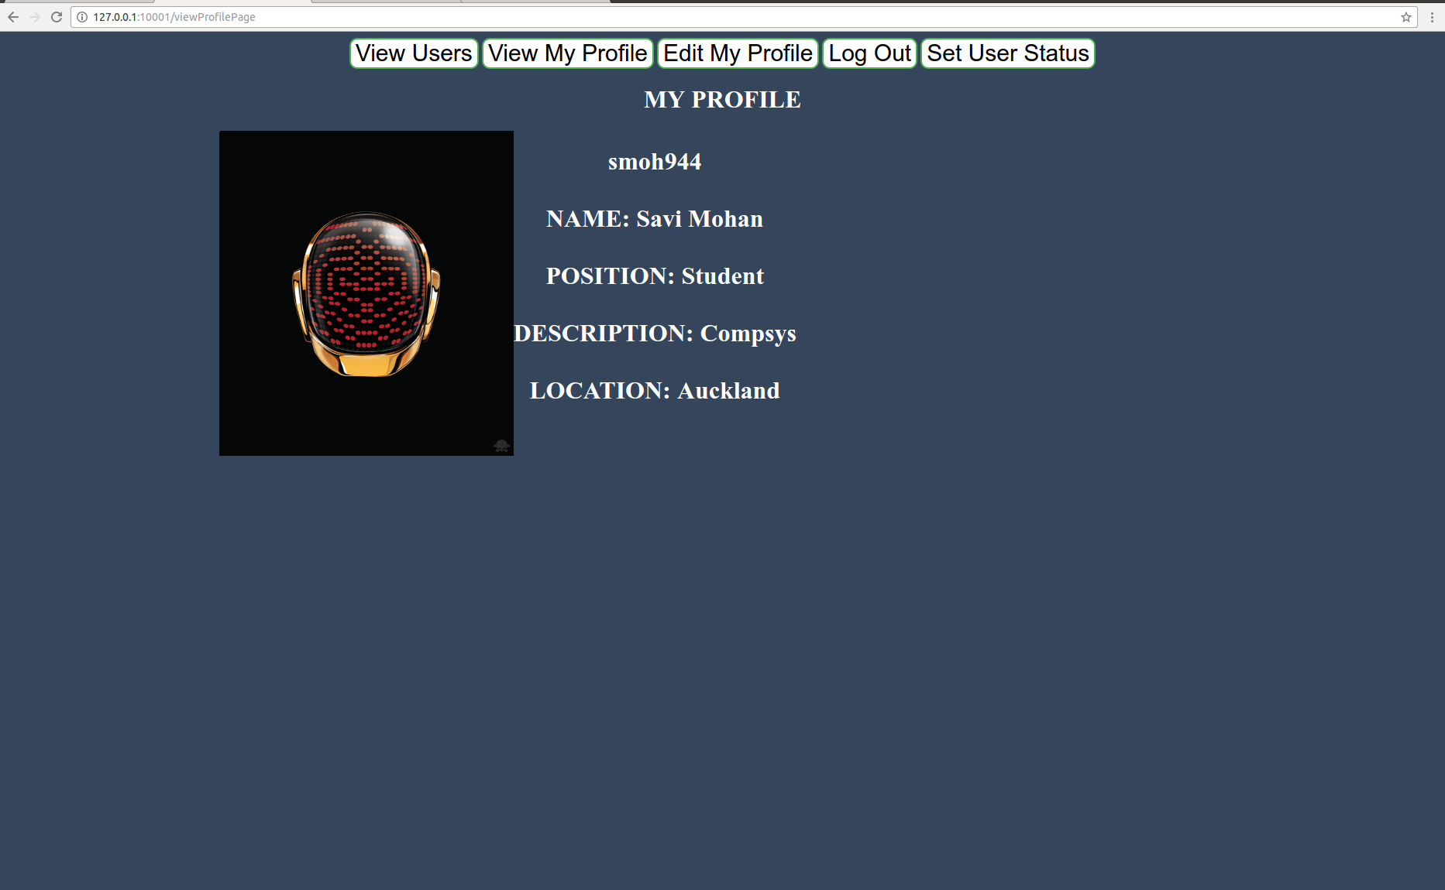
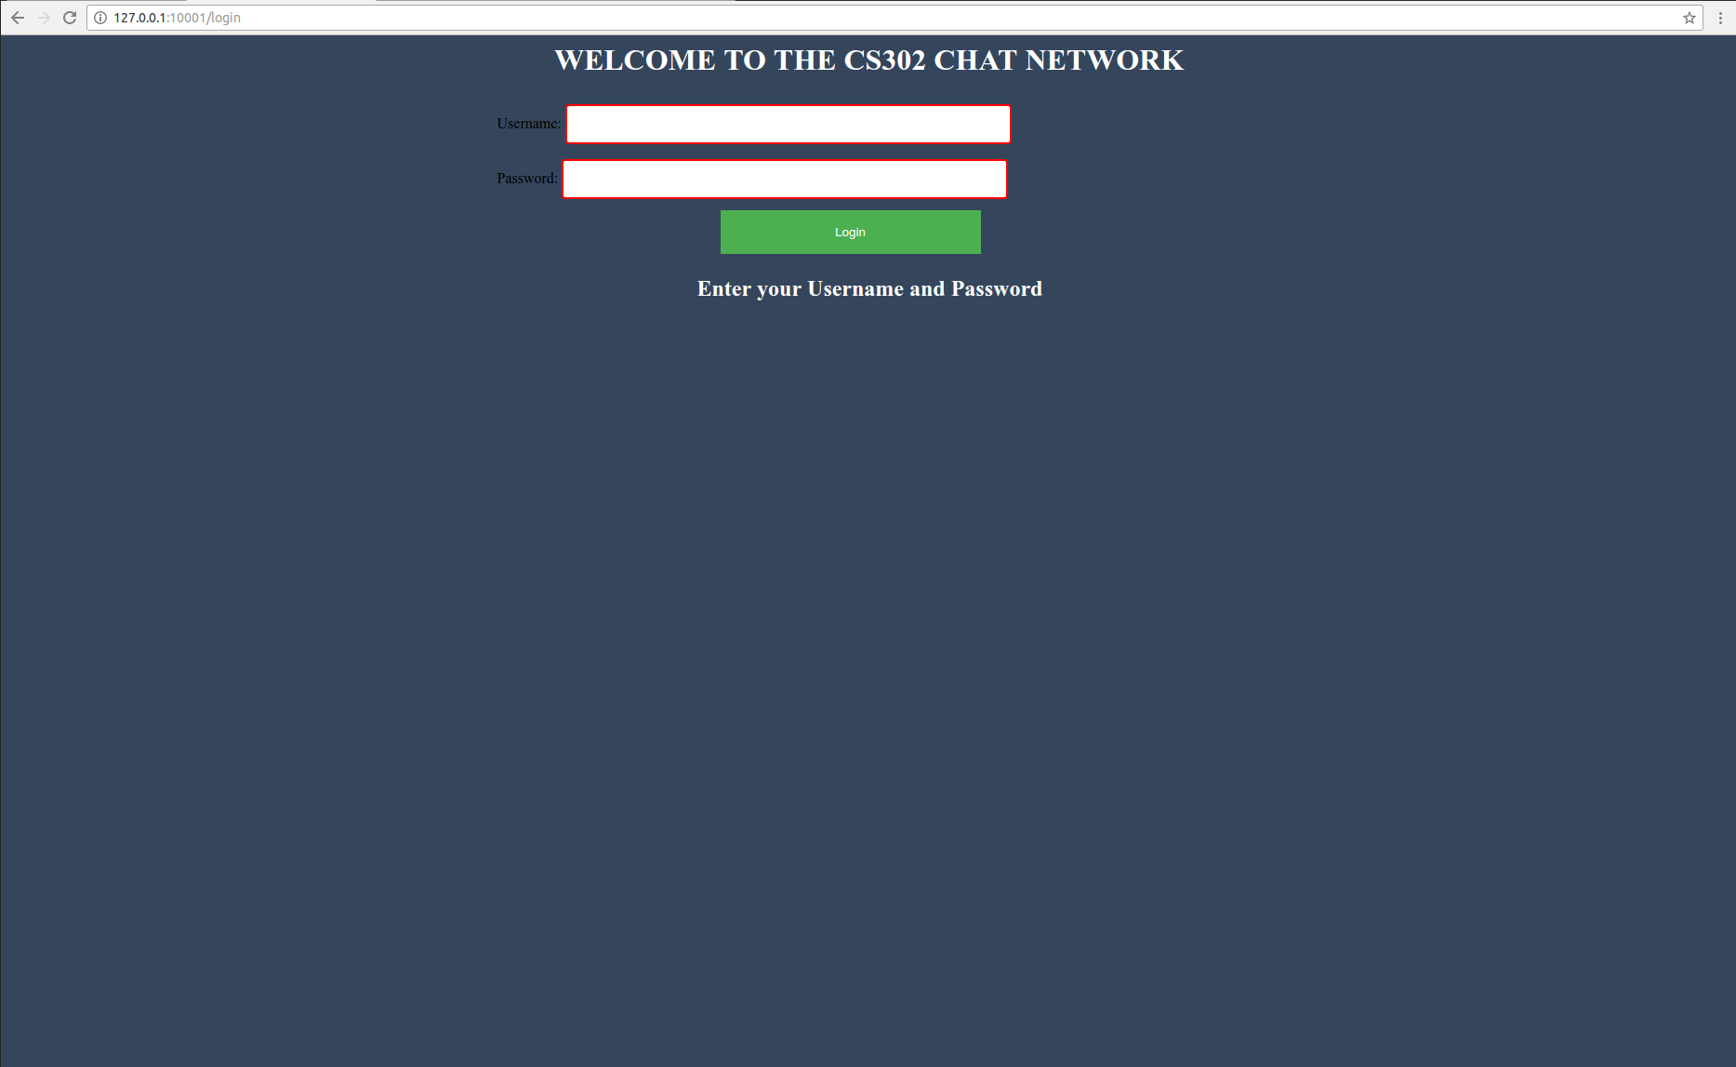

Slide 4
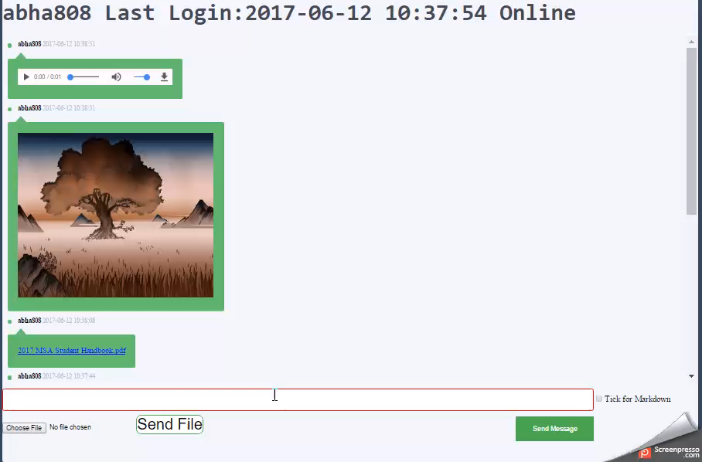

Slide 5
Login server network model
Compromise between Pure P2P and Central Server
Ease of connectivity of Central Server
Messages not stored in vulnerable central server

Slide 6
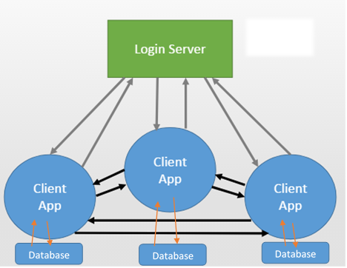
Top level view

Slide 7
Tools Used
CherryPy web application framework
Abstracts away the HTTP protocols, makes developing a web application much easier.
Manages sessions for logins, which makes it a lot easier to support multiple user sessions on the same application.
Python to write the server side.
Functions written in significantly fewer lines that in other languages.
In-built python libraries make web development much easier.
SQLite Database for data storage
HTML and CSS for client side user interface

Slide 8
Special Features -
Aesthetically Pleasing and Easy to Navigate UI
Embedded Video, Audio, Images
User can set Online status
Support for sending messages and files offline
Support for sending and receiving messages in markdown format
Rate Limiting
CherryPy session data is used to prevent external users from accessing the logged in user’s data
Application periodically keeps logging the user back into server
Multiple user sessions on one application

Slide 9
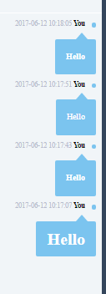
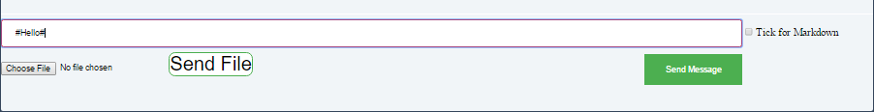
Support for markdown

Slide 10
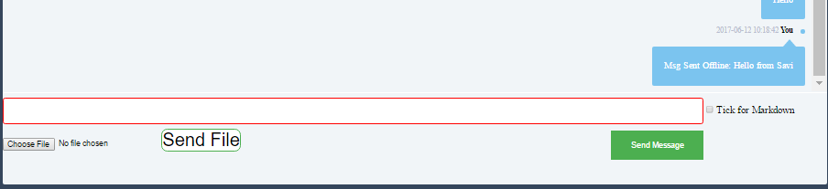
Offline Messaging
Messages sent offline are tagged with “Msg Sent Offline”

Slide 11
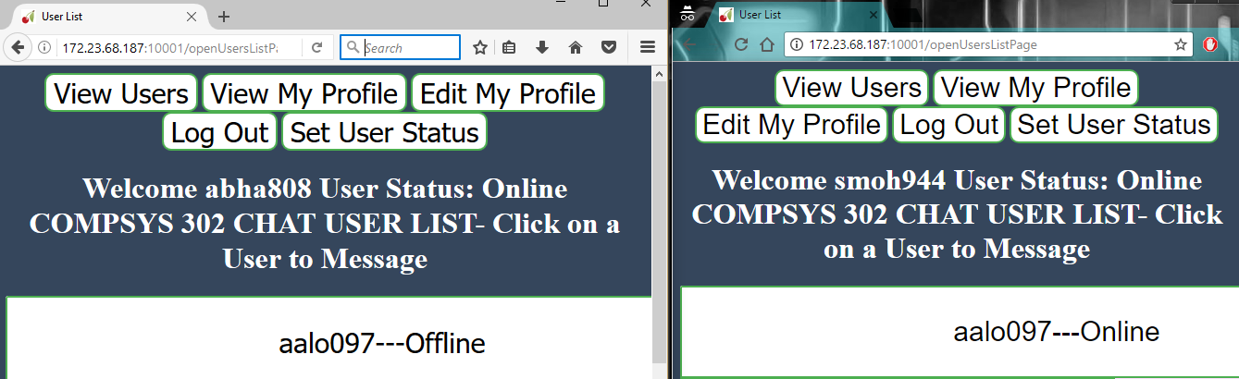
Multiple user sessions simultaneously

Slide 12
How I have met the project requirements AND MORE
All Client requirements have been met
Navigation made easy (GUI)
Additional Special Features

