Slide 1


Timekeeper
Team CELL
Adil Bhayani, Savi Mohan, Mark Yep

Slide 2
Problem
New Zealanders work about 15% longer than the OECD average and produce about 20% less output per person.
Timekeeper aims to address this problem of reduced productivity in the workplace
Computers are productive, but also distracting
With increased productivity comes increased profits and companies do better financially
Allows companies to better support New Zealanders

Slide 3





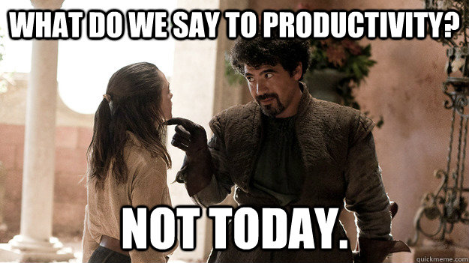


Distractions

Slide 4
Solution

Slide 5



Technology

Slide 6
Technology II

Slide 7
Market Research

Slide 8
Unique Solution

Slide 9
References
http://www.productivity.govt.nz/blog/how-does-nz%E2%80%99s-productivity-performance-stack-up

