Slide 1


Timekeeper
Team CELL
Adil Bhayani, Savi Mohan, Mark Yep

Slide 2
Problem
New Zealanders work about 15% longer than the OECD average and produce about 20% less output per person.
Timekeeper aims to address this problem of reduced productivity in the workplace
Computers are productive, but also distracting
With increased productivity comes increased profits and companies do better financially
Allows companies to better support New Zealanders

Slide 3





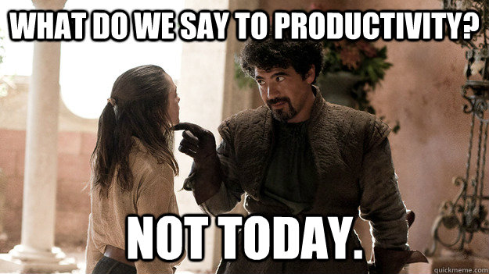


Distractions

Slide 4

Solution
System tracking software installed on employee workstation
Determine the current active window over time
Track trends in worker productivity
Supervisor views mobile / windows cross platform application
Can set classifications for applications and websites
Choose to set names or not
Allows supervisors to tailor plans to workplace productivity trends

Slide 5
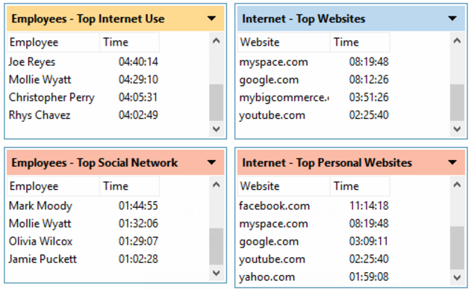
Market Research
Main competitor: Existing product called WorkTime
Timekeeper will have a more modern and easier to view UI
Less invasive
More company wide productivity trends and graphs
More outcome focussed
Aimed at helping supervisors to plan for improvement, rather than simply showing real time and past statistics

Slide 6
Business Model

Slide 7



Technology

Slide 8
Technology II

Slide 9
References
http://www.productivity.govt.nz/blog/how-does-nz%E2%80%99s-productivity-performance-stack-up

