Slide 1


Timekeeper
Team CELL
Adil Bhayani, Savi Mohan, Mark Yep

Slide 2
Problem
New Zealanders work about 15% longer than the OECD average and produce about 20% less output per person.
Timekeeper aims to address this problem of reduced productivity in the workplace
Computers are productive, but also distracting
With increased productivity comes increased profits and companies do better financially
Allows companies to better support New Zealanders

Slide 3





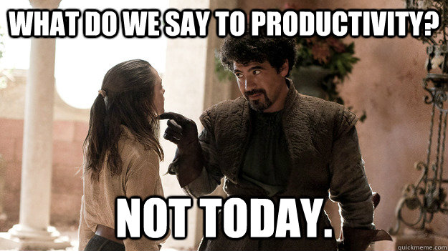


Distractions

Slide 4

Solution
System tracking software installed on employee workstation
Determine the current active window over time
Track trends in worker productivity
Supervisor views mobile / windows cross platform application
Can set classifications for applications and websites
Choose to set names or not
Allows supervisors to tailor plans to workplace productivity trends

Slide 5
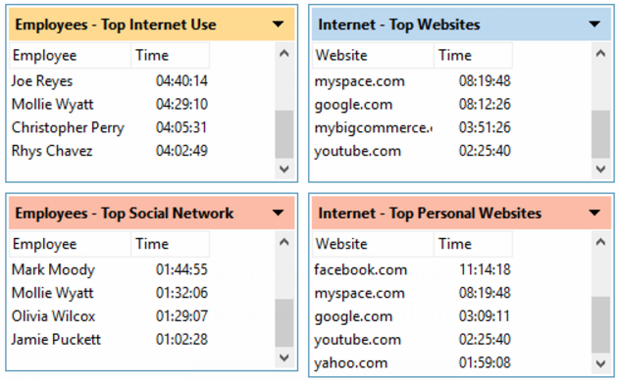
Market Research
Main competitor: Existing product called WorkTime
Timekeeper will have a more modern and easier to view UI
More customisable for individual businesses
Less invasive, no sensitive or personal information collected
More company wide productivity trends and graphs
Helps supervisors to plan for improvement, not just shows real time and past statistics

Slide 6
Business Model
Small to medium sized NZ companies that use computers
Particularly those lagging in the transition to digital technology
Recurring subscription based software as a service
Optional installation fee
Relatively cheap to provide, only server maintenance and employee wages
Partner with companies that already provide software or web service to companies (i.e. Microsoft)
Some sort of package deal

Slide 7


Technology Employee Side
Installed as a windows forms application
Exists solely in the system tray
No application window
Uploads to database the current active window title
Workstation ID
Date and time

Slide 8

Technology II Supervisor Side
A Xamarin mobile / windows cross platform application
Supervisor can use both phone and desktop to view
List of users
List of applications and websites
Customisation
Company-wide trends and graphs
Suggestions to improve productivity
Live demo

Slide 9
References
http://www.productivity.govt.nz/blog/how-does-nz%E2%80%99s-productivity-performance-stack-up
https://www.worktime.com/images/worktime-corporate-screenshot.png

