Slide 1



Timekeeper
Team CELL
Adil Bhayani, Savi Mohan, Mark Yep

Slide 2



Team
We are third year computer systems engineering students
Looking to innovate and help people like ourselves
We have experience in building:
Windows desktop application collects data
Xamarin front end (Windows, Android, iOS apps)

Slide 3
Problem
Medium to large sized businesses
Employees that do most of their work on their computers
Data entry, call centres, etc…
Wasting time at work on social media and videos
Employers want to know how to improve worker efficiency
Which employees are productive and which aren’t?

Slide 4
Solution
Track application and web usage
Display statistics and graphs for each employee for each week
Compare the usage to other employees and the company average
Background application which starts with Windows
Client app on both mobile and Windows (Xamarin)

Slide 5



Technical Aspects
Windows desktop application + Mobile/Windows App
WorkTime already exists
Our unique features:
Outlook Integration (Tasks/Meetings/Deadlines)
Much more modern UI
More Analytics – Weekly/Monthly/Yearly trends
Positive reinforcement rewards system

Slide 6
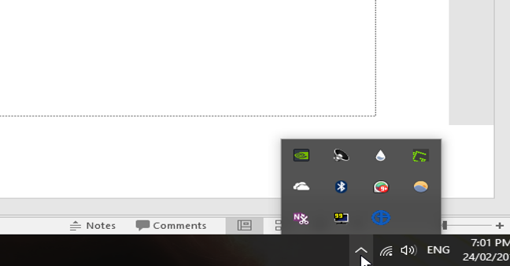
Visual Design I

Slide 7
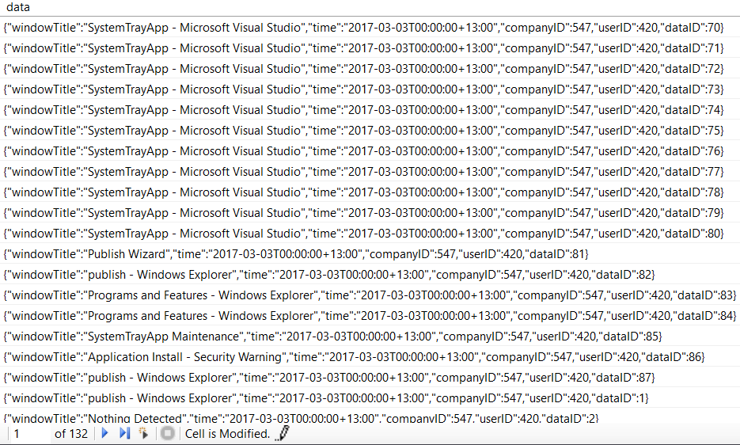
Database

Slide 8
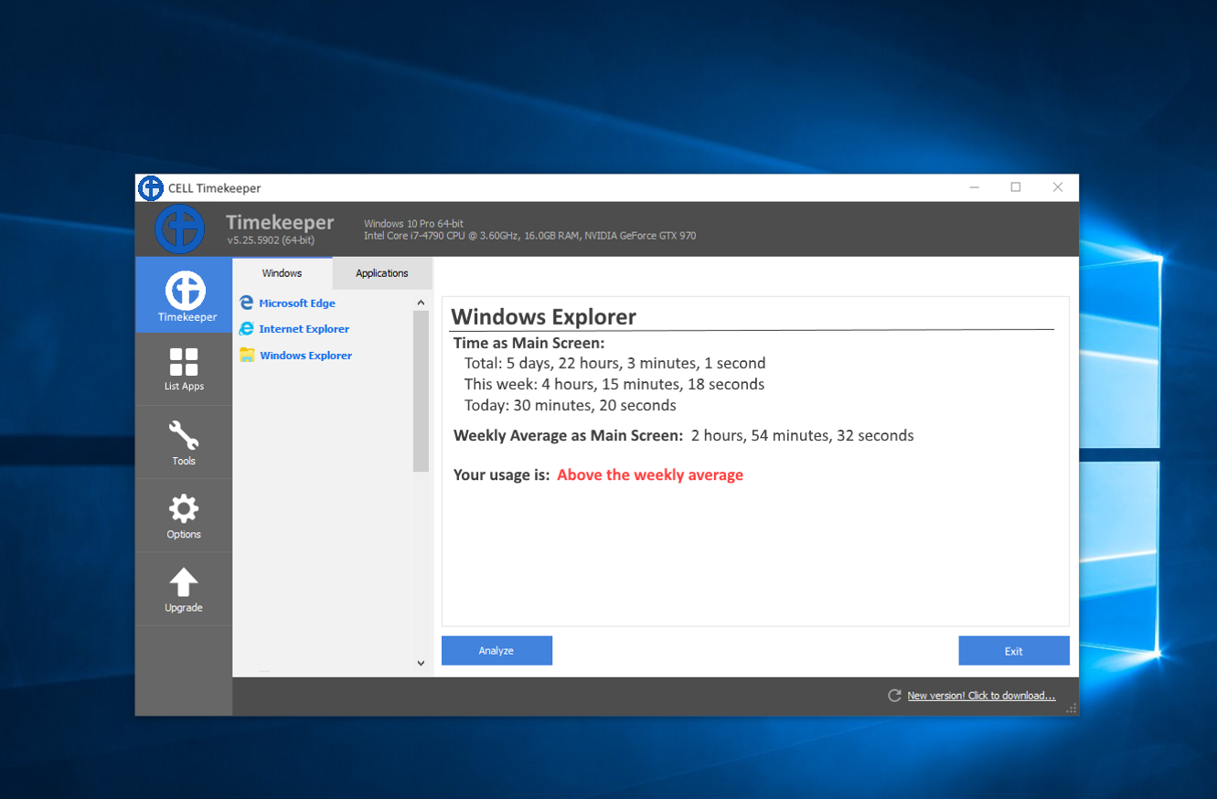
Visual Design II

Slide 9
Conclusions
People want to waste less time on a computer
Timekeeper will track usage of applications
Will also be able to rank the applications by usage
This will show people where they can reduce time spent and where they should increase time spent

