Slide 1



Timekeeper
Team CELL
Adil Bhayani, Savi Mohan, Mark Yep

Slide 2



Team
We are third year computer systems engineering students
Looking to innovate and help people like ourselves
We have experience in building:
Windows desktop application collects data
Xamarin front end (Windows, Android, iOS apps)

Slide 3


Problem
Students are spending large amounts of time on their computers
Are finding themselves unproductive and wasting time
Want to know how to improve their efficiency
Want to know where all their time is going

Slide 4
Solution
Track application usage
Display statistics and graphs for each application each week
Compare the usage to a weekly average to track progress
Targeted towards university students
Background application which starts with Windows
Window can be opened which displays information

Slide 5



Technical Aspects
Project will be distributed as a windows desktop application
Will be installed via an installer .exe file
Initial application will be released as freeware
Premium version in the future for additional features
Notifications
Server to compare usage
Suggestions to improve efficiency
Web browser tracking

Slide 6
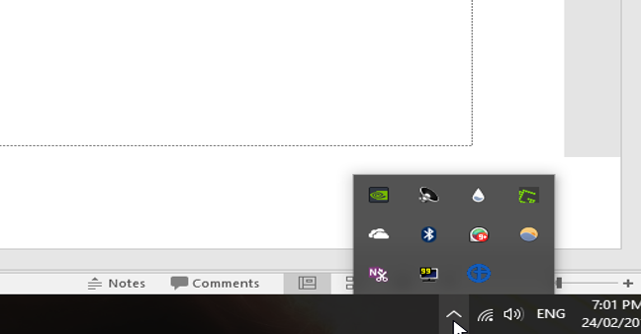
Visual Design I

Slide 7
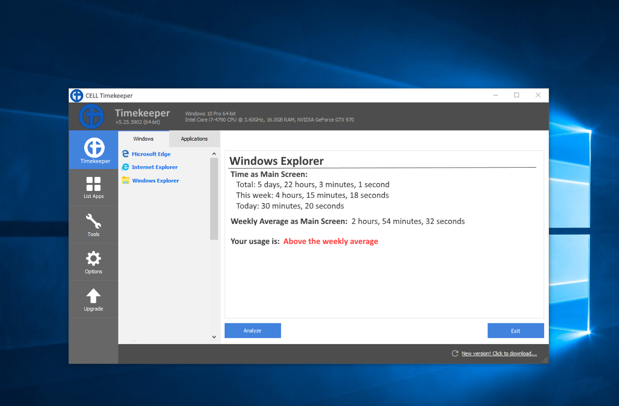
Visual Design II

Slide 8
Conclusions
People want to waste less time on a computer
Timekeeper will track usage of applications
Will also be able to rank the applications by usage
This will show people where they can reduce time spent and where they should increase time spent

