Slide 1
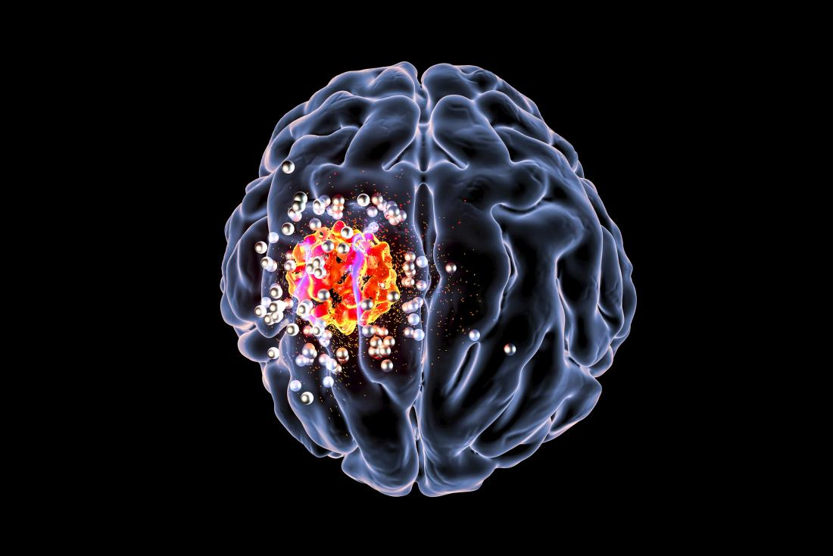
COMPUTATIONAL ONCOLOGY The role of Computer Scientists in the field of Oncology and Treatment of Cancer.

Slide 2
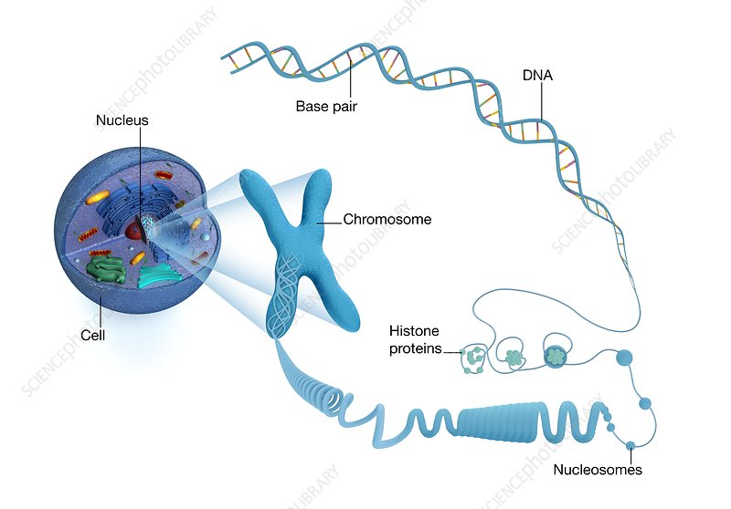
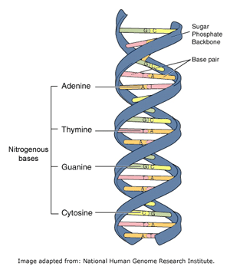
DNA

Slide 3
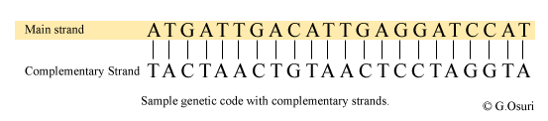
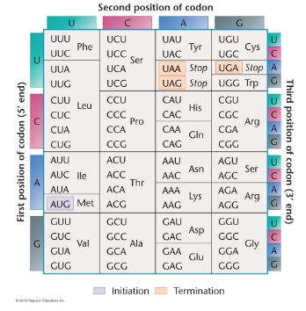
GENETIC CODE AND MUTATIONS
RAM HAS RED CAP
RAM HAS BRE DCA P
RAM HAS BIR EDC AP
RAM HAS BIG RED CAP
RAM HAS EDC AP
RAM HAS DCA P
RAM HAS CAP

Slide 4
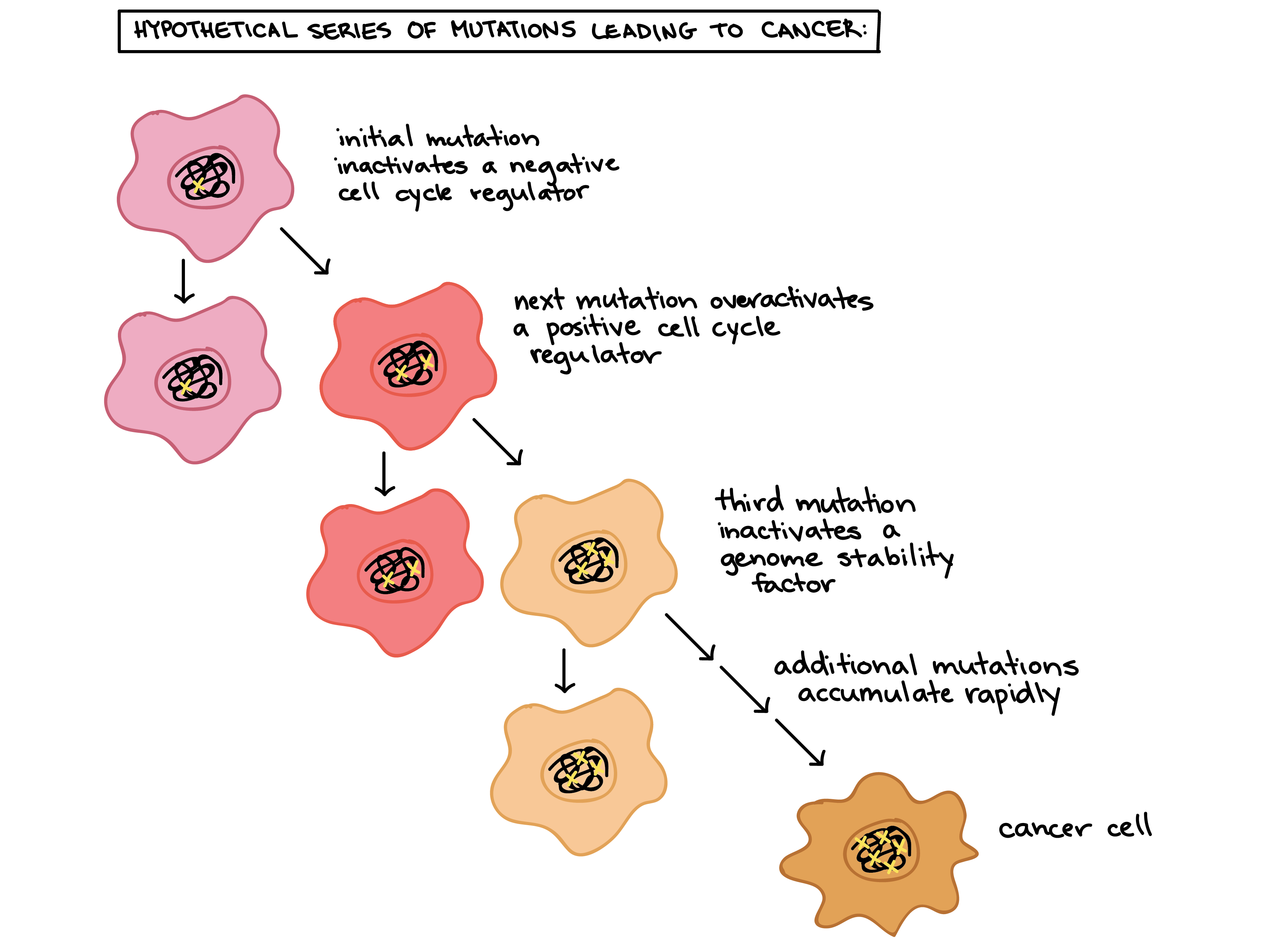
“CANCER IS NOT
A SINGLE
DISEASE”
BRCA1
BRCA2

Slide 5
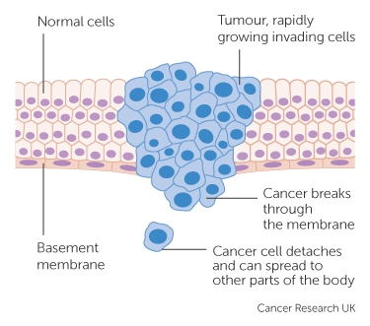
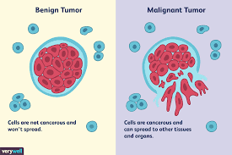
FORMATION OF A TUMOR

Slide 6
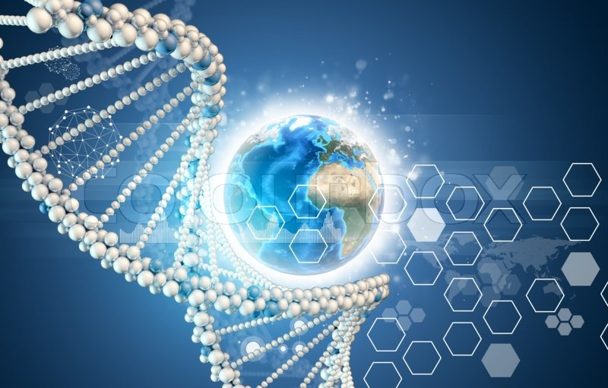
THE TOTAL LENGTH OF THE HUMAN GENOME IS OVER 3 BILLION BASE PAIRS.
The human genome is a complete set of nucleic acid sequences for humans, encoded as DNA within the 23 chromosome pairs in cell nuclei .
Human Genome Project.
20 x Earth’s Circumference

Slide 7
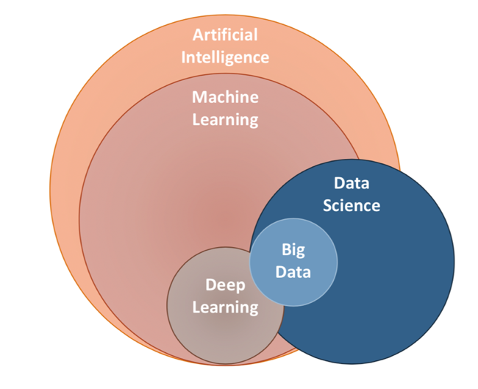
“DATA SCIENCE”
“Given that there are 3 billion letters in the human genome, there’s a huge amount of data to crunch. Hence the need for high-processing-power computers and computational experts who know how to write code that can detect patterns in large datasets.”

Slide 8
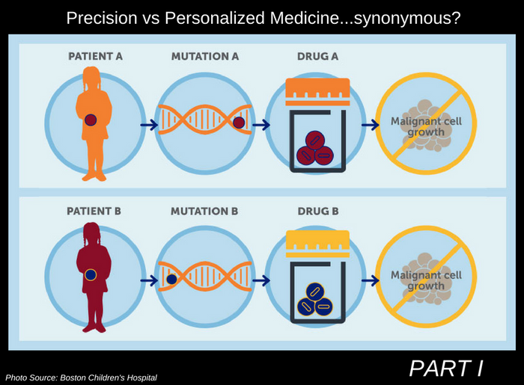
Nowadays, cancer research would simply not be possible without data science,” says Francesca Ciccarelli, a computer scientist who heads up the Cancer Systems Biology Lab,
Francis Crick Institute, London.
“Every tumor is unique. We need to take this into account when deciding how best to treat someone”. -Paul Bates' lab.

Slide 9
Physical exam, Laboratory tests, Imaging tests (CT,MRI,X-RAY), Tumor Biopsy.
Gene Sequencing, identification of the type of mutation, identification of the type of tumor.
Precision treatment based on the attributes of the tumor.
Classification of tumors, based on size, stage, grade and mutation.

Slide 10
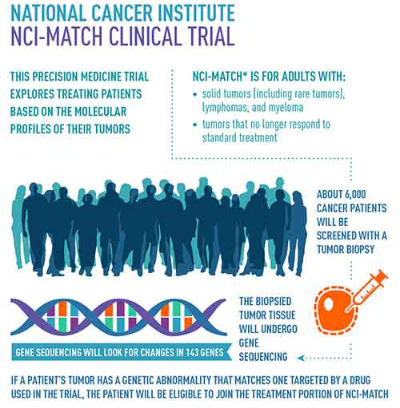
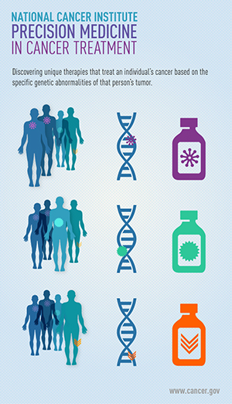

Slide 11
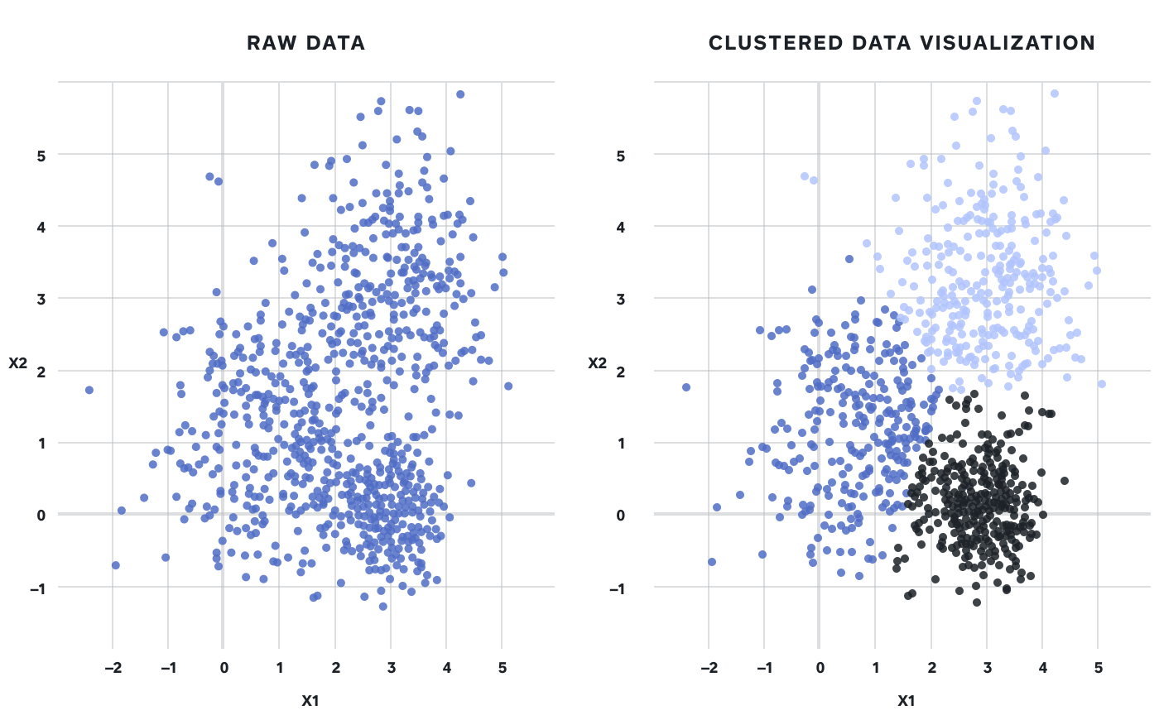
“CLUSTERING”
Cluster analysis or clustering is the task of grouping a set of objects in such a way that objects in the same group are more similar to each other than to those in other groups.

Slide 12
K-MEANS CLUSTERING
K=2
Arbitrarily
partition
objects into
K subsets.
Update the cluster centroids.
The initial data set.
Loop if needed.
Reassign
Objects.
Partition objects into K subsets.
Compute centroid (mean point) for each partition.
Assign each object to the cluster of its nearest centroid.
Repeat step 2 and 3 until no change.
Update the cluster centroids
using
distance metrics.

Slide 13
COMMENTS ON THE K-MEANS METHOD
Strength- Efficient time complexity- O(tkn).
K-means clustering is one of the simplest and popular unsupervised machine learning algorithms.
It has no built-in mechanism for determining the optimal number of clusters, thus requiring the number of clusters k to be provided manually.
Sensitive to noisy data.

Slide 14
DATA SCIENCE ALGORITHMS USED IN CANCER RESEARCH
Naïve- Bayes Classifier.
Neural Networks Method.
Decision Tree.
KNN.
Logistic Regression Algorithm.
Support Vector Machines.

Slide 15
THANK YOU!
CITATIONS
https://byjus.com/ncert-book-biology-class-12/
https://www.crick.ac.uk/news/2019-02-04_how-computer- scientists-are-helping-beat-cancer
https://www.cancernetwork.com/oncology-journal/artificial-intelligence-oncology-current-applications-and-future-directions
https://towardsdatascience.com/data-science/home
https://www.ncbi.nlm.nih.gov/pmc/articles/PMC5598970/
https://www.mayoclinic.org/diseases-conditions/cancer/diagnosis-treatment/drc-20370594

