Slide 1
PHYS 570: Quantum Biology
Lecture 01a
Crash intro to quantum mechanics
De Broglie wavelength
Time-dependent Schrödinger equation (TDSE)
Time-independent Schrödinger equation (TISE)
Free particle, particle in a box, particle in a harmonic potential
Operators, measurements, expectation values
Operators, eigenvalues, and eigenfunctions
Matrix representation of operators and wavefunctions
Notes:
Discuss

Slide 2
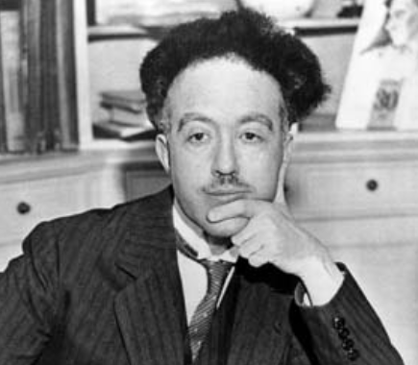
Matter: wave-particle duality
Louis de Broglie
1910: Sorbonne, his first degree in history
1913: degree in science (influenced by his brother)
1914: military service (World War I)
1919: continued scientific studies
Idea:
Photon energy is:
if it is a particle, according to Einstein:
→ Extend this idea to other objects, like electrons, with momentum p=mv
Louis Victor Pierre Raymond,
7th Duc de Broglie
1892-1987
de Broglie wavelength Frequency
Note: a more elaborate derivation can be done starting from the group velocity of a wave packet, v = dω/dk, hν = sqrt(p²c²+m₀²c² )
See https://physics.stackexchange.com/questions/223720/doubt-regarding-de-broglie-relation-from-group-velocity
Notes:
Note: a more elaborate derivation can be done starting from the group velocity of a wave packet, v = dω/dk,
hν = sqrt(p²c²+m₀²c² )
See https://physics.stackexchange.com/questions/223720/doubt-regarding-de-broglie-relation-from-group-velocity

Slide 3
De Broglie wavelength
de Broglie wavelength Frequency
Particle Wave
Energy Frequency
Momentum Wavelength
Explained Bohr’s model of the atom (standing waves)
2024, Thesis « Recherches sur la Théorie des Quanta » (Researches on the quantum theory)
(defended at the Faculty of Sciences at Paris University)
(Nobel Prize in 2029)

Slide 4
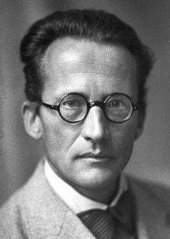
Schrödinger: wave equation
Erwin Schrödinger
Oct 1925: Schrödinger read the Einstein paper on the latest developments in atomic
physics that mentioned the de Broglie thesis
Presented a colloquium on the de Broglie ideas
Peter Debye’s reaction: if matter is a wave, there must be a wave equation!
An equation must exist that describes the motion of a wave!
In a few months, Schrödinger derived the equation that is the foundation of quantum mechanics
Erwin Schrödinger
1887 -1961
Notes:
The Nobel Prize in Chemistry 1936 was awarded to Petrus (Peter) Josephus Wilhelmus Debye "for his contributions to our knowledge of molecular structure through his investigations on dipole moments and on the diffraction of X-rays and electrons in gases"

Slide 5
Schrödinger: wave equation
Requirements for the matter wave equation:
Consistent with de Broglie-Einstein postulates:
Consistent with the energy equation:
Must be linear in Ψ(x,t), i.e. if Ψ₁(x,t) and Ψ₂(x,t) are solutions,
then any linear combination must be a solution:
Required to produce constructive/destructive interference
4. For a constant potential V, the solution must include a sinusoidal traveling wave of constant ν and λ
i.e., no external forces → constant momentum (wavelength), and energy (frequency)
For the logic behind the derivation of TDSE, see the YouTube Physics Explained lecture:
https://youtu.be/2WPA1L9uJqo

Slide 6
Schrödinger: wave equation
The Schrödinger Equation (1926) (Nobel in 1933)

Slide 7
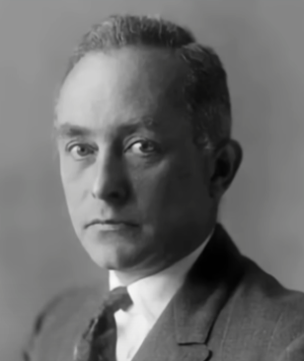
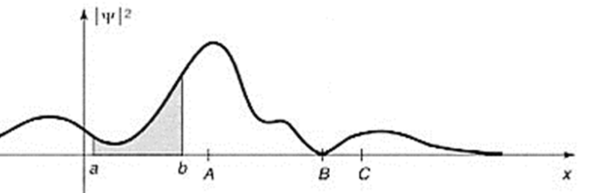
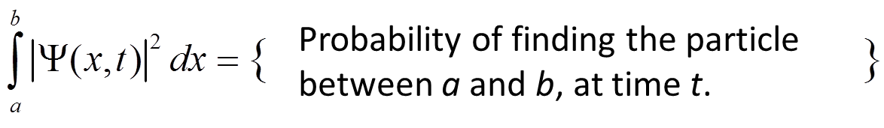
Wavefunction
But what is the wavefunction Ψ(x,t)?
- It is a complex function, but measurement results are real numbers!
Max Born, 1926 (Nobel 1954):
| Ψ(x,y)|²dx represents the probability of finding particle between x and x+dx:
Max Born
1882-1970
Note: A particle with a definite energy has a definite frequency, so it is spread over infinite space
Note: If a particle has a specific location, it must be represented as a wave packet
You cannot predict with certainty the outcome of an experiment
Quantum mechanics offers statistical information about possible results
Notes:
Schrodinger’s derivation is not exactly the same as shown here

Slide 8
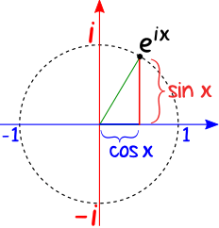
Solving the Schrödinger Equation: time-independent V
Separate variables:
Euler’s formula
Function of t = Function of x for all x and t
Must be constant!
Time-independent
Schrödinger equation

Slide 9
Solving the Schrödinger Equation: time-independent V
Solutions:
Note:
Or:
The probability to find a particle at a certain location does not depend on time
We only need to solve for ψ(x):
We can have more than 1 solution: a set of ψ_{i}(x) and respective E_{i}
Notes:
Note that any combination of ψ(x) satisfies also the TISE, but that has no real meaning as each component fluctuates at its own frequency, so you cannot add common time dependence to it

Slide 10
Solving the Schrödinger Equation: time-independent V
We only need to solve for ψ(x):
Can have more than 1 solution: a set of ψ_{i}(x) and respective E_{i}
Notes:
These are stationary solutions, the |Ψ_{i}(x,t)|² does not change in time
These are states with definite energy
ψ_{i} and E_{i} are eigenfunctions (or eigenstates) and eigenvalues of the time-independent Schrödinger equation
These states are mutually orthogonal, i.e.
Any linear combination of these wavefunctions satisfies the Shrödinger equation:
It is a complete set: any solution to SE can be represented by such a linear combination
Expectation energy value
But the energy of this state is not definite!
The measurement will return one of the E_{i} values with the probability |c_{i}|²
Notes:
Note that any combination of ψ(x) satisfies also the TISE, but that has no real meaning as each component fluctuates at its own frequency, so you cannot add common time dependence to it

Slide 11
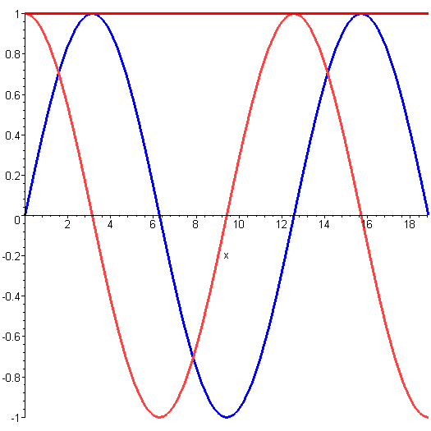
Solving the Schrödinger Equation: free particle
Example: Free particle, V = 0
Solution:
Combine with time-dependent part
→
←
These are waves traveling in opposite directions,
combine:
The energy is not quantized and can take any value, continuous spectrum
What is the amplitude A=?
Notes:
Note that any
combination of ψ(x) satisfies also the TISE, but that has no real meaning as each component fluctuates at its own frequency, so you cannot add common time dependence to it
Note: ψ₄ not shown, combinations are random suporpositions of all 4.

Slide 12
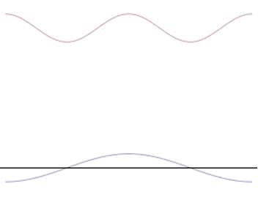
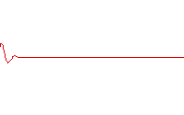
Particle as a wave packet
Any function can be represented as Fourier series integral
Notes:
The Wienn’s law was derived by Planck (more strictly) by defining entropy of oscillator and d2S/dU2=const/U. To get Raylegh one needed const/U2. So Planck simply combined that two as const/U(U+b) – it will be U for small U ((high frequency) and thus will give Wienn, and for large U (i.e. at low frequencies) will give Rayleigh.
Rubens & Kurlbaum – showed experimentally that Wien’s law does not work for long wavelength

Slide 13
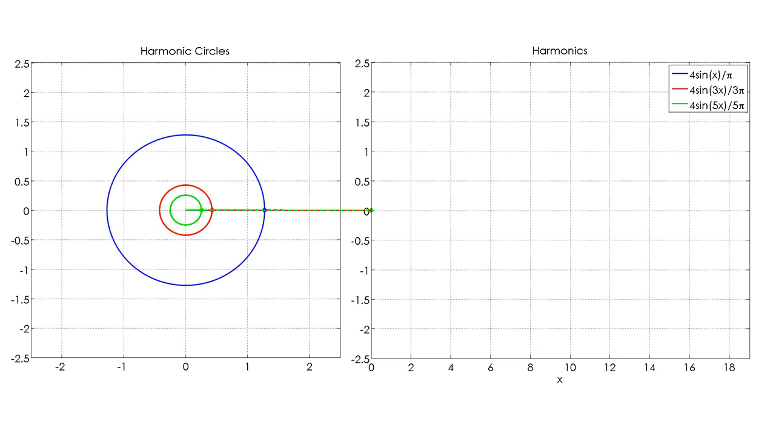
The Fourier series
Create your own: https://www.geogebra.org/m/aenhzjpz
Cool visualization: https://www.youtube.com/watch?v=r6sGWTCMz2k

Slide 14
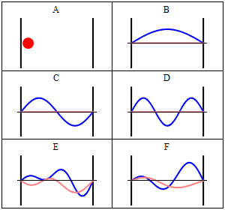
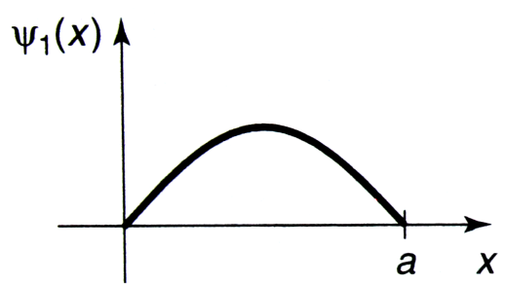
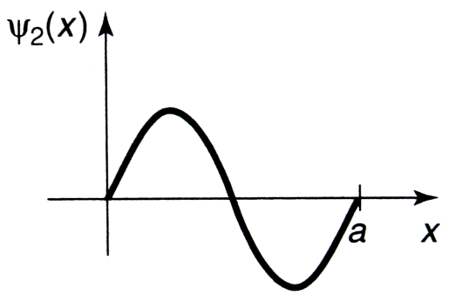
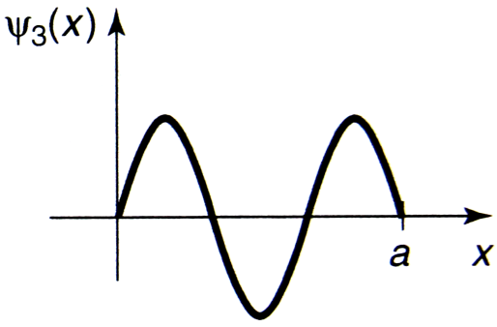
Particle in a box
Example: particle in a box
Solutions:
V(x)
E₄~4²
E₃~3²
Standing waves! Discrete spectrum of energies (energy is quantized)
E₂~2²
E₁~1²
a x
Classical
Ψ₁
Re(Ψ)
Im(Ψ)
Ψ₂
Ψ₃
Stationary
Superposition of
Ψ₁, Ψ₂, Ψ₃ and Ψ₄,
http://en.wikipedia.org/wiki/Particle_in_a_box
Notes:
Discuss: The solutions within the box should be the same as for a free particle
However, solutions outside the box with V=∞ must be zero
The boundary conditions: wavefunction at boundaries should equal looking from both sides
→ The solutions are standing waves with zeros at sides and cos() inside
Note that any combination of ψ(x) satisfies the TISE, but that has no real meaning, as each component fluctuates at its own frequency, so you cannot add a common time dependence to it
Note: ψ₄ not shown, combinations are random suppositions of all 4.

Slide 15
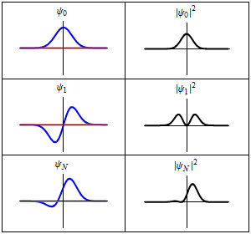
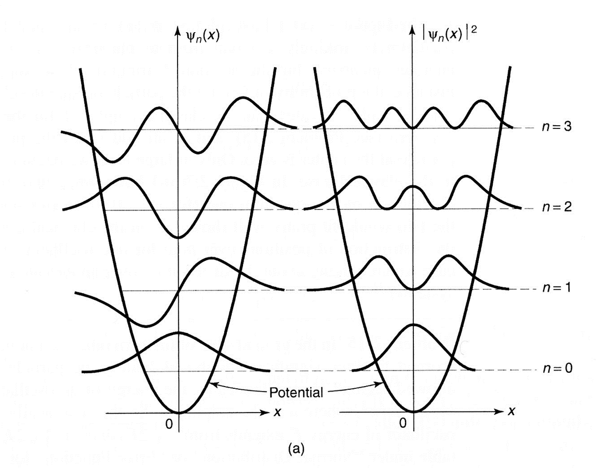

Particle in harmonic potential
Note: any potential function V(x) near minimum can be approximated as V(x)~x² (the first =term in Taylor series, V(x)=c₀+c₂x²+c₃x⁴+… )
Spring-mass: V = kx²/2=mω²x² → Hook’s law → F = -dV/dx = -kx
Hermite polynomials
Mixed state
Notes:
Discuss:
Solution inside resembles a harmonic function, outside – exponential
Particle can be found in a classically forbidden region
equidistant spectrum of energy, zero energy is not zero
Traditionally, the wavefunctions are plotted on top of the V-graph with ‘zero’ lines at their respective energies
Note that stationary states (eigenfunctions) are stationary, the mixes are not

Slide 16
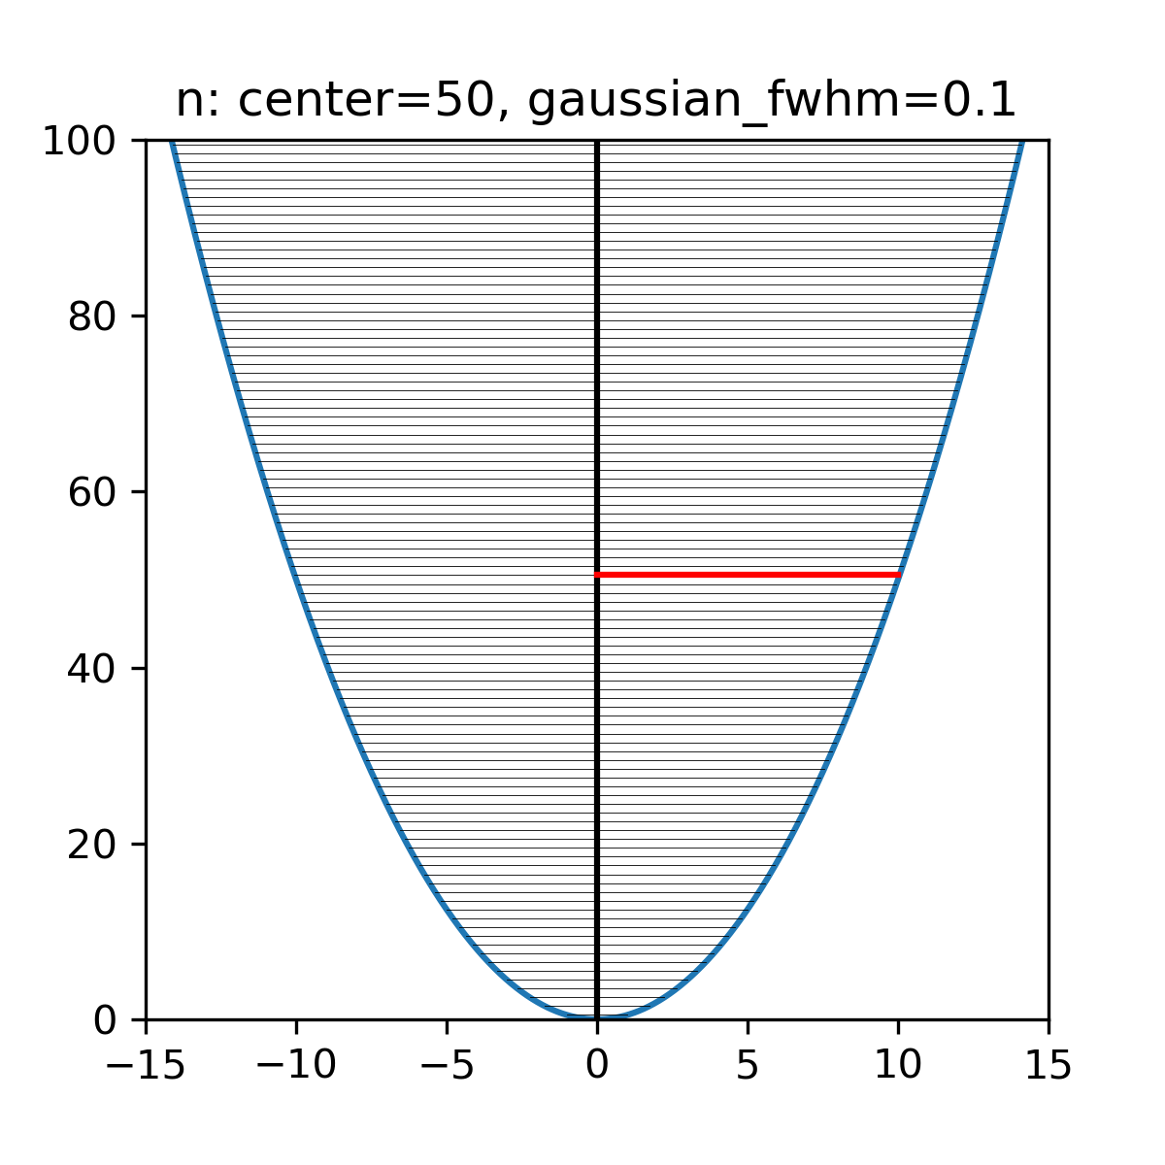
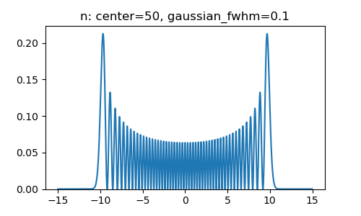
Particle wavepacket in a harmonic potential
Superposition:
n=50, fwhm = 0
Wavepacket center n_{c} = 50
Expansion coefficients follow a Gaussian distribution:
Only one level is populated
→stationary state
Notes:
Note that this ω is also the frequency at which a classical oscillator oscillates in such a potential.
Python prog to make snapshots of |Ψ|² at different times, saves into png, join into animated gif using JASC animation shop
---------------------
import matplotlib.pyplot as plt
import numpy
import math
#Choose simple units
m=1.
w=1
hbar=1.
#Discretized space, x-axis
dx = 0.005
x_lim = 15
x = numpy.arange(-x_lim,x_lim,dx)
#wavepacket center and width
center = 50
width = 2
# service functions
def hermite(x, n):
xi = numpy.sqrt(m*w/hbar)*x
herm_coeffs = numpy.zeros(n+1)
herm_coeffs[n] = 1
return numpy.polynomial.hermite.hermval(xi, herm_coeffs)
def stationary_state(x,n):
xi = numpy.sqrt(m*w/hbar)*x
prefactor = 1./math.sqrt(2.**n * math.factorial(n)) * (m*w/(numpy.pi*hbar))**(0.25)
psi = prefactor * numpy.exp(- xi**2 / 2) * hermite(x,n)
return psi
def gauss(pos,center,width):
sigma = width/2.35492
return 1./sigma/2/math.pi*math.exp(-(pos-center)**2/sigma**2/2)
def classical_P(x,n):
E = hbar*w*(n+0.5)
x_max = numpy.sqrt(2*E/(m*w**2))
classical_prob = numpy.zeros(x.shape[0])
x_inside = abs(x) < (x_max - 0.025)
classical_prob[x_inside] = 1./numpy.pi/numpy.sqrt(x_max**2-x[x_inside]*x[x_inside])
return classical_prob
plt.figure(figsize=(10, 8))
plt.subplot(3,2,1)
plt.plot(x, numpy.conjugate(stationary_state(x,0))*stationary_state(x,0), label="n=0")
plt.plot(x, classical_P(x,0))
plt.legend()
plt.subplot(3,2,2)
plt.plot(x, numpy.conjugate(stationary_state(x,3))*stationary_state(x,3), label="n=3")
plt.plot(x, classical_P(x,3))
plt.legend()
plt.subplot(3,2,3)
plt.plot(x, numpy.conjugate(stationary_state(x,8))*stationary_state(x,8), label="n=8")
plt.plot(x, classical_P(x,8))
plt.legend()
plt.subplot(3,2,4)
plt.plot(x, numpy.conjugate(stationary_state(x,15))*stationary_state(x,15), label="n=15")
plt.plot(x, classical_P(x,15))
plt.legend()
plt.subplot(3,2,5)
plt.plot(x, numpy.conjugate(stationary_state(x,25))*stationary_state(x,25), label="n=25")
plt.plot(x, classical_P(x,25))
plt.legend()
plt.subplot(3,2,6)
plt.plot(x, numpy.conjugate(stationary_state(x,50))*stationary_state(x,50), label="n=50")
plt.plot(x, classical_P(x,50))
plt.legend()
plt.show()
# make superposition
i=1
for t in numpy.arange(0,2*math.pi,math.pi/15):
wf_re = x*0
wf_im = x*0
for n in range(center-width*2,center+width*2):
phase = (n+0.5)*t # Note: these are beats, so not sure why t=2pi gave a period with n~50
# I guess it is because wqith n~50 it takes 2pi*50 periods to to get n+1 oscillation to match again
wf_re = wf_re + math.cos(phase)*stationary_state(x,n)*gauss(n,center,width)
wf_im = wf_im + math.sin(phase)*stationary_state(x,n)*gauss(n,center,width)
plt.figure(figsize=(5, 3))
plt.ylim(0,0.2)
plt.plot(x,numpy.sqrt(wf_re**2 + wf_im**2)) #,label=f'center={center}, fwhm={width}')
plt.title(f'n: center={center}, gaussian_fwhm={width}')
plt.savefig(f'fig-c{center:002}-w{width:002}-{i:003}', dpi = 100, facecolor = 'white')
i = i + 1

Slide 17
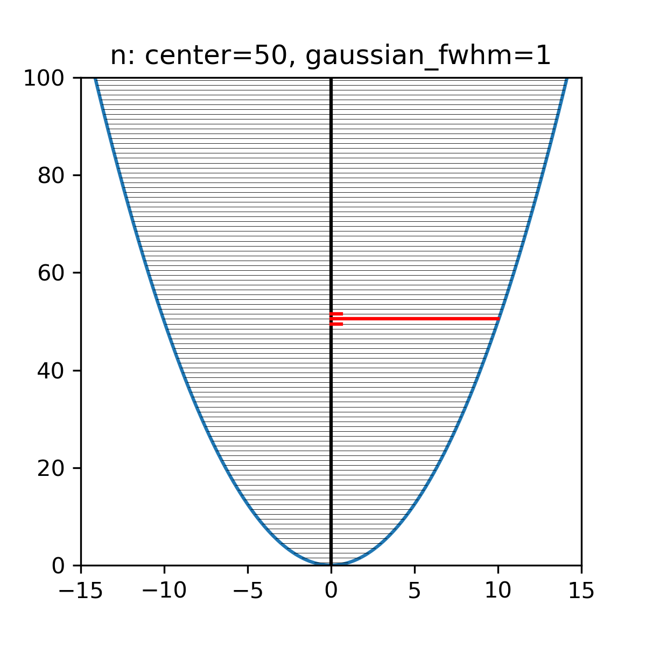
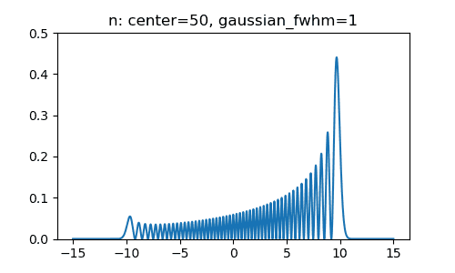
Particle wavepacket in a harmonic potential
Superposition:
n=50, fwhm = 1
Wavepacket center n_{c} = 50
Expansion coefficients follow a Gaussian distribution:
Two nearby states are slightly mixed in
Not a stationary state!
Notes:
Note that this ω is also the frequency at which a classical oscillator oscillates in such a potential.
Python prog to make snapshots of |Ψ|² at different times, saves into png, join into animated gif using JASC animation shop
---------------------
import matplotlib.pyplot as plt
import numpy
import math
#Choose simple units
m=1.
w=1
hbar=1.
#Discretized space, x-axis
dx = 0.005
x_lim = 15
x = numpy.arange(-x_lim,x_lim,dx)
#wavepacket center and width
center = 50
width = 2
# service functions
def hermite(x, n):
xi = numpy.sqrt(m*w/hbar)*x
herm_coeffs = numpy.zeros(n+1)
herm_coeffs[n] = 1
return numpy.polynomial.hermite.hermval(xi, herm_coeffs)
def stationary_state(x,n):
xi = numpy.sqrt(m*w/hbar)*x
prefactor = 1./math.sqrt(2.**n * math.factorial(n)) * (m*w/(numpy.pi*hbar))**(0.25)
psi = prefactor * numpy.exp(- xi**2 / 2) * hermite(x,n)
return psi
def gauss(pos,center,width):
sigma = width/2.35492
return 1./sigma/2/math.pi*math.exp(-(pos-center)**2/sigma**2/2)
def classical_P(x,n):
E = hbar*w*(n+0.5)
x_max = numpy.sqrt(2*E/(m*w**2))
classical_prob = numpy.zeros(x.shape[0])
x_inside = abs(x) < (x_max - 0.025)
classical_prob[x_inside] = 1./numpy.pi/numpy.sqrt(x_max**2-x[x_inside]*x[x_inside])
return classical_prob
plt.figure(figsize=(10, 8))
plt.subplot(3,2,1)
plt.plot(x, numpy.conjugate(stationary_state(x,0))*stationary_state(x,0), label="n=0")
plt.plot(x, classical_P(x,0))
plt.legend()
plt.subplot(3,2,2)
plt.plot(x, numpy.conjugate(stationary_state(x,3))*stationary_state(x,3), label="n=3")
plt.plot(x, classical_P(x,3))
plt.legend()
plt.subplot(3,2,3)
plt.plot(x, numpy.conjugate(stationary_state(x,8))*stationary_state(x,8), label="n=8")
plt.plot(x, classical_P(x,8))
plt.legend()
plt.subplot(3,2,4)
plt.plot(x, numpy.conjugate(stationary_state(x,15))*stationary_state(x,15), label="n=15")
plt.plot(x, classical_P(x,15))
plt.legend()
plt.subplot(3,2,5)
plt.plot(x, numpy.conjugate(stationary_state(x,25))*stationary_state(x,25), label="n=25")
plt.plot(x, classical_P(x,25))
plt.legend()
plt.subplot(3,2,6)
plt.plot(x, numpy.conjugate(stationary_state(x,50))*stationary_state(x,50), label="n=50")
plt.plot(x, classical_P(x,50))
plt.legend()
plt.show()
# make superposition
i=1
for t in numpy.arange(0,2*math.pi,math.pi/15):
wf_re = x*0
wf_im = x*0
for n in range(center-width*2,center+width*2):
phase = (n+0.5)*t # Note: these are beats, so not sure why t=2pi gave a period with n~50
# I guess it is because wqith n~50 it takes 2pi*50 periods to to get n+1 oscillation to match again
wf_re = wf_re + math.cos(phase)*stationary_state(x,n)*gauss(n,center,width)
wf_im = wf_im + math.sin(phase)*stationary_state(x,n)*gauss(n,center,width)
plt.figure(figsize=(5, 3))
plt.ylim(0,0.2)
plt.plot(x,numpy.sqrt(wf_re**2 + wf_im**2)) #,label=f'center={center}, fwhm={width}')
plt.title(f'n: center={center}, gaussian_fwhm={width}')
plt.savefig(f'fig-c{center:002}-w{width:002}-{i:003}', dpi = 100, facecolor = 'white')
i = i + 1

Slide 18
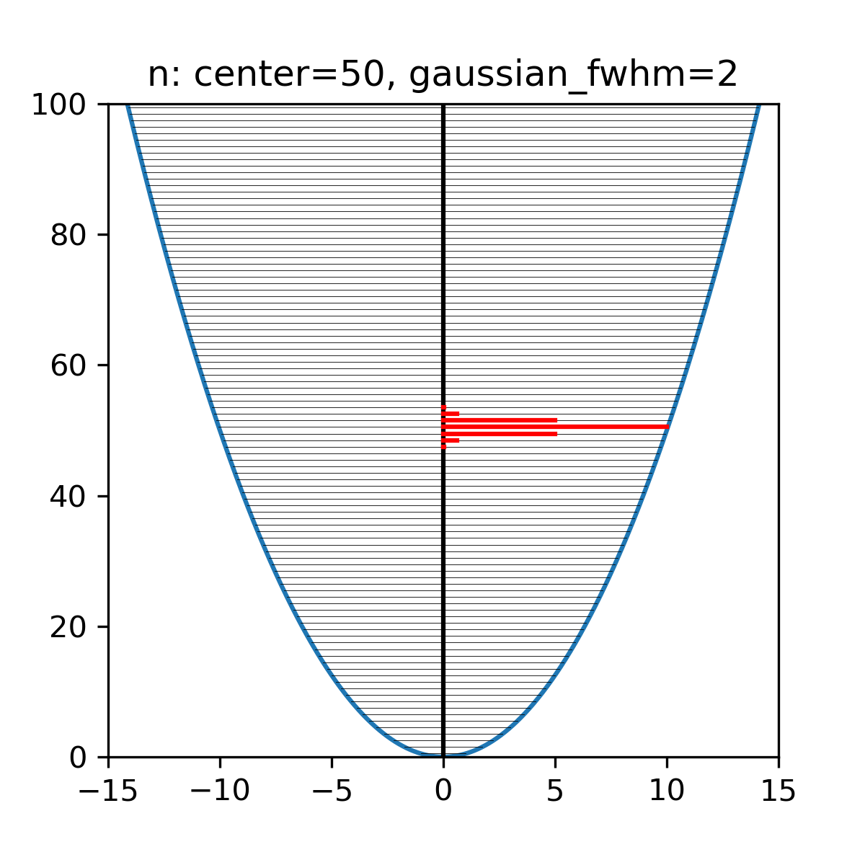
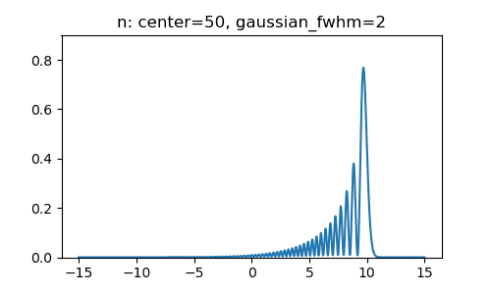
Particle wavepacket in a harmonic potential
Superposition:
n=50, fwhm = 2
Wavepacket center n_{c} = 50
Expansion coefficients follow a Gaussian distribution:
A few nearby states are mixed in
Not a stationary state!
Notes:
Note that this ω is also the frequency at which a classical oscillator oscillates in such a potential.
Python prog to make snapshots of |Ψ|² at different times, saves into png, join into animated gif using JASC animation shop
---------------------
import matplotlib.pyplot as plt
import numpy
import math
#Choose simple units
m=1.
w=1
hbar=1.
#Discretized space, x-axis
dx = 0.005
x_lim = 15
x = numpy.arange(-x_lim,x_lim,dx)
#wavepacket center and width
center = 50
width = 2
# service functions
def hermite(x, n):
xi = numpy.sqrt(m*w/hbar)*x
herm_coeffs = numpy.zeros(n+1)
herm_coeffs[n] = 1
return numpy.polynomial.hermite.hermval(xi, herm_coeffs)
def stationary_state(x,n):
xi = numpy.sqrt(m*w/hbar)*x
prefactor = 1./math.sqrt(2.**n * math.factorial(n)) * (m*w/(numpy.pi*hbar))**(0.25)
psi = prefactor * numpy.exp(- xi**2 / 2) * hermite(x,n)
return psi
def gauss(pos,center,width):
sigma = width/2.35492
return 1./sigma/2/math.pi*math.exp(-(pos-center)**2/sigma**2/2)
def classical_P(x,n):
E = hbar*w*(n+0.5)
x_max = numpy.sqrt(2*E/(m*w**2))
classical_prob = numpy.zeros(x.shape[0])
x_inside = abs(x) < (x_max - 0.025)
classical_prob[x_inside] = 1./numpy.pi/numpy.sqrt(x_max**2-x[x_inside]*x[x_inside])
return classical_prob
plt.figure(figsize=(10, 8))
plt.subplot(3,2,1)
plt.plot(x, numpy.conjugate(stationary_state(x,0))*stationary_state(x,0), label="n=0")
plt.plot(x, classical_P(x,0))
plt.legend()
plt.subplot(3,2,2)
plt.plot(x, numpy.conjugate(stationary_state(x,3))*stationary_state(x,3), label="n=3")
plt.plot(x, classical_P(x,3))
plt.legend()
plt.subplot(3,2,3)
plt.plot(x, numpy.conjugate(stationary_state(x,8))*stationary_state(x,8), label="n=8")
plt.plot(x, classical_P(x,8))
plt.legend()
plt.subplot(3,2,4)
plt.plot(x, numpy.conjugate(stationary_state(x,15))*stationary_state(x,15), label="n=15")
plt.plot(x, classical_P(x,15))
plt.legend()
plt.subplot(3,2,5)
plt.plot(x, numpy.conjugate(stationary_state(x,25))*stationary_state(x,25), label="n=25")
plt.plot(x, classical_P(x,25))
plt.legend()
plt.subplot(3,2,6)
plt.plot(x, numpy.conjugate(stationary_state(x,50))*stationary_state(x,50), label="n=50")
plt.plot(x, classical_P(x,50))
plt.legend()
plt.show()
# make superposition
i=1
for t in numpy.arange(0,2*math.pi,math.pi/15):
wf_re = x*0
wf_im = x*0
for n in range(center-width*2,center+width*2):
phase = (n+0.5)*t # Note: these are beats, so not sure why t=2pi gave a period with n~50
# I guess it is because wqith n~50 it takes 2pi*50 periods to to get n+1 oscillation to match again
wf_re = wf_re + math.cos(phase)*stationary_state(x,n)*gauss(n,center,width)
wf_im = wf_im + math.sin(phase)*stationary_state(x,n)*gauss(n,center,width)
plt.figure(figsize=(5, 3))
plt.ylim(0,0.2)
plt.plot(x,numpy.sqrt(wf_re**2 + wf_im**2)) #,label=f'center={center}, fwhm={width}')
plt.title(f'n: center={center}, gaussian_fwhm={width}')
plt.savefig(f'fig-c{center:002}-w{width:002}-{i:003}', dpi = 100, facecolor = 'white')
i = i + 1

Slide 19
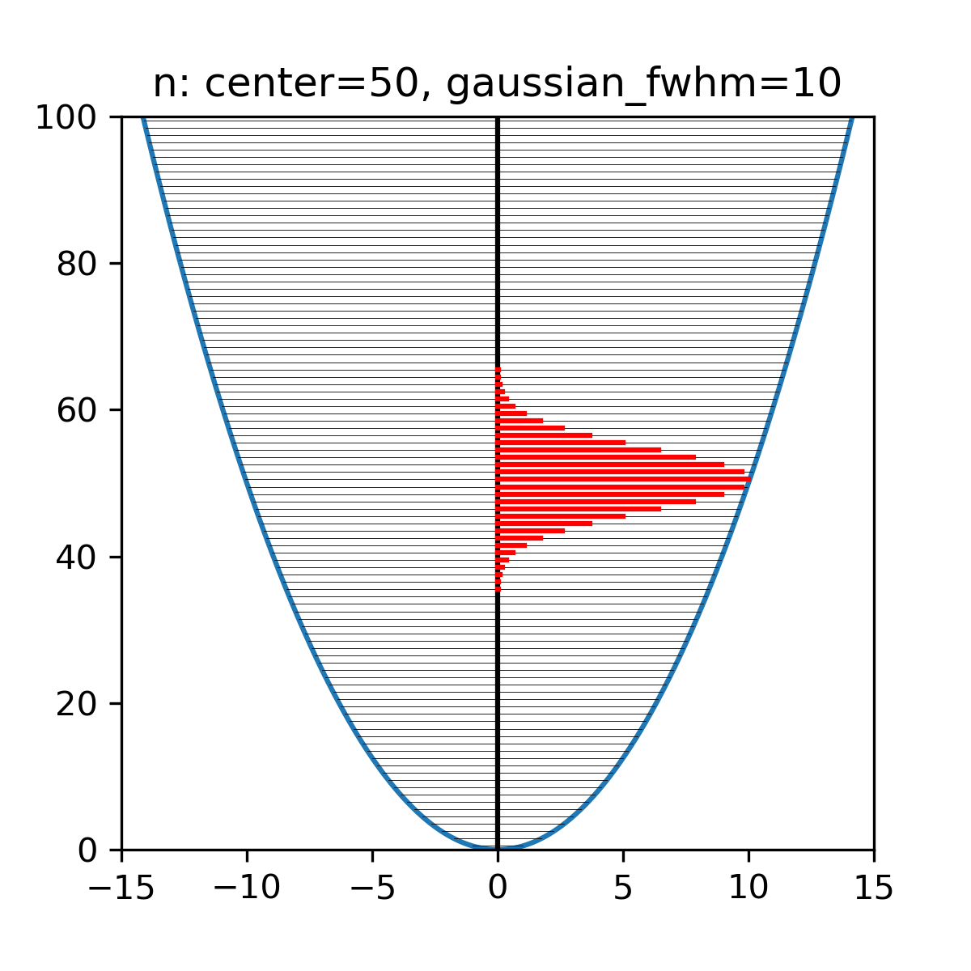
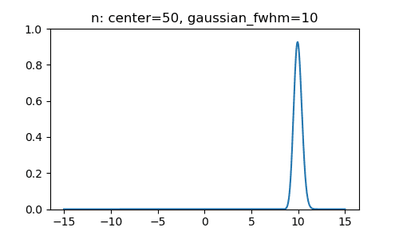
Particle wavepacket in a harmonic potential
Superposition:
n=50, fwhm = 10
Wavepacket center n_{c} = 50
Expansion coefficients follow a Gaussian distribution:
Several nearby states are mixed in
Not a stationary state!
Notes:
Note that this ω is also the frequency at which a classical oscillator oscillates in such a potential.
Python prog to make snapshots of |Ψ|² at different times, saves into png, join into animated gif using JASC animation shop
---------------------
import matplotlib.pyplot as plt
import numpy
import math
#Choose simple units
m=1.
w=1
hbar=1.
#Discretized space, x-axis
dx = 0.005
x_lim = 15
x = numpy.arange(-x_lim,x_lim,dx)
#wavepacket center and width
center = 50
width = 2
# service functions
def hermite(x, n):
xi = numpy.sqrt(m*w/hbar)*x
herm_coeffs = numpy.zeros(n+1)
herm_coeffs[n] = 1
return numpy.polynomial.hermite.hermval(xi, herm_coeffs)
def stationary_state(x,n):
xi = numpy.sqrt(m*w/hbar)*x
prefactor = 1./math.sqrt(2.**n * math.factorial(n)) * (m*w/(numpy.pi*hbar))**(0.25)
psi = prefactor * numpy.exp(- xi**2 / 2) * hermite(x,n)
return psi
def gauss(pos,center,width):
sigma = width/2.35492
return 1./sigma/2/math.pi*math.exp(-(pos-center)**2/sigma**2/2)
def classical_P(x,n):
E = hbar*w*(n+0.5)
x_max = numpy.sqrt(2*E/(m*w**2))
classical_prob = numpy.zeros(x.shape[0])
x_inside = abs(x) < (x_max - 0.025)
classical_prob[x_inside] = 1./numpy.pi/numpy.sqrt(x_max**2-x[x_inside]*x[x_inside])
return classical_prob
plt.figure(figsize=(10, 8))
plt.subplot(3,2,1)
plt.plot(x, numpy.conjugate(stationary_state(x,0))*stationary_state(x,0), label="n=0")
plt.plot(x, classical_P(x,0))
plt.legend()
plt.subplot(3,2,2)
plt.plot(x, numpy.conjugate(stationary_state(x,3))*stationary_state(x,3), label="n=3")
plt.plot(x, classical_P(x,3))
plt.legend()
plt.subplot(3,2,3)
plt.plot(x, numpy.conjugate(stationary_state(x,8))*stationary_state(x,8), label="n=8")
plt.plot(x, classical_P(x,8))
plt.legend()
plt.subplot(3,2,4)
plt.plot(x, numpy.conjugate(stationary_state(x,15))*stationary_state(x,15), label="n=15")
plt.plot(x, classical_P(x,15))
plt.legend()
plt.subplot(3,2,5)
plt.plot(x, numpy.conjugate(stationary_state(x,25))*stationary_state(x,25), label="n=25")
plt.plot(x, classical_P(x,25))
plt.legend()
plt.subplot(3,2,6)
plt.plot(x, numpy.conjugate(stationary_state(x,50))*stationary_state(x,50), label="n=50")
plt.plot(x, classical_P(x,50))
plt.legend()
plt.show()
# make superposition
i=1
for t in numpy.arange(0,2*math.pi,math.pi/15):
wf_re = x*0
wf_im = x*0
for n in range(center-width*2,center+width*2):
phase = (n+0.5)*t # Note: these are beats, so not sure why t=2pi gave a period with n~50
# I guess it is because wqith n~50 it takes 2pi*50 periods to to get n+1 oscillation to match again
wf_re = wf_re + math.cos(phase)*stationary_state(x,n)*gauss(n,center,width)
wf_im = wf_im + math.sin(phase)*stationary_state(x,n)*gauss(n,center,width)
plt.figure(figsize=(5, 3))
plt.ylim(0,0.2)
plt.plot(x,numpy.sqrt(wf_re**2 + wf_im**2)) #,label=f'center={center}, fwhm={width}')
plt.title(f'n: center={center}, gaussian_fwhm={width}')
plt.savefig(f'fig-c{center:002}-w{width:002}-{i:003}', dpi = 100, facecolor = 'white')
i = i + 1

Slide 20
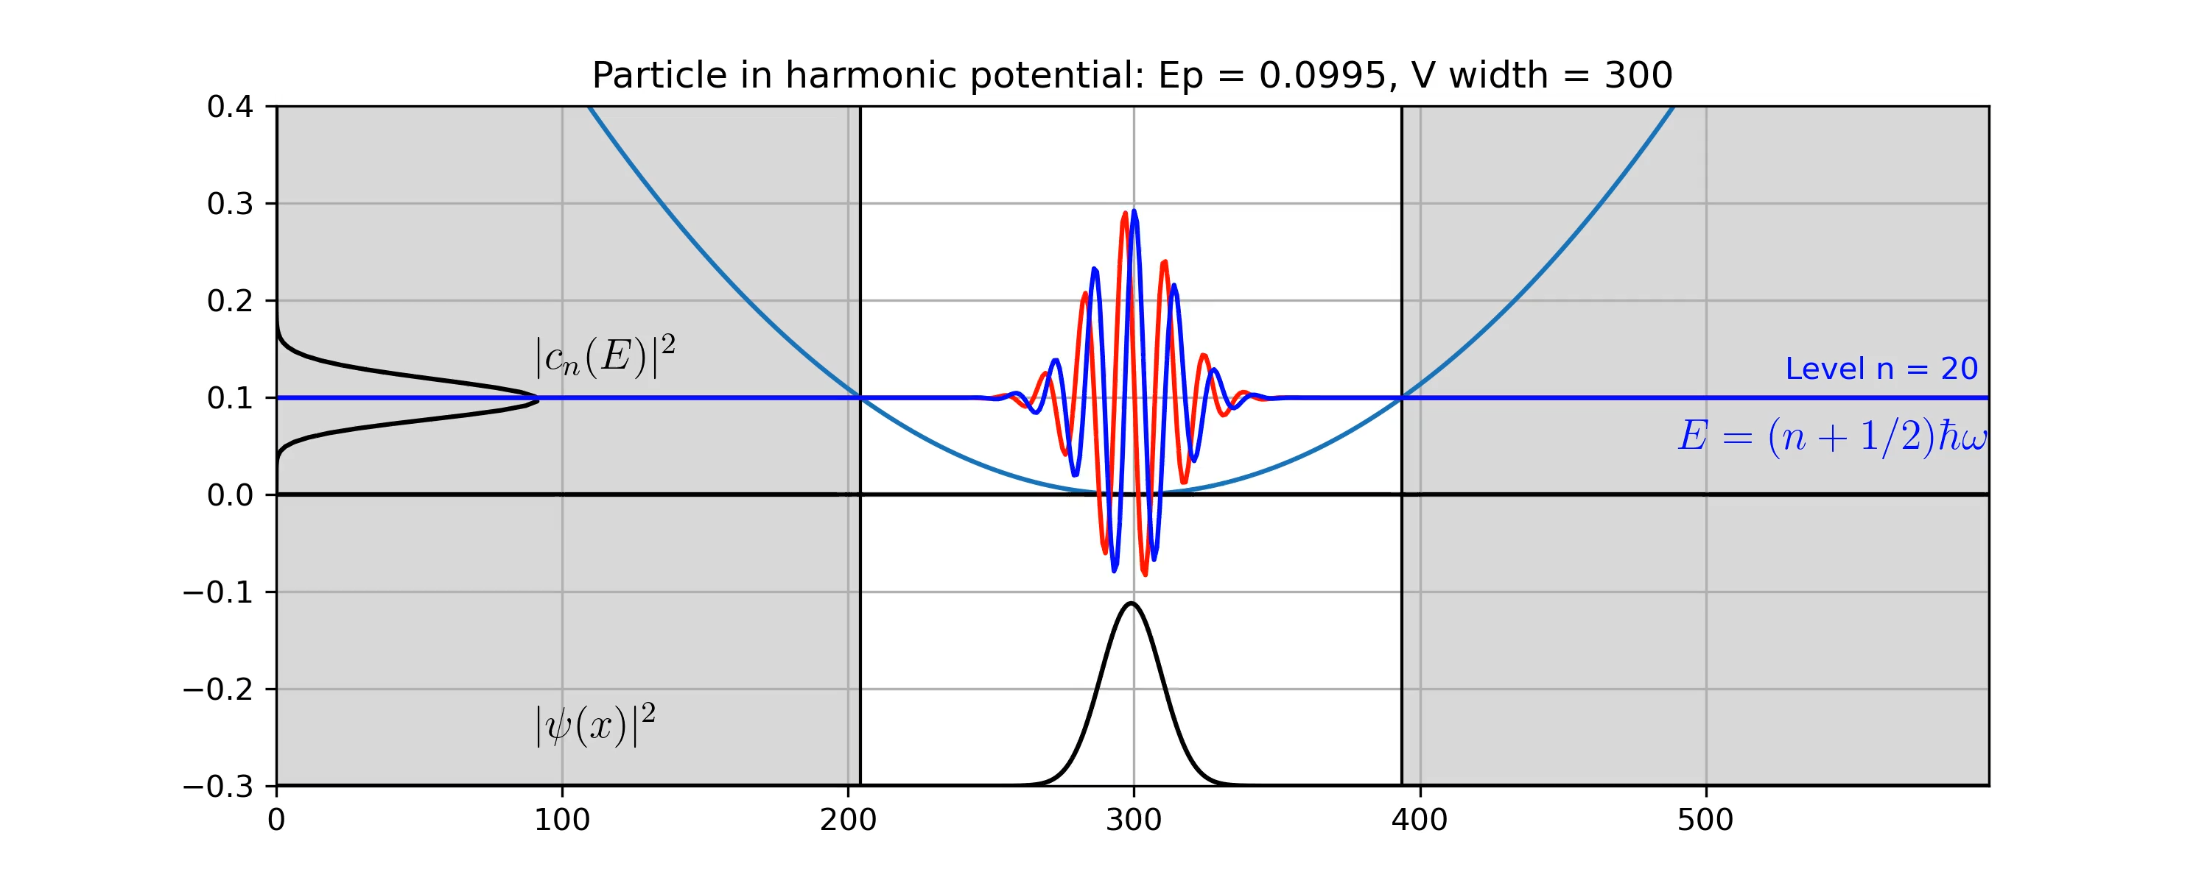
Particle in harmonic potential
Simulation by S. Savikhin
Notes:
-make the mass big and the wavefunction will occupy a narrow range that bounces back and forth according to Hook’s law solution for the spring-mass system
The frequency (time-dependent term in QM), is not the same as frequency of classical oscillating particle. The probability distribution in QM is constant, no oscillation. To make it oscillate need to create a superposition of many wf’s. (Make that animation next time)
Python:
import matplotlib
import matplotlib.pyplot as plt
import numpy
import numpy.polynomial.hermite as Herm
import math
#Choose simple units
m=1.
w=1.
hbar=1.
#Discretized space
dx = 0.01
x_lim = 15
x = numpy.arange(-x_lim,x_lim,dx)
def hermite(x, n):
xi = numpy.sqrt(m*w/hbar)*x
herm_coeffs = numpy.zeros(n+1)
herm_coeffs[n] = 1
return Herm.hermval(xi, herm_coeffs)
def stationary_state(x,n):
xi = numpy.sqrt(m*w/hbar)*x
prefactor = 1./math.sqrt(2.**n * math.factorial(n)) * (m*w/(numpy.pi*hbar))**(0.25)
psi = prefactor * numpy.exp(- xi**2 / 2) * hermite(x,n)
return psi
def classical_P(x,n):
E = hbar*w*(n+0.5)
x_max = numpy.sqrt(2*E/(m*w**2))
classical_prob = numpy.zeros(x.shape[0])
x_inside = abs(x) < (x_max - 0.025)
classical_prob[x_inside] = 1./numpy.pi/numpy.sqrt(x_max**2-x[x_inside]*x[x_inside])
return classical_prob
plt.figure(figsize=(10, 8))
plt.subplot(3,2,1)
plt.plot(x, numpy.conjugate(stationary_state(x,0))*stationary_state(x,0), label="n=0")
plt.plot(x, classical_P(x,0))
plt.legend()
plt.subplot(3,2,2)
plt.plot(x, numpy.conjugate(stationary_state(x,3))*stationary_state(x,3), label="n=3")
plt.plot(x, classical_P(x,3))
plt.legend()
plt.subplot(3,2,3)
plt.plot(x, numpy.conjugate(stationary_state(x,8))*stationary_state(x,8), label="n=8")
plt.plot(x, classical_P(x,8))
plt.legend()
plt.subplot(3,2,4)
plt.plot(x, numpy.conjugate(stationary_state(x,15))*stationary_state(x,15), label="n=15")
plt.plot(x, classical_P(x,15))
plt.legend()
plt.subplot(3,2,5)
plt.plot(x, numpy.conjugate(stationary_state(x,25))*stationary_state(x,25), label="n=25")
plt.plot(x, classical_P(x,25))
plt.legend()
plt.subplot(3,2,6)
plt.plot(x, numpy.conjugate(stationary_state(x,50))*stationary_state(x,50), label="n=50")
plt.plot(x, classical_P(x,50))
plt.legend()
plt.show()

Slide 21
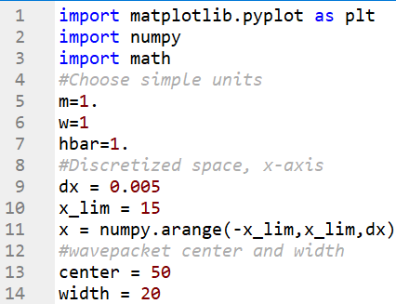
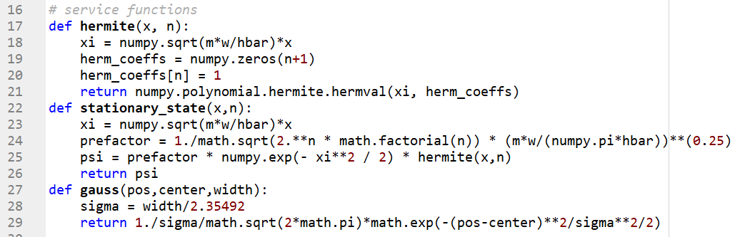
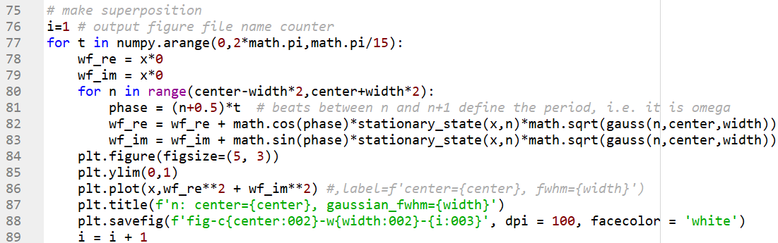
Particle wavepacket in a harmonic potential

Slide 22
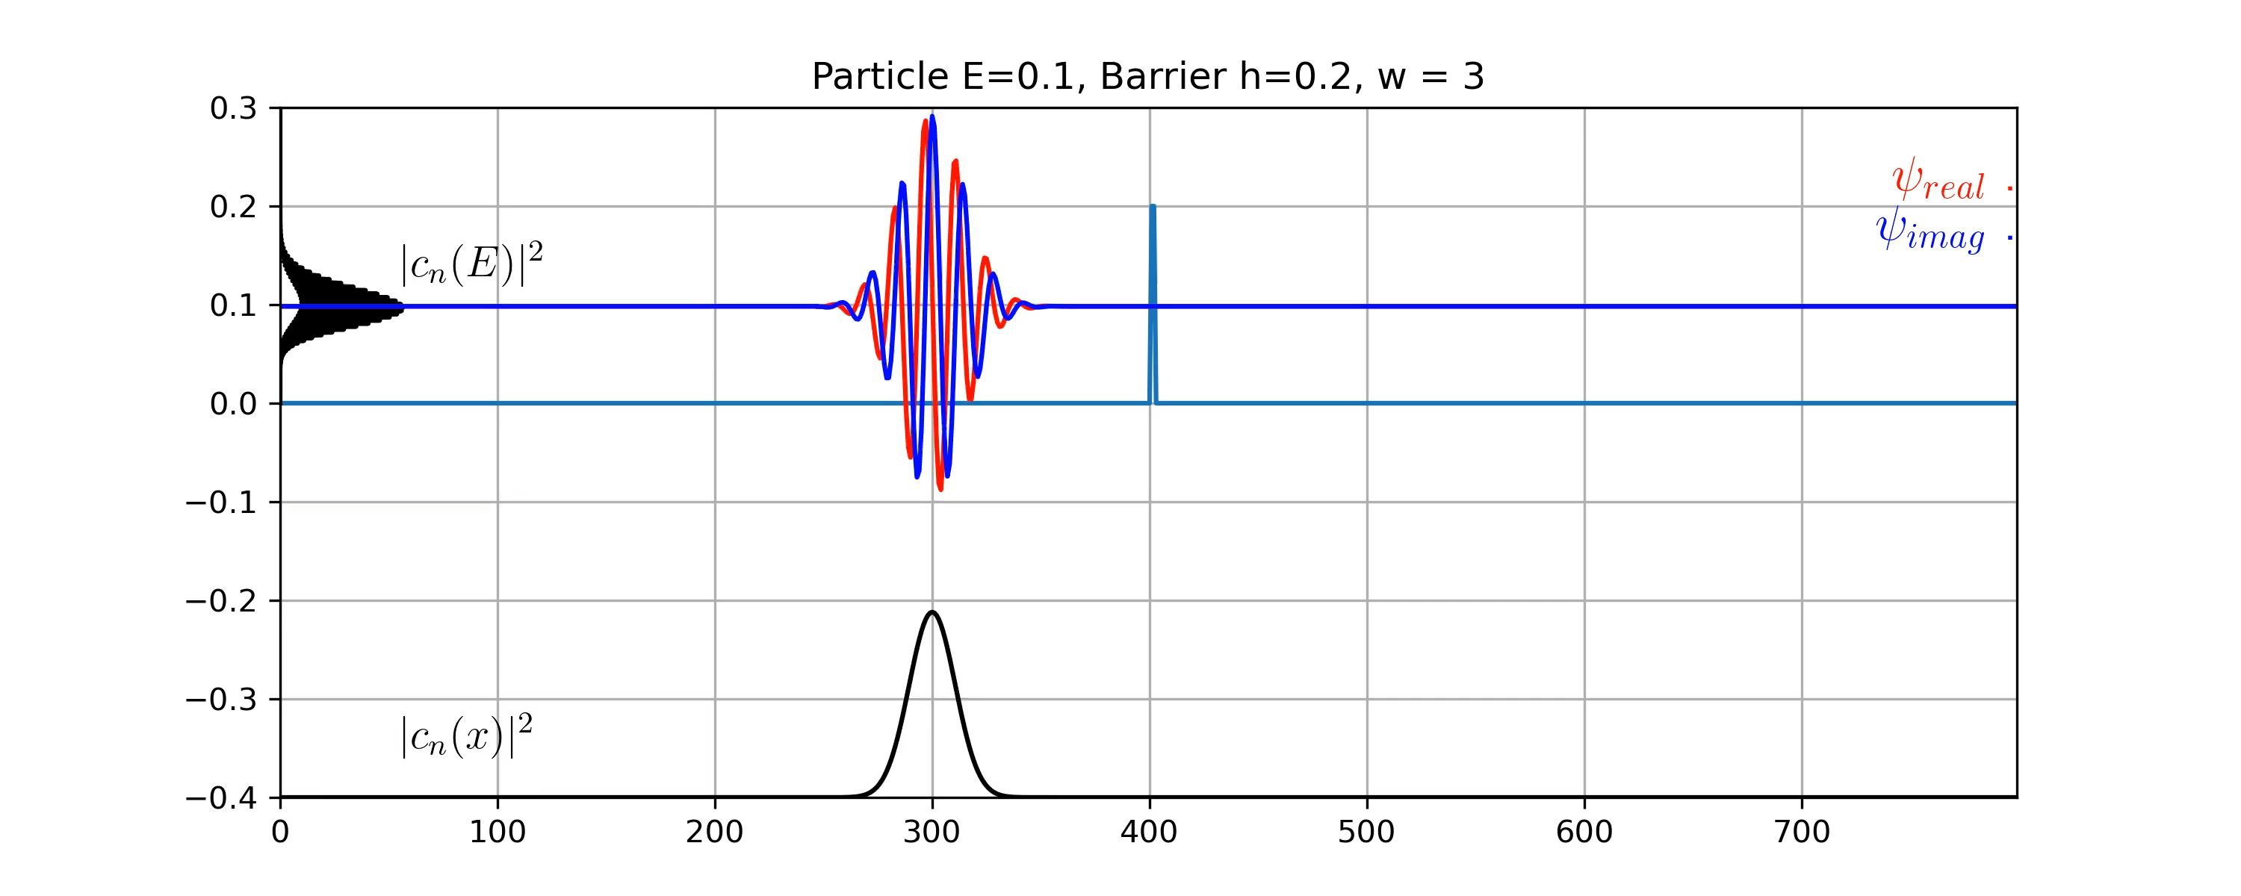
Quantum mechanical tunneling
V_{barrier} = 0.2
E_{particle} = 0.01
V = 0
Notes:
Where is the particle after passing the barrier???
PYTHON animation program that makes mp4
-------
import numpy as np
import matplotlib.pyplot as plt
from matplotlib.animation import FuncAnimation
from IPython.display import HTML
plt.style.use('seaborn')
class Gaussian_Wave:
# N_grid -number of x-points
# L - length of the x-axis
# E = energy of a particle
# a - location of the barrier
# V0 - height of the barrier
# w = width of the barrier
# x0 - wavepachet initial location
# k0 - k-vector
def __init__(self, N_grid, L, E, a, V0, w, x0, k0,sigma, t):
self.t=t
self.L=L
self.N_grid = N_grid
self.x = np.linspace(0,self.L,self.N_grid+1) #grid of points
self.dx = self.x[1]-self.x[0] #grid point spacing or 'discrete' analogue of the differential length
self.E = E #(particle energy)
def integral(f,axis = 0):
"""This function allows us to approximate integrals in discrete space"""
return np.sum(f*self.dx, axis = axis)
self.Psi0 = np.exp( -1/2* (self.x[1:-1]-x0)**2/sigma**2) *np.exp(1j*k0*self.x[1:-1])
#use this range for x because as mentionned, we need the wavefunction to be 0 at the endpoints of the grid.
#normalise the initial state
norm = integral(np.abs(self.Psi0)**2)
self.Psi0 = self.Psi0/np.sqrt(norm)
#kinetic energy
self.T = -1/2 * 1/self.dx**2 * (np.diag(-2*np.ones(self.N_grid-1))+ np.diag(np.ones(self.N_grid-2),1)+ np.diag(np.ones(self.N_grid-2),-1))
print(self.T.shape)
#potential as a flat array, shift it by -E, so that particle energy is 0 (E above potential)
self.V_flat = np.array([(V0-E) if a< pos < a+w else (-E) for pos in self.x[1:-1]])
#potential energy as a diagonal matrix
self.V = np.diag(self.V_flat)
#Hamiltonian
self.H = self.T+self.V
#solve the eigenvalue problem and get the time-dependent wavefunction
def animation(self):
def integral(f,axis = 0):
"""This function allows us to approximate integrals in discrete space"""
return np.sum(f*self.dx, axis = axis)
#get eigenvalues and eigenvectors and normalise
E, psi = np.linalg.eigh(self.H)
psi = psi.T
norm = integral(np.abs(psi)**2)
psi = psi/np.sqrt(norm)
#get expansion coeffs
c_n = np.zeros_like(psi[0], dtype=complex)
for j in range(0, self.N_grid-1):
c_n[j] = integral(np.conj(psi[j]) * self.Psi0) #for each eigenvector, compute the inner product
#get a function that returns the time dependent wavefunction
def Psi(t):
t=t*3. # sergei to make it faster
return psi.T@(c_n*np.exp(-1j*E*t))
fig = plt.figure(figsize = (10,6),dpi=300)
ax = plt.axes(xlim=(0, self.L), ylim=(-0.32, 0.25))
line, = ax.plot([], [], lw=2)
ax.plot(self.x[1:-1],self.V_flat + self.E, label = '$V(x)$') # add E to shift V0 to zero
ax.set_title('Gaussian wave packet with a potential barrier', fontsize = 20)
line1, = ax.plot(self.x[1:-1],np.zeros(self.N_grid-1),lw=2,color="red", label = '$\Re(\psi)$')
line2, = ax.plot(self.x[1:-1],np.zeros(self.N_grid-1),lw=2,color="blue", label = '$\Im(\psi)$')
line3, = ax.plot(self.x[1:-1],np.zeros(self.N_grid-1),lw=2,color="black", label = '$|\psi|^2$')
ax.plot([self.x[1],self.x[-1]],[-.3,-.3], lw = 2,color = 'black')
ax.legend(fontsize = 10)
ax.set_xlabel('$x$', fontsize = 20)
def animate(t):
a = Psi(t)
y1 = np.real(a)
y2 = np.imag(a)
line1.set_data(self.x[1:-1],y1/1.5 + self.E) # add E so that particler energy is 0.01
line2.set_data(self.x[1:-1], y2/1.5 + self.E)
line3.set_data(self.x[1:-1], (y1**2 + y2**2)*4 - 0.3)
return (line1, line2,)
def init():
line1.set_data([],[])
line2.set_data([], [])
line3.set_data([], [])
return (line1,line2,line3)
ani = FuncAnimation(fig, animate, len(self.t), init_func=init,
interval=20, blit=False)
return ani
# (N_grid, L, E, a, V0, w, x0, k0,sigma, t)
#wavepacket = Gaussian_Wave(750,750, 420,0.1,50,100,0.4,15, np.linspace(0.,2500,1000))
wavepacket = Gaussian_Wave(750,750, 0.01, 400, 0.1,5,100,0.4,15, np.linspace(0.,2500,420))
Psi = wavepacket.animation()
Psi.save('tunneling_animation.mp4')
#HTML(Psi.to_html5_video())

Slide 23
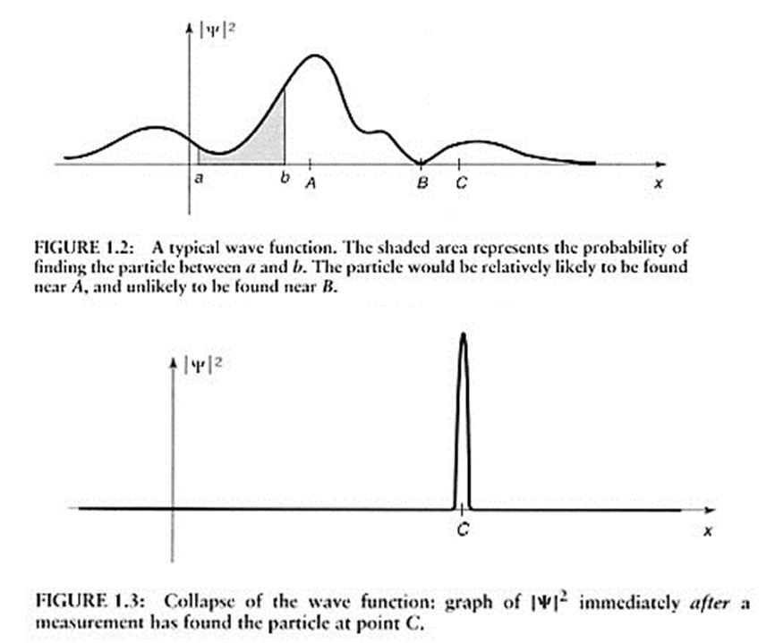
Measurement of a position
What will be the result of the position measurement?
You will get only 1 number, uncertainty in the measurement
Suppose you got c, and then take another measurement
on the same particle. What will you get?
You will get c again!
→ The wavefunction will collapse into a definite position state!

Slide 24
Measurement and expectation values
What will be the average of many position measurements on a particle with such a wavefunction?
Expectation value:
← Dirac’s Bra-ket notation

Slide 25
Operators, measurements, and expectation values
Physical quantities are represented by operators:
Expectation value:
Examples:
Operators:
- position
- momentum
energy

Slide 26
Operators, eigenfunctions, and eigenvalues
For any operator, we can find a set of wavefunctions that will produce a definite result in a respective measurement.
Solve the equation:
The solutions are called eigenfunctions ϕ_{i} and eigenvalues A_{i} of operator .
Note: operator A acting on the eigenfunction just multiplies it by some constant (eigenvalue)
These solutions are complete, orthogonal and normalized (orthonormalized):
Any other possible wavefunction can be represented as a linear combination of these solutions,
or represented in the basis of eigenfunctions of operator
The same wavefunction can be represented as a superposition of eigenfunctions of a different operator (i.e., using a different set of eigenfunctions), though the expansion coefficients c_{i} (eigenvector) will be different.

Slide 27
Vector representation of a wavefunction
Time-Independent Schrödinger Equation (TISE)
Or:
Energy operator
(Hamiltonian)
Then any other possible wavefunction can be represented as :
The expansion coefficients c_{i} uniquely define this wavefunction in the basis of eigenfunctions of H.
Can represent the wavefunction as
a vector in the basis of this operator
Normalization:
Note: the vector components will depend on the choice of the basis, i.e., in bases of eigenfunctions of different operators, the coefficients will be different, but they will represent the same wavefunction!
This is similar to expressing a geometrical vector in different systems of coordinates.
You can think of the coefficients c_{i} as of the projections of the wavefunction Ψ to eigenfunctions ψ_{i}

Slide 28
Matrix representation of operators
Let (ψ_{i} , E_{i}) be the solutions of:
The Hamiltonian in the basis of its own eigenfunctions can be represented as a diagonal matrix with respective eigenvalues on its diagonal:
The expectation value for energy then can be found in the matrix form as:
Note: in the basis of other operator eigenfunctions, the H-matrix will look different.
Note: as long as the wavefunction vector and operator matrix are expressed in the same basis, the

Slide 29
Vector: projections to basis functions
The wavefunction vector components and operator matrix components depend on the choice of the basis! Iin bases of eigenfunctions of different operators, the coefficients will be different, but they will represent the same wavefunction!
This is similar to expressing a geometrical vector in different systems of coordinates.
You can think of the coefficients c_{i} as the projections of the wavefunction Ψ to eigenfunctions ψ_{i}
ϕ₂
ϕ₂’
y
y’
c₂
Ψ
c'₂
Ψ
x
x’
c₁
ϕ₁
c’₁
ϕ₁’
Projections:
What is the length of this vector?

