Slide 1
HYBRID NETWORK SETUP

Slide 2
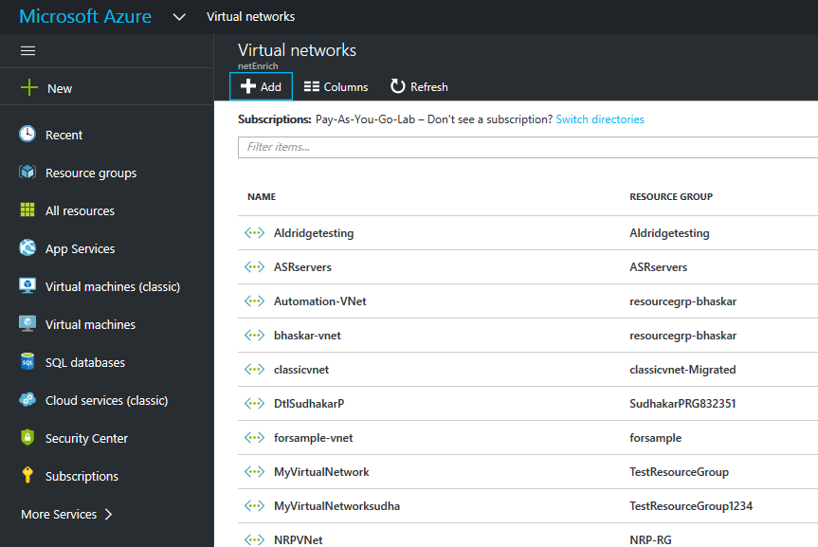
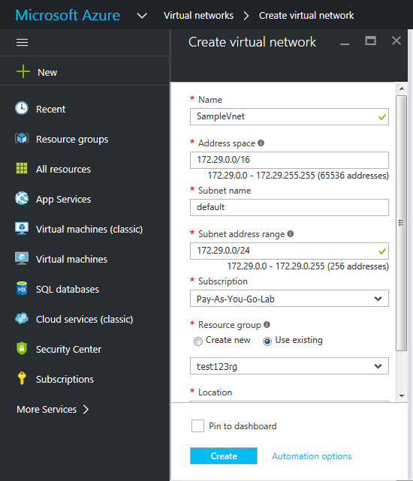
Create Virtual Network

Slide 3
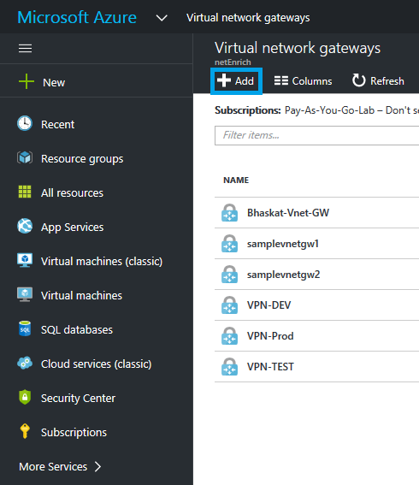
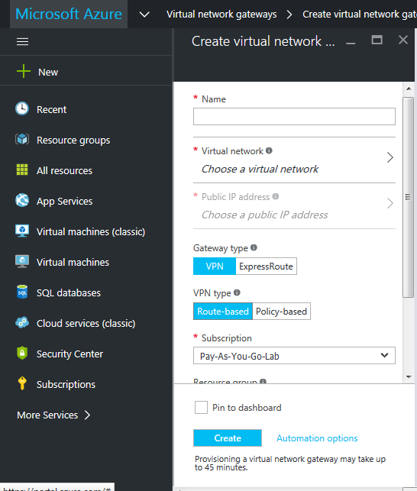
Create Virtual Network Gateway

Slide 4
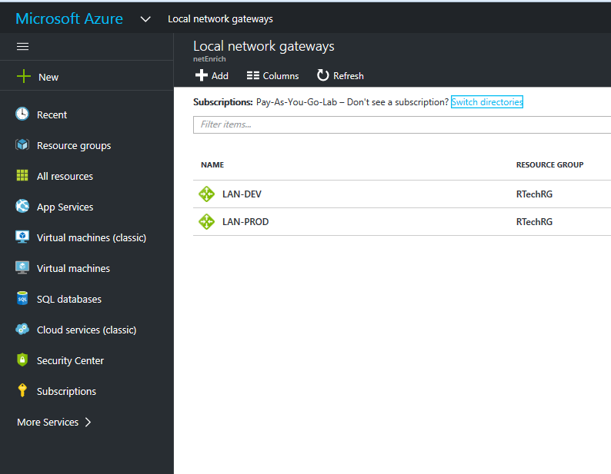
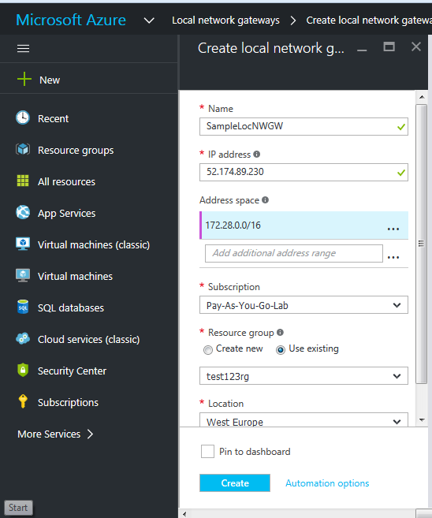
Create Local Network Gateway

Slide 5
CREATE SITE-TO-SITE CONNECTION

Slide 6
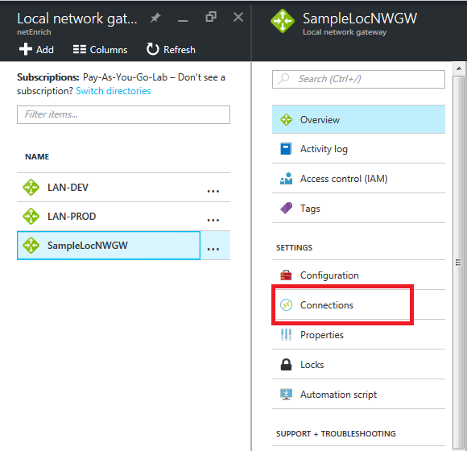
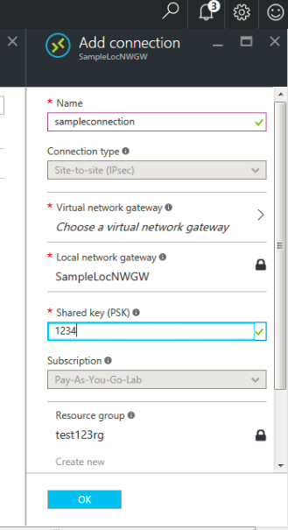
Create Site-to-Site Connection

Slide 7
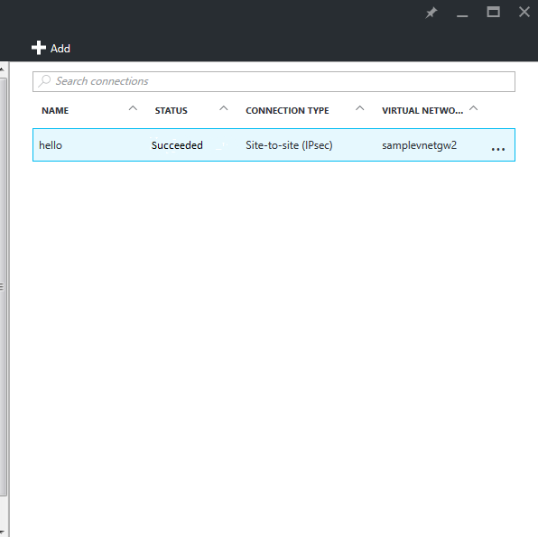

Slide 8
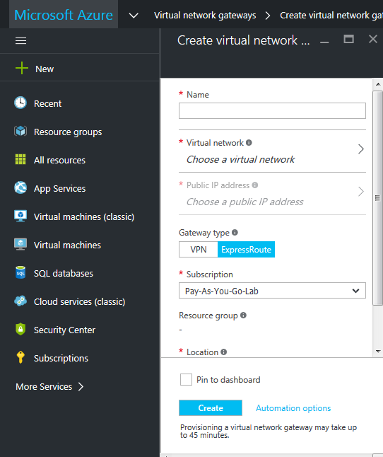
Create Express Route Virtual Network Gateway

Slide 9
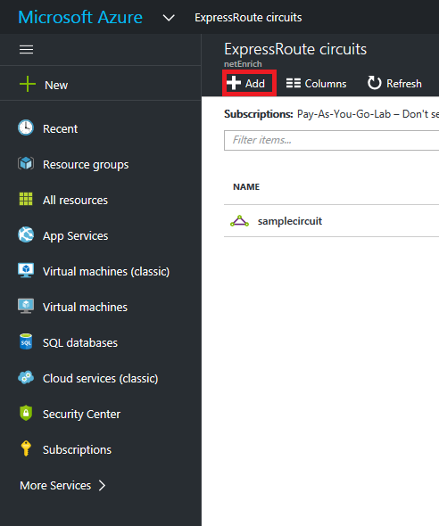
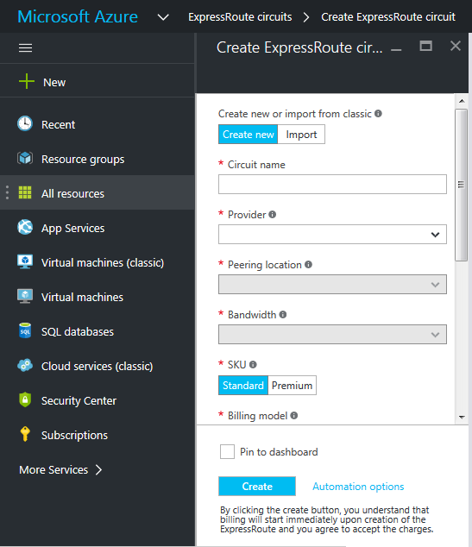
Create Express Circuit

Slide 10
CREATE EXPRESS ROUTE CONNECTION

Slide 11
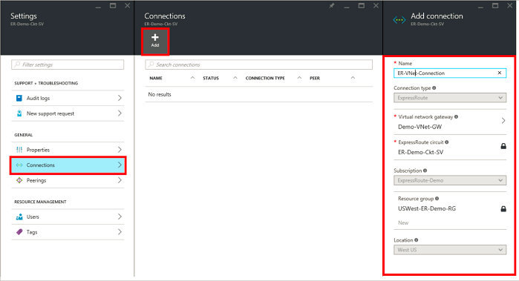
Add Connection

Slide 12
