Slide 1
CampusNest
Smart Hostel Management System
University of Moratuwa
Faculty of Information Technology
IN1101 – Programming Fundamentals
Academic Year 2024/2025

Slide 2
Team Members & Contributions
Registration No. | Assigned Module | Key Responsibilities
254156 | Student Management | Student registration, search, update, delete, and sorting operations
254157 | Room Management | Room allocation, room availability tracking, status updates, and room management
254158 | Fee Management | Fee recording, payment status updates, fee summaries, and reporting
254159 | Visitor Management | Visitor registration, visitor tracking, search functions, and visitor reports
254160 | Maintenance Management | Maintenance request handling, status tracking, priority management, and maintenance reports

Slide 3
Problem Context
🏠
📋
⏱️
Manual Record Keeping
Inconsistent Data
Slow Response Times
All student and room data is tracked on paper, causing delays and human error.
Multiple paper registers lead to conflicting records and lost information.
Visitor logs, fee tracking, and maintenance requests take hours to process.

Slide 4
Problem Statement
University hostels lack a centralized, digitalsystem to manage students, rooms, fees,visitors, and maintenance — resulting inoperational inefficiencies and poor datareliability.
Key Gaps Identified
✗ No centralized digital record system
✗ Human error in manual registers
✗ No structured fee tracking
✗ No visitor log management
✗ Maintenance requests untracked

Slide 5
Proposed Solution
CampusNest
A Console Based C System
⚙️
📁
🧩
C Language
File Persistence
Modular Design
Pure C99
no external libraries, no frameworks. Exactly at PF level.
All data saved to .txt files. Persists between runs. No database needed.
5 independent modules, each with its own .c file and clear responsibility.

Slide 6
Project Objectives
01
👨‍🎓 Student Management
Register, track, search, and deactivate hostel residents.
02
🏠 Room Management
Configure rooms, manage capacity, and track allocations.
03
💰 Fee Management
Record monthly fees, mark payments, view outstanding dues.
04
👥 Visitor Management
Log all visitor entries with contact and purpose details.
05
🔧 Maintenance Tracking
Raise, monitor, and resolve hostel maintenance requests.

Slide 7
System Modules
👨‍🎓 student.c
🏠 room.c
📁 students.txt
📁 rooms.txt
Add / View / Search / Delete
Add / View / Allocate / Free
💰 fee.c
👥 visitor.c
🔧 maintenance.c
📁 fees.txt
📁 visitors.txt
📁 requests.txt
Add / View / Pay / Unpaid
Log / View / Search
Log / View / Resolve / Pending

Slide 8
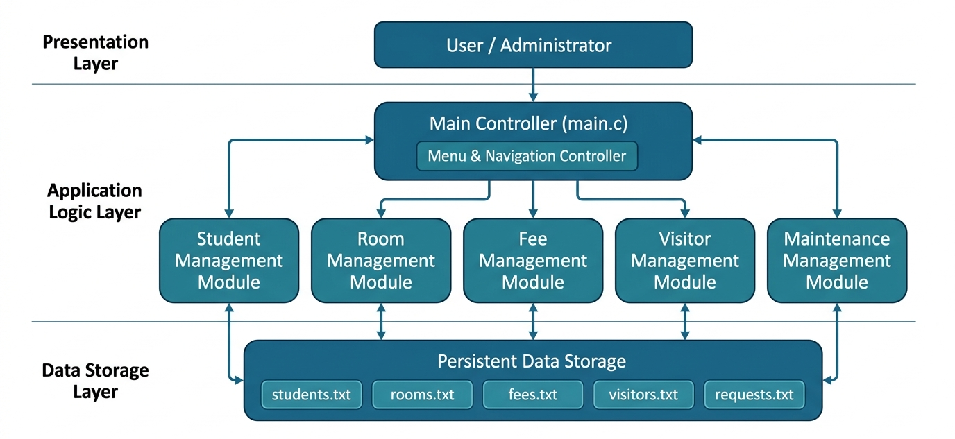
System Architecture

Slide 9
Technical Stack
🔵 C Language (C99)
📄 File Handling
Core programming language. Structs, arrays, pointers, and standard I/O.
fopen / fclose / fprintf / fscanf — append and read for persistence.
🗂️ Structures
🔧 Functions
typedef struct — Student, Room, FeeRecord, Visitor, MaintenanceRequest.
Modular decomposition with single-responsibility per function.
🔁 Control Flow
🛡️ Input Validation
while loop + switch-case for menu-driven interaction and safety.
fgets + sscanf pattern — prevents buffer overflow and bad input.

Slide 10
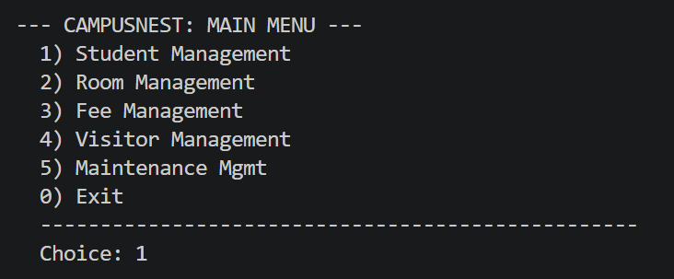
System Execution Evidence
Figure 1 – CampusNest Main Menu Interface

Slide 11
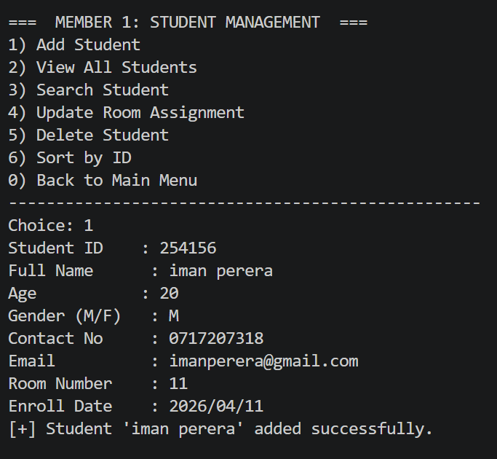
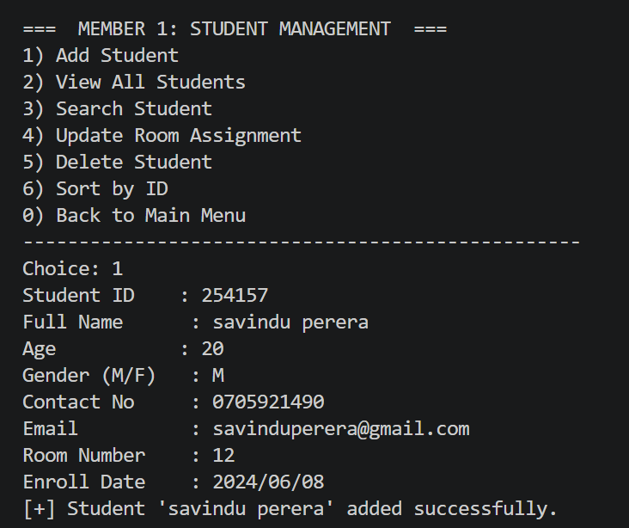
Figure 2 – Student Records Display and add Student Input Interface

Slide 12
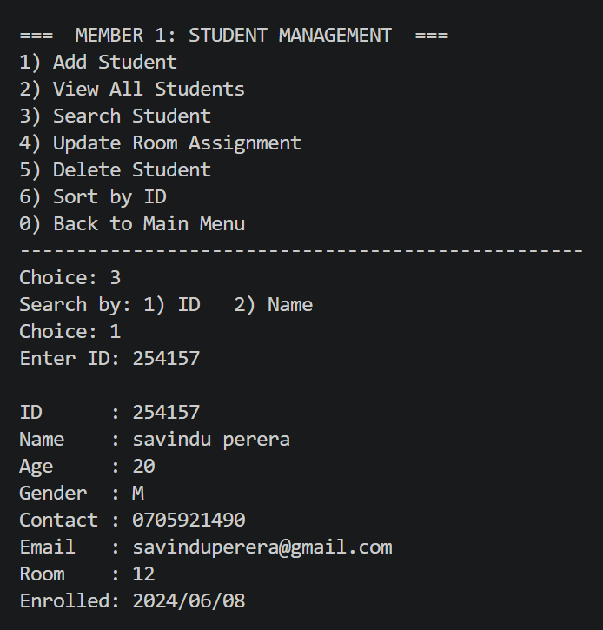
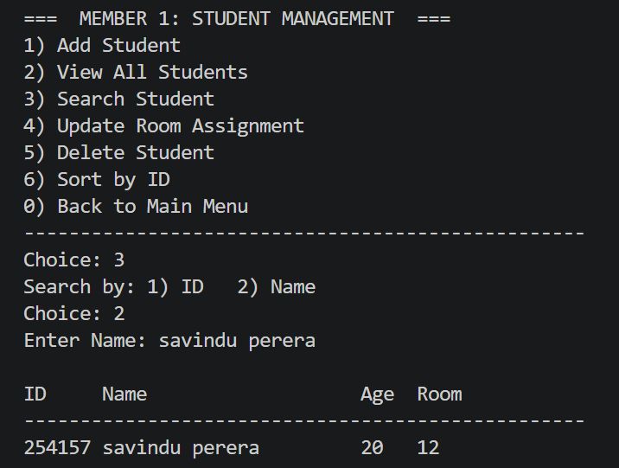
Figure 4 – Student Search Result

Slide 13
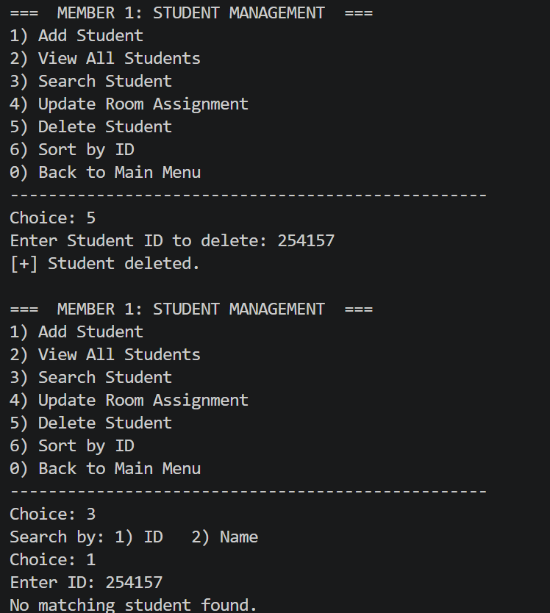
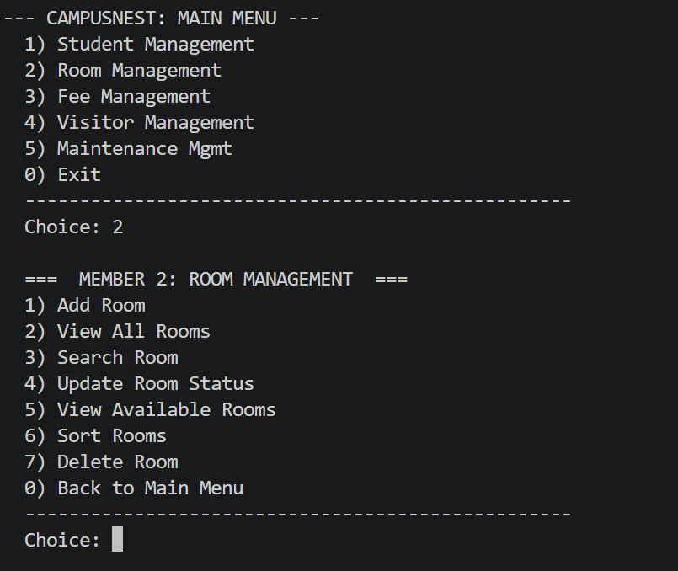
Figure 5 – Student Deletion Confirmation
Figure 6 – Room Records Display

Slide 14
Figure 5 – Student Deletion Confirmation
Figure 6 – Room Records Display

Slide 15
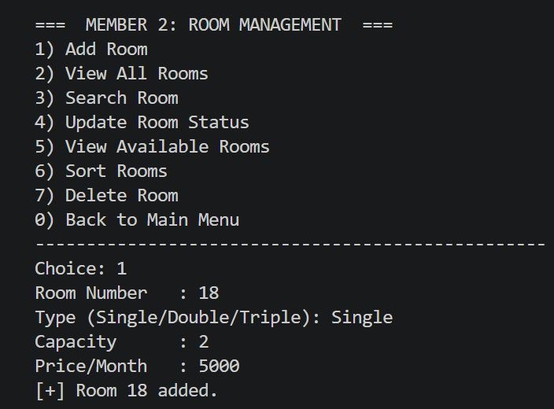
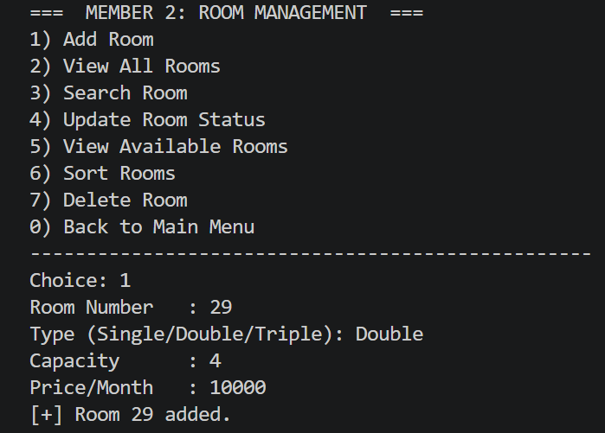
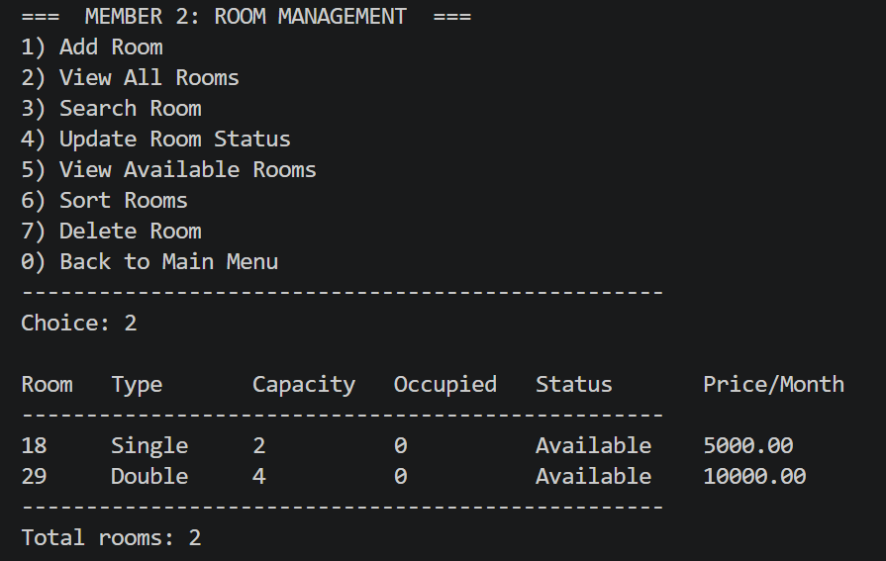
Figure 7 – Add Room Interface

Slide 16
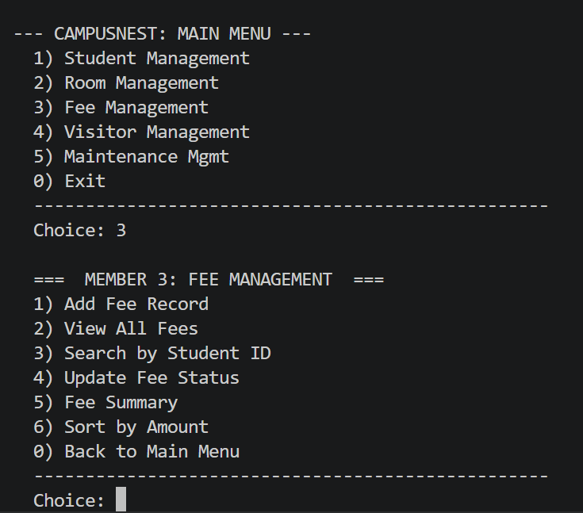
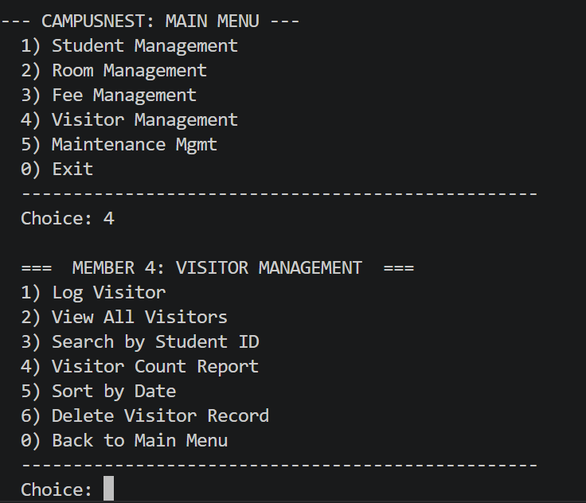
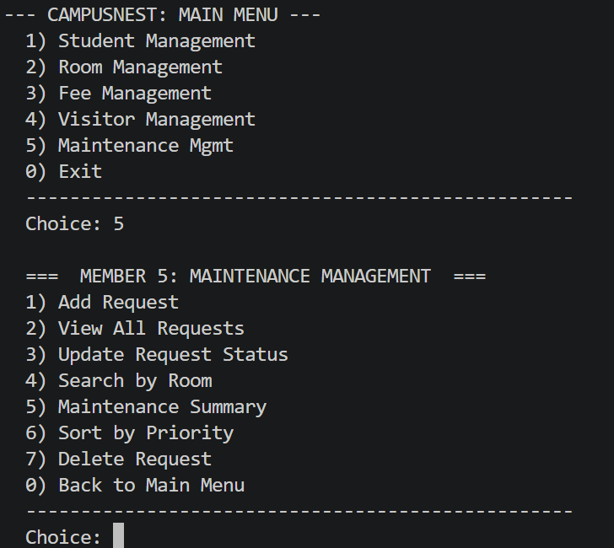
Figure 8 – Fee Records Display
Figure 9 – Visitor Records Display Figure 11 – Maintenance Requests Display

Slide 17
System Benefits
✅
⚡
🔒
Centralised Records
Faster Operations
Reduced Human Error
All hostel data in one system — students, rooms, fees, visitors, maintenance.
Instant search, allocation, and report generation via menu-driven interface.
Structured input and validation eliminates data inconsistency.
💾
📊
🧩
Data Persistence
Audit Trail
Easy Maintainability
Text-file storage ensures data survives across all program restarts.
All fee payments, visitor logs, and maintenance requests are permanently recorded.
Modular .c files allow updates to one module without affecting others.

Slide 18
Conclusion
CampusNest is a console-based hostel management system developed to simplify the management of students, rooms, fees, visitors, and maintenance requests. The project successfully applies key C programming concepts such as structures, functions, arrays, searching, sorting, and input validation to solve a real-world problem.
Thank You!
CampusNest – Smart Hostel Management System
Questions?

