Slide 1

Team Name : SavioMohan1
Team Leader Name : Savio Mohan
Problem Statement : Intelligent Candidate Discovery and Ranking

Slide 2
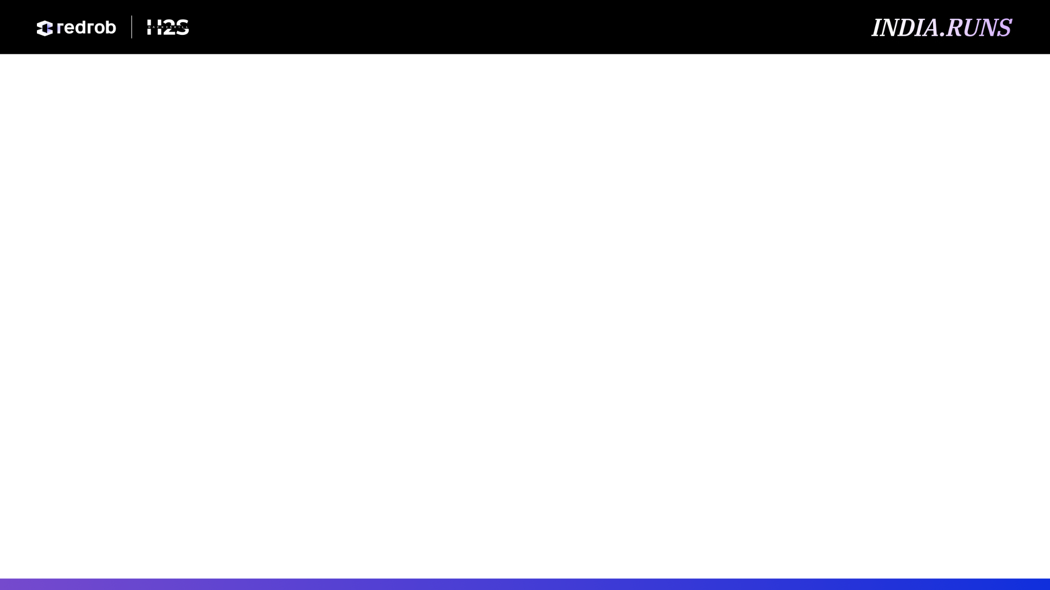
Solution Overview
Proposed solution: an offline, explainable ranker that reads the Senior AI Engineer JD and scores all 100,000 candidates into a trusted top-100 shortlist.
The system focuses on recruiter-grade evidence: production retrieval, search, ranking, embeddings, evaluation maturity, product ML experience, availability, and logistics.
Differentiator: it does not rank by raw AI keyword count. Skills are trusted only when backed by career history, duration, endorsements, assessments, and behavioral signals.
Output: a validator-compliant CSV with candidate_id, rank, score, and fact-grounded reasoning for every selected candidate.

Slide 3
JD Understanding & Candidate Evaluation
Key JD requirements: 5-9 years of hands-on production ML engineering, strong Python, retrieval/ranking ownership, vector or hybrid search, ranking evaluation, and product-shipping mindset.
High-value candidate evidence: shipped search/recommendation/ranking systems, embedding pipelines, FAISS/Milvus/Qdrant/Pinecone/Weaviate/OpenSearch, NDCG/MRR/MAP, A/B tests, scale and latency work.
Behavioral relevance: recent activity, recruiter response rate, response speed, open-to-work status, interview completion, notice period, GitHub signal, recruiter saves/views.
Fit beyond keywords: the ranker reads role history and descriptions, distinguishes product ML builders from keyword stuffers, and down-weights stale or suspicious profiles.

Slide 4
Ranking Methodology
Retrieval/scoring pass: stream candidates.jsonl, extract text and structured features, compute a weighted score, and keep a deterministic top-100 heap.
Algorithms used: interpretable feature engineering, regex-backed career evidence extraction, weighted scoring, behavioral modifier, logistics adjustment, and trap penalties.
Signal fusion: title fit, experience-band fit, retrieval/ranking evidence, evaluation evidence, production evidence, trusted skills, product-company signal, behavior, and location are combined.
Final score: adjusted evidence score is passed through a monotonic 0-1 calibration, then sorted by score descending and candidate_id ascending for deterministic ties.

Slide 5
Explainability & Data Validation
Reasoning is generated from facts already present in the candidate record: title, years, location, relevant evidence category, response rate, recency, notice period, and concerns.
Hallucination prevention: the generator never invents employers, degrees, skills, or projects. It describes evidence categories only after the scorer found those signals.
Low-quality profile handling: weak expert claims, low skill duration, zero endorsements, stale activity, poor response behavior, and long notice period reduce score.
Suspicious profile handling: severe experience-year mismatches, career duration inconsistencies, non-technical keyword stuffing, off-domain AI, and services-only careers are penalized.

Slide 6
End-to-End Workflow
1. Input: load candidates.jsonl or candidates.jsonl.gz and the fixed Senior AI Engineer JD interpretation encoded in the scorer.
2. Feature extraction: parse profile, career history, skills, education, certifications, languages, and Redrob behavioral signals.
3. Score: combine JD evidence, trusted skills, behavioral availability, logistics, and validation penalties.
4. Select: maintain top 100 in memory, sort deterministically, and generate concise recruiter-facing reasoning.
5. Output: write outputs/submission.csv and outputs/audit_top100.json, then validate with validate_submission.py.

Slide 7
System Architecture
CLI entry point: rank.py
Core engine: src/ranker.py
Input layer: streaming JSONL reader with gzip support.
Feature layer: title, text-pattern, skill-trust, product-company, behavior, logistics, and consistency features.
Scoring layer: weighted ranker with engagement gate and trap penalties.
Output layer: top-100 CSV, audit JSON, and fact-grounded reasoning.
Complexity: O(N log 100) over 100,000 candidates, with only the top heap and current record in memory.

Slide 8
Results & Performance
Full dataset run completed locally in about 3 minutes 19 seconds on CPU, below the 5-minute challenge limit.
The generated submission passed the official validator: exactly 100 rows, valid candidate IDs, unique ranks, non-increasing scores, and UTF-8 CSV format.
Top-100 quality audit: 95/100 India-based candidates, 0 services-only careers, 0 stale profiles, and no non-technical keyword-stuffer titles.
Top title mix: Recommendation Systems Engineer (18), Applied ML Engineer (13), Machine Learning Engineer (12), Search Engineer (11).
Top examples:
#1 CAND_0077337: Staff Machine Learning Engineer, 7.0 yrs, Kochi, Kerala, score 0.9995
#2 CAND_0018499: Senior Machine Learning Engineer, 7.2 yrs, Noida, Uttar Pradesh, score 0.9994
#3 CAND_0081846: Lead AI Engineer, 6.7 yrs, Jaipur, Rajasthan, score 0.9992

Slide 9
Technologies Used
Python 3.11: selected for portable, reproducible ranking under the CPU/no-network constraint.
Standard library only for ranking: json, csv, gzip, re, heapq, argparse, datetime, math, dataclasses, pathlib.
ReportLab: used only for generating the explanatory PDF deck; it is not required by the ranking pipeline.
No hosted LLM APIs, no GPU, no vector database, no pandas, no scikit-learn, no sentence-transformers, and no network calls during ranking.
This stack was selected because the evaluation rewards reproducibility, latency discipline, explainability, and defensible engineering tradeoffs.

Slide 10
Submission Assets
GitHub repo: https://github.com/SavioMohan1/redrob-intelligent-candidate-discovery
Ranked output file: outputs/submission.csv
PDF deck: output/pdf/redrob_intelligent_candidate_discovery_template_filled.pdf
Reproduce command: python rank.py --candidates ./candidates.jsonl --out ./outputs/submission.csv
Validation command: python validate_submission.py ./outputs/submission.csv
Main implementation files: rank.py, src/ranker.py, README.md, docs/approach.md.
Sandbox/demo link: https://colab.research.google.com/github/SavioMohan1/redrob-intelligent-candidate-discovery/blob/main/redrob_demo.ipynb

Slide 11

Thank You
The solution is designed to rank candidates the way a strong recruiter would: evidence first, behavior-aware, explainable, and reproducible under real-world constraints.

