Slide 1
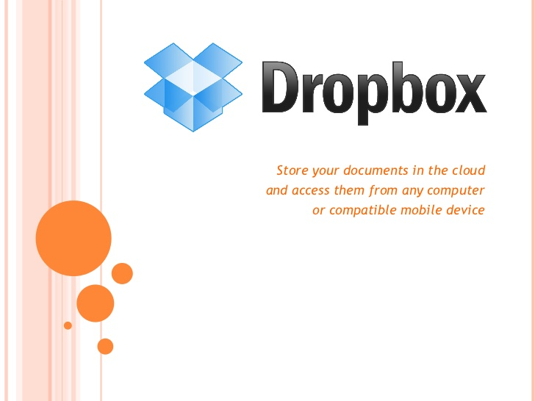

Slide 2
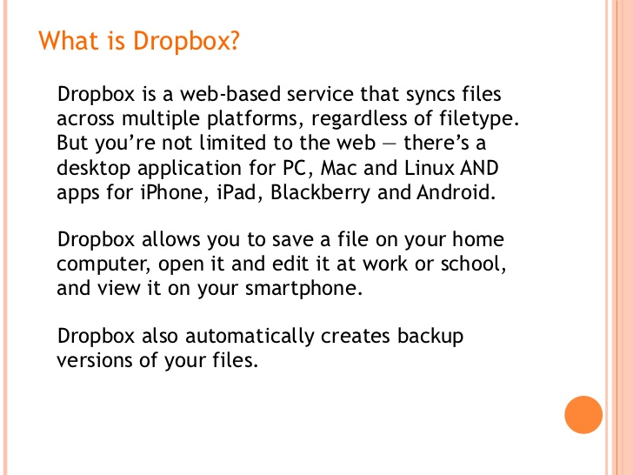

Slide 3
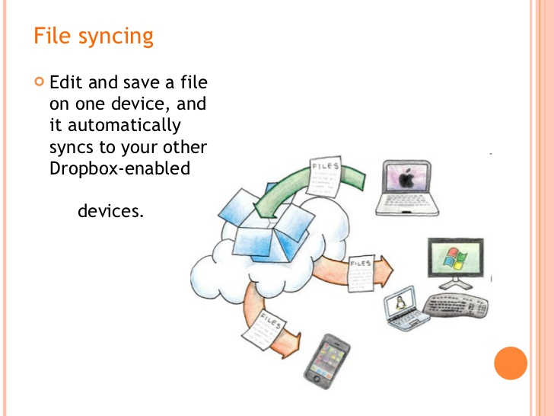

Slide 4
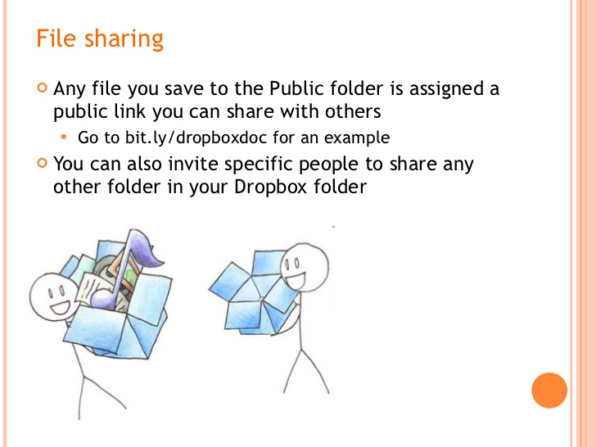

Slide 5
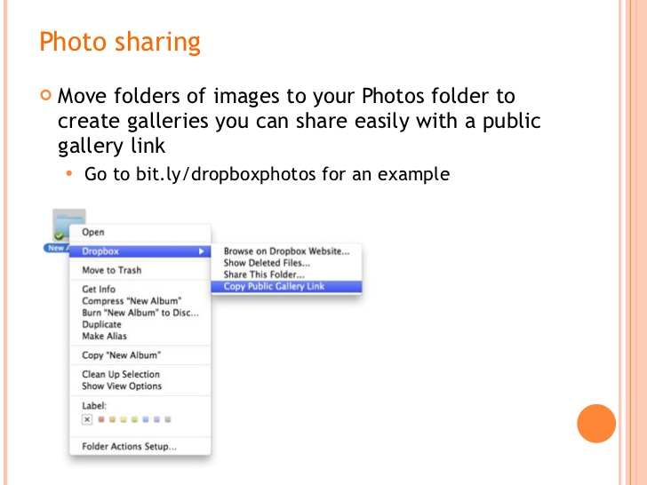

Slide 6
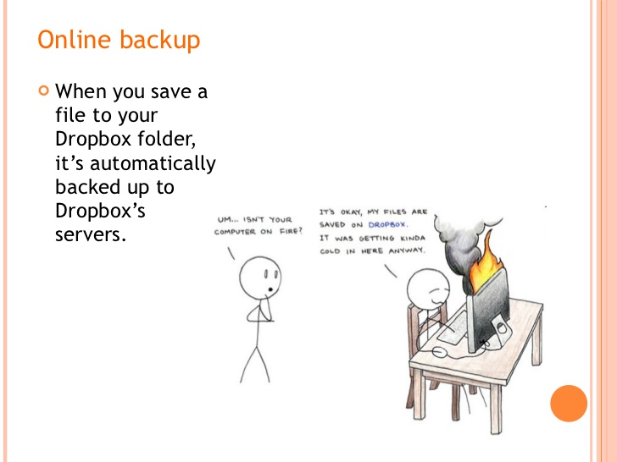

Slide 7
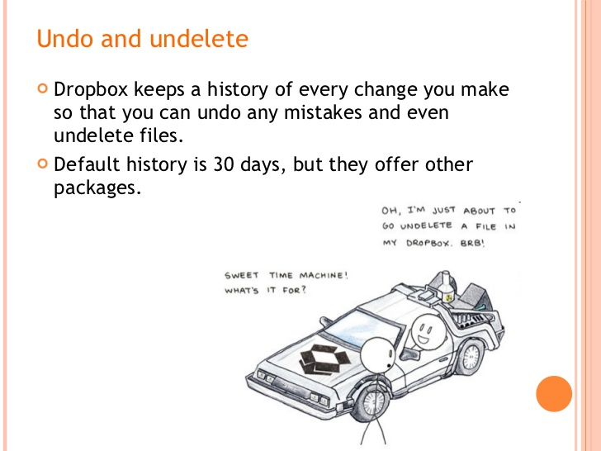

Slide 8
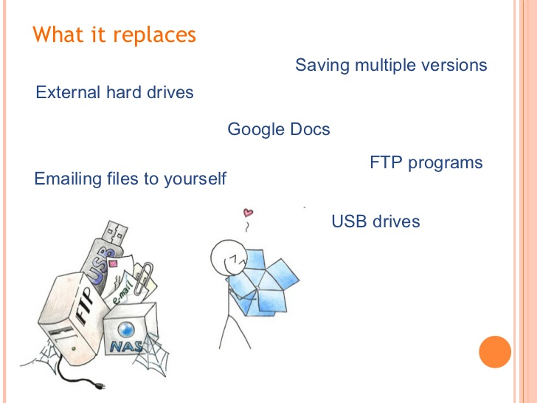

Slide 9
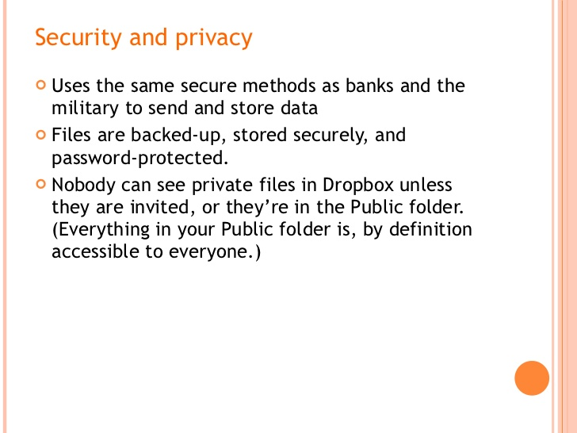

Slide 10
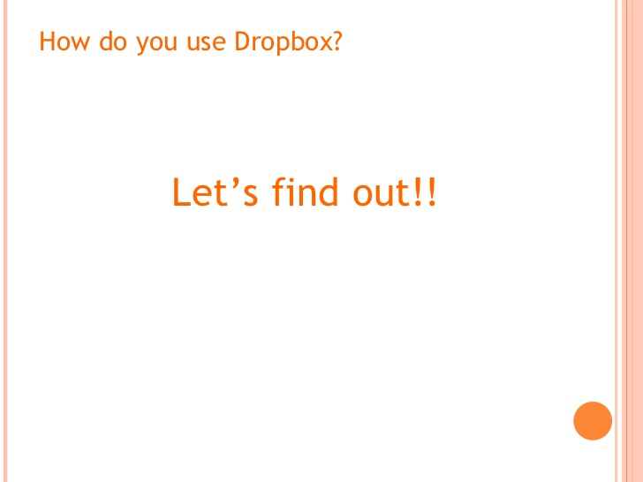

Slide 11
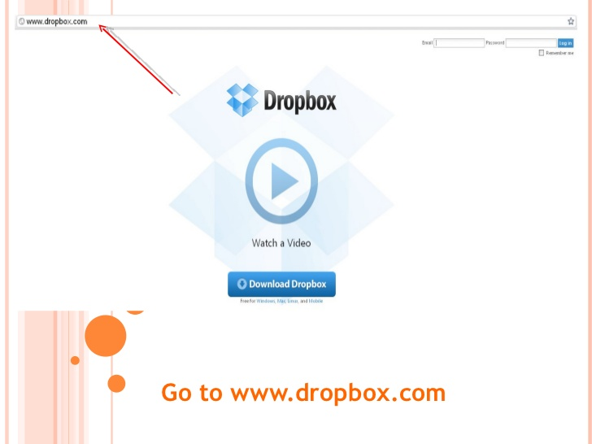

Slide 12
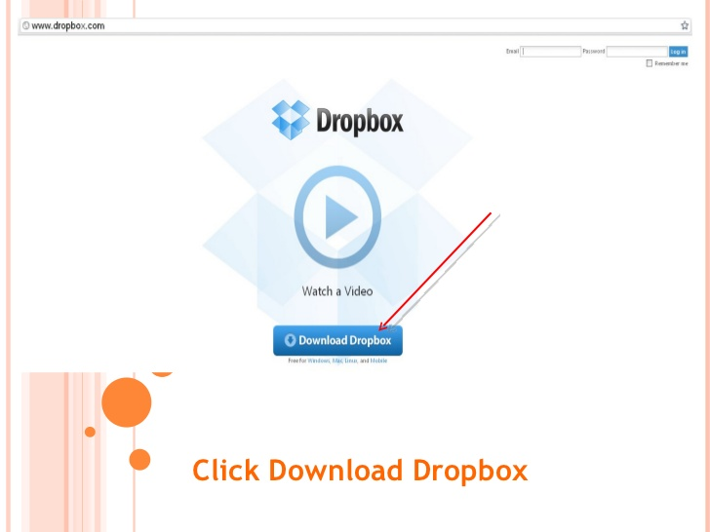

Slide 13
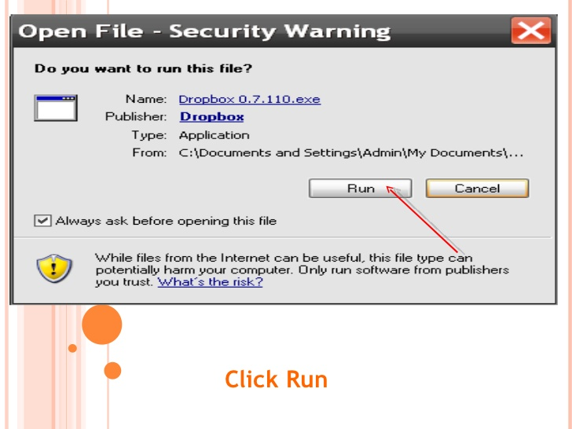

Slide 14
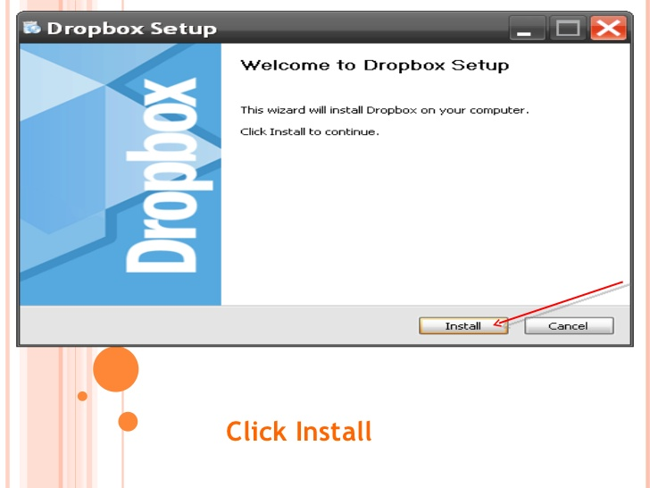

Slide 15
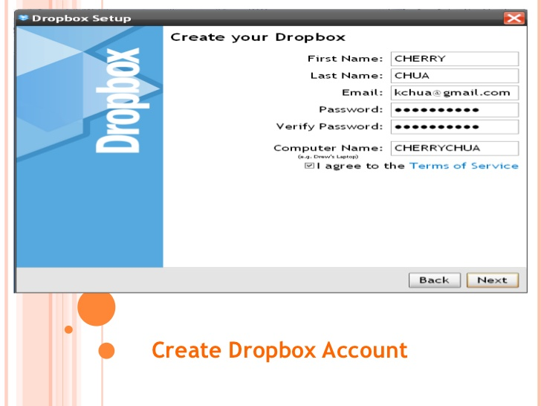

Slide 16
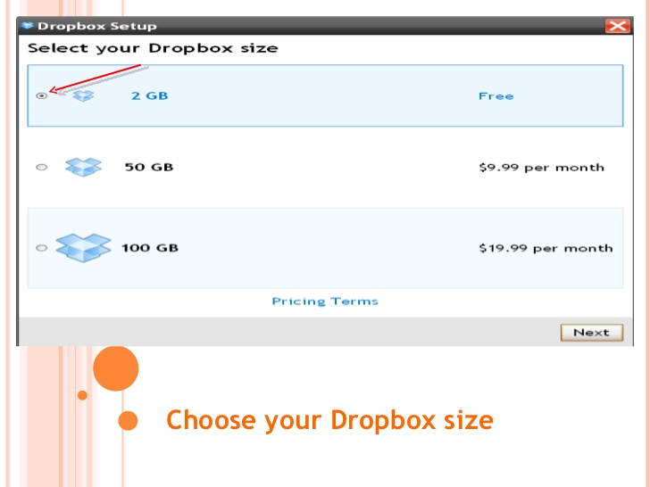

Slide 17
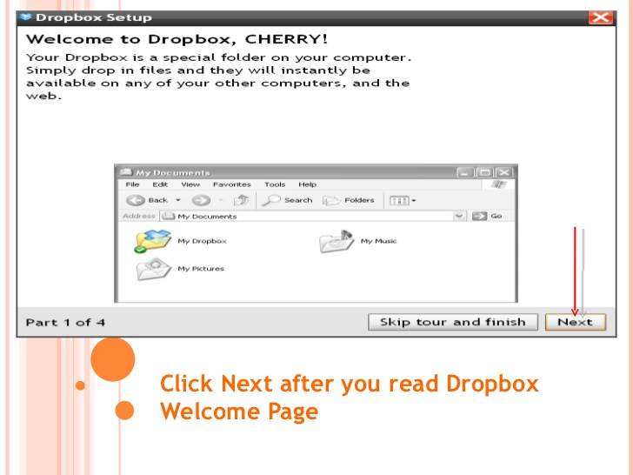

Slide 18
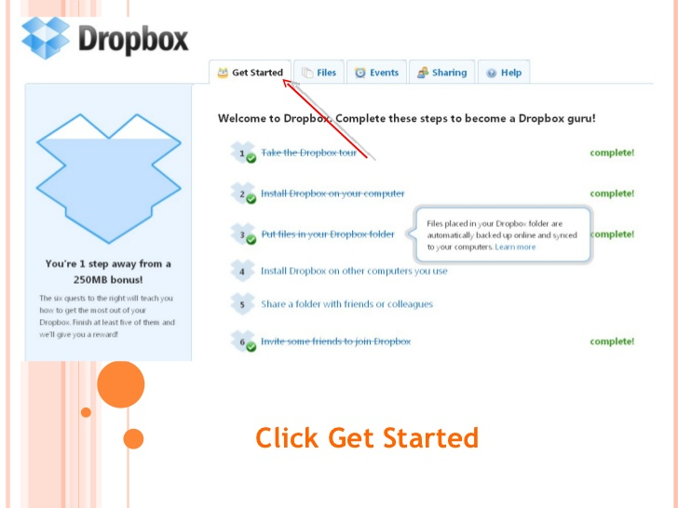

Slide 19
Advantages The main advantage of Dropbox is that it is completely free. When you register for a Dropbox account, you automatically get 2 gigabytes (GB) of storage space. This is a good amount of storage space. However, there are methods that you can use to increase the space without paying a single cent. These methods include sending fan mail about Dropbox, connecting your Dropbox to social media as well as inviting family, friends and other people to join Dropbox. Dropbox is extremely convenient. It is easy to use and one can learn how to use it very quickly. You can access Dropbox by connecting to the Internet. On the other hand, you can simply download the application on your smart devices and your computer. Thus, you can simply open the application and upload or download files. Dropbox is designed such that you will be able to access the latest version of every file. As such, if you update a document using your smart-phone, you can download the same updated document using your computer. By using the application, you bypass the need for a browser.

Slide 20
Disadvantages One of the disadvantages of this service is that the administrators or developers who maintain the service have the right to delete information from free, inactive accounts. This means that if you store some information on Dropbox and abandon the account for a few months, it is unlikely that you will get it after you log back on. Also, there are serious concerns about the security of Dropbox. There have been various cases of servers being hacked and information stolen. Thus, one would want any sensitive information stored on Dropbox to remain secure. Currently, the encryption used to secure user data on Dropbox is only known to the developers. Users are not allowed to perform encryption on their information before uploading it on Dropbox.

Slide 21


Slide 22
