Slide 1
Arts & Crafts with AWS Glue
Lydia White and James Zhang
Notes:
Who here has worked with AWS before?
Who here has worked with AWS glue?
This talk will be an introduction on AWS glue and it's associated services
Disclaimer, we don't work for Amazon and aren't being paid by them. Just use their products

Slide 2





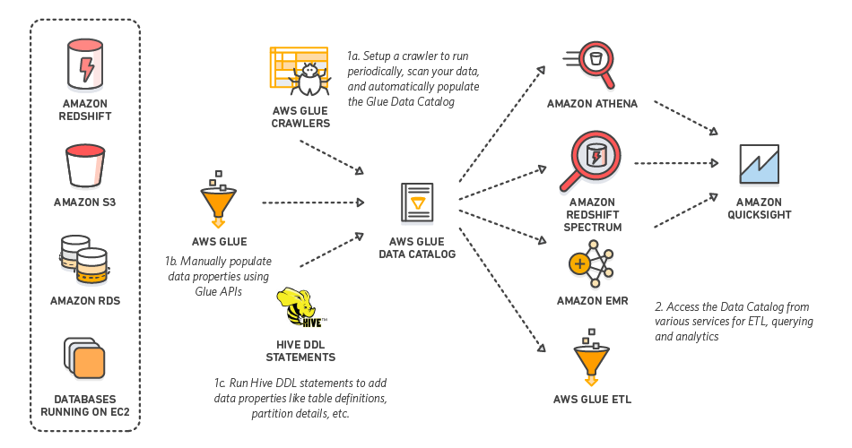



Amazon Web Services
Data File
S3
Glue
Redshift
QuickSight
Glue Crawler
Athena
SQL Workbench/J
Notes:
File ingestion process, where the data file will be used by glue among other aws services.
Overview workflow and explain more later on

Slide 3
AWS Glue
What is Glue?
Notes:
So, what is glue.

Slide 4
AWS Glue
Extract, Transform, and Load(ETL) tool by Amazon Web Services
Used to prepare data for business analytics
Notes:
Glue is an Amazon Web Services tool. Made available a couple year ago.
(ETL explained in next slide)
Prepare data for business analytics or business intelligence

Slide 5
ETL
Extract: Pull data from a source
Files
Database
Reporting Tool
Transform: Modify the data to fit your needs
Add new columns (data source, timestamp, etc.)
Remove unwanted data
Alter existing data
Load: Store in your database
Notes:
Database functions/process of moving data from one data source to another.
Extract-files database, or even Business intelligence Reporting tool
Transform- modify data to fit needs
Load-in to your datawarehouse

Slide 6
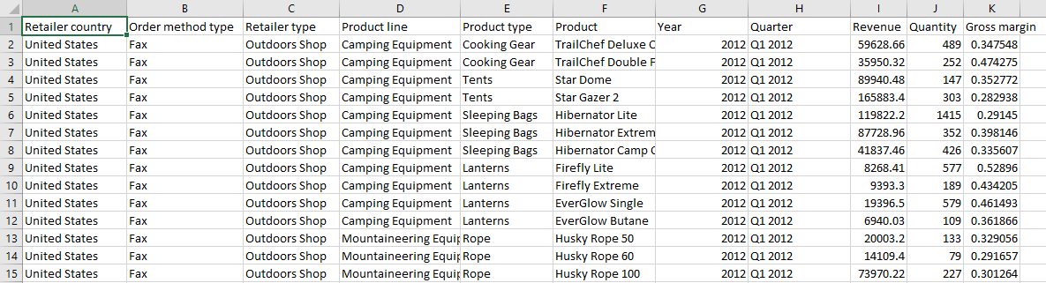
ETL
Original Data File
Example Business Requirements:
Remove the Year from Quarter
Add a profit column from revenue * gross margin columns
Add a current date column
Notes:
Remove year from quarter since there's already a year column
Add a profit column from revenue * quantity
Add a current data column to show when the data was loaded

Slide 7
Why use Glue?
Serverless
companies do not have to invest and maintain on premise servers
Easily scalable
adjust storage needs up and down based on need
Cost Effective – Glue is cheaper than other ETL Services
Only pay when being used, where Matillion and Informatica charge hourly or yearly
Matillion: $2.74 per hour (m4.large EC2), Informatica $3.66 per hour (m4.large EC2), Glue $0.44 per DPU-Hour
Code based (Python or Scala) so you can do anything you can program
Easy integration with other AWS tools
Automatic error handling and logging
Notes:
Serverless- companies don't need to pay to house on premise servers 24/7. "Rent out" Amazon's servers as needed
Easily scalable- increase or decrease storage as needed
Cost Effective- because only paying for what you use, it saves $. Other ETL services charge hourly or yearly
Dpu data processing unit???
Easy integration because all the services used are aws services

Slide 8
AWS vs. Hadoop
Hadoop – A popular platform used to store and transform big data
AWS is more flexible – scale up or down storage based on need
AWS is less complex – no need to set up and maintain servers
AWS cheaper
No start up cost
No maintenance cost
Pay as you go
Hadoop has challenges handling a lot of small files
AWS – End to End solution for data needs
Storage
Transform
Business Intelligence
ETL(AWS) vs. ELT(Hadoop)
Durability
Data stored in multiple locations within region
If a location fails data is still available
Notes:
Hadoop you need to buy storage before hand
Hadoop has challenges handling many small files??? It is better at handling
ELT – extract and load everything in to a data warehouse first. And then transform as needed.
With aws, you can actually set up services to do either ETL or ELT based on your needs.

Slide 9



Glue Tutorial Overview
Setup Redshift Cluster
Create Redshift table
S3 bucket for storing the file
Athena table to access data in file
Glue connection
Glue job
Run Glue job
QuickSight
Data File
S3
Glue
Redshift
QuickSight
Glue Crawler
Athena
SQL Workbench/J

Slide 10

Redshift
Create AWS Data Warehouse
Data File
S3
Glue
Redshift
QuickSight
Glue Crawler
Athena
SQL Workbench/J

Slide 11
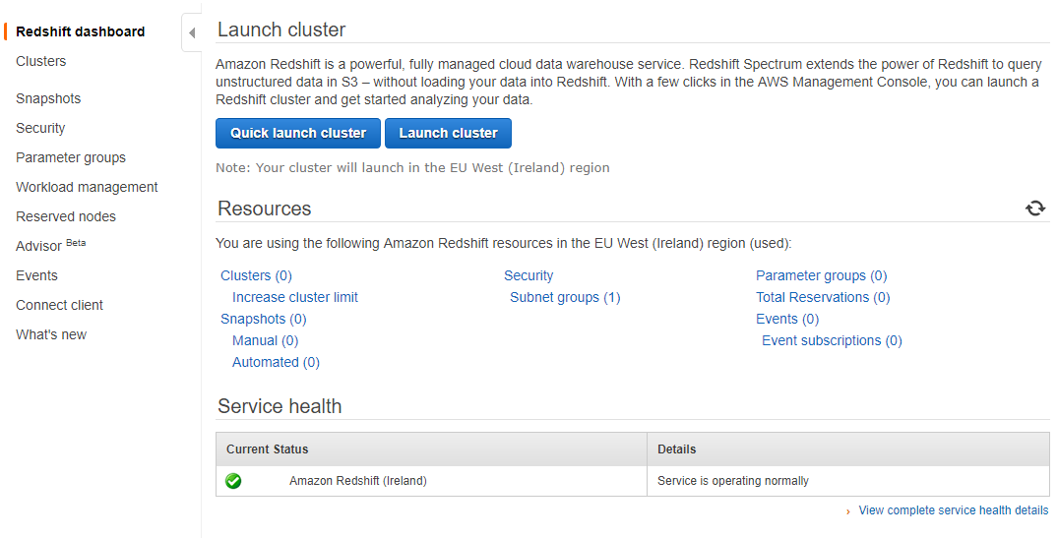
Redshift
Create AWS Data Warehouse

Slide 12
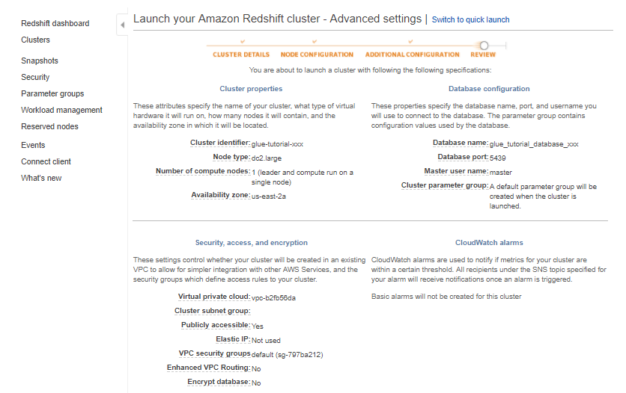
Redshift
Create AWS Data Warehouse

Slide 13
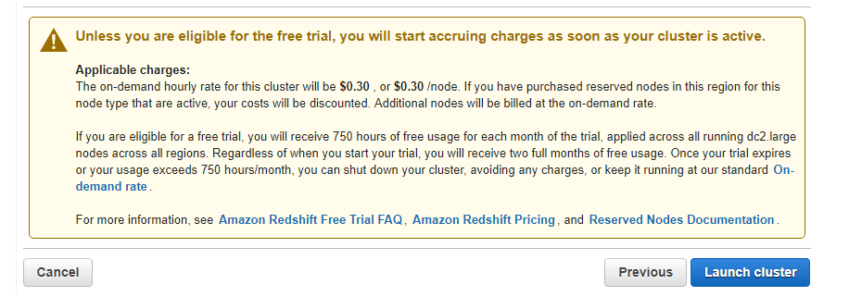
Redshift
Create AWS Data Warehouse

Slide 14
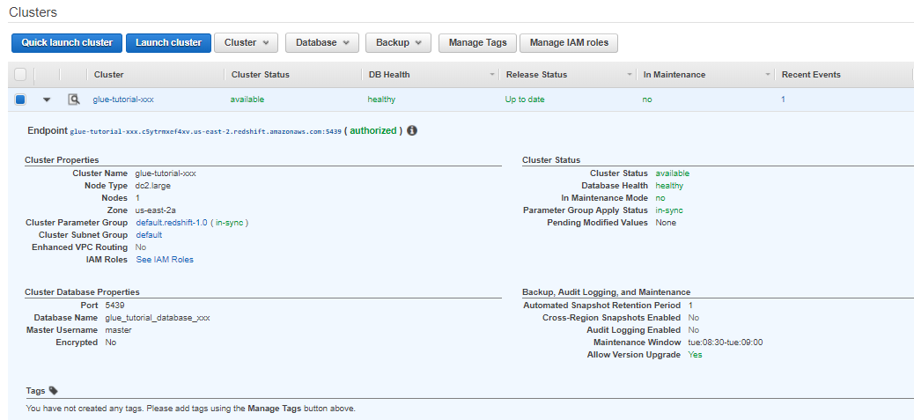
Redshift
Create AWS Data Warehouse

Slide 15
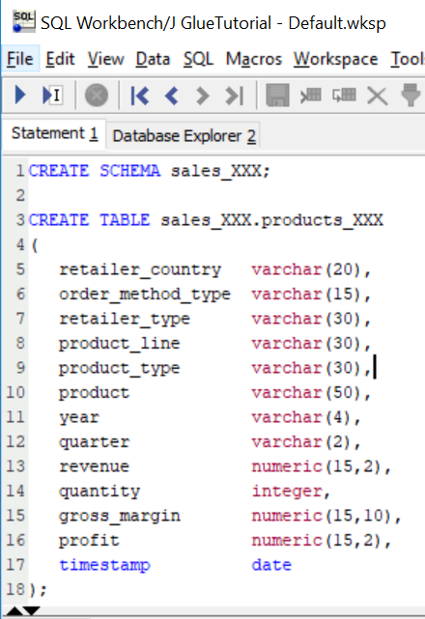
Redshift
Create table
Create empty table in the Redshift database

Slide 16
S3
Create S3 bucket with AWS Console
Data File
S3
Glue
Redshift
QuickSight
Glue Crawler
Athena
SQL Workbench/J

Slide 17
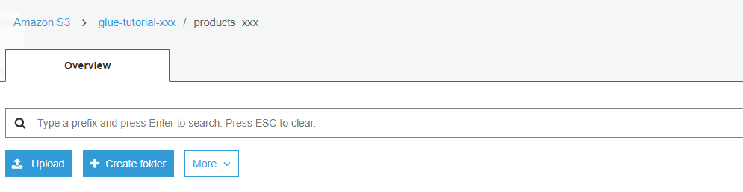
S3
Add file to S3 bucket with AWS Console

Slide 18
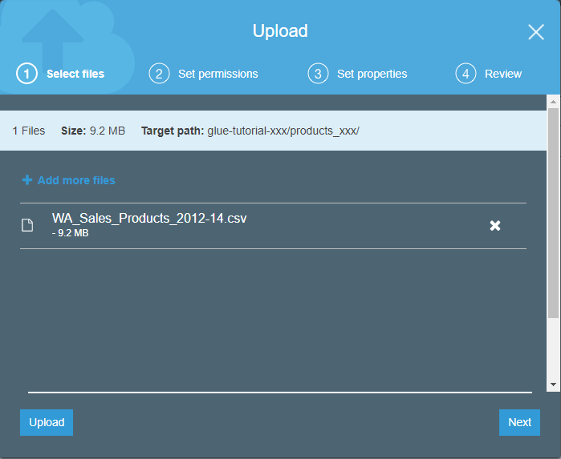
S3
Add file to S3 bucket with AWS Console
Add file from repository called “WA_Sales_Products_2012-14”

Slide 19
S3
Add file to S3 bucket with AWS CLI* (Alternative)
$ aws s3 cp <your-file-path>/aws-glue-tutorial/WA_Sales_Products_2012-14.csv s3://glue-tutorial-XXX/products_XXX/
* Must install and set up AWS CLI in order to use this

Slide 20



Glue Crawler
Data File
S3
Glue
Redshift
QuickSight
Glue Crawler
Athena
SQL Workbench/J

Slide 21
Glue Crawler
Scans data to create metadata
Determines column names and data types
Creates a Glue Table
Queryable with Athena

Slide 22
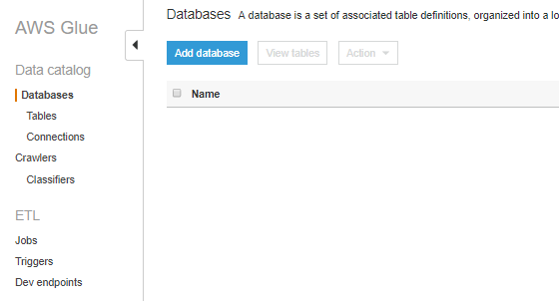
Glue
Create Glue Database
Create a new Database

Slide 23
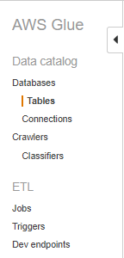
Glue Crawler
Create Table with Glue Crawler
Create a table using a crawler

Slide 24
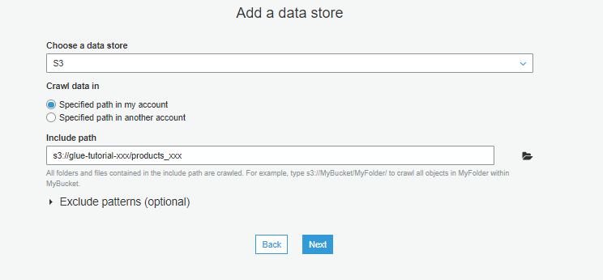
Glue Crawler
Create Table with Glue Crawler
Specify the path for the table to search for in S3

Slide 25
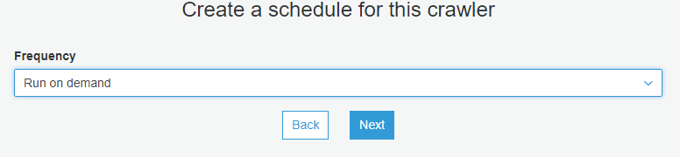
Glue Crawler
Create Table with Glue Crawler
Your crawler can run on either a timed schedule or on demand

Slide 26
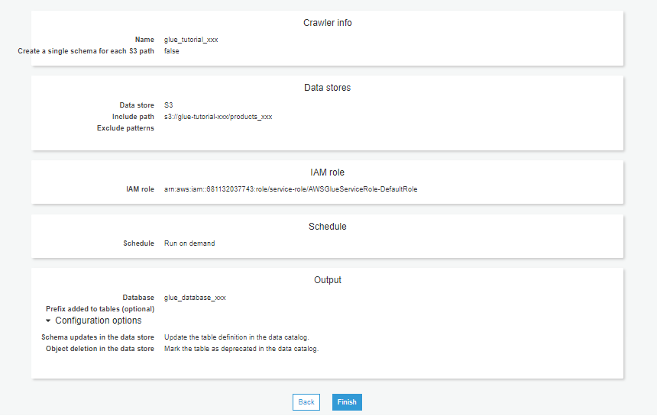
Glue Crawler
Create Table with Glue Crawler

Slide 27
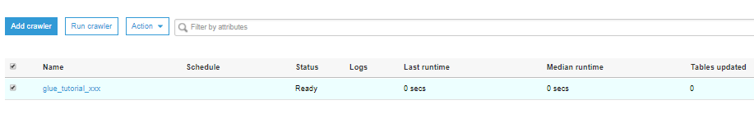
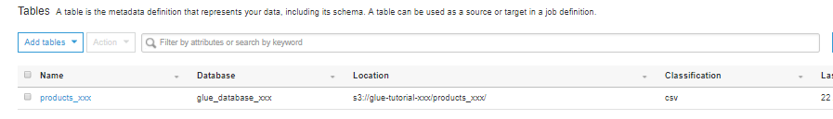
Glue Crawler
Create Table with Glue Crawler
Select your crawler
Run your crawler
Your table should be in the Tables tab

Slide 28
Athena
Data File
S3
Glue
Redshift
QuickSight
Glue Crawler
Athena
SQL Workbench/j

Slide 29
Athena
Interactive query service used to analyze data
Data stored in S3
Run queries to verify your data is stored correctly

Slide 30
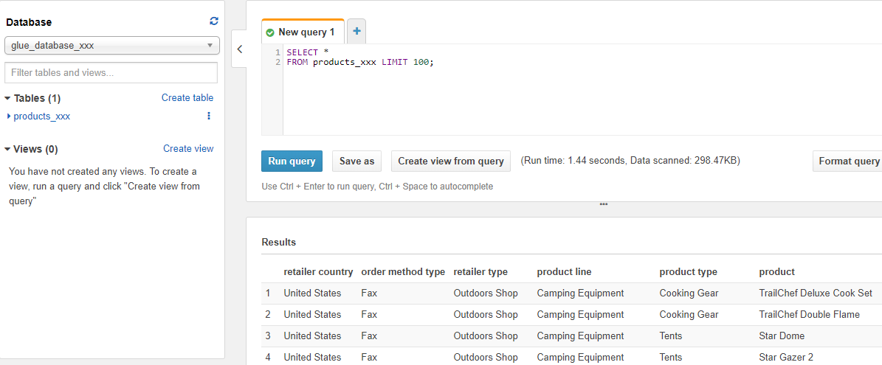
Athena
Run an SQL select query to verify data populating correctly
SELECT * FROM products_xxx LIMIT 100;

Slide 31
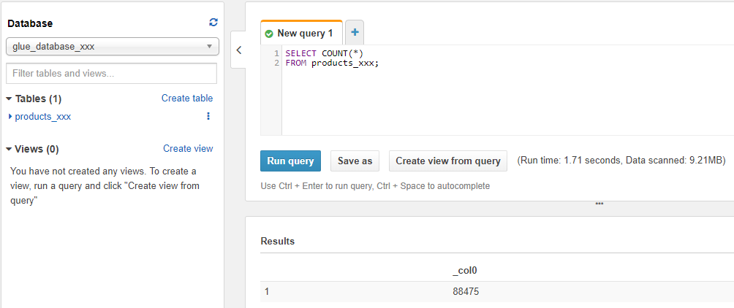
Athena
Run an SQL count query to verify all data is there
SELECT COUNT(*) FROM products_xxx;

Slide 32

Glue
Data File
S3
Glue
Redshift
QuickSight
Glue Crawler
Athena
SQL Workbench/j

Slide 33

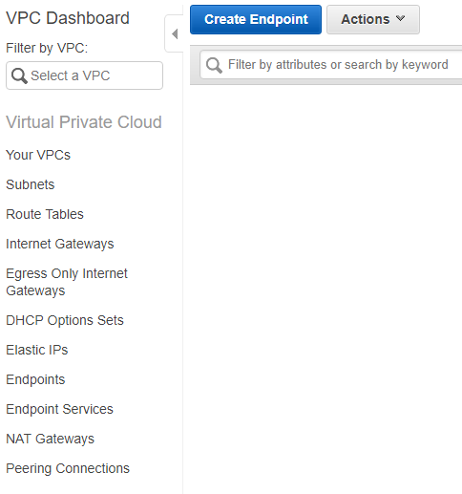
VPC
Create a S3 endpoint
We need to create a S3 endpoint for Glue to access S3
Notes:
.Create private ip address for AWS Glue to access S3 data without exposing to the public

Slide 34
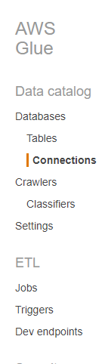
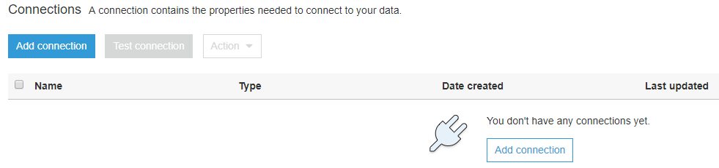
Glue
Create a connection to Redshift
Click on “Add Connection” to create a connection to the Redshift cluster
Notes:
To begin, we need to setup a connection to Redshift with Glue. Reminder Redshift is a datawarehouse

Slide 35
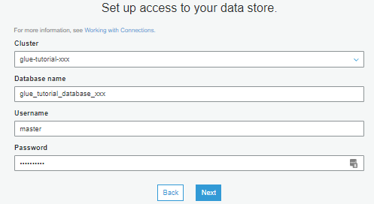
Glue
Create a connection to Redshift
Name of the cluster: glue-tutorial-XXX
Username and password created for Redshift
Name of the database:
glue_tutorial_database_xxx

Slide 36
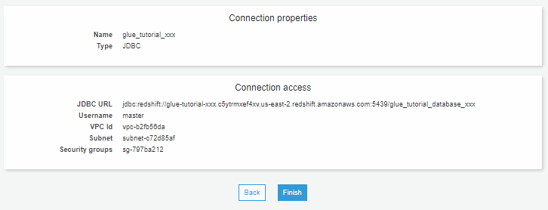
Glue
Create a connection to Redshift

Slide 37

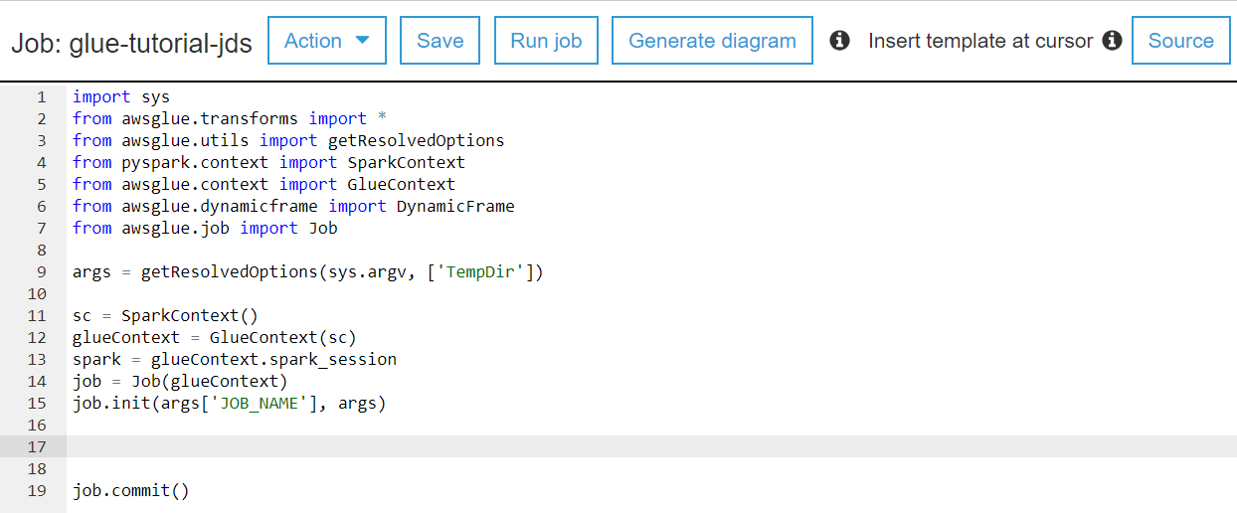
Glue
Data File
S3
Glue
Redshift
QuickSight
Glue Crawler
Athena
SQL Workbench/j

Slide 38
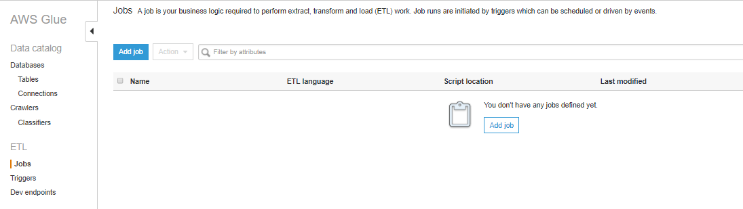
Glue
Create a Glue job

Slide 39
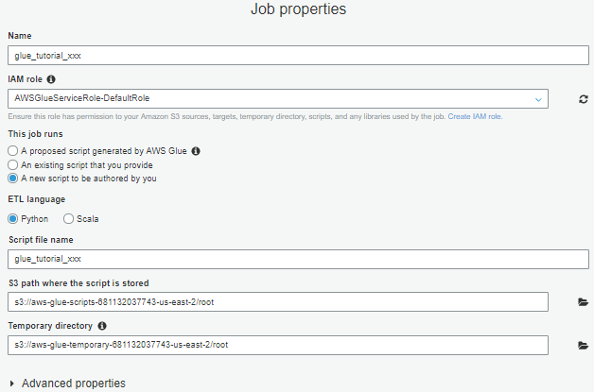
Glue
Create a Glue job
Give your job a name: glue-tutorial-XXX
Give your job a role to perform the actions necessary to run
The language used to write the script
Create a new blank script

Slide 40
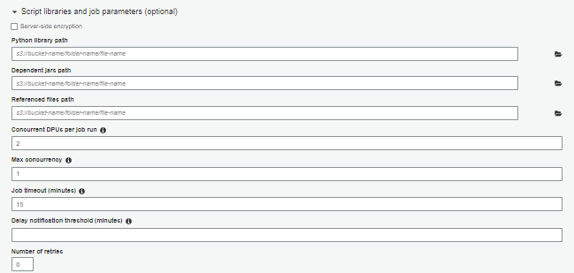
Glue
Create a Glue job
DPU = Data Processing Unit. Glue jobs are charged per DPU hour. Change to 2
Job automatically stops after set time
Notes:
Timeout set to about 2 days initially

Slide 41
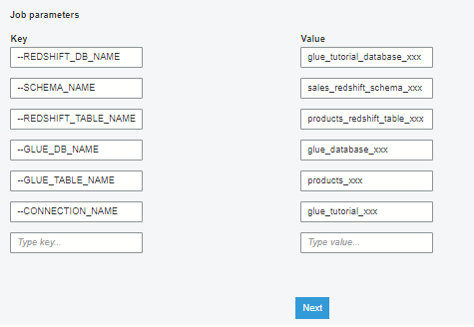
Glue
Create a Glue job
Parameters:
--REDSHIFT_DB_NAME glue_tutorial_database_xxx
--REDSHIFT_TABLE_NAME products_redshift_table_xxx
--SCHEMA_NAME sales_redshift_schema_xxx
--GLUE_DB_NAME
glue_database_xxx
--GLUE_TABLE_NAME
products_xxx
--CONNECTION_NAME
glue_tutorial_xxx
Parameterize values to be used in the script
Notes:
Timeout set to about 2 days initially

Slide 42
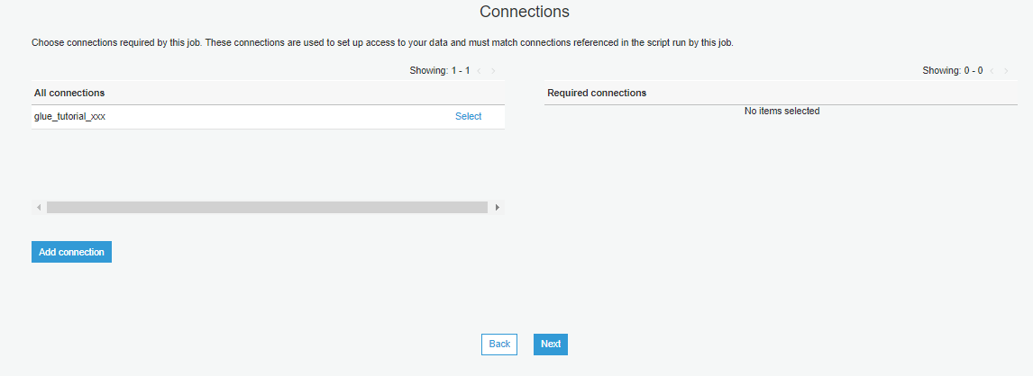
Glue
Create a Glue job
Select the Redshift connection that you want to use: glue-tutorial-XXX
Notes:
Select the Redshift connection setup before

Slide 43
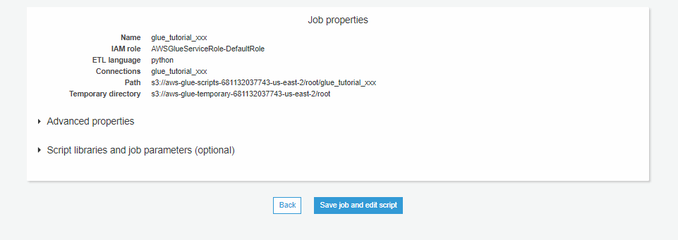
Glue
Create a Glue job

Slide 44
Glue
Writing the Script
PySpark is a service that allows the developer to perform data analysis on the data that is being used.
This is setting up the Spark and Glue environment to be able to interact with the data
Notes:
This code all comes pre-generated with the “empty script”
AWS Glue uses PySpark which is python for Apache Spark. Spark is an analytics engine for large scale data processing.

Slide 45
Glue
Writing the Script
import sys
from awsglue.transforms import *
from awsglue.utils import getResolvedOptions
from pyspark.context import SparkContext
from awsglue.context import GlueContext
from awsglue.dynamicframe import DynamicFrame
from awsglue.job import Job
from pyspark.sql.functions import *
from pyspark.sql.types import *
from datetime import datetime
args = getResolvedOptions(sys.argv, ['TempDir', 'JOB_NAME', 'REDSHIFT_DB_NAME', ‘REDSHIFT_TABLE_NAME’, ‘GLUE_DB_NAME’, ‘GLUE_TABLE_NAME’, 'SCHEMA_NAME’, 'CONNECTION_NAME’])
sc = SparkContext()
glueContext = GlueContext(sc)
spark = glueContext.spark_session
job = Job(glueContext)
job.init(args['JOB_NAME'], args)
Include SQL functions, types, and datetime to use later
Add the parameters that were passed into the Glue job

Slide 46
Glue
Writing the Script
The data will be written to the datasource as a DynamicFrame
...
job.init(args['JOB_NAME'], args)
datasource = glueContext.create_dynamic_frame.from_catalog(
database = args[‘GLUE_DB_NAME'],
table_name = args[‘GLUE_TABLE_NAME']
)
These are the database and the table that we created in Glue
Notes:
Dynamic Frame is Glue’s version of a table. It is designed to work with Spark’s Data Frame, which is Spark’s version of a table.

Slide 47
Glue
Writing the Script
...
# Convert to PySpark Data Frame
sourcedata = datasource.toDF()
split_col = split(sourcedata["quarter"], " ")
sourcedata = sourcedata.withColumn("quarter new", split_col.getItem(0))
sourcedata = sourcedata.withColumn("profit", col("revenue")*col("gross margin"))
sourcedata = sourcedata.withColumn(“current date", current_date())
# Convert back to Glue Dynamic Frame
datasource = DynamicFrame.fromDF(sourcedata, glueContext, "datasource")
sourcedata needs to be set to a Data Frame
This is where the transformations happen
Convert back to a Dynamic Frame
Notes:
Glue Dynamic Frame, Pyspark Data Frame
The DynamicFrame needs to be changed in to a dataframe in order for Pyspark to be able to do transformations on it. Dynamic Frame is Glue’s version of a table. It is designed to work with Spark’s Data Frame, which is Spark’s version of a table.
Transformations:
“quarter” column is using a split to remove the year from the quarter column which initially has “quarter year”
Creating “profit“ column with a calculation of “revenue” multiplied with “gross_margin”
Creating “timestamp” column with current date

Slide 48
Glue
Writing the Script
...
applymapping = ApplyMapping.apply(
frame = datasource,
mappings = [
("retailer country", "string", "retailer_country", "varchar(20)"),
("order method type", "string", "order_method_type", "varchar(15)"),
("retailer type", "string", "retailer_type", "varchar(30)"),
("product line", "string", "product_line", "varchar(30)"),
("product type", "string", "product_type", "varchar(30)"),
("product", "string", "product", "varchar(50)"),
("year", "bigint", "year", "varchar(4)"),
("quarter new", "string", "quarter", "varchar(2)"),
("revenue", "double", "revenue", "numeric"),
("quantity", "bigint", "quantity", "integer"),
("gross margin", "double", "gross_margin", "decimal(15,10)"),
("profit", "double", "profit", "numeric"),
(“current date", "date", “current_date", "date")
]
This is how the data in the DynamicFrame will be mapped to the columns in Redshift
Notes:
Mapping out AWS Glue Data in the Dynamic Frame to columns in Redshift
Column name and type in Glue maps out to what column name and type will be in Redshift

Slide 49
Glue
Writing the Script
...
# datasink (loading) using spark
datasink = glueContext.write_dynamic_frame.from_jdbc_conf(
frame = applymapping,
catalog_connection = args['CONNECTION_NAME'],
connection_options = {
"dbtable": "{}.{}".format(args['SCHEMA_NAME'], args[‘REDSHIFT_TABLE_NAME']),
"database": args['REDSHIFT_DB_NAME']
},
redshift_tmp_dir = args["TempDir"]
)
The datasink will connect to Redshift using the parameters given and load the data to Redshift
Notes:
Using datasink to connect with Redshift and load the data
Using parameters set from before to connect to the correct Redshift database, schema and table.

Slide 50
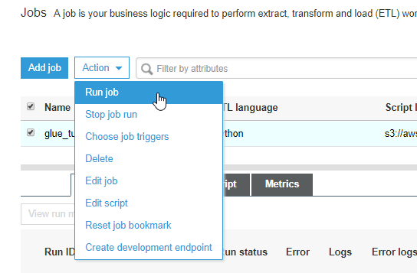
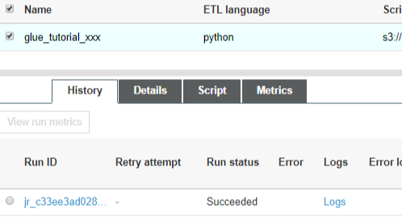
Glue
Run the Glue job
Run your Glue job
When the job succeeds, check the Redshift table

Slide 51
SQL Workbench
Data File
S3
Glue
Redshift
QuickSight
Glue Crawler
Athena
SQL Workbench/J

Slide 52
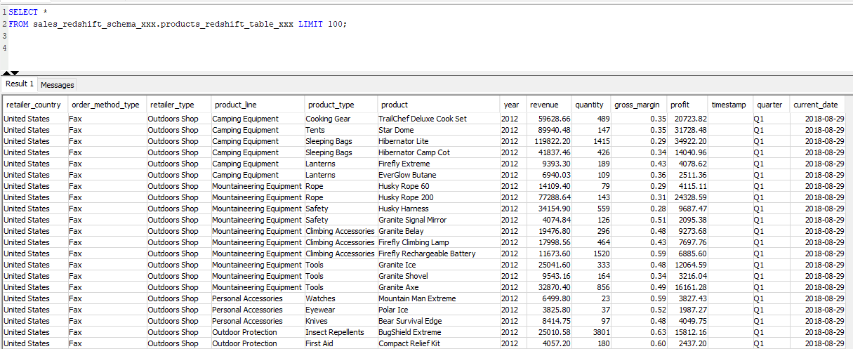
Redshift
Verify data in the table

Slide 53
Enhancements
Improve the versatility of your Glue job
Create a Glue Trigger
Automatically run the Glue job
Run multiple different Glue jobs
Control how resources can interact with other services
Easily create, modify, and delete as well as move Glue jobs with a template
Create reports for business analytics with the data that was loaded with the Glue job.

Slide 54

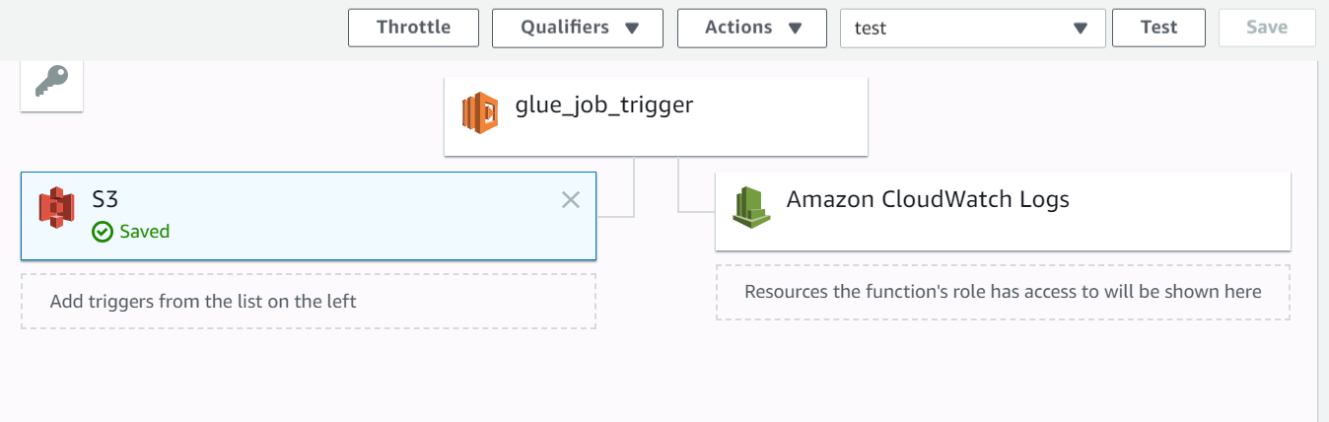
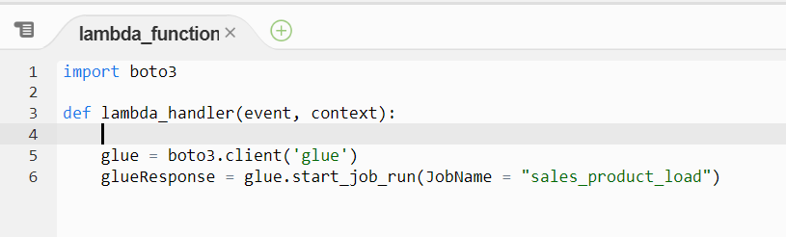
Glue Trigger
Automatically run Glue job using Lambda – a serverless function
Instead of running the Glue job manually, have it run automatically when a file is added to S3
Use a Lambda
You can set a Lambda to run when a file lands in an S3 bucket
Then make the Lambda run the Glue job
Notes:
Notice that the name of the glue job is hardcoded in the lambda. It would be better if it could run different glue jobs based on the file. We could store that information in…

Slide 55

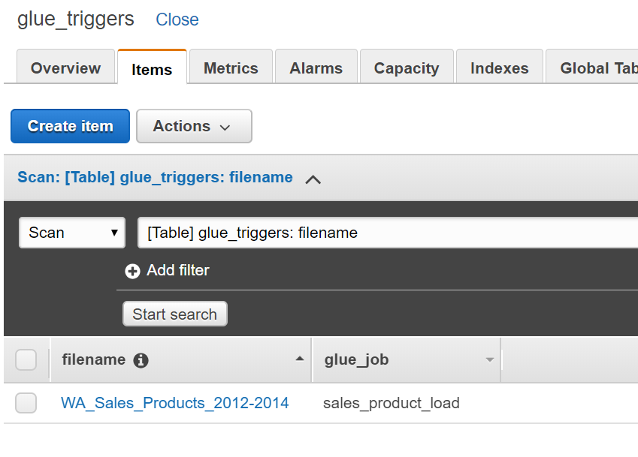
Glue Trigger
Run multiple different Glue jobs with DynamoDB – a non-relational database
The Lambda currently can only run one Glue job
It would be better if it could run different Glue jobs based on the file.
We could store that information in a DynamoDB table

Slide 56
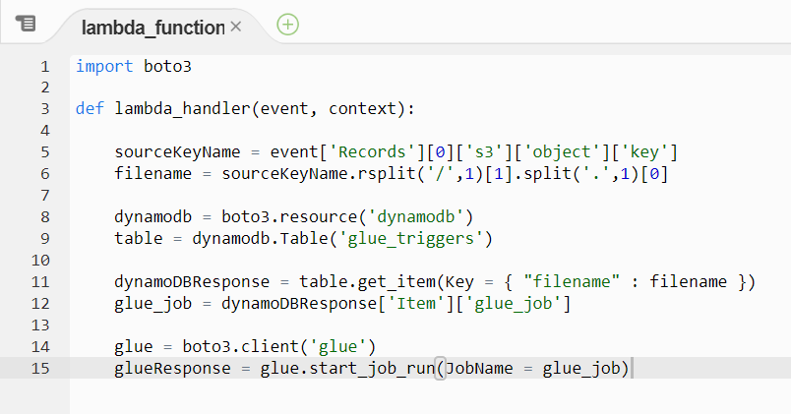
Glue Trigger
Lambda receives an event from S3, which includes the ‘key’
Automatically run Glue job using Lambda
The Lambda can look up the filename in the DynamoDB table to find which Glue job to run
This returns the Glue job associated with that file
We get the filename from the key, then search the DynamoDB table with it

Slide 57

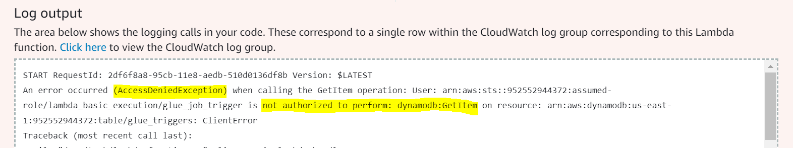
Glue Trigger
IAM Roles determine how a resource can interact with other services
If you made the lambda from the previous slides, you would get an AccessDeniedException
We need to add permission to the Lambda’s IAM Role to access DynamoDB and Glue

Slide 58
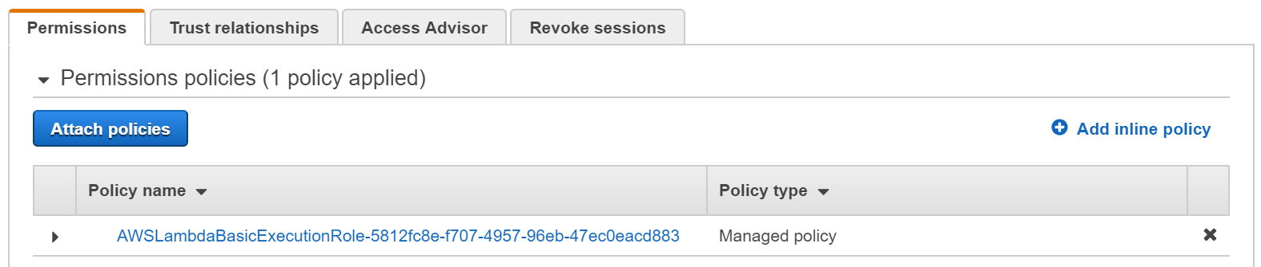
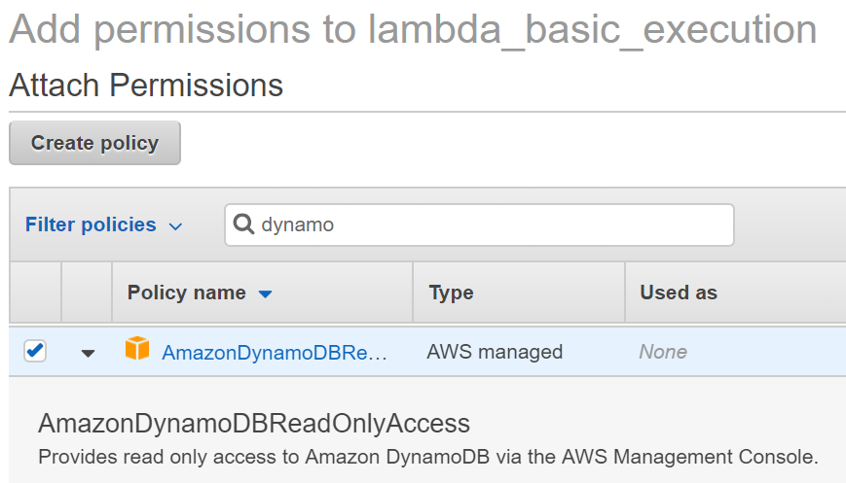
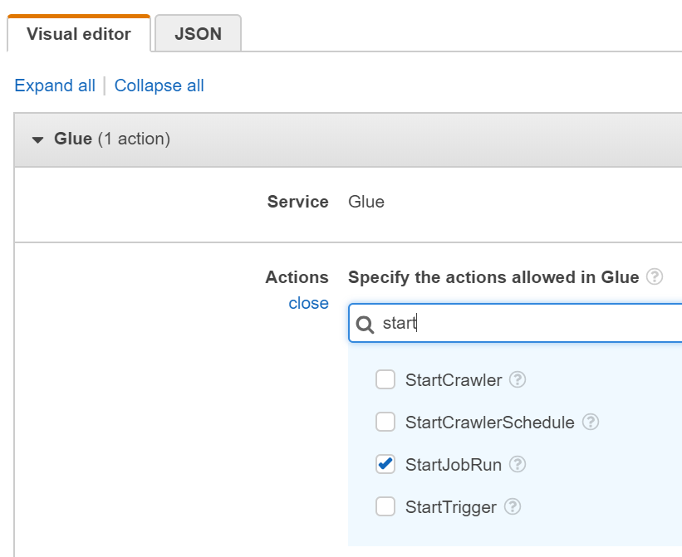
Glue Trigger
IAM Roles determine how a resource can interact with other services
Notes:
To add policies, we can select “Attach policies” and search through the AWS managed polices for the one we want. In this case, we want the DynamoDB Read Only Access. For the glue permission, there isn’t a managed policy that fits what we need, so we can add an inline policy instead. We only need to allow one action, called StartJobRun. Now, our lambda will be able to access the DynamoDB table and start the Glue job.

Slide 59

CLOUDFORMATION
Templates
Template used build the infrastructure for AWS resources
Use Case:
Build Glue job through Cloud Formation vs Glue console
Advantages
Easy to modify
Easy to create multiple Glue jobs with similar patterns
Easy to delete multiple related resources at once
Easy to deploy to a different account

Slide 60
CLOUDFORMATION
Templates
Resources: MyJob:
Type: AWS::Glue::Job
Properties:
Command:
Name: glueetl
ScriptLocation: !Ref ScriptLocation
AllocatedCapacity: 2
DefaultArguments:
"--REDSHIFT_DB_NAME": !Ref RedshiftDBName
"--SCHEMA_NAME": !Ref SchemaName
"--REDSHIFT_TABLE_NAME": !Ref RedshiftTableName
"--GLUE_TABLE_NAME": !Ref GlueTableName
"--CONNECTION_NAME": !Ref GlueConnectionName
"--GLUE_DB_NAME": !Ref GlueDatabaseName
ExecutionProperty:
MaxConcurrentRuns: 2
Connections: !Ref GlueConnectionName
MaxRetries: 0
Name: !Ref GlueJobName

Slide 61
CLOUDFORMATION
AWSTemplateFormatVersion: "2010-09-09“
Parameters:
GlueDatabaseName:
Type: String
Default: glue_database_XXX
GlueConnectionName:
Type: String
Default: glue_tutorial_XXX
RedshiftDBName:
Type: String
Default: glue_tutorial_database_XXX
SchemaName:
Type: String
Default: sales_redshift_schema_XXX
RedshiftTableName:
Type: String
Default: products_redshift_table_XXX
GlueTableName:
Type: String
Default: products_glue_table_XXX
GlueJobName:
Type: String
Default: glue_tutorial
ScriptLocation:
Type: String
Default: "s3://glue-tutorial-XXX/products_XXX"
Templates

Slide 62
QUICKSIGHT
AWS Business Intelligence Tool
Data File
S3
Glue
Redshift
QuickSight
Glue Crawler
Athena
SQL Workbench/J

Slide 63
QUICKSIGHT
AWS Business Intelligence Tool
Cloud based Business Intelligence reporting tool
Build Reports from
Files in S3
Redshift
Athena
Notes:
Tableau

Slide 64
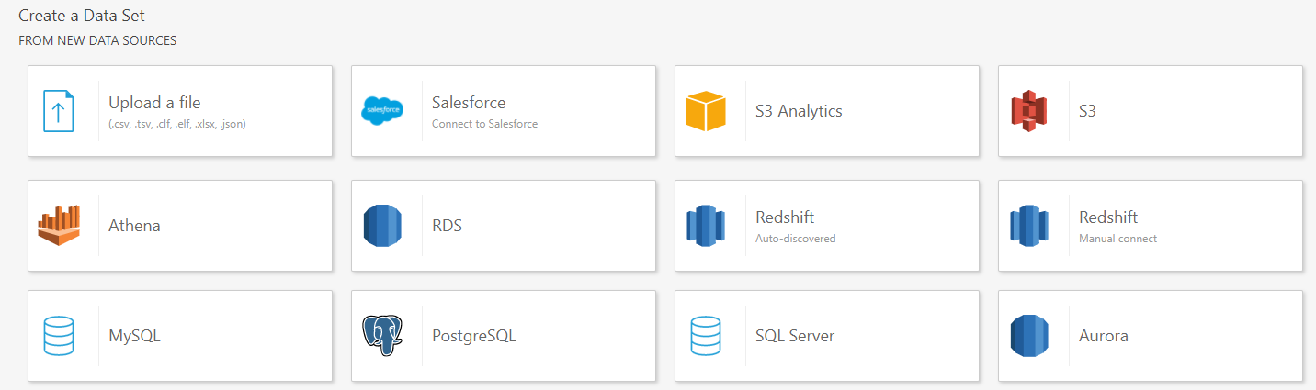
QUICKSIGHT
AWS Business Intelligence Tool

Slide 65
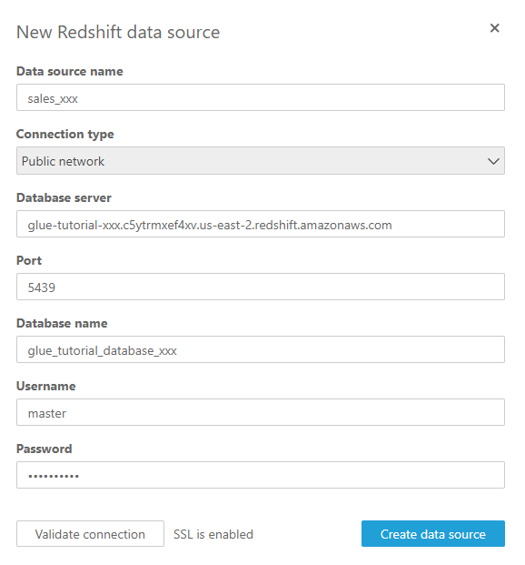
QUICKSIGHT
AWS Business Intelligence Tool

Slide 66
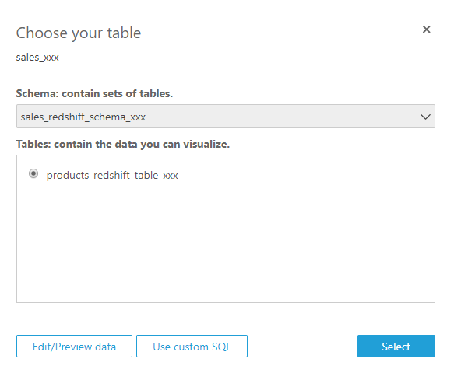
QUICKSIGHT
AWS Business Intelligence Tool

Slide 67
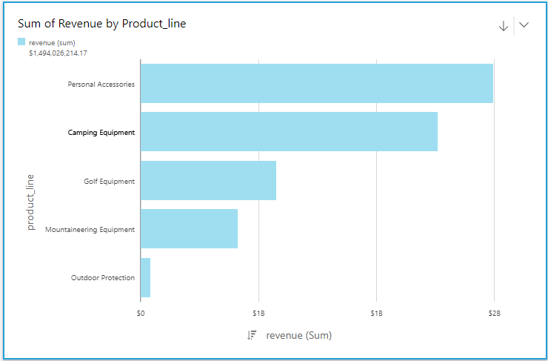
QUICKSIGHT
AWS Business Intelligence Tool

Slide 68
SUMMARY
AWS Data Workflow
Data File
S3
Glue
Redshift
QuickSight
Glue Crawler
Athena
SQL Workbench/J

Slide 69
CONCLUSION
Glue - AWS ETL Tool
Simple –
Use AWS for your entire ETL workflow
Less Setup
Flexible –
Good for developers as well as non-developers
Customizable
Cost Effective –
Cheaper than other ETL tools
Pay only when you use Glue

Slide 70
CLEAN UP
AWS
Delete the following resources:
Redshift Cluster *
S3 Bucket *
QuickSight Account *
Glue Job
Glue Database
Glue Table
Glue Connection
* These services will accrue charges to your AWS account if not removed

Slide 71
RESOURCES
AWS Glue Documentation
https://aws.amazon.com/glue/
Pricing
Informatica
https://aws.amazon.com/marketplace/pp/B0752DY9DV?qid=1534179668153&sr=
0-1&ref_=srh_res_product_title
Glue
https://aws.amazon.com/glue/pricing/
Matillion
https://aws.amazon.com/marketplace/pp/B010ED5YF8
AWS Services Documentation
https://aws.amazon.com/documentation/
Hadoop vs AWS
https://www.trustradius.com/compare-products/amazon-web-services-vs-hadoop
https://databricks.com/blog/2017/05/31/top-5-reasons-for-choosing-s3-over-hdfs.html
https://data-flair.training/blogs/13-limitations-of-hadoop/

Slide 72
Links
AWS Glue Tutorial Presentation: https://github.com/jackdsilverman/aws-glue-tutorial/blob/master/glue-tutorial.pptx
AWS Glue Workshop: https://github.com/jackdsilverman/aws-glue-tutorial
James Zhang jzhang@manifestcorp.com
Lydia White lwhite@manifestcorp.com
Thanks to Jack Silverman and Jerry Ralph
Notes:
You can find the full workshop presentation at this git repository if you want to work on it on your own later on.
Reminder, you will need to remember to delete any resources that AWS bills you for after you're finished.
Cost is about $5?
If you have any questions please feel free to reach out to either of us afterwards.

