Slide 1
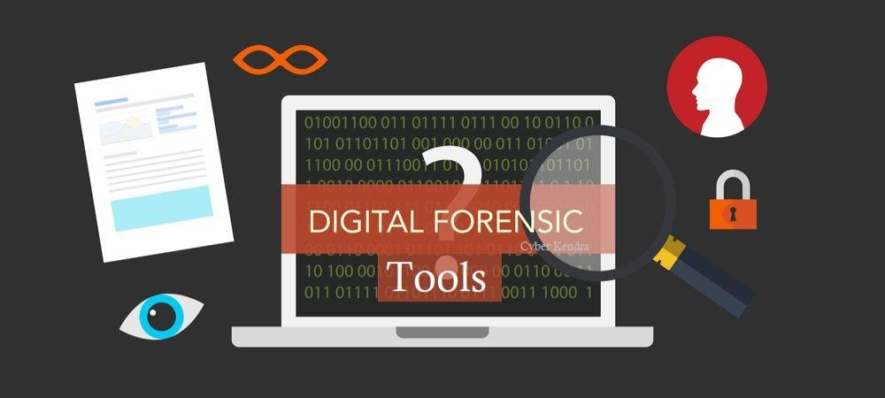
PRESENTED BY
PRATHISHA.V & SAVITHA.E

Slide 2
Overview
What is forensic ?
What is digital forensics ?
Digital forensics tool
Key elements of digital forensics
Branches of digital forensics
What is the future for digital forensics
Benefits of digital forensics tool
Technologies that have inspired more interest in digital forensics cont’d

Slide 3

WHAT IS FORENSIC?
The adjective forensic comes from the Latin word forensic, meaning “ in open court “ or “ public “
When forensic usually mean that has to do with finding evidence to solve a crime

Slide 4
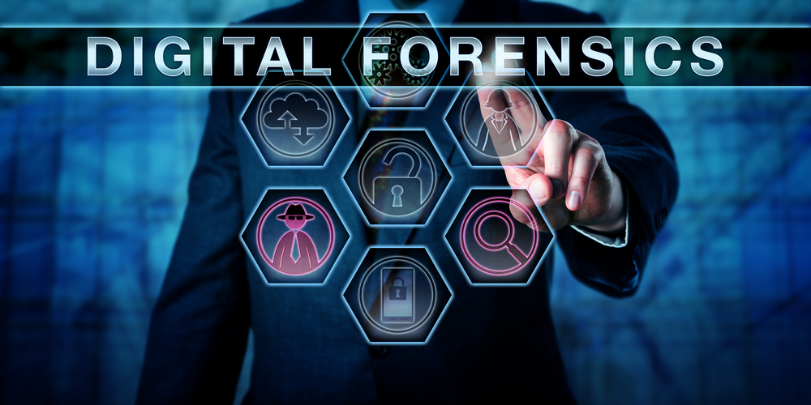
What is digital forensics?
Digital Forensics is the preservation, identification, extraction, in terpretation and documentation of computer evidence which can be used in the court of law

Slide 5
Digital Forensics Tool
Some forensic tools are :
Autopsy
Sift
FTK imager
bulk_extractor
Xplico
Volatility
Linux’dd’
CAINE
HxD
DEFT
PlainSight
HELIX3 Free
USB Historian

Slide 6

Autopsy
Autopsy is computer software that makes it simpler to deploy many of the open source programs and plugins used in The Sleuth Kit. The graphical user interface displays the results from the forensic search of the underlying volume, making it easier for investigators to flag pertinent sections of data.

Slide 7

Sift workstation
The SIFT Workstation is a collection of free and open-source incident response and forensic tools designed to perform detailed digital forensic examinations in a variety of settings

Slide 8
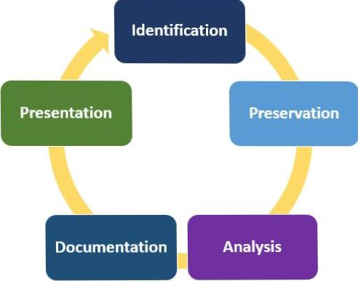
Key elements of digital forensics
There are 5 key elements of digital forensics
  Identification
  Preservation
  Analysis
  Documentation
  Presentation

Slide 9
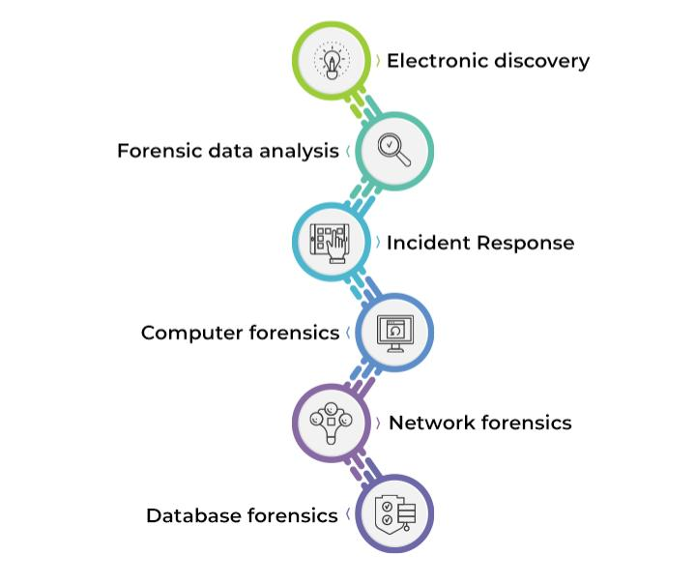
Branches of digital forensics

Slide 10
What is the future of digital forensics ?
There is an increasing wife array of tools used to preserve and analyse digital evidence
Huge targets will require more sophisticated analysis techniques and equipment
There will also be better collaboration functions to allow Forensics investigators to perform investigation a lot more efficiently that they do presently

Slide 11
Benefits of digital forensics tool
The advantages of using forensic tools during a computer investigation include the ability to quickly search through vast amounts of data, to be able to search in several languages (especially important since the internet doesn’t have boundaries), and that data that was once considered deleted can now be retrieved with the forensic tools.

Slide 12
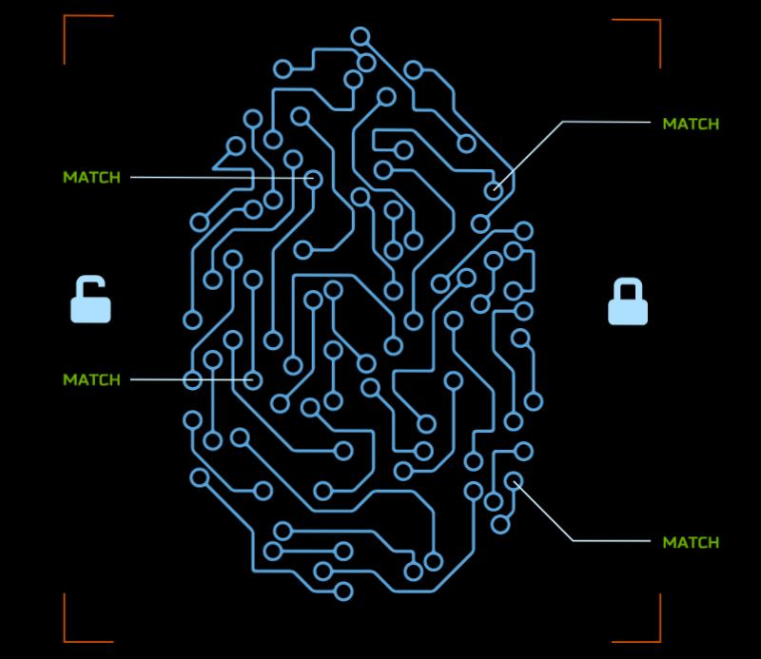
Technologies that have inspired more interest in digital forensics cont’d
AccessData
-A pioneer in digital investigation
since 1987.
-Provide state of the art cyber security,
password cracking , eDiscovery and
decryption solution

Slide 13
Case #1
On Friday September 03,2010 in Abu Dhabi , United Arab Emirates, a case concerning the alleged raping of a 14 year old brazillian girl was brought to the court.
As details of the case unfolded in the court the charges changed from rape to consensual sex.
Digital forensics helped in uncovering evidence in the form of intimate text messages and photographs sent the girl to the man from her mobile phone.

Slide 14
Case #1 cont’d
The girl was eventually sentenced to six months in jail followed by deportation and the 25 years old Pakistani bus driver was sentenced to one year in jail followed by deportation
Digital forensics played an important role in the final verdict of the case

Slide 15
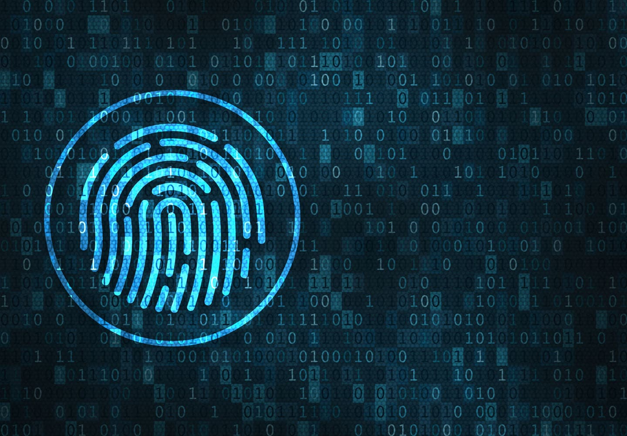
Thank you for your attention

