Slide 1
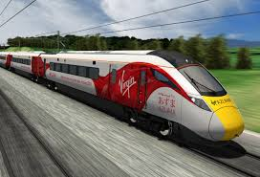

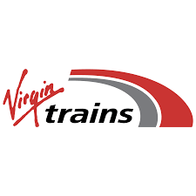
Virgin Trains
DB for current year
By
Savitha Yerram

Slide 2
Virgin Trains: List of tables
Stations
Routes
Customers
Payment_Methods
Tickets
Route_Costs

Slide 3
Virgin Trains:
Stations table properties
Column name | Data type | Length | Key type
Station_id | Int |  | Primary
Station_name | Varchar | 100 | Not null
Location | Varchar | 150

Slide 4
Virgin Trains:
Routes table properties
Column name | Data type | Length | Key type
Route_id | Int |  | Primary key
Start_station_id | Int |  | Not null
End_station_id | Int |  | Not null
Distance_km | Decimals | 6 decimals 2 | Not null
Constraint:
CONSTRAINT FK_Routes_StartStation
FOREIGN KEY (start_station_id) REFERENCES Stations(station_id),
CONSTRAINT FK_Routes_EndStation
FOREIGN KEY (end_station_id) REFERENCES Stations(station_id)

Slide 5
Virgin Trains:
Customers table properties
Column name | Data type | Length | Key type
Customer_id | Int |  | Primary key
First_name | Varchar | 50 | Not null
Last_name | Varchar | 50 | Not null
Email | Varchar | 100 | unique
Age | Int |  | Not null

Slide 6
Virgin Trains:
Payment_methods table properties
Column name | Data type | Length | Key type
Payment_id | Int |  | Primary key
Method_name | Varchar | 50 | Not null

Slide 7
Virgin Trains:
Tickets table properties
Column name | Data type | Length | Key type
Ticket_Id | Int |  | Primary key
customer_id | Int |  | Not null
Route_id | Int |  | Not null
Purchase-date | Date |  | Not null
Sales_channel | Varchar | 20
Price | Decimal | 10 , 2
Payment_id | Int |  | Not null
Constraint:
CONSTRAINT FK_Tickets_Customer
FOREIGN KEY (customer_id) REFERENCES Customers(customer_id),
CONSTRAINT FK_Tickets_Route
FOREIGN KEY (route_id) REFERENCES Routes(route_id),
CONSTRAINT FK_Tickets_Payment
FOREIGN KEY (payment_id) REFERENCES Payment_Methods(payment_id)

Slide 8
Virgin Trains:
Route_Costs table properties
Column name | Data type | Length | Key type
Customer_id | Int |  | Primary key
Route_id | Int |  | Not null
Month | Varchar | 20 | Not null
Operational_cost | Decimal | 12 , 2
Constraint:
CONSTRAINT FK_RouteCosts_Route
FOREIGN KEY (route_id) REFERENCES Routes(route_id)

Slide 9
Entity Relationship Diagram (ERD): Virgin_Train_DB
STATIONS
Station_id (PK)
Location
Route_costs
Cost_id (PK)
Route_id (FK)
Month
Operational_cost
Tickets
Ticket_id (PK)
Customer_id (FK)
Route_id (FK)
Purchase_id
Sales_channel
Price
Payment_id (FK)
Customers
Customer_id (PK)
First_name
Last_name
Email
Age
Routes
Route_id (PK)
Start_station_id (FK)
End_station_id (FK)
Distance_km
Payment_methods
Payment_id (PK)
Method_name

Slide 10
Business Questions

Slide 11
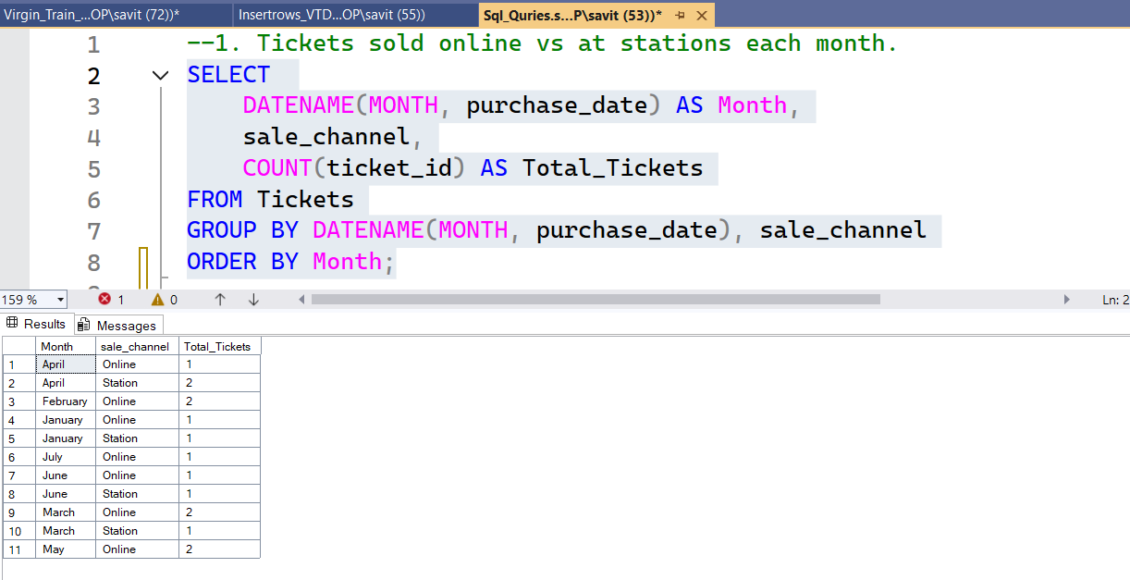
1. How many tickets were sold online vs at stations each month?
Outcome
This question helps identify which sales channel (online or station) customers prefer and how that trend changes over time. By comparing monthly ticket sales, Virgin Trains can measure the effectiveness of digital adoption (e-ticketing, self-service machines) and understand seasonal demand patterns.

Slide 12
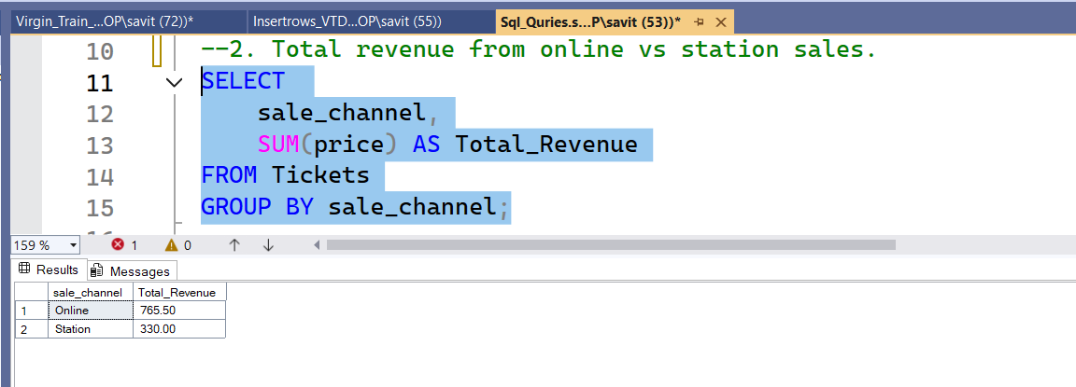
2. How much total revenue was earned from online ticket sales versus station ticket sales?
Outcome
This determines which ticket channel generates more income and contributes more to total revenue. It shows whether online sales are not only more popular but also more profitable, helping Virgin Trains decide where to focus marketing and operational improvements.

Slide 13
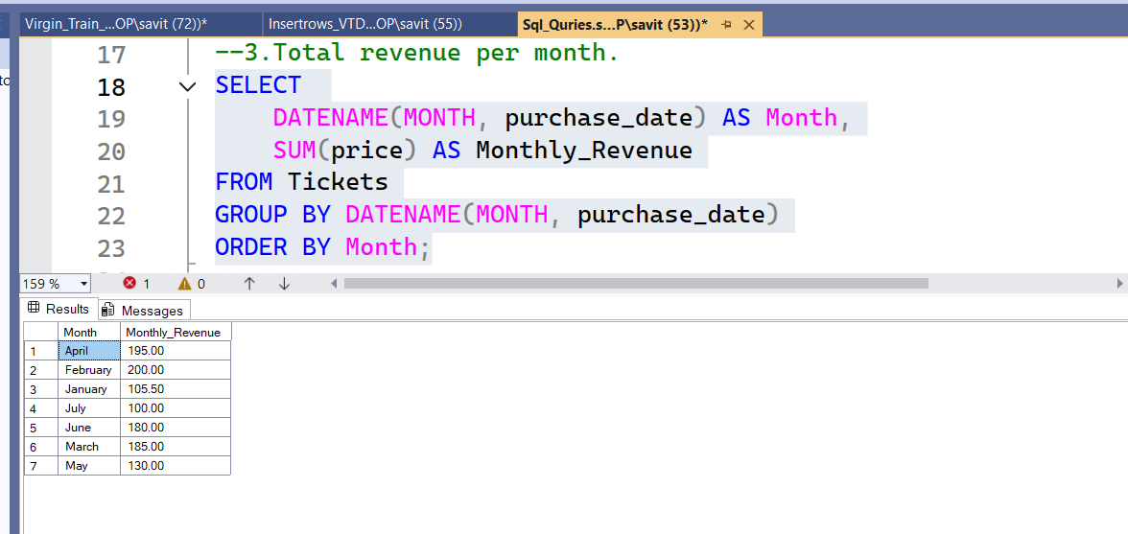
3. What is the total revenue generated from ticket sales each month?
Outcome
This analysis reveals monthly revenue trends, allowing the company to track performance over time and identify peak and off-peak months. It can also help forecast future revenue and assist in budgeting and capacity planning.

Slide 14
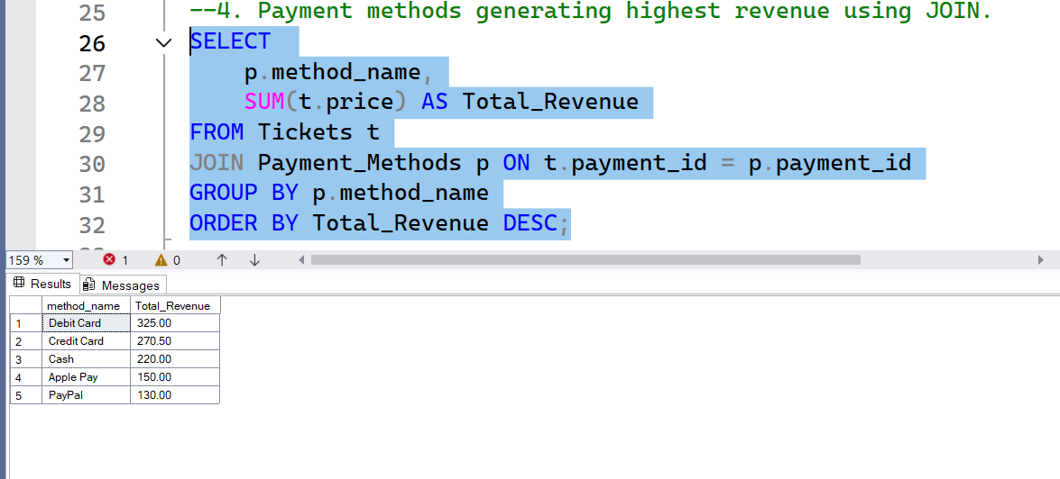
4. Which payment methods generate the highest revenue?
This question highlights customer payment preferences (e.g., credit card, debit card, mobile payments, cash) and determines which methods are linked to higher-value transactions. Virgin Trains can use this information to promote convenient payment options and possibly reduce transaction costs.

Slide 15
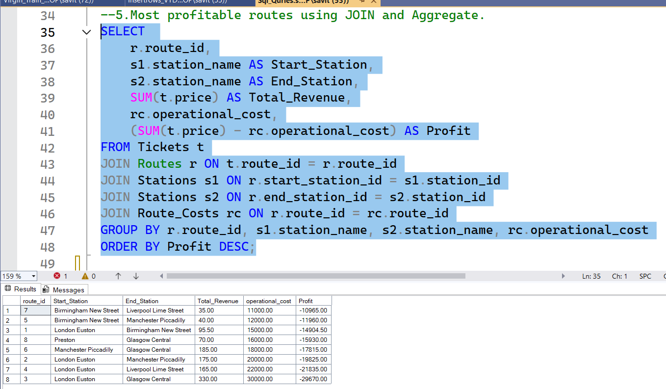
5. Which routes are the most profitable?
This question identifies the most and least profitable routes by comparing total revenue and operating costs for each route. The results can help Virgin Trains allocate resources efficiently, adjust pricing, or increase services on high-performing routes.

