Slide 1
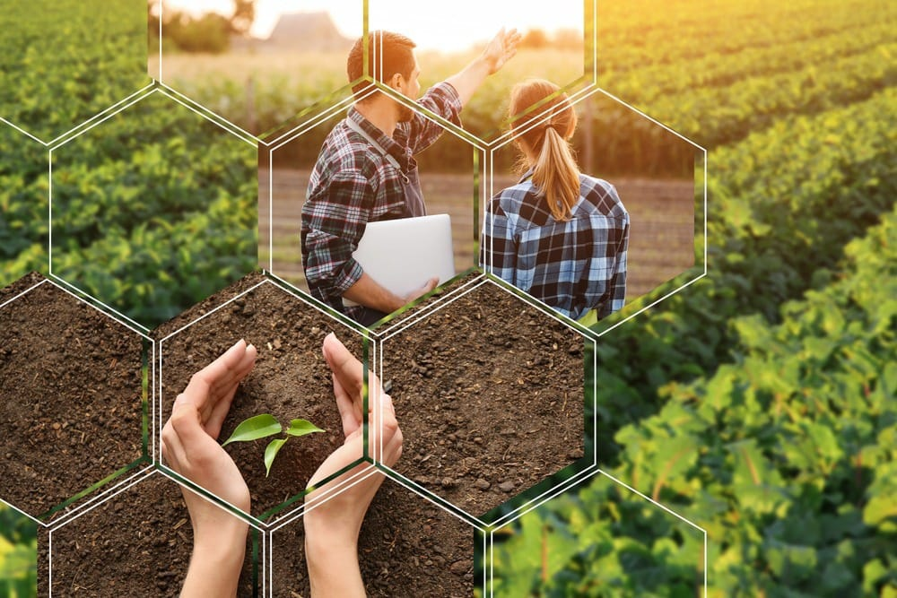
Agronomy
Agronomy is the science and technology of producing and using plants by agriculture for food, fuel, fiber, chemicals, recreation, or land conservation. Agronomy has come to include research of plant genetics, plant physiology, meteorology, and soil science.

Slide 2
APPLICATION OF AGRONOMY
Agronomy is the branch that deals with various sources like food , fodder, ploughing ,harvesting , cultivating of various crops based on its duration from cultivating and harvesting.

