Slide 1


K. RAMAKRISHNAN COLLEGE OF ENGINEERING
(AUTONOMOUS), SAMAYAPURAM - TRICHY DEPARTMENT OF CSE
CGB1221 – DATABASE MANAGEMENT SYSTEMS
Real time Stock Monitoring and Alert System
PRESENTED BY SUPERVISOR
Savitha sri.N Ms. J. Chitra M.E.
8115U23AM046 Assistant Professor / CSE.

Slide 2
PRESENTATION OVERVIEW
Project Introduction
Objective
Problem Statement
Technologies Used
ER Diagram
Modules Used
Output Screenshots
Conclusion
Future Scope

Slide 3
PROJECT INTRODUCTION
The Real-Time Stock Monitoring and Alert System is a simple and useful tool that helps users keep track of stock prices instantly. It allows users to enter stock symbols (like TCS, INFY, or AAPL) and set price limits. When the stock price goes above or below the set limit, the system gives a sound or message alert. This helps investors make quick decisions without constantly watching the market.

Slide 4
OBJECTIVE
The objective of this system is to monitor stock prices in real time. It lets users set custom price alerts for selected stocks. When the price crosses the limit, it sends an instant alert. This helps users make quick and informed investment decisions.

Slide 5
PROBLEM STATEMENT
Investors and traders find it difficult to monitor stock prices continuously.
Rapid price changes can result in missed opportunities or financial loss.
Manually checking prices is time-consuming and not efficient.
A real-time alert system is needed to notify users instantly when stock prices reach specific limits.

Slide 6
TECHNOLOGIES USED
HTML – For designing the structure of the web interface.
CSS – For styling the web pages and improving the user interface.
JavaScript – For real-time functionality and handling user interactions.
Alert Sound/Notification System – For giving instant alerts when price limits are reached.

Slide 7
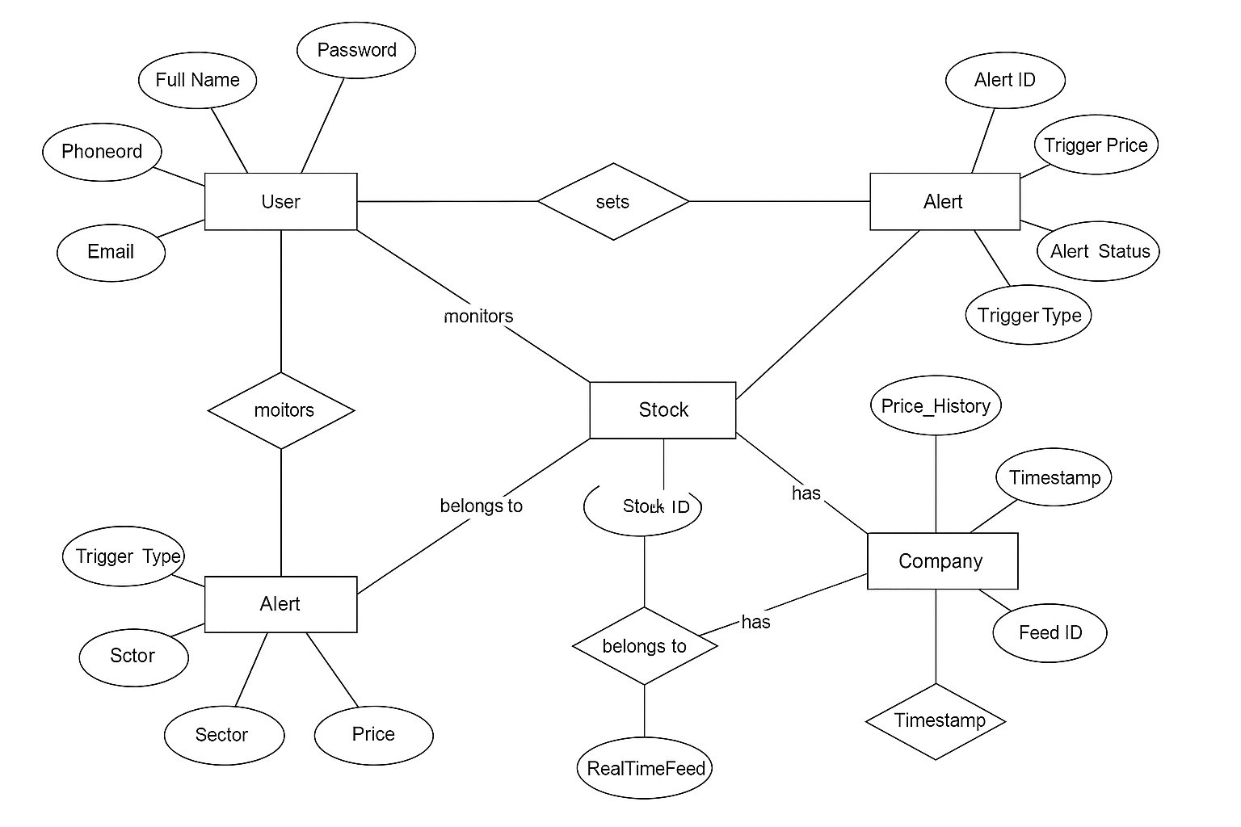
ER DIAGRAM

Slide 8
MODULES USED
User Input Module
Data Fetching Module
Alert & Notification Module
User Interface (UI) Module

Slide 9
MODULE 1 – USER INPUT MODULE
Takes input from the user for stock symbols (e.g., TCS, INFY, AAPL).
Allows users to set upper and lower price limits for alerts.
Validates the entered stock symbols and price values.
Stores user preferences for monitoring and alert generation.

Slide 10
MODULE 2 – DATA FETCHING MODULE
Connects to a stock market API (e.g., Alpha Vantage or Yahoo Finance).
Fetches real-time stock prices based on user input.
Updates the stock prices at regular time intervals.
Ensures accurate and up-to-date data is available for comparison.

Slide 11
MODULE 3 – ALERT & NOTIFICATION MODULE
Monitors live stock prices continuously.
Compares current prices with user-set alert limits.
Triggers an alert (sound or popup) when price crosses the set threshold.
Sends instant notifications to help users take timely actions.

Slide 12
MODULE 4 – USER INTERFACE (UI) MODULE
Displays stock prices and alert status clearly to the user.
Provides an easy-to-use layout for entering stock symbols and price limits.
Shows real-time updates of stock data on the screen.

Slide 13
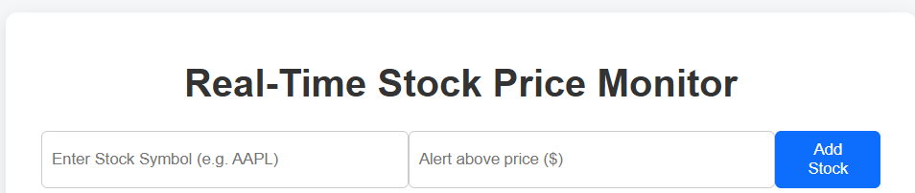
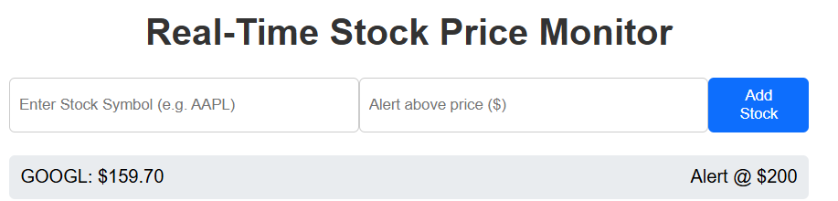
OUTPUT SCREENSHOTS

Slide 14
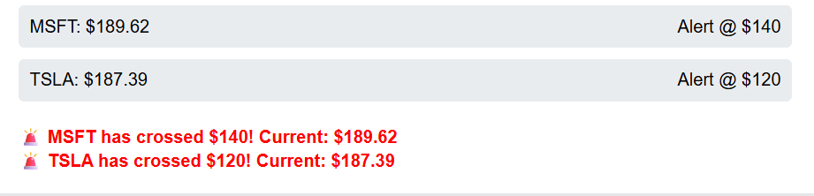

Slide 15
CONCLUSION
The Real-Time Stock Monitoring and Alert System provides an efficient way to keep track of stock prices as they change throughout the day. By delivering instant alerts when prices reach user-defined limits, it helps investors and traders respond quickly to market movements. The easy-to-use interface and real-time updates make monitoring convenient and accessible for everyone.

Slide 16
FUTURE SCOPE
The system can be improved by adding AI-based price predictions, support for more markets and assets like cryptocurrencies, and mobile app integration with push notifications for better accessibility.

Slide 17
Thank you

