Slide 1

ARTIFICIAL INTELLIGENCE AND MACHINE LEARNING
18CS62
“Fraudulent Credit Card Detection Using Ensemble Machine Learning Models”
Presented by – T J S L Savitri 1RV19CS171
Sinchana Raj 1RV19CS158

Slide 2
Introduction
Stolen credit cards are used to make purchases in e-commerce websites which have vulnerabilities.
The actual owners will be notified with the purchase and the details of the e-commerce application.
Later, illegal users of the stolen credit cards would request the e-commerce websites for refund, claiming that the previous transaction was a wrong one, and get a refund to a different account.
Meanwhile, the legitimate users are notified that they are refunded with their money, when they actually aren’t.
This causes damage to the reputation of the e-commerce websites because it would be believed that the authentication process was not proper.
Hence E-commerce websites are heading towards implementing a credit card fraud detection system.

Slide 3
Objectives
The objective is to implement machine learning algorithms to detect credit card transactions which are fraudulent during any purchase so the real customers or the merchants aren’t charged for fraudulent transactions.
Analysing the dataset after standardizing, oversampling, sending through autoencoder
Balancing and denoising the imbalanced dataset using autoencoder algorithm
Finding AROC values at different thresholds at different dataset conditions on the application of ANN model

Slide 4
Literature Survey
Sl. No. | Title of the work | Authors & Publication Details | Objectives of the work carried out | Results obtained
1 | Credit Card Fraud Detection using Machine Learning Algorithms | Varun Kumar K S, Vijaya Kumar V G, Vijay Shankar A, Pratibha K Published in IJERT, ISSN: 2278-0181, Vol. 9, Issue 07, July 2020 | To implement machine learning algorithms to detect credit card fraud with respect to time and amount of transaction. | By using the time and amount feature in the data set given in the Kaggle. First, we build the model using some machine learning algorithms such as logistic regression, decision tree, and support vector machine, these all are supervised machine learning algorithms in machine learning.

Slide 5
Literature Survey
Sl. No. | Title of the work | Authors & Publication Details | Objectives of the work carried out | Results obtained
2 | Credit card fraud detection using machine learning algorithms. | Vaishnavi Nath Dornadulaa, Subbiah Geetha, Vellore Institute of Technology, Chennai-600127, India Published in the journal: Procedia Computer Science, in the year 2019 | To design and develop a novel fraud detection method for Streaming Transaction Data, with an objective, to analyze the past transaction details of the customers and extract the behavioral patterns. | Logistic regression, decision tree and random forest are the algorithms that gave better results. It was also observed that the Matthews Correlation Coefficient was the better parameter to deal with imbalance dataset

Slide 6
Literature Survey
Sl. No. | Title of the work | Authors & Publication Details | Objectives of the work carried out | Results obtained
3 | A survey paper on credit card fraud detection techniques. | Aisha Mohammad Fayyomi, Derar Eleyan, Amina Eleyan Published in IJSTR, ISSN: 2277-8616, Volume-10, Issue-9, September 2021 edition | This paper aims in using the multiple algorithms of Machine learning such as support vector machine (SVM), k-nearest neighbour (Knn) and artificial neural network (ANN) in predicting the occurrence of the fraud. | In this model, using an artificial neural network (ANN) which gives accuracy approximately equal to 100% is best suited for credit card fraud detection. It gives accuracy more than that of the unsupervised learning algorithms. In this research work, data pre-processing, normalization and under-sampling were carried out to overcome the problems faced by using an imbalanced dataset.

Slide 7
Literature Survey
Sl. No. | Title of the work | Authors & Publication Details | Objectives of the work carried out | Results obtained
4 | Credit Card Fraud Detection Using Autoencoder Neural Network | Ping Jiang, Jinliang Zhang, Junyi Zou Published in August 2019 | This paper proposes a denoising autoencoder neural network (DAE) algorithm which can not only oversample minority class samples through misclassification cost, but it can denoise and classify the sampled dataset. | This study combined stacked denoising autoencoder neural networks with oversampling to build the model, which can achieve minority class sampling on the basis of misclassification cost, and denoise and classify the sampled datasets. The proposed algorithm increases the classification accuracy of minority classes compared to the former methods; we can achieve different accuracy by controlling the threshold. In this study, when the threshold equals 0.6, we can achieve the best performance, which is 97.93%.

Slide 8
Literature Survey
Sl. No. | Title of the work | Authors & Publication Details | Objectives of the work carried out | Results obtained
5 | Credit Card Fraud Detection Using Autoencoder Model in Unbalanced Datasets | August 2019 Journal of Advances in Mathematics and Computer Science Authors: Mohammed Abdulhameed Al-Shabi Taibah University | This paper aims to propose an efficient approach that automatically detects fraud credit card related to insurance companies using deep learning algorithm called Autoencoders. The effectiveness of the proposed method has been proved in identifying fraud in actual data from transactions made by credit cards in September 2013 by European cardholders. | In this paper, some advanced techniques have been introduced to detect the fraud credit card of the insurance company. This study reviewed how machine learning can be used to address some of the issues of financial fraud detection in credit cards. The focus on the design model is capable of reporting the most fraud transactions for investigators using an autoencoder algorithm that can deal with unbalanced datasets. The algorithm was able to detect between 64% at the threshold = 0.5, 79% at the threshold = 0.3 and 91% at threshold= 0.07

Slide 9
Dataset
The dataset contains transactions made by credit cards in September 2013 by European cardholders.
This dataset presents transactions that occurred in two days, where we have 492 frauds out of 284,807 transactions.
The dataset is highly unbalanced, the positive class (frauds) account for 0.172% of all transactions.
Time – Number of seconds elapsed between the current transaction and the first transaction in the dataset
v1 – v28 - Dimensionality reduction to protect user identities and sensitive features
Amount – Transaction amount
Class – 1 for fraudulent transactions, 0 otherwise

Slide 10
Approach
Collect the dataset for the online transactions of the acquired credit card.
Observe the patterns and behaviour of the dataset on oversampling, standardizing and on application of the autoencoder.
Train the model using fully connected neural network
Find AROC score of the trained system and depict all the required statistics.
Comparative analysis at different thresholds

Slide 11
Novelty
There is no substantial work done on ensemble ANN models for card not present fraud detection.
As the dataset is very imbalanced, we use an auto-encoder algorithm to balance the data by oversampling the minority class by taking care of the noise in the data.
Now, this balanced data is fed to the fully connected ANN model to compare AROC scores at different thresholds, understanding the behaviour based on the condition of the dataset
ANN models are chosen because of their better representation

Slide 12
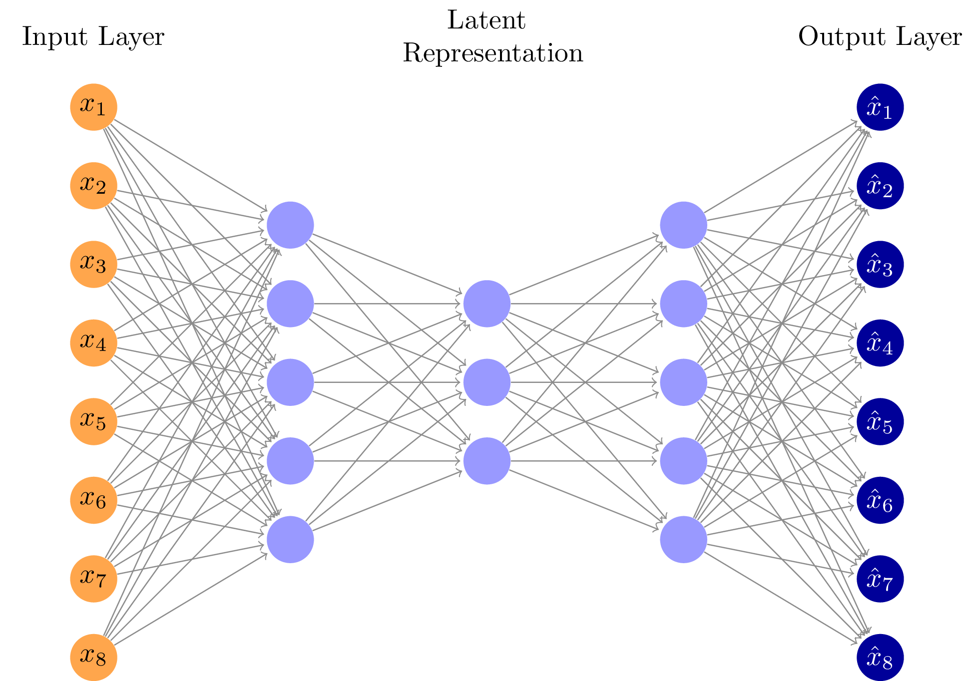
Model used
Auto encoder model which is used for balancing imbalanced data

Slide 13
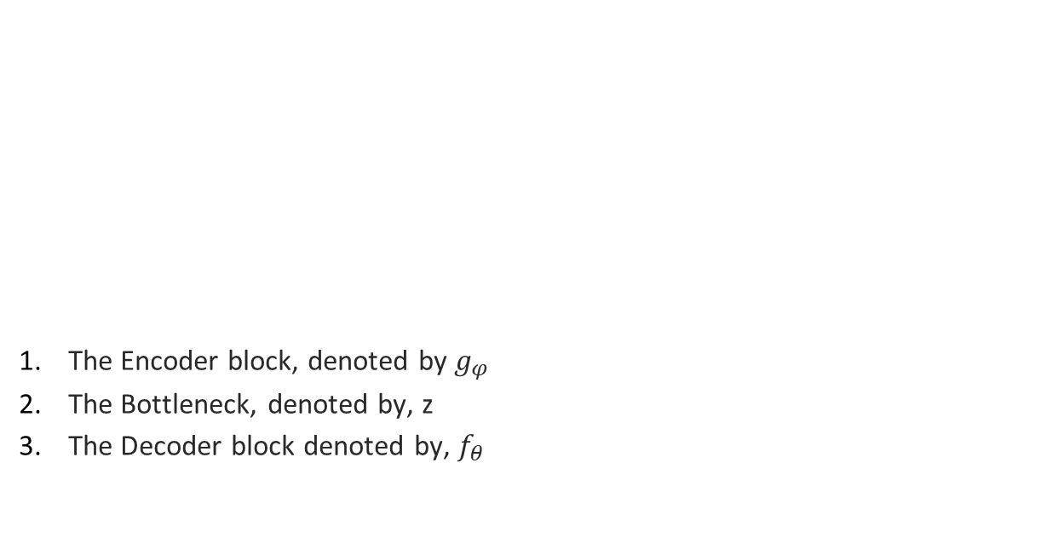
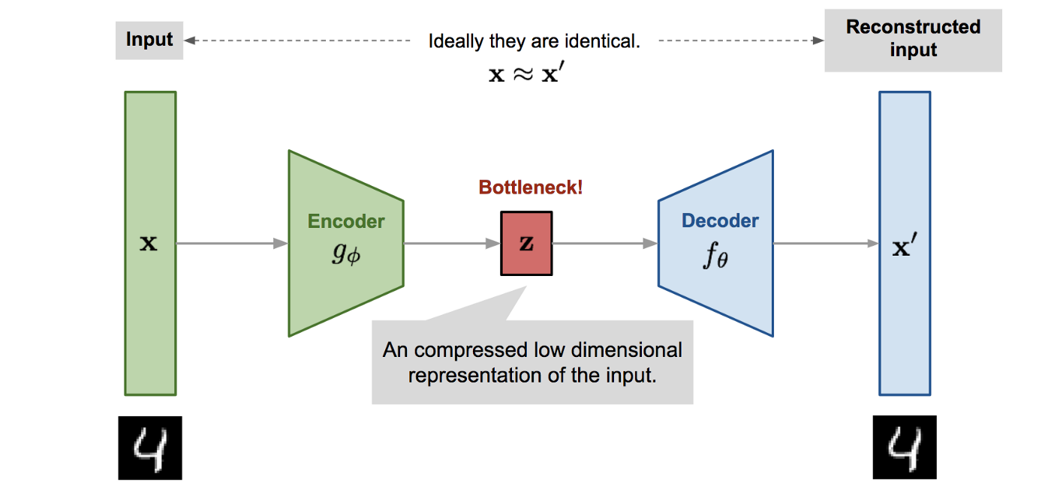
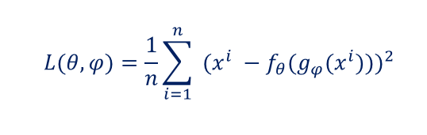
Models used - Autoencoder
Autoencoder loss function:

Slide 14
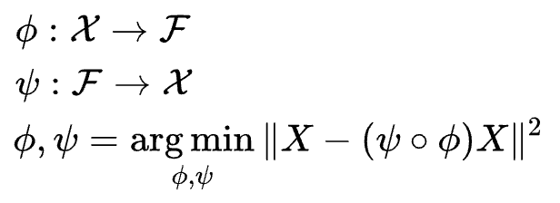


Models used - Autoencoder
X is the original data
F is the latent space at the bottle neck of the output
𝞼 is the activation function of the neural networks
W is the weight and b is the bias
L(x, x’) is this loss function that we will use to train the neural network through the standard backpropagation procedure.

Slide 15
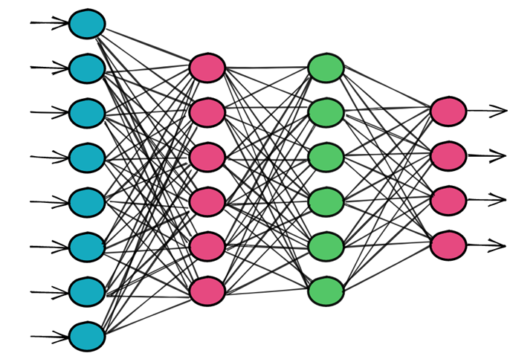

Models Used - ANN
Fully connected ANN is used
Weight is attached to all the input nodes
Input value and weight are multiplied
Weighted sum is calculated at hidden layers
Weighted sum is given to the activation function
Based on the values obtained from the activation function, input is given to the next layer
Finally, the output layer has the number of nodes = number of target classes
Based on the values obtained at the output layer, classification is done based on different probabilities (thresholds)
Value calculator by hidden layer =
Output of hidden layer = activation(
)

Slide 16
Model description
Model: "model"
_________________________________________________________________
Layer (type) Output Shape Param #
=================================================================
Input (Input Layer) [(None, 30)] 0
Encoding (Dense) (None, 100) 3100
Latent (Dense) (None, 50) 5050
Decoding (Dense) (None, 100) 5100
Output (Dense) (None, 30) 3030
=================================================================
Total params: 16,280
Trainable params: 16,280
Non-trainable params: 0

Slide 17
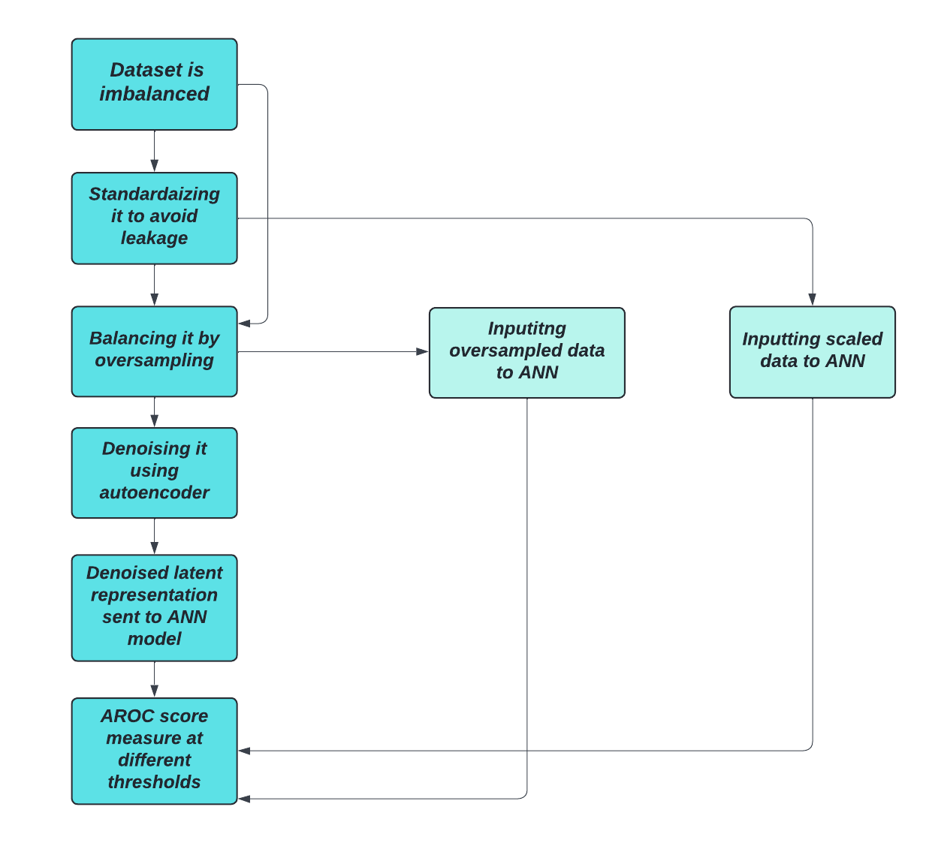
Methodology

Slide 18
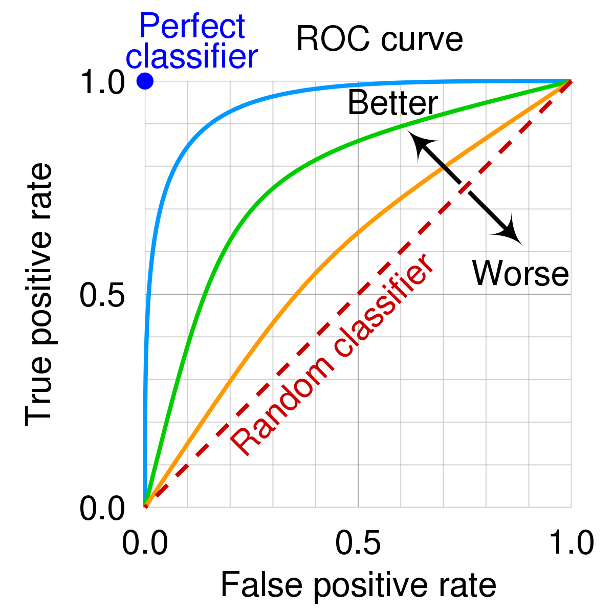
Evaluation Metrics
The project uses the AROC metric over accuracy, as it deals with the classification problem (classification of fraud and non-fraud cases)
An ROC curve (receiver operating characteristic curve) is a graph showing the performance of a classification model at all classification thresholds. This curve plots two parameters:
True Positive Rate (TPR=TP/(TP+FN))
False Positive Rate (FPR=FP/(FP+TN))
AROC is the area beneath the ROC curve. It is a single estimate report of completion.
Accuracy v/s AROC
Accuracy: It estimates how many observations, both positive and negative, were accurately classified. It is typically used for training algorithms. You shouldn’t use Precision on imbalanced difficulties. Then, it is obvious to get an extraordinary accuracy score by solely transcribing all comments as the majority class.
ROC/ AROC: When it proceeds to a classification problem, we can calculate an AROC. A ROC curve (receiver operating characteristic curve) is a plot of achievement of a classification model at each classification threshold. It is one of the numerous fundamental evaluation metrics for monitoring any classification model’s achievement.

Slide 19
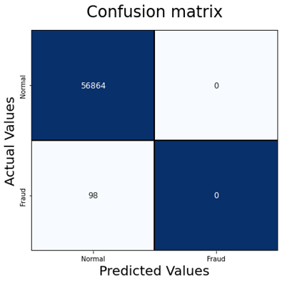

Results and Analysis
Confusion matrices when the dataset is oversampled and given to ANN model:
Classified 0 out of 98 fraud cases correctly
Misclassified 0 out of 56864 normal cases
AROC score: 0.5
Threshold = 0.1
Classified 0 out of 98 fraud cases correctly
Misclassified 0 out of 56864 normal cases
AROC score: 0.5
Threshold = 0.9

Slide 20

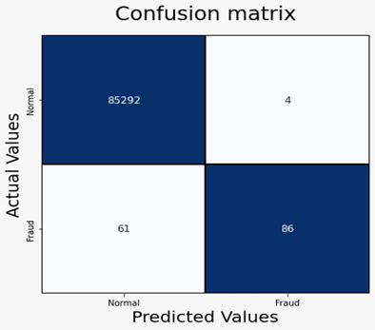
Results and Analysis
Confusion matrices when the dataset is standardized and given to ANN model:
Classified 120 out of 147 fraud cases correctly
Misclassified 27 out of 85296 normal cases
AROC score: 0.9080
Threshold = 0.1
Classified 86 out of 98 fraud cases correctly
Misclassified 4 out of 56864 normal cases
AROC score: 0.7924
Threshold = 0.9

Slide 21
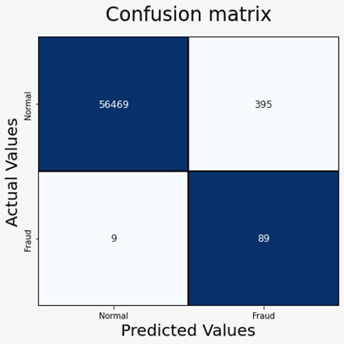

Results and Analysis
Confusion matrices when the dataset is outputted by the autoencoder
Classified 89 out of 98 fraud cases correctly
Misclassified 395 out of 56864 normal cases
AROC score: 0.9506
Threshold = 0.1
Classified 86 out of 98 fraud cases correctly
Misclassified 47 out of 56864 normal cases
AROC score: 0.9383
Threshold = 0.9

Slide 22
Tabular Information
 | AROC score
Threshold | ANN applied on autoencoder | ANN on scaled data | ANN on oversampled data
0.1 | 0.9506 | 0.908 | 0.5
0.2 | 0.9516 | 0.9046 | 0.5
0.3 | 0.9471 | 0.9012 | 0.5
0.4 | 0.9474 | 0.8978 | 0.5
0.5 | 0.9425 | 0.8944 | 0.5
0.6 | 0.9428 | 0.874 | 0.5
0.7 | 0.9429 | 0.8502 | 0.5
0.8 | 0.9432 | 0.8366 | 0.5
0.9 | 0.9383 | 0.7924 | 0.5

Slide 23
THANK YOU

