Slide 1

Project Title –Seasonal Agriculture Performance Analysis
Student Name:-Savitri Indi
College Name- KLE Technological University
AICTE STU ID : STU6a69d2d55ea871785320149

Slide 2

PROBLEM STATEMENT
Agricultural activities are influenced by seasonal variations in environmental conditions, farming practices, resource availability, and market conditions. As a result, agricultural performance can vary from one season to another.
The available agricultural data contains useful information, but the seasonal patterns and relationships are not easily understood from raw data.
The main problem is to analyze agricultural data and identify meaningful seasonal patterns, trends, relationships, and variations in agricultural performance.

Slide 3
Project Description
The Seasonal Agriculture Performance Analysis project focuses on analyzing agricultural data to understand how agricultural performance changes across different seasons.
The project involves:
Collecting and loading the agricultural dataset.
Cleaning and preparing the data for analysis.
Performing exploratory data analysis.
Comparing agricultural performance across seasons.
Identifying important patterns and trends.
Studying relationships between different agricultural factors.
Creating visualizations to present the findings clearly.
Using data-driven insights to understand seasonal agricultural performance

Slide 4

WHO ARE THE END USERS?
Farmers – to understand seasonal agricultural performance and make better farming decisions.
Agricultural Researchers – to study seasonal trends and relationships in agricultural data.
Agricultural Officers – to support planning and decision-making.
Government and Policy Makers – to understand agricultural patterns for better policies.
Agribusiness Organizations – to analyze seasonal performance and support business planning.
Students and Data Analysts – to study and visualize agricultural data.

Slide 5

Technology Used
Programming Language
Python
Libraries
Pandas – Data loading, cleaning, grouping, aggregation, and analysis
NumPy – Numerical operations and calculations
Matplotlib – Creating bar charts and other visualizations
Seaborn – Scatter plots, box plots, and heatmaps
Development Environment
Jupyter Notebook / Google Colab
Dataset
Seasonal Agriculture Performance Dataset
Visualization Techniques Used
Bar Charts – Compare yield, profit, rainfall, water usage, etc. across seasons
Scatter Plots – Analyze relationships such as rainfall vs. yield and temperature vs. yield
Box Plots – Analyze the distribution of water usage across seasons
Heatmap – Analyze correlations between agricultural variables

Slide 6
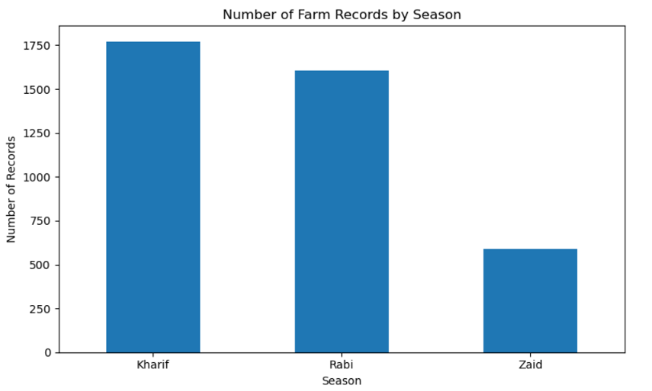
RESULTS

Slide 7
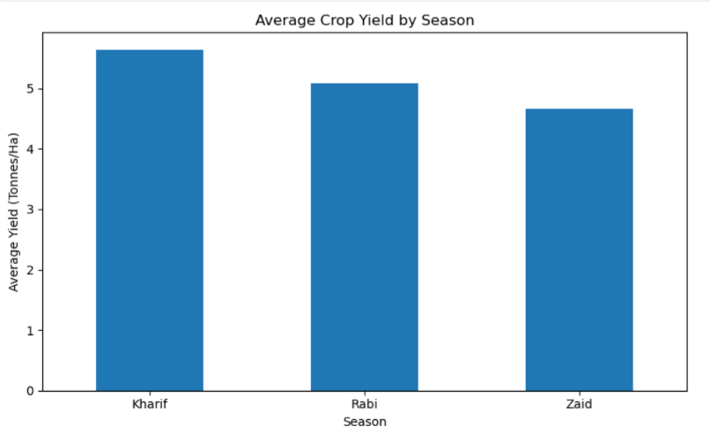
RESULTS

Slide 8
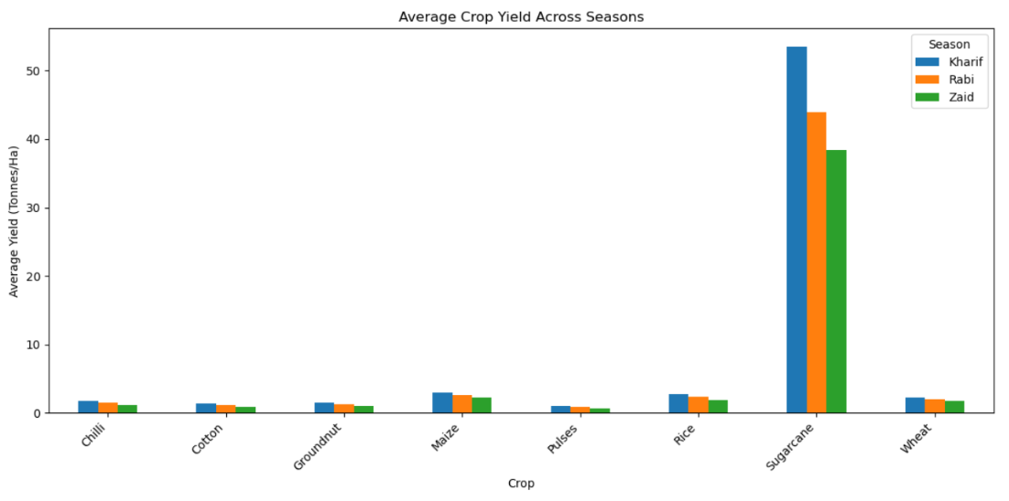
RESULTS

Slide 9
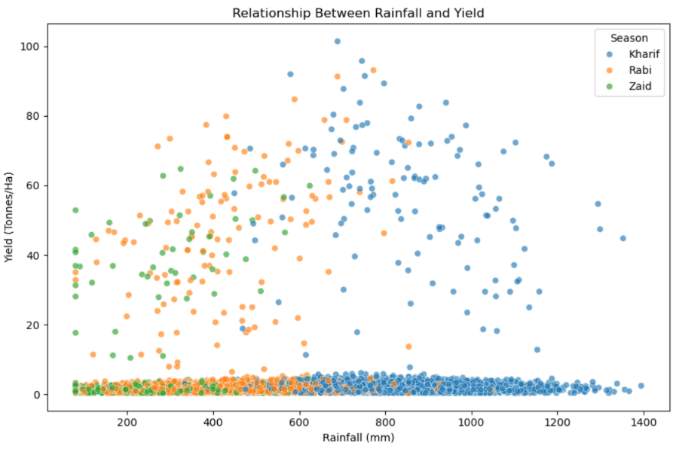
RESULTS

Slide 10
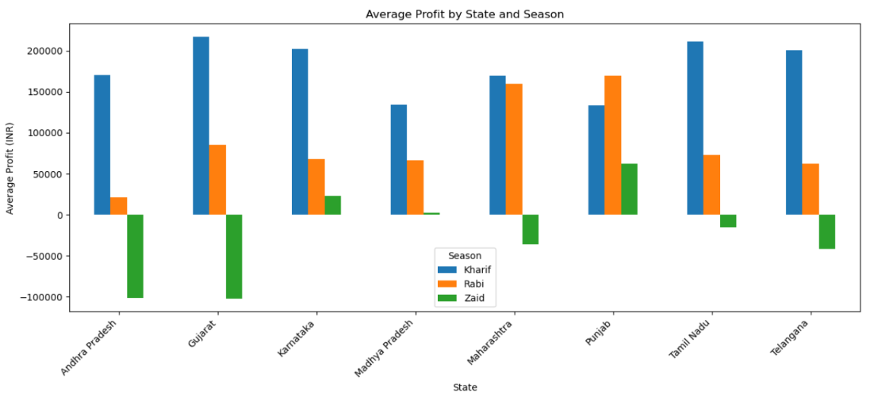
RESULTS

Slide 11
Future scope
Develop an interactive agricultural dashboard
Add real-time weather information
Include real-time market prices
Develop crop recommendation features
Predict crop yield using Machine Learning
Predict seasonal profitability
Add more geographical regions and historical data
Develop early-warning systems for disease and pest risk
Provide personalized recommendations for farmers

Slide 12
GitHub Link

Slide 13
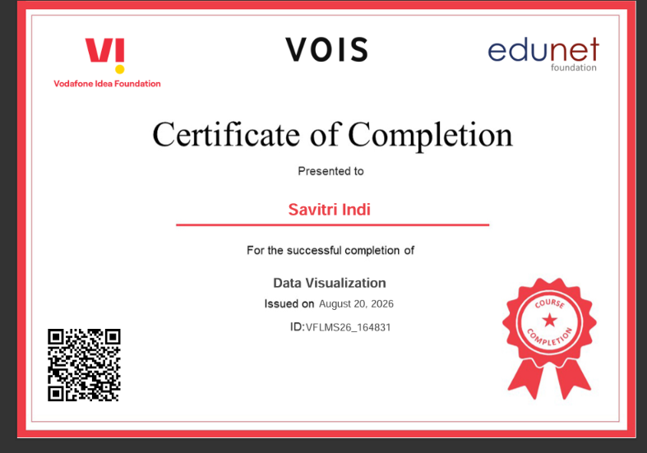
VOIS Course completion certificate -
Course name- Data Visualization

Slide 14
Thank you
.
.

