Slide 1
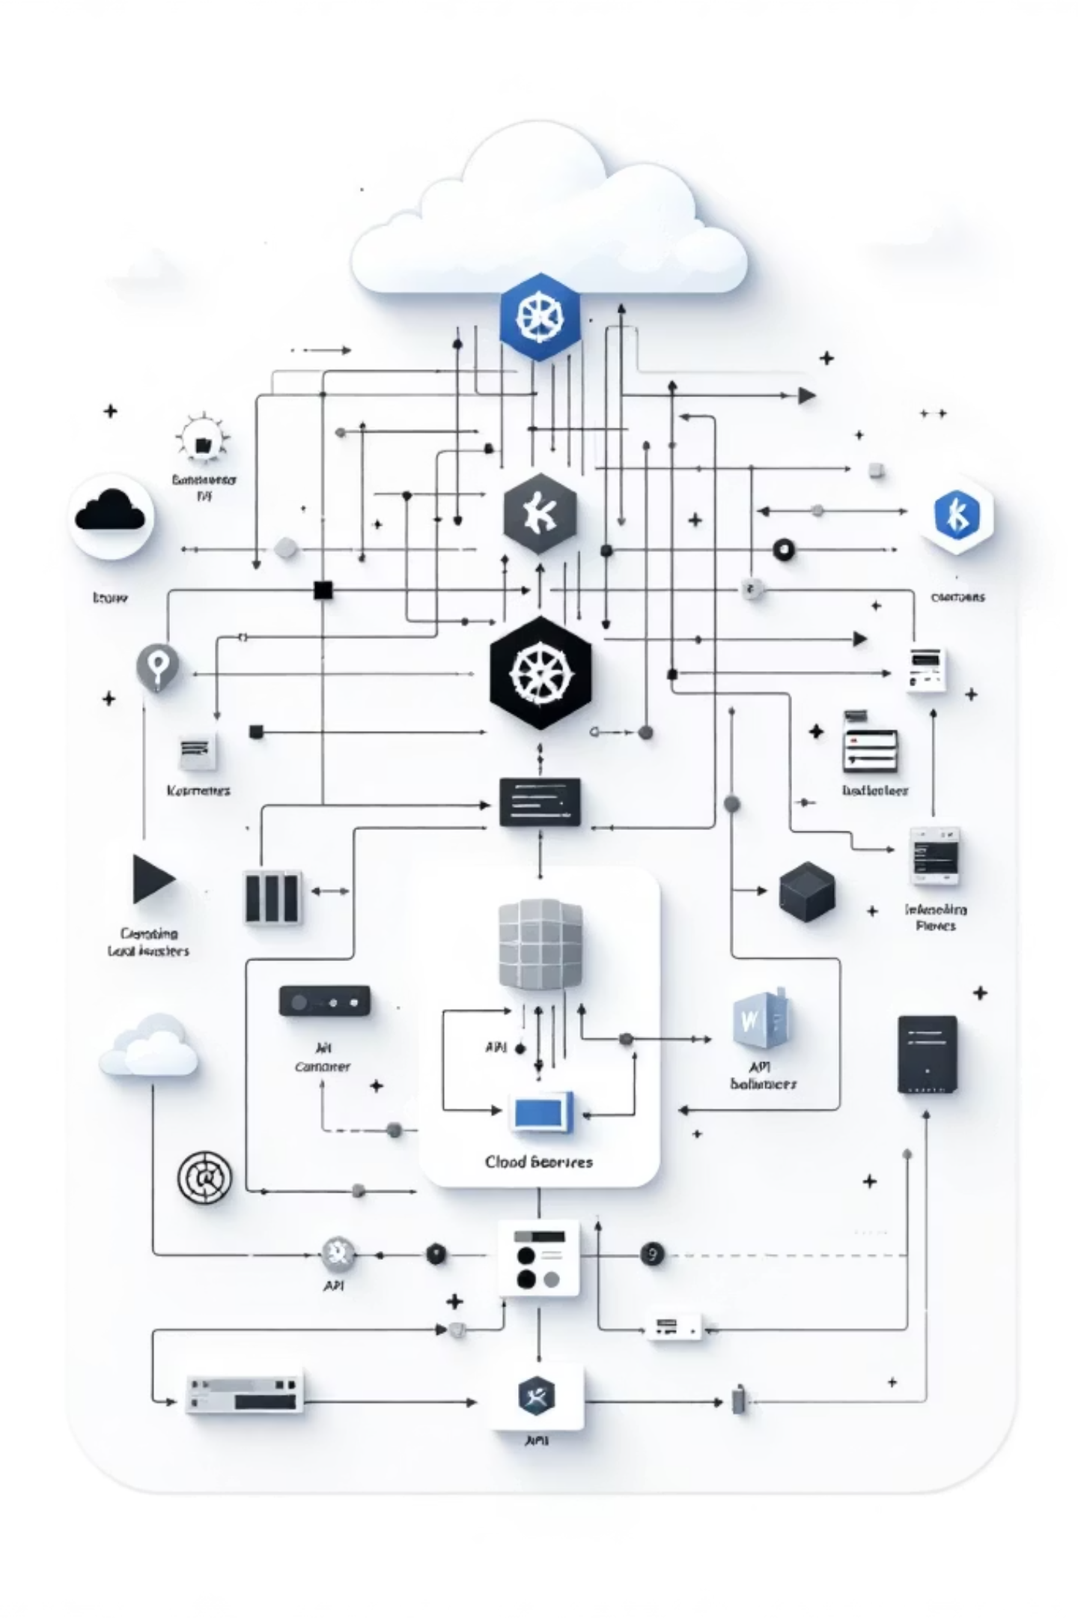
Kubernetes Gateway API and K-Gateway
Understanding API Gateway Concepts: From Gateway API to Production-Ready Solutions

Slide 2
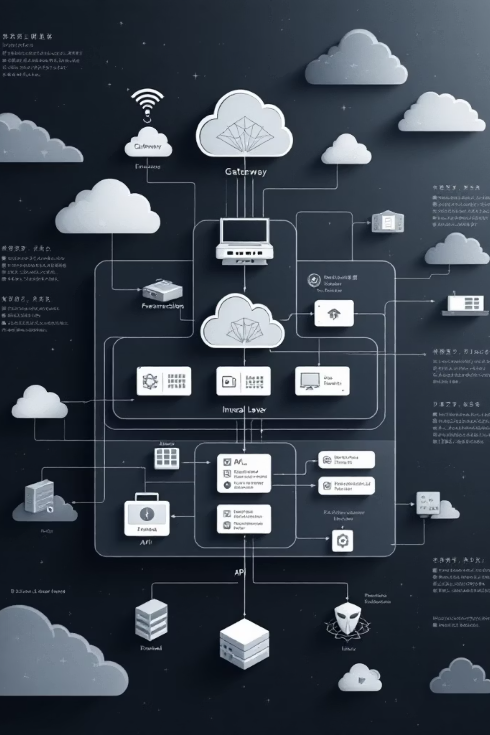
What is Gateway API?
The Problem with Ingress
The Gateway API Solution
Ingress combines everything—entry points, routing rules, and controller configuration—into a single monolithic resource. This creates tight coupling and limits flexibility.
Gateway API introduces a separation of concerns by splitting responsibilities into distinct, composable resources. Each component has a clear purpose and can be managed independently.

Slide 3




Core Idea: Separation of Concerns
Gateway
HTTPRoute
GatewayClass
Entry point configuration: ports, protocols, TLS settings
Routing logic: path matching, header conditions, backend selection
Controller binding: specifies which controller manages the gateway
Key Difference: Ingress combines all these concerns into a single resource. Gateway API separates them, enabling role-based access control and independent evolution.

Slide 4




Component Mapping: Ingress vs Gateway API
GatewayClass
Gateway
Ingress Equivalent: IngressClass
Ingress Equivalent: Ingress (entry point)
Defines which controller implementation manages the gateway resources
Configures listening ports, protocols, and TLS certificates
HTTPRoute
Controller
Ingress Equivalent: Ingress rules
Ingress Equivalent: Same concept
Contains path-based routing, header matching, and backend references
Implementation (Envoy, NGINX, HAProxy) that watches resources and configures load balancers

Slide 5
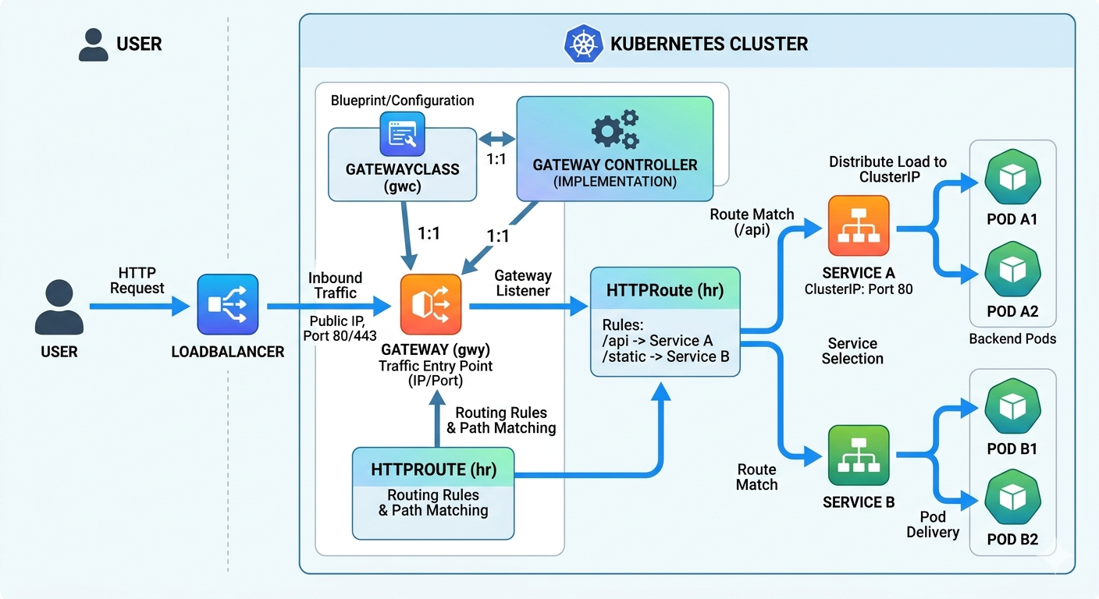

Slide 6
Request Flow Comparison
Ingress Flow
Gateway API Flow
01
01
User Request
User Request
02
02
Ingress Controller
Gateway
03
03
Service
HTTPRoute
04
04
Pod
Service → Pod
Gateway API's modular flow enables fine-grained control at each stage. HTTPRoute can be updated independently without touching Gateway configuration.

Slide 7
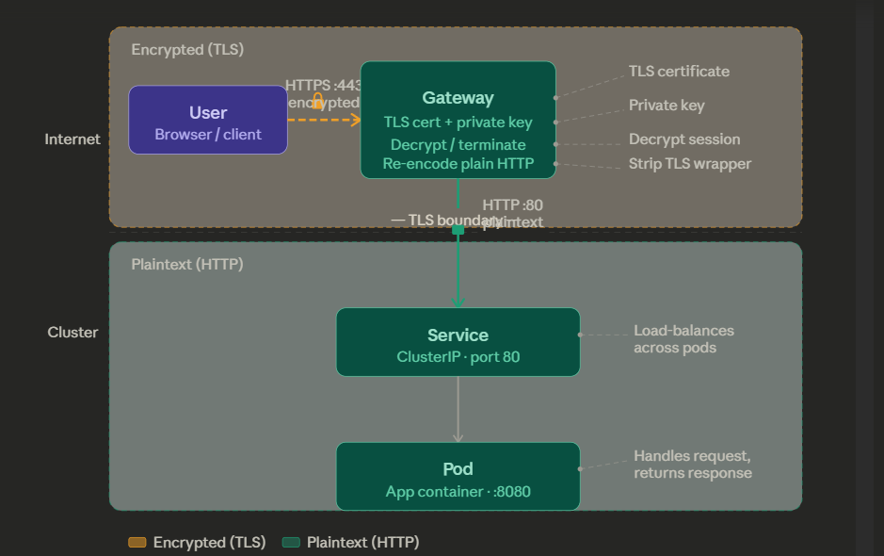
TLS TERMINATION IN GATEWAY API

Slide 8
YAML Examples
GatewayClass
Gateway
HTTPRoute
apiVersion: gateway.networking.k8s.io/v1
kind: GatewayClass
metadata:
name: envoy
spec:
controllerName: gateway.envoyproxy.io/gatewayclass-controller
apiVersion: gateway.networking.k8s.io/v1
kind: Gateway
metadata:
name: my-gateway
spec:
gatewayClassName: envoy
listeners:
- protocol: HTTP
port: 80
apiVersion: gateway.networking.k8s.io/v1
kind: HTTPRoute
metadata:
name: my-route
spec:
parentRefs:
- name: my-gateway
rules:
- matches:
- path:
type: PathPrefix
value: /
backendRefs:
- name: frontend
port: 80
Similar to ingressClassName field in Ingress
Defines entry point, like Ingress host rules
Contains routing rules from Ingress spec

Slide 9
Gateway API vs Ingress
Aspect
Ingress
Gateway API
Structure
Monolithic resource
Modular components
Routing
Limited path/host matching
Advanced: headers, methods, query params
Role Separation
None - all in one
Clear: GatewayClass, Gateway, Route
Standardization
Controller-dependent annotations
Standardized API with vendor extensions
Extensibility
Annotations (non-standard)
Structured filters and extensions

Slide 10


Introduction to K-Gateway (API Gateway)
What is an API Gateway?
Popular Implementations
A specialized server that sits between clients and microservices, providing unified entry point with advanced features like authentication, rate limiting, and request transformation.
Kong: Extensible, plugin-based
Envoy: High-performance proxy
NGINX Plus: Enterprise features
Key Distinction: Gateway API is a standard. K-Gateway (like Kong) is a tool implementation that can use Gateway API resources.

Slide 11



Advanced API Gateway Features
JWT Authentication
Rate Limiting
Request Filters
Validate JSON Web Tokens before forwarding requests. Extract user identity and permissions from token claims for authorization.
Control request rates per client or endpoint. Prevent abuse and ensure fair resource allocation across services.
Modify headers, rewrite URLs, redirect requests. Transform requests/responses without changing service code.
01
02
03
User Request
Gateway → Auth Filter
Rate Limit Check
04
05
Request Modification
Service → Pod

Slide 12
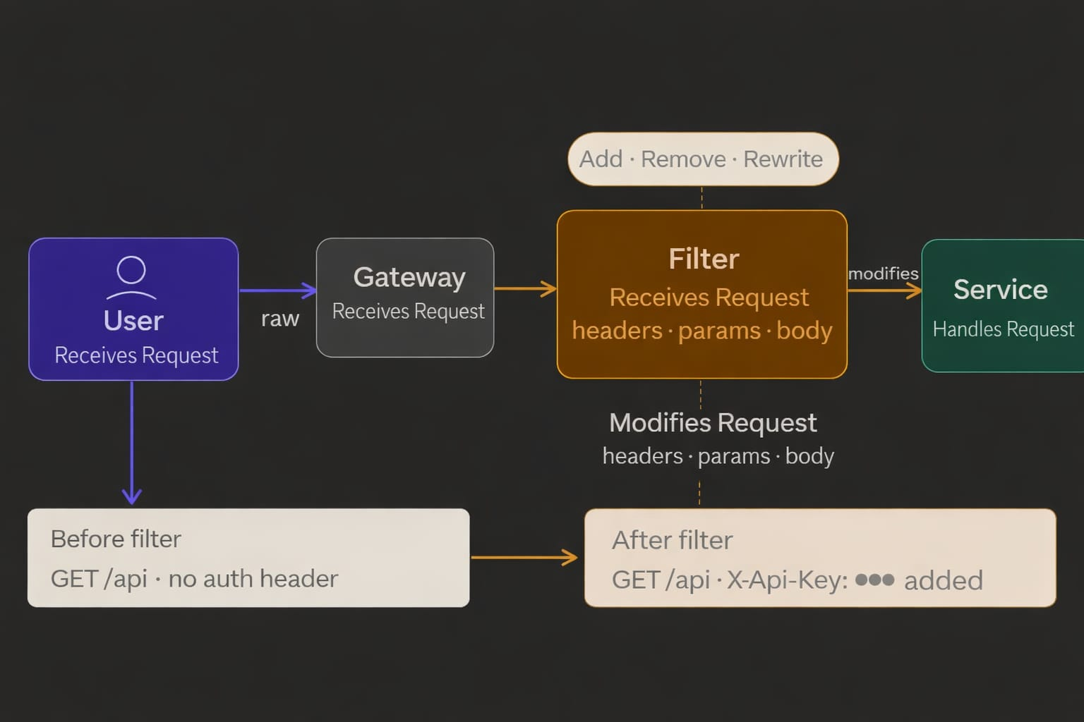
REQUEST FILTER

Slide 13
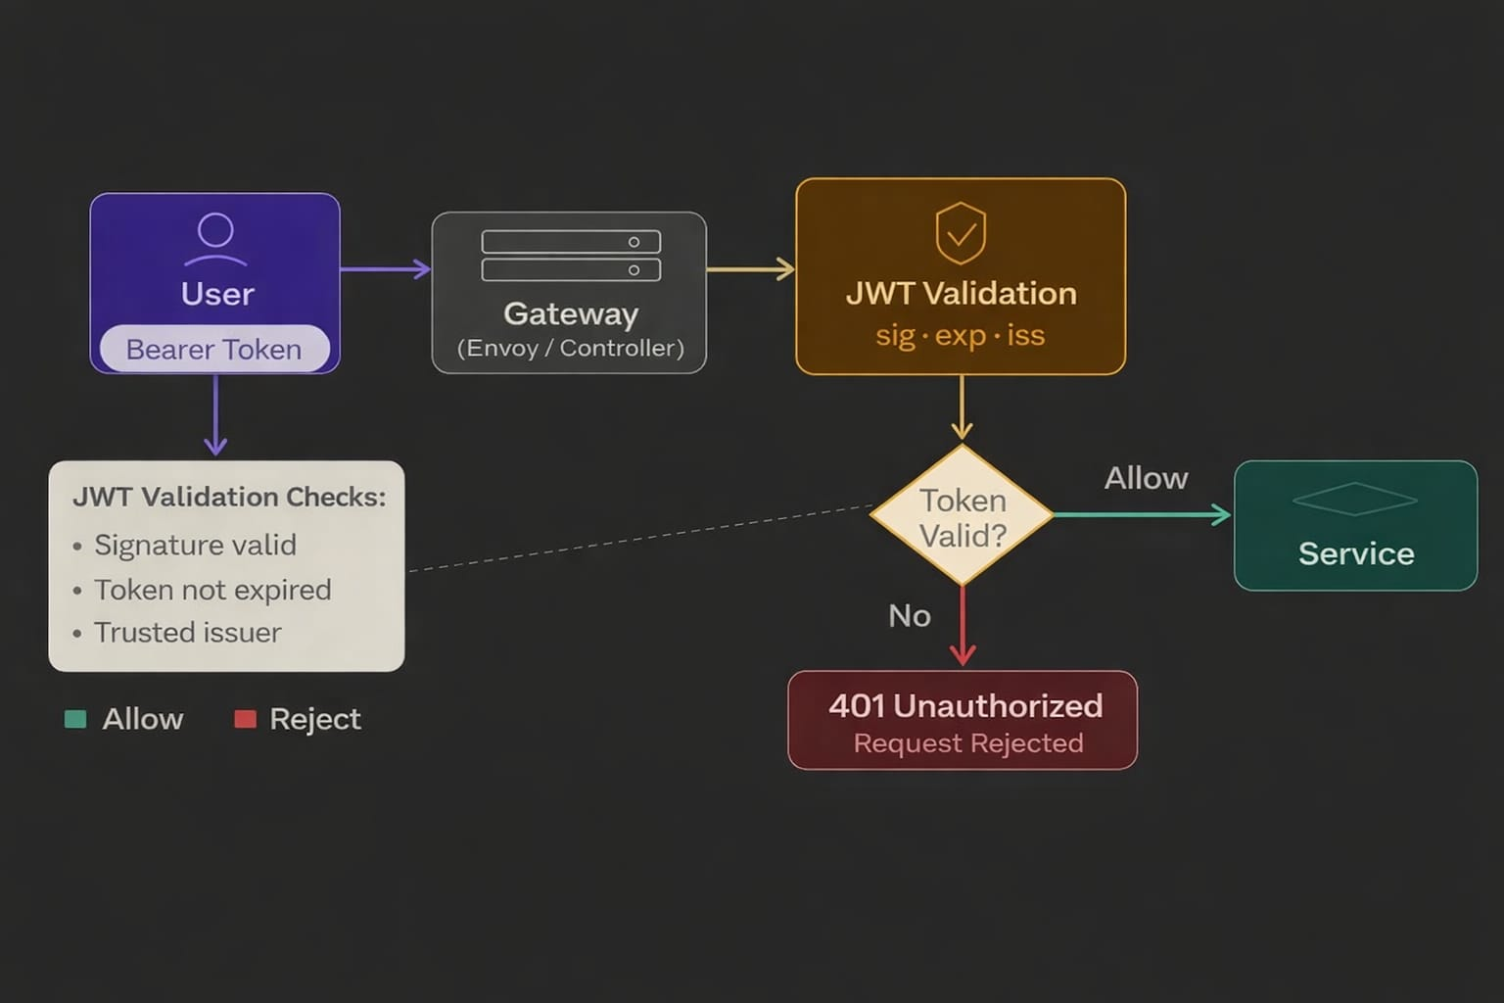
JWT

Slide 14
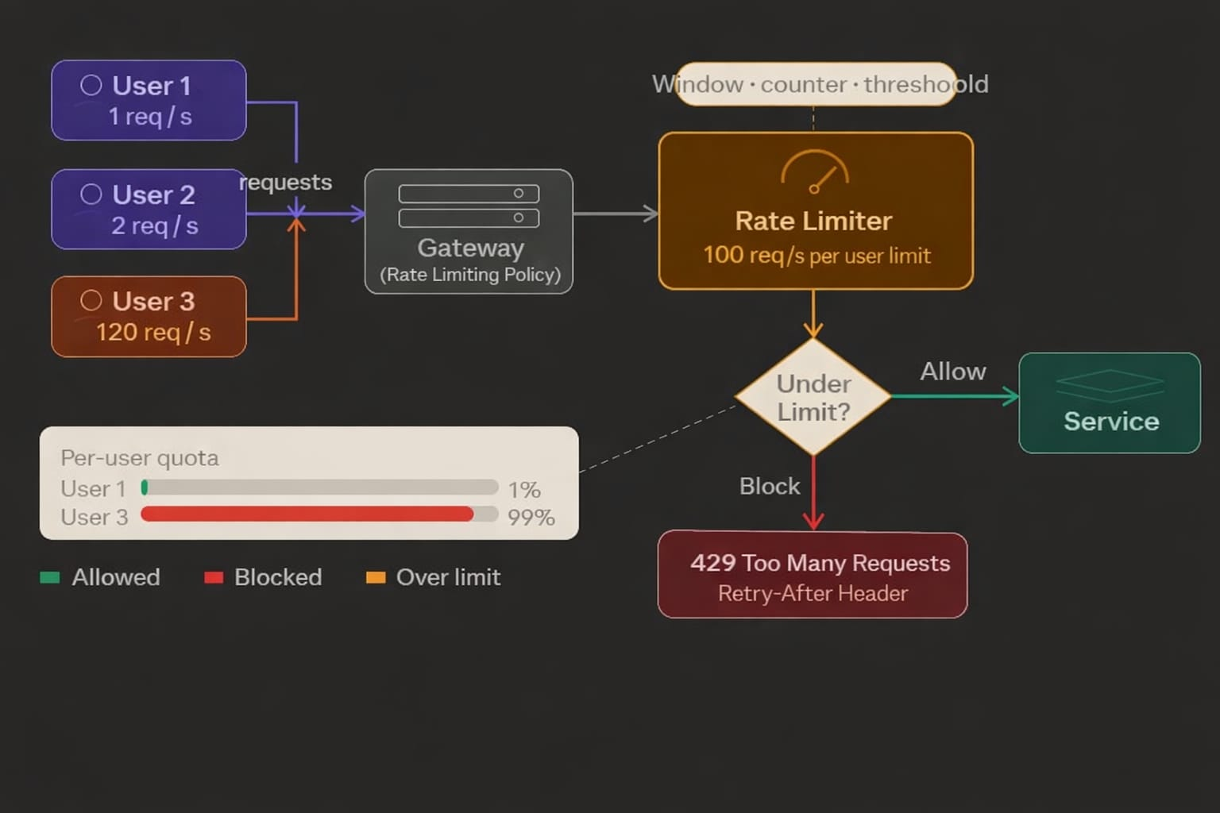
RATE LIMITER

Slide 15

Key Takeaways
Gateway API Separates Concerns
GatewayClass, Gateway, and HTTPRoute are distinct resources, enabling role-based access and independent evolution
Ingress is Simpler but Limited
Monolithic resources work for basic use cases but lack advanced routing and extensibility
API Gateway Adds Production Features
JWT auth, rate limiting, and filters transform Gateway API from routing to full API management
Together They Scale
Gateway API provides standard routing. API Gateway implementations like Kong add enterprise features for production systems

