Slide 1

TECHNICAL REFERENCE
Docker Volumes
A Comprehensive Technical Guide
Complete reference for commands, flags, options, and practical examples for persistent storage in containerized environments
~Chriss

Slide 2
Table of Contents
Comprehensive coverage of Docker volume management
1
Introduction to Docker Volumes
2
Volume Types and Use Cases
Understanding persistent storage in containerized environments
Named volumes, anonymous volumes, bind mounts, and tmpfs mounts
3
Volume Management Commands
4
Mounting Volumes in Containers
Complete CLI reference for creating, inspecting, and managing volumes
Using -v and --mount flags with comprehensive examples
5
Docker Compose Volume Configuration
6
Volume Drivers and Plugins
Declarative volume management in multi-container applications
Extending Docker storage with third-party drivers
7
Backup, Restore, and Migration
8
Best Practices and Cleanup
Data protection strategies for containerized applications
Operational guidelines for volume management

Slide 3
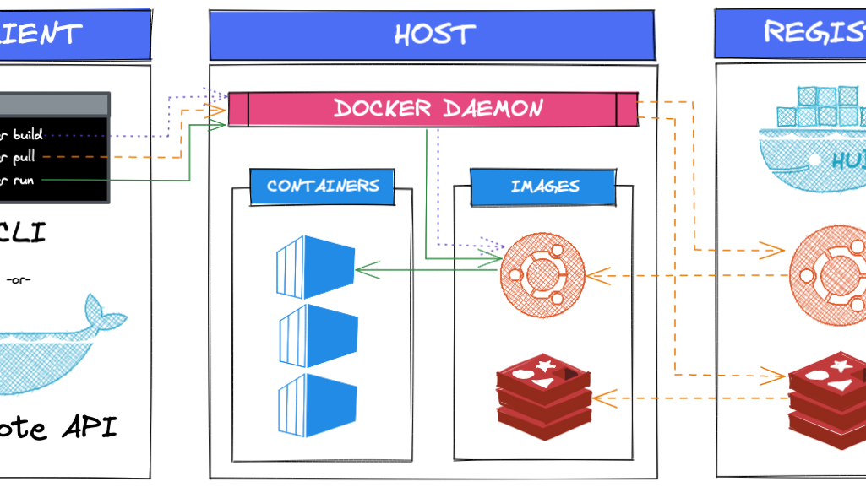
1
Introduction to
Docker Volumes
Understanding persistent storage in containerized environments

Slide 4
1.1
What Are Docker Volumes?
Definition
Three Main Storage Options
Docker volumes are the preferred mechanism for persisting data generated by and used by Docker containers. They are completely managed by Docker and stored in /var/lib/docker/volumes/ on the host filesystem.
1
Volumes
Docker-managed, stored in /var/lib/docker/volumes/
2
Bind Mounts
Key Advantages
Direct host filesystem mapping, any location
Easier to back up and migrate than bind mounts
Shareable between multiple containers
3
tmpfs Mounts
Volume drivers allow storage on remote hosts or cloud
RAM-based, ephemeral, never written to disk
Managed by Docker CLI and API
Best Practice: Use volumes for production databases and persistent data. Bind mounts are better for development and configuration files.

Slide 5
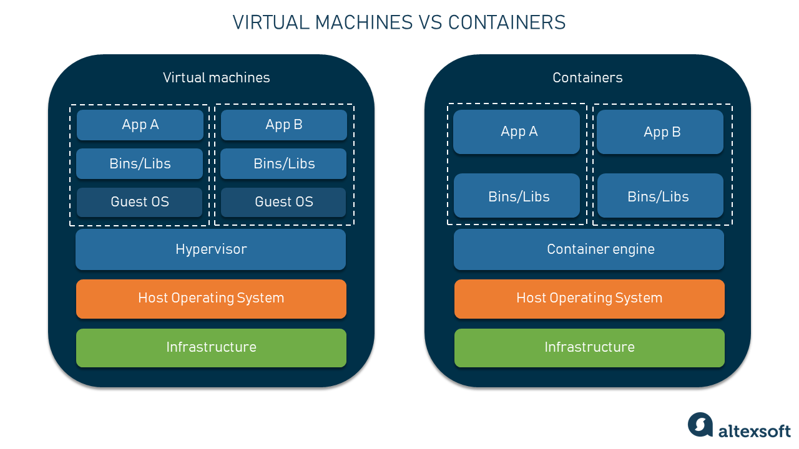
2
Volume Types
and Use Cases
Named volumes, anonymous volumes, bind mounts, and tmpfs mounts

Slide 6
2.1
Volume Types Comparison
Volume Type | Persistence | Host Access | Performance | Use Cases
Named Volumes | Persistent | Managed by Docker | High (native FS) | Databases, persistent data, production workloads
Anonymous Volumes | Persistent | Auto-generated names | High (native FS) | Temporary data, cache, avoid in production
Bind Mounts | Persistent | Direct host path | High (native FS) | Development, config files, source code
tmpfs Mounts | Ephemeral | RAM only | Very High (RAM) | Sensitive data, session cache, temporary files
Named Volumes (Recommended)
Bind Mounts (Development)
docker run -v mydata:/app/data nginx
docker run -v /host/path:/container/path nginx
Docker-managed, easy to identify, share between containers, backup-friendly.
Direct filesystem mapping, host-dependent paths, good for live code editing.

Slide 7
2.1
Anonymous Volumes
Commands | Flags | Meaning | Examples | Use Cases
Docker run | -v <container-path> | Create anonymous volume | docker run -v /data nginx
Docker run | -v <container-path>:rw | Read-write access (default) | docker run -v /data:rw nginx
Docker run | -v <container-path>:ro | Read-only volume | docker run -v /data:ro nginx
Docker run | -v <container-path>:z | Shared SELinux label | docker run -v /data:z nginx
Docker run | -v <container-path>:Z | Private SELinux label | docker run -v /data:Z nginx
Docker run | -v <container-path>:nocopy | Prevent copying container data | docker run -v /data:nocopy nginx
Docker run | --mount type=volume,target=<path> | Create anonymous volume | docker run --mount type=volume,target=/data nginx
Docker run | readonly | Read-only mount | docker run --mount type=volume,target=/data,readonly nginx

Slide 8
2.1
Anonymous Volumes
Commands | Flags /Options | Meaning | Examples | Use Cases
Docker run | volume-nocopy | Disable copying container data | docker run --mount type=volume,target=/data,volume-nocopy nginx
Docker run | volume-driver | Specify driver | docker run --mount type=volume,target=/data,volume-driver=local nginx
Docker run | volume-label | Add metadata label | docker run --mount type=volume,target=/data,volume-label=env=dev nginx
Docker rm | -v | Remove container + attached volumes | docker rm -v mycontainer
Docker run | -f | Force remove container | docker rm -f mycontainer
docker volume ls | -q | Show only volume names | docker volume ls -q
docker volume ls | --filter | Filter volumes | docker volume ls --filter dangling=true
docker volume ls | --format | Format output | docker volume ls --format "{{.Name}}"
docker volume inspect | <volume-name> | Inspect specific volume | docker volume inspect abc123

Slide 9
2.1
Anonymous Volumes
Commands | Flags /Options | Meaning | Examples
docker volume rm | <volume> | Remove specific volume | docker volume rm abc123
docker volume rm | -f | Force remove | docker volume rm -f abc123
docker volume prune | none | Remove unused volumes | docker volume prune
docker volume prune | -f | Force without confirmation | docker volume prune -f

Slide 10
2.1
Named Volumes
Commands | Flags | Meaning | Examples
docker volume create | <volume-name> | Create named volume | docker volume create myvol
docker volume create | --driver | Specify volume driver | docker volume create --driver local myvol
docker volume create | --label | Add metadata label | docker volume create --label env=dev myvol
docker volume create | --opt | Driver-specific options | docker volume create --opt type=tmpfs myvol
Docker run | -v volume:container_path | Mount named volume | docker run -v myvol:/data nginx
Docker run | :ro | Read-only mount | docker run -v myvol:/data:ro nginx
Docker run | :rw | Read-write (default) | docker run -v myvol:/data:rw nginx
Docker run | :z | Shared SELinux label | docker run -v myvol:/data:z ngin
Docker run | :Z | Private SELinux label | docker run -v myvol:/data:Z nginx

Slide 11
2.1
Named Volumes
Commands | Flags | Meaning | Examples
Docker run | type=volume | Specify volume mount | docker run --mount type=volume,source=mydata,target=/app/data nginx
Docker run | source=<volume> | Volume name
Docker run | target=<path> | Container path
Docker run | readonly | Mount read-only | docker run --mount type=volume,source=mydata,target=/data,readonly nginx
Docker run | volume-nocopy | Disable data copy
Docker run | volume-driver | Specify driver
Docker run | volume-label | Attach labels
Docker run | :z | Shared SELinux label
Docker run | :Z | Private SELinux label

Slide 12
2.1
Named Volumes
Commands | Flags | Meaning | Examples
Docker volume ls | none | List volumes | docker volume ls
docker volume ls | -q | Only show names | docker volume ls -q
docker volume ls | --filter | Filter volumes | docker volume ls --filter dangling=true
docker volume ls | --format | Custom output format | docker volume ls --format "{{.Name}}"
docker volume inspect | <volume-name> | Inspect volume details | docker volume inspect mydata
docker volume inspect | --format | Format output | docker volume inspect --format '{{.Mountpoint}}' mydata
docker volume rm | <volume> | Remove named volume | docker volume rm mydata
docker volume rm | -f | Force remove
docker volume prune | none | Remove unused volumes | docker volume prune

Slide 13
Bind Mounts
2.1
Commands | Flags | Meaning | Examples
Docker run | -v host_path:container_path | Mount host directory | docker run -v /home/user/data:/app/data nginx
Docker run | :ro | Read-only mount | docker run -v /home/user/data:/app/data:ro nginx
Docker run | :rw | Read-write (default) | docker run -v /home/user/data:/app/data:rw nginx
Docker run | :z | Shared SELinux label | docker run -v /data:/app/data:z nginx
Docker run | :Z | Private SELinux label | docker run -v /data:/app/data:Z nginx
Docker run (with –mount) | type=bind | Specifies bind mount | docker run –mount type=bind,source=/home/ubuntu/data,target=/app/data nginx
Docker run | source=<host-path> | Host directory | docker run –mount type=bind,source=/home/ubuntu/data,target=/app/data nginx
Docker run | target=<container-path> | Container path | docker run –mount type=bind,source=/home/ubuntu/data,target=/app/data nginx
Docker run | readonly | Read-only mount | docker run –mount type=bind,source=/home/ubuntu/data,target=/app/data nginx

Slide 14
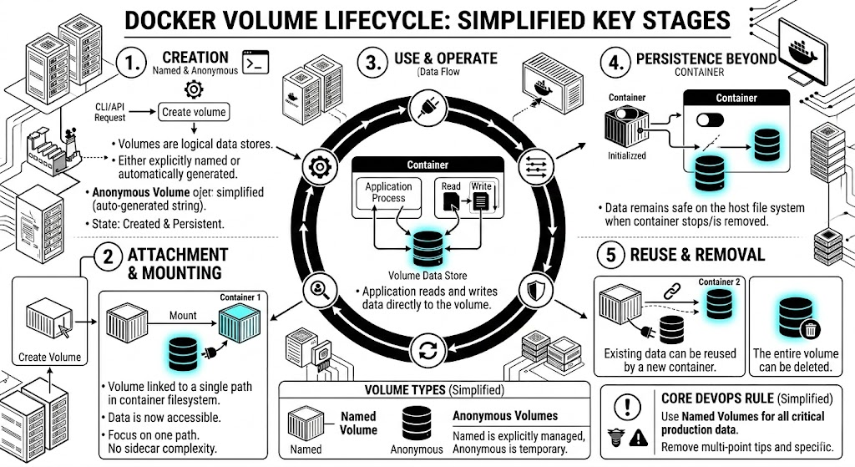

Slide 15

3
Volume Management
Commands
Complete CLI reference for creating, inspecting, and managing volumes

Slide 16
3.1
Core Volume Commands
1
docker volume create
3
docker volume inspect
docker volume create [OPTIONS] [VOLUME_NAME]
docker volume inspect [OPTIONS] VOLUME [VOLUME...]
-d, --driver — Volume driver (default: local)
-f, --format — Format output using Go template
--label — Set metadata labels
docker volume inspect -f '{{ .Mountpoint }}' myvolume
-o, --opt — Driver-specific options
docker volume create -d local -o type=nfs -o device=:/data mynfs
4
docker volume rm
docker volume ls
docker volume rm [OPTIONS] VOLUME [VOLUME...]
2
docker volume ls [OPTIONS]
-f, --force — Force removal of in-use volumes
docker volume rm -f myvolume oldvolume
-f, --filter — Filter by driver, label, name
--format — Custom output format
-q, --quiet — Only display volume names
5
docker volume prune
docker volume ls -f driver=local -f label=app=database
docker volume prune [OPTIONS]
--filter — Filter volumes to prune
-f, --force — Skip confirmation prompt
docker volume prune -f --filter label!=keep

Slide 17
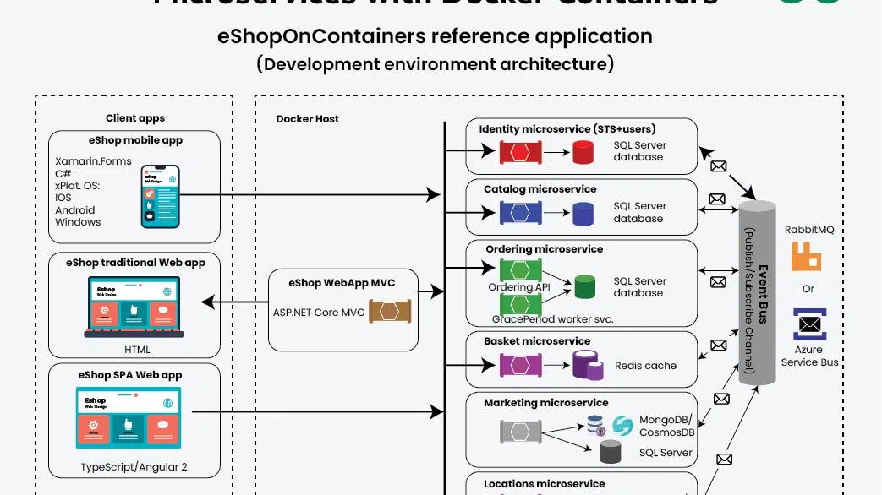
4
Mounting Volumes
in Containers
Using -v and --mount flags with comprehensive examples

Slide 18
4.1
-v/--volume vs --mount Syntax
-v/--volume Format
--mount Format
[volume-name|:][host-path:][container-path][:options]
type=volume|bind|tmpfs,source=,target=,readonly,...
Short form: -v or --volume
Explicit syntax: Key=value pairs
Order matters: All fields are positional
Order doesn't matter: More verbose but clearer
Options: ro, rw, volume-nocopy
Recommended: For production and scripts
Equivalent Commands Comparison
-v Syntax
--mount Syntax
docker run -v myvol:/data nginx
docker run --mount source=myvol,target=/data nginx
docker run -v /host/data:/data:ro nginx
docker run --mount type=bind,src=/host/data,target=/data,readonly nginx
docker run -v type=bind,src=/data,dst=/app nginx
docker run --mount type=bind,src=/data,target=/app nginx
Read-Only Mount
Multiple Volumes
tmpfs Mount
docker run -v data:/app:ro nginx
docker run -v v1:/data -v v2:/config nginx
docker run --mount type=tmpfs,target=/cache nginx
Prevents container from modifying data
Mount multiple volumes in one command
RAM-based storage, never persisted

Slide 19

5
Docker Compose
Volume Configuration
Declarative volume management in multi-container applications

Slide 20
5.1
Compose Volume Syntax and Options
Named Volumes in Compose
Volume Options Reference
volumes:
db_data:
driver: local
driver_opts:
type: nfs
o: addr=192.168.1.100,rw
device: ":/data/db"
services:
mysql:
image: mysql:8.0
volumes:
- db_data:/var/lib/mysql
driver — Volume driver (default: local)
driver_opts — Driver-specific options
external — Use pre-existing volume
labels — Metadata for organization
name — Custom volume name
External Volumes
volumes:
production_db:
external: true
name: "prod_postgres_data"
services:
app:
volumes:
- production_db:/var/lib/postgresql/data
Bind Mounts in Compose
services:
web:
image: nginx
volumes:
- ./html:/usr/share/nginx/html:ro
- ./nginx.conf:/etc/nginx/nginx.conf:ro
- /var/log/nginx:/var/log/nginx
Use volumes created outside Compose
Best Practice: Always define volumes in the top-level volumes: section for named volumes. Use bind mounts with relative paths for development and absolute paths for production configs.

Slide 21
6
Volume Drivers
and Plugins
Extending Docker storage with third-party drivers

Slide 22
6.1
Volume Drivers and Storage Plugins
Built-in local Driver Options
Plugin Management Commands
NFS Volume
docker plugin install vieux/sshfs
docker volume create -d local \ -o type=nfs \ -o o=addr=192.168.1.100,rw \ -o device=:/exports/data \ nfs_volume
docker plugin ls
CIFS/Samba Volume
docker plugin disable vieux/sshfs
docker volume create -d local \ -o type=cifs \ -o device=//server/share \ -o o=username=user,password=pass \ cifs_volume
docker plugin rm vieux/sshfs
Third-Party Plugins
SSHFS Plugin Example
SSHFS: Remote filesystem mounting
# Install plugin
docker plugin install vieux/sshfs
# Create SSHFS volume
docker volume create -d vieux/sshfs \
-o sshcmd=user@host:/remote/path \
-o password=secret \
ssh_volume
# Use in container
docker run -v ssh_volume:/data nginx
REX-Ray: AWS EBS, Azure Disk, GCE PD
GlusterFS: Distributed filesystem
Portworx: Enterprise cloud-native storage
Security Note: Volume plugins run with elevated privileges. Only install plugins from trusted sources and verify their authenticity before installation.

Slide 23
7
Backup, Restore,
and Migration
Data protection strategies for containerized applications

Slide 24
7.1
Volume Backup and Restore Procedures
Backup Workflow
Complete Backup Script
Step 1: Stop the container
#!/bin/bash
set -e
CONTAINER_NAME="${1:-myapp}"
BACKUP_DIR="${2:-./backups}"
TIMESTAMP=$(date +%Y%m%d_%H%M%S)
BACKUP_FILE="${BACKUP_DIR}/${CONTAINER_NAME}_${TIMESTAMP}.tar.gz"
mkdir -p "$BACKUP_DIR"
echo "Stopping container: $CONTAINER_NAME"
docker stop "$CONTAINER_NAME" >/dev/null
echo "Creating backup: $BACKUP_FILE"
docker run --rm \
--volumes-from "$CONTAINER_NAME" \
-v "$BACKUP_DIR":/backup \
alpine tar czf "/backup/$(basename "$BACKUP_FILE")" /data
echo "Starting container: $CONTAINER_NAME"
docker start "$CONTAINER_NAME" >/dev/null
echo "Backup completed: $BACKUP_FILE"
docker stop my_container
Step 2: Create backup container
docker run --rm \ --volumes-from my_container \ -v $(pwd):/backup \ alpine tar czf /backup/backup.tar.gz /data
Step 3: Restart container
docker start my_container
Restore Workflow
Migration Between Hosts
Step 1: Create new volume
# On source host
docker volume create myvolume
docker run --rm -v myvolume:/data \
alpine tar czf - /data | \
ssh user@dest-host \
'docker run --rm -i -v myvolume:/data alpine tar xzf - -C /'
docker volume create new_volume
Step 2: Extract backup
docker run --rm \ -v new_volume:/data \ -v $(pwd):/backup \ alpine tar xzf /backup/backup.tar.gz -C /
Step 3: Mount to container
docker run -v new_volume:/data nginx
Best Practices: Always backup before updates. Test restore procedures regularly. Document volume purposes with labels. Use consistent naming conventions. Automate backups with cron jobs.

Slide 25
8
Best Practices
and Cleanup
Operational guidelines for volume management

Slide 26
8.1
Volume Management Best Practices
Naming and Organization
Cleanup and Maintenance
• Use descriptive names: postgres_data_prod
• Regular cleanup: docker volume prune
• Include environment in name
• Remove unused volumes weekly
• Label volumes with metadata
• Avoid anonymous volumes in prod
• Separate data by lifecycle
• Archive old data before deletion
Security
Data Protection
• Use read-only mounts when possible
• Backup before updates
• Handle permissions with UID/GID
• Test restore procedures monthly
• Avoid bind mounts in production
• Use volume labels for backup policy
• Encrypt sensitive data volumes
• Keep multiple backup copies
Monitoring
Production Checklist
• Monitor usage: docker system df
✓ All volumes are named
• Set up alerts for disk space
✓ Labels document purpose
• Track volume growth over time
✓ Backup strategy in place
• Document volume purposes
✓ Monitoring configured
✓ Cleanup schedule established
Quick Reference Commands
List volumes
Inspect volume
Prune unused
Disk usage
docker volume ls
docker volume inspect
docker volume prune
docker system df

