Slide 1
Hiring Process Analytics
BY: SAVNESH DAKSH

Slide 2
Project Description
Hiring process is the fundamental and the most important function of a company.
Hiring Process Analytics involves the collection, analysis, and interpretation of data related to an organization's recruitment process.
The goal of this analysis is to improve the effectiveness and efficiency of the hiring process by identifying areas of improvement and evaluating the success of various recruitment strategies.
This can involve tracking metrics such as applicant-to-hire ratios, and candidate quality.
By using data to inform recruitment decisions, organizations can make more informed hiring decisions.

Slide 3
Approach A. Download all Data provided B. Understanding the data C. Checking for outliers D. Removing outliers E. Drawing Data Summary

Slide 4



Tech-Stack Used
I have used MS Excel to perform statistical analysis on this dataset because allows users to edit, organize, and analyze different types of information. It allows collaborations, and multiple users can edit and format files in real-time, and any changes made to the spreadsheet can be tracked by a revision history.
Google Drive
Power Point Presentation
MS Excel

Slide 5

Insights
All the questions asked can be answered through Excel. I used various functions available on Excel to get the solutions.
Solution
Task 1 : Determine the gender distribution of hires. How many males and females have been hired by the company?
Conclusion:

Slide 6

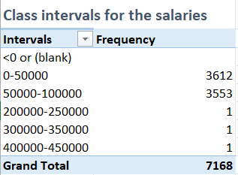
Task 2: What is the average salary offered by this company? Use Excel functions to calculate this. Conclusion:
Task 3: Create class intervals for the salaries in the company. This will help you understand the salary distribution.
Conclusion :

Slide 7
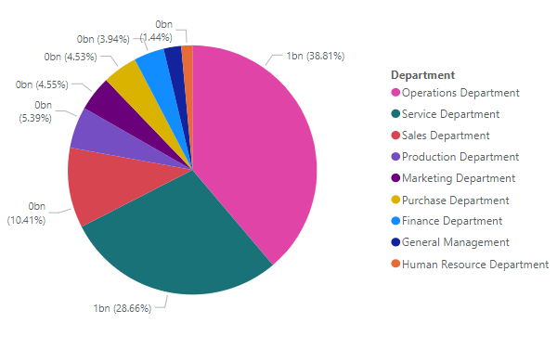
Task 4: Use a pie chart, bar graph, or any other suitable visualization to show the proportion of people working in different departments.
CONCLUSION :

Slide 8
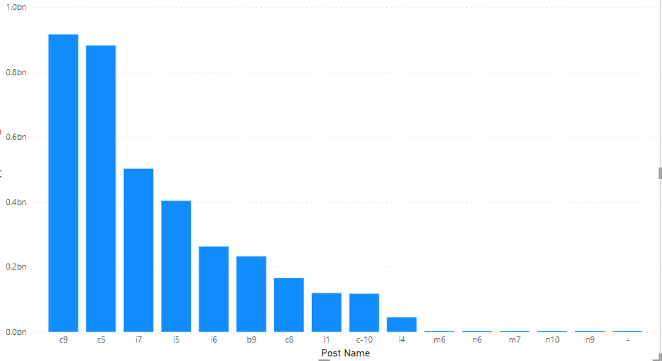
Task 5 : Use a chart or graph to represent the different position tiers within the company. This will help you understand the distribution of positions across different tiers.
Conclusion:

Slide 9
Thank You
Ms Excel Dataset Link :-https://docs.google.com/spreadsheets/d/1ONrZjlidwqzYvxI003zypnuIY7CnuUpU/edit?usp=drive_link&ouid=109044338237006780040&rtpof=true&sd=true

