Slide 1
NAM PCA results
10/21/19

Slide 2
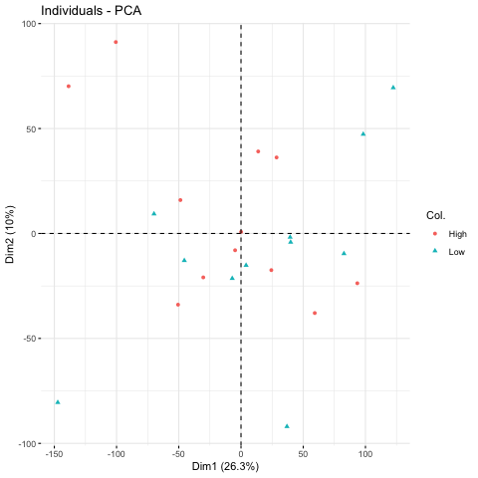
Analyses with NAM samples
PCA using RNA-seq data was recreated.
36.3% variation explained by PC1 and PC2. This is moderate, but not amazing.
This is the same results from the previous analysis.

Slide 3
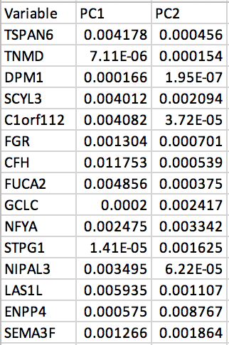
Top Contributors to the explained variation
To the right is a list of the top 15 variables contributing to the variation explained from PC1 and PC2. The value in the cells is the score of the measure of the contribution to that PC. The higher the value, the more the contribution to that component. Values are small due to the number of variables included in the analysis overall.
Conceptually, these 15 genes are those that separate the groups the most.

Slide 4
Base Coats Linear Regression
10/21/19

Slide 5
Method
When using a linear regression model there is a limit to the number of variables you can use.
Due to this, I limited the analysis to the top 23 (number of samples included) correlated genes from the correlation matrix file and the Base Coats variable which we are trying to predict.
A step wise model selection was used to obtain the final model. This means that at each step all variables were evaluated for significance of being included or excluded if no longer significant in the model.

Slide 6
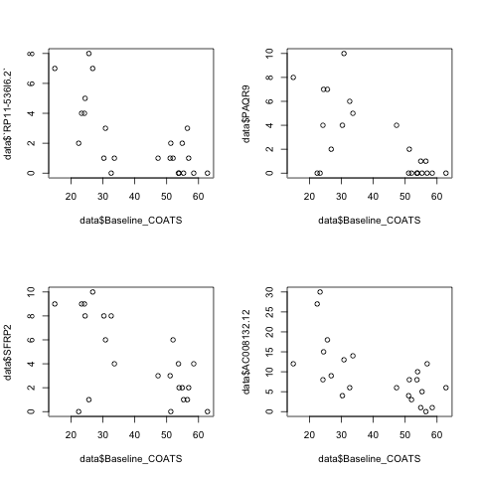
Diagnostics
These plots are a few examples of checking the variable for a linear relationship with Base Coats. As the method for choosing variables consisted of choosing those with a high correlation, this is exactly what I expected to see.

Slide 7
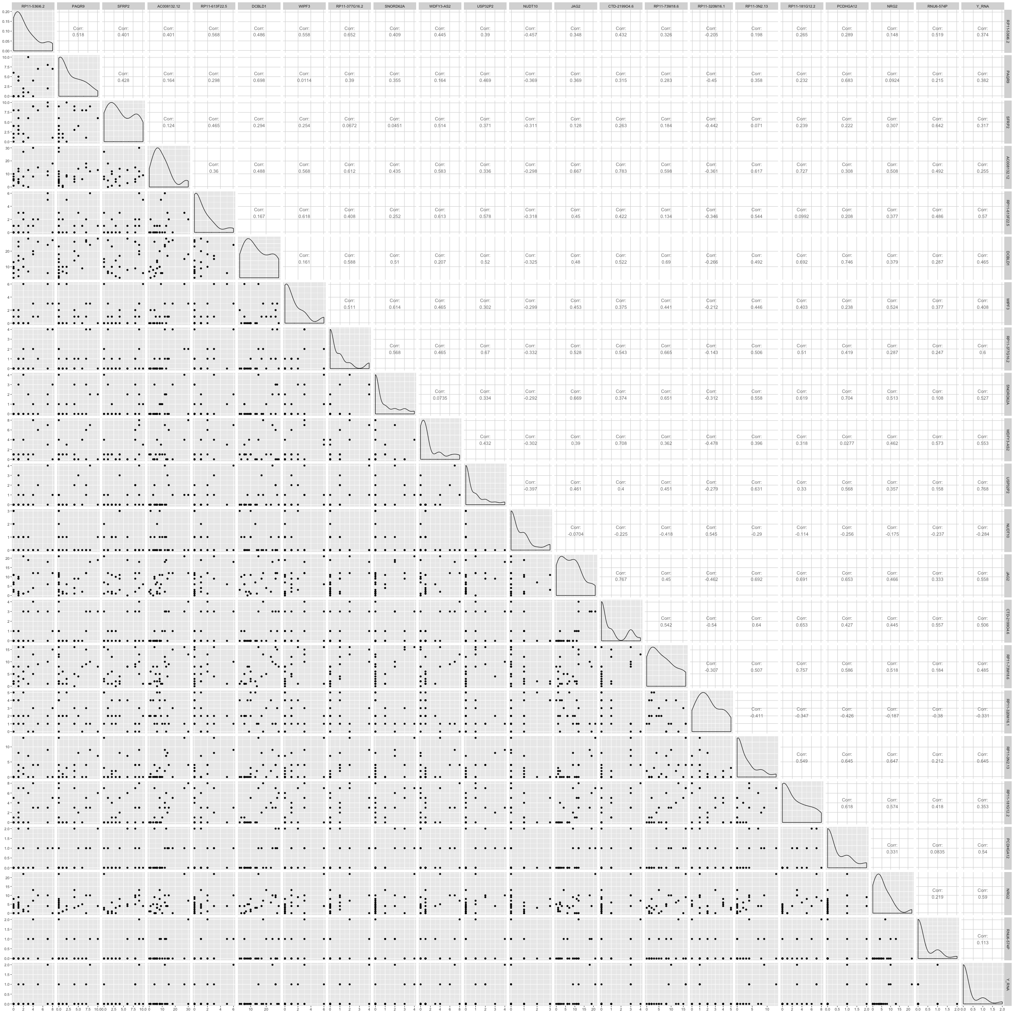
Diagnostics - Collinearity
This plot is of each pair of variables plotted. The goal of this figure is to make sure that we aren’t putting in variables that are measuring the same thing.
I was looking for graphs that showed a strong linear relationship between variables. As most of these are clouds of dots without a strong upward or downward trend, none were excluded.
This plot is difficult to read due to the number of variables included. If you would like the original plot let me know.

Slide 8
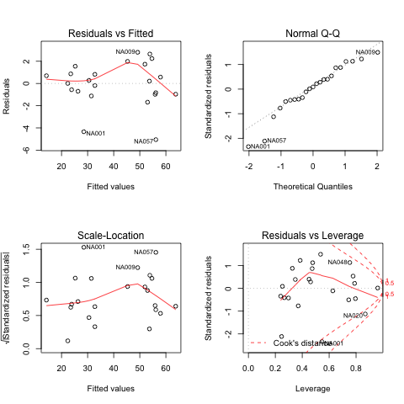
Diagnostics of model
Constant variance was evaluated using the Residuals vs Fitted plot. The residuals are scattered around the 0 mark which is desired.
The model was checked for multivariate normality by evaluating the Q-Q plot. The points do not deviate from the expected (dotted line) values enough to discredit the analysis. Samples NA001 and NA057 are showing a left skew in the data which is due to the 0 boundary in the data. Since the variance is alright, the analysis can still be conducted.

Slide 9
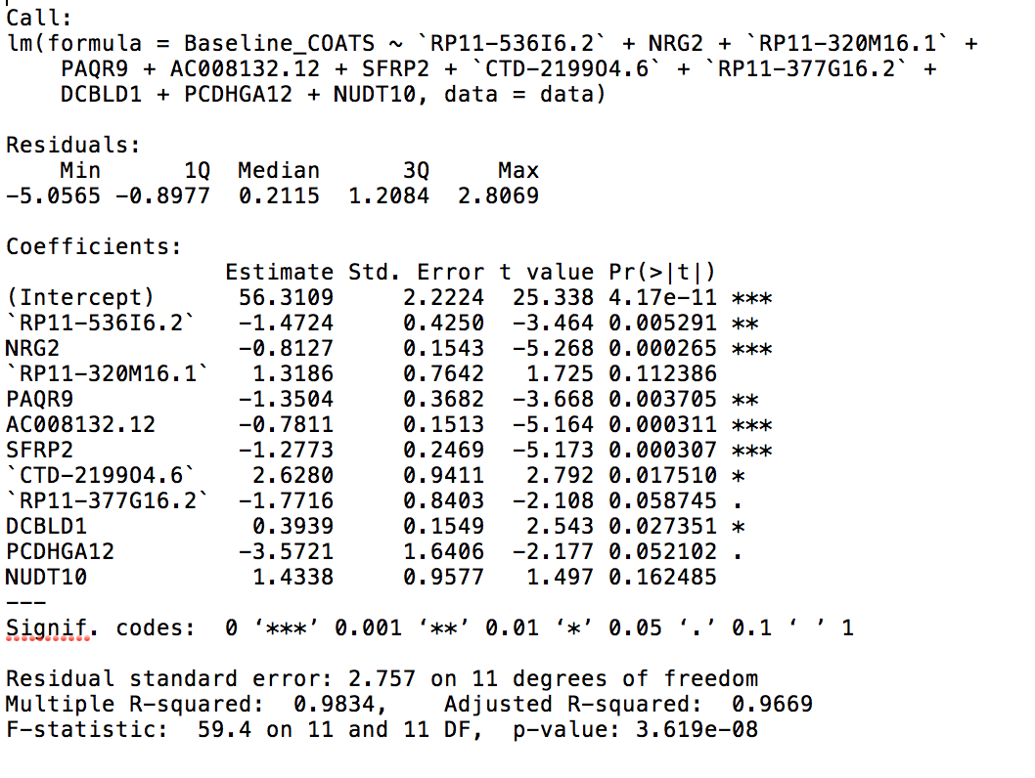
Model
The final regression model yielded the predictors and coefficients shown to the right.
The gene’s estimate shows the direction (- or +) and amount that the gene related to Base Coats.
For example, the gene CTD-219904.6 is the biggest predictor in the model (2.6280) and it has a positive relationship with Base Coats.

Slide 10
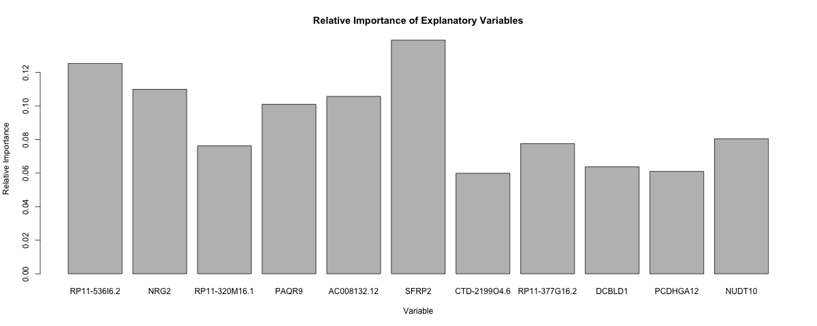
Model – Relative Importance
Another way to look at the variables is by their relative importance.
This model has an adjusted R² value of 0.9669. This means that 96.69% of the variation in Base Coats is explained by the model.
This plot shows each variable and the amount of that total variation (96.69%) they explain. It is interesting to notice that SFRP2 contributes the most although it does not have the highest regression slope.

