Slide 1


Discovering patterns, imbalanced classification & boundary surfaces in Heliophysics with artificial neural networks
Savvas Raptis¹
¹APL/JHU, Laurel, MD, USA
SR acknowledges the support by John Hopkins University Applied Physics Laboratory independent R&D fund
savvas.raptis@jhuapl.edu / https://savvasraptis.github.io

Slide 2
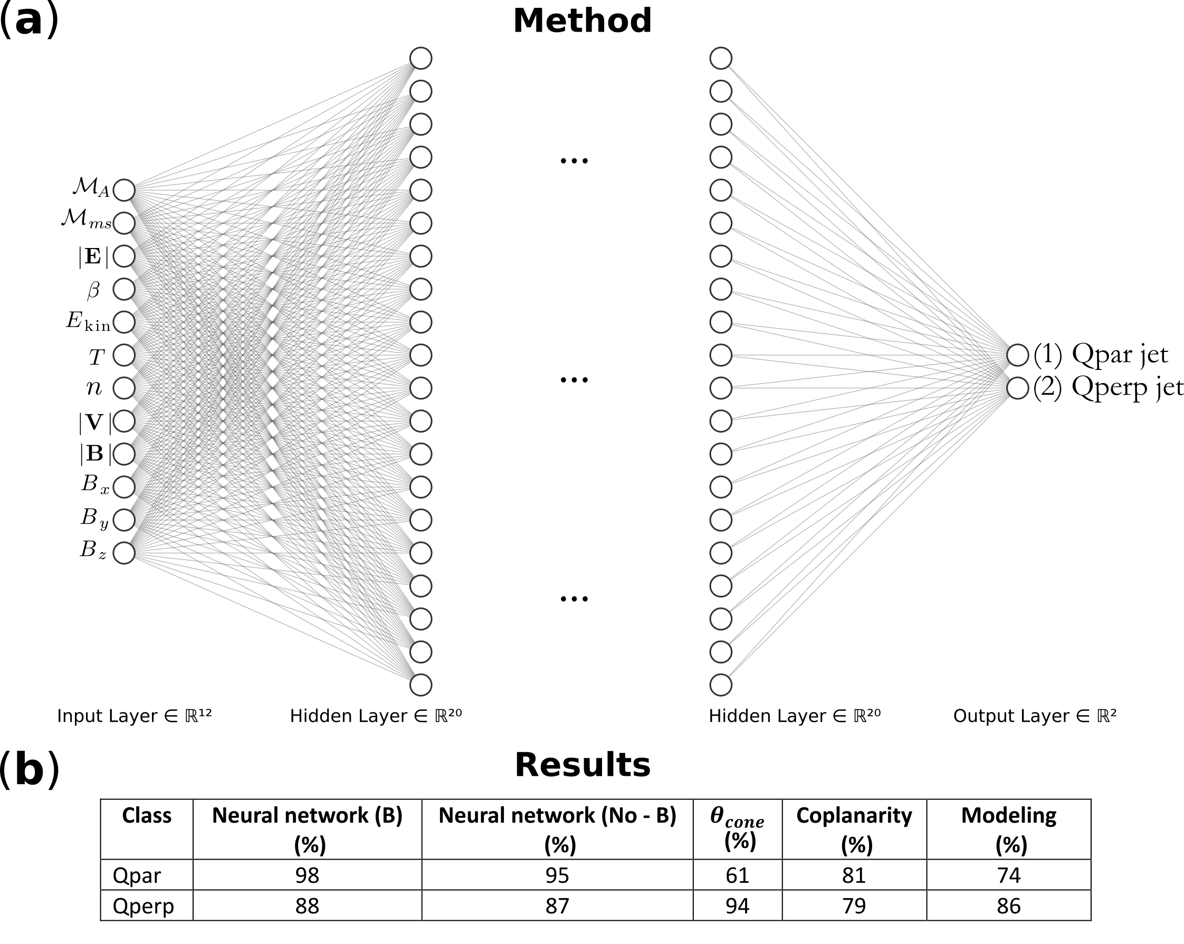




Discovering patterns
Goal
Bow Shock
$$θ_{Bn}$$
$$\hat{B}$$
$$\hat{n}$$
Earth
Calculate angle
between n and B
Discussion
NN > standard techniques
Works without (B) → Patterns found with SW classes & properties
ML
Standard
Raptis, Aminalragia-Giamini et al. (2020) | Front. Astron. Space Sci

Slide 3
Imbalanced learning
Occurrence of SEP based on X-rays of flares
Goal
24 features
SEP forecasting associated with a flare using GOES SXR.
 | SEP predicted always YES | SEP predicted always NO
SEP occurred YES | 191/220 [86.81 %] | 19/220 [8.63%]
SEP occurred NO | [7.77 %] | [92.23%]
Discussion
https://imbalanced-learn.org/stable/
Undersample / Oversample
Synthetic Data
Weight training / Weight loss function
https://github.com/SavvasRaptis/machine-learning-examples
Aminalragia-Giamini, Raptis et al. (2021) | J. Space Weather Space Clim

Slide 4
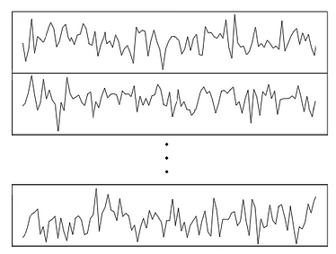
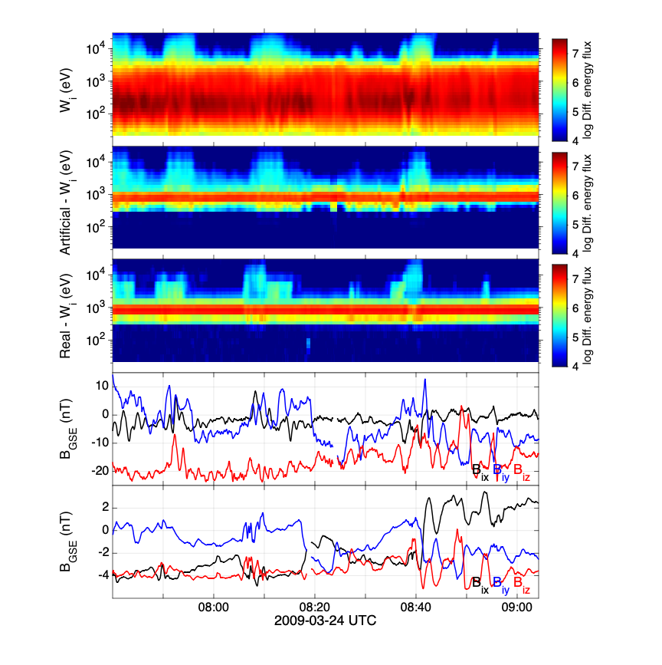

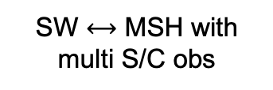
Evaluating boundary surfaces
Goal
Goal
Bow Shock
Earth
SW
MSH
CNN to extract Tseries feature
SW $⟷$ MSH with multi S/C obs
Discussion
How do we treat variable time series?
What are some good evaluation metrics in these case?
(not shown) – Preprocess of data (90% of work)
$$\begin{matrix}F_{u,1} \\ ⋮ \\ F_{u,32}\end{matrix}$$
Raptis et al. (ongoing)

Slide 5
Summary
Using various features & evaluating their effect → insights to unexplored patterns
Imbalanced learning has advanced a lot over the last years. Careful treatment of dataset& choice of methodology → Much better results.
How do we evaluate our results ? Experiment with different datasets, scales and phenomena needs special treatment. Pre-process is the most crucial aspect, let’s discuss this more.

