Slide 1

Compressive Structures in the Foreshock of Collisionless Shocks
Savvas Raptis
APL/JHU, Laurel, MD, USA
Domenico Trotta, Drew L. Turner, Xóchitl Blanco-Cano, Heli Hietala, Tomas Karlsson, Immanuel Christopher Jebaraj, Ivan Y. Vasko, Adnane Osmane, Kazue Takahashi, David Lario, Lynn B. Wilson III, Gregory G. Howes, Robert F. Wimmer-Schweingruber
Acknowledgments:
MMS Early Career Grant
Raptis+ 2026 (ApJL) - Compressive Structures in the Foreshock of Collisionless Shocks
savvas.raptis@jhuapl.edu / https://savvasraptis.github.io

Slide 2
Shocks & Transient Structures
Notes:
2 minutes

Slide 3
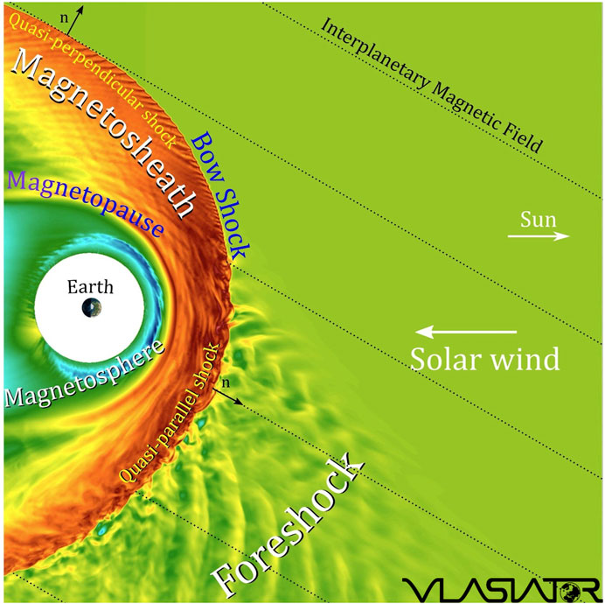
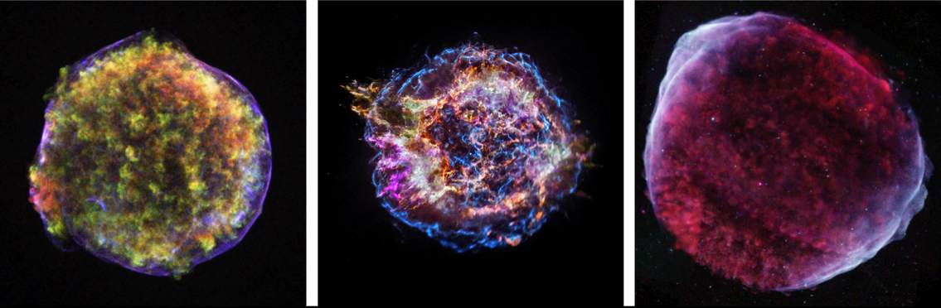

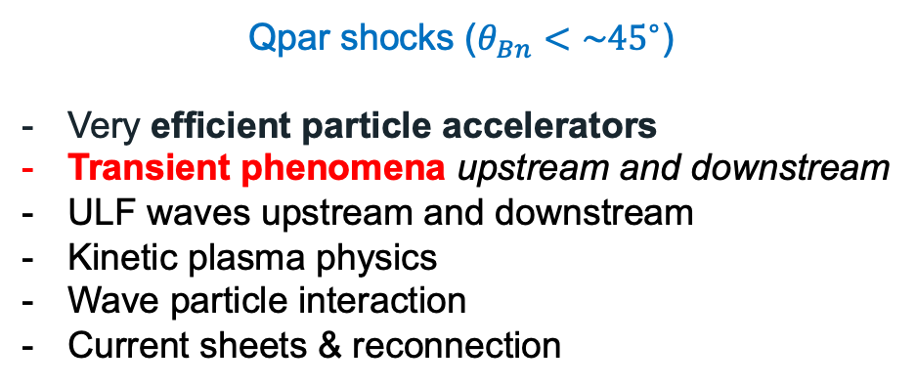
Earth’s Qpar bow shock and foreshock
*Some Astro references on Qpar importance: Caprioli+2014, Giuffrida+2022, Vink+2024
Qpar shocks ($θ_{Bn}<\sim {45}^{∘}⁡$)
Very efficient particle accelerators
Transient phenomena upstream and downstream
ULF waves upstream and downstream
Kinetic plasma physics
Wave particle interaction
Current sheets & reconnection
See our latest work on transients & particle acceleration published today!
https://www.nature.com/articles/s41586-026-10473-z
Plan to discuss this more at SWT meeting ☺

Slide 4
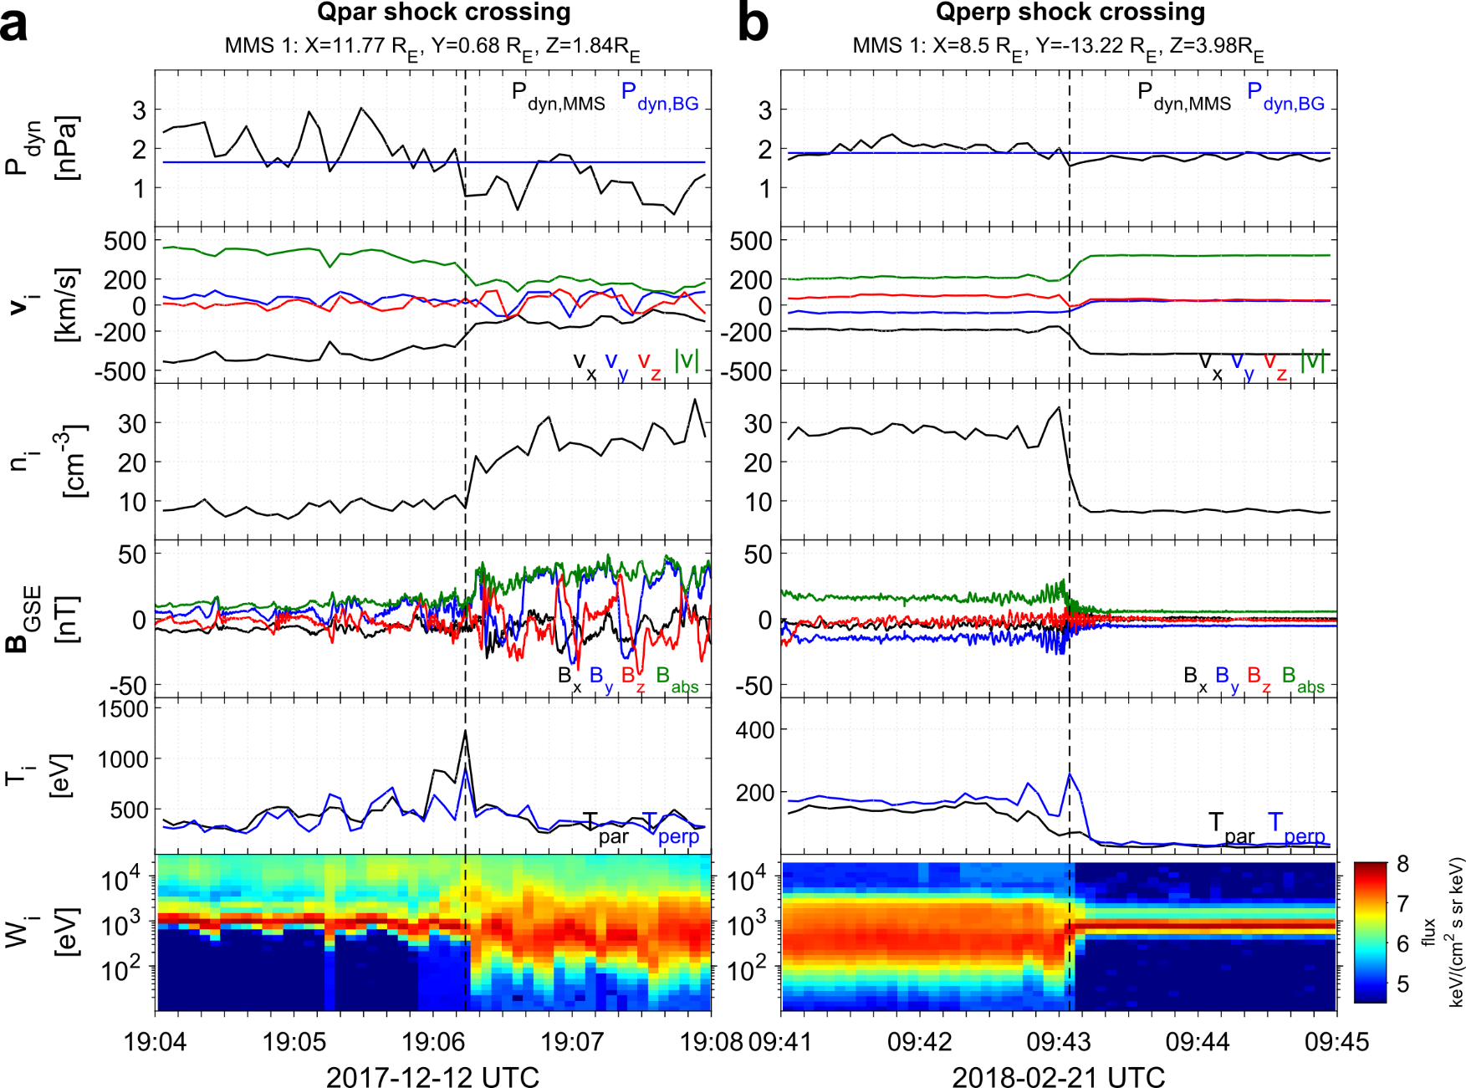

Community Reminder: Qpar – Qperp Shocks
Qpar shocks and downstream plasma:
Presence of foreshock
Magnetic field fluctuations ↑
High energy ions ↑
Temperature anisotropy ↓
Upstream
Upstream
Downstream
Downstream
(2)
(4)
(1)
(3)
MMS, Cluster, THEMIS, MMS
Raptis+(2020), Karlsson+(2021), Koller+(2024), Svenningsson+(2024)
Figure taken from PhD Thesis (Raptis 2022)

Slide 5

What is a Dayside Transient?
Transient phenomena are events that disrupt the steady-state plasma conditions, occurring temporarily and introducing dynamic changes to the physical system
← Latest review paper about high-speed jets!
Global (Solar):
Coronal Mass Ejection (CME)
High-Speed Stream (HSS)
Pressure Pulse / IP Shocks
Fluid scale:
Flux Transfer Event (FTE)
Magnetopause (bursty) Reconnection
Mesoscale:
Hot Flow Anomalies (HFAs)
Foreshock Bubbles (FBs)
Magnetosheath High Speed Jets (HSJs)
Kinetic:
ULF waves
Shocklets
SLAMS
Figure adapted from Krämer et al., 2025, Credits: Florian Koller
NOTE: Transients can be intrinsic (e.g., ULF waves) or driven (e.g., HFAs)
GEM FG: Multiscale Dayside Transients and their Effect on Earth's Magnetosphere
(2025 - 2029; Savvas Raptis, Ivan Vasko, Yuxi Chen, Gonzalo Cucho-Padin, Imogen Gingell, Terry Z. Liu, Ying Zou)
Notes:
Mesoscale → Foreshock ions referring 1000th of kilometers. Relative to solar wind ions they can be still considered fluid scales
Absolute scale of HFA/FB ~ FTEs reconnection

Slide 6
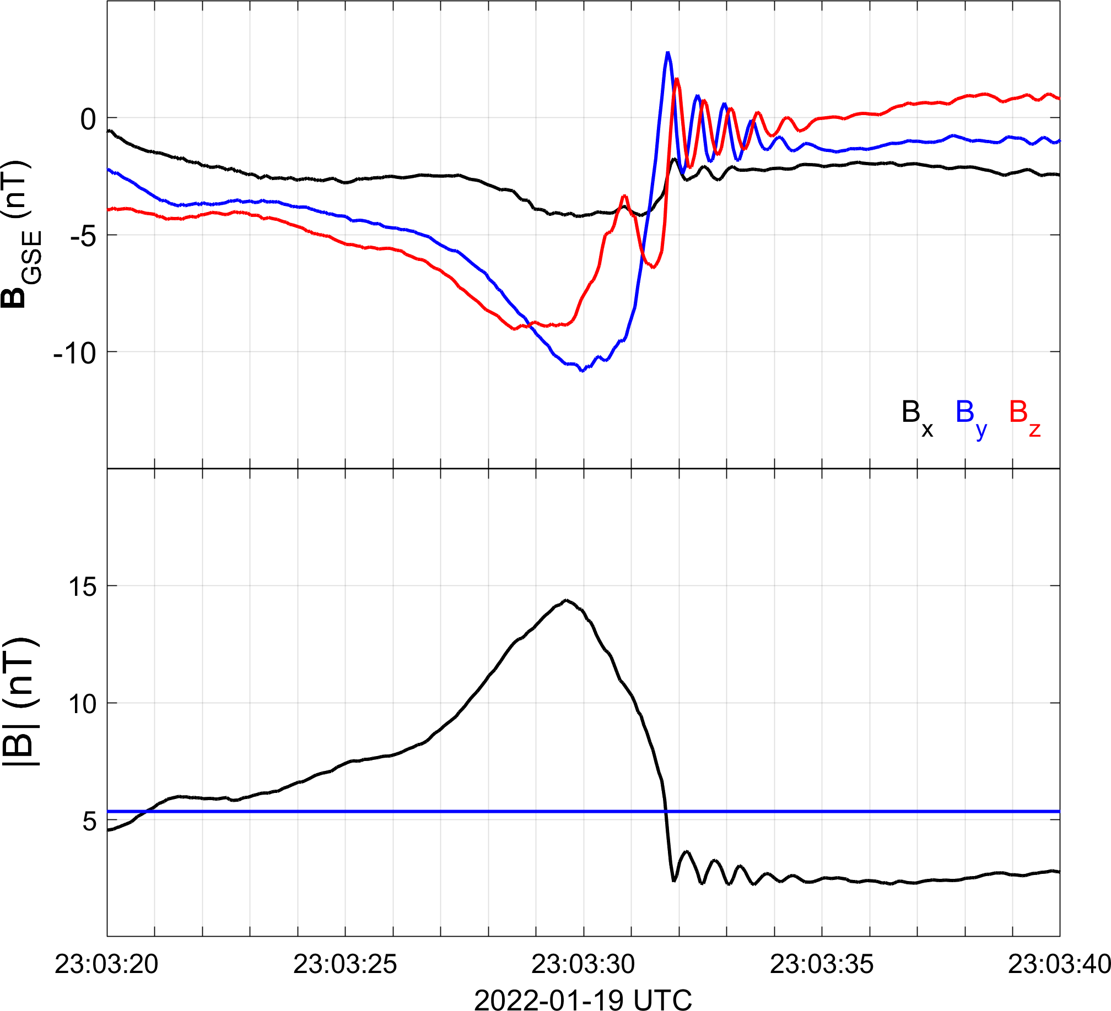
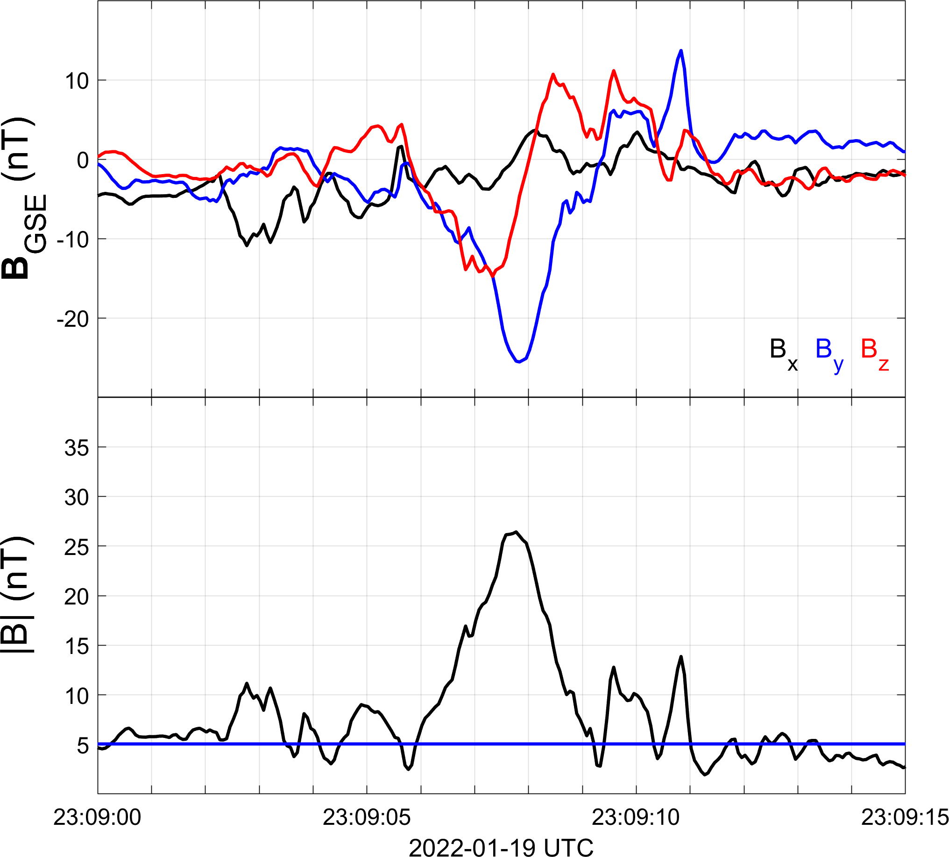
ULF Waves, Shocklets & SLAMS
Foreshock Compressive Structures (FCS)
Shocklets
SLAMS
ΔB/B0 >2
Act like local shock fronts
Dispersive whistler wave train
Shocklets = non-linear, steepened
SLAMS = More monolithic (?)

Slide 7
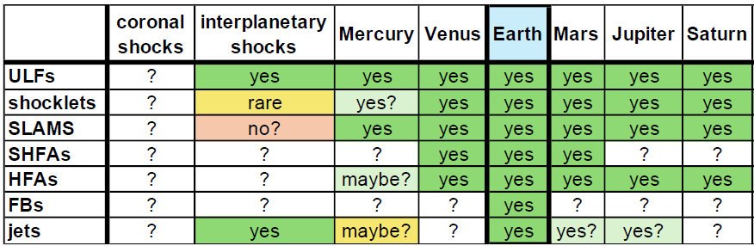
Universality of shock-generated transients
*
*
*
Hietala et al. ISSI 2019
Yes!*
Yes!*
Maybe? (Let’s discuss it today!)
Maybe? (we’ll discuss it another day ☺)
*Omidi+2020, Gunell+ 2023, Madanian+2023, Zhou+ 2024, Mohammed-Amin+ 2025, Raptis+2026

Slide 8
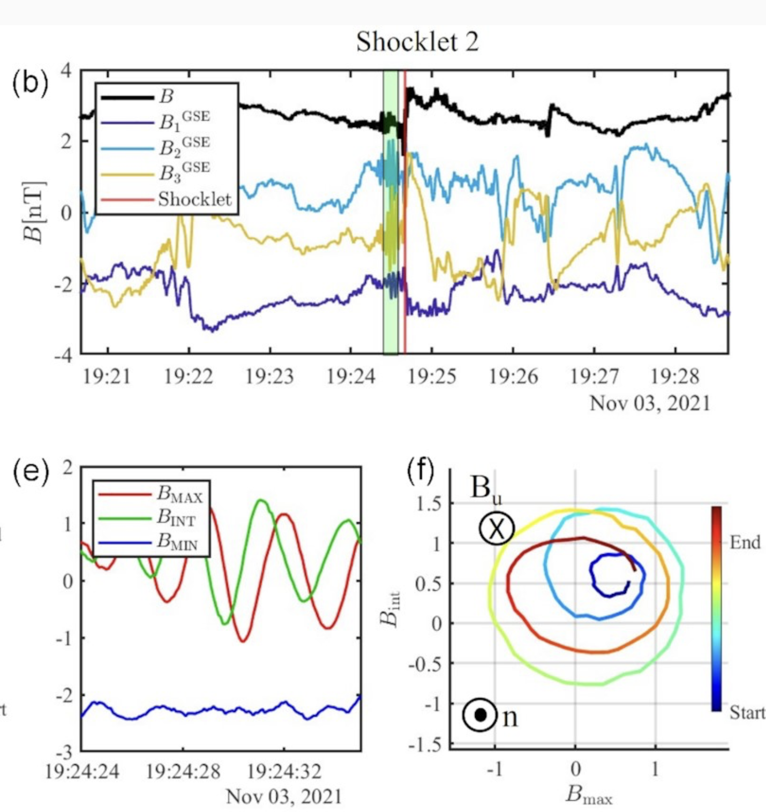
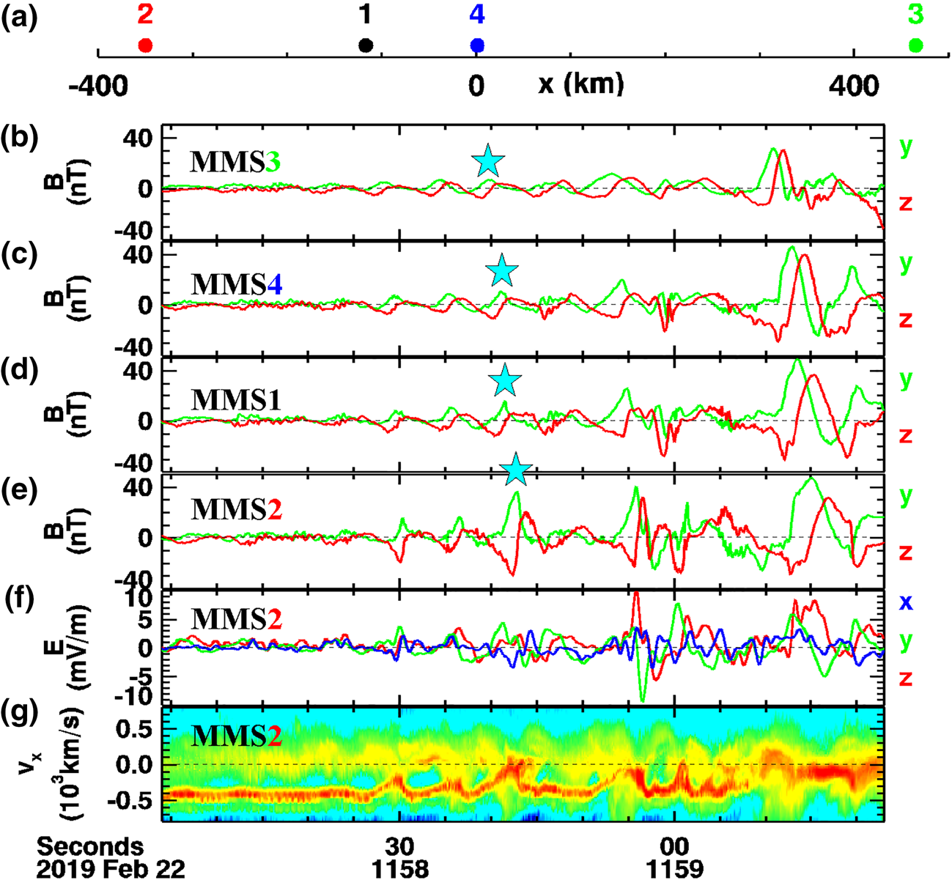
Disclaimer: Shocklets at IP shocks & Differences to Intrinsic FCS
IP Shock
Earth’s Bow shock
Formation of Shocklets at IP Shocks originates from Alfvenic Structures pre-existing at the solar wind
At Earth compressive structures form from intrinsic wavefield of the foreshock, rather than large scale alfvenic fluctuations
Interestingly, several high Mach IP shocks appear to lack such structures (e.g., Jebaraj+2024)
Chen+2020
Trotta+2023, Wilson+2009, 2025

Slide 9
Our Goal & Challenges
We compare two shocks of similar Mach numbers to evaluate their foreshock structures (1) Earth’s Bow Shock with MMS during latest campaign and (2) an IP Shock using Solar Orbiter.
Planetary Bow Shocks: A curved, quasi-stationary obstacle. Reflected ions are magnetically connected for long durations, allowing observations to be taken showing waves to grow and steepen into complex structures.
IP Shocks: A “planar” and propagating structure moving rapidly (∼800 km/s) through the solar wind, potentially restricting the foreshock development and limiting our observation capabilities.
Notes:
Roughly 6mins

Slide 10
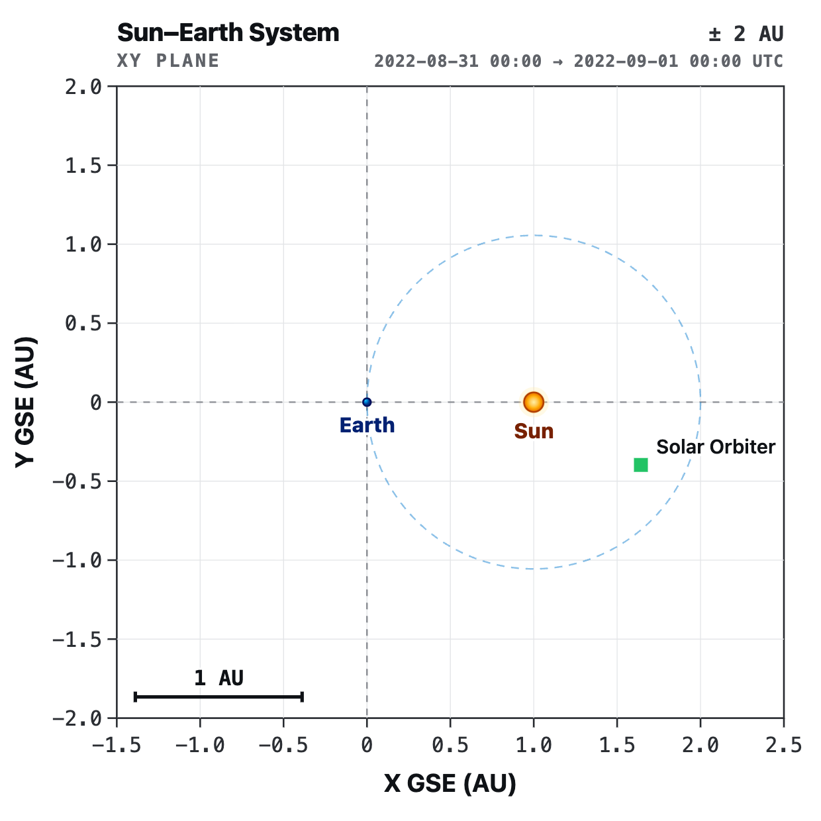
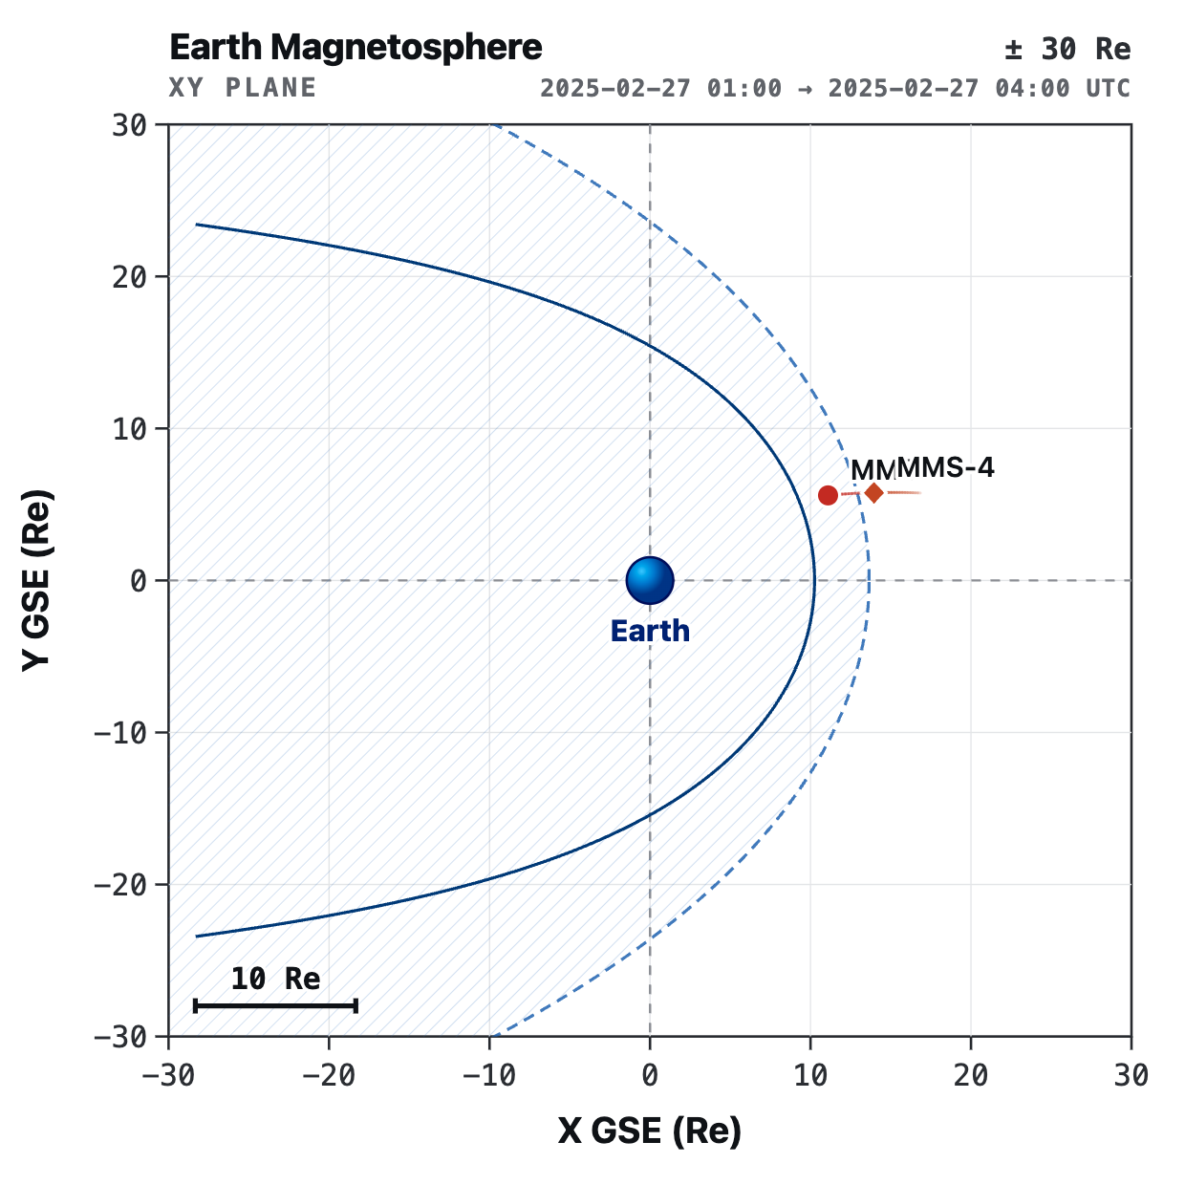

Results
Solar Orbiter Nugget
Case Study
MMS String of Pearl Campaign
Bow shock
MMS
2025/02/27
IP Shock
Solar Orbiter
2022/08/31
Article
MMS1-4 separation >2 Re

Slide 11
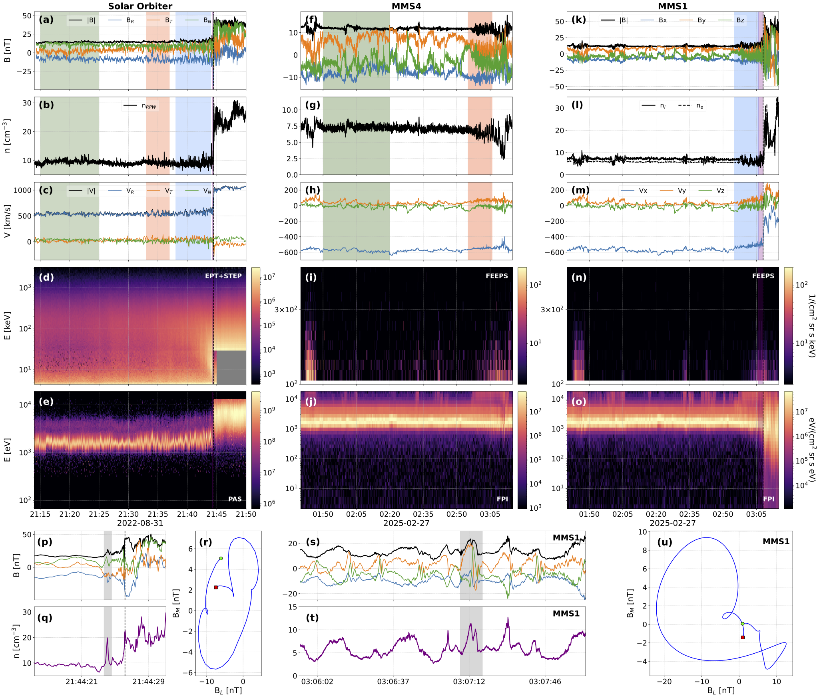
Overview observations
*Fun fact: I had to get special clearance to show 21 panels on a single figure.
High-Level takeaways
Solar Orbiter observes an IP shock with elliptically polarized structure just 3 seconds upstream. Saturation of STEP on Solar Orbiter
MMS-4 observes foreshock, but limited non-linear evolution
MMS-1 observes distinct polarized compressive structure upstream of the bow shock (a few minutes)
Green = Solar Wind
Red = Far Upstream Foreshock
Blue = Near Shock Foreshock
Some questions we follow up:
Is the foreshock different?
Are these structures of similar origin?
Do they happen at relatively similar distances?

Slide 12
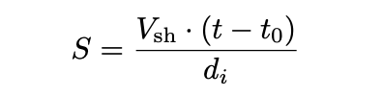
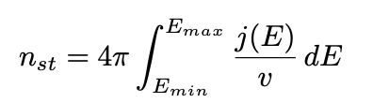
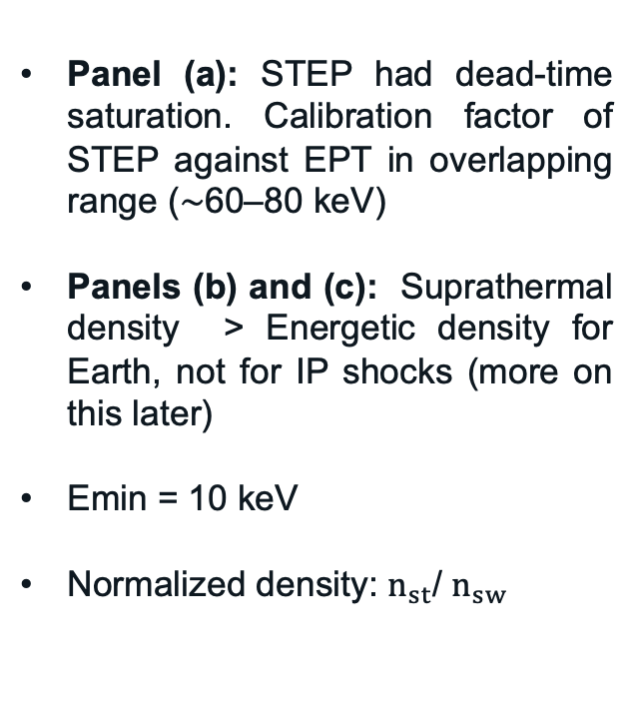
Methodology & Assumptions
Panel (a): STEP had dead-time saturation. Calibration factor of STEP against EPT in overlapping range (∼60–80 keV)
Panels (b) and (c): Suprathermal density > Energetic density for Earth, not for IP shocks (more on this later)
Emin = 10 keV
Normalized density: $n_{st}$/ $n_{sw}$
Some reminders: $Ma \sim v\sqrt{n}/B$, $di \sim 1/\sqrt{n}$,
$\hat{n} \& θ_{Bn}$: can be estimated with several methods. All of them can be seriously misleading (we can discuss this).

Slide 13
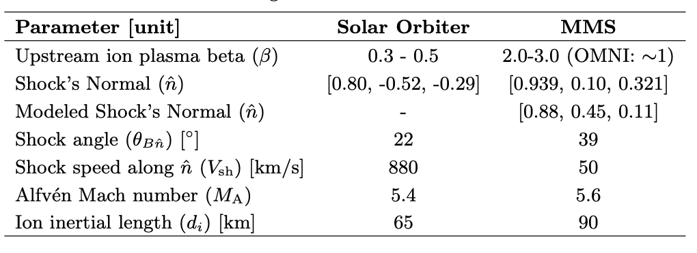
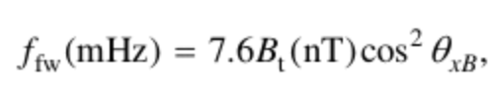
Global Shock & Foreshock Properties
*Disclaimer: I am no turbulence expert. Please be gentle.
High Mach number shocks, but some differences in plasma beta, and shock speed
Slopes of SW look fine, the more we approach the shock, the more shock-driven processes dominate.
IP Shock: Broadband increase as we approach the shock
Earth: Peaks in ULF waves, and ~1Hz
ULF frequency expectation:

Slide 14
Compressive Structures
Keypoints:
Compressive structures develop at distances < 50 di from the shock front.
~1% of density is associated with suprathermals and energetic particles (>10 keV) when significant steepening occurs.
This only occurs at a very narrow time window for Solar Orbiter (~10s), while being up to several hours for MMS.
Note: We don’t really know the speed of the shock at Earth, so we have an upper and lower limit.

Slide 15
MMS Separation & Effective Comparisons of Shocks
Keypoints:
Ratio of unity: 35+ keV deliver as much suprathermal density as 8-35 keV
STEP dominates very close to the shock at ~315di (23s), with sharpest gradient at ~135di (10s) from the shock.
At Earth, we are always in the <35 keV regime.
At IP shock we may only be in the <35 KeV regime for 10s of seconds
STEP (<35 keV) dominated
EPT (>35 keV) dominated

Slide 16
Summary & Discussion
Key Findings
Intrinsic foreshock compressive structures (FCSs) form upstream at similar normalized distances (≲50 di) when the suprathermal (>10 keV) ion density exceeds ∼1% of the total.
the “growth zone” capable of sustaining these structures is spatially limited (∼135 di), which, due to the high speed of the propagating IP shock, corresponds to a brief observational window of ~10 s.
Other physical processes that may inhibit are the different geometry (curved vs ”planar”) resulting in a lack of “Cross-talk” between neighboring regions of the shock. Statistically difficult to evaluate since only a few high-Mach Qpar IP shocks.
Discussion points:
A potential threshold? At both shocks, steepened foreshock compressive structures fully form when the suprathermal ion density reaches ∼1% of the background solar wind density. Is this what is required? Can this be supplied by different processes?
Observational biases: The perceived difference in foreshock compressive structure occurrence is largely observational. For IP shocks, missions traverse the shock rapidly, providing only a brief "spatial cut" that misleadingly suggests structures are rare or absent. In contrast, planetary observations provide long "time histories”, which misleadingly suggests an overabundance and extended range.
Solar Orbiter Nugget
Article

Slide 17
Appendix

Slide 18


Shock-generated Transients & Particle Acceleration
New plot, much easier to understand!
Compressive edges
Core
Solar Wind
With respect to upstream conditions (SW/FS):
Electron fluxes (>50 keV) up to x6
Ion fluxes (>50 keV) up to x15
: Raptis+ 2025 (NatComm) - Revealing an Unexpectedly Low Electron Injection Threshold via Reinforced Shock Acceleration
: Raptis+ 2025 (ApJL) - Multi-Mission Observations of Relativistic Electrons and High-Speed Jets Linked to Shock Generated Transients

Slide 19
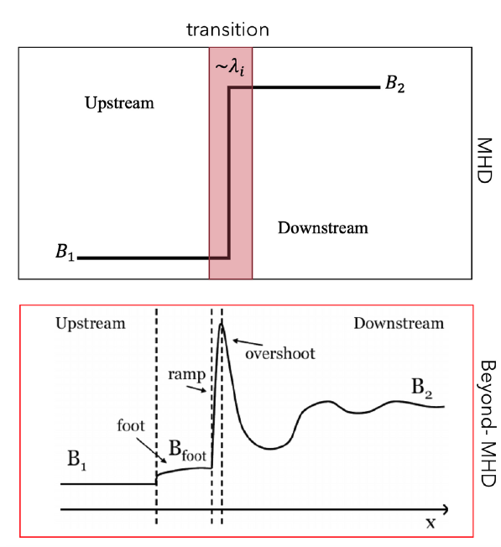
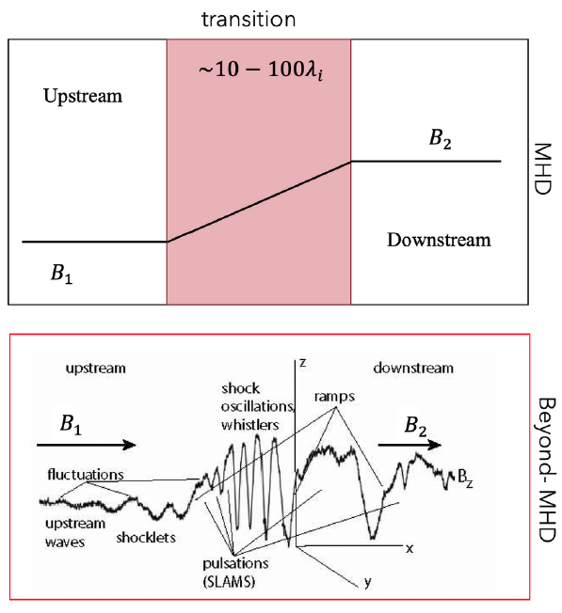
Quasi-parallel and Quasi-perpendicular shocks
Qperp
Qpar

