Slide 1
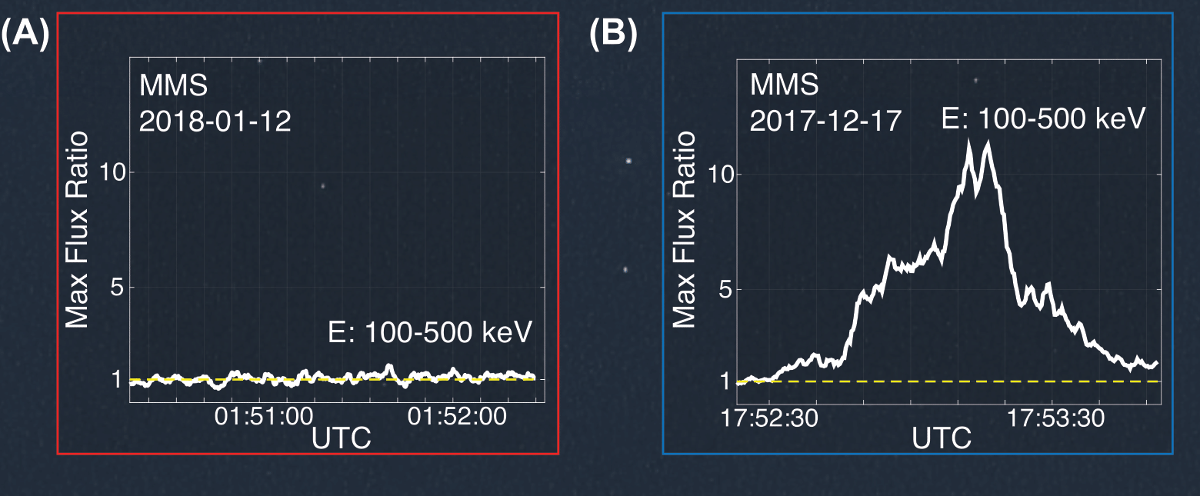
Revealing an Unexpectedly Low Electron Injection Threshold via Reinforced Shock Acceleration
Savvas Raptis (JHU/APL), Ahmad Lalti (Northumbria University), Martin Lindberg (Queen Mary University of London), Drew L. Turner (JHU/APL), Damiano Caprioli (The University of Chicago), James L. Burch (Southwest Research Institute)
What is the science question?
How are relativistic electrons generated at planetary bow shocks? What are the mechanisms responsible for their acceleration, and what solar wind conditions enhance or inhibit this process?
What were your findings?
Combining data from the MMS and THEMIS/ARTEMIS missions, we investigated the acceleration of high-energy electrons (over 500 keV) upstream of Earth's bow shock. Our analysis of multiple energetic events showed that this acceleration is a cross-scale process, involving both kinetic and fluid scales. Furthermore, we demonstrated that fast solar wind with a high suprathermal electron flux (around 1-5 keV) is essential for seeding the acceleration and generating relativistic electrons.
What was the impact?
The processes we describe are rooted in fundamental physics, making them applicable to other planets within our solar system and even to exoplanets. This framework therefore provides insights into the long-standing question of how relativistic electrons are generated at collisionless shocks. Given that this relativistic population is a component of cosmic rays, our findings also have implications to space weather effects.
Why does it matter to non-scientists?
Space weather can have significant real-world consequences, such as disruptions to satellites, communication systems, and power grids, directly affecting people's lives. Moreover, our research contributes to our broader understanding of the universe, highlighting how studies of our own solar system can help answer fundamental astrophysical questions and illuminate phenomena occurring light-years away.
(A): MMS measurements showing the absence of 100-500 keV (high-energy) electrons during the observation of a foreshock transient. (B): MMS measurements during an event with energetic electrons. The Y-axis represents the ratio between the background flux and the observations.
Published in Nature Communications, January 2025 https://www.nature.com/articles/s41467-024-55641-9

