Slide 1
Recent Advancements in Transient Processes and Particle Energization at Collisionless Shocks
Savvas Raptis
JHU/APL, Laurel, MD, USA
Thanks to collaborators and friends: Drew L. Turner, Ahmad Lalti, Martin Lindberg, Damiano Caprioli, George Clark, Terry Liu, Jamey R. Szalay, Lynn Wilson III, Imogen Gingell, Ying Zou, Ivan Vasko, Colby C. Haggerty, Yufei Zhou, David Sibeck, Primoz Kajdic, Adnane Osmane, Ian Cohen, Philippe Escoubet, and more
Acknowledgments:
MMS Early Career Grant
savvas.raptis@jhuapl.edu / https://savvasraptis.github.io

Slide 2
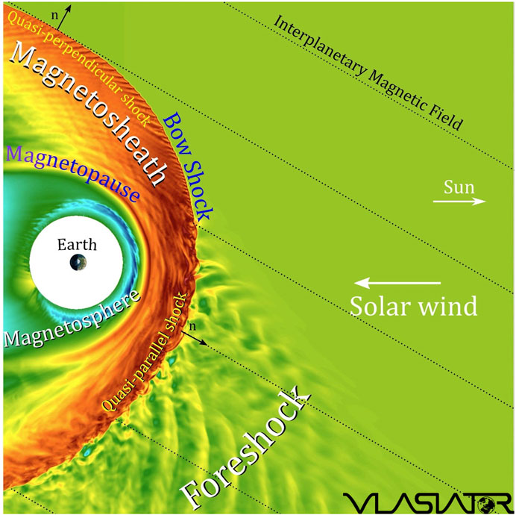
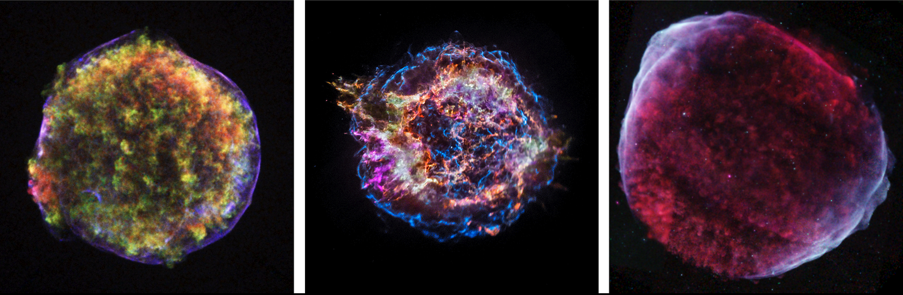
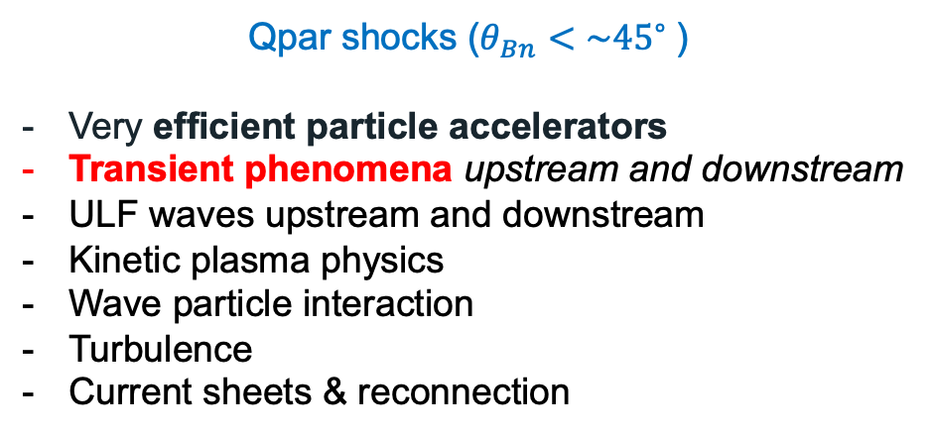
Earth’s Qpar bow shock and foreshock
Qpar shocks ($θ_{Bn}<\sim {45}^{∘}⁡$)
Very efficient particle accelerators
Transient phenomena upstream and downstream
ULF waves upstream and downstream
Kinetic plasma physics
Wave particle interaction
Turbulence
Current sheets & reconnection
*Astro references on Qpar importance: Caprioli+2014, Giuffrida+2022, Vink+2024

Slide 3

What is a Dayside Transient?
Transient phenomena are events that disrupt the steady-state plasma conditions, occurring temporarily and introducing dynamic changes to the physical system
←See the latest review paper about high-speed jets!
Global (Solar):
Coronal Mass Ejection (CME)
High-Speed Stream (HSS)
Pressure Pulse / IP Shocks
Fluid scale:
Flux Transfer Event (FTE)
Magnetopause (bursty) Reconnection
Mesoscale:
Hot Flow Anomalies (HFAs)
Foreshock Bubbles (FBs)
Magnetosheath High Speed Jets (HSJs)
Kinetic:
ULF waves
Shocklets
SLAMS
Figure adapted from Krämer et al., 2025, Credits: Florian Koller
NOTE: Transients can be intrinsic (e.g., ULF waves) or driven (e.g., HFAs)
GEM FG: Multiscale Dayside Transients and their Effect on Earth's Magnetosphere
(2025 - 2029; Savvas Raptis, Ivan Vasko, Yuxi Chen, Gonzalo Cucho-Padin, Imogen Gingell, Terry Z. Liu, Ying Zou)
Notes:
Mesoscale → Foreshock ions referring 1000th of kilometers. Relative to solar wind ions they can be still considered fluid scales
Absolute scale of HFA/FB ~ FTEs reconnection

Slide 4
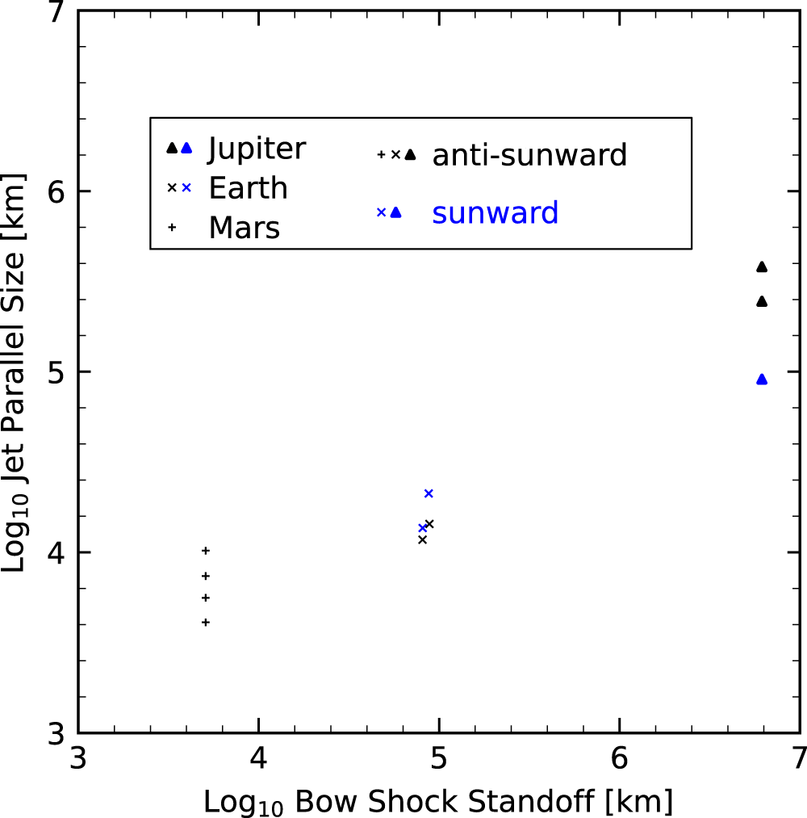
Transients Scaling Across Different Systems
Foreshock Transient Scaling
Downstream Jet Scaling
Zhou, et al. 2024
Adapted form Valek et al. (2017) | JGR
Important point to remember

Slide 5
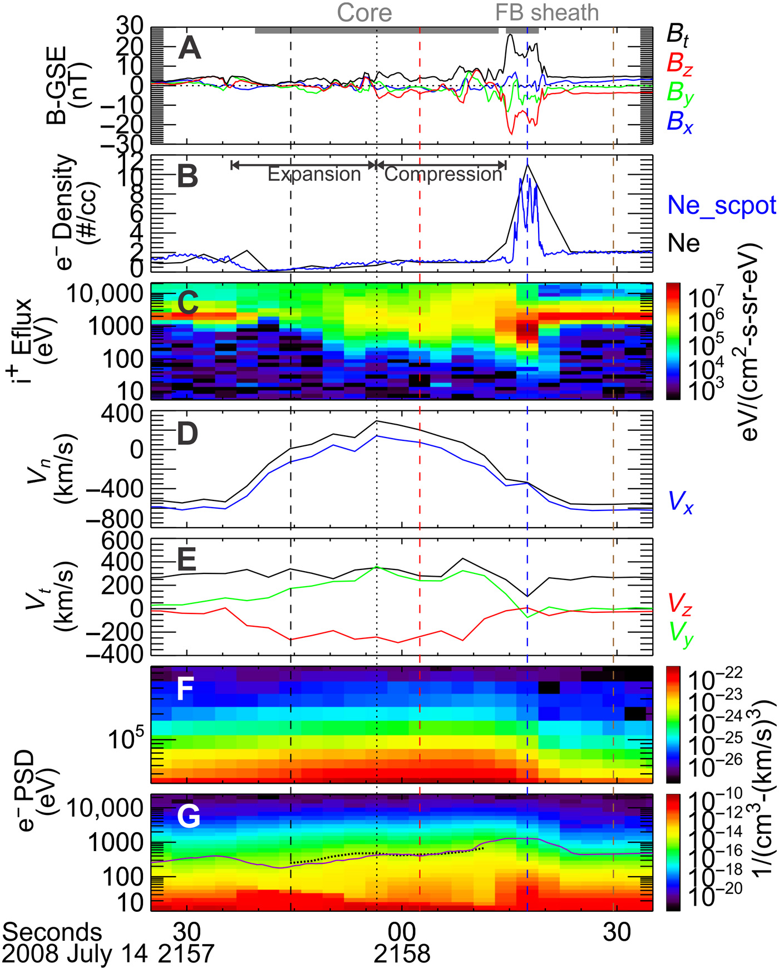
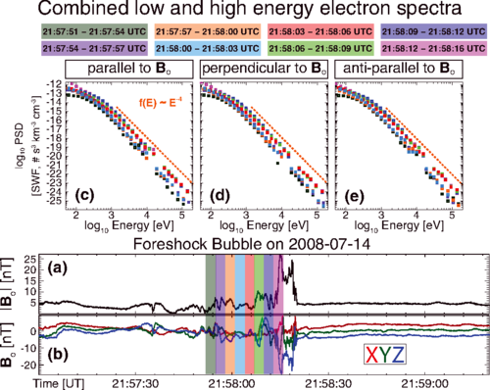
Foreshock Transients & Electron acceleration
See also: Turner et al. 2018; Liu et al. 2019; Shi et al. 2023,2025 ; Tonoian et al. 2023; Kamaletdinov et al. 2024; Li et al. 2025; Liu et al., 2026
~300 KeV electrons
Wilson III L. et al. 2016 | PRL
~200 KeV electrons
Liu T. et al. 2019 | Science Adv.
Notes:
Lynn Wilsson: Shock Drift Acceleration up to 300 KeV, non local acceleration that can then get even further accelerated at the shock
Terry Liu : Betatron acceleration on Foreshock transients = Making Qpar shock more effective in accelerating particles

Slide 6
Mental Picture to Keep in Mind
Qpar Extended shock includes the foreshock, the magnetosheath and their transient processes
Sketch by Florian Koller

Slide 7



Latest Results Transients & Particle Acceleration
Raptis et al.2025 | NatComm
Raptis et al.2025 | ApJL
Raptis et al.2026 | Nature
Notes:
5 mins

Slide 8
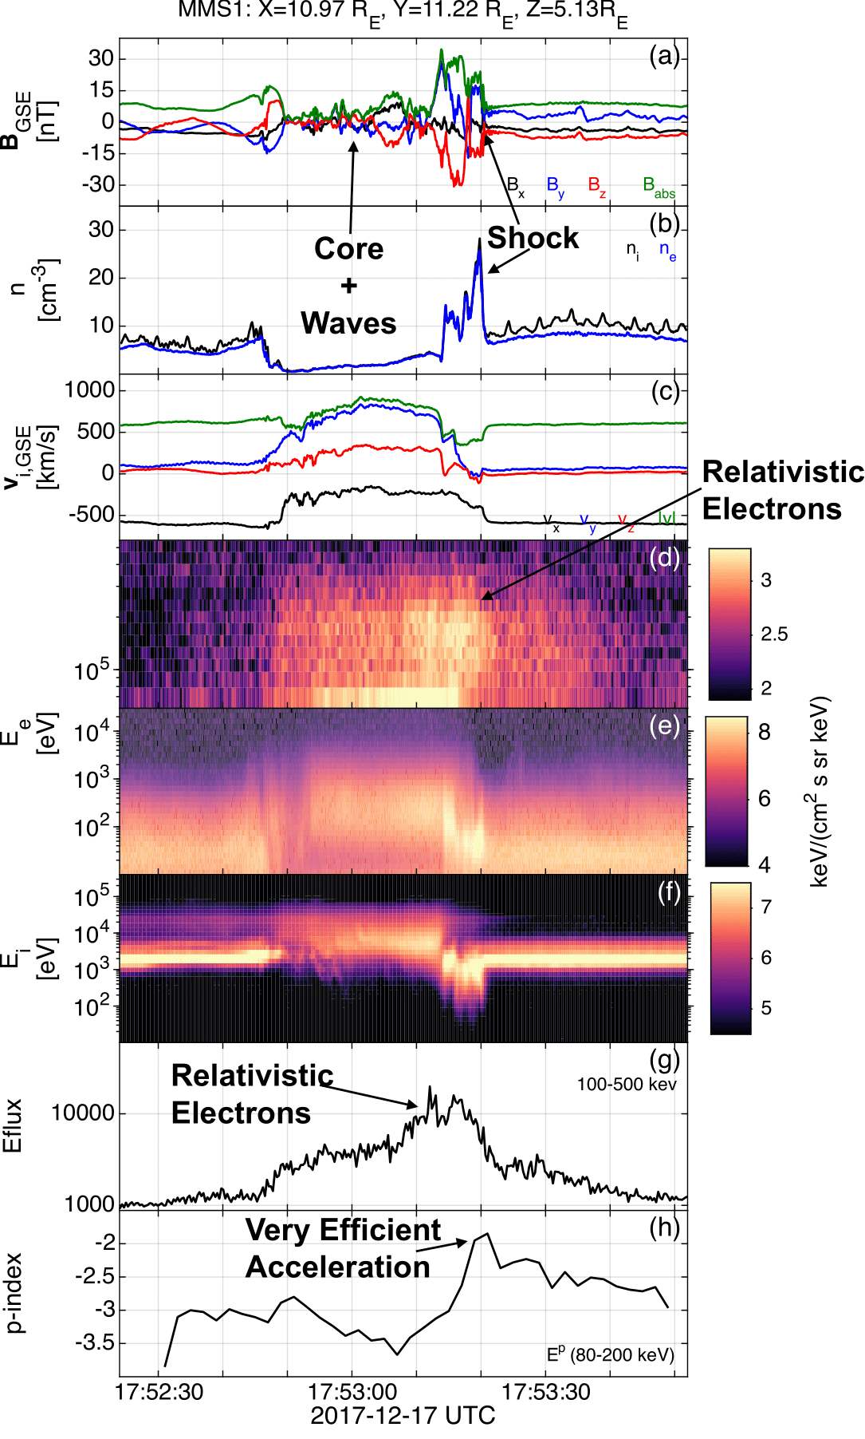


Transients & Relativistic Electrons with MMS
Typical properties of transient:
- Depleted Core (low B, n)
- Mature HFA (ΔΒ/B0 ~ 1-4)
- SW beam disrupted
- Strong density and magnetic field compressive boundaries
- Formation of a Qperp “shock”
- Flow anomaly (velocity decreasing)
Unique property
>500 keV electrons throughout the core and shock region
New plot, much easier to understand!
Compressive edges
Made for
PO yellow book
Core & Waves
With respect to upstream conditions (SW/FS):
Electron fluxes (>50 keV) up to x6
Ion fluxes (>50 keV) up to x15
Foreshock transient
Bow shock
Raptis et al.2025 | NatComm

Slide 9
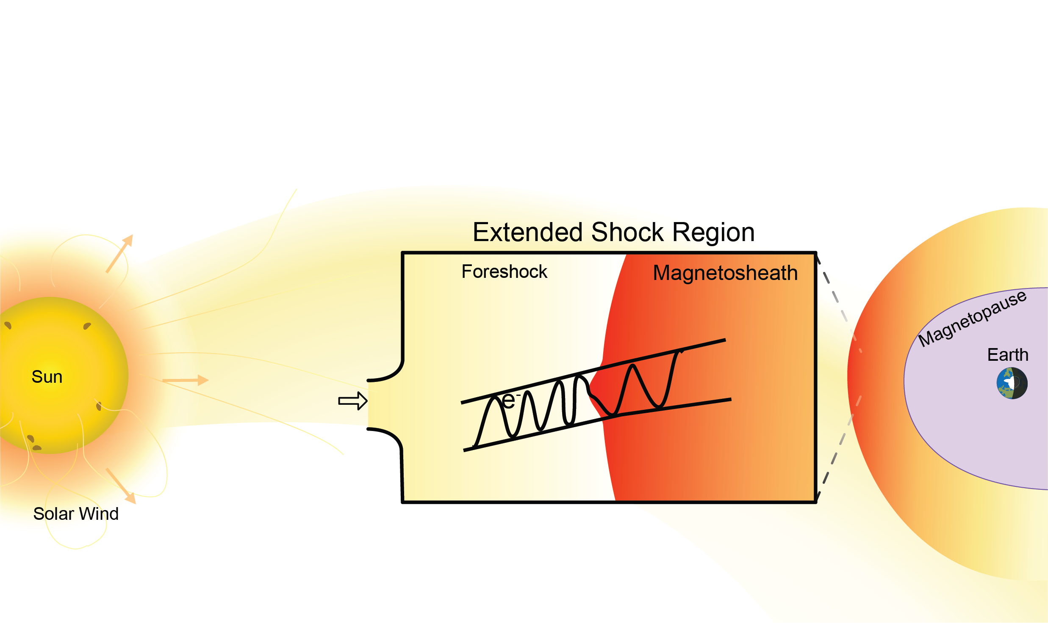
But let’s ask one more question
What do we expect to see when transients cross the bow shock and go downstream?
Transient
Sketch by Florian Koller

Slide 10
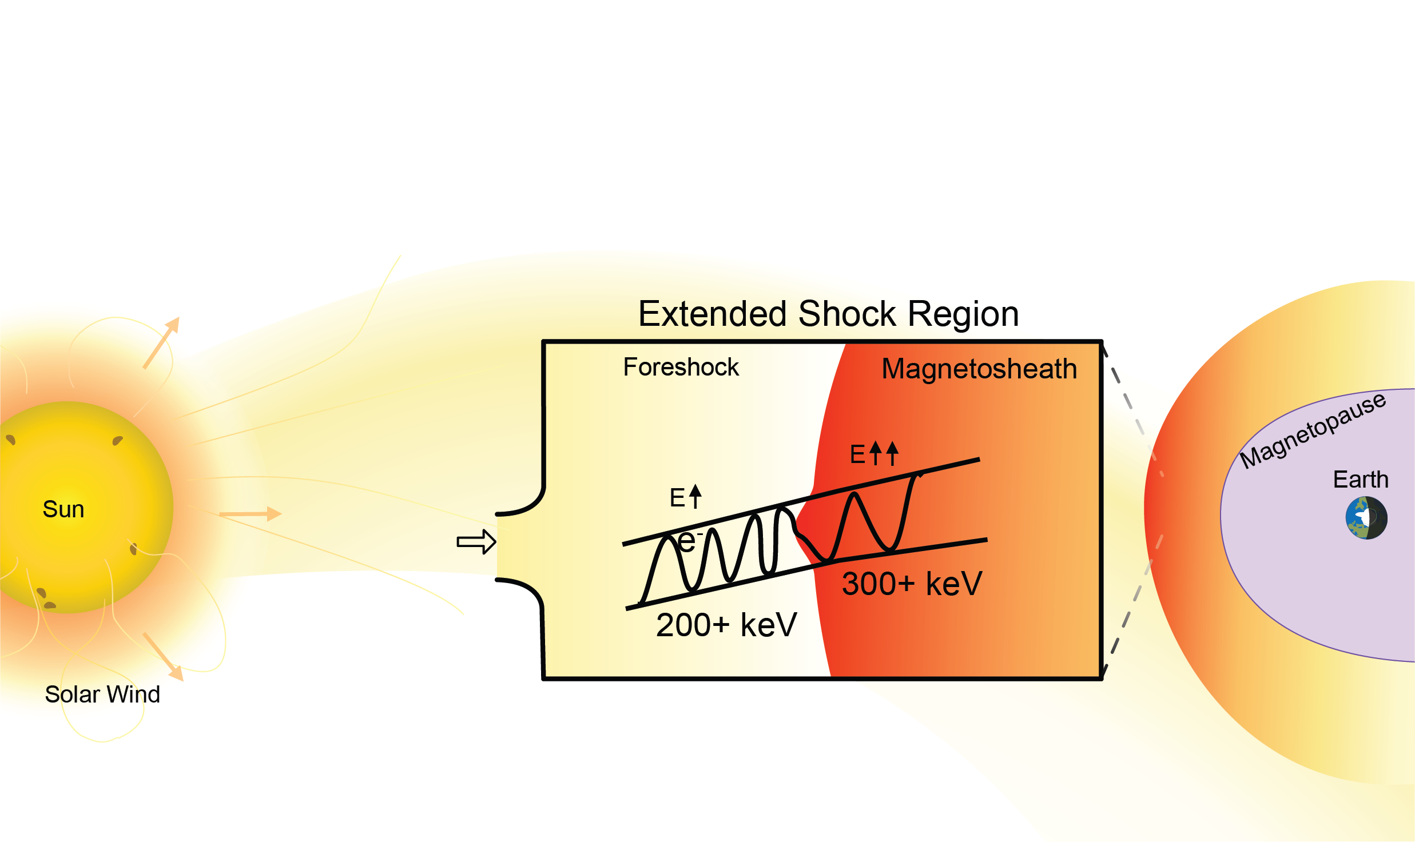
But let’s ask one more question
What do we expect to see when transients cross the bow shock and go downstream?
Cluster
MMS
Transient
Indeed, energization occurs
(+ We get localized magnetosheath jets)
Sketch by Florian Koller

Slide 11
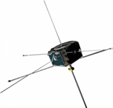




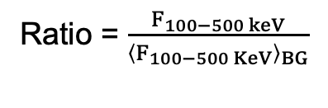

Reinforced Shock Acceleration (RSA): From Sun to Earth
(A)
?
Discontinuity (SW) ARTEMIS
Transient (FS) MMS
(B)
Transient (FS) Cluster
Transient (MSH) MMS
Coronal Hole SW
V> 400 km/s
X → X+100 keV
~1 keV
>100-500 keV
$${\left(\frac{B}{B0}\right)}^{2/3}$$
Ratio = $\frac{F_{100−500 keV}}{{\left\langle F_{100−500 KeV}\right\rangle }_{BG}}$
Ratio = $\frac{F_{1−5 keV}}{{\left\langle F_{1−5 KeV}\right\rangle }_{BG}}$
Max flux ratio
Max flux ratio
SW – ARTEMIS/THEMIS
Foreshock - MMS
Note: Framework is consistent with other studies (e.g., Wilson+2016, Liu+2019, Shi+2025)
Magnetosheath – CL/MMS
Fast SW seeding ~1 keV particles
: Raptis+ 2025 (NatComm) - Revealing an Unexpectedly Low Electron Injection Threshold via Reinforced Shock Acceleration
: Raptis+ 2025 (ApJL) - Multi-Mission Observations of Relativistic Electrons and High-Speed Jets Linked to Shock Generated Transients

Slide 12
The question now is:
What about other planetary shocks?
Raptis et al.2026

Slide 13
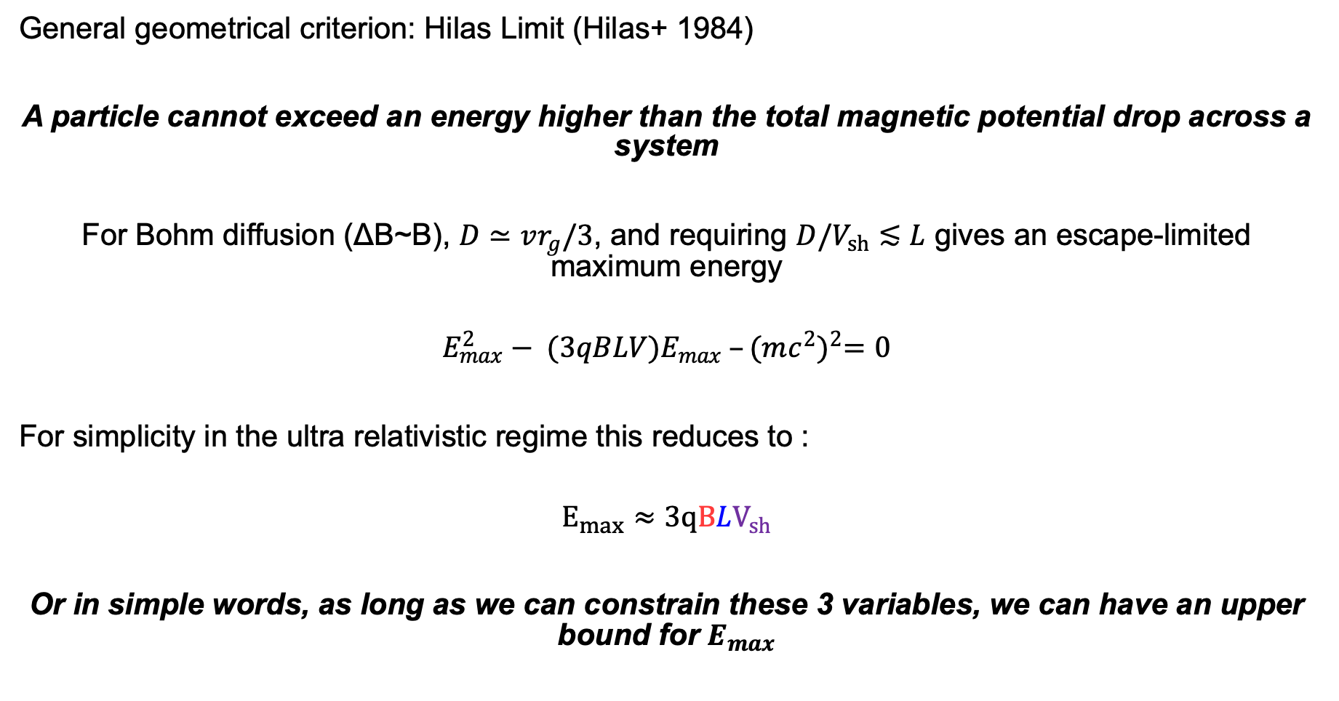
Particle Acceleration: Hillas Criterion and Scales
General geometrical criterion: Hilas Limit (Hilas+ 1984)
A particle cannot exceed an energy higher than the total magnetic potential drop across a system
For Bohm diffusion (ΔB~B), $D≃vr_{g}/3$, and requiring $D/V_{sh}≲L$ gives an escape-limited maximum energy
$$E_{max}^{2}− (3qBLV)E_{max} –{(mc^{2})}^{2}=0$$
For simplicity in the ultra relativistic regime this reduces to :
$$E_{max}≈3qBLV_{sh}$$
Or in simple words, as long as we can constrain these 3 variables, we can have an upper bound for $E_{max}$
For a more proper explanation see the great work from Oka+ 2025
Notes:
the velocity is the flow speed that generates the motional electric field and controls acceleration efficiency.

Slide 14
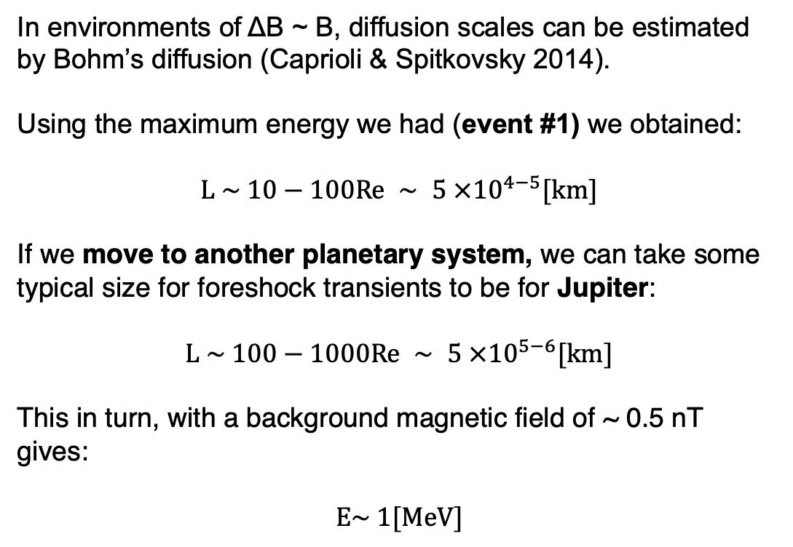
Electron Acceleration in other planets
Adapted from Valek + 2017
Re
In environments of ΔB ~ B, diffusion scales can be estimated by Bohm’s diffusion (Caprioli & Spitkovsky 2014).
Using the maximum energy we had (event #1) we obtained:
$$L \sim 10−100Re ∼ 5 ×{10}^{4−5}[km]$$
If we move to another planetary system, we can take some typical size for foreshock transients to be for Jupiter:
$$L \sim 100−1000Re ∼ 5 ×{10}^{5−6}[km]$$
This in turn, with a background magnetic field of ~ 0.5 nT gives:
$$E\sim 1[MeV]$$
Unpublished figure based on Raptis et al.2025a NatComm

Slide 15
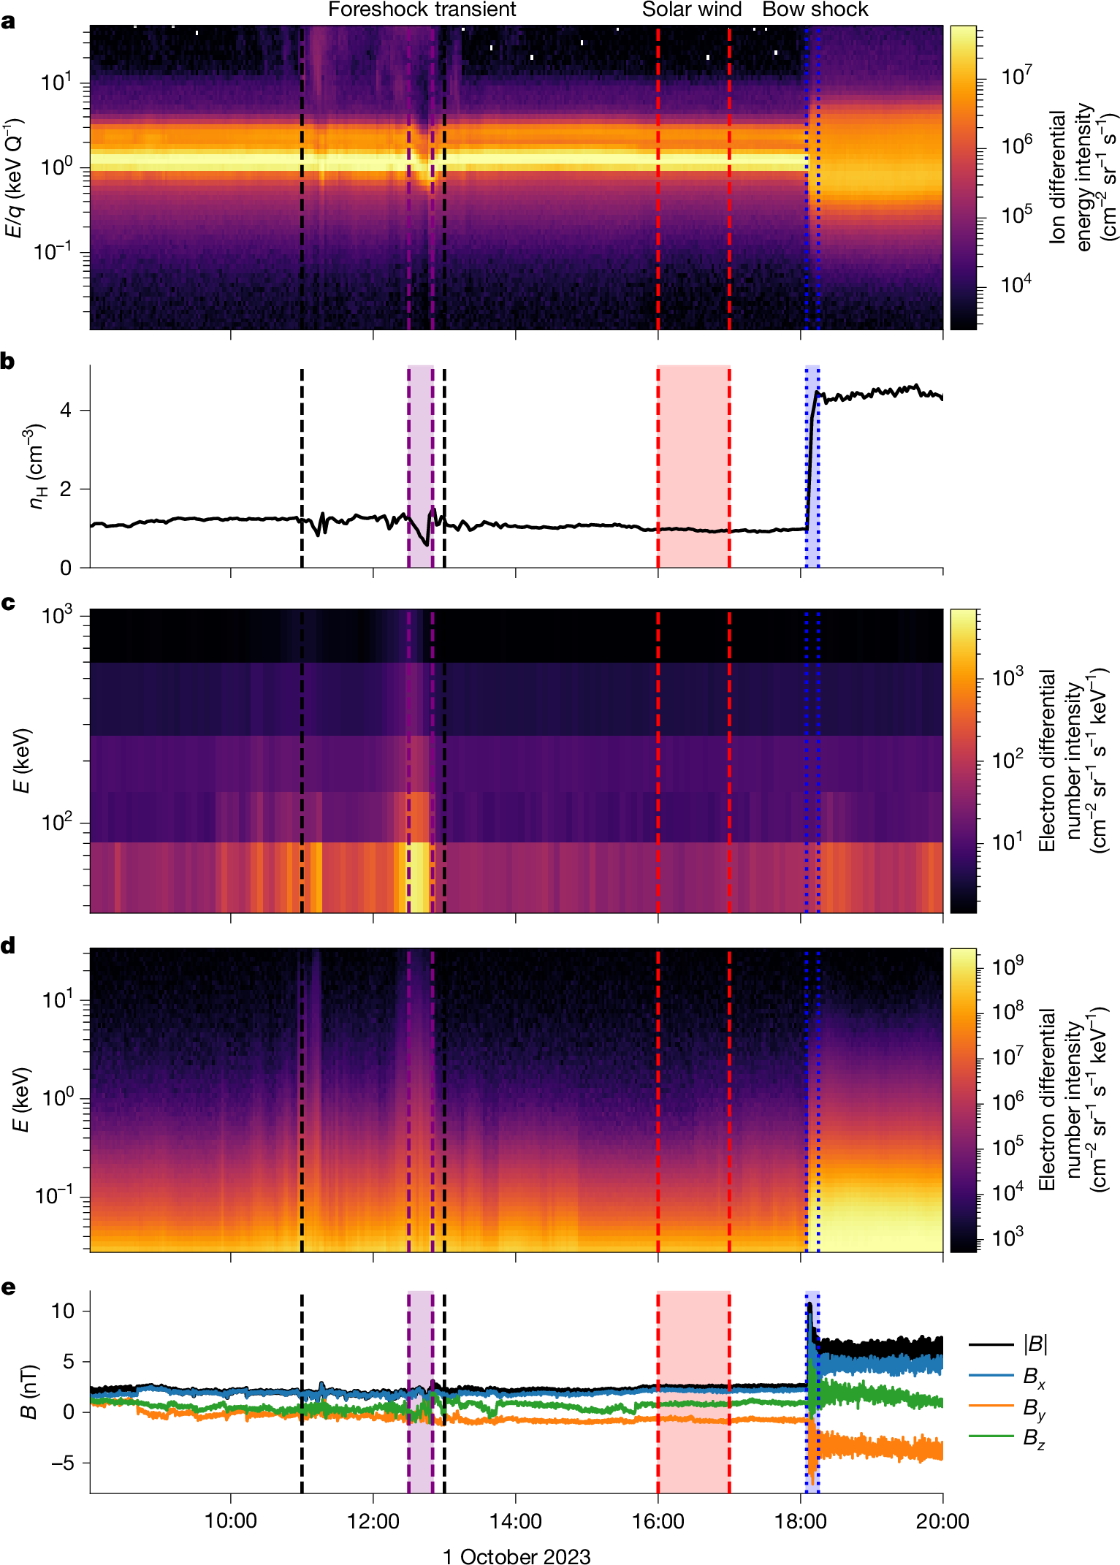
Juno Observations – Jovian Bow Shock Crossing
Ion spectrum
Foreshock Transient (HFA):
Energetic electrons up to 1 MeV
Disrupted solar wind beam
Localized depletion of n and B
Solar wind (SW):
Typical SW:~ 1-2/cc, 2.5 nT
No energetic electrons
Bow shock (BS):
Typical compression of ~2 for B and n
suprathermal electrons present but minimal energetic electrons only up to 10ish KeV
Ion density
Electron
Spectra
JADE + JEDI
Magnetic
field
Raptis et al. 2026

Slide 16
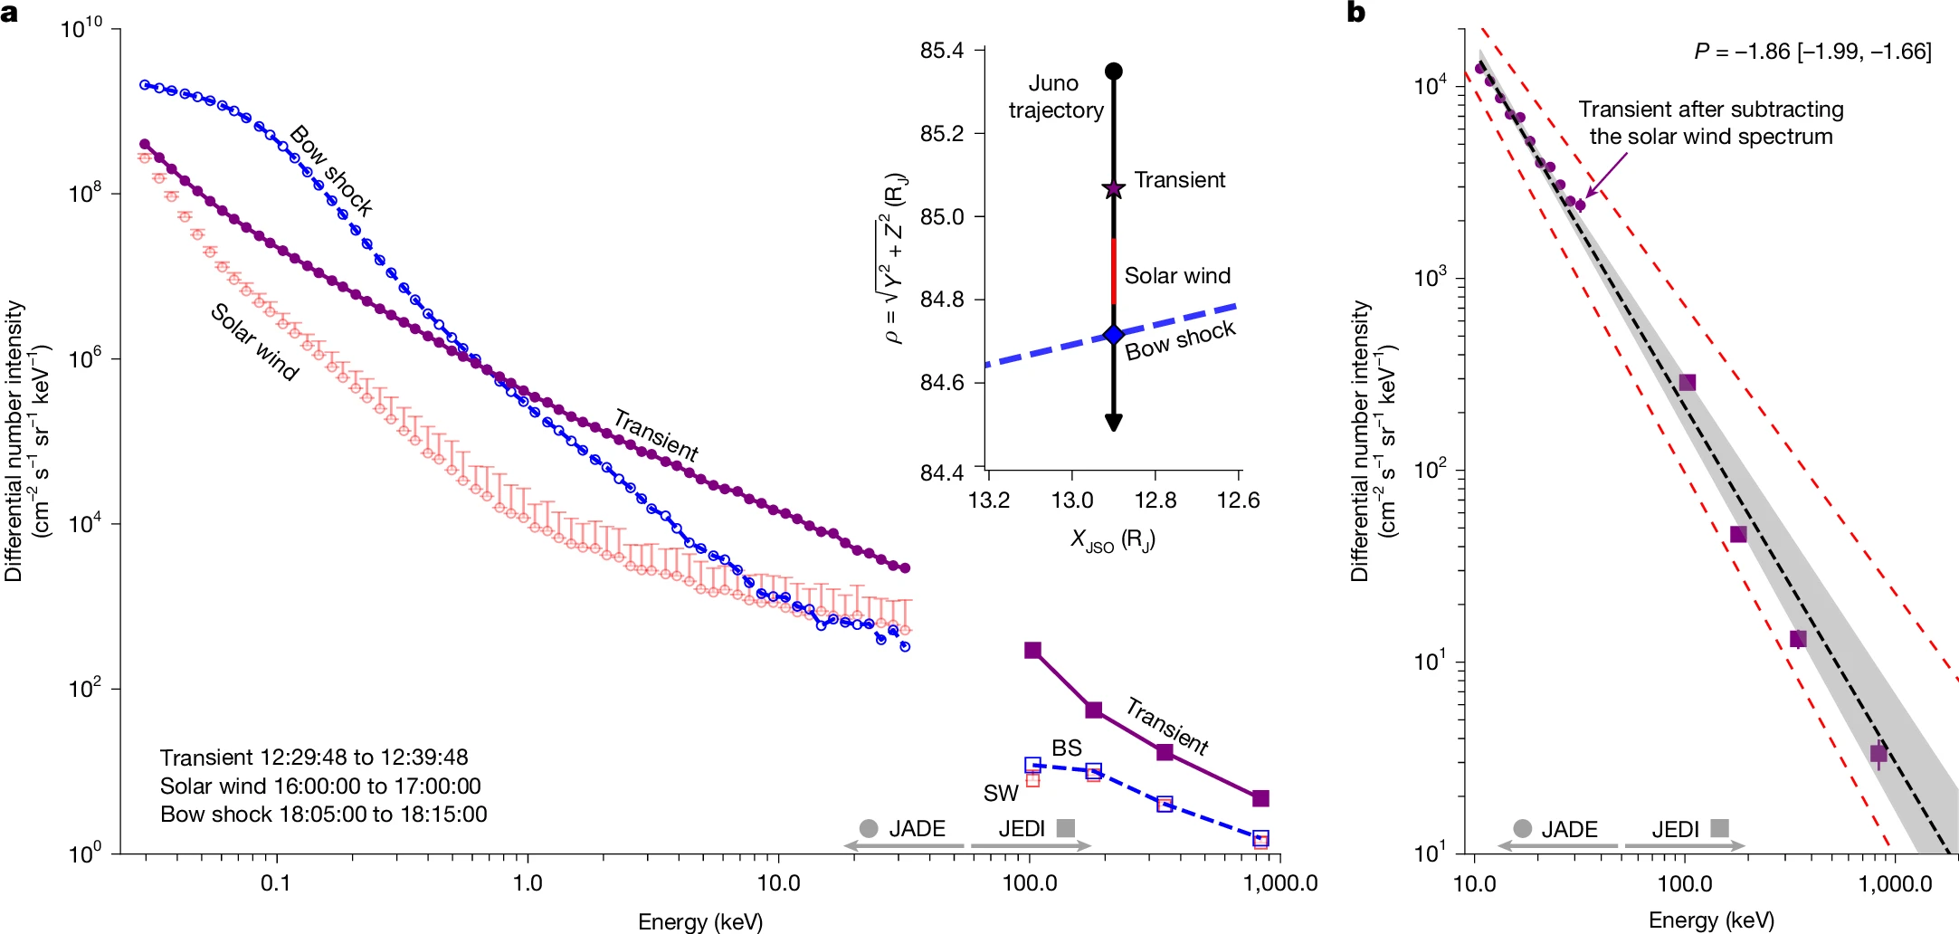
Reinforced Shock Acceleration at Jupiter
DSA (rel) ~2
DSA (non-rel) ~1.5
Most efficient acceleration happens at the foreshock. The bow shock crossing only up to <10 keV
Raptis et al. 2026

Slide 17
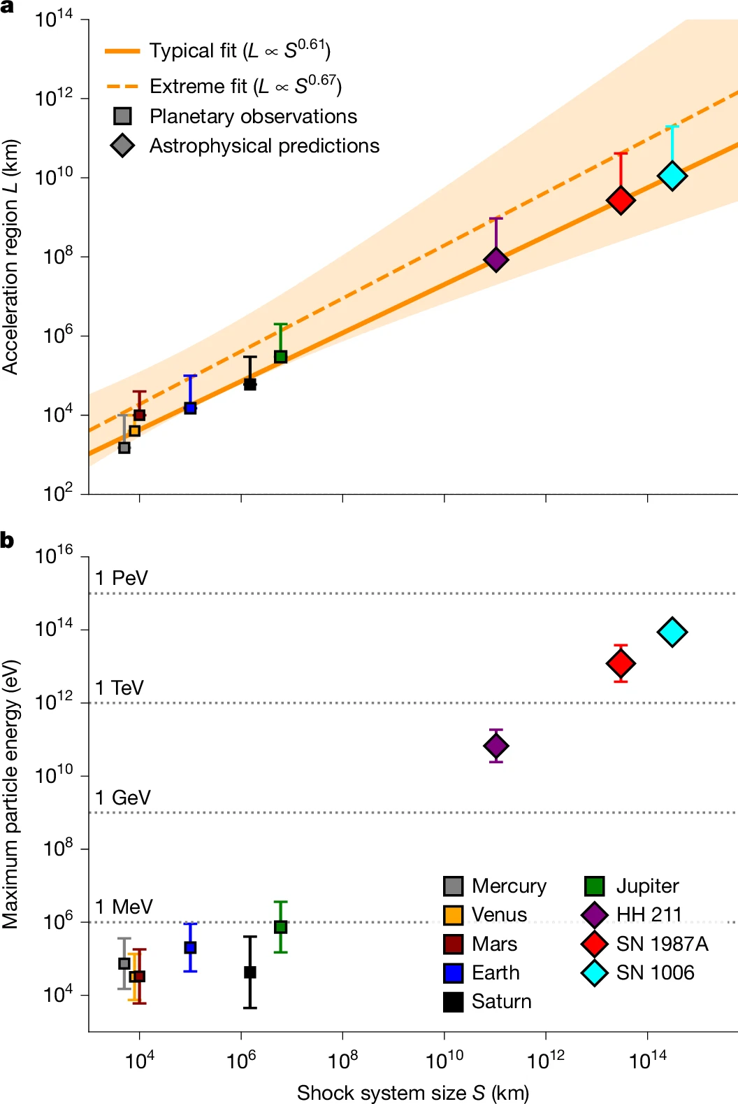
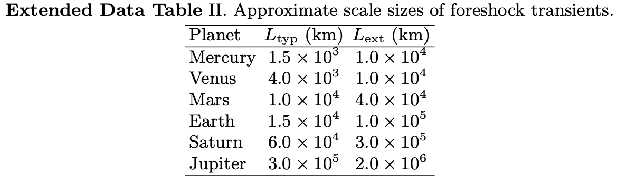
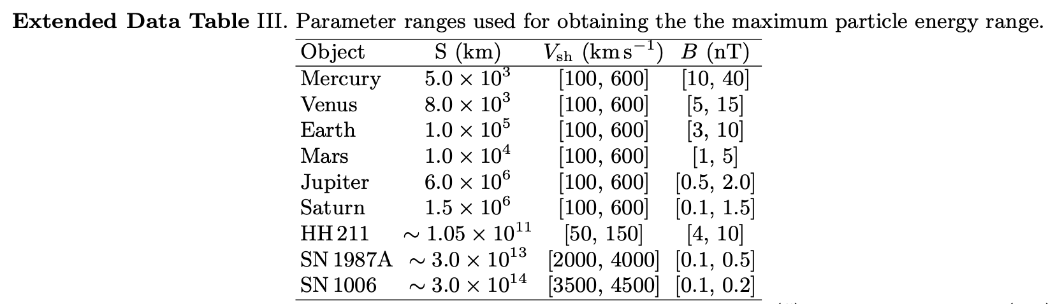
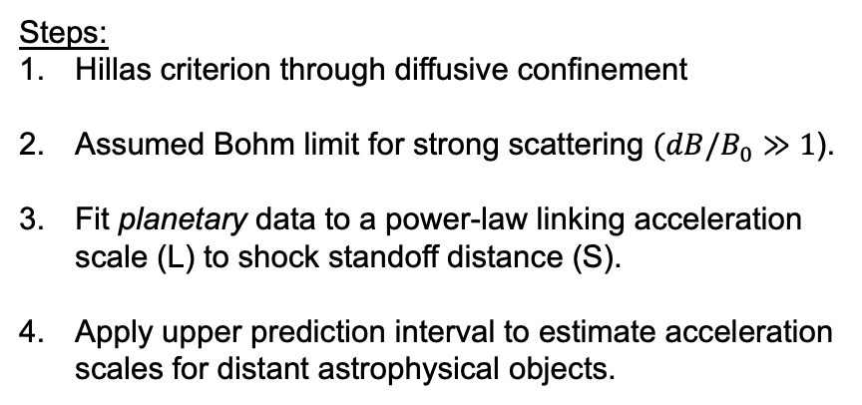
Can we extrapolate to astrophysical shocks?
Assumptions & Methods
Caveats & Assumptions:
An impossible to verify extrapolation
Geometric limitations
Magnetic coherence can vary strongly in each system
Broader Discussion:
Jupiter and Earth show most efficient acceleration during a large scale transient rather than at the shock transition.
Predicted max energies ~ observations at SN1006
fit
extrapolation
Steps:
Hillas criterion through diffusive confinement
Assumed Bohm limit for strong scattering $(dB/B_{0}≫1$).
Fit planetary data to a power-law linking acceleration scale (L) to shock standoff distance (S).
Apply upper prediction interval to estimate acceleration scales for distant astrophysical objects.
Raptis et al. 2026
Inspired by Uritsky et al., 2014 & Valek et al., 2017

Slide 18
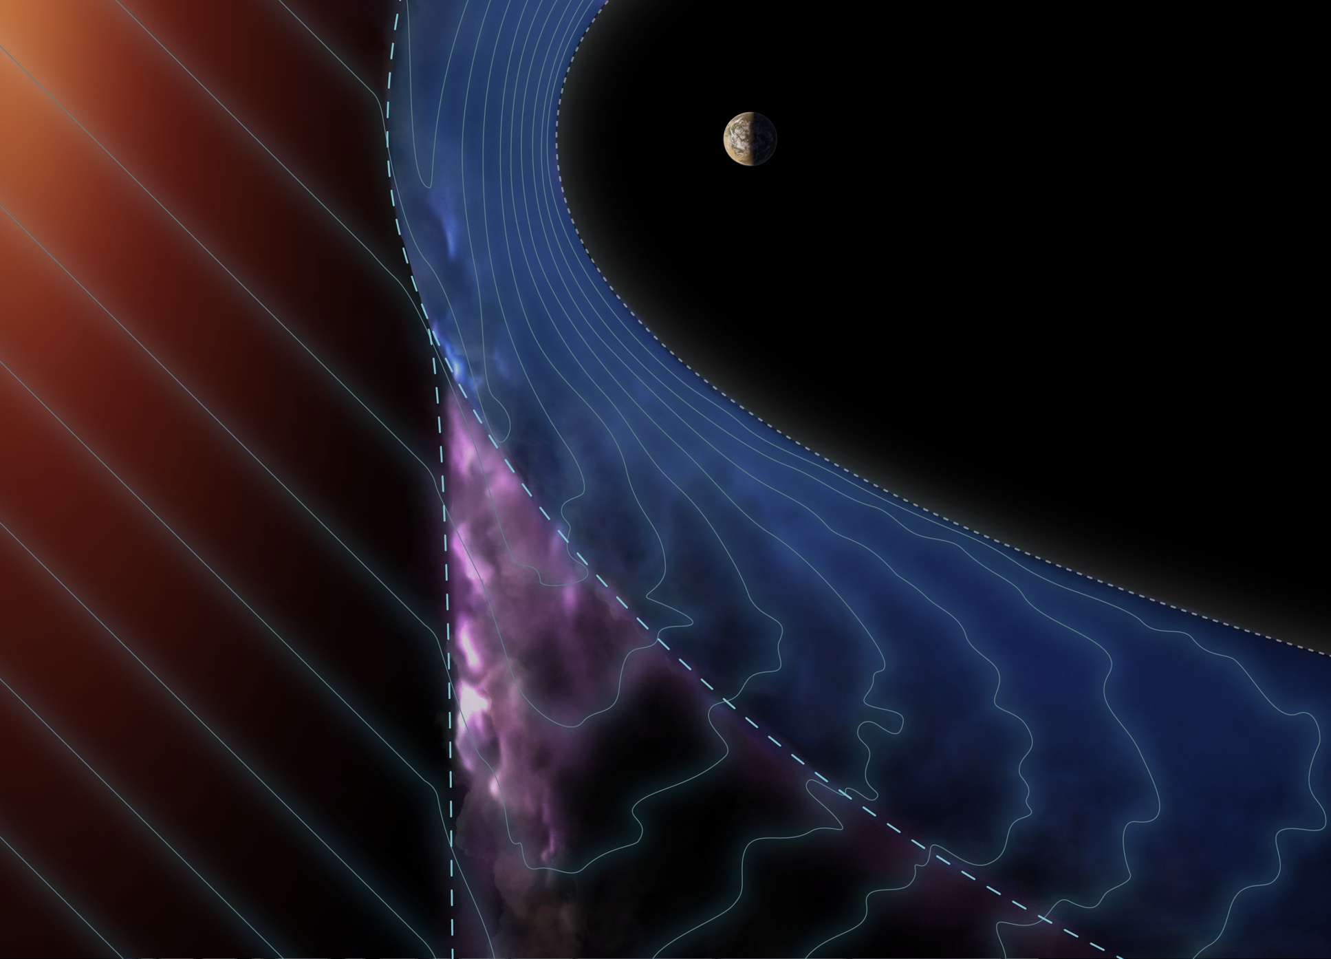
Illustration of the process in an arbitrary planet
Raptis et al. 2026

Slide 19

Illustration of the process in an arbitrary planet
Raptis et al. 2026

Slide 20
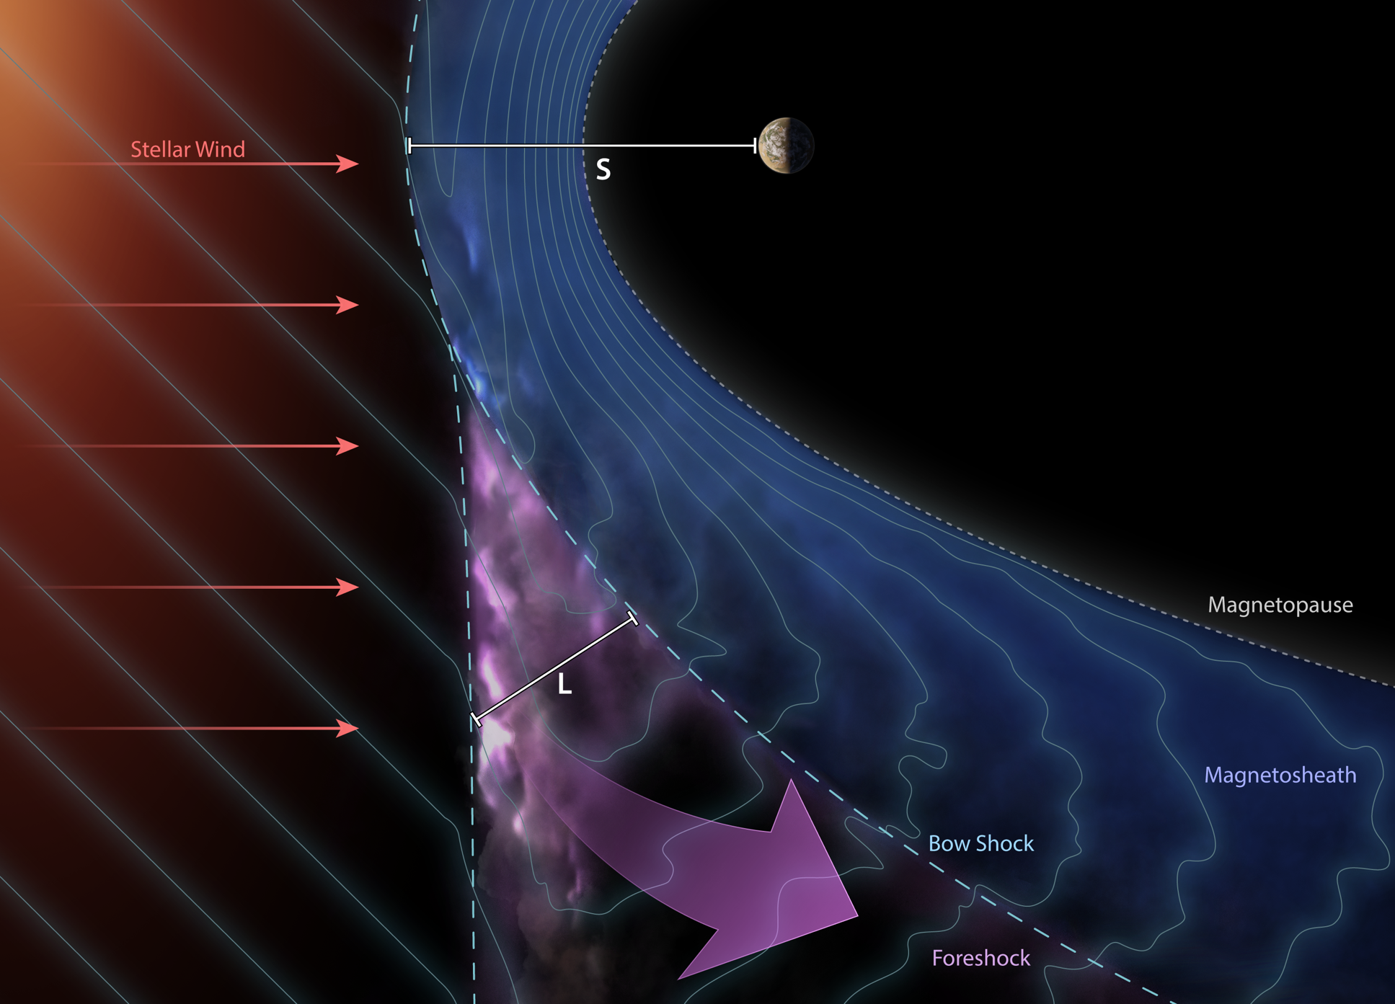
Illustration of the process in an arbitrary planet
Raptis et al. 2026

Slide 21
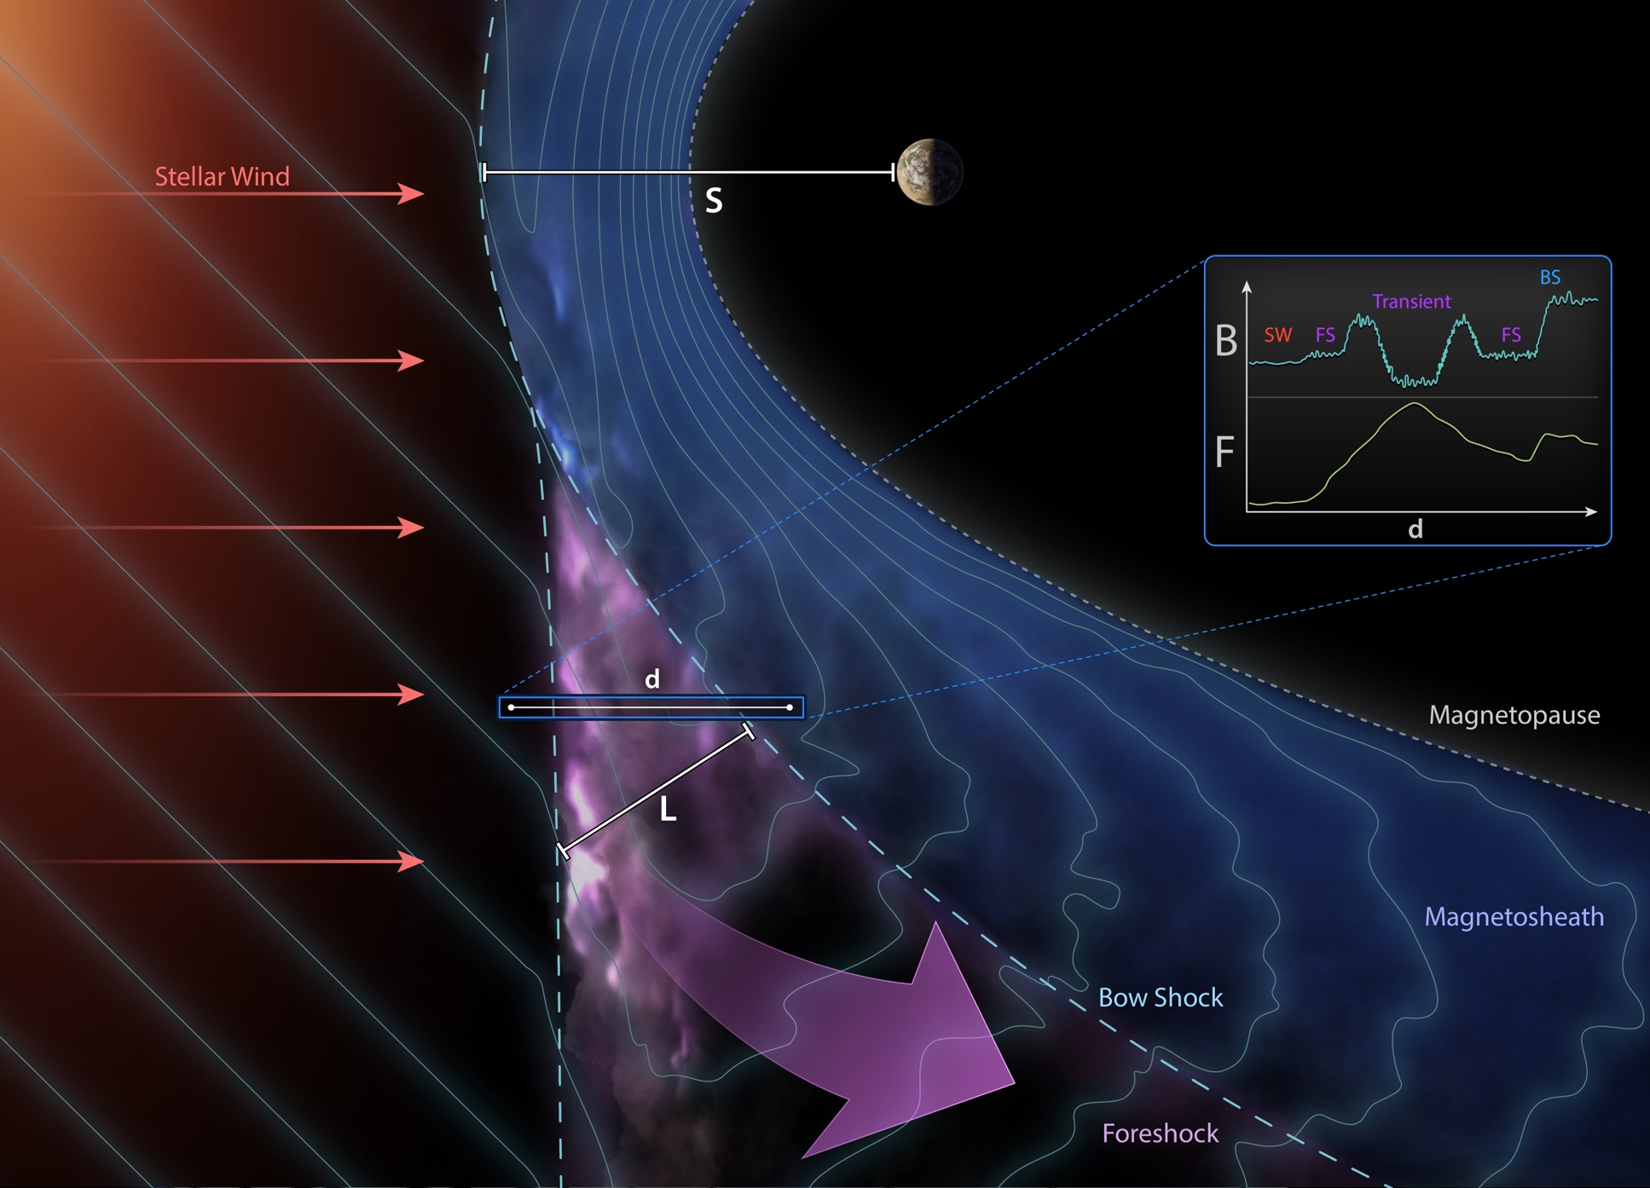
Illustration of the process in an arbitrary planet
Raptis et al. 2026

Slide 22
Summary & Future Work
Transient Processes at Quasi-Parallel shocks may be more important than previously realized! relativistic particles, localized compressive edges/shocks operating multiple temporal and spatial scales all interacting with each other.
Recent results:
Seeding and Max Energy: Identified a systematic suprathermal seeding (~1–5 keV) intrinsic to fast solar wind. Localized transients act as the primary driver to energize these these electrons to high energies (100s of keV). (Raptis et al., 2025a)
A Two-Step Mechanism: Particles get more energized when larger transients (i.e., HFAs/FBs) cross the bow shock. For energetic particles, additional acceleration can be modeled by compression (betatron) and strong scattering. (Raptis et al., 2025b)
Broader Implications: We expanded this model to test its universality at other planetary boundaries (e.g., Jupiter – 1 MeV electrons) and fundamental astrophysical shocks. This model predicts ~10-100 TeV particles in in supernova shocks (e.g., SN 1006) consistent with cosmic ray observations. (Raptis et al., 2026)
Future steps:
MMS can tackle the following outstanding questions:
String-of-pearl-campaign: Connection of transient processes upstream to downstream (origin & energization)
Energy transfer & wave particle interaction is still unclear. We need to look at electron scales for formulating the connection from thermal to suprathermal energies and to uncover the processes of pre-seeding

