Slide 1
What Science Can We Do with The L1 Spacecraft Fleet?
PRELIMINARY IMAP DATA
PRE REALEASE - UNVALIDATED
Savvas Raptis
JHU/APL, Laurel, MD, USA
D. L. Turner, T. Horbury, D. Chakrabarty, E. Christian, C. M. S. Cohen, M. E. Cuesta, M. A. Dayeh, R. W. Ebert, H. A. Farooki, M. Gkioulidou, C. O. Lee, D. J. McComas, C. O’Brien, S. Pal, J. S. Rankin, K. Sankarsubramanian, A. Szabo, R. Torbert, D. Vassiliadis, S. Vines, L. B. Wilson III
Acknowledgments*:
IMAP Mission
savvas.raptis@jhuapl.edu | https://savvasraptis.github.io
*Direct support from all missions: IMAP, SOLAR-1, Aditya-L1, Wind, ACE, DSCOVR

Slide 2
Questions & Outline
We've gone from one solar wind L1 monitor to six.
Which science questions changed because of that and how?*
What is the SW magnetic field across multiple scales? Can we reconstruct it? and what can L1 fleet tell us about what eventually happens at Earth?
If we take one IP shock, can we find its orientation from one spacecraft? What about the whole fleet? What can this tell us about the shock?
How coherent is a CME across ~100-200 Re? When two signals correlate well, is it shared physics, a shared trend, or maybe even a coincidence?
But first some intro about L1 fleet!
*… a subjective and biased take from an in-situ data person studying mostly Earth

Slide 3
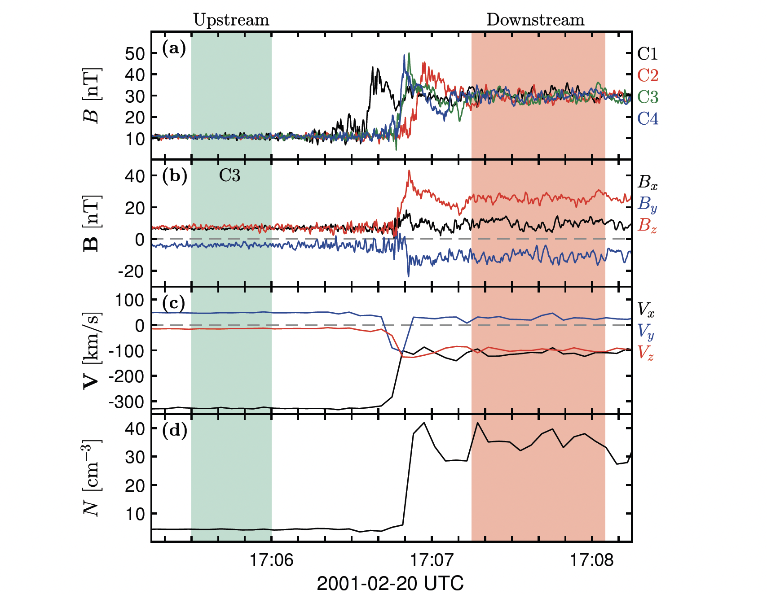
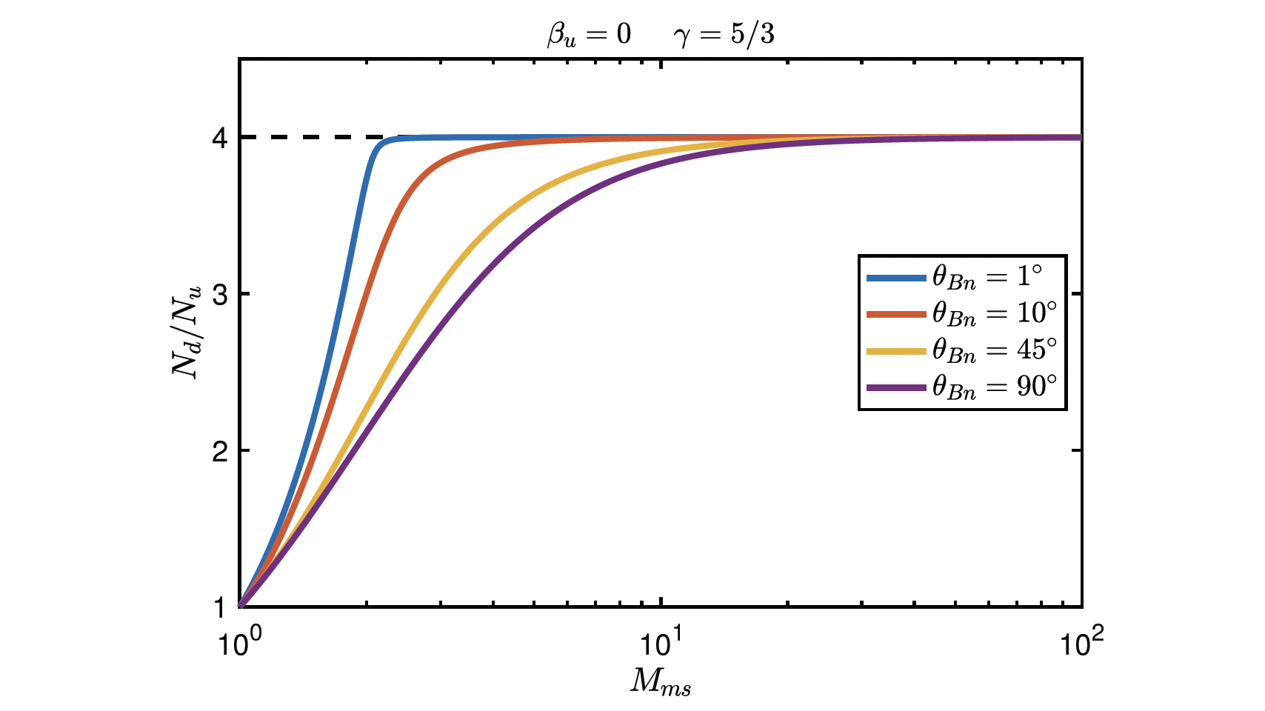
Community Reminder: in-situ Data & Shocks
Cluster observations at Earth’s bow shock
“We can also see this in the compression factor that is 8, which we know from the Rankine-Hugoniot is not allowed”. This highlights one of the considerations regarding accuracy and reliability of methods when working with spacecraft data from shocks in space”
A. Johlander PhD Thesis 2019

Slide 4
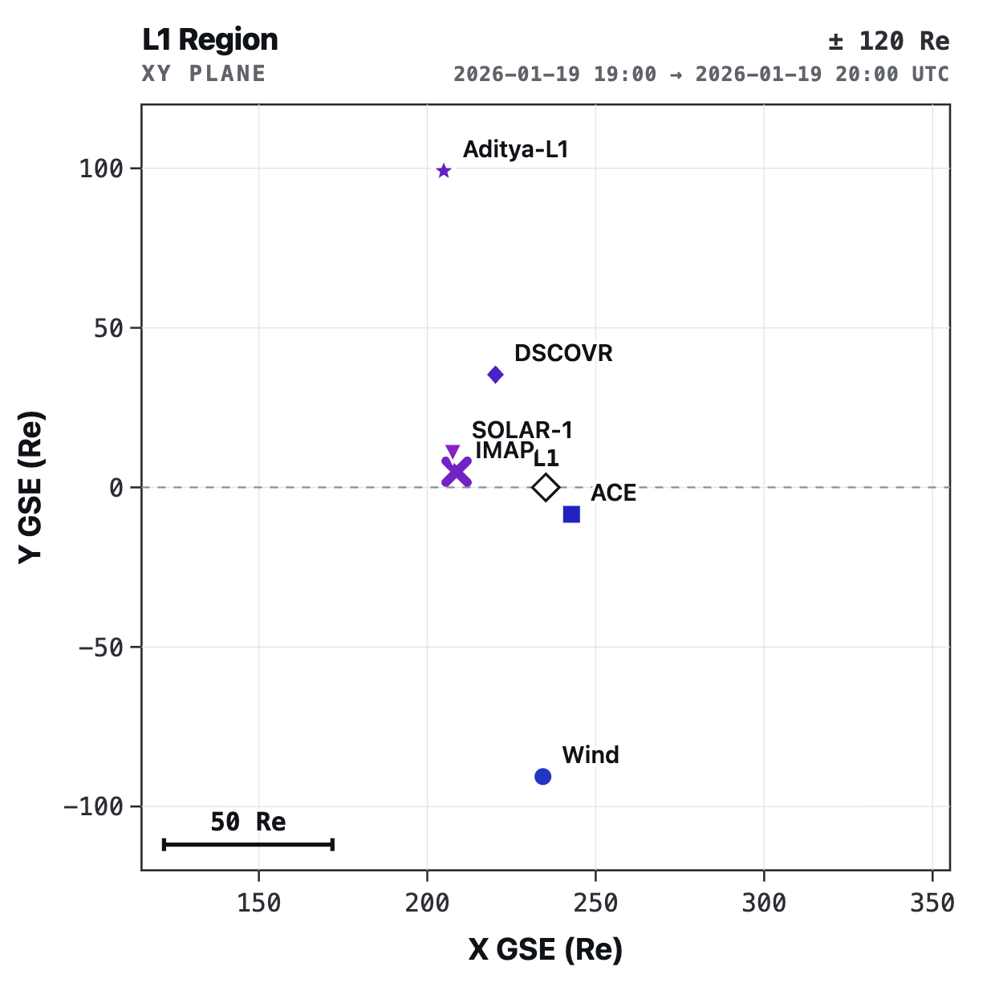
L1 Constellation/Fleet/Swarm/Monitors
Six-spacecraft L1 era began practically a few months ago!
S/C | Launched | At L1 | B | Plasma | SEP | Comp.
Wind | Nov 1994 | ~2004 | ✓ | ✓ | ✓ | ✓
ACE | Aug 1997 | 1998 | ✓ | ✓ | ✓ | ✓
DSCOVR | Feb 2015 | 2015 | ✓ | ✓ | – | –
Aditya-L1 | Sep 2023 | Jan 2024 | ✓ | ✓ | ✓ | ~
IMAP | Sep 2025 | Jan 2026 | ✓ | ✓ | ✓ | ✓
SOLAR-1 | Sep 2025 | Jan 2026 | ✓ | ✓ | ✓ | –
~200 Re
IMAP: No Later than August 1st , less than a month!
SOLAR-1: All data should be accessible already. Data of previous dates from releases (i.e., 1st of April for MAG, 27th of May for STIS (suprathermal/energetics), and 2nd of June for SWiPS (plasma), may take a while
* Important reminder: Intercalibration for plasma is difficult (impossible?), but magnetometers should be doable
Notes:
Spin stabilizer : unknown offset, that is found from the spin
3-axis: need some modeling

Slide 5
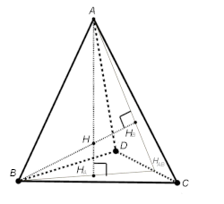
Multipoint Data Analysis
In 3D space, 4-points are needed to calculate vector gradients, divergence and curl, planar boundary orientations and speed, etc.
Ideal orientation of the 4-points is an orthocentric tetrahedron
With 6 observatories around L1, there are 15 different tetrahedral sets
However, the quality factor (Q), the planarity (P), and the elongation (E) of the tetrahedra must be considered
3
 | Permutations with 4 of 6 Spacecraft
1 | 1 | 2 | 3 | 4
2 | 1 | 2 | 3 | 5
3 | 1 | 2 | 3 | 6
4 | 1 | 2 | 4 | 5
5 | 1 | 2 | 4 | 6
6 | 1 | 2 | 5 | 6
7 | 1 | 3 | 4 | 5
8 | 1 | 3 | 4 | 6
9 | 1 | 3 | 5 | 6
10 | 1 | 4 | 5 | 6
11 | 2 | 3 | 4 | 5
12 | 2 | 3 | 4 | 6
13 | 2 | 3 | 5 | 6
14 | 2 | 4 | 5 | 6
15 | 3 | 4 | 5 | 6
2
4
Orthocentric Tetrahedron
1
6
15 combinations from 6 observatories
5
"Analysis Methods for Multi-Spacecraft Data" (Paschmann & Daly, 1998 and 2008)

Slide 6
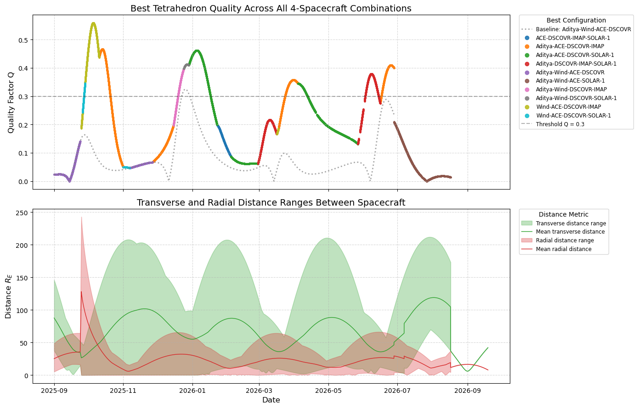
The Geometry of the L1 Constellation
Tetrahedral quality factor for IMAP, SOLAR-1, ACE, Wind, DSCOVR, and Aditya-L1 between Sep-2025 and July-2026
Due to orbital configuration around L1, quality is typically not great
Question: Can we make up for some of this with sheer number of tetrahedra available?
Fuselier+ [SSR 2016]:

Slide 7
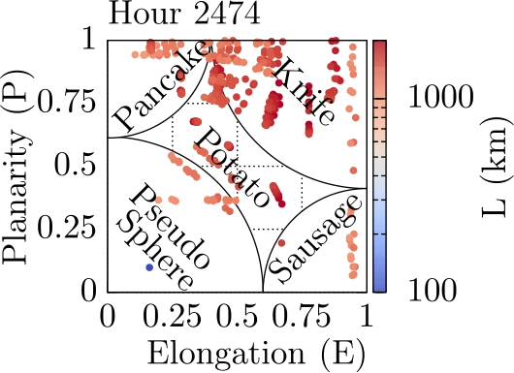
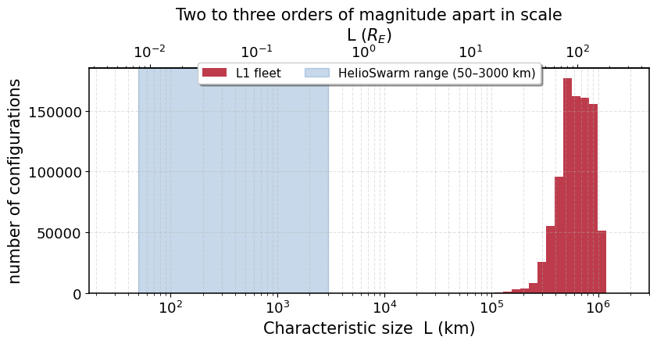
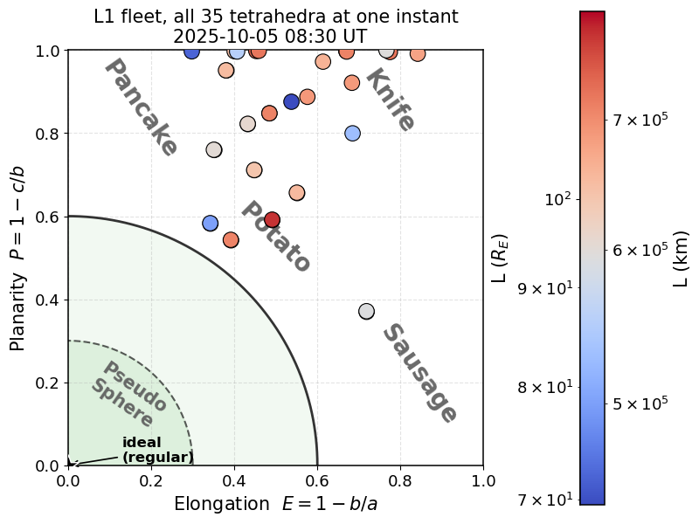
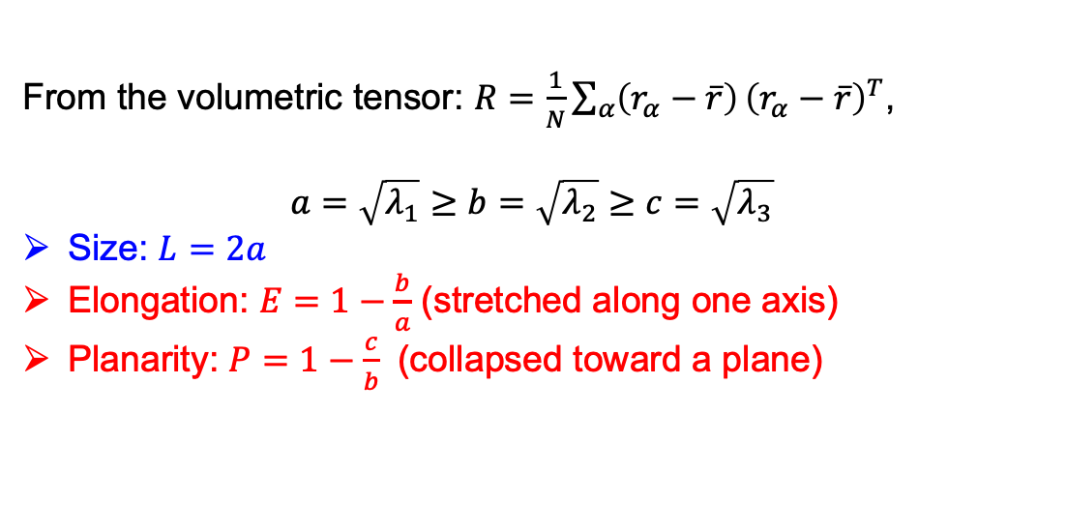
The L1 fleet samples a huge range of shapes and scales, but it never chose any of them.
Klein+ [SSR, 2023]
From the volumetric tensor: $R=\frac{1}{N}\sum_{α}{\left(r_{α}−\overline{r}\right)}{\left(r_{α}−\overline{r}\right)}^{T}$,
$$a=\sqrt{λ_{1}}≥b=\sqrt{λ_{2}}≥c=\sqrt{λ_{3}}$$
Size: $L=2a$
Elongation: $E=1−\frac{b}{a}$ (stretched along one axis)
Planarity: $P=1−\frac{c}{b}$ (collapsed toward a plane)
Helioswarm
Dunlop+ [Frontiers, 2024]
L sets the scale, E and P tell you which components of the gradient you can believe
L1 Fleet

Slide 8
Solar wind Structure & Modeling
PRELIMINARY IMAP DATA
(1)
What is the SW magnetic field across multiple scales? Can we reconstruct it? and what can L1 fleet tell us about what eventually happens at Earth?

Slide 9
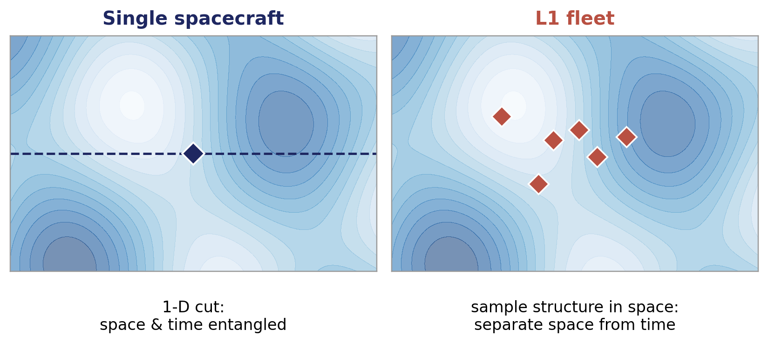
Probing the 3D Structure & Spatiotemporal Evolution of the Solar Wind
A single monitor gives only a 1-D cut, multiple points can help us map structure in 3-D rather than along one track.
Question with 2 monitors: over what distance does the solar wind stay the same? Now we can attempt:
“what is the structure, and how is it changing?”
Burkholder+ 2020
Borovsky 2017

Slide 10
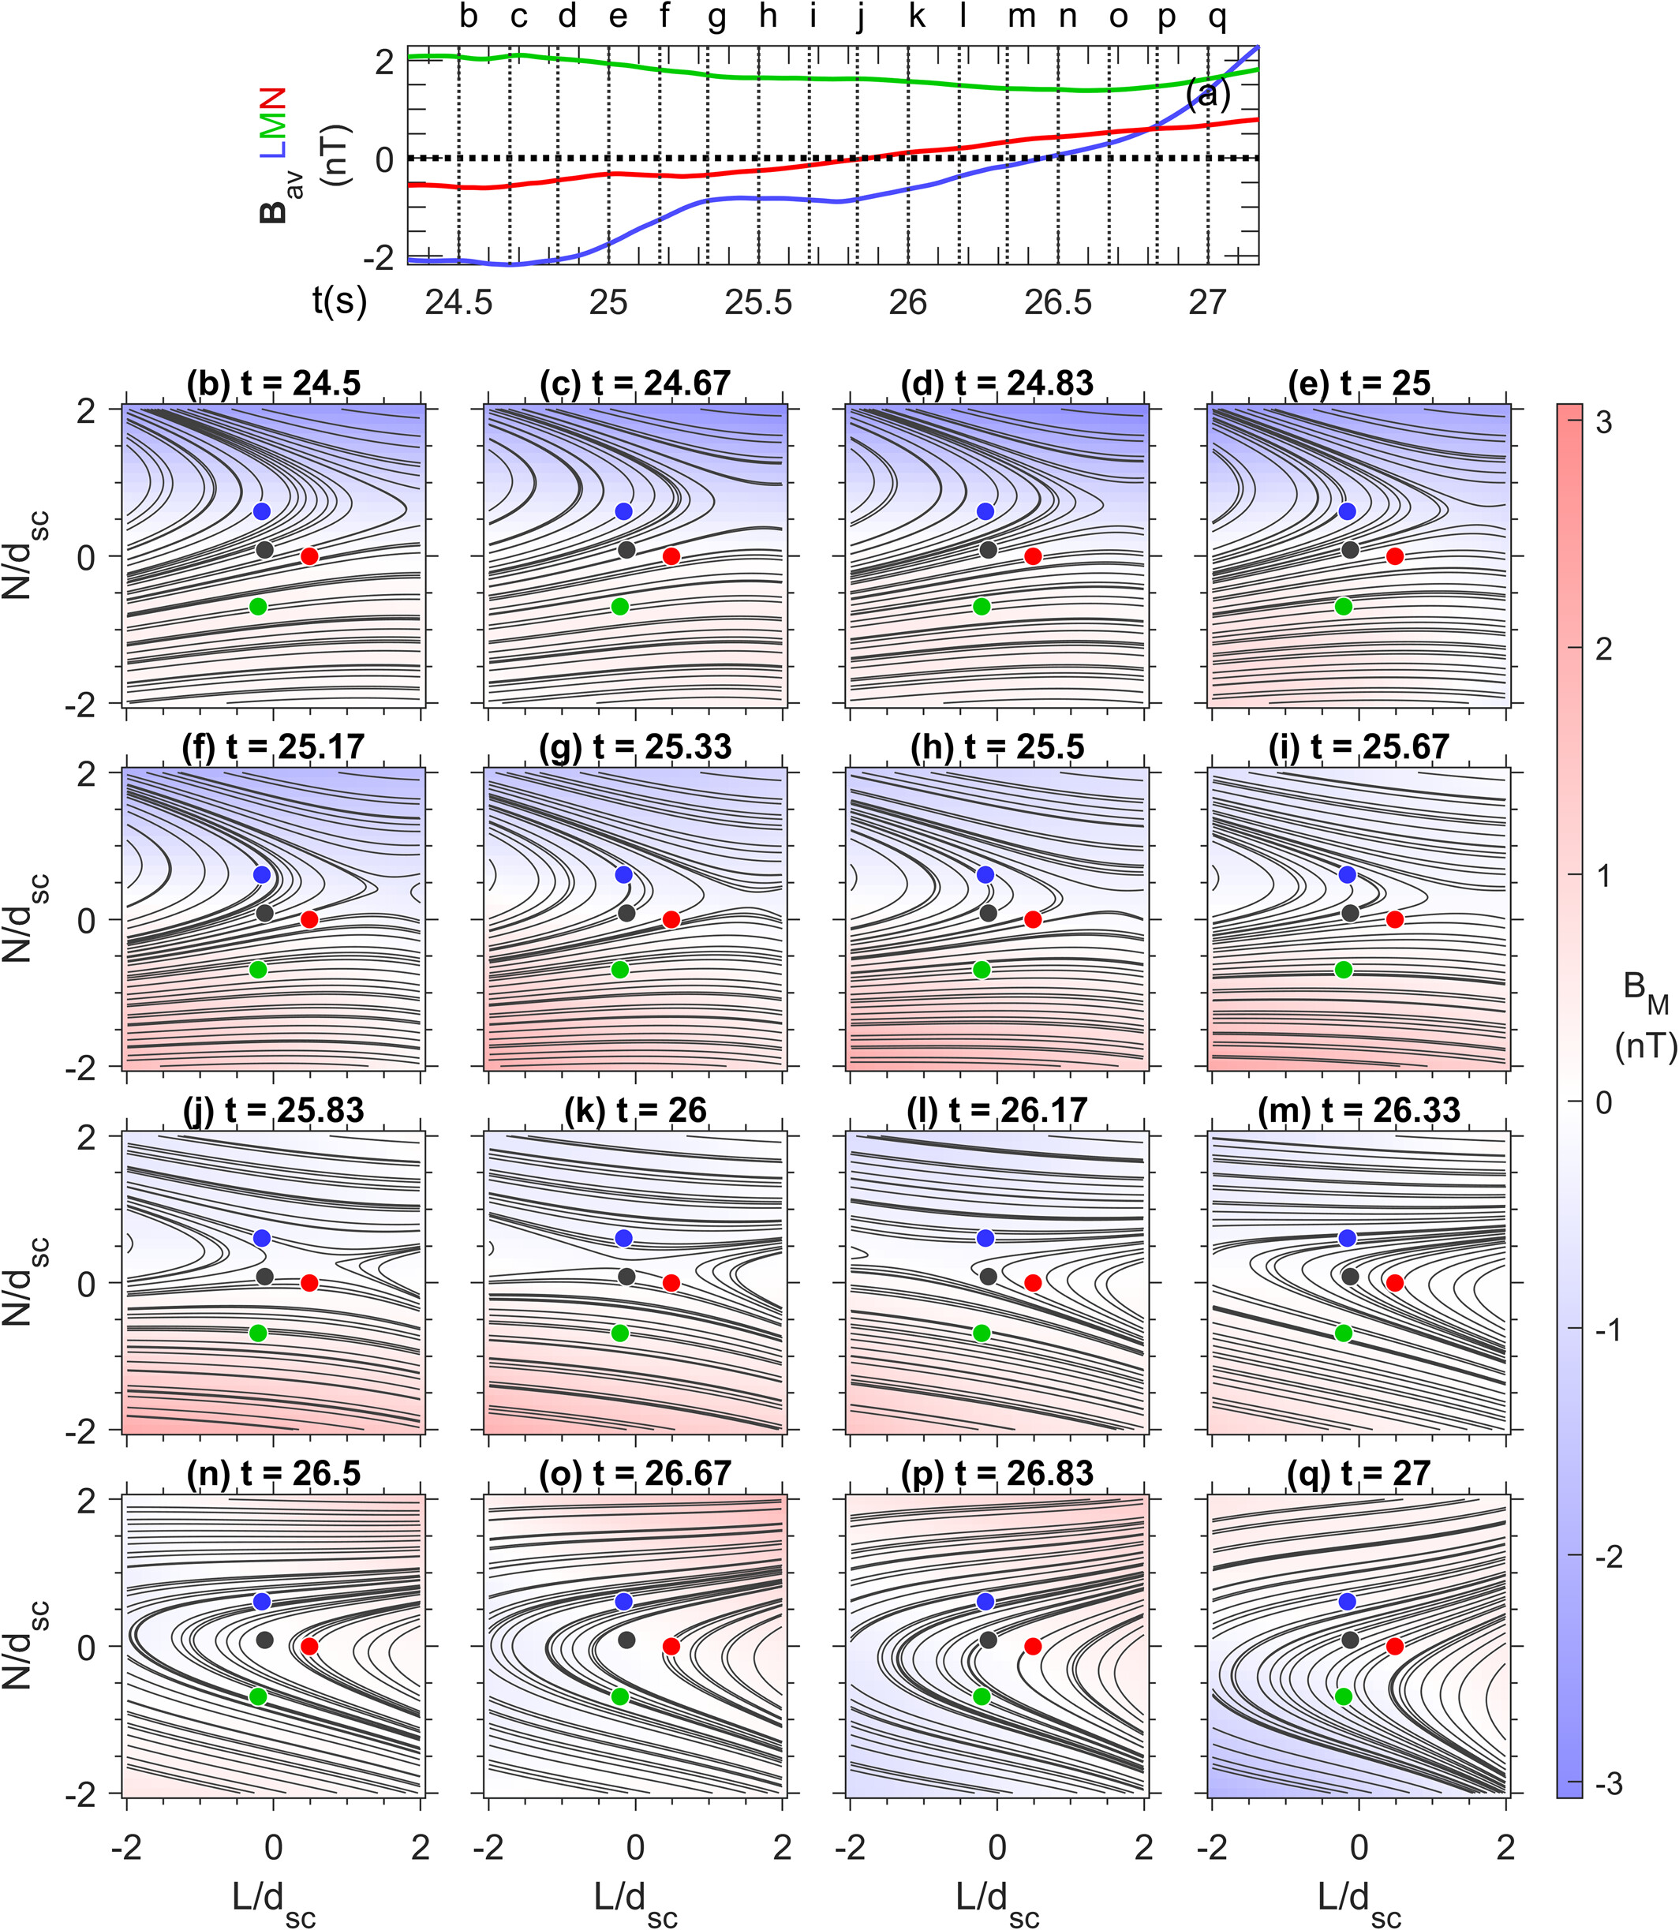
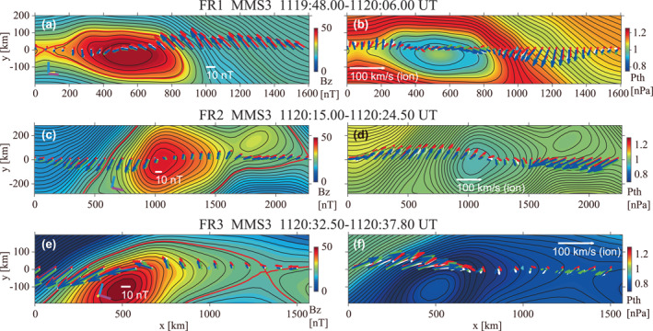
Magnetic Field Reconstruction
R. Denton+
[JGR 2022]
Grad-Safranov
Using MHD to reconstruct B from time-series observations
Assumes MHD & Equilibrium
Hasegawa+ [JGR 2023]
Wind Data
MHD Sims / Test
2nd order Taylor
Essentially a polynomial reconstruction from MMS data
Farooki+ [ApJS 2024]
Notes:
Grad-Shafranov reconstruction assumes the structure is roughly 2-D and in magnetohydrostatic equilibrium, a balance between magnetic and plasma pressure that does not change along one axis (the flux-rope axis). Under that assumption the field obeys the Grad-Shafranov equation, a single PDE for a magnetic potential
2nd order Tayloe is the "polynomial fit": a local quadratic in space, no equilibrium assumed. It only reaches as far as the expansion stays accurate, so it maps the immediate neighborhood rather than a whole rope.

Slide 11
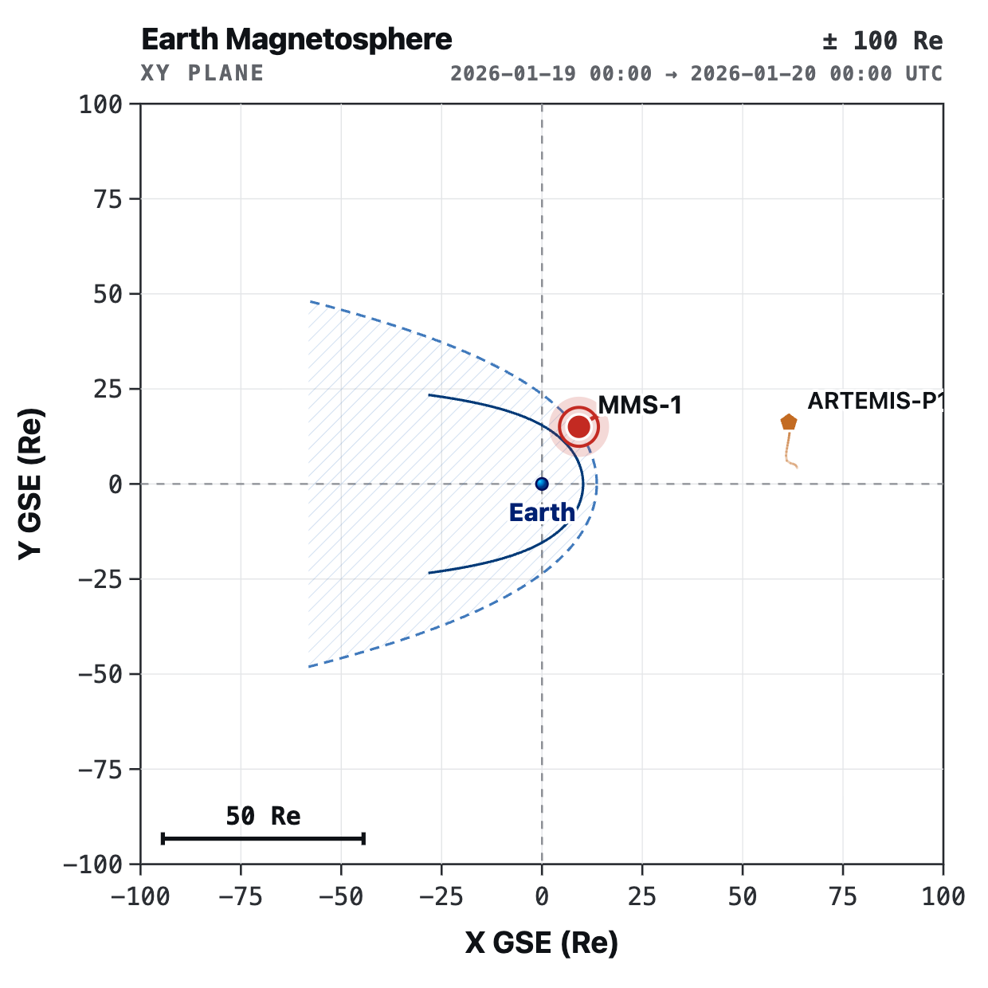
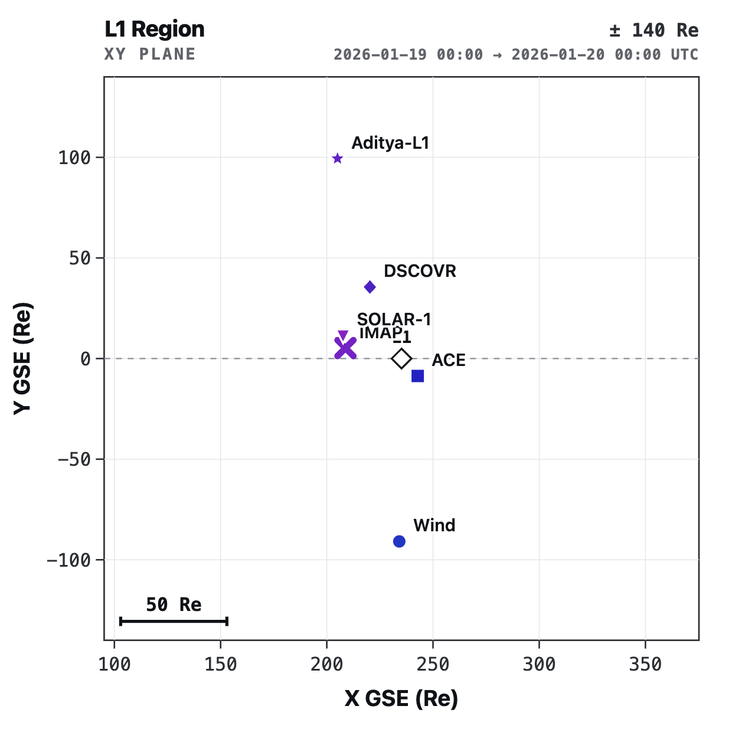
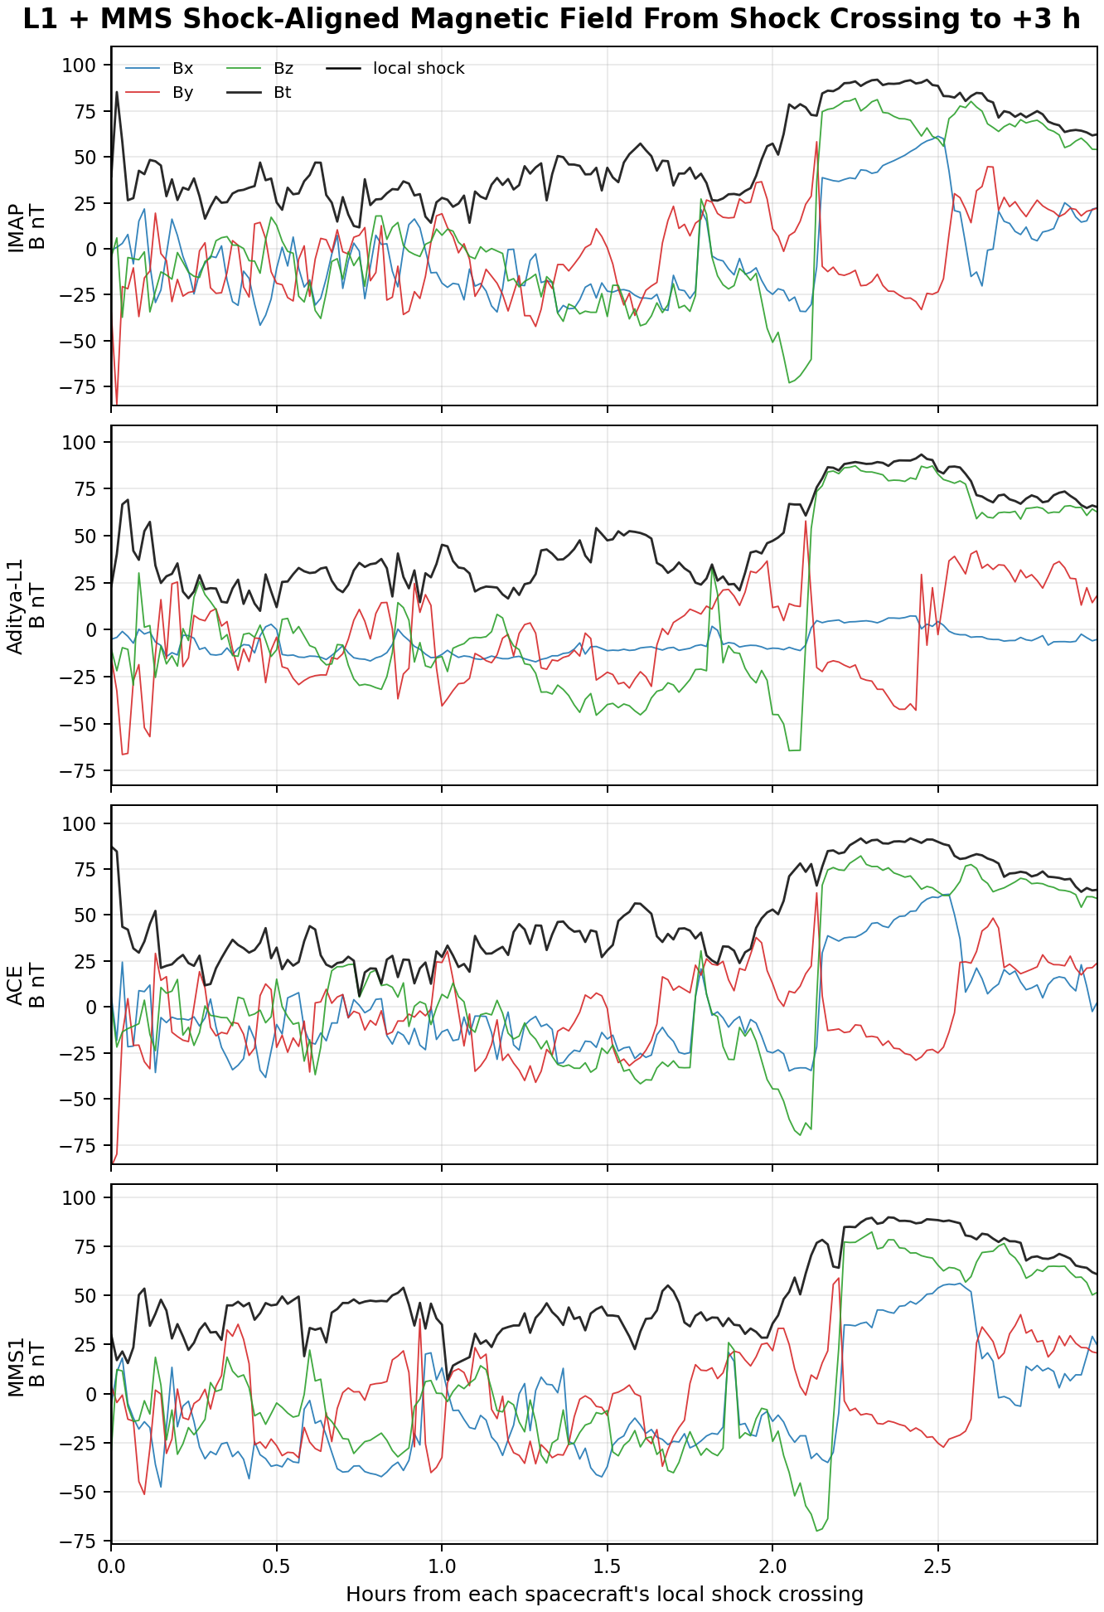
Things evolve from L1 to Earth, sometimes significantly
IMAP
ADITYA-L1
ACE
Propagation over ~100+ Re misses parts of the evolution, and the L1 fleet cannot sample that evolution.
This is a limit of position. No number of SC fleet can fully close this without modeling or near-Earth observations to ground it.
MMS
PRELIMINARY IMAP DATA
PRE REALEASE - UNVALIDATED

Slide 12
IP Shocks Geometry and Orientation
(2)
If we take one IP shock, can we find its orientation from one spacecraft? What about the whole fleet? What can this tell us about the shock?

Slide 13
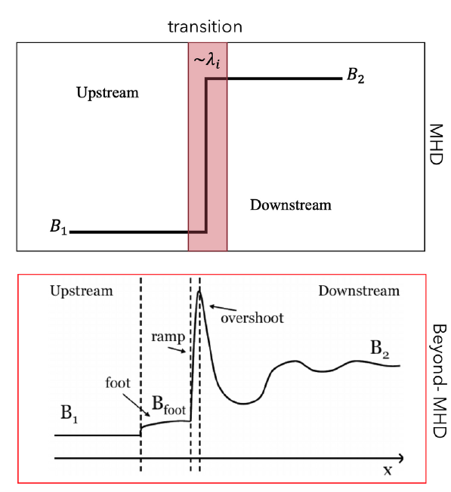
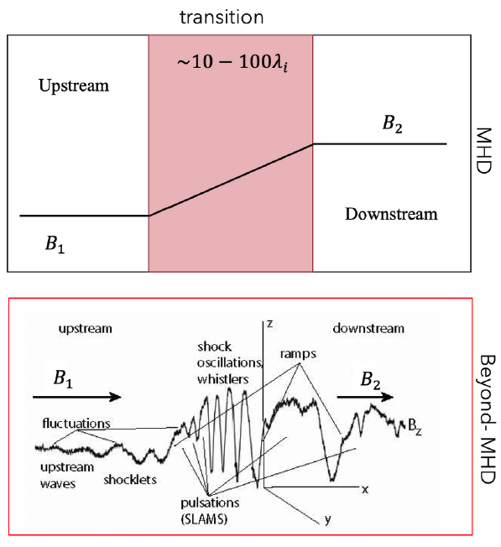


Collisionless Shocks Geometry
Typically, we care about many things:
Ma, θBn, Shock, beta, etc. etc.
Let’s focus just on, θBn
Taken from Balogh & Treumann 2013
$$Qperp: Θ_{Bn} >45°$$
Why we care? Totally different regimes, processes, and phenomena!
Shock properties change acceleration, rippling, transient processes, SEPs, Turbulence etc.:
Balogh & Treumann 2013, Burgess & Scholer 2015,
Trotta+2023, Jebaraj+2024, Kajdič+2024, Raptis+2026, Cuesta+2026 [L1;Ongoing], Allen+2026 [L1;Ongoing] & many others
$$Qpar: Θ_{Bn} <45°$$

Slide 14
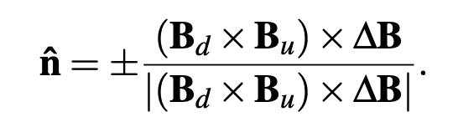
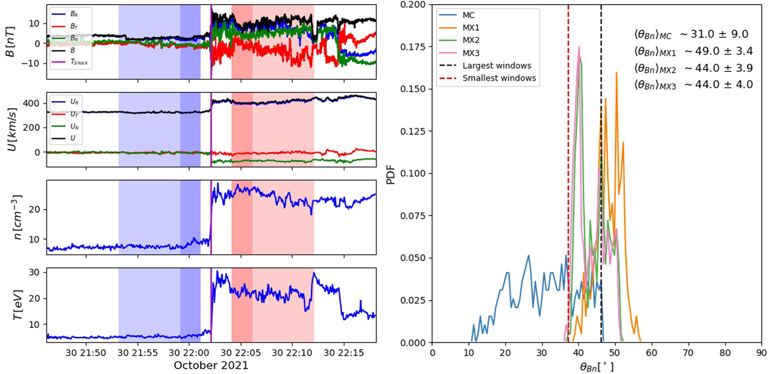

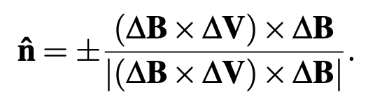
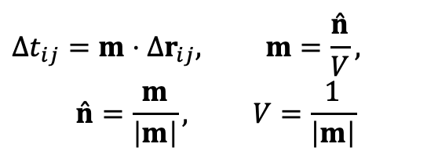
How to Estimate the Orientation of the Shock
upstream
downstream
Abraham‐Shrauner+1972, Schwartz, 1998
Now: with L1 Fleet we can do Multi-SC timing!
See: Paschmann & Daly, 1998, Vogt+2011, Toy-Edens+2025
$$Δt_{ij}=m⋅Δr_{ij}, m=\frac{\overset{ˆ}{n}}{V},$$
$$\overset{ˆ}{n}=\frac{m}{\left|m\right|}, V=\frac{1}{\left|m\right|}$$
Trotta et al. 2022
Question to the room: when two methods disagree on θBn, is that because of physics? Ripples? Other things at the shock? or because of our method?
Notes:
Coplanarity: upstream field, the downstream field, and the normal all lie in one plane

Slide 15
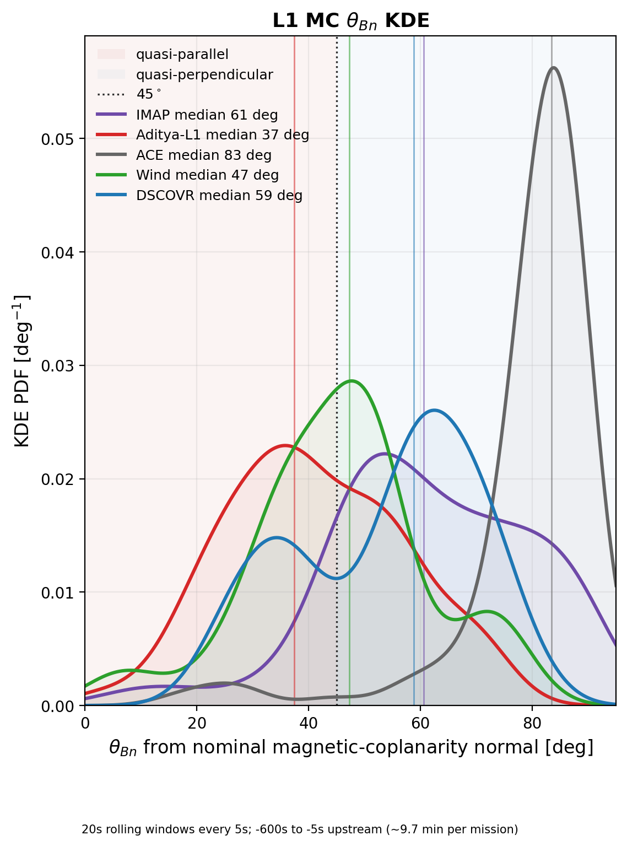
What if one method gives different answers per spacecraft?
Question: Is this real? Methodological? What orientation the actual shock has locally there?
Can multi-spacecraft timing from the L1 fleet help us answer this?
Distribution from
10-min upstream
NOTE: Here I used a fix window for upstream and downstream for MC, if I bootstrap this, the result varies even more! Can timing constrain this?

Slide 16
IP Shock & CME Coherency
(3)
How coherent is a CME across ~100-200 Re? When two signals correlate well, is it shared physics, a shared trend, or can it even be a coincidence?
Notes:
5 mins

Slide 17
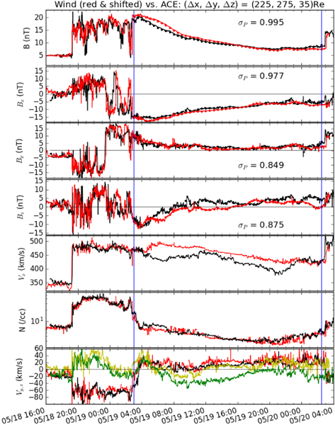
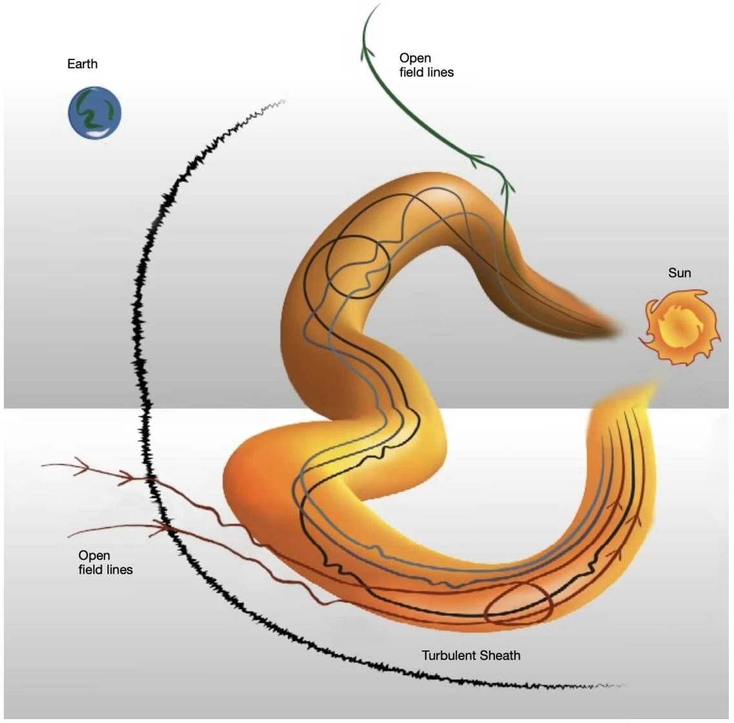
Are CMEs Coherent Structures?
“Magnetic coherence inside MEs of 0.25–0.35 au for the magnitude of the magnetic field, but 0.06–0.12 for B components”
Lugaz+ [ApJL 2018]
Al-Haddad & Lugaz [SSR 2025]
~200 Re
Now, we can ask: How coherent is a CME across ~100-200 Re?
Notes:
Sketch includes Key features: (i) a kinked axis, (ii) not uniform, slightly elliptical ME cross-section, (iii) a mix of closed and open field lines throughout the ME, (iv) weak and non-uniform twist distribution.

Slide 18
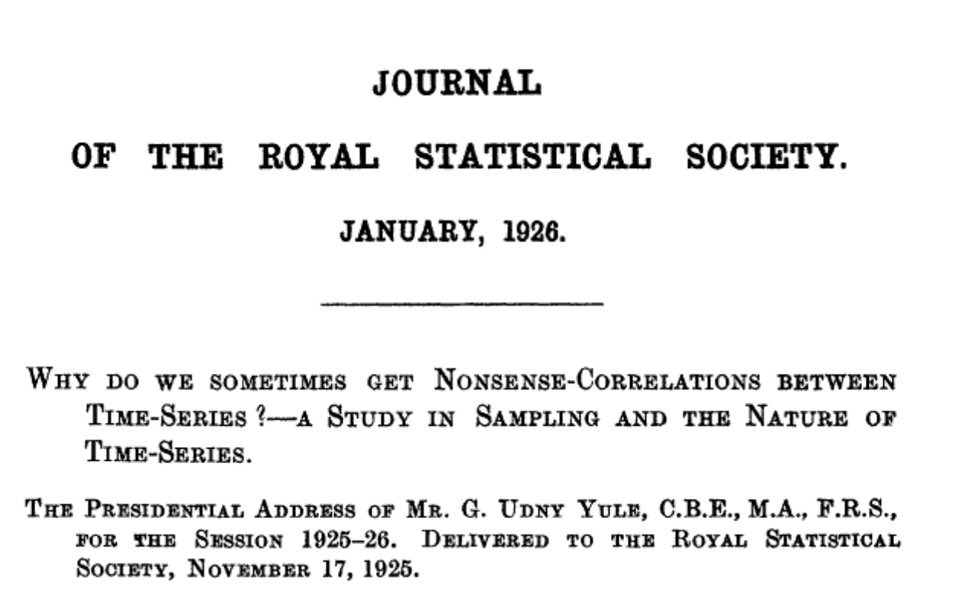
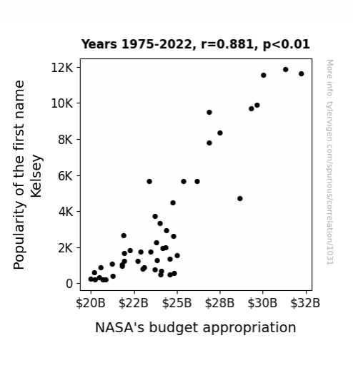
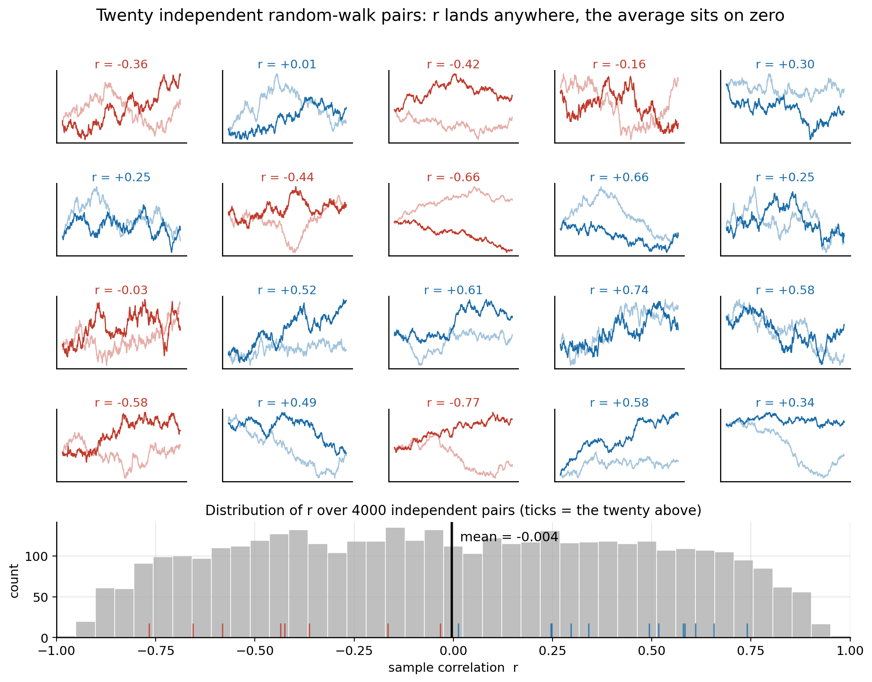
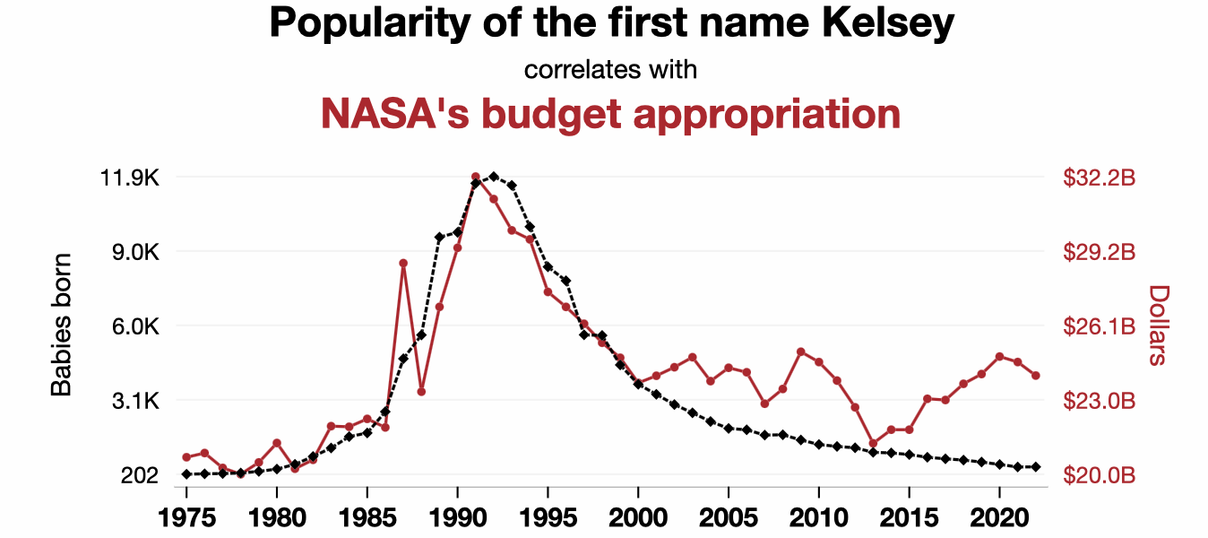
The Random Walk Trap (#1 issue)
Let’s do an exercise! Can unrelated timeseries be correlated?
A question from 100 years ago
Yule+1926
The solution to our funding issue:
Have kids and name them Kelsey!
r assumes that your n points are n independent observations.
Random walks are uniformly distributed in r

Slide 19
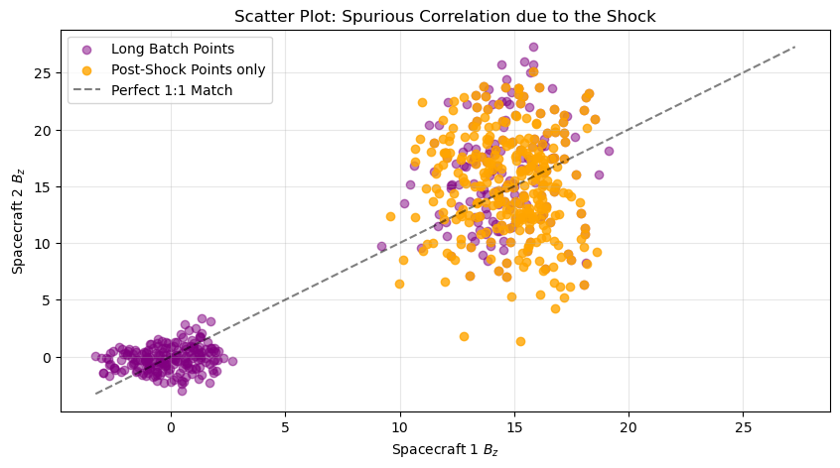
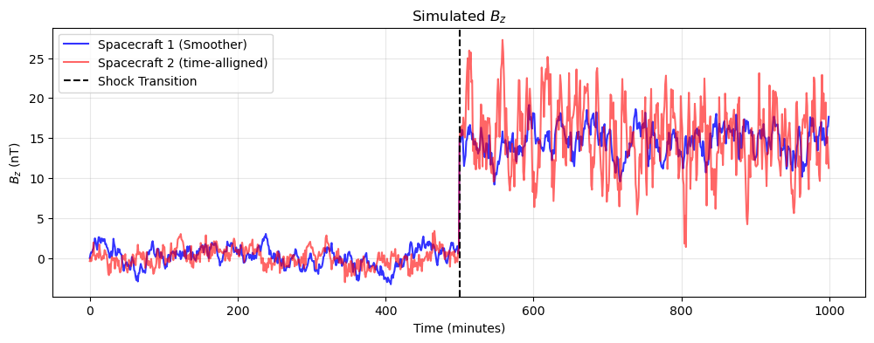
The Spurious Correlation Plasma Mixing Trap (#2 issue)
Broader Discussion
Mixing two distinct regimes breaks "stationarity.” Macro-scale variations wash out micro-scale differences in metrics such as correlations
Pre-Shock Only: r = 0.267
Post-Shock Only: r = -0.076
Spanning the Shock: r = 0.914
Granger & Newbold 1974 (Economics); Matthaeus & Goldstein 1982
Jagarlamudi+2019: “Most studies of turbulence in the solar wind invoke stationarity as a working hypothesis. Unfortunately, this concept is difficult to verify in practice”
See novel method of calculating ACF: Perez+2026 (also #175 poster)
Let’s do another exercise and ask a question:
What happens when we observe an IP shock/discontinuity between two spacecraft and we ask whether these signals are correlated?

Slide 20
L1 Dataset & How to make it useful?

Slide 21
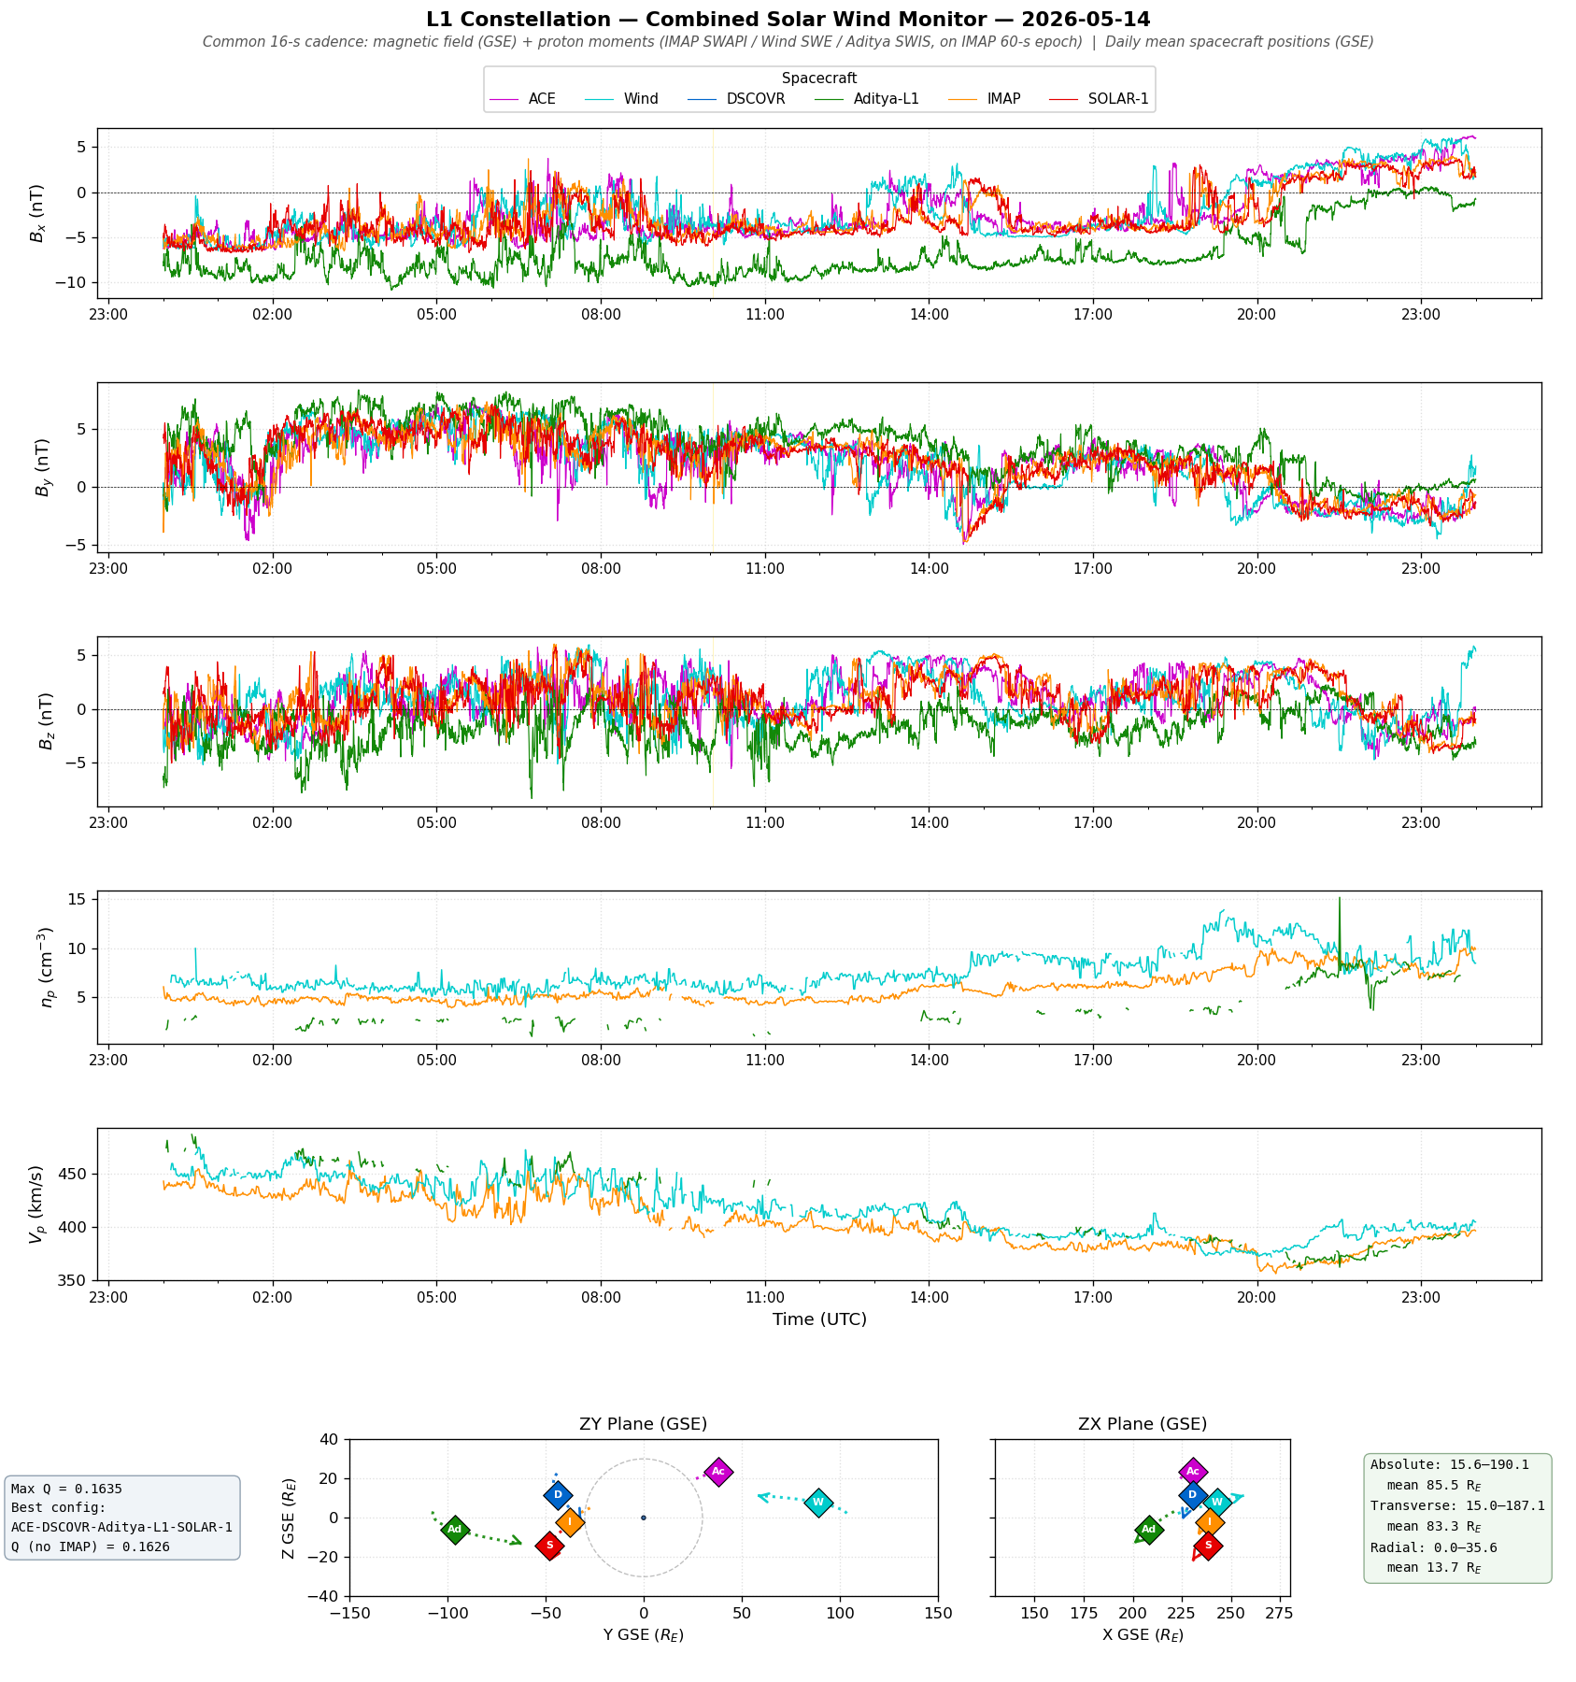
Current efforts for combining L1 data, what else does the community needs?
Ongoing effort lead by IMAP team (1 Dataset – 6 SCs):
One merged product (R, B, V, n, T)
Common/Native cadence
Common frame (GSE)
Documented gaps.
Formation Characteristics (Q, P, E, L)
Few open questions:
How do you make this useful to the community?
What else do you wish to see?
Who maintains it after the mission teams move on?
Preview
Quickplot
PRELIMINARY IMAP DATA
PRE REALEASE - UNVALIDATED
Current dataset (V012): Nov 2025 - Now

Slide 22
Summary
Six monitors at L1 are available, but only since practically this year 2026!
What we can do now
Multi-spacecraft techniques at L1 for the first time: timing, gradients, reconstruction
Probe coherence and structure across 100s of Re
Reconstruct a more realistic magnetic field than any single point allows
What we can’t fully do (?)
Follow the L1-to-Earth evolution from L1 data alone (needs modeling or near-Earth data to asses evolution)
In about 20 years we went from one monitor to six. The real question is not whether we have enough data, but which questions change because of this and whether we have build the expertise & capabilities to answer them
Things I didn’t talk: (1) connection from PSP, SolO to L1, (2) Evolution of Turbulence, (3) Heliospheric Current Sheet modeling, (4) Machine Learning capabilities, (5) Space Weather modeling, and many many more…

Slide 23
Appendix

Slide 24
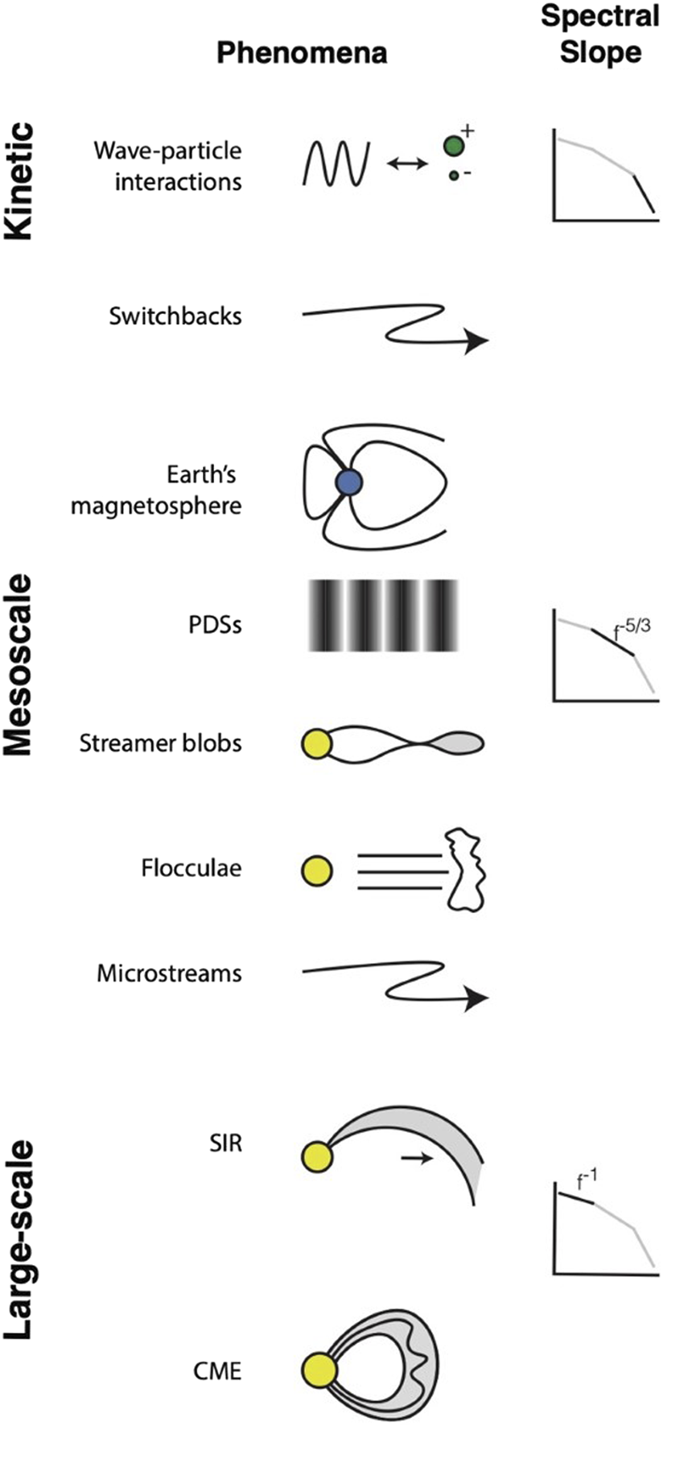
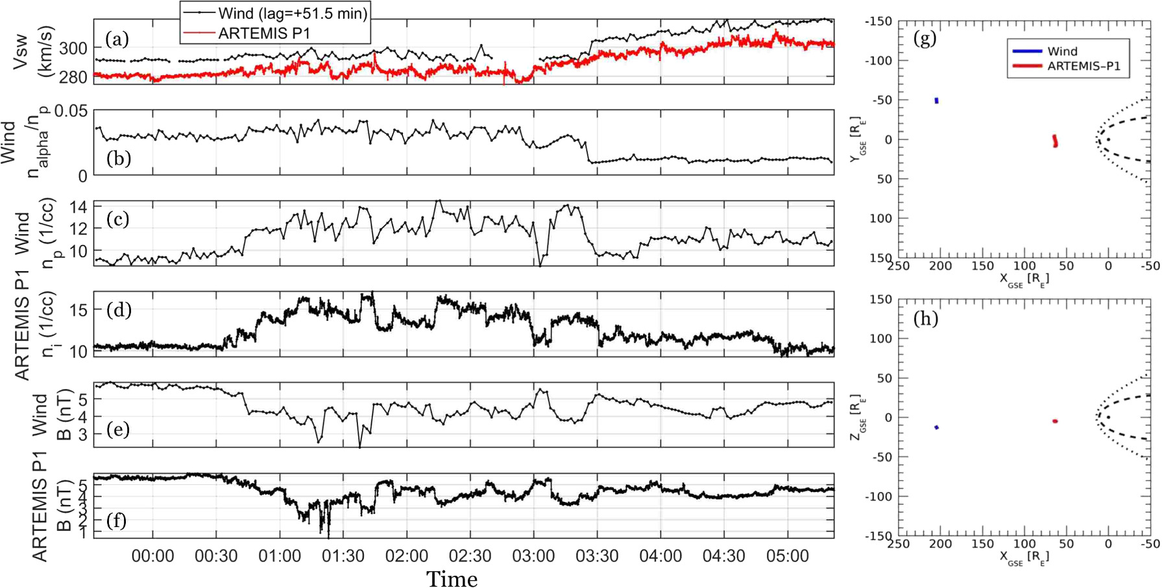
Mesoscale Structures in the Solar Wind – Example PDSs
Mesoscales: bridge kinetic physics and global solar-wind structure, shaped by both solar sources and propagation.
PDSs: An example of mesoscales structure, a quasi-periodic density trains carried by the solar wind
Di Matteo et al., 2024
Viali et al., 2021

Slide 25
Bow shocks vs IP shocks
Planetary Bow Shocks: A curved, quasi-stationary obstacle. Reflected ions are magnetically connected for long durations, allowing observations to be taken showing waves to grow and steepen into complex structures.
IP Shocks: A “planar” and propagating structure moving rapidly (∼800 km/s) through the solar wind, potentially restricting the foreshock development and limiting our observation capabilities.

Slide 26
Quasi-parallel and Quasi-perpendicular shocks
Qperp
Qpar

