Slide 1
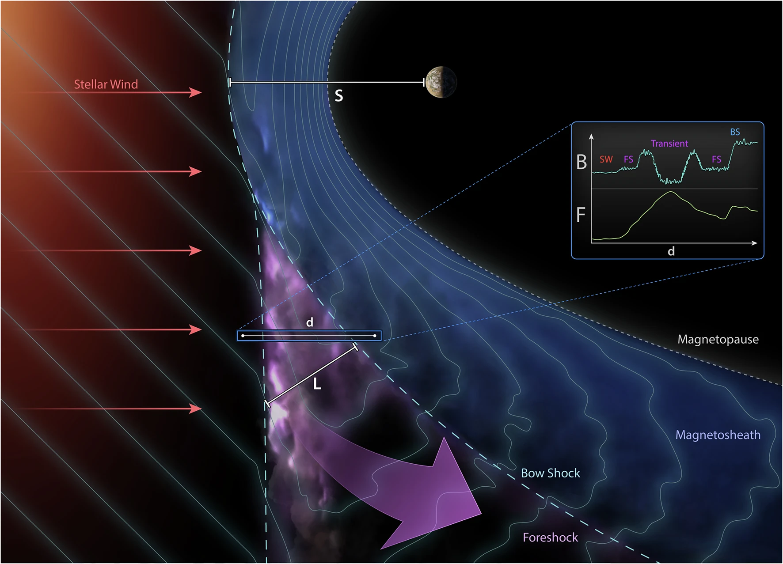
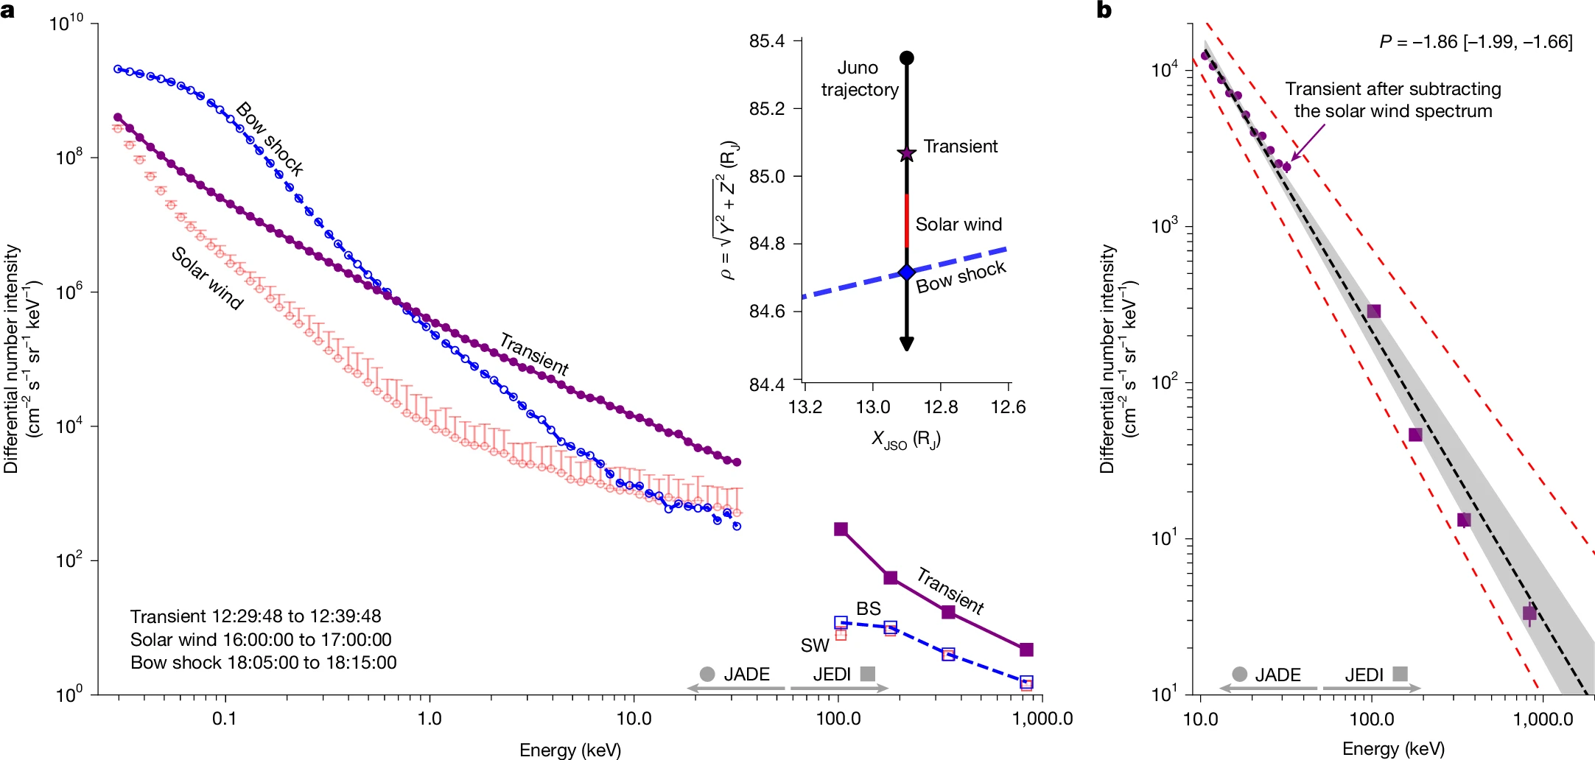
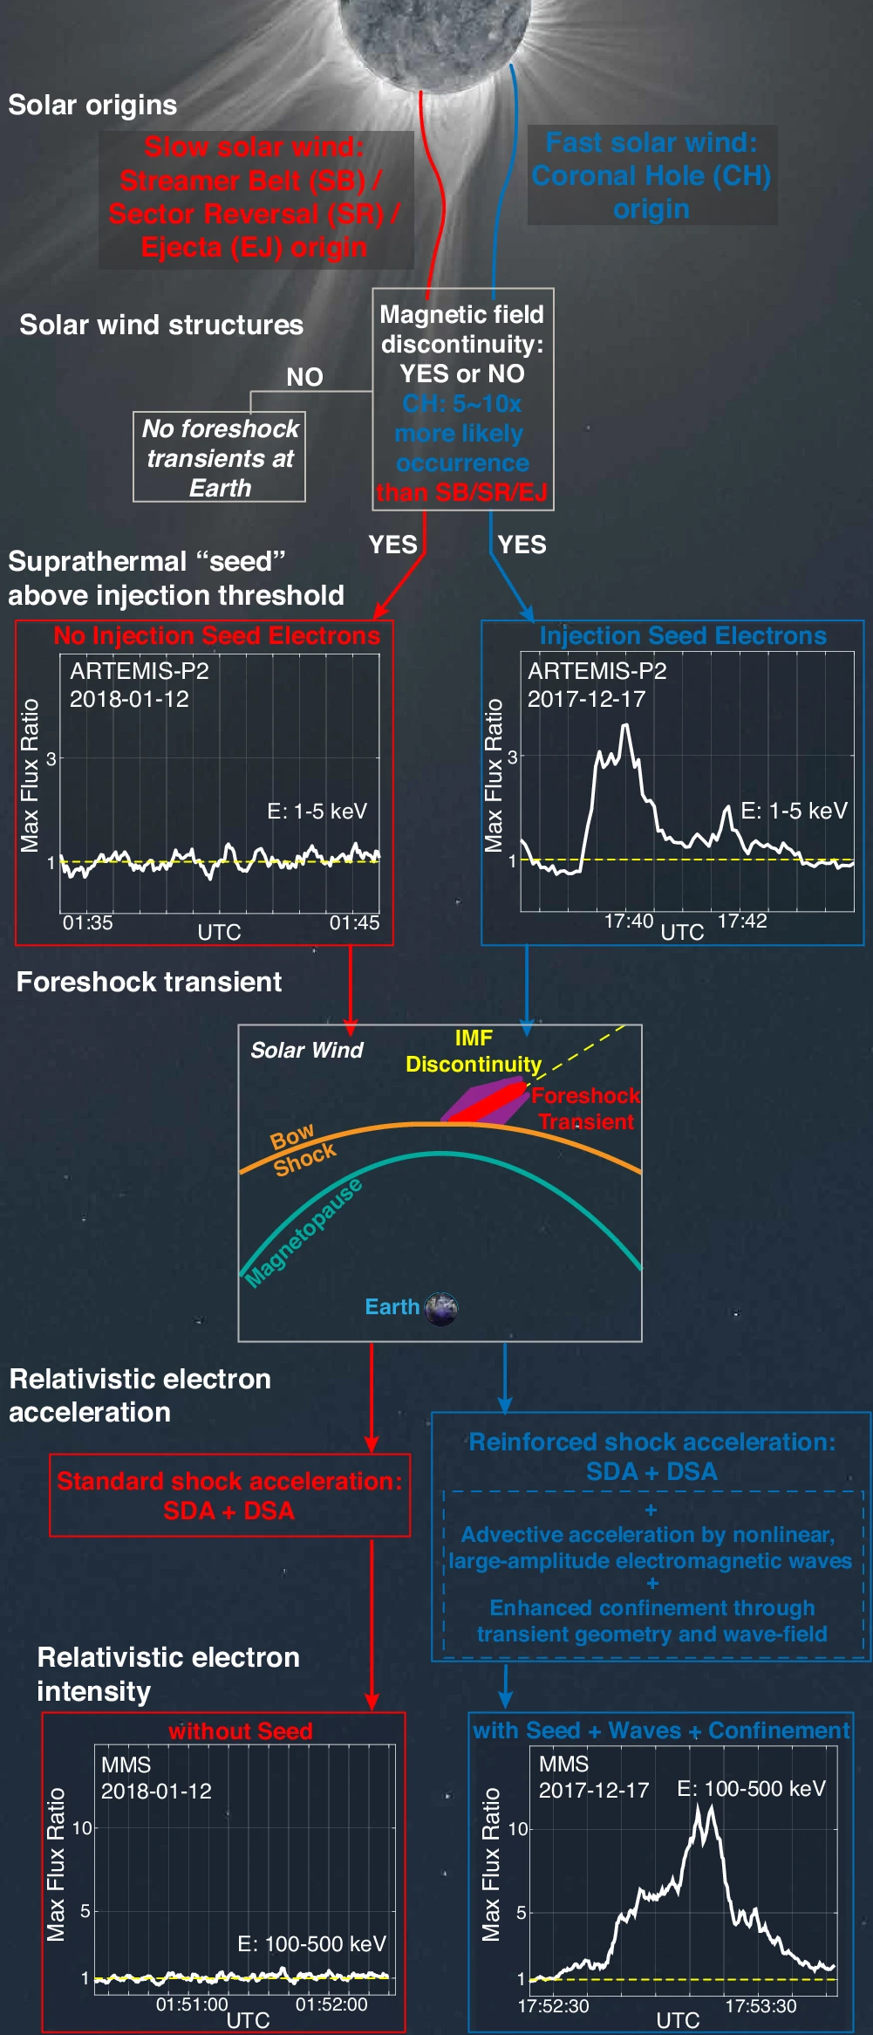
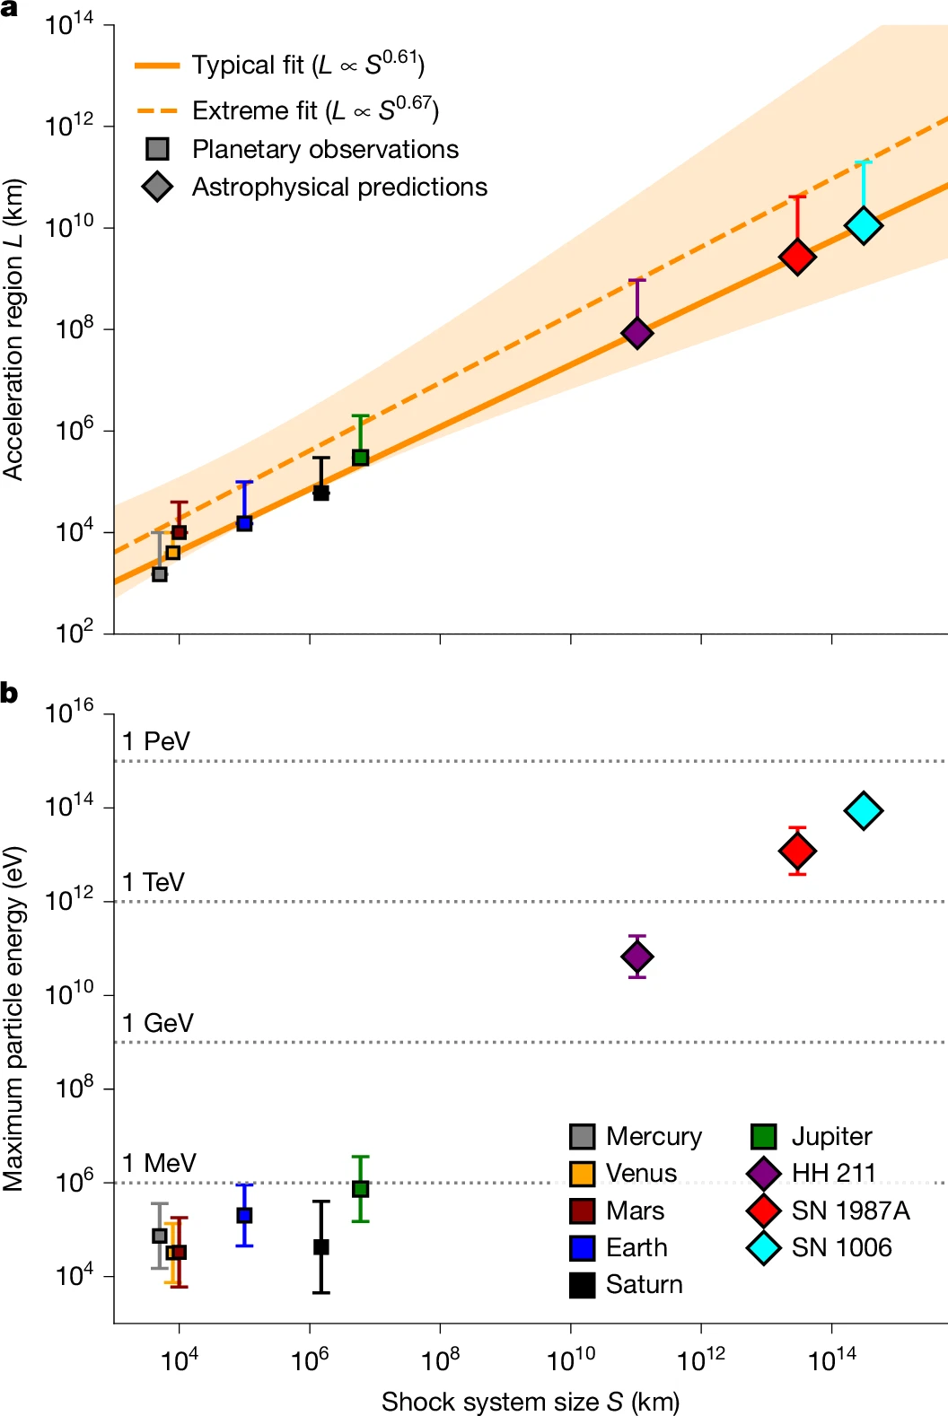



Abstract
Reinforced Shock Acceleration
Across the Solar System and Beyond
Reinforced Shock Acceleration
Collisionless shocks accelerate particles throughout the universe, yet how they reach relativistic energies remains an open problem. We present reinforced shock acceleration (RSA), a framework built from in situ observations at Earth (MMS, ARTEMIS, Cluster) and Jupiter (Juno). At Earth, foreshock transients accelerate electrons to 500 keV (A) and transmit through the bow shock with further energization downstream (B). At Jupiter, we report the first detection of ≥1 MeV electrons upstream of the bow shock, driven by a transient spanning several Jupiter radii. From these planetary observations, we derive a scaling law connecting shock system size to maximum particle energy. Applied to supernova remnants, the model predicts energies up to tens of TeV, consistent with observations of SN 1006 (C).
Collisionless shocks accelerate electrons through a hierarchy of coupled processes spanning kinetic to global scales. RSA attempts to unify these processes into a single framework, looking at the extended shock region. Foreshock transients provide the acceleration site, wave-particle interactions and confinement supply the efficiency, and the system size sets the energy ceiling.
S. Raptis¹, D. L. Turner¹, D. Caprioli², A. Lalti³, M. Lindberg⁴,
T. Z. Liu⁵, J. R. Szalay⁶, G. Clark¹, C. C. Haggerty⁷
¹The Johns Hopkins University Applied Physics Laboratory, Laurel, MD, USA, ² The University of Chicago, 5640 S Ellis Ave, Chicago, IL, USA Department of Astronomy & Astrophysics and E. Fermi Institute ³Department of Mathematics, Physics and Electrical Engineering, Northumbria University, Newcastle upon Tyne, UK ⁴Department of Physics and Astronomy, Queen Mary University of London, Mile End Road, London E1 4NS, UK, ⁵Shandong Key Laboratory of Space Environment and Exploration Technology, Institute of Space Sciences, School of Space Science and Technology, Shandong University, Shandong, China. ⁶Department of Astrophysical Sciences, Princeton University, Princeton, NJ, USA, ⁷ Institute for Astronomy, University of Hawai‘i, Honolulu, HI, USA
From Earth to Jupiter and beyond: a universal scaling of relativistic particle acceleration at collisionless shocks
Schematic of RSA at Earth
Below is a schematic illustrating how fast solar wind conditions (right/blue path) lead to energetic electrons forming at foreshock transients, while slow solar wind conditions (left/red path) lack a seed population, resulting in limited energization at Earth’s foreshock.
Scaling and Maximum Energy
Caption: Illustration of this transient driven acceleration at a planetary bow shock. A magnetic field discontinuity interacts with the foreshock to form a large-scale transient upstream of the shock. Particles are accelerated within this transient, reaching peak energies that exceed those at the main shock crossing. Inset shows idealized profiles of magnetic field magnitude and energetic particle flux along a spatial cut through the structure. Illustration: Ben C. Smith, JHU/APL, Taken from Raptis et al., 2026.
Caption: Combined electron energy spectrum from Juno's JADE and JEDI instruments during the foreshock transient (purple), the adjacent bow shock crossing (blue), and quiet solar wind (red). After background subtraction (b), the energetic tail follows a power law with P ≈ −1.85, bounded by the canonical DSA limits of −1.5 and −2. Peak electron energies in the transient exceed those at the bow shock by an order of magnitude. Taken from Raptis et al., 2026.
Summary & Discussion
RSA essentially operates through a synergy of shock and fermi-like acceleration, wave-particle interactions, and geometric confinement within foreshock transients. At Earth, these processes can collectively lower the electron injection threshold to the suprathermal range (1–5 keV), achievable under fast solar wind conditions.
Foreshock transients survive transmission through the bow shock. Downstream, elevated compression drives additional betatron acceleration, while the transient structure continues to broadly confine the energetic particles, extending the effective acceleration region well beyond the shock front itself.
At Jupiter, Juno observations reveal electrons accelerated to ≥1 MeV within a foreshock transient whose peak intensity exceeds that of the adjacent bow shock crossing by an order of magnitude. The clean power-law spectrum (P ≈ −1.85) confirms that the same efficient acceleration at Earth scales to larger planetary systems.
The acceleration region size (L) follows a power law with the shock standoff distance (S) across six Solar System planets. Coupling this empirical scaling to the Hillas limit yields maximum energy predictions consistent with observations at Earth, Saturn, and Jupiter.
Extrapolation to astrophysical shocks (HH 211, SN 1987A, SN 1006) predicts maximum electron energies reaching tens of TeV. For SN 1006, predictions agree with energies inferred from X-ray synchrotron and gamma-ray observations, providing direct support for the framework.
Quasi-parallel shocks emerge as more efficient accelerators than previously understood, with the primary driver being the transient processes at the extended foreshock region rather than the shock transition.
Caption: Acceleration region size (L) scales as a power law with shock system size (S) across six Solar System planets (a). Applying the Hillas criterion with this empirical scaling predicts maximum electron energies (b) consistent with observations at Earth, Saturn, and Jupiter, and with the tens-of-TeV energies inferred for SN 1006. Squares denote planetary in situ measurements; diamonds denote astrophysical predictions. Taken from Raptis et al., 2026; inspired by Uritsky et al., 2014 & Valek et al., 2017.
Want to learn more?
Read these 3 papers or just talk to me!
Raptis+ 2025 (NatComm) - Revealing an Unexpectedly Low Electron Injection Threshold via Reinforced Shock Acceleration
Raptis+ 2025 (ApJL) - Multi-Mission Observations of Relativistic Electrons and High-Speed Jets Linked to Shock Generated Transients
Raptis+ 2026 (Nature) - Relativistic electron acceleration at the bow shock of Jupiter and beyond
Contact info: 📧 savvasraptis@pm.me / savvas.raptis@jhuapl.edu | 🔗 savvasraptis.github.io
Taken from Raptis+2025 (NatComm)

