Slide 1
On The Coherence & Substructure of CMEs
Savvas Raptis (JHU/APL)
Drew L. Turner, Manuel Cuesta, Hameedullah Farooki, Tim Horbury + many others
✉ Savvas.raptis@jhuapl.edu | 🔗 https://savvasraptis.github.io

Slide 2
Main Idea & Synergy
Use all 6-spacecraft around the Sun-Earth L1 point to compare and contrast the structure and spatiotemporal evolution of solar wind, and its transient processes.
Current plan:
Two companion papers one lead by Drew L. Turner and one by Savvas Raptis
First paper (Drew L. Turner) tackles general solar wind and SIRs spatiotemporal evolution in terms of coherency and substructure
Second paper (Savvas Raptis) focuses on 2-3 CMEs and their different regions (i.e., shock, sheath, magnetic cloud etc.)
11-13 Nov 2025 | 19 Jan 2026 | 4-9 Feb 2026
Support efforts by Manuel Cuesta & Hameedullah Farooki
Reasoning:
(a) Multiple science articles on a vital topic in heliophysics and space weather
(b) Consistent methodological framework, also applicable to all future related analysis efforts
(c) Initiate L1 constellation science with IMAP leading on data curation, availability, and science
(d) Support other members of science team on ongoing efforts to facilitate collaboration

Slide 3
First Thoughts
”Our” community’s usual approaches:
- Cross-correlation, maybe some non-linear methods (mutual information) or some coherency metric (e.g., cross-wavelet)
Other communities who deal with timeseries:
Dynamic Time Warping (DTW), Predictability metrics (coefficient of determination, prediction efficiently etc.), Longest Common Subsequence (LCS), Fréchet Distance etc.
Still investigating what we can use, but let’s keep it simple for now (mostly correlations)
*See: https://www.sktime.net/en/stable , http://tslearn.readthedocs.io, https://www.statsmodels.org/stable/ etc.

Slide 4
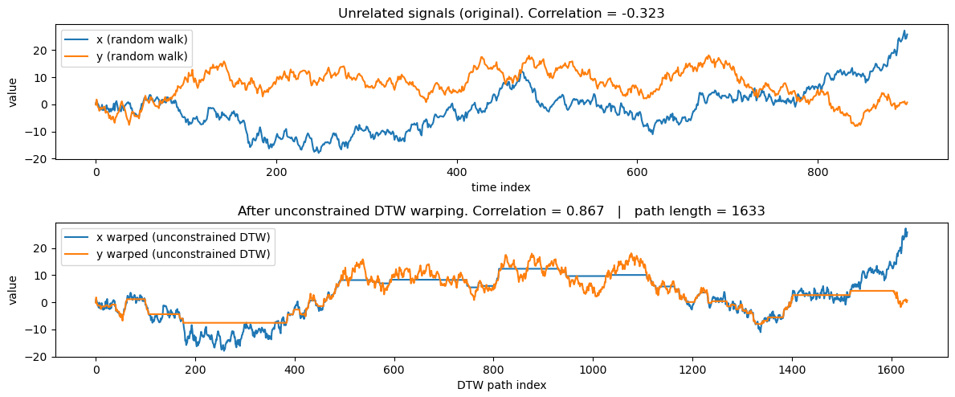
Toy data and DTW

Slide 5
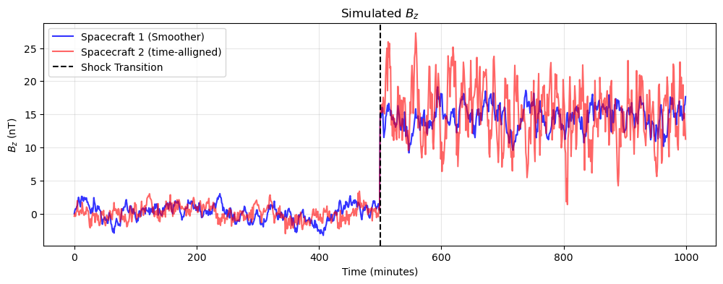
Demonstration of 2 challenges Using Toy Data

Slide 6
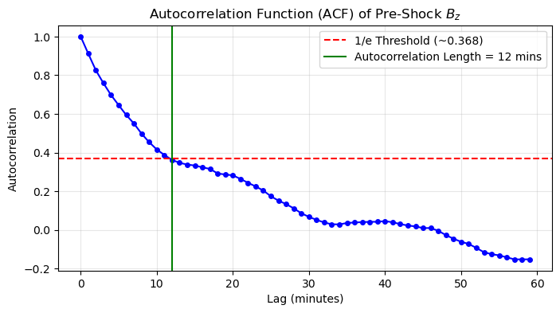
Challenge 1 – Solar Wind "Memory" (Autocorrelation)
Metrics like correlation assume independent data points.
Solution: Calculate the 1/e drop-off (e-folding time) to find when the plasma "forgets" its previous state.
Rule of thumb: to be safe go ~2-3 times that, so 25-40mins in this toy example. So how far can we go?

Slide 7
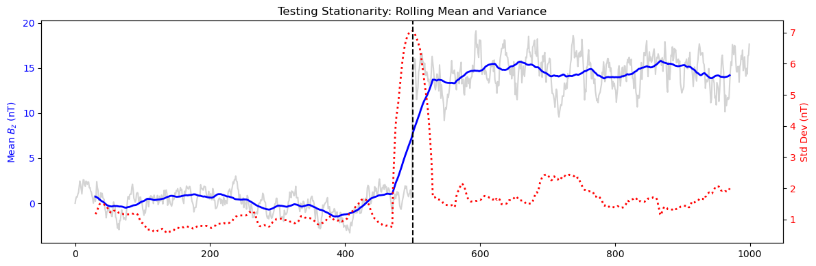
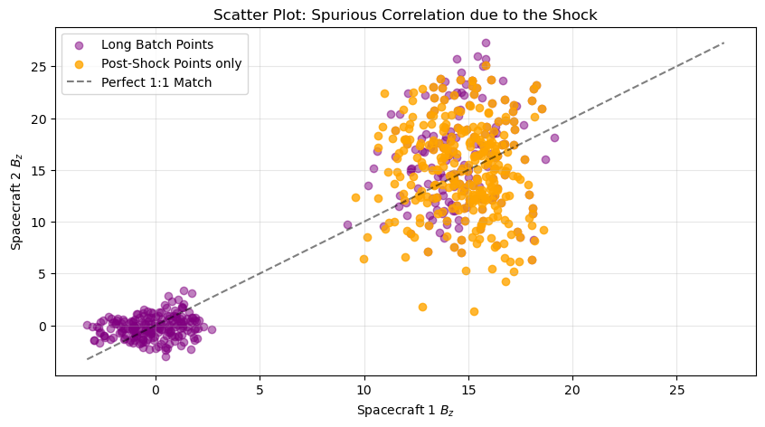
Challenge 2 – The "Long interval" illusion (Non-Stationarity)
Mixing two distinct regimes breaks "stationarity.” Macro-scale variations wash out micro-scale differences in such metrics
Solution:
Reasonable batches & distinct plasma environments
Pre-Shock Only: r = 0.267
Post-Shock Only: r = -0.076
Spanning the Shock: r = 0.914
Community Reminder: if we mix different environments are result can be statistically dubious

Slide 8
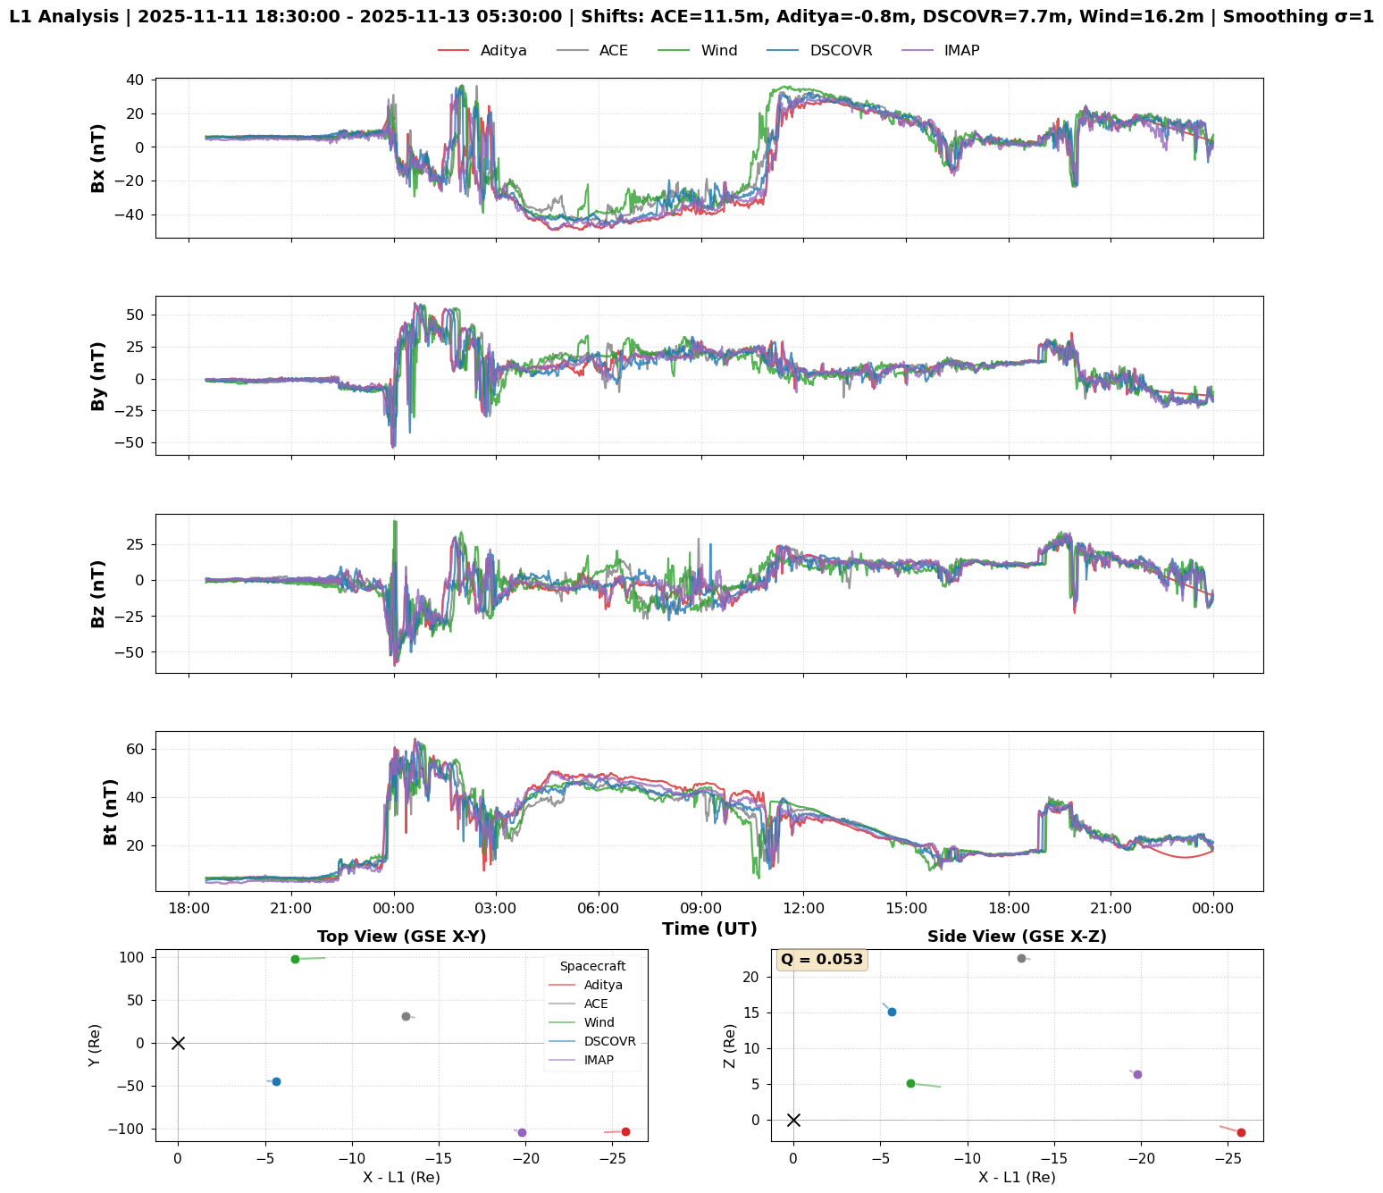
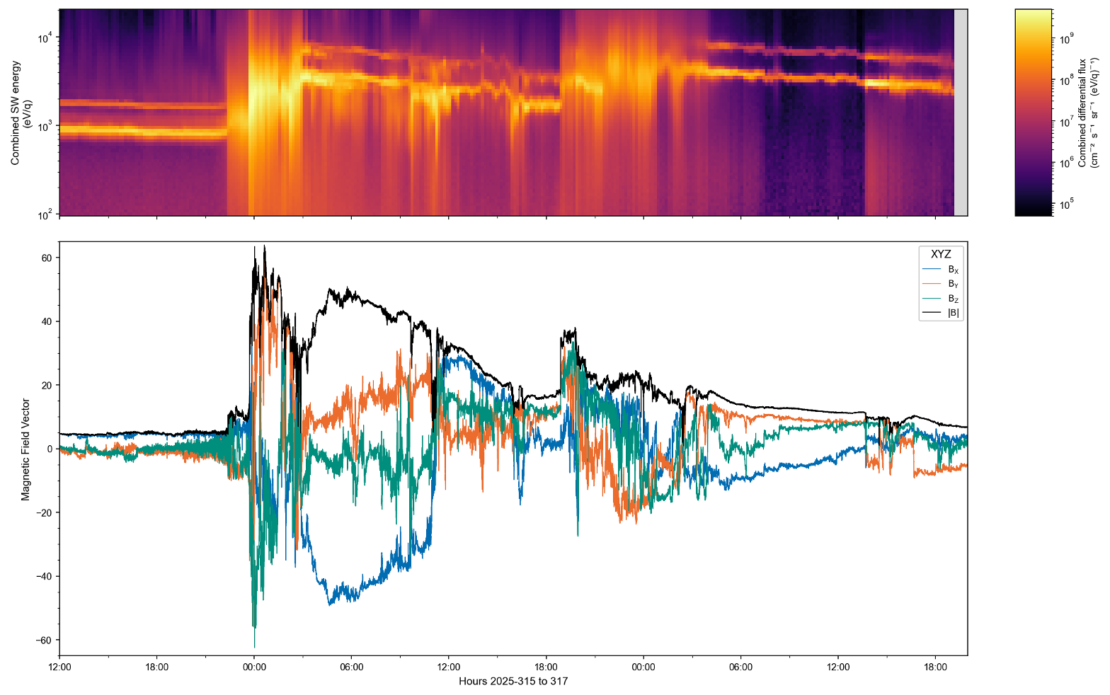
Real Data Nov 11-13 2025 CME
PRELIMINARY IMAP DATA
PLEASE DON’T SHARE
Great example because:
- 2 CMEs interacting with each other
Geoeffective event
Over 200 Re transverse separation between missions

Slide 9
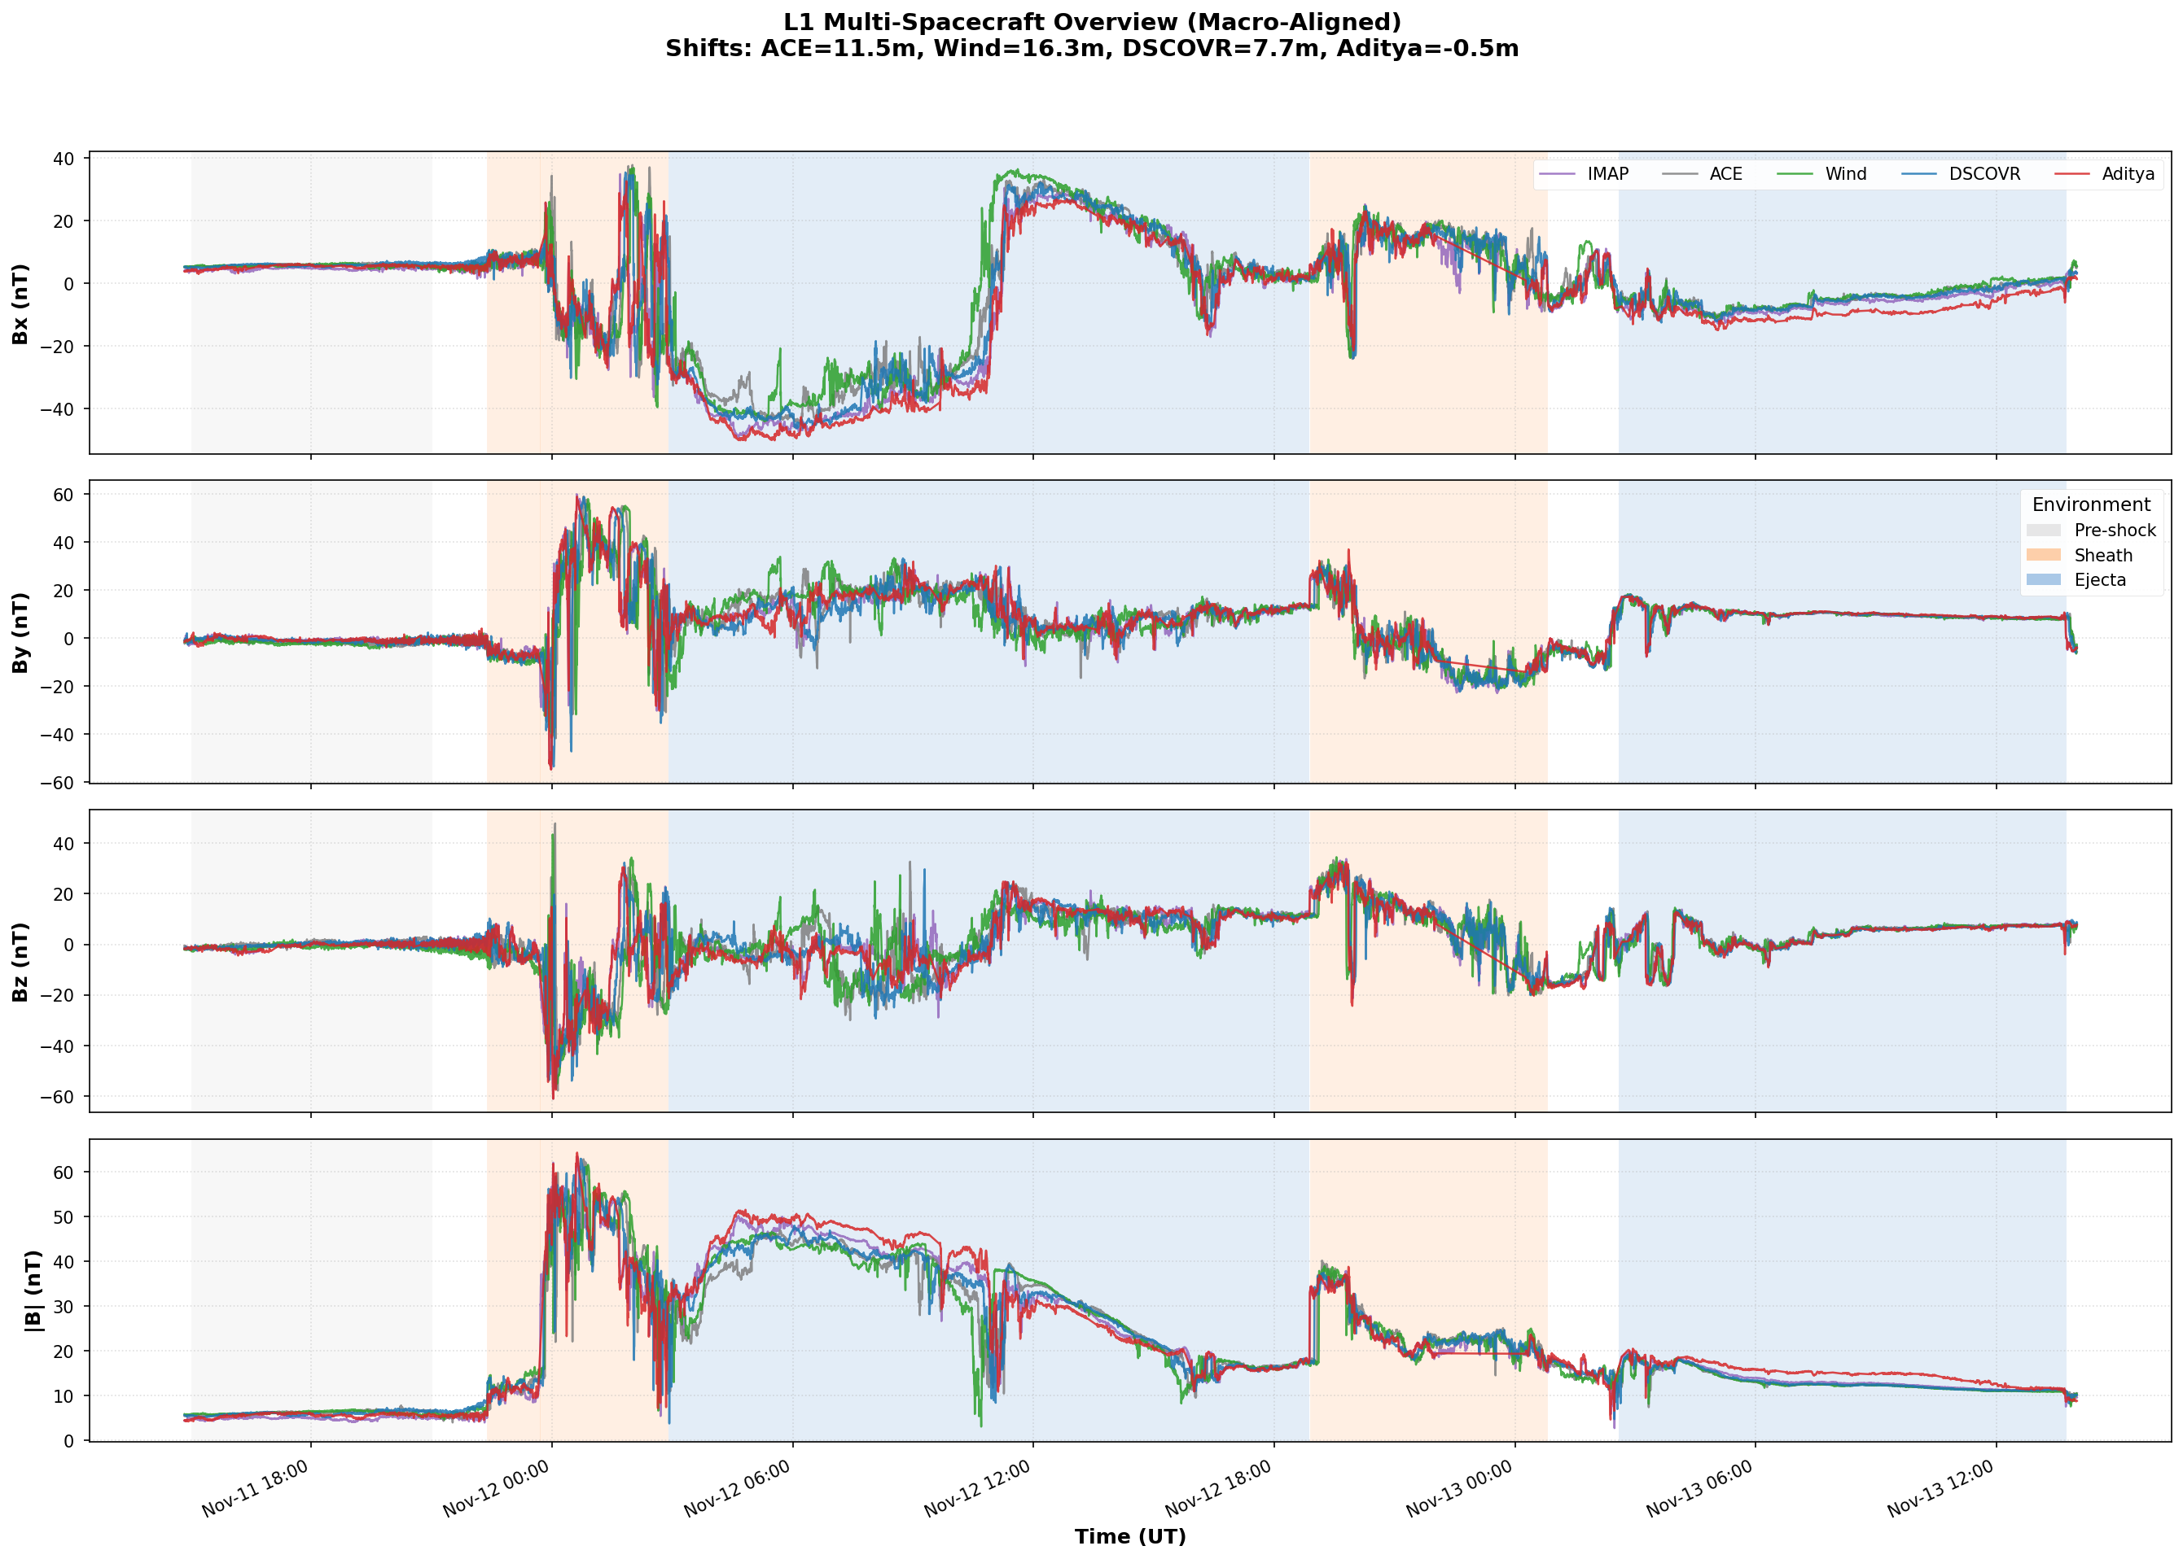
November 11-13 Coronal Mass Ejection (CME)
PRELIMINARY IMAP DATA
PLEASE DON’T SHARE
Figure has the following postprocess steps:
Dead-time Calibration of Aditya
Resampling to common resolution (12 sec)
Automatic Shock Finding. Based on |B|
Automatic time alignment between all probes wrt IMAP
i.e., the CDF product we have available already!

Slide 10
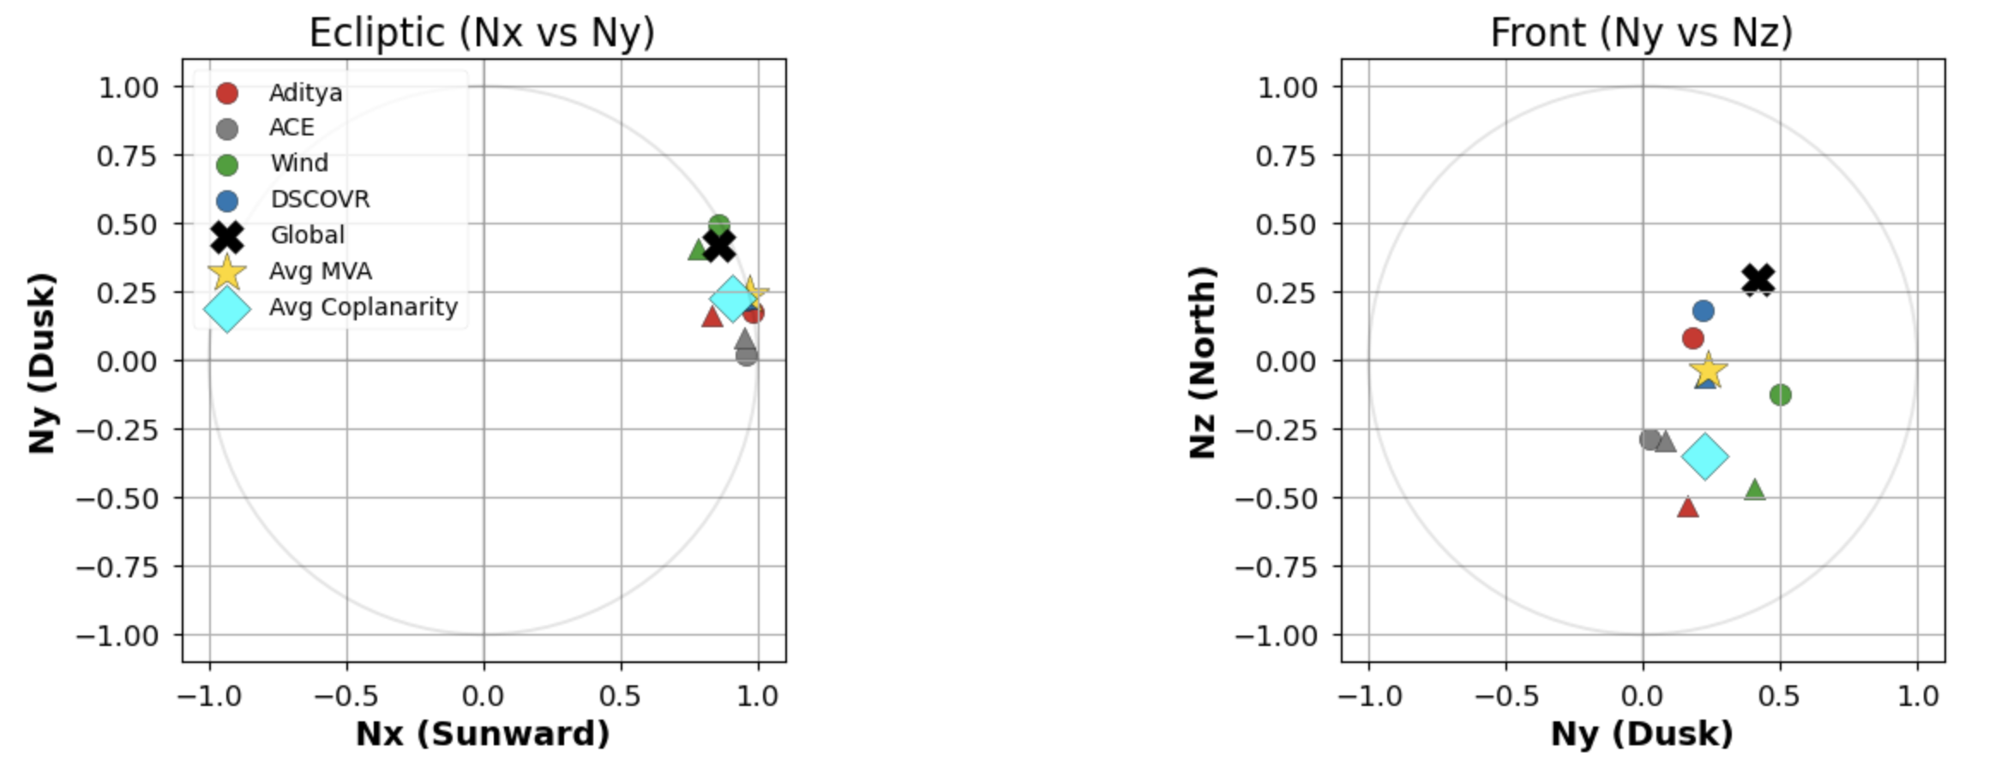
CME IP Shock Geometry Calculation
Automated methodology for Shock geometry using
Magnetic Coplanarity
MVA
Timing
Interestingly, there is great agreement between all methods!
*Working with Manuel Cuesta to verify these

Slide 11
The 2 Challenges With Real Data
PRELIMINARY IMAP DATA
PLEASE DON’T SHARE

Slide 12
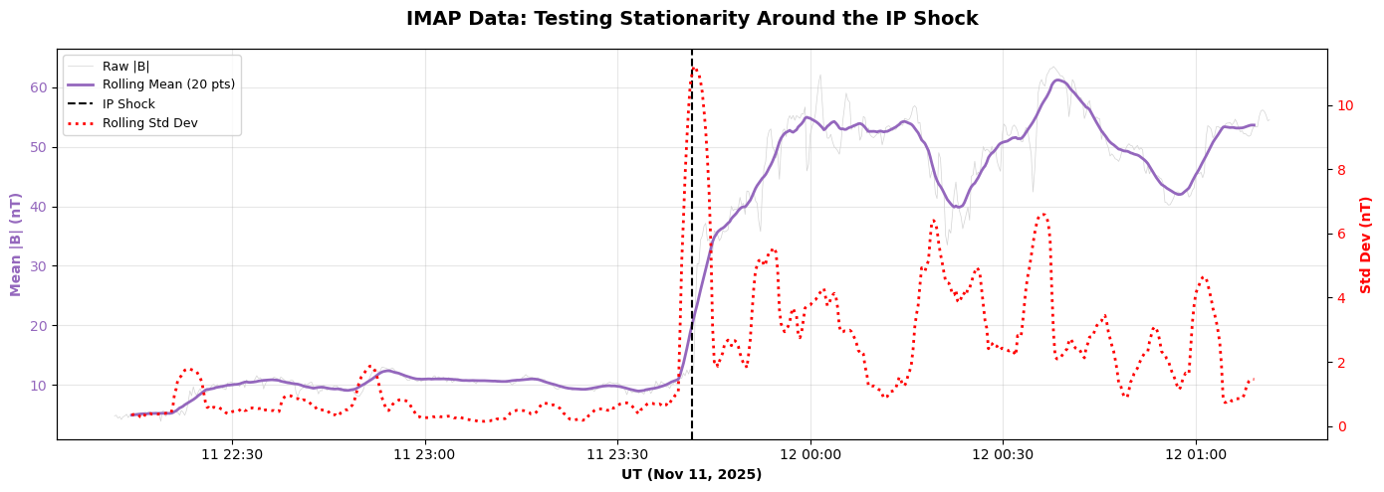
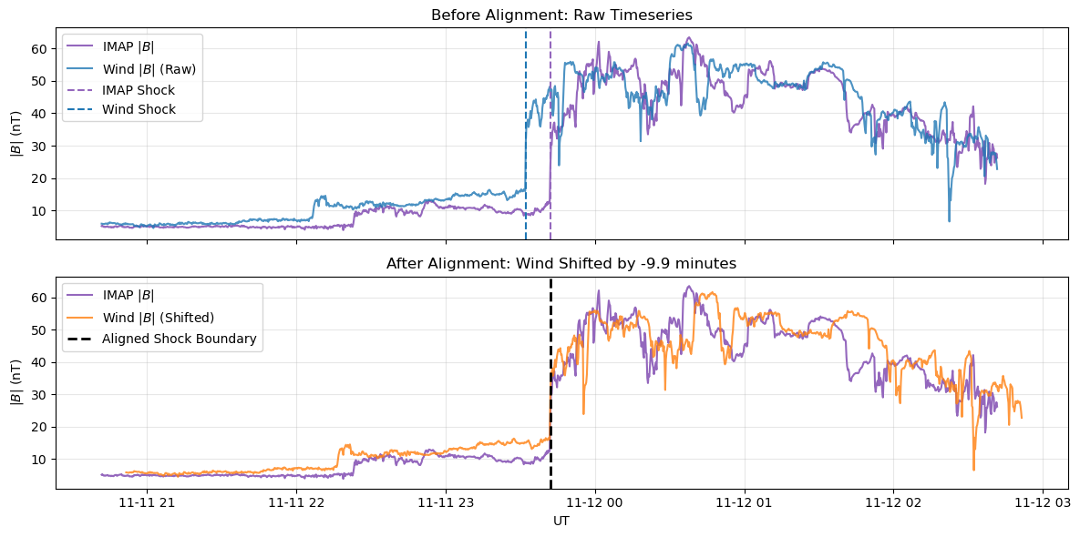
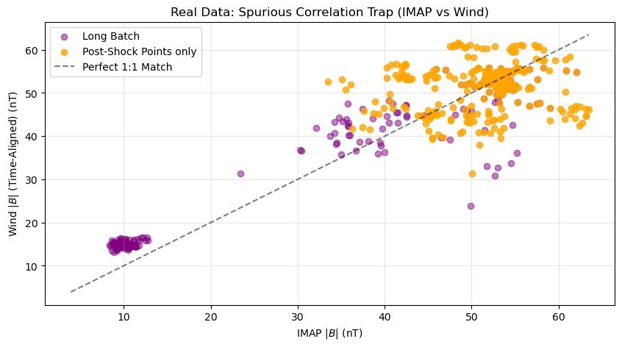
The Same Challenges on Real Data
STEP 2: Confirm non-stationarity
STEP 1: Time alignment
ACF e-fold: ~10min (~12 with toy data)
Pre-Shock Only: r = -0.200
Post-Shock Only: r = +0.103
Spanning the Shock: r = 0.963
Offset?
Spurious Correlation

Slide 13
Results
PRELIMINARY IMAP DATA
PLEASE DON’T SHARE

Slide 14
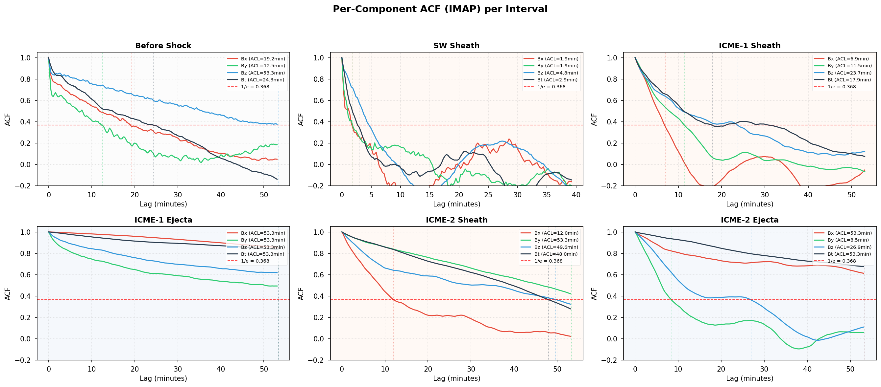
Autocorrelation results per region
Key Takeaway: ACF can be different per component and for each environment

Slide 15
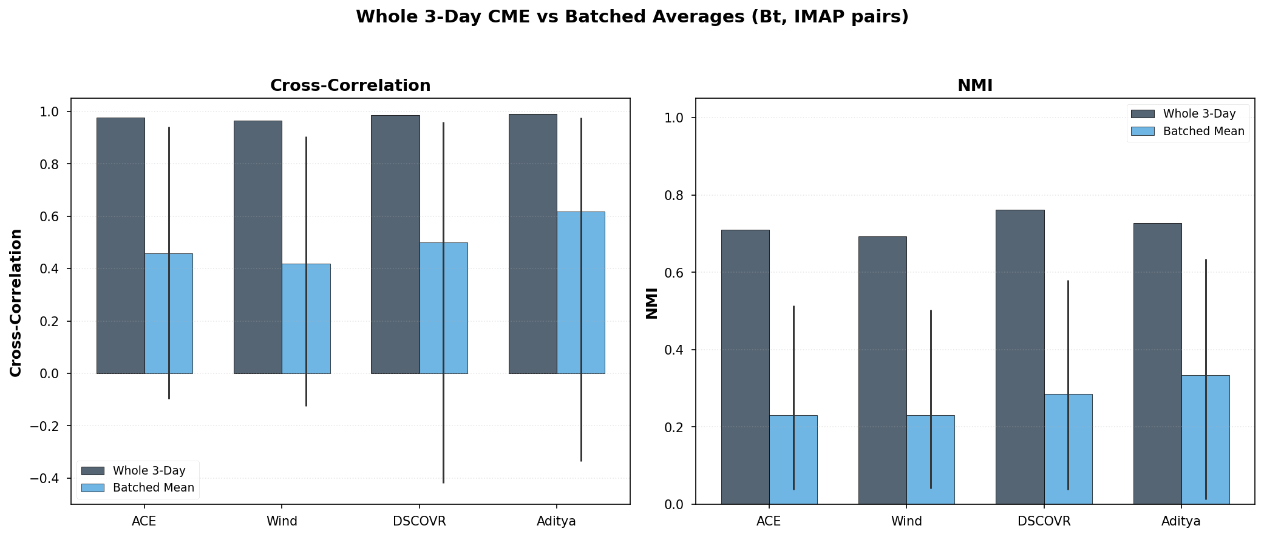
Visual reminder: |B| metrics batched vs 3 days
Key Takeaway: batched mean + range reveals variation previously hidden

Slide 16
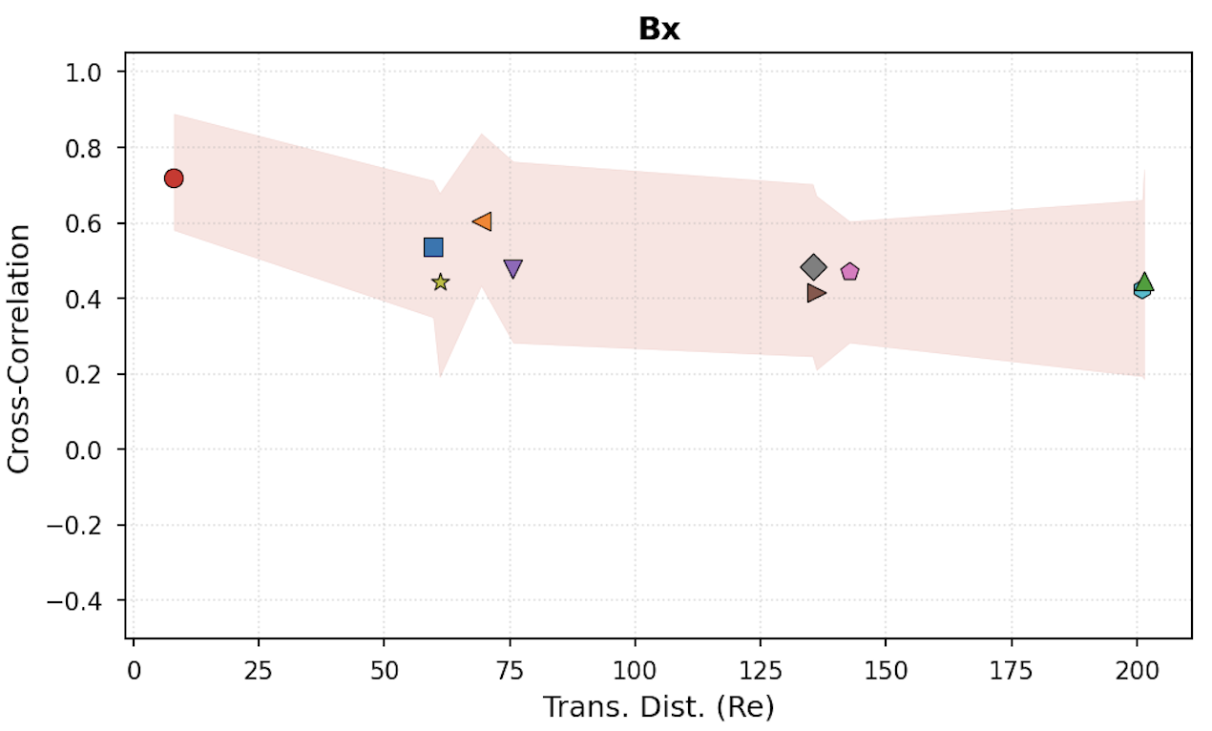
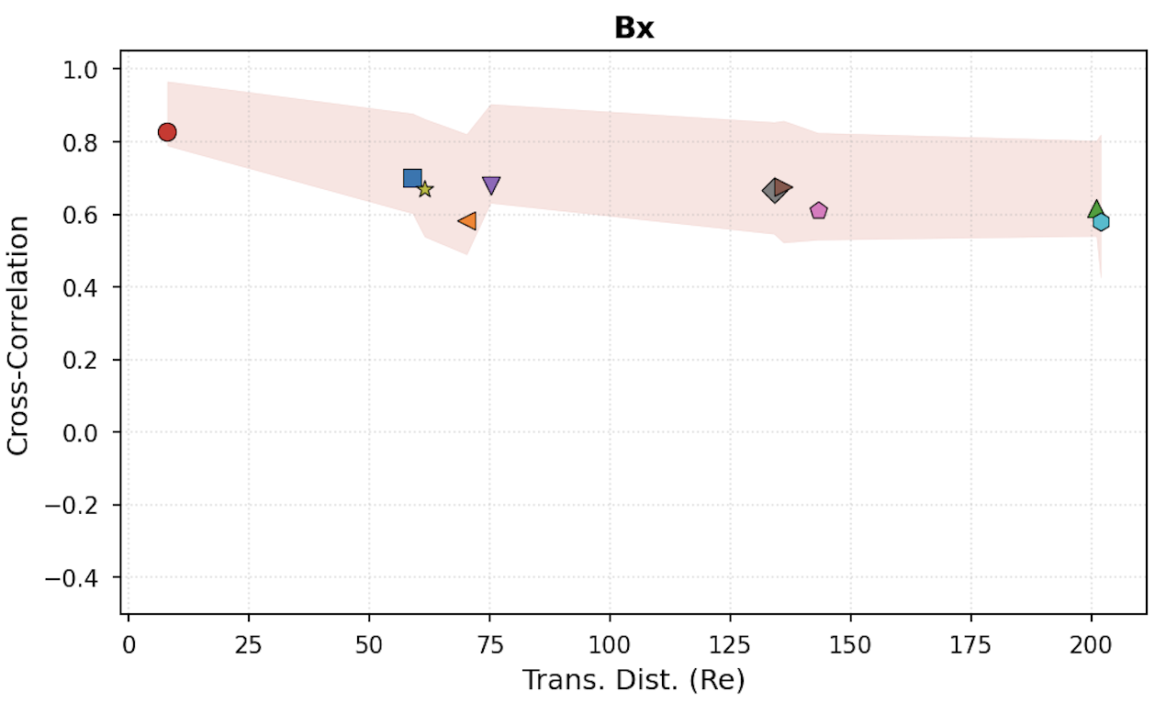
Bx correlation evolution over distance
CME #1Sheath
CME #1Ejecta

Slide 17
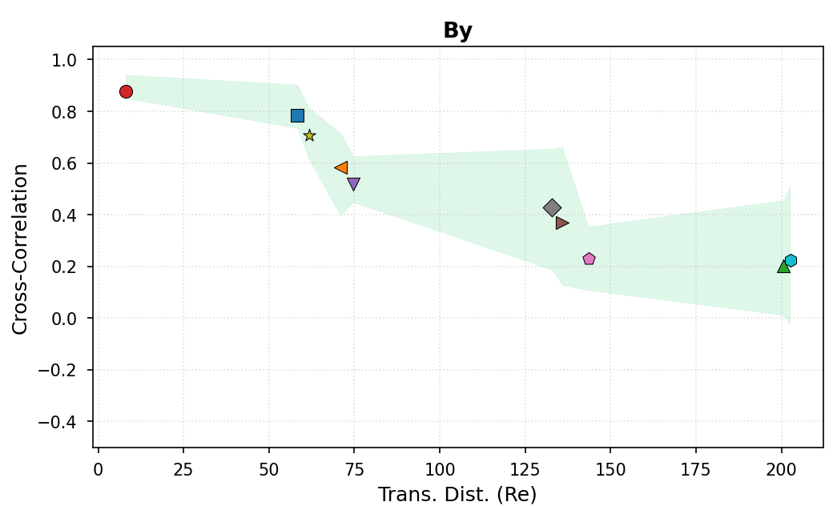
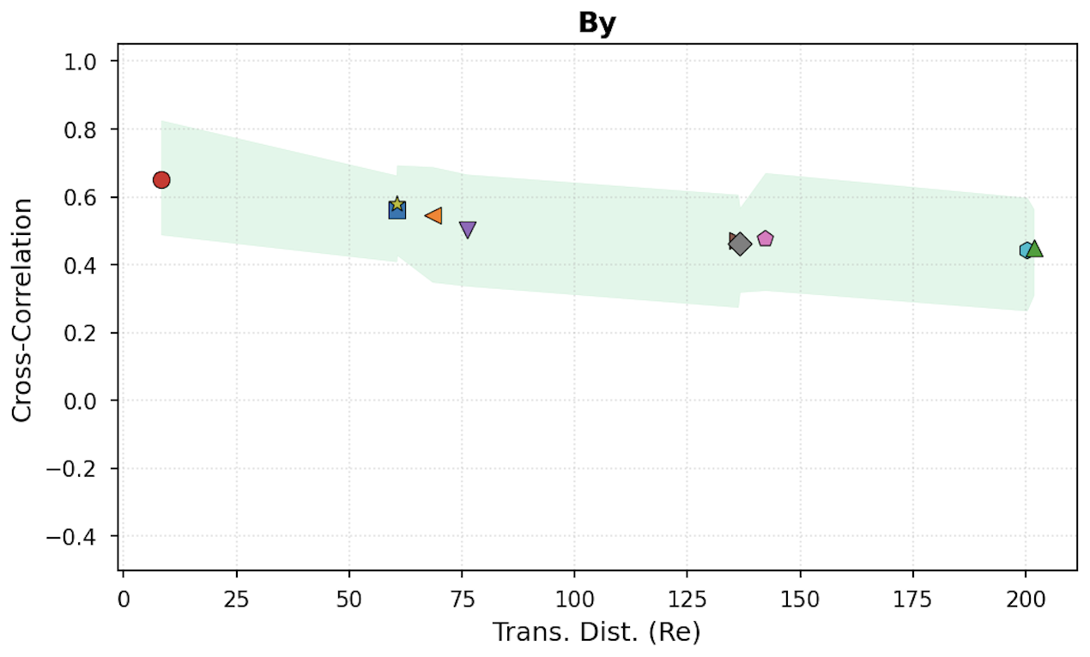
By correlation evolution over distance
CME #1Sheath
CME #1Ejecta

Slide 18
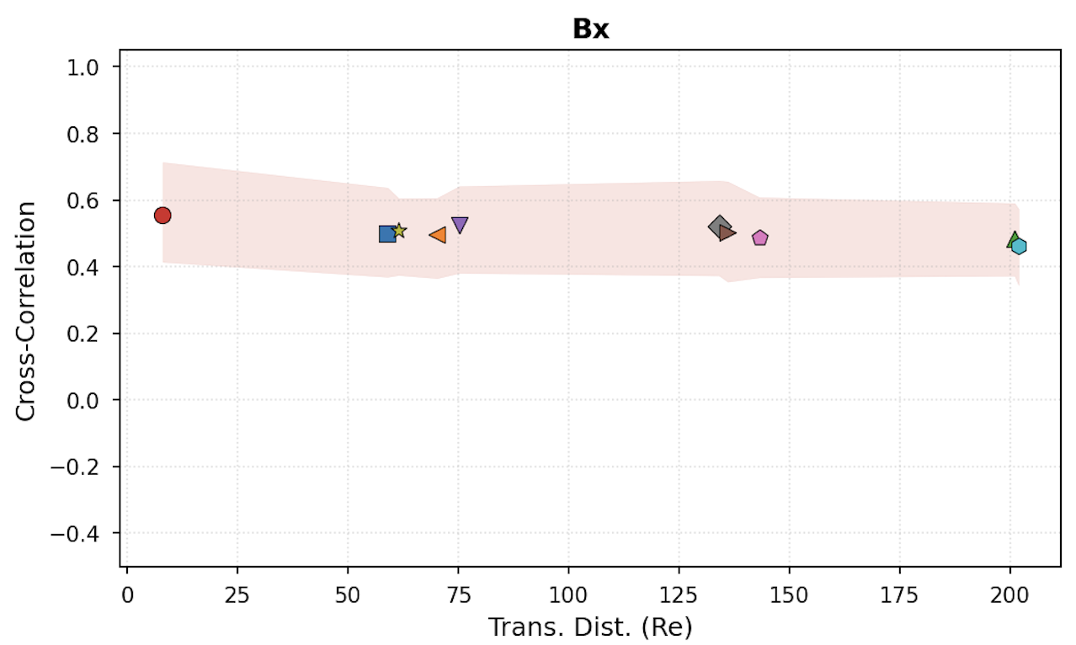
CME Ejecta Full versus Detrend
CME #1Ejecta - Full
CME #1Ejecta - Detrend

Slide 19
Some Next Steps
Methodological
Use normal of shock (orientation) to calculate the scales and propagation of each CME environment.
Evaluate the effect of resampling
Evaluate Aditya’s Bx component calibration problem
Include the other 2 CMEs in the analysis to see if differences are consistent.
Science:
Revise up on literature Wing+ Borovsky+, Lugaz+ ,Owens+ and looking for suggestions by the team (if you know things mail them please)

Slide 20
IMAP Related Advertisements
SHINE Workshop Session (2026):
Shock Waves and Energetic Particles Across the Heliosphere: Evolution of Structure and Processes from the Sun to the Outer Heliosphere
June 29- July 2 | Madison, WI
Organizers: Parisa Mostafavi, Christina Cohen, Savvas Raptis
GEM Focus Group (2025 – 2029):
Multiscale Dayside Transients and their Effect on Earth’s Magnetosphere (MDT) July 12-17 | Portland, ME.
Leads: Savvas Raptis, Ivan Vansko, Imogen Gingell, Terry Z. Liu, Ying Zou, Yuxi Chen, Gonzalo Cucho Padin

Slide 21
Appendix

Slide 22
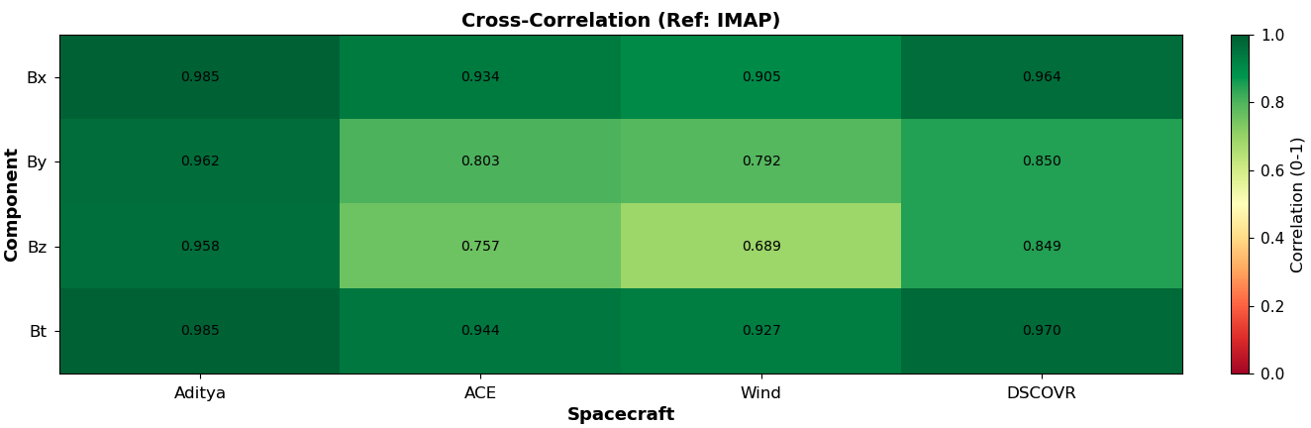
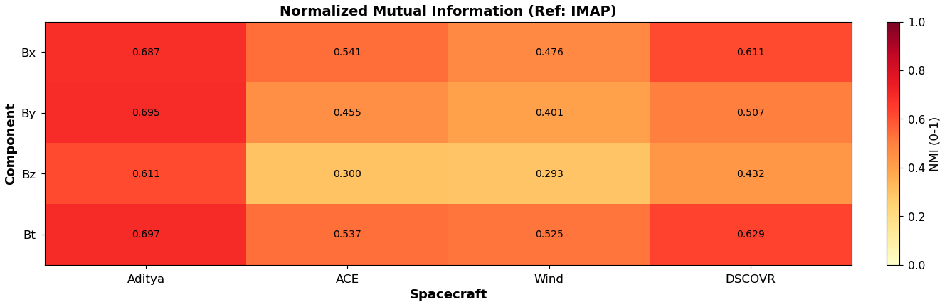
Cross Correlation & Mutual information wrt IMAP
First Impressions:
Cross correlation is naturally high
Aditya & IMAP are almost at the same location.
Metrics can drop significantly in large distances (e.g., IMAP to Wind)

Slide 24
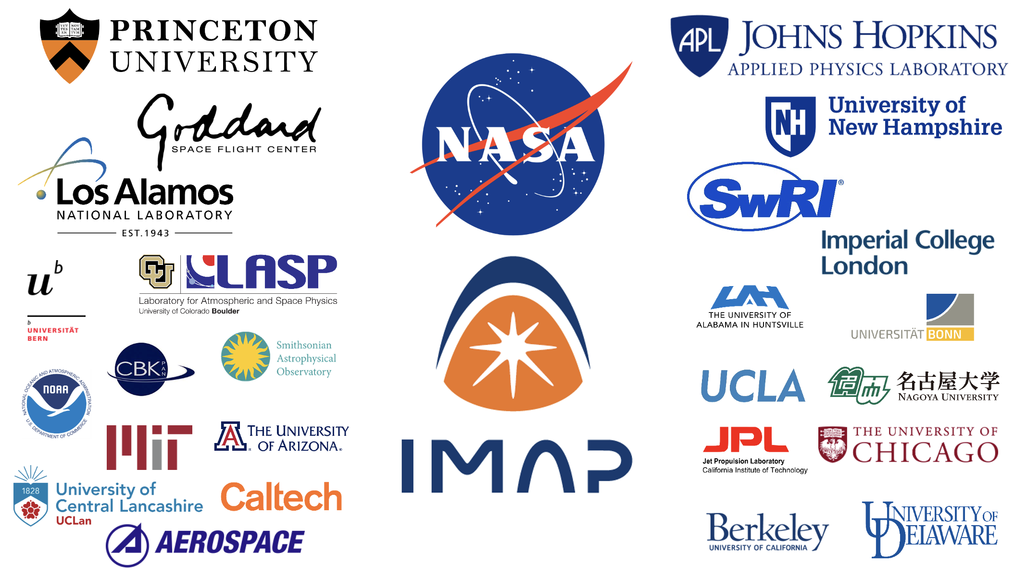
2 August 2023
5

