Slide 1


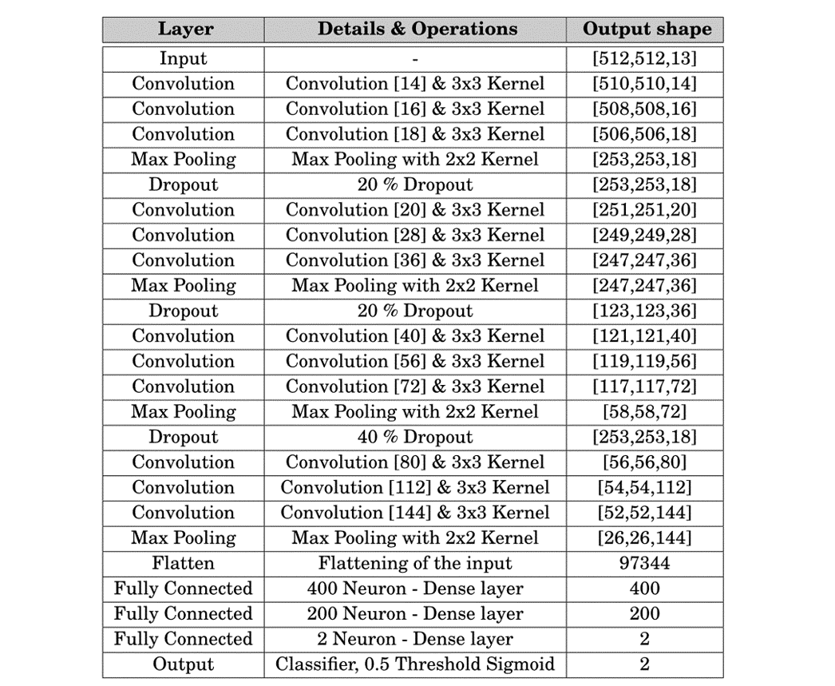
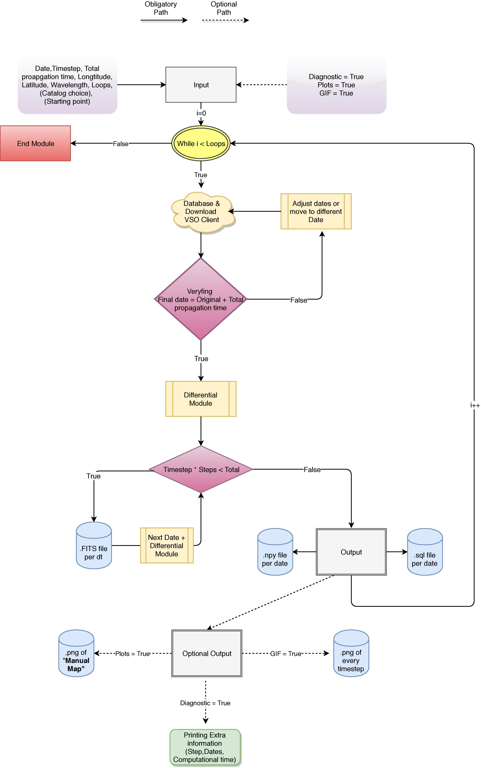
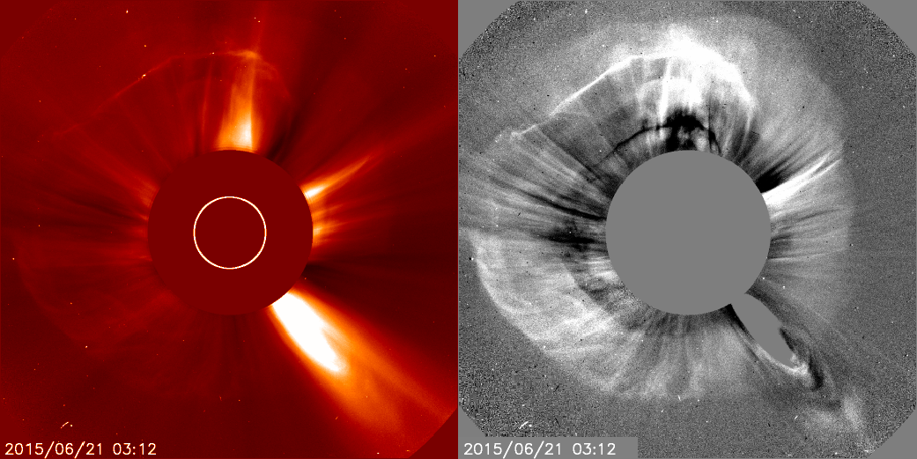
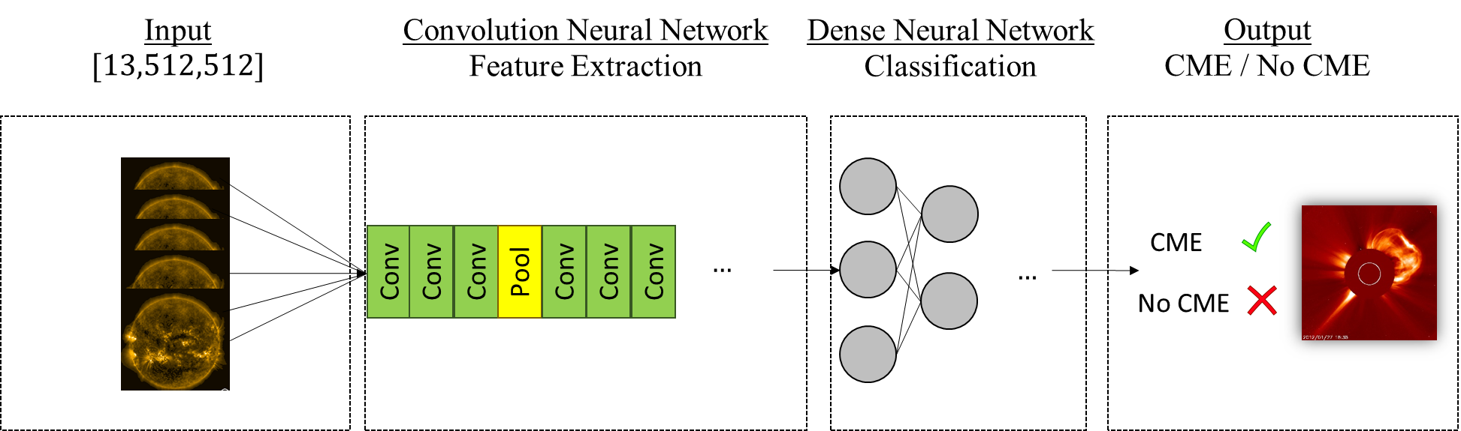
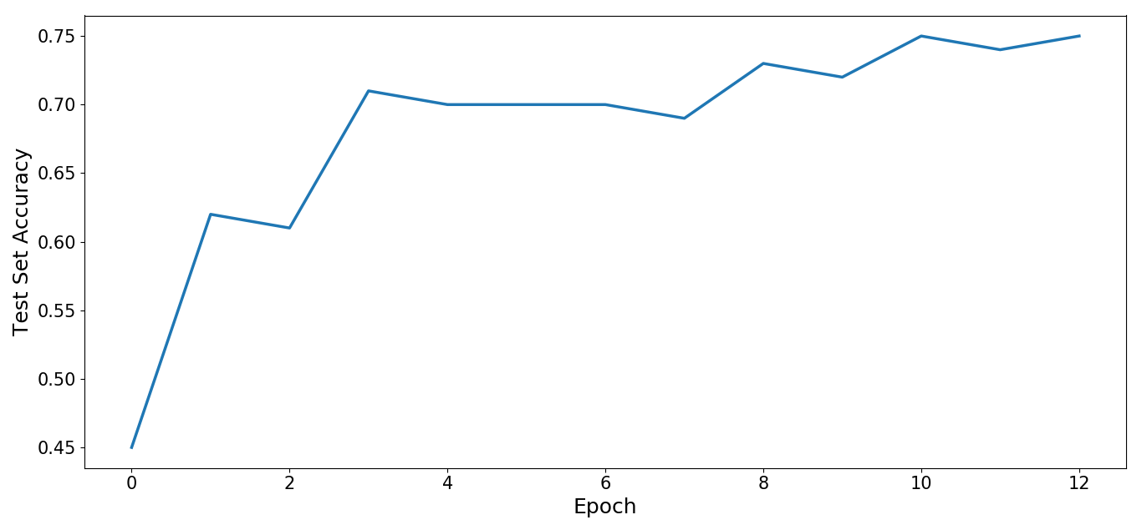
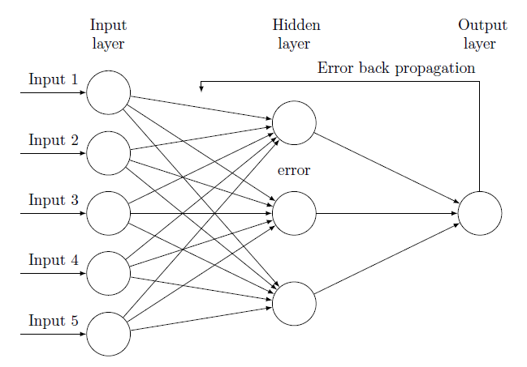
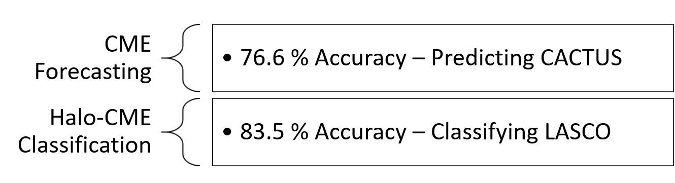
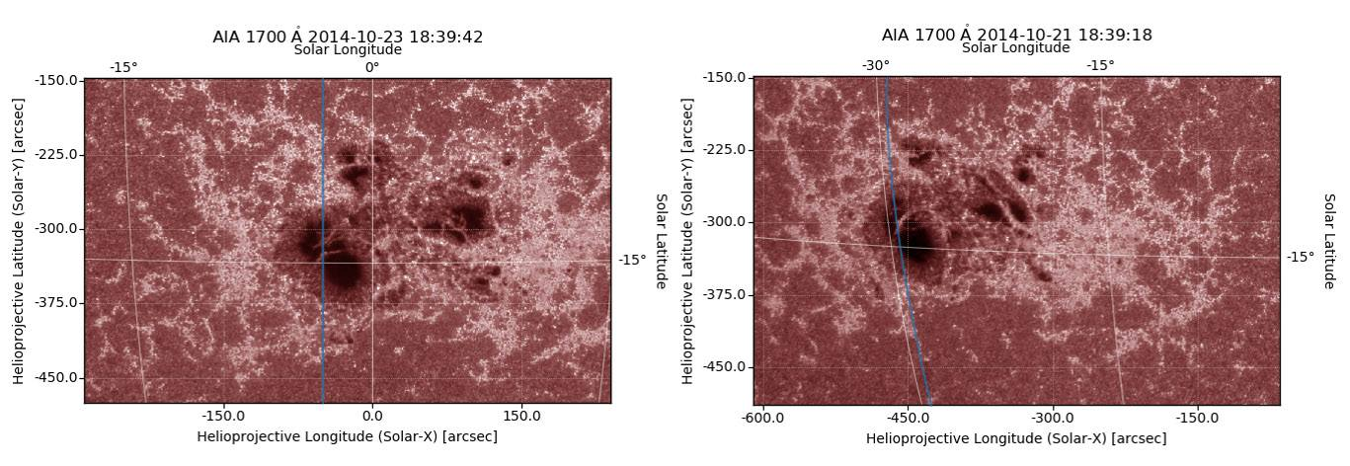
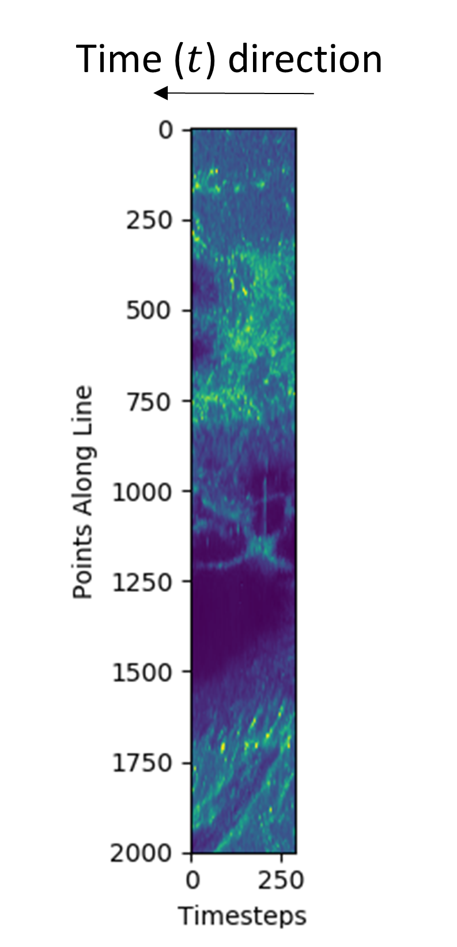
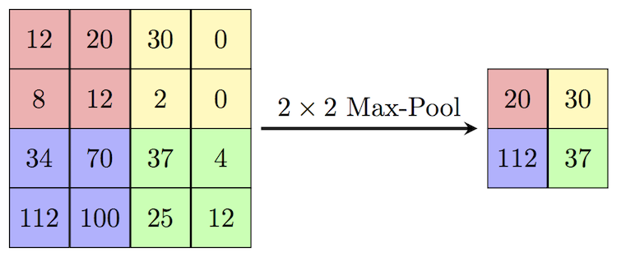
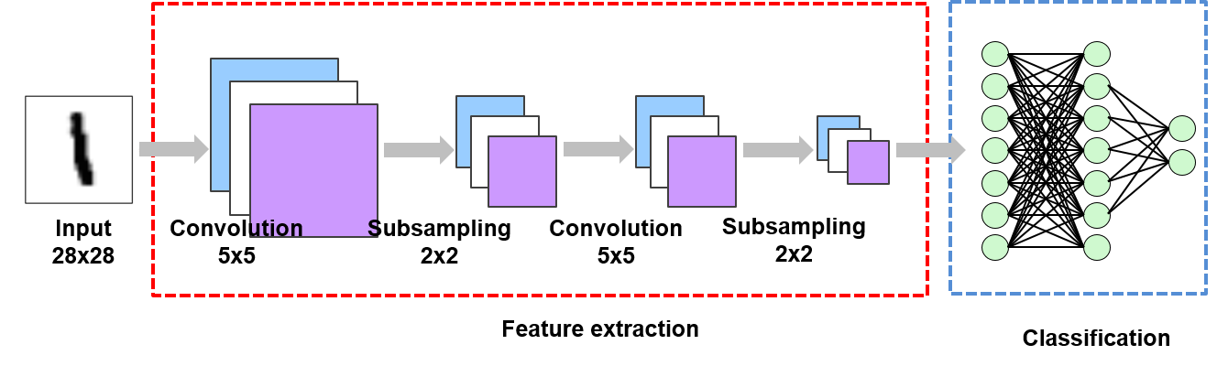


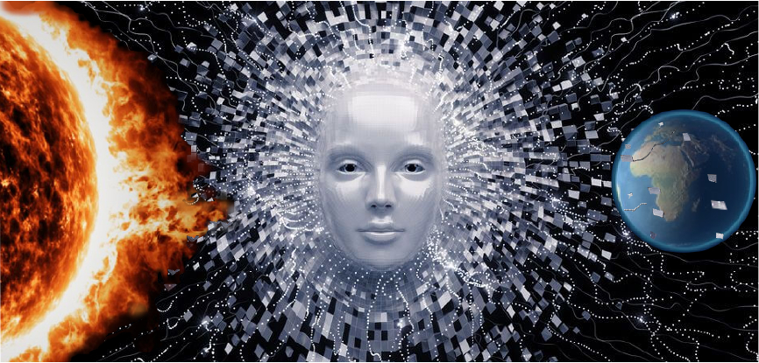
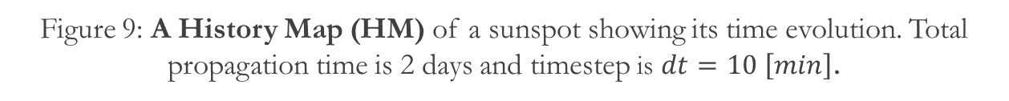

Processing Solar Images to forecast Coronal Mass Ejections using Artificial Intelligence
Savvas Raptis^{1,2}, Jorge Amaya², Adam Shamash², Gilles Depypere², Giovanni Lapenta²
¹KTH Royal Institute of Technology, Department of Space and Plasma Physics
²KU Leuven, Centre for mathematical Plasma Astrophysics
Introduction
Machine Learning Project
Pre-Processing Tool
Energetic activity on the Sun influences space missions, satellites, airplanes, electrical/electronic devices and grid networks. The origin of these disastrous effects is the phenomenon of Coronal Mass Ejection (CME).
CME is as an extensive structure of magnetized plasma which propagates away from the Sun into space, driven by magnetic forces. A specific subcategory of CMEs are the halo CMEs that propagate in the direction of the Earth.
For the year 2014 and by using SDO data of 512x512 resolution and $λ=171 \left[Å\right]$, we obtained:
An accuracy of 76.6% for the prediction of the CMEs as described in CACTUS catalog.
An 83.5% classification between halo and non-halo CMEs as shown in LASCO catalog.
For the download and process of data along with the creation of the Pre-processing tool, we used the Sunpy (http://sunpy.org) library of Python language. For the implementation of CNNs we used as backend the TensorFlow library (https://www.tensorflow.org) and the Keras API (https://keras.io ).
For the training of the CNNs and for the image processing, we used the Flemish Supercomputer Centre (VSC).
The pre-processing tool downloads, processes and organizes images of the Sun derived from the VSO client. It consists of an automatic procedure that uses the Sun’s differential rotation to derive new features (History maps) that may be used in Solar data analysis and machine learning applications.
Figure 1: Images of the Sun showing a halo CME on 20/6/2015. Figure Courtesy: ESA & NASA SOHO.
Table 1: Basic architecture of the CNN model used for the prediction of CMEs and its classification between halo and non-halo.
Figure 5: Diagram of the CNN implementation done for the machine learning project.
Method – Neural Networks
Neural Network (NN) is specialized machine learning algorithm “trained” to perform a specific task. The training is being done by introducing numerous data several times to the NN and by then optimizing the NN’s parameters according to these examples (“back propagation”). The basic idea behind neural networks is that after parametrizing a network to classify known data, the network can be used for prediction, given new unknown information.
Convolution Neural Network (CNN) is an advanced neural network that works ideally when dealing with images. It consists of different layers and parameters that try to obtain features originating from the input images in order to perform a specific task.
In our case, the task is the prediction of CMEs and their classification as halo and non-halo.
Figure 7: A diagram showing the pre-processing tool algorithm.
Figure 6: Accuracy of test set versus epoch. Accuracy is given as a percentage, $y∈\left[0.1\right]$
Figure 8: Visualization of a Sunspot as shown in a time-lapse of 2 days. A longitude line at $−2°$ is shown which follows the differential rotation of the Sun back in time.
Figure 2: Neural Network (NN) and visualization of back propagation.
Figure 9: A History Map (HM) of a sunspot showing its time evolution. Total propagation time is 2 days and timestep is $dt=10 \left[min\right]$.
Figure 3: [Left]: Visualization of Convolution layer. [Right] Visualization of Max pooling/Subsampling layer. Figure courtesy: Cambridge Spark Ltd
Conclusion & Discussion
A promising result was obtained for the prediction and the classification of CMEs as described by CACTUS and LASCO catalogs using Artificial Intelligence techniques. In specific, 76.6% prediction and 83.5% classification between halo and non-halo CME.
A new tool was developed that may be a valuable asset in analyzing and predicting solar related phenomena (CMEs, Sunspots, Solar Flares etc.)
Figure 4: Visualization of CNN used to classify the number “1”. Figure Courtesy: Suhyun Kim, iSystems Design Lab.
Contact / More information
Savvas Raptis
KTH Royal Institute of Technology
savvra@kth.se
This work is part of the AIDA H2020 (www.aida-space.eu) project funded by the European Commission (EC).

