Slide 1



Classification of Magnetosheath Jets using Neural Networks and High Resolution OMNI (HRO) data Savvas Raptis¹, S. Aminalragia-Giamini², Tomas Karlsson¹ & Per-Arne Lindqvist¹ ¹Space and Plasma Physics, School of Electrical Engineering and Computer Science, KTH Royal Institute of Technology, Sweden ²Space Applications & Research Consultancy (SPARC), Greece Amsterdam, 18/9/2019

Slide 2
Introduction

Slide 3
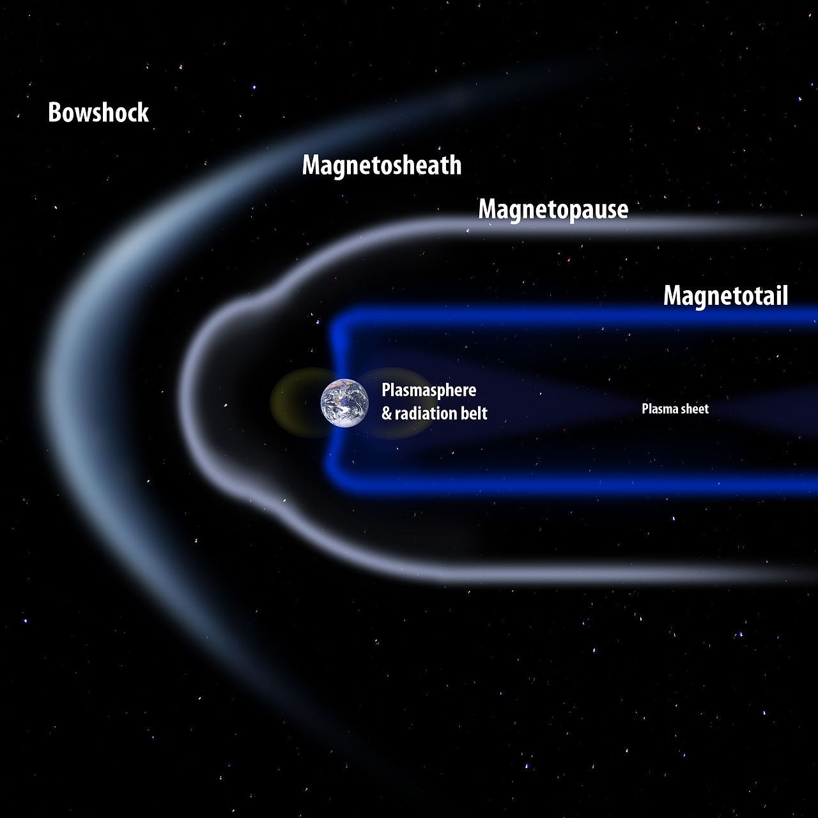
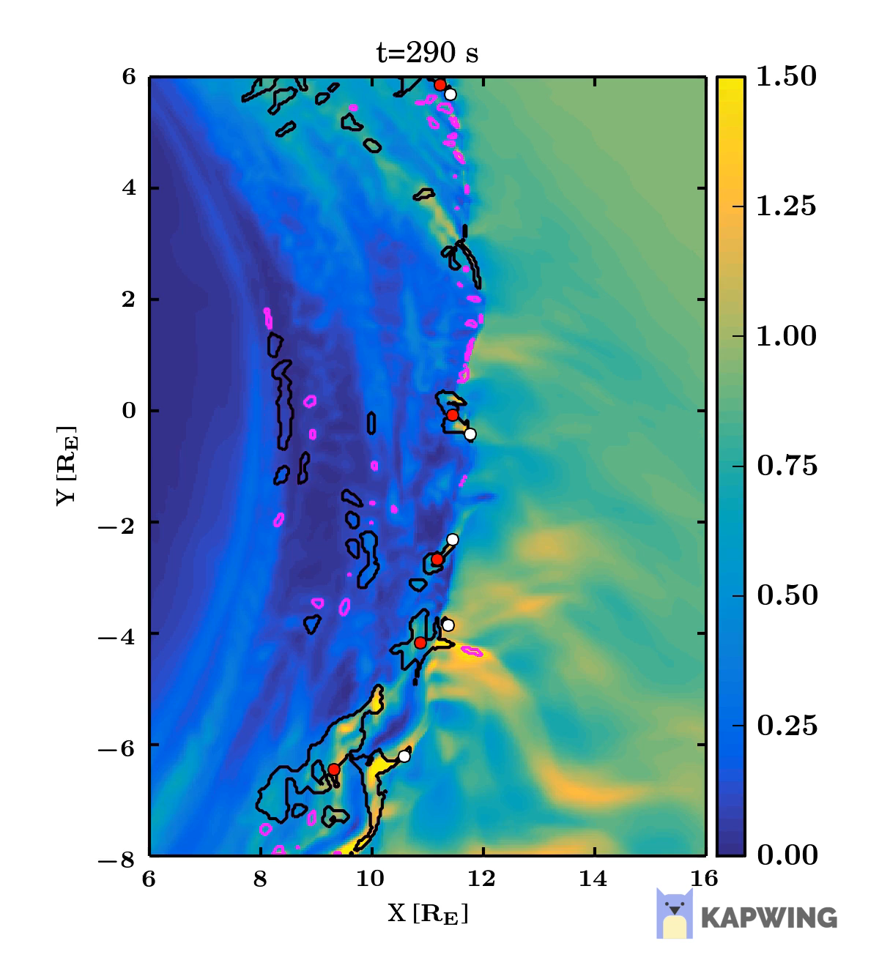
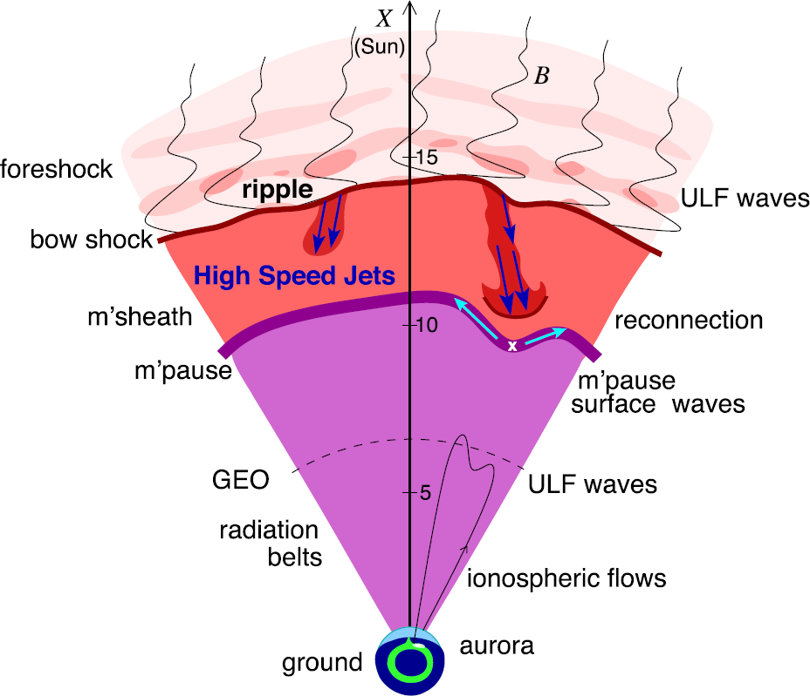
Magnetosheath Jets
Where: Magnetosheath
What: Enhancements of dynamic pressure above the general fluctuation level
How: MMS (Magnetosheath) – OMNIweb database (Solar Wind)
Why: Interaction of SW & Magnetosphere, magnetopause reconnection, radiation belts, auroral features…
Palmroth Minna et al. (2018)
Plaschke F. et al. (2018)

Slide 4
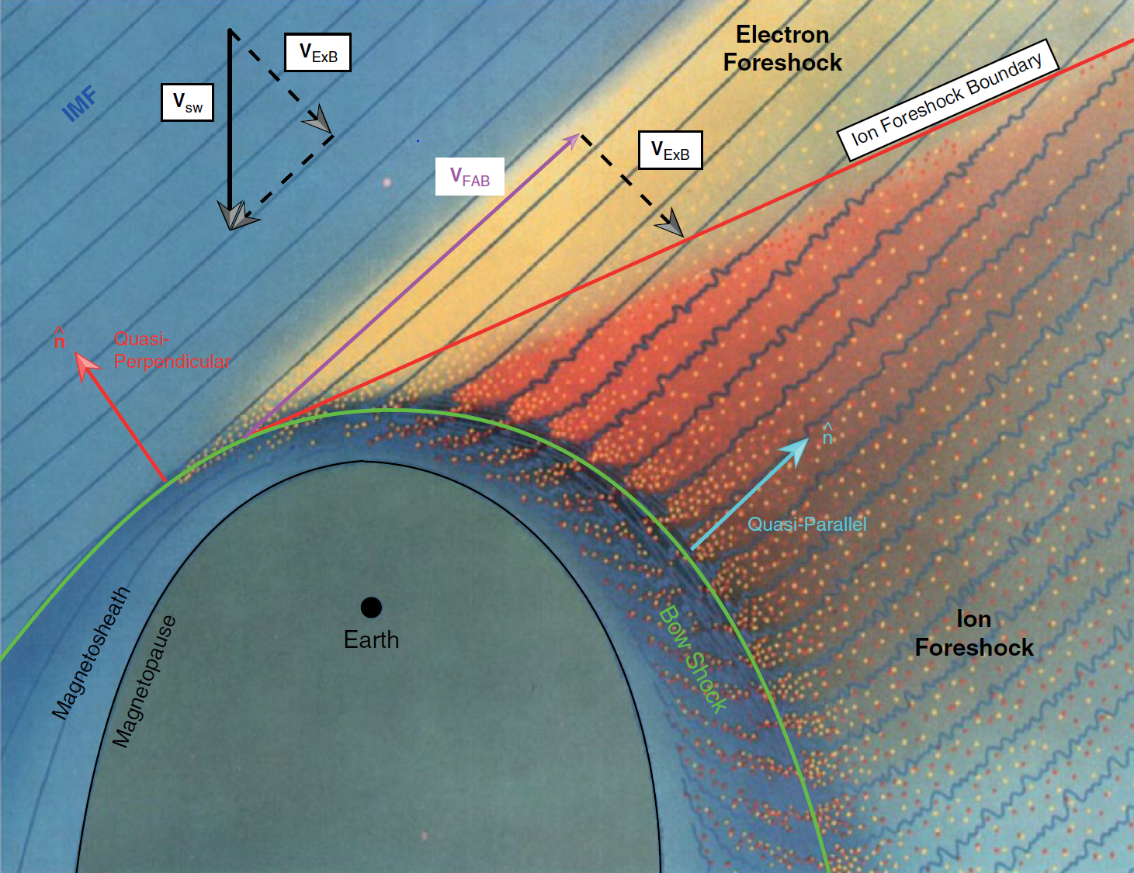


Classes of Magnetosheath Jets
Jets are found mainly in quasi-parallel shock ($θ_{n}<45°$). However, fluctuations also found in quasi-perpendicular regions.
$$Q_{par}$$ | $$Q_{per}$$
L. B. Wilson (2016)

Slide 5
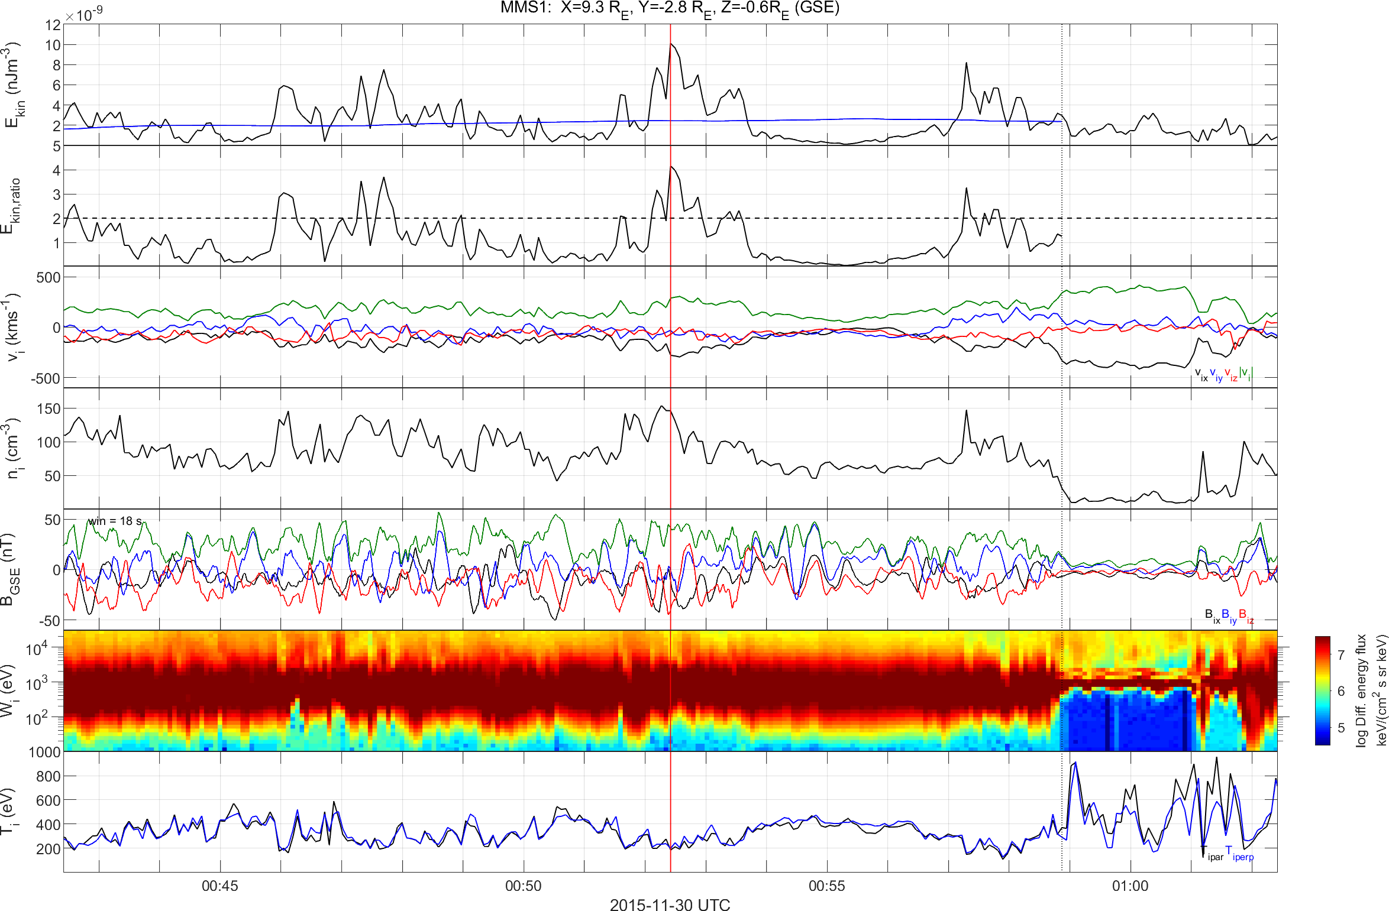
Quasi-parallel jet using MMS
High $B$ Variance, High Energetic Particles, Low Anisotropy
Dynamic Pressure
Jet
Dynamic Pressure Ratio
Velocity
Density
Magnetic Field
Ion Energy Spectrum
Temperature

Slide 6
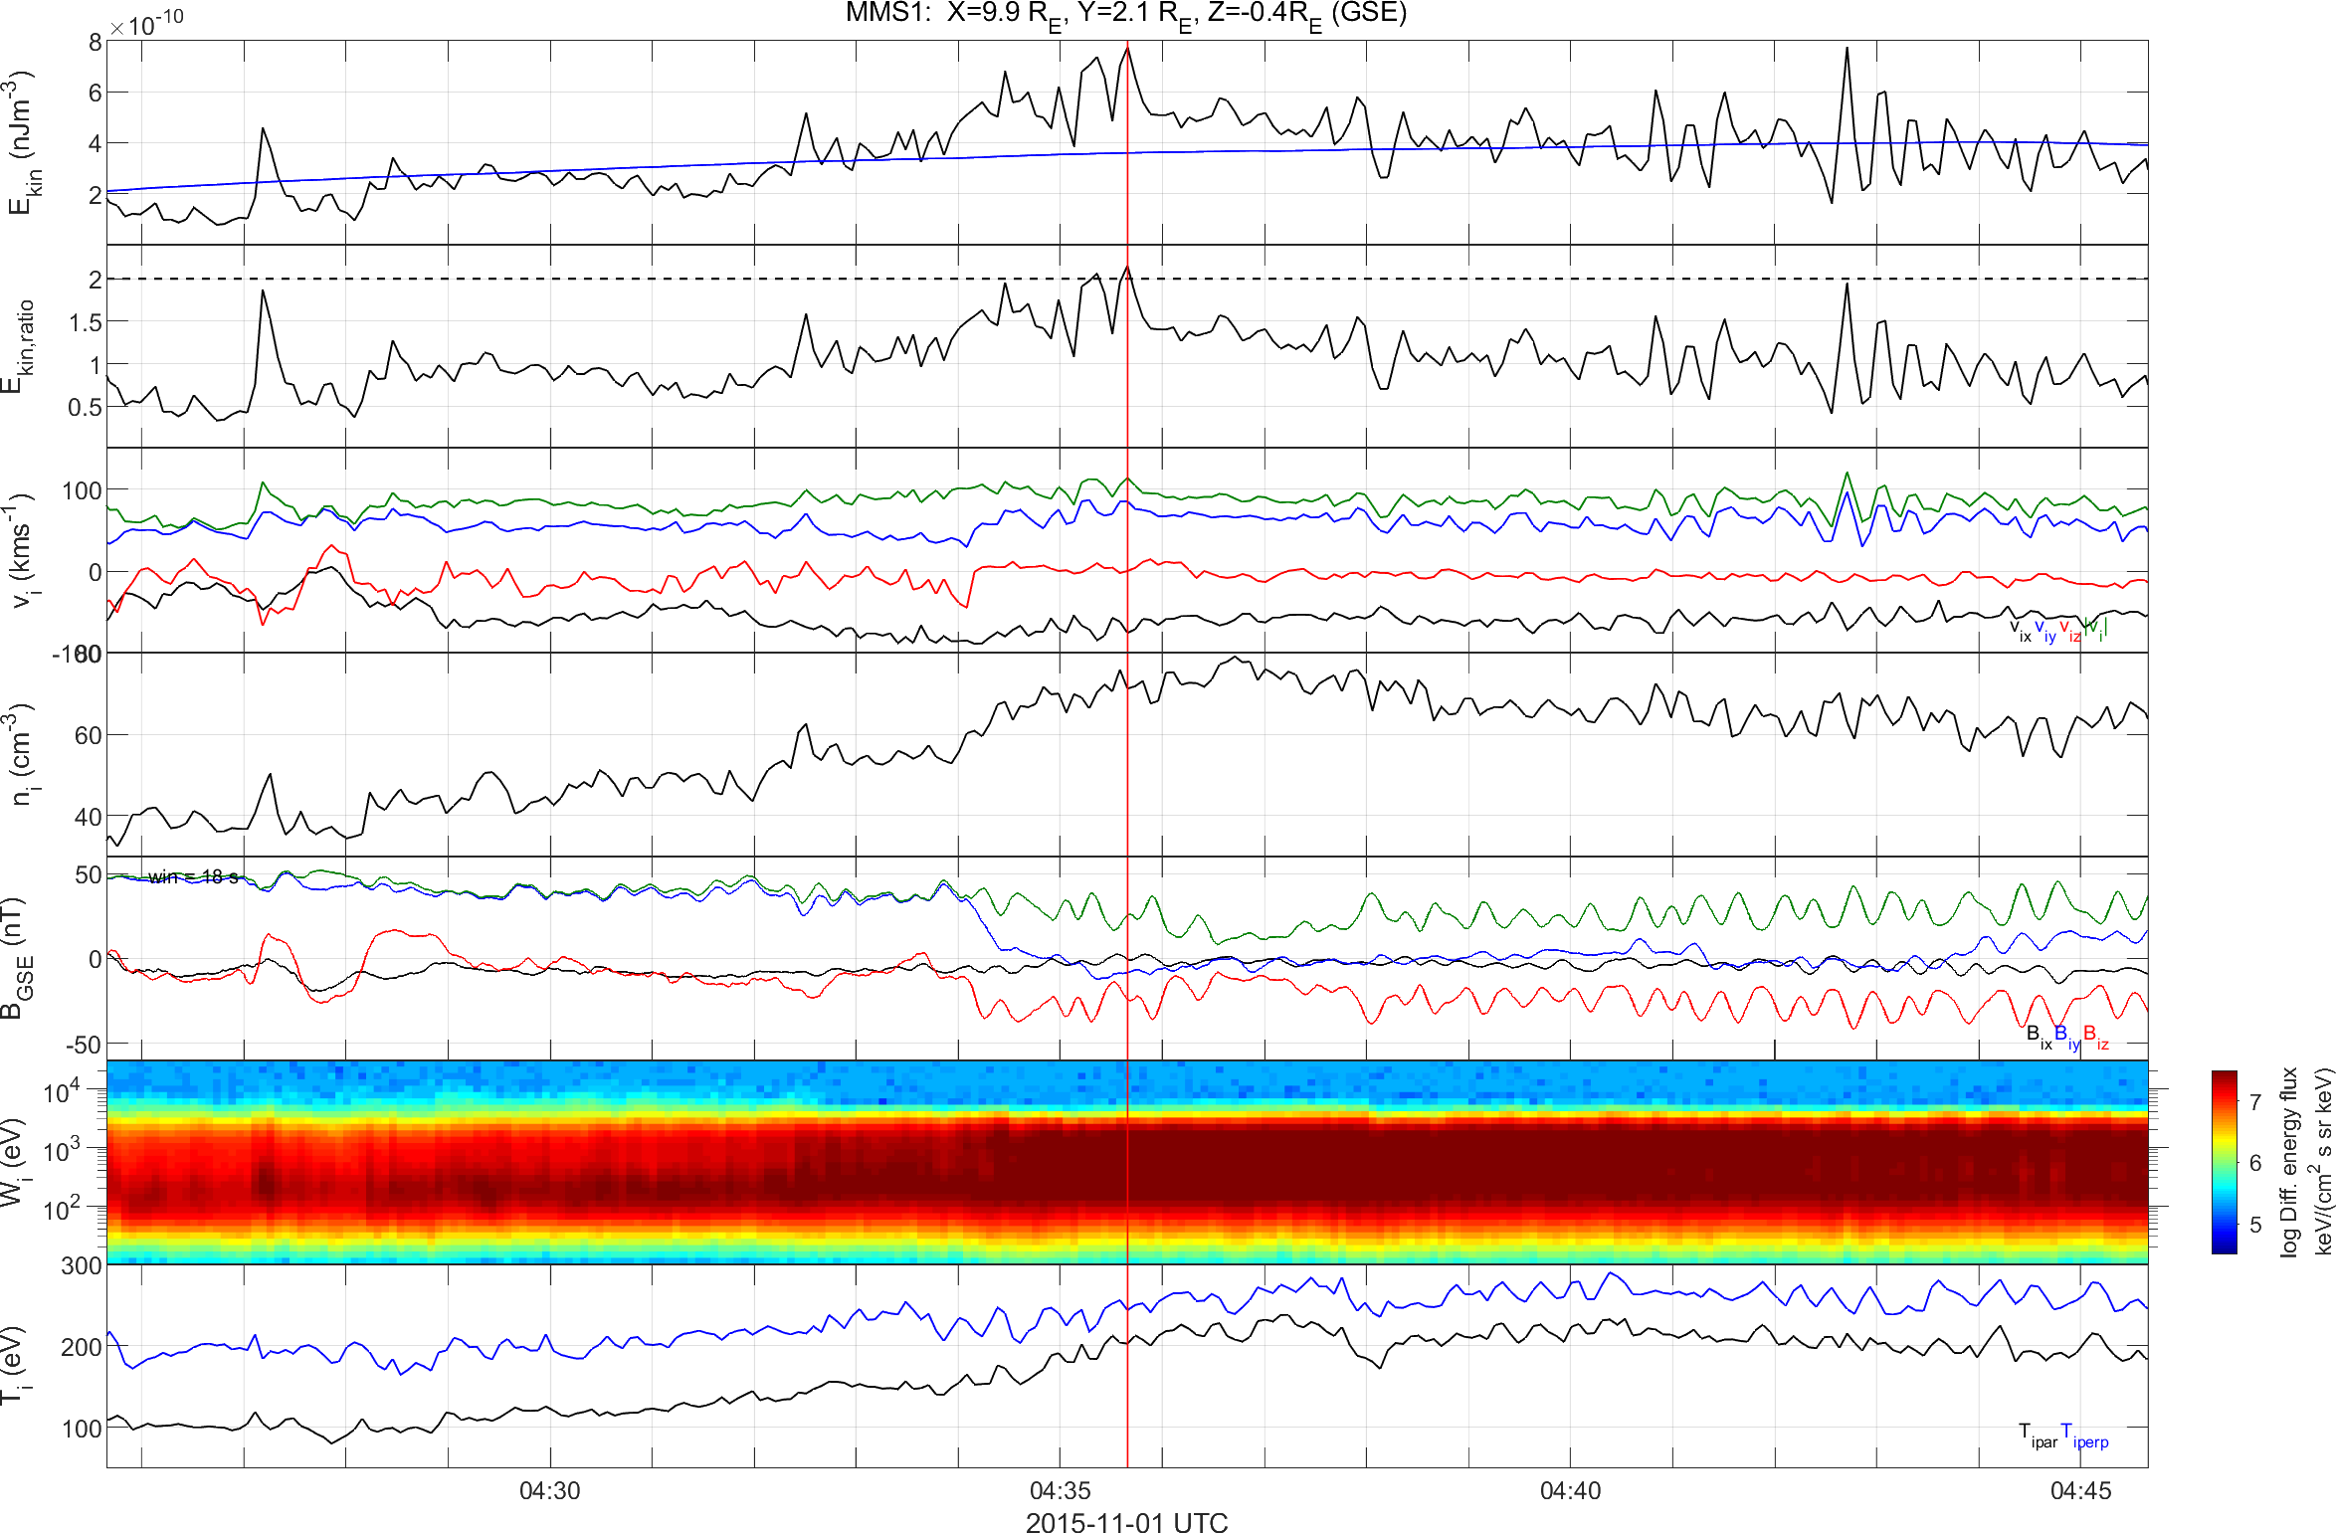
Quasi-perpendicular jet using MMS
Low $B$ Variance, Low Energetic Particles, High Anisotropy
Dynamic Pressure
Dynamic Pressure Ratio
Velocity
Density
Magnetic Field
Ion Energy Spectrum
Temperature

Slide 7
Differences of each class
High Variance, High Energetic Particles, Low Anisotropy
Low Variance, No Energetic Particles, High Anisotropy
Quasi – Parallel Jet
Quasi – Perpendicular

Slide 8
Main Categories
Qpar Jet
Qperp Jet
Boundary Jet
Encapsulated Jet
Raptis S., et al. 2019 (In progress)

Slide 9
Main Categories
Qpar Jet
Qperp Jet

Slide 10



Motivation
Quasi-Parallel
Quasi-Perpendicular
Bow Shock
Neural Networks
Magnetopause
Jets
$$L_{1}$$
ΗRO Data (1 min averaged)
Earth
$$ACE$$
MMS

Slide 11

Main Goal
Find class of magnetosheath jet found by MMS using OMNIweb SW data
Input
Solar Wind Data (OMNIweb)
Output
Magnetosheath Jet Class (MMS)
$$Q_{par}$$ | $$Q_{per}$$
Absolute Magnetic Field
Dynamic Pressure
Mach Number
Beta Parameter
Electric Field
Velocity
Density
Temperature
Magnetic Field Components…

Slide 12
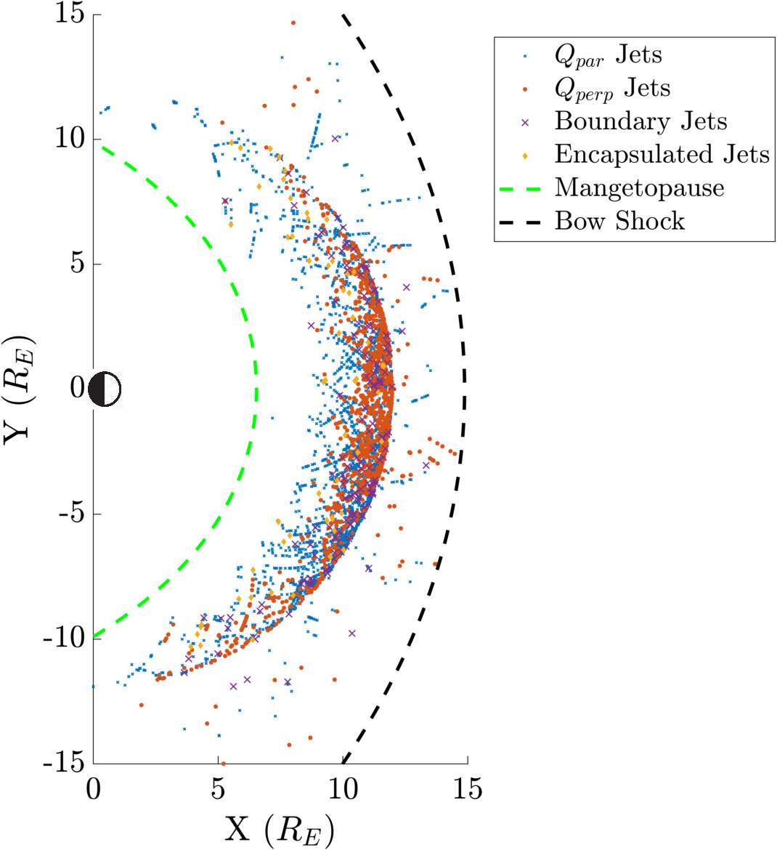
Output Jet list

Slide 13






Input (Solar Wind)
Solar Wind at $t_{0}=t_{MMS}$
Mean Solar Wind $\left(t_{0}−10,t_{0}+5\right)$
Mean Solar Wind $\left(t_{0}−5,t_{0}\right)$
Μax Solar Wind $\left(t_{0}−5,t_{0}\right)$
Bow Shock
Magnetopause
$$t^{′′}$$
OMNIweb
Earth
$$t$$
$$t^{′}$$

Slide 14

Why Connect SW to jets?
Associate Solar Wind parameters and Jets (SW → MSH)
Assist initial classification based on SW conditions
Compare results with other techniques
Known
Mach Number = Increased Frequency
To be determined
Temperature
Absolute Magnetic Field
Density
Velocity
Electric Field
Plasma beta
…
Provide percentages for unclassified jets
Jet’s class is determined by $θ_{Bn}$
Can neural networks outperform that using other solar wind parameters ?

Slide 15
Method

Slide 16
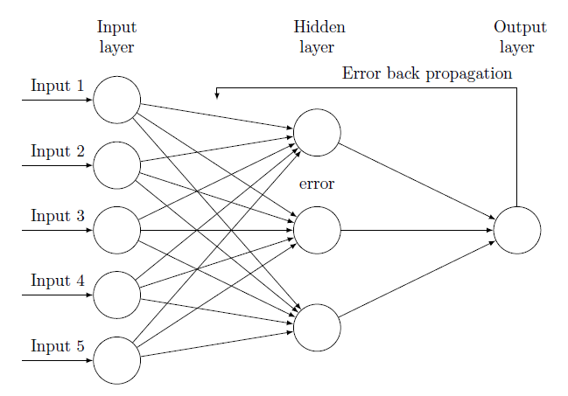
Neural Networks & Backpropagation
Output

Slide 17
A Trained Neural Network
*Video Courtesy: 3Blue1Brown (Check him on YouTube!)

Slide 18


Schematic of Procedure
Input
Solar Wind Data
Neural Network
Classification
Output
MMS Jet’s Class
$\vec{B}, P, β, Τ, \vec{v},ρ$…
Quasi – Parallel
0
$$…$$
Quasi – Perpendicular
1

Slide 19
Results

Slide 20
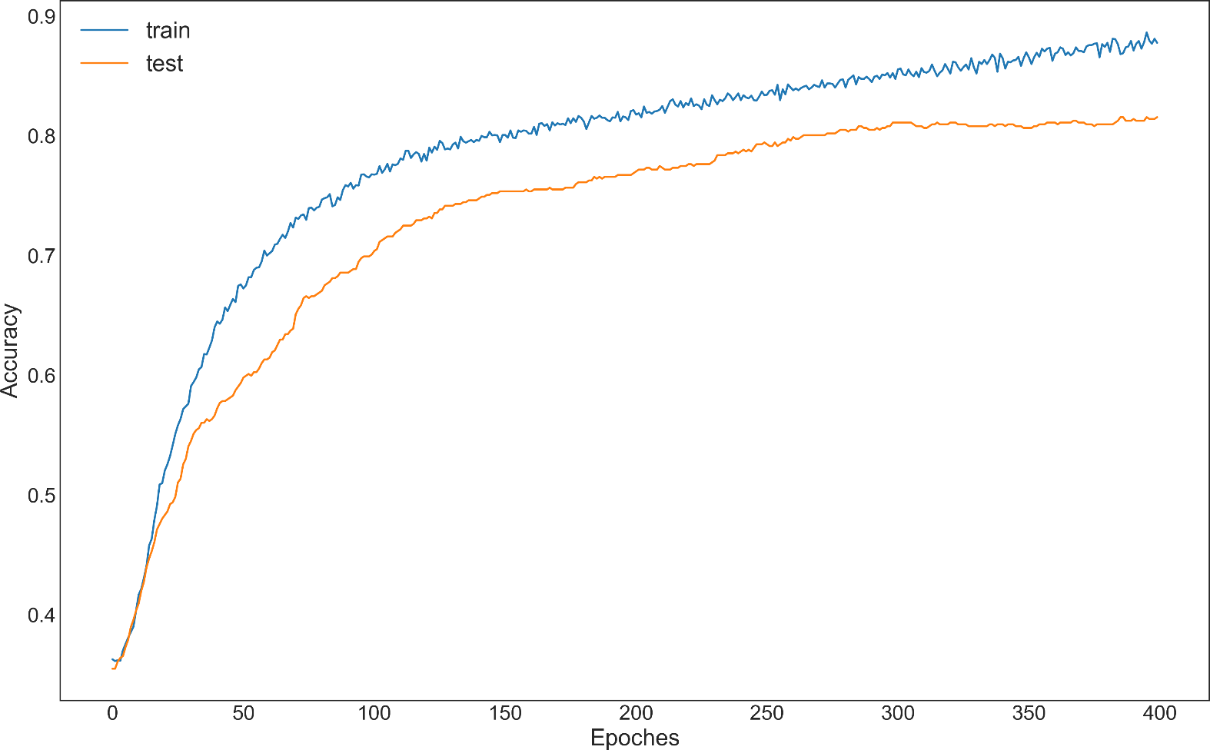
Best parameters
Neural Network Parameters
Training – Test set : 80 – 20%
Optimizer: Nadam
Activation Function: (P)ReLu, Softmax
Extra: Batch Normalization, Class Weight
Input Evaluation
Most important:
Alfvenic Mach Number
Magnetosonic Mach Number
Temperature
Beta parameter
Velocity
Density

Slide 21
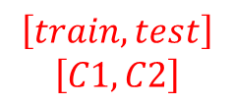
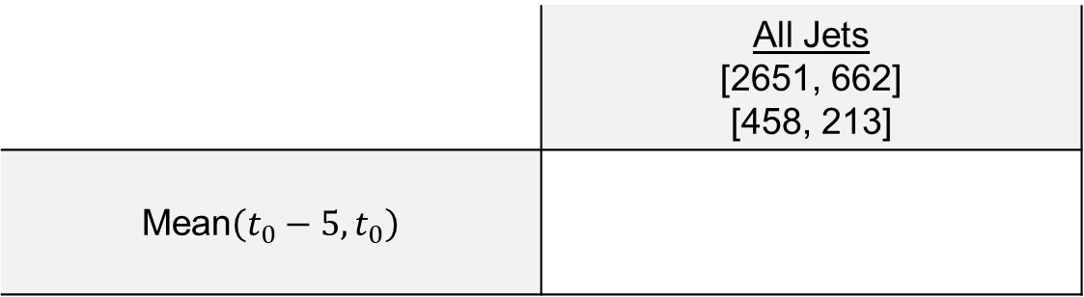
Results – Example
$$\left[train,test\right]$$
$$\left[C1,C2\right]$$
 | All Jets [2651, 662] [458, 213]
Mean$\left(t_{0}−5,t_{0}\right)$
360 | 89
32 | 181
80%
86%

Slide 22

Results – Example
$$Input$$
 | All Jets [2651, 662] [458, 213]
Mean$\left(t_{0}−5,t_{0}\right)$
360 | 89
32 | 181
80%
86%

Slide 23
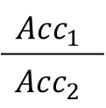
Results – Example
 | All Jets [2651, 662] [458, 213]
Mean$\left(t_{0}−5,t_{0}\right)$
360 | 89
32 | 181
80%
86%
True | False
False | True
$$Acc_{1}$$
$$Acc_{2}$$

Slide 24
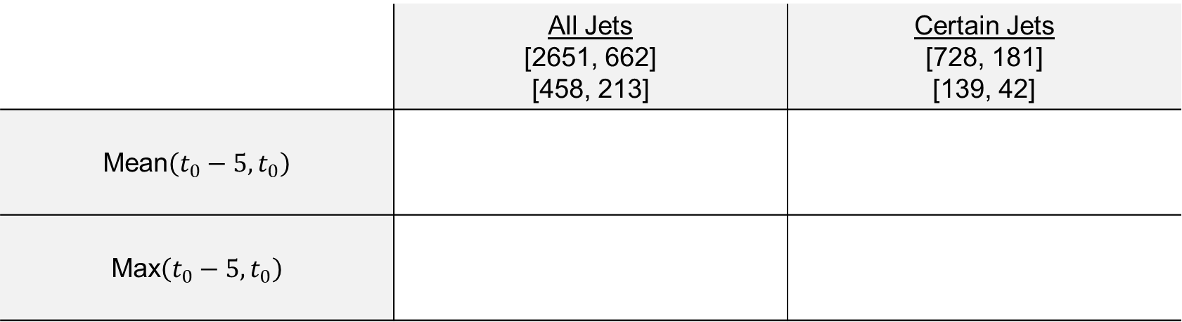
Results – Classification Accuracies
 | All Jets [2651, 662] [458, 213] | Certain Jets [728, 181] [139, 42]
Mean$\left(t_{0}−5,t_{0}\right)$
Max$\left(t_{0}−5,t_{0}\right)$
360 | 89
32 | 181
80%
86%
135 | 4
2 | 40
97%
95%
345 | 104
55 | 158
77%
74%
131 | 8
4 | 38
94%
90%

Slide 25

Work in progress …
Solar Wind
Magnetosheath & Magnetosphere
Bow Shock
Cluster
Magnetopause
MMS
Neural Networks
Earth
$$ACE$$
Physical
Modeling (?)
Qpar MSH
Qperp MSH

Slide 26
Conclusion
Summary
Investigated different solar wind parameters and found the best combination for jet classification.
Successfully classified part of the jets from our initial dataset with accuracy 80 – 96%
Provided support to initial dataset from achieving a classification using different satellite data.
Future Work
Add more categories of jets from the initial dataset (e.g. “boundary” Jets : Associated with IMF rotation)
Try to classify unknown jets that could not be determined using initial algorithm.
Revaluate classification based on the results.
Work towards finding the dominant features of SW for jet phenomena and prediction.

Slide 27
Extra

Slide 28
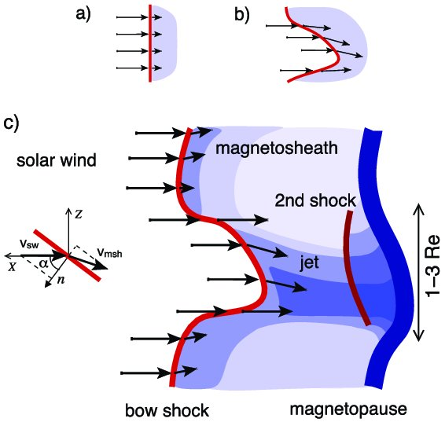
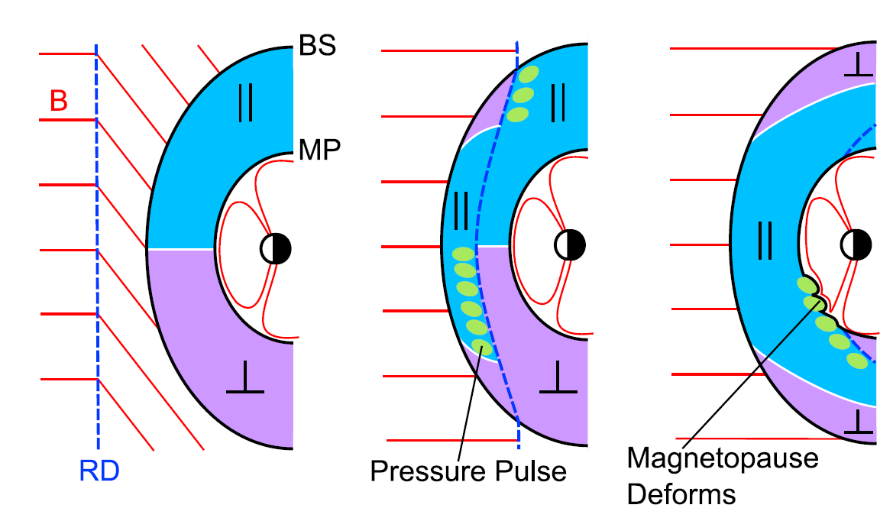
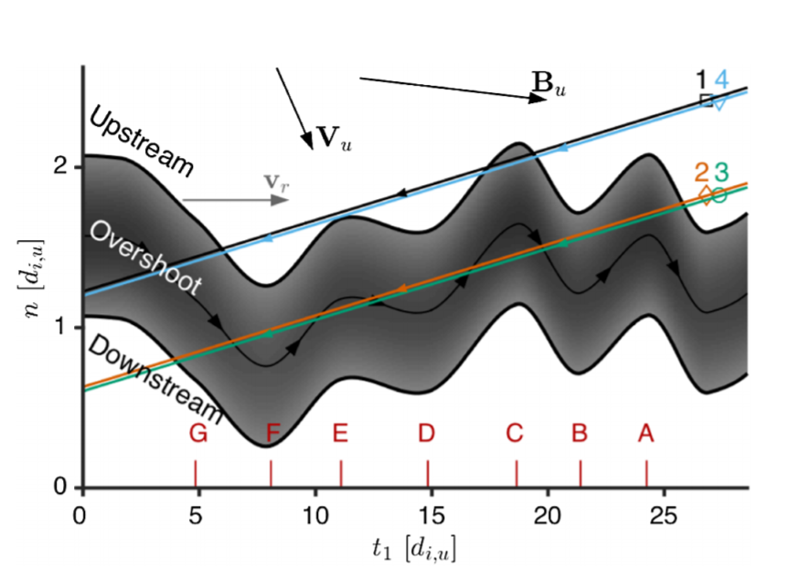
Mechanisms ideas for each jets
Quasi – Parallel
Boundary
Quasi – Perpendicular
Boundary
Hietala et al. (2012)
Archer et al. (2012)
Johlander et al. (2016)

