Slide 1


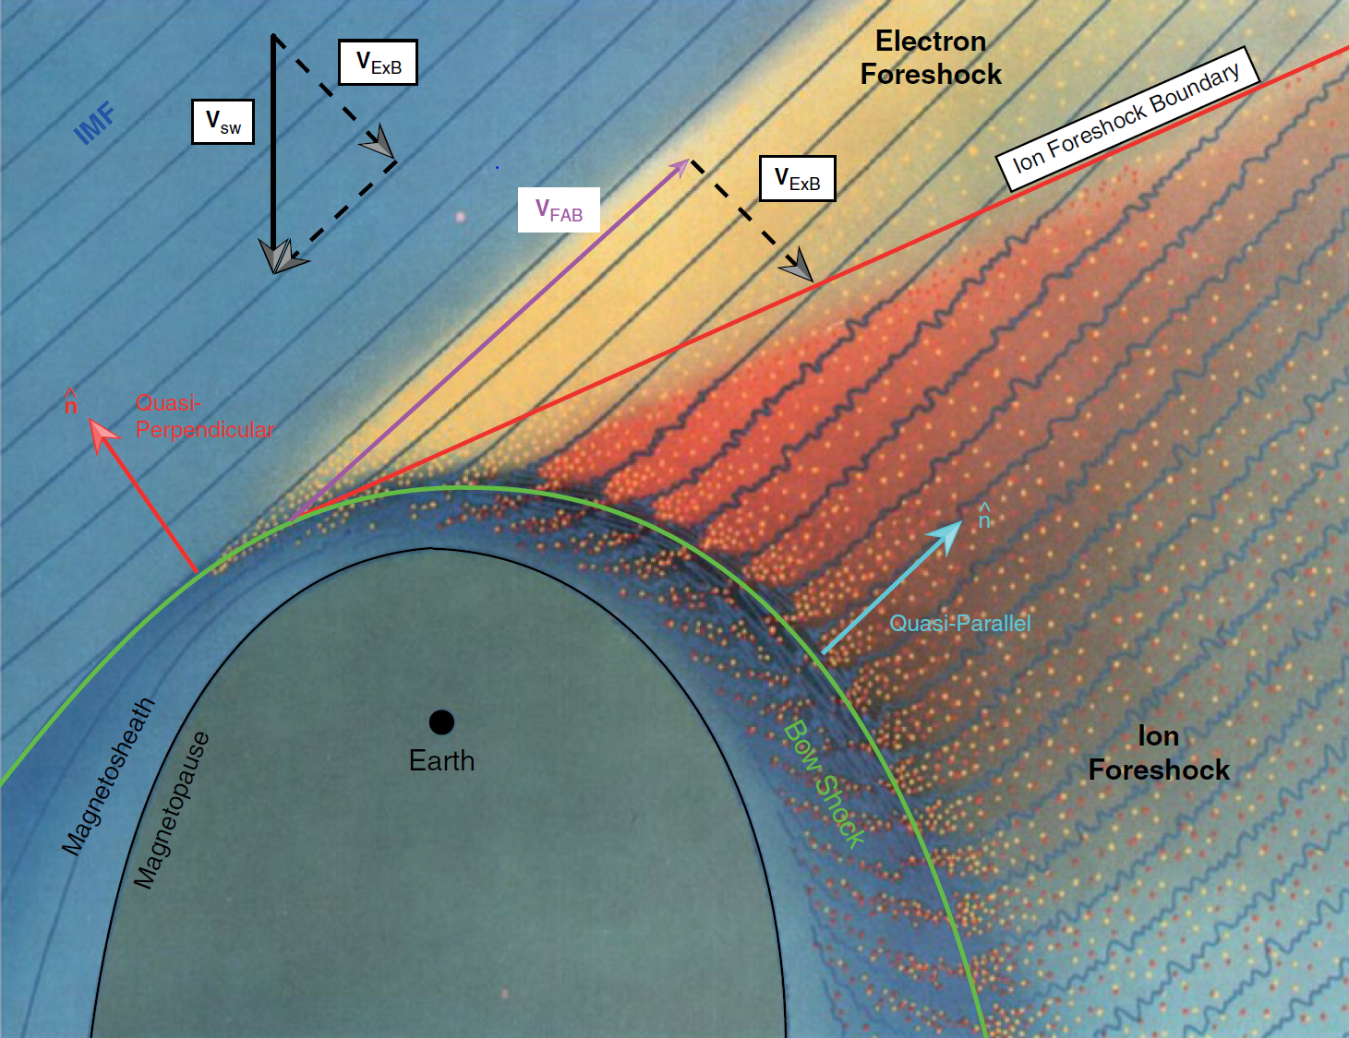
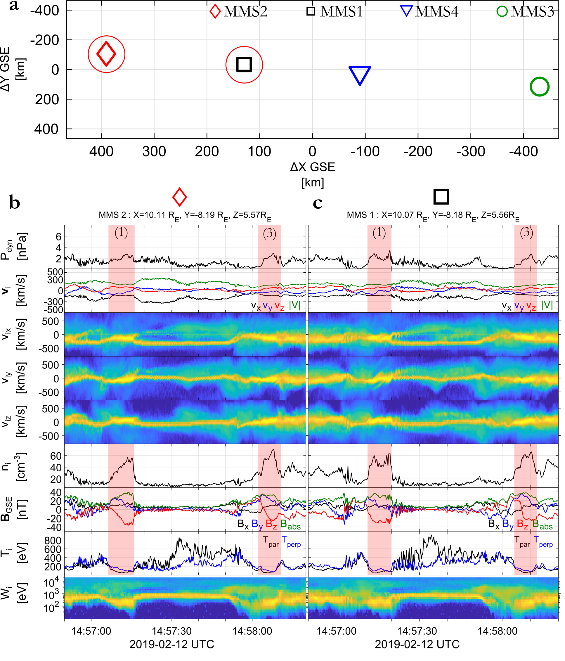
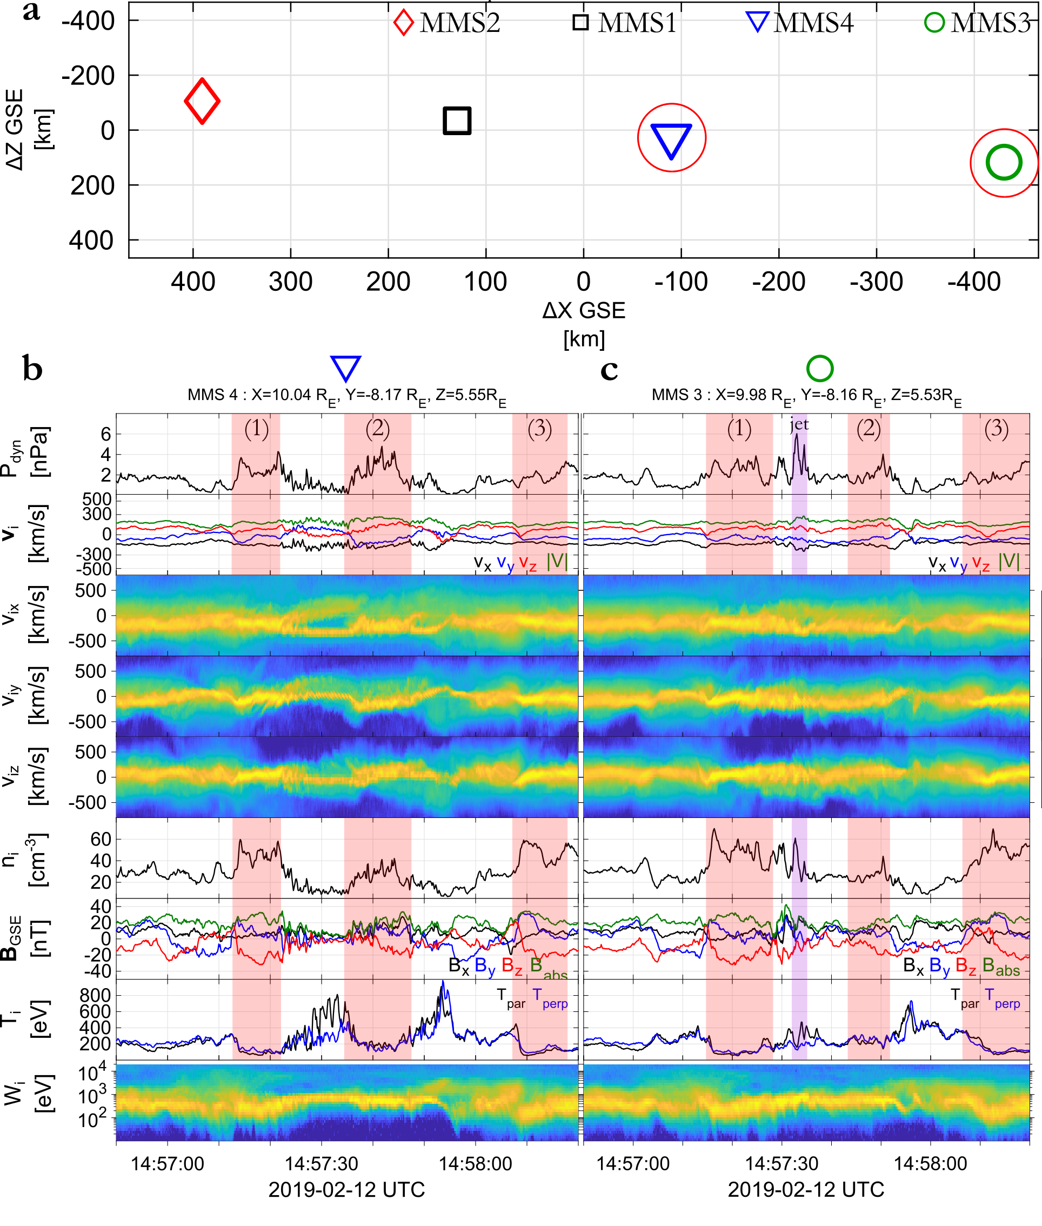
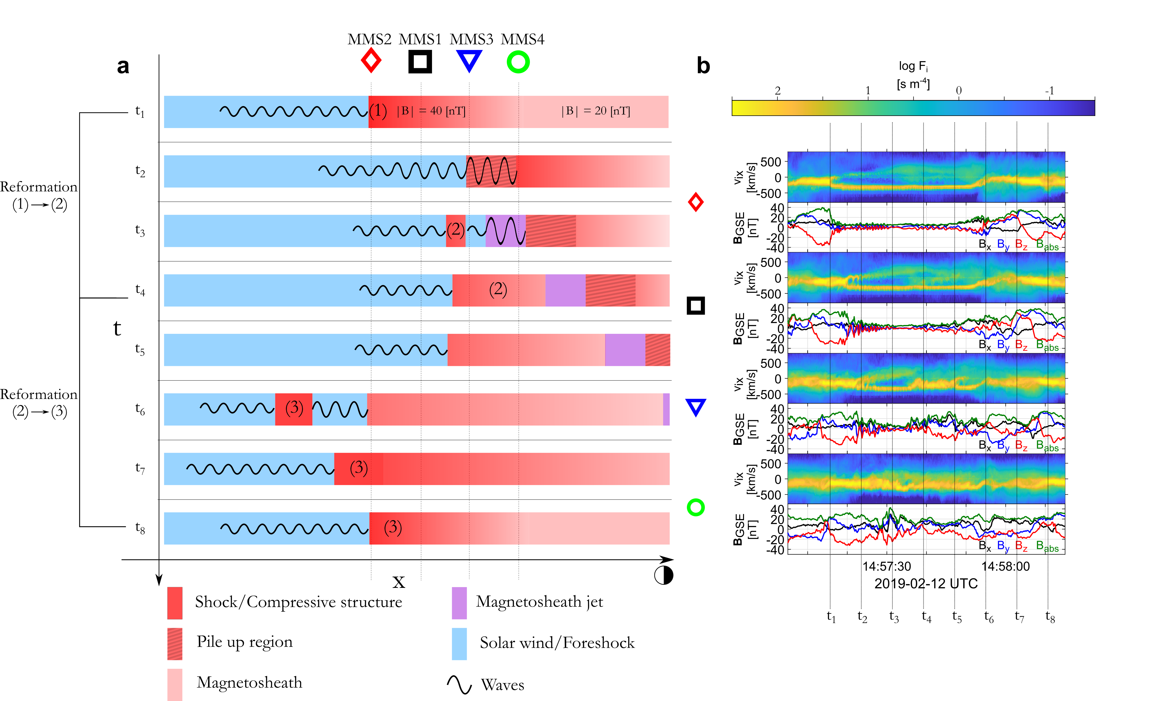
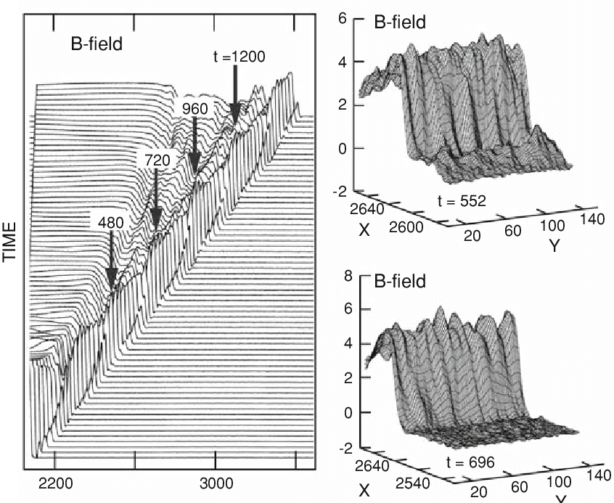
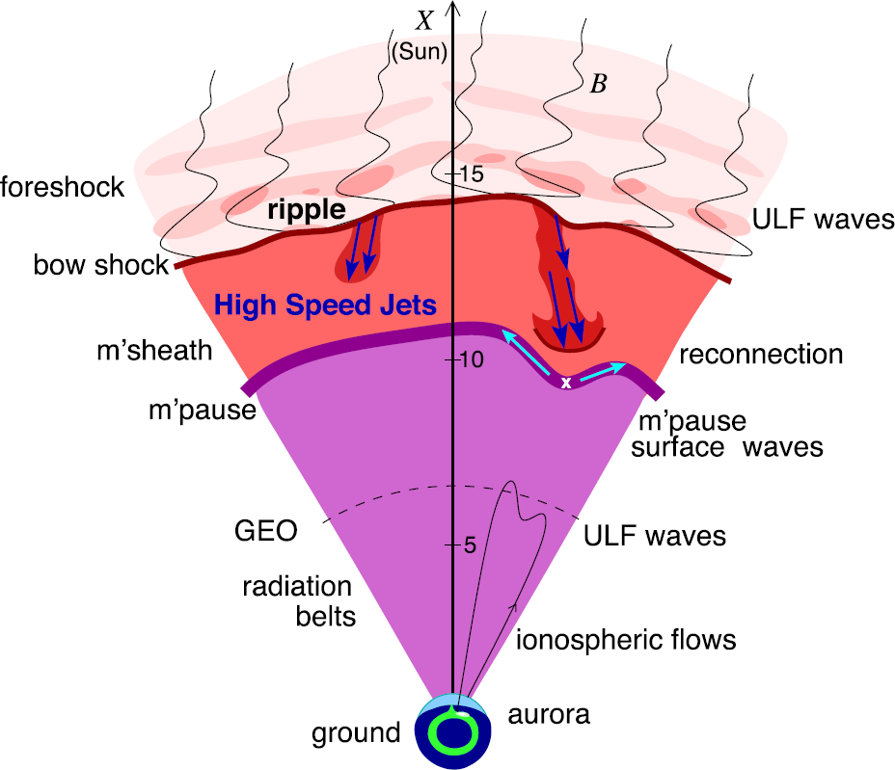
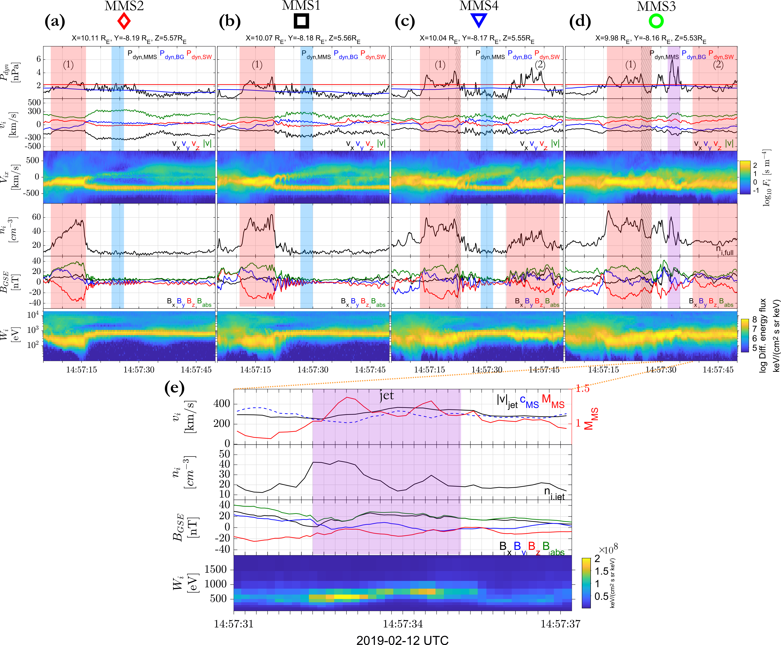
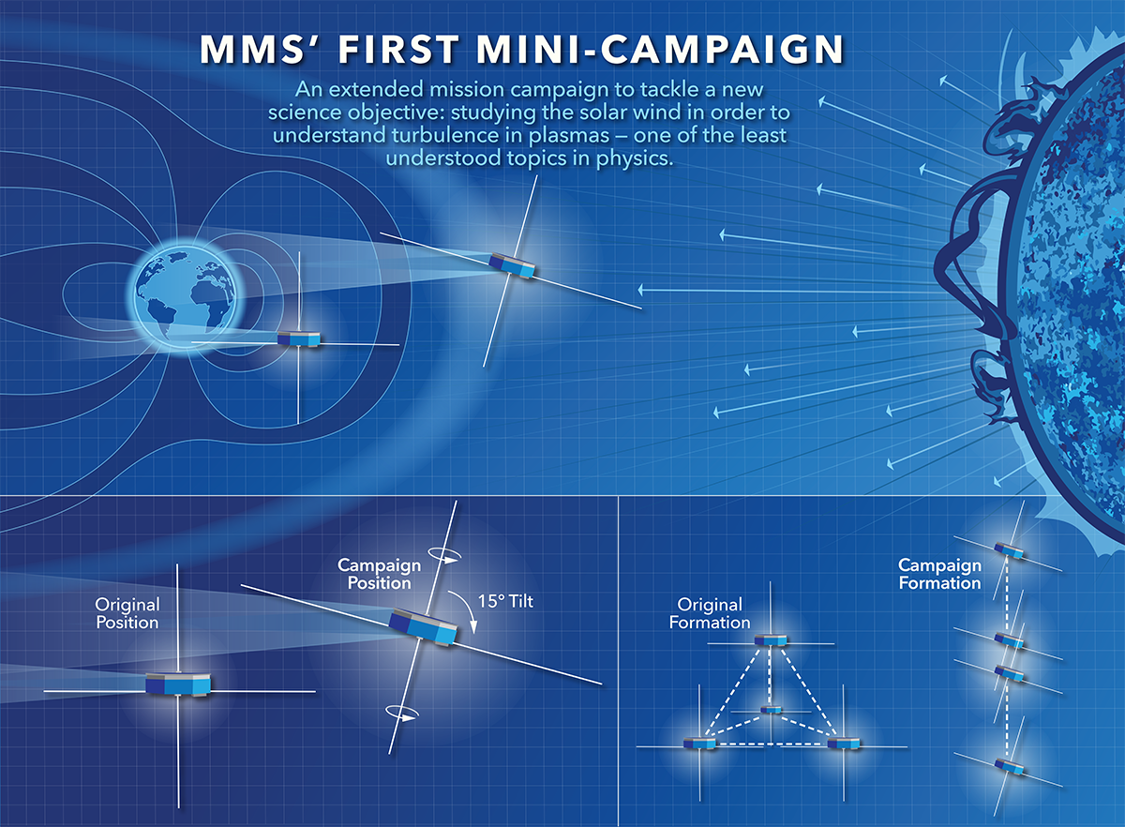
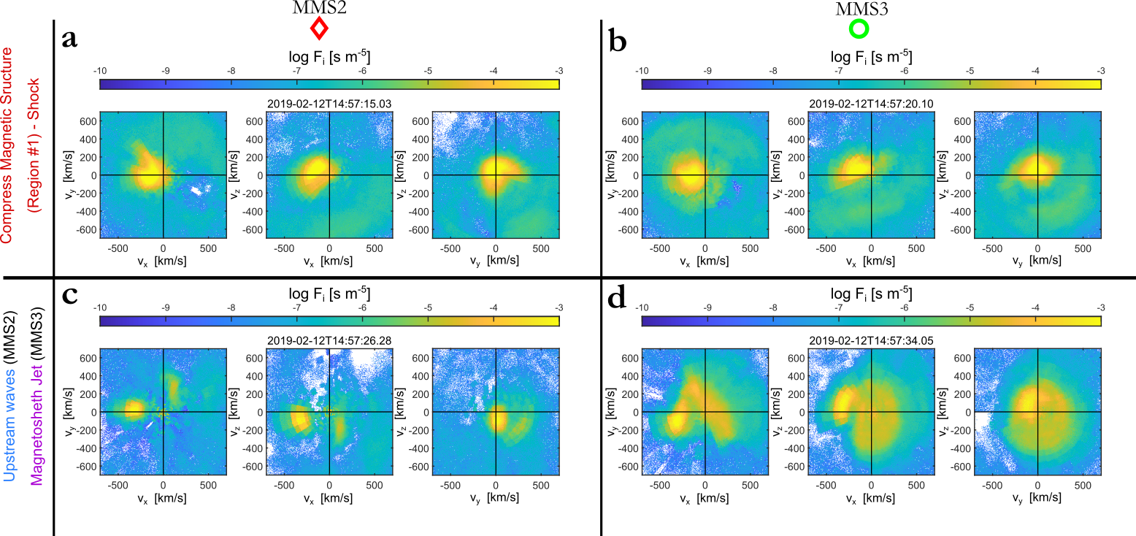
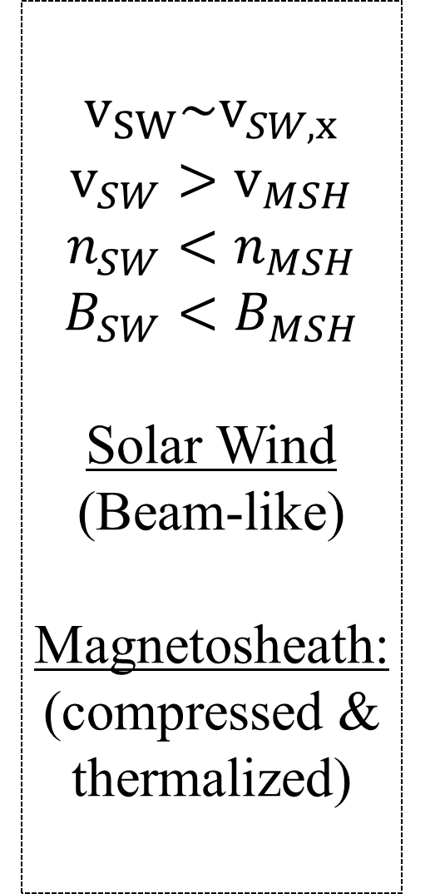



Super-magnetosonic Downstream Jet Formation Caused by Shock Reformation
Savvas Raptis¹, Tomas Karlsson¹, Andris Vaivads¹, Craig Pollock², Ferdinand Plaschke³, Andreas Johlander⁴, Henriette Trollvik¹, Per-Arne Lindqvist¹
¹Space and Plasma Physics, KTH Royal Institute of Technology, Stockholm, Sweden, ²Denali Scientific, Fairbanks, AK, 99709, USA, ³Institute of Geophysics and Extraterrestrial Physics, Technische Universitat Braunschweig, Germany, ⁴Swedish institute of Space Physics, Uppsala, Sweden
Bow shock & Magnetosheath Jets
Results | in-situ observations
Results | Model
Bow Shock
Solar wind is braked, thermalized and compressed, forming the magnetosheath, downstream of the shock
Quasi-par shock
$θ_{Bn}≾45$ (angle between IMF & shock normal) → reflected ions → wave and particle interaction
→ turbulent foreshock & magnetosheath
$$v_{SW}\sim v_{SW,x}$$
$$v_{SW}>v_{MSH}$$
$$n_{SW}<n_{MSH}$$
$$B_{SW}<B_{MSH}$$
Solar Wind
(Beam-like)
Magnetosheath:
(compressed & thermalized)
Model of the shock evolution, reformation and
the generation of a magnetosheath jet.
L. B. Wilson (2016) | Geophysical Monograph Series
Whistlers
Jet
SLAMS
- Shock
Embedded
plasmoid
Lembège and Savoini (2002)
Plaschke F. et al. (2018); sketch by H. Hietala | Space Sci. Rev
Shock Reformation
Shock is constantly reforming, due to the evolution of foreshock compressive structures (e.g. SLAMS/shocklets) that effectively form the shock front locally
Magnetosheath jets are dynamic pressure enhancements relative to the background magnetosheath.
$$P_{dyn}≥2{\left\langle P_{dyn}\right\rangle }_{MHS}$$
Supermagnetosonic: $M_{MS}≈1.2 − 1.4$
Anti-sunward: $V_{x}≈350 km/s$
$\frac{P_{dyn,jet}}{P_{dyn, MSH}}≈\frac{P_{dyn,jet}}{P_{dyn, SW}}≈3$
Jet is a 2nd plasma population different from the background magnetosheath → Partial moment derivation required.
Summary & Conclusion
MMS mission
Super-magnetosonic downstream jets are generated directly from the bow shock evolution. Density enhancement is associated to upstream foreshock waves while velocity is connected to solar wind having a weak interaction with the reforming shock.
Embedded plasmoids (downstream density enhancements) appear to be shock remnants originating from the same shock reformation process.
We show a generation mechanism that does not require specific geometry or external effect. Jets are generated from a fundamental collisionless shock process.
Results may be relevant to other shock environments & acceleration mechanisms (cosmic rays, astrophysical shocks, planetary shocks, etc.).
Unique opportunity for shock research for the Magnetosphere Multiscale (MMS) Mission
Turbulence campaign (large separation)
Spacecraft aligned in the x direction (GSE)
Burst data (high resolution) available
2D reduced VDF
Credits: NASA's Goddard Space Flight Center/Mary Pat Hrybyk-Keith
More info: 📧 | savvra@kth.se 🔗 | savvasraptis.github.io

