Slide 1

Characterization of the Earth’s Magnetosheath and its Fast Plasma Flows Using Upstream Measurements and Machine Learning Savvas Raptis¹, Tomas Karlsson¹, Sigiava Aminalragia-Giamini², P-A. Lindqvist¹, Martin Lindberg¹ , Henriette Trollvik¹ ¹Division of Space and Plasma Physics, KTH Royal Institute of Technology, Sweden ²Space Applications & Research Consultancy (SPARC), Greece Asia Oceania Geosciences Society 2021 Meeting 03 August 2021

Slide 2
Introduction
(Neural Networks)

Slide 3
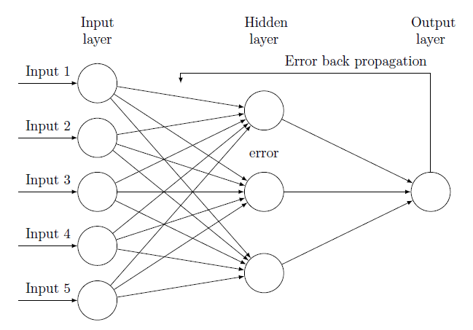
Neural Networks & Backpropagation
Supervised Learning
Labeled Data
Known input output
Unknown map/relationship
Output

Slide 4
A Trained Neural Network
*Video Courtesy: 3Blue1Brown (Check his YouTube page for more)

Slide 5
Introduction
(Bow Shock, Magnetosheath and Jets)

Slide 6
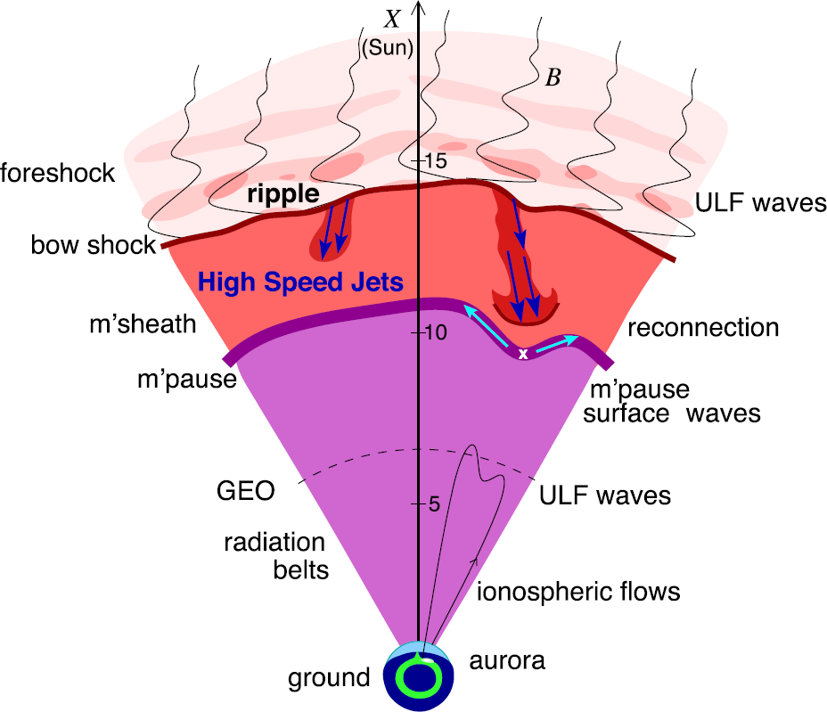
Magnetosheath Jets
Definition
Magnetosheath jets are transient localized enhancements of dynamic pressure (density and/or velocity increase)
e.g. 200% dynamic pressure enhancement compared to background magnetosheath
Related phenomena
Radiation belts
Aurora
Magnetopause reconnection
Magnetopause penetration
Shock acceleration
Magnetopause surface eigenmodes
ULF wave excitation
Plaschke F. et al. (2018); sketch by H. Hietala | Space Sci. Rev

Slide 7
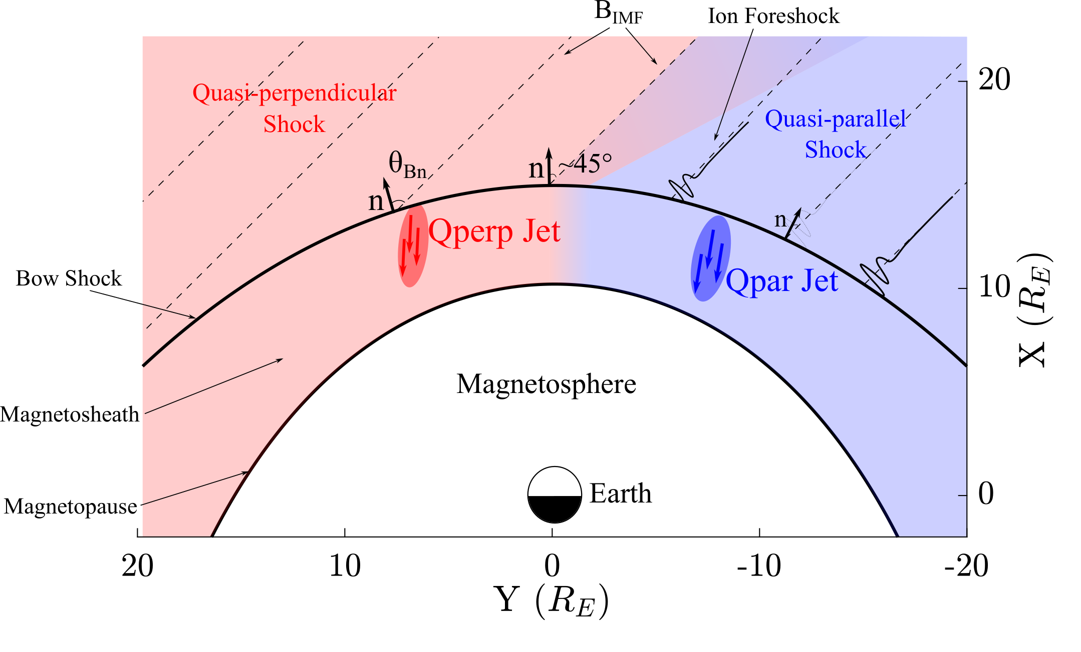
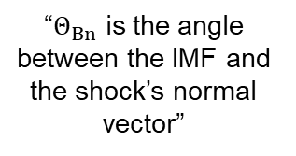
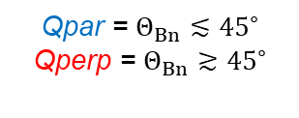
Shock, Magnetosheath & Jet classification
“$Θ_{Βn}$ is the angle between the IMF and the shock’s normal vector”
Qpar = $Θ_{Βn}≲{45}^{∘}$
Qperp = $Θ_{Βn}≳{45}^{∘}$
”Jets are found ~9 times more often behind the Qpar bow shock”
Raptis, Karlsson, et al. (2020) | JGR
Raptis, Aminalragia-Giamini et al. (2020) | Front. Astron. Space Sci
Kajdič, Raptis et al. (2021) | GRL
Karlsson, Raptis, et al. (2021) | JGR - Under Review
Raptis, et al. (2021b) | Ongoing
Vuorinen, et al. (2019)
Notes:
In this work we will focus on the so called Quasi-parallel bow shock. This is where the angle between the normal vector of the shock and the IMF has less than 45 degrees. That’s where we have a turbulent magnetosheath, an ion foreshock and also where we find the most energetic jets

Slide 8
Results

Slide 9



Review of current work
(1) Statistical properties of jets (Raptis et al. (2020 | JGR)
“Showed us which quantities can be used for in-situ classification using MMS”
(2) Classification of jets using Neural networks (Raptis et al. (2020) | Front. Astron. Space Sci)
“Showed us that there is information in the Solar Wind that correspond to Qpar and Qperp jets and possibly to magnetosheath”
(3) Classification of the magnetosheath (Karlsson et al. (2021) | JGR – Under review)
“Showed us that we can have strong statistical relationship between upstream and downstream measurements. Supporting the findings of (1) and (2)”
(4) Mapping magnetosheath & shock transitions using neural networks (Raptis et al. (2021) | Ongoing)
“Will proceed to map the relation between the different plasma population upstream and downstream by using machine learning techniques similarly to (2) and the datasets of (1-3)”
Quasi-Parallel
Quasi-Perpendicular
Bow Shock
Neural Networks
Magnetopause
MMS
$$L_{1}$$
Jets
$$ACE$$
Earth
Cluster
SW
MSH
Cluster + MMS
SW
MSH

Slide 10
Review of current work
(1) Statistical properties of jets (Raptis et al. (2020 | JGR)
“Showed us which quantities can be used for in-situ classification using MMS”
(2) Classification of jets using Neural networks (Raptis et al. (2020) | Front. Astron. Space Sci)
“Showed us that there is information in the Solar Wind that correspond to Qpar and Qperp jets and possibly to magnetosheath”
(3) Classification of the magnetosheath (Karlsson et al. (2021) | JGR – Under review)
“Showed us that we can have strong statistical relationship between upstream and downstream measurements. Supporting the findings of (1) and (2)”
(4) Mapping magnetosheath & shock transitions using neural networks (Raptis et al. (2021) | To be submitted)
“Will proceed to map the relation between the different plasma population upstream and downstream by using machine learning techniques similarly to (2) and the datasets of (1-3)”
Quasi-Parallel
Quasi-Perpendicular
Bow Shock
Magnetopause
MMS
Jets
Earth

Slide 11


Main Categories of magnetosheath & jets
Dynamic Pressure
Dynamic Pressure Ratio
Velocity
Number Density
Magnetic Field
Ion Energy Spectrum
Ion Temperature
Qpar Jet
Qperp Jet
Jets found in $Q_{∥}$ MSH
Jets found in $Q_{∥}$ MSH
Raptis, Karlsson et al (2020) | JGR

Slide 12
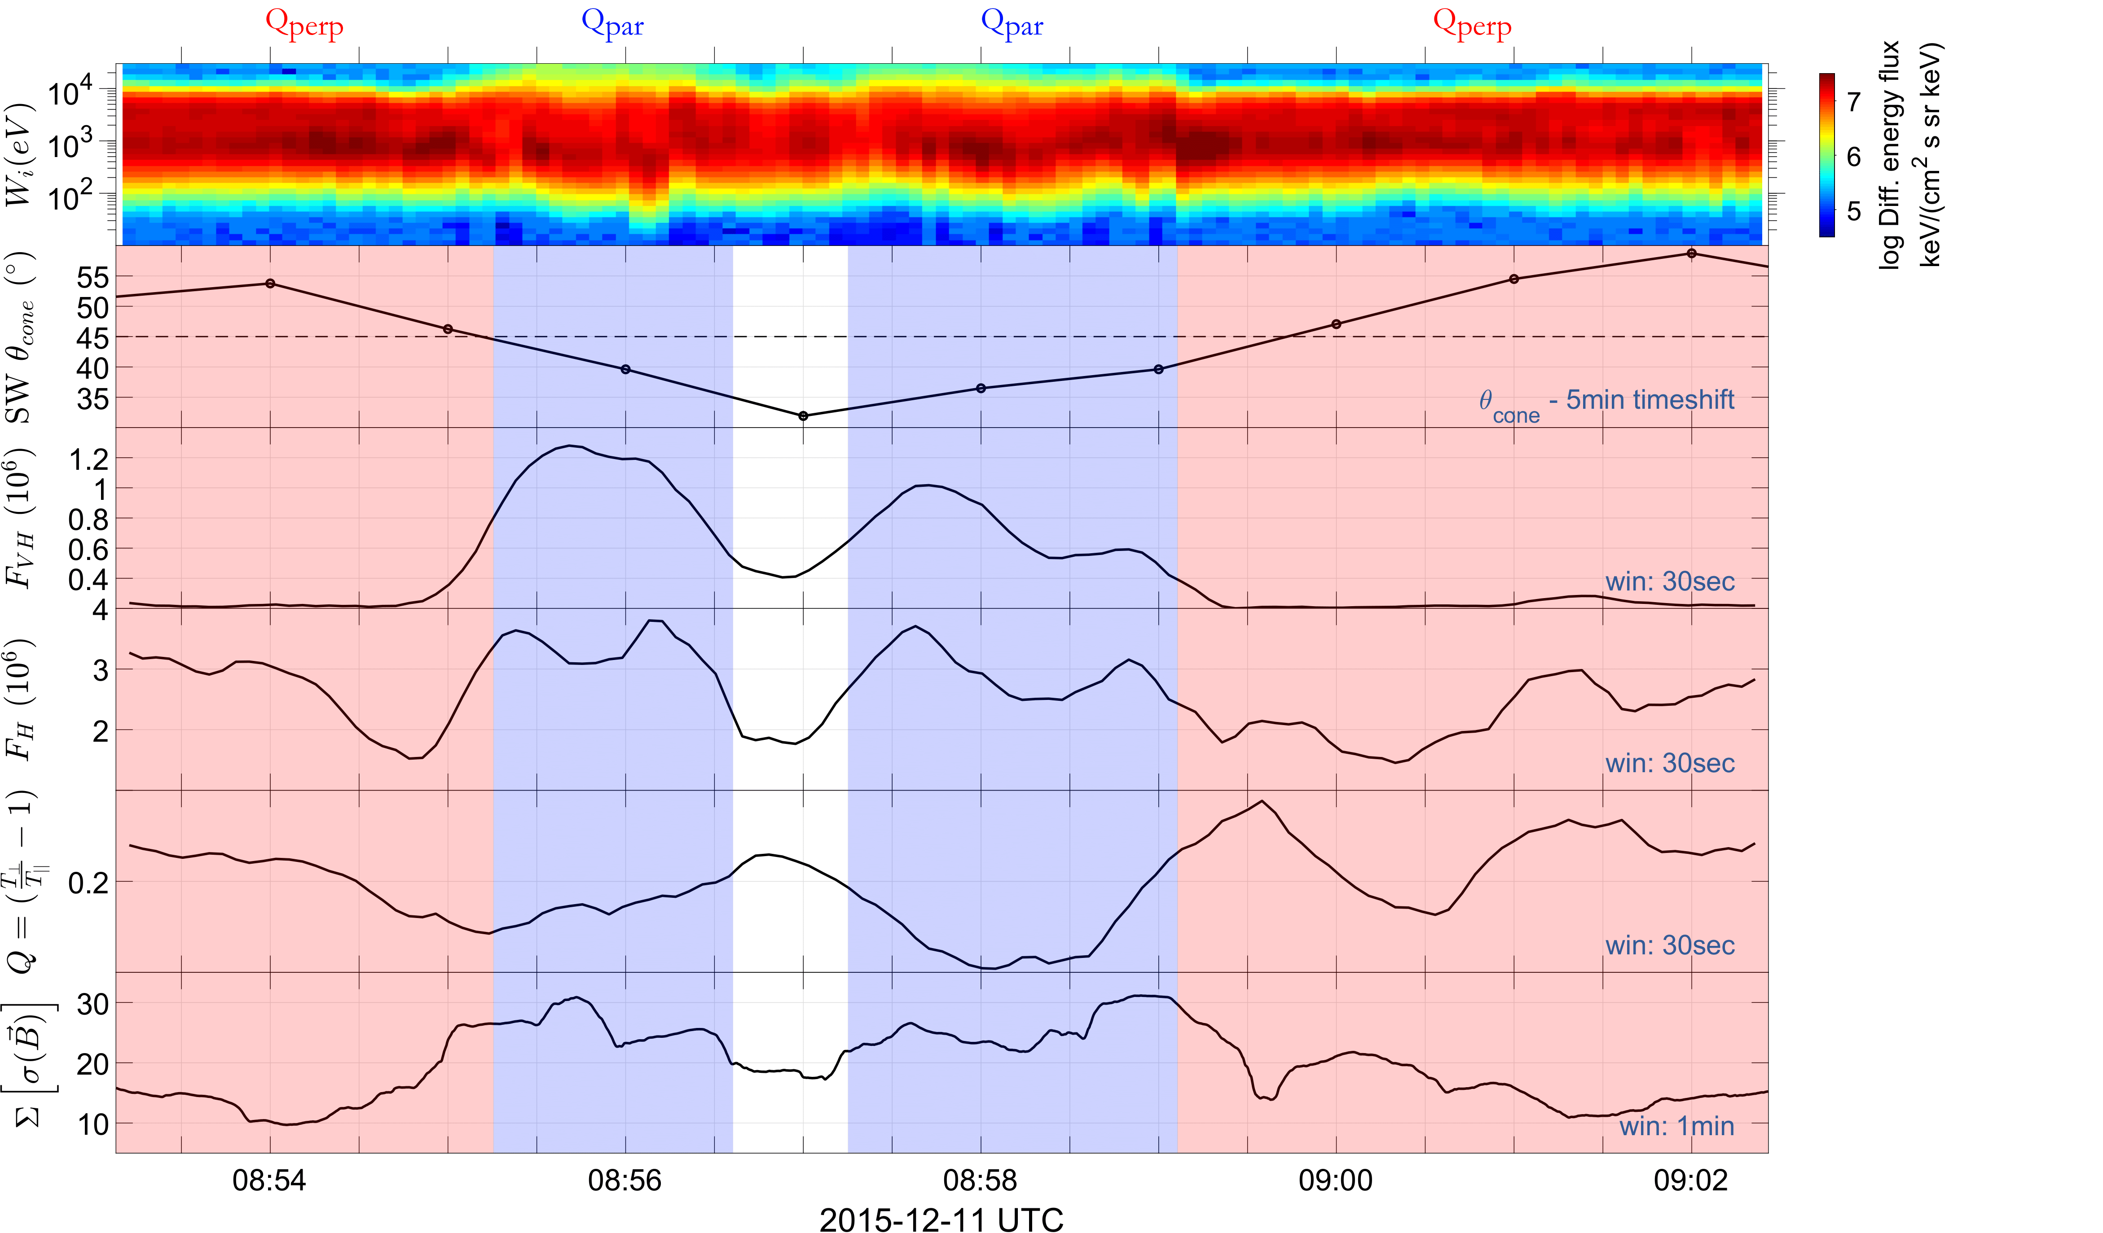
Classification Procedure in progress
Ion Energy
Spectrum
Cone Angle
Very High Energy
Flux
High Energy Flux
Anisotropy
Magnetic Field
stdev
Raptis, Karlsson, et al. (2020) | JGR

Slide 13
Classifying Magnetosheath Jets
Using Neural networks
Raptis, Aminalragia-Giamini et al. (2020) | Front. Astron. Space Sci

Slide 14
Review of current work
(1) Statistical properties of jets (Raptis et al. (2020 | JGR)
“Showed us which quantities can be used for in-situ classification using MMS”
(2) Classification of jets using Neural networks (Raptis et al. (2020) | Front. Astron. Space Sci)
“Showed us that there is information in the Solar Wind that correspond to Qpar and Qperp jets and possibly to magnetosheath”
(3) Classification of the magnetosheath (Karlsson et al. (2021) | JGR – Under review)
“Showed us that we can have strong statistical relationship between upstream and downstream measurements. Supporting the findings of (1) and (2)”
(4) Mapping magnetosheath & shock transitions using neural networks (Raptis et al. (2021) | To be submitted)
“Will proceed to map the relation between the different plasma population upstream and downstream by using machine learning techniques similarly to (2) and the datasets of (1-3)”
Quasi-Parallel
Quasi-Perpendicular
Bow Shock
Neural Networks
Magnetopause
MMS
$$L_{1}$$
Jets
$$ACE$$
Earth

Slide 15


Schematic of Procedure
Input
Omniweb Data
Neural Network
Classification
Output
MMS Jet’s Class
$\vec{B}, P, β, Τ, \vec{v},ρ$…
Quasi – Parallel
0
$$…$$
Quasi – Perpendicular
1
Raptis, Aminalragia-Giamini et al. (2020) | Front. Astron. Space Sci

Slide 16
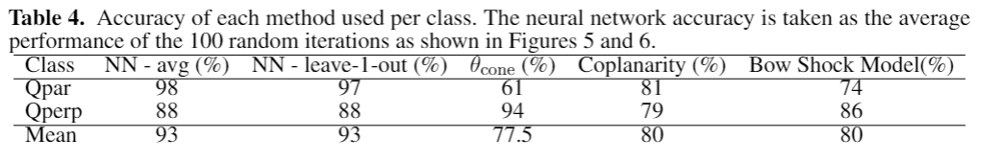
Neural Networks vs Physical Models
Neural Networks
Physical Modeling Approach
Neural networks outperformed “all” the physical methods quite drastically
Raptis, Aminalragia-Giamini et al. (2020) | Front. Astron. Space Sci

Slide 17
Classification of the Magnetosheath
(Under Review)
Karlsson, Raptis et al (2021) | JGR (Under review)

Slide 18
Review of current work
(1) Statistical properties of jets (Raptis et al. (2020 | JGR)
“Showed us which quantities can be used for in-situ classification using MMS”
(2) Classification of jets using Neural networks (Raptis et al. (2020) | Front. Astron. Space Sci)
“Showed us that there is information in the Solar Wind that correspond to Qpar and Qperp jets and possibly to magnetosheath”
(3) Classification of the magnetosheath (Karlsson et al. (2021) | JGR – Under review)
“Showed us that we can have strong statistical relationship between upstream and downstream measurements. Supporting the findings of (1) and (2)”
(4) Mapping magnetosheath & shock transitions using neural networks (Raptis et al. (2021) | To be submitted)
“Will proceed to map the relation between the different plasma population upstream and downstream by using machine learning techniques similarly to (2) and the datasets of (1-3)”
Bow Shock
Magnetopause
Earth
Cluster
SW
MSH

Slide 19
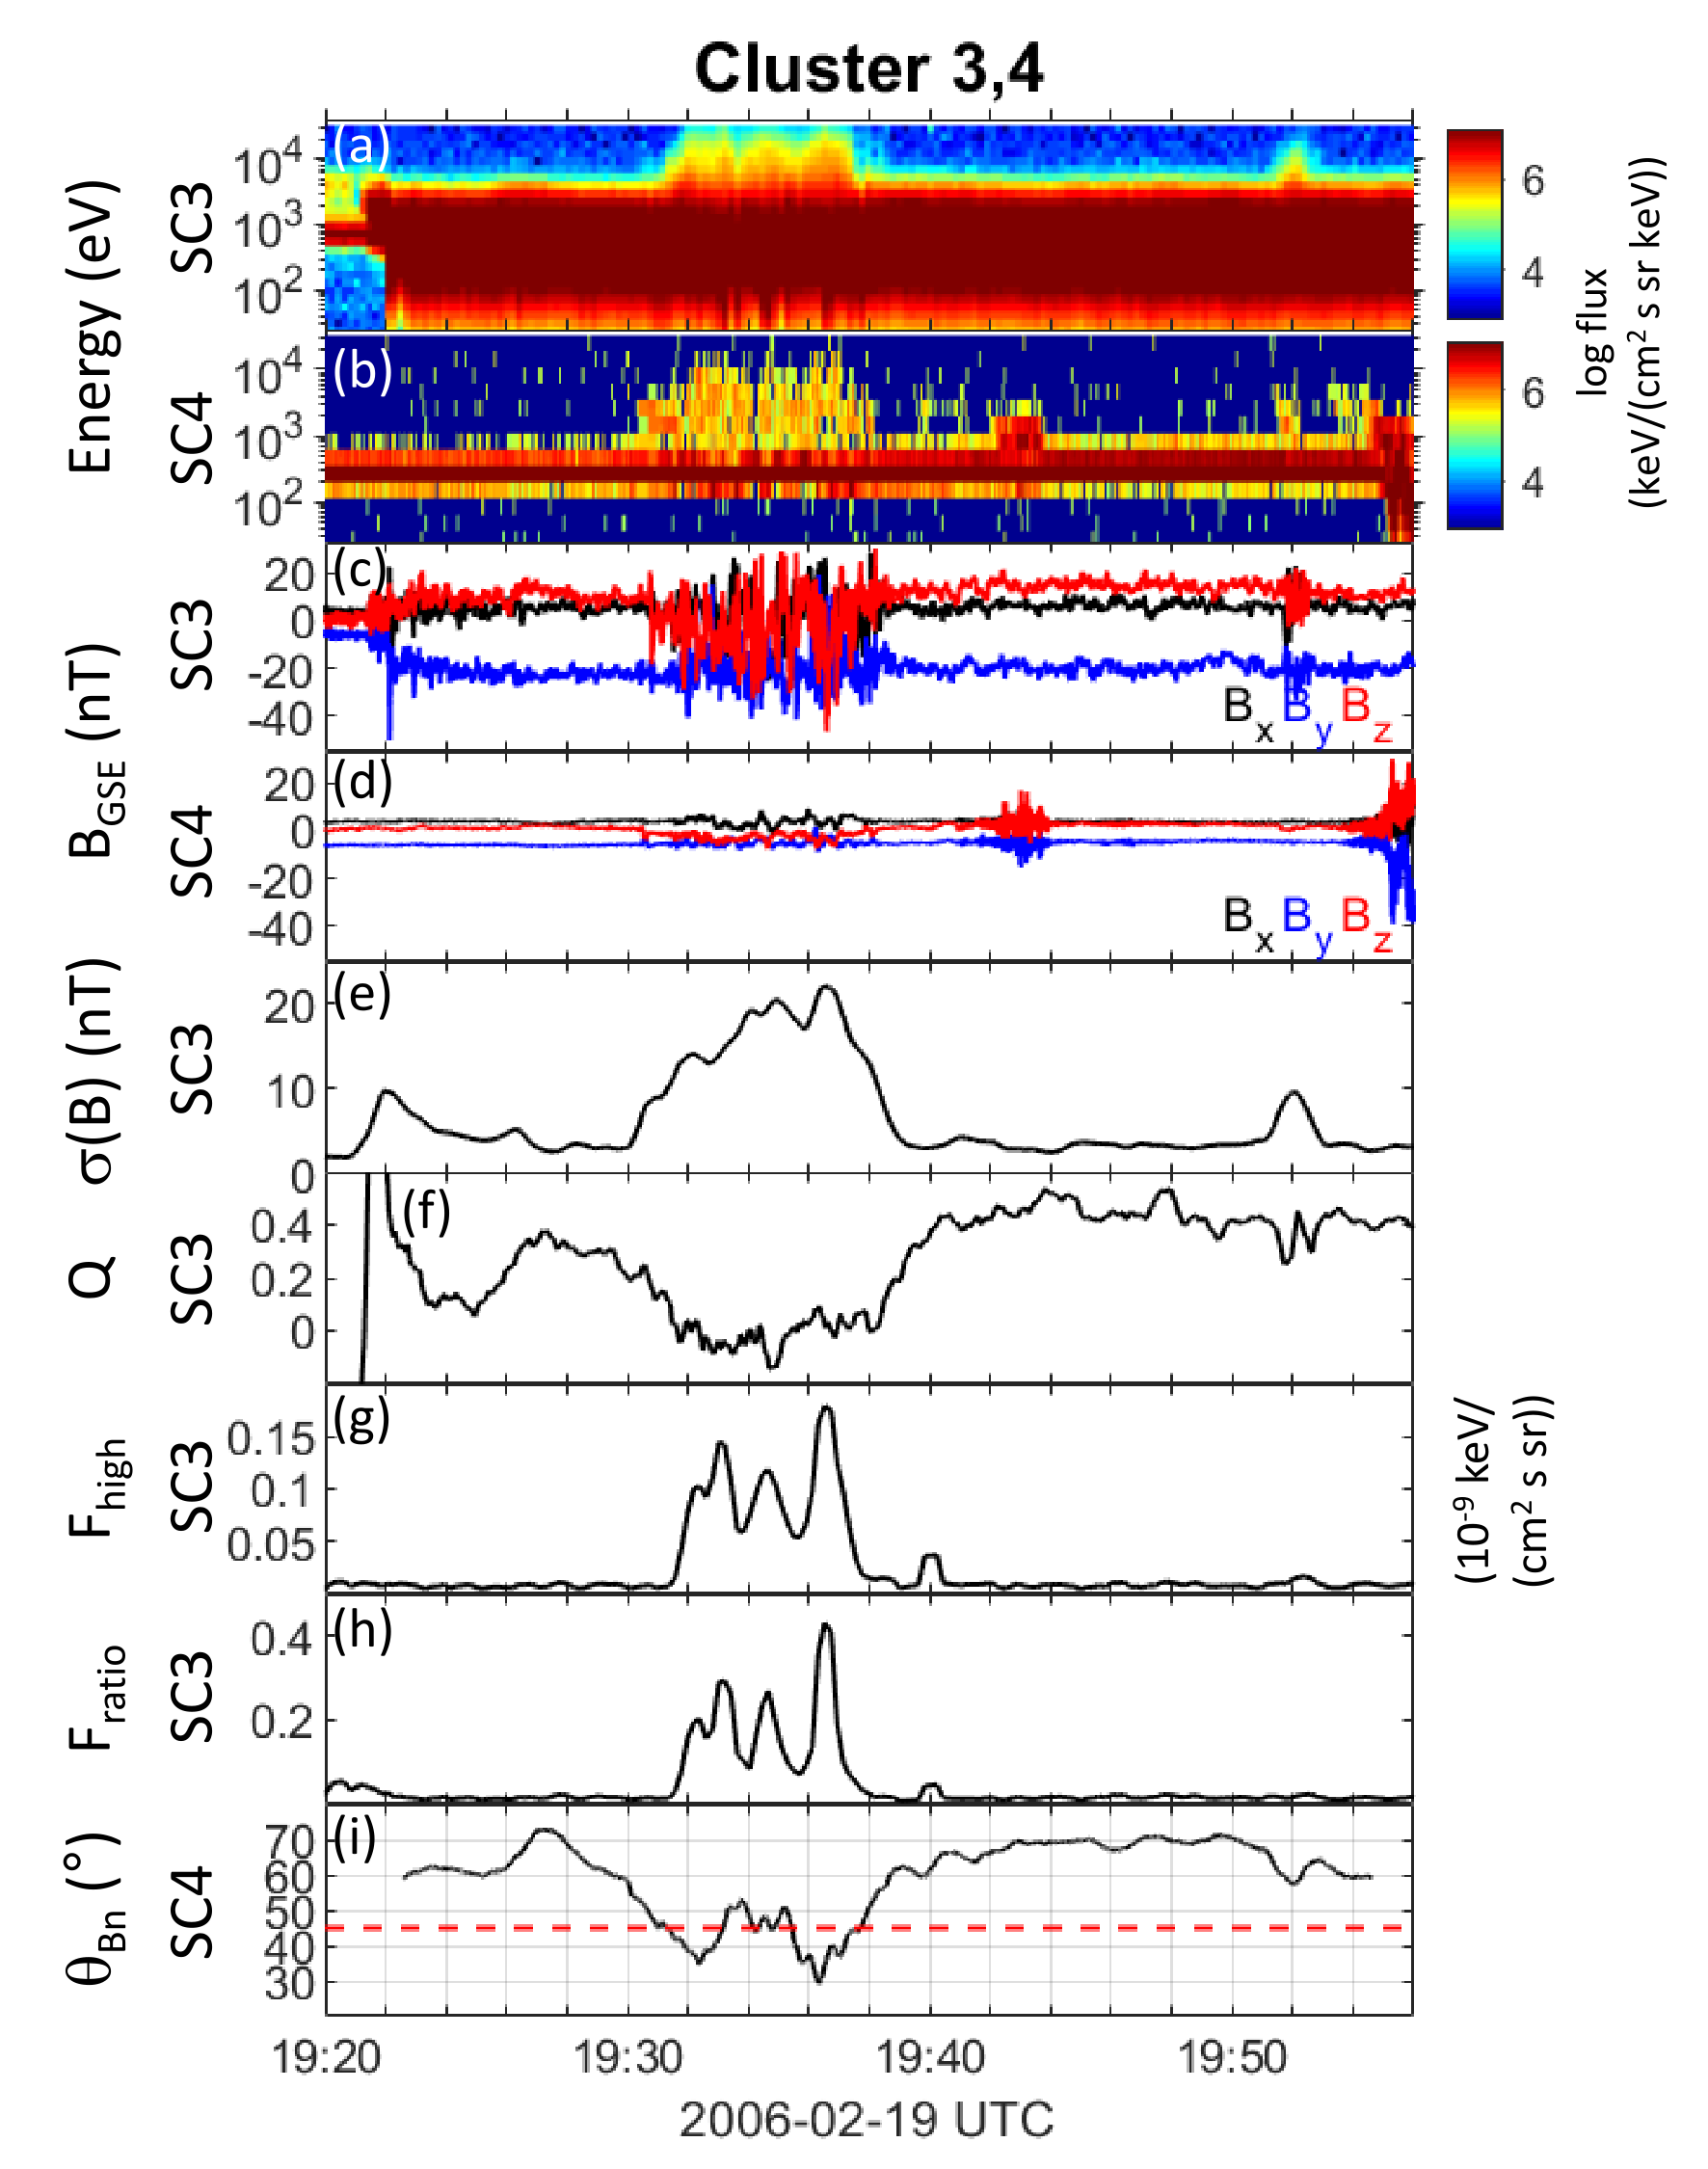
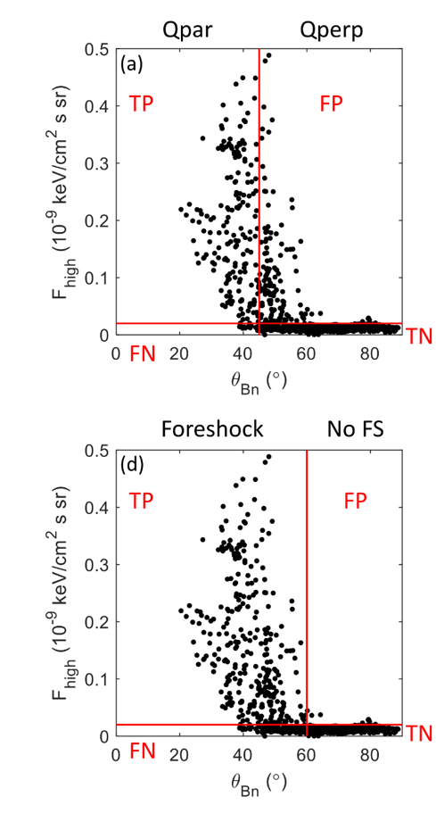
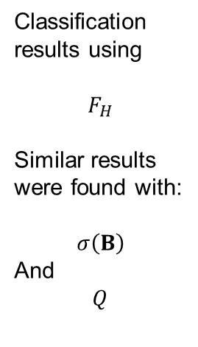
Magnetosheath vs Solar Wind/Foreshock
Downstream satellite
Classification results using
$$F_{H}$$
Similar results were found with:
$$σ\left(Β\right)$$
And
$$Q$$
Upstream satellite
Karlsson, Raptis et al (2021) | JGR (Under review)

Slide 20
Characterization of the Magnetosheath
Using Neural Networks (ongoing)
Raptis et al. (2021) | (Ongoing)

Slide 21
Review of current work
(1) Statistical properties of jets (Raptis et al. (2020 | JGR)
“Showed us which quantities can be used for in-situ classification using MMS”
(2) Classification of jets using Neural networks (Raptis et al. (2020) | Front. Astron. Space Sci)
“Showed us that there is information in the Solar Wind that correspond to Qpar and Qperp jets and possibly to magnetosheath”
(3) Classification of the magnetosheath (Karlsson et al. (2021) | JGR – Under review)
“Showed us that we can have strong statistical relationship between upstream and downstream measurements. Supporting the findings of (1) and (2)”
(4) Mapping magnetosheath & shock transitions using neural networks (Raptis et al. (2021) | To be submitted)
“Will proceed to map the relation between the different plasma population upstream and downstream by using machine learning techniques similarly to (2) and the datasets of (1-3)”
Bow Shock
Magnetopause
Cluster + MMS
SW
MSH
Earth

Slide 22
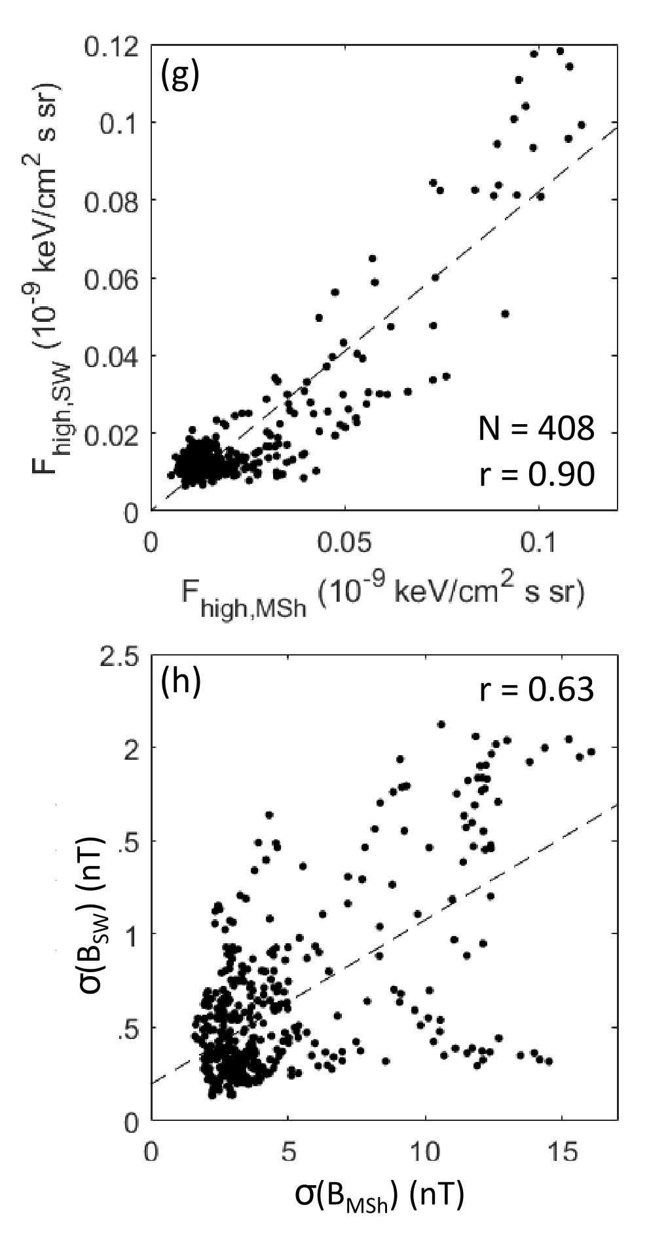
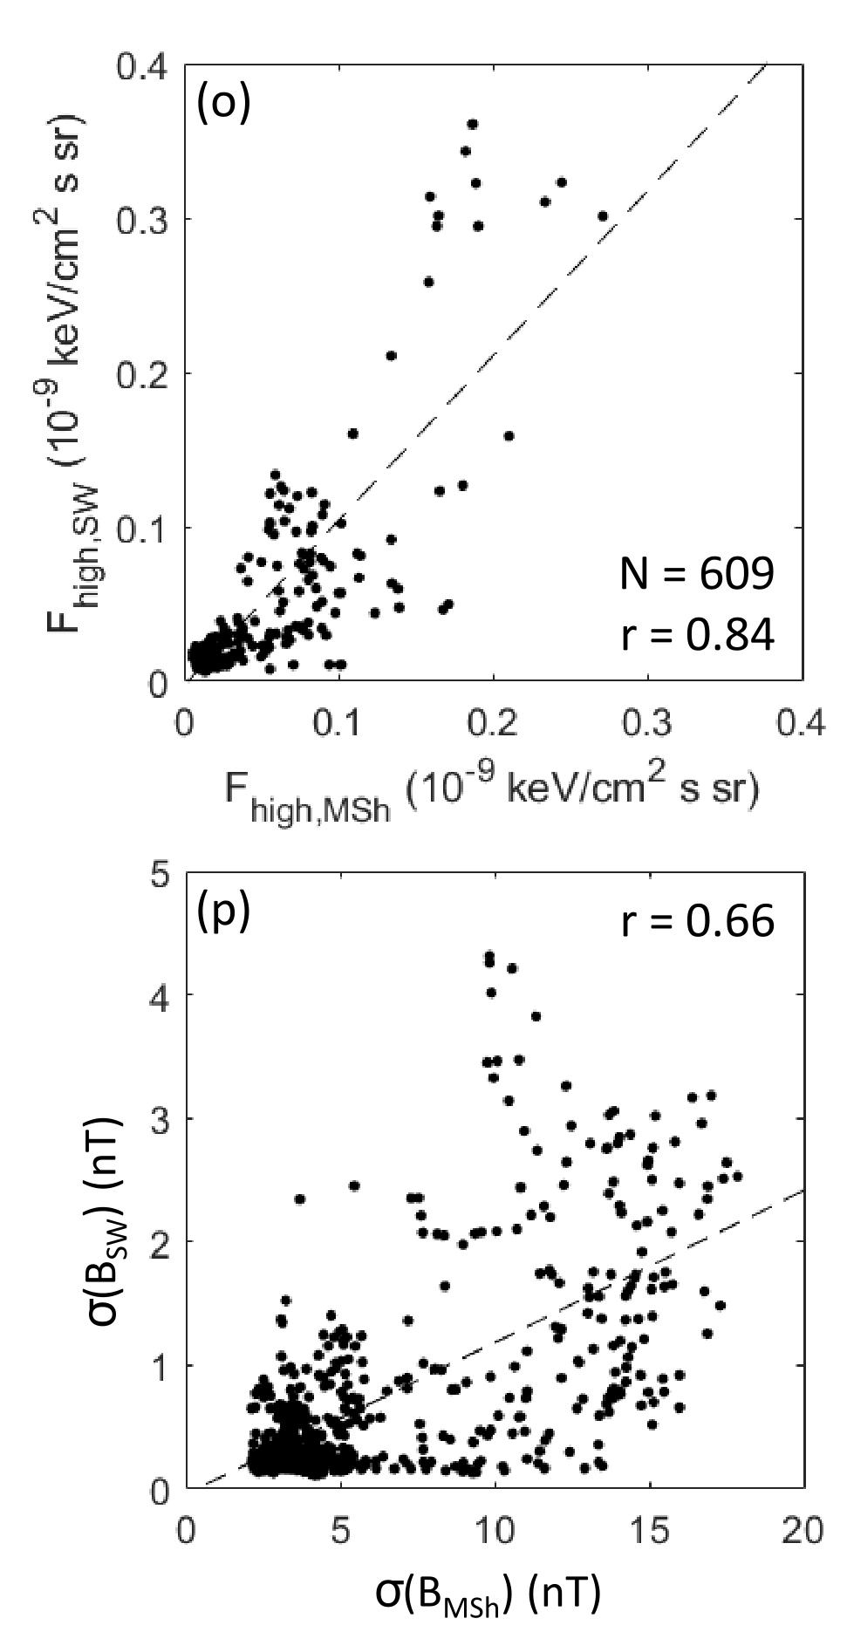
Motivation & Current approach
Full dataset of cross correlated
Upstream & downstream measurements
High linear correlation → Good news
Input: Upstream data
Output: Downstream Flux &
classification to Qpar/Qperp/FS/No-FS
Or vice versa!
Finally: Can we use Cluster for MMS and MMS for cluster ? (generalizing dataset for magnetospheric physics)
Raptis et al. (2021) | (Ongoing)

Slide 23
Summary & Ongoing work
Successfully used Neural networks to classify jets in the magnetosheath in different categories using MMS
Found correlations and relationships between upstream and downstream measurements using Cluster that sufficiently separate the regions of a shock even in the absence of upstream or downstream data
Ongoing work:
Use the extended dataset (MMS & Cluster) generated from previous works to train a neural network to map upstream to downstream and vice versa of Earth’s bow shock and test resulting using both MMS and Cluster missions
Generalize multiple spacecraft measurements (Cluster & MMS)
Provide indirect classification of foreshock environment when magnetosheath measurements are available and vice versa.

