Slide 1



Fast Plasma Flows Downstream of the Bow Shock Using MMS: Correlations and Generation Mechanisms Savvas Raptis¹, Tomas Karlsson¹, Ferdinand Plaschke², Anita Kullen¹, P-A. Lindqvist¹ ¹Division of Space and Plasma Physics, KTH Royal Institute of Technology, Sweden ²Space Research Institute, Austrian Academy of Sciences, Graz, Austria This work has been supported by Hellenic Astronomical Society (https://helas.gr) EGU 2021 20/04/2021

Slide 2
Introduction

Slide 3
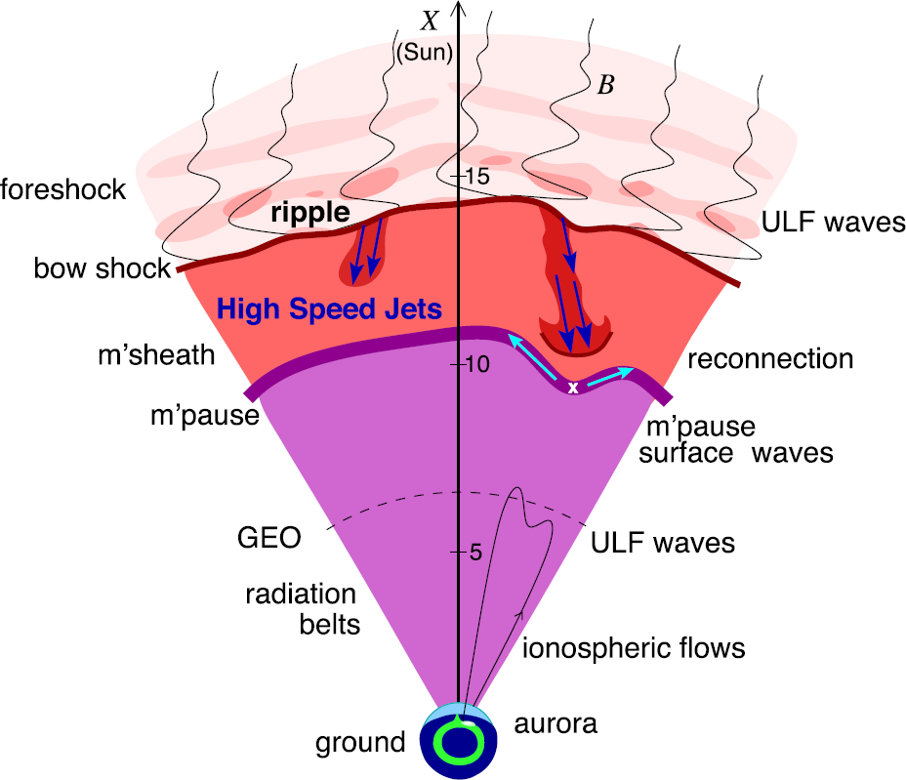
Magnetosheath Jets
Definition
Magnetosheath jets are transient localized enhancements of dynamic pressure (density and/or velocity increase)
e.g. 100% dynamic pressure enhancement compared to background magnetosheath
Related phenomena
ULF wave excitation
Radiation belts
Aurora
Magnetopause reconnection
Magetopause penetration
Shock acceleration
Magnetopause surface eigenmodes
Plaschke F. et al. (2018); sketch by H. Hietala | Space Sci. Rev

Slide 4
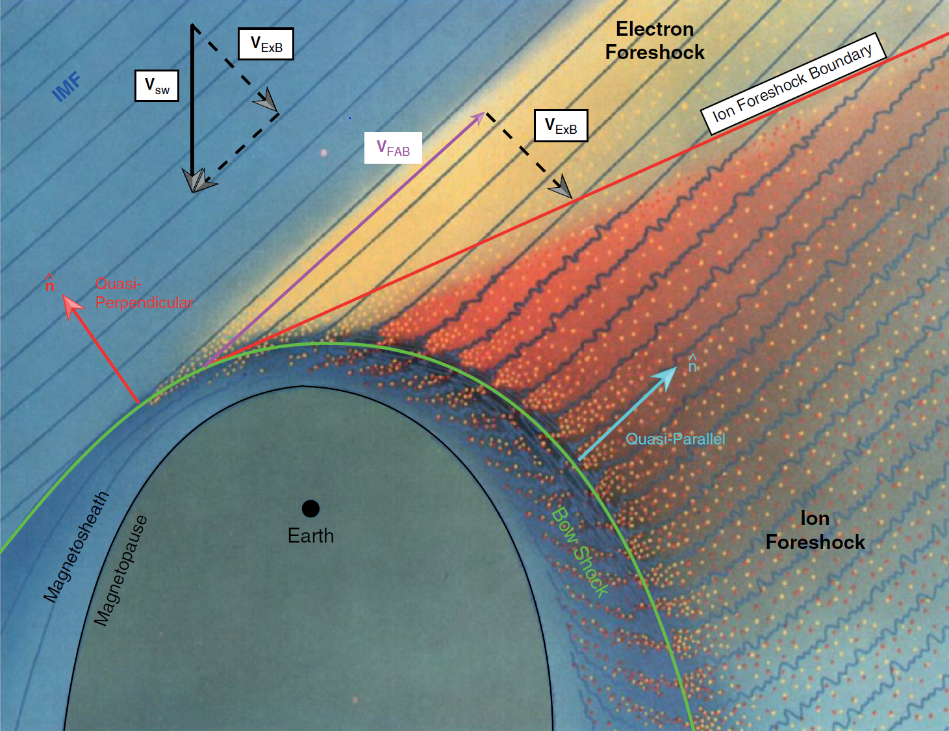
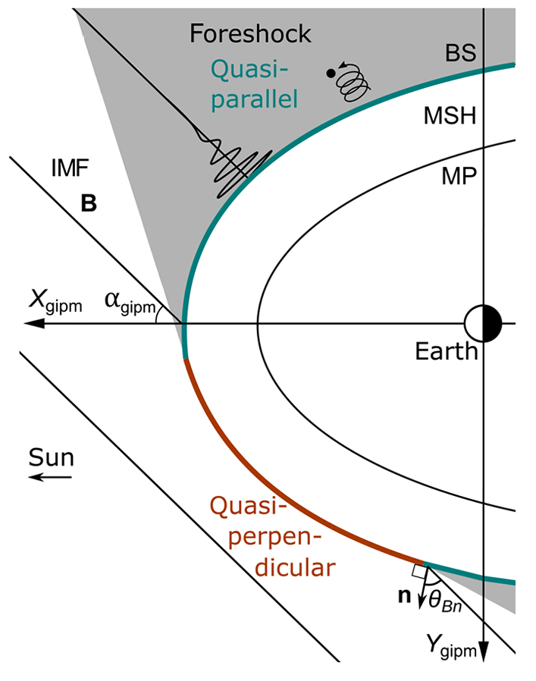
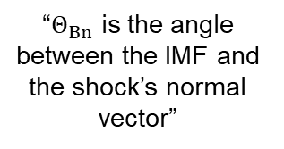
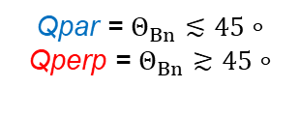

Motivation – Shock configuration and Jets
$$Q_{par}$$ | $$Q_{perp}$$
“$Θ_{Βn}$ is the angle between the IMF and the shock’s normal vector”
Qpar = $Θ_{Βn}≲45∘$
Qperp = $Θ_{Βn}≳45∘$
”Jets are found ~9 times more often behind the Qpar bow shock”
L. B. Wilson (2016) | Geophysical Monograph Series
Vuorinen, et al. (2019) | Annales

Slide 5
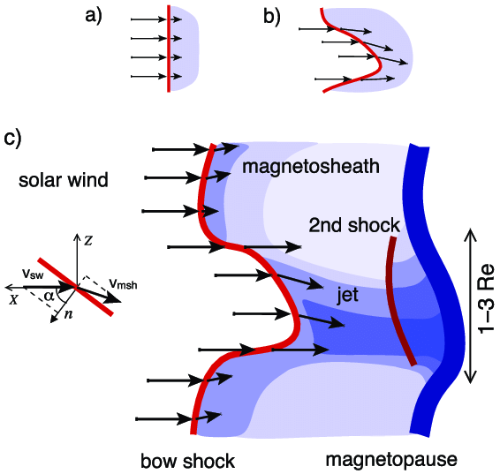
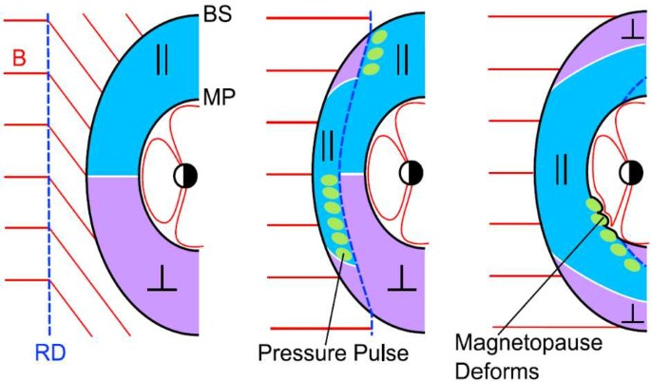
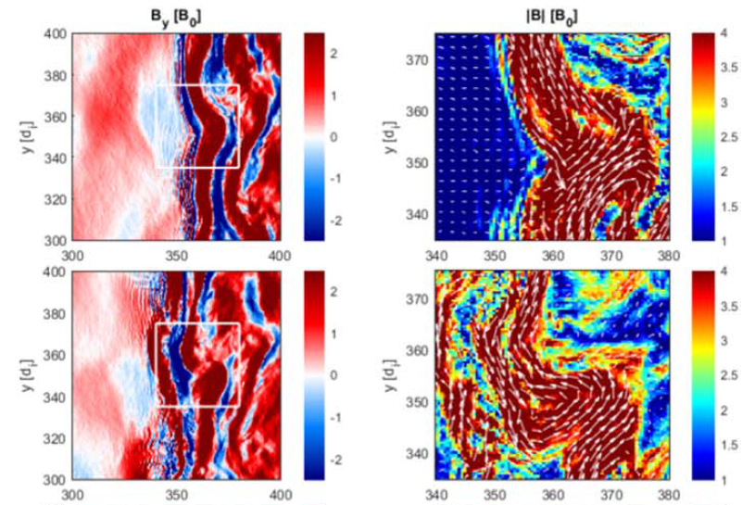
Some Possible Generation Mechanisms
Bow Shock Ripples
Pressure Pulses
Solar wind slipping through the local inclination of the shock ripples
Association to
Solar wind rotational discontinuities and pressure pulses
Qpar : Hietala et al., (2009,2012) | Qperp : Johlander et al. (2016)
Archer et al. (2012)
Foreshock structures (e.g. SLAMS)
Reconnection
Fast plasmoid
Embedded plasmoid
SLAMS
BS
v
Reconnection at the bow shock
SLAMS
Foreshock structures going through the bow shock
v
v
Hietala et al., (2009,2012), Karlsson et al. (2015)
Preisser, Luis, et al. (2020) | ApJL

Slide 6
Database generation & jet classes

Slide 7


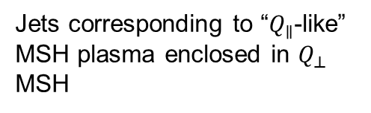
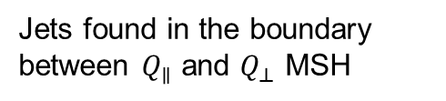
Different Classes
Qpar Jet
Qperp Jet
Boundary Jet
Encapsulated Jet
Jets found in $Q_{∥}$ MSH
Jets found in $Q_{⊥}$ MSH
Jets found in the boundary between $Q_{∥}$ and $Q_{⊥}$ MSH
Jets corresponding to “$Q_{∥}$-like” MSH plasma enclosed in $Q_{⊥}$ MSH
Raptis S., Karlsson T., et al. (2020) | JGR
Raptis S., Aminalragia-Giamini S., et al. (2020) | Frontiers
Kajdic P., Raptis S., et al. (2021) | GRL (under review)

Slide 8

Fast/Survey MMS data
Burst MMS data
Resolution (samples/s)
Resolution (samples/s)
FGM (magnetic field):
FPI (plasma moments ions):
EDP(electric field):
0.0625
4.5
0.0313
0.0078
0.15
0.00012218
Pros
Always available
Decent resolution
Can be good for statistics due to availability
Pros
Very high resolution
Able to resolve structures close to boundary surfaces (e.g. mix of plasma close to magnetopause, bow shock, foreshock etc.)
Cons
Not available all the time, mostly available close to vital mission objectives (magnetopause, diffusion regions, shock transitions etc.)
Hard to do proper large scale statistics due to biases generated from specific availability and manual choice of intervals
Cons
Not suitable for small scale studies especially these related to ion moments
Could be misleading close to boundary surfaces (Magnetopause, Bow shock etc.) due to very similar observational signatures
More information: Baker, et al. (2016) | Space Sci Rev 19

Slide 9
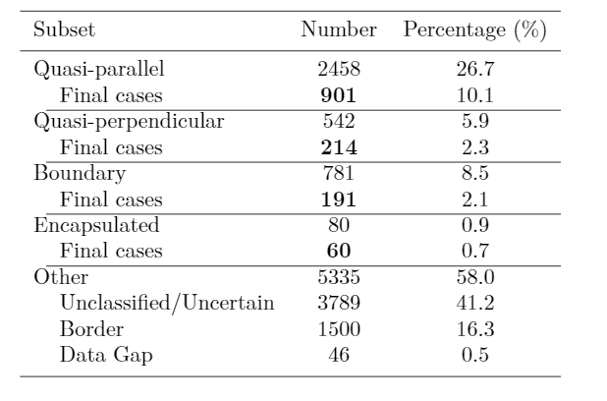
Jets database of MMS
Fast/Survey
Burst
9/2015 - 9/2020
Jets with full burst data
Qpar | 423
Qperp | 34
Boundary | 35
Encapsulated | 31
Close to BS / MP | 495
Others | 428
Useful to study early properties & generation
Raptis S., Karlsson T., et al. (2020) | JGR
Raptis S., Aminalragia-Giamini S., et al. (2020) | Frontiers
Palmroth M., Raptis S., et al. (2021) | Annales
Raptis, Karlsson, et al. | Ongoing

Slide 10
Statistical Results

Slide 11
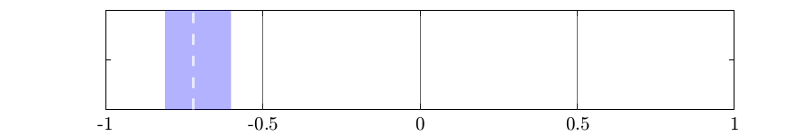
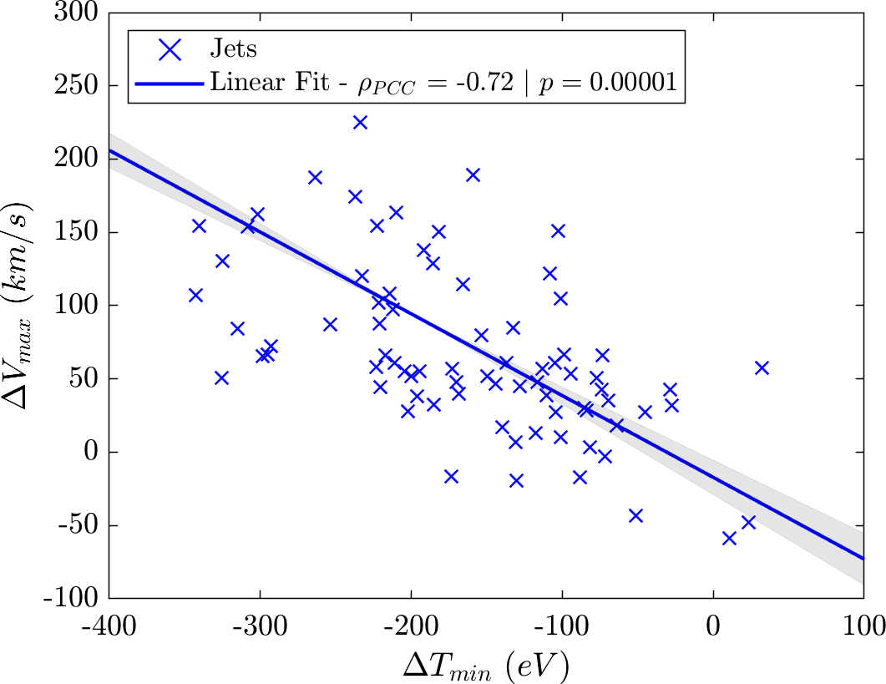



Close to the Bow shock statistics (fast data) - Ripples
Theory / Expectation
$$n=90$$
Statistics
$95\% CI:[−0.81 , −0.6$]
Interaction of the solar wind with locally curved bow shock results in a less deaccelerated (ΔV) and less heated (ΔT)
flow.
Qpar : Hietala et al., (2009,2012) | Qperp : Johlander et al. (2016)
$$ΔX = Χ_{jet}−{\left\langle Χ_{BG}\right\rangle }_{5min}$$
Raptis, Karlsson, et al. | Ongoing

Slide 12
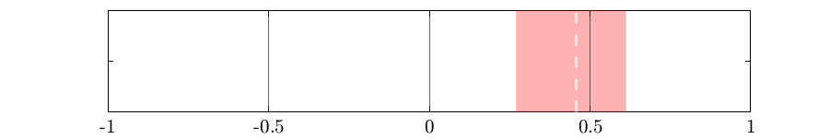
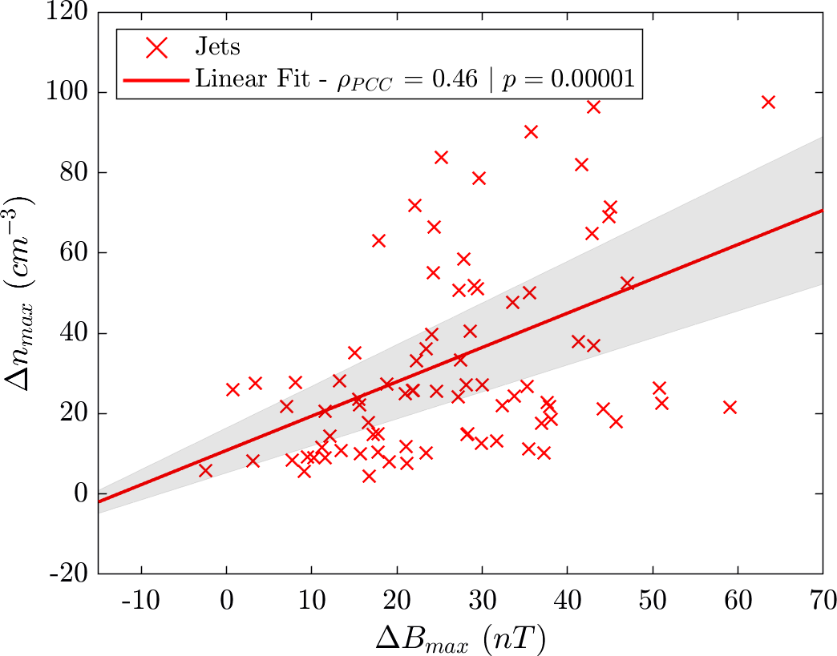

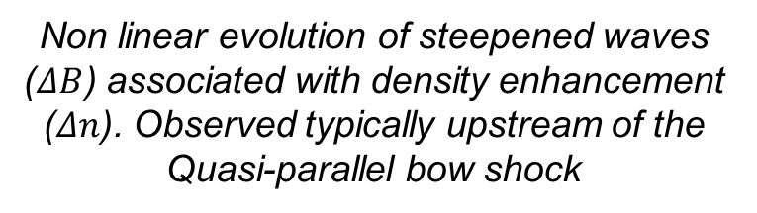
Close to the Bow shock statistics (fast data) - SLAMS
Theory / Expectation
$$n=90$$
Statistics
$95\% CI:[0.27 , 0.62$]
Fast plasmoid
Embedded plasmoid
SLAMS
BS
v
SLAMS
v
v
Non linear evolution of steepened waves ($ΔB$) associated with density enhancement ($Δn$). Observed typically upstream of the Quasi-parallel bow shock
Hietala et al., (2009,2012), Karlsson et al. (2015)
$$ΔX = Χ_{jet}−{\left\langle Χ_{BG}\right\rangle }_{5min}$$
Raptis, Karlsson, et al. | Ongoing

Slide 13
Case Studies / Examples

Slide 14
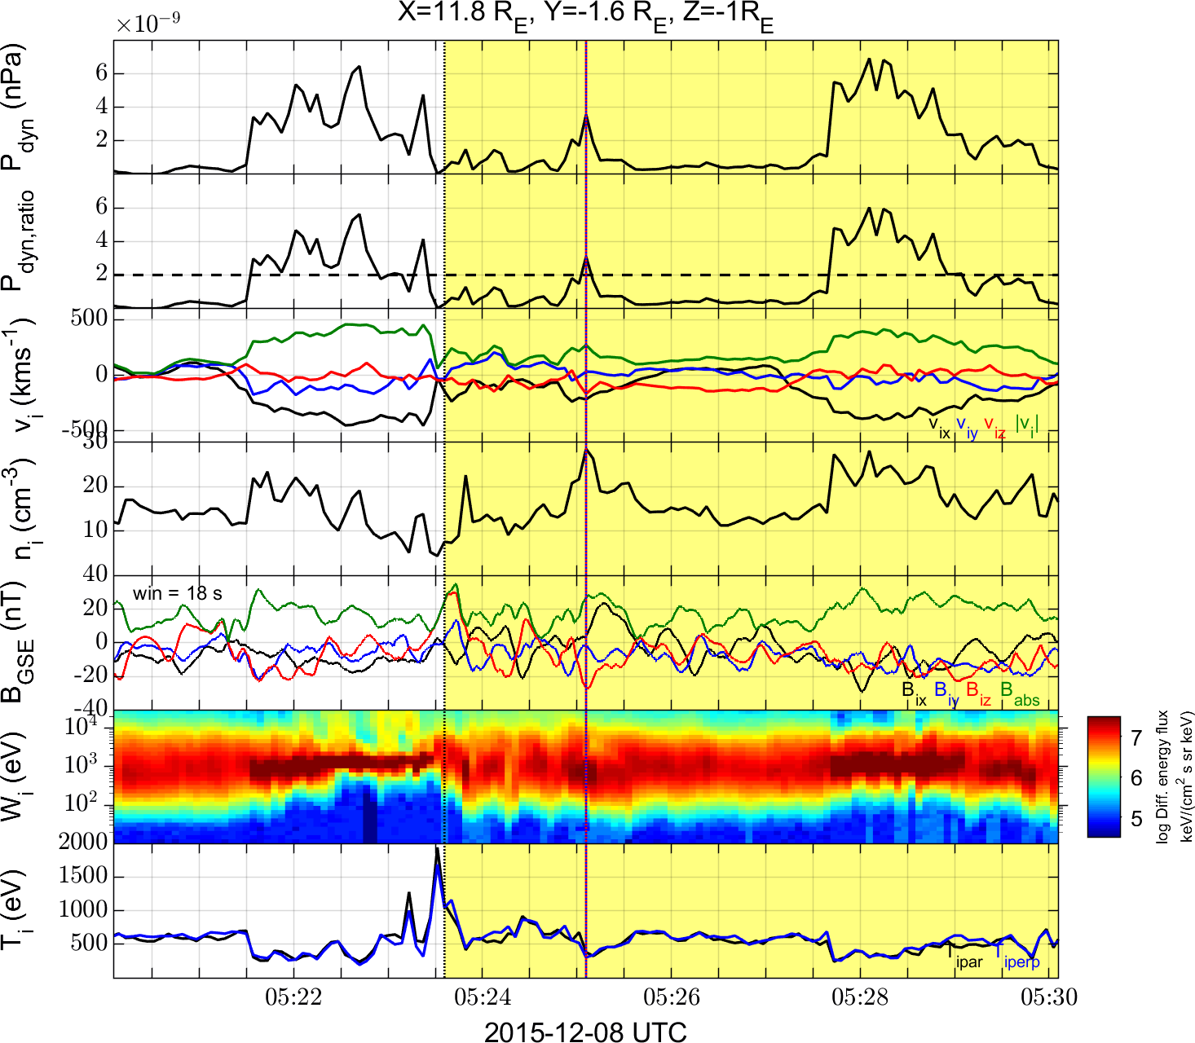
Example 1 (fast data): close to the bow shock jet
Basic Properties
Dynamic pressure enhancement
Velocity enhancement (Δ|v|>0)
Magnetic field enhancement (Δ|Β|>0)
Density enhancement (Δn>0)
Colder population shown in ion energy spectrum
Less heated plasma (ΔΤ <0)
Close proximity to BS (Δt < 5min)
Yellow area = estimated magnetosheath background
Dotted black line = estimated bow shock crossing

Slide 15
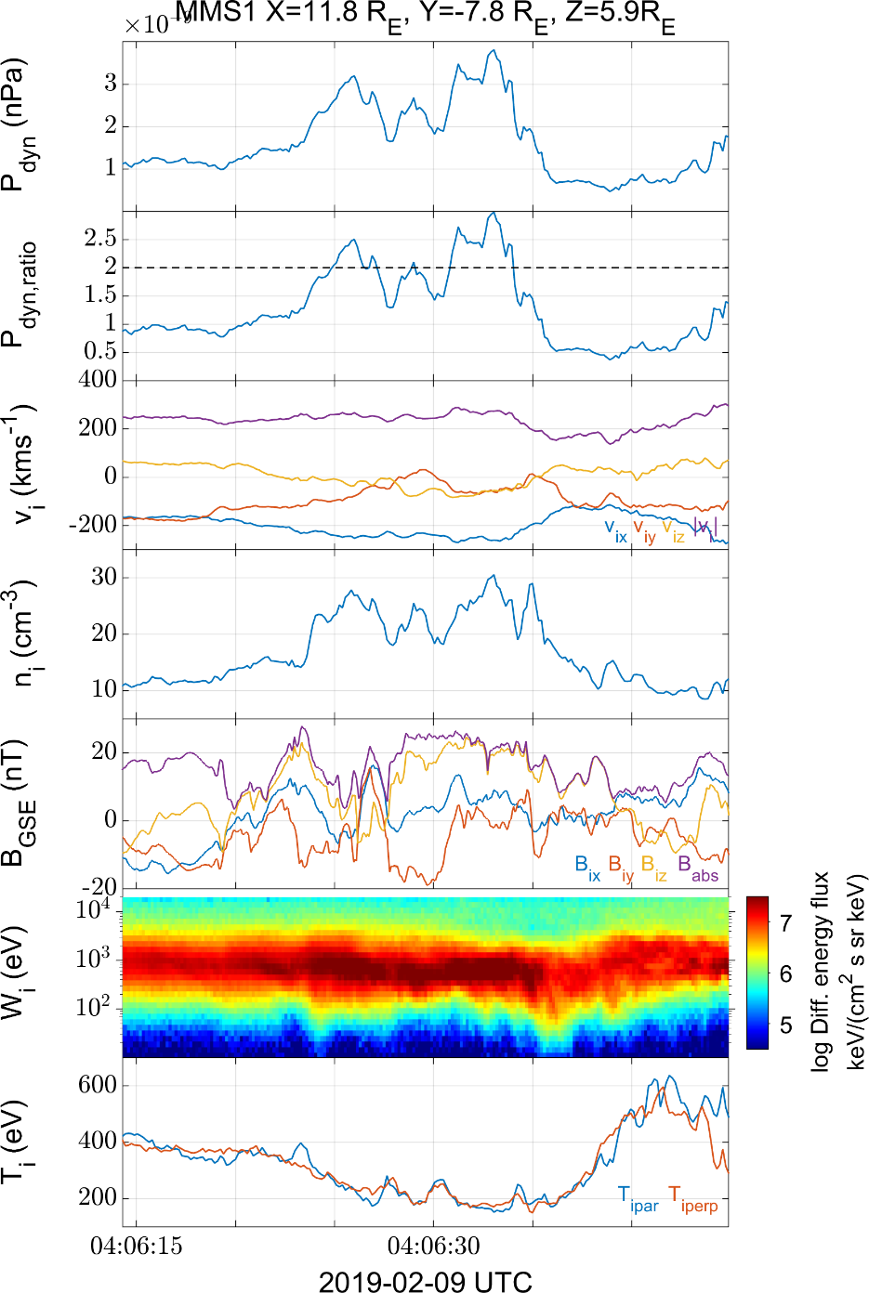
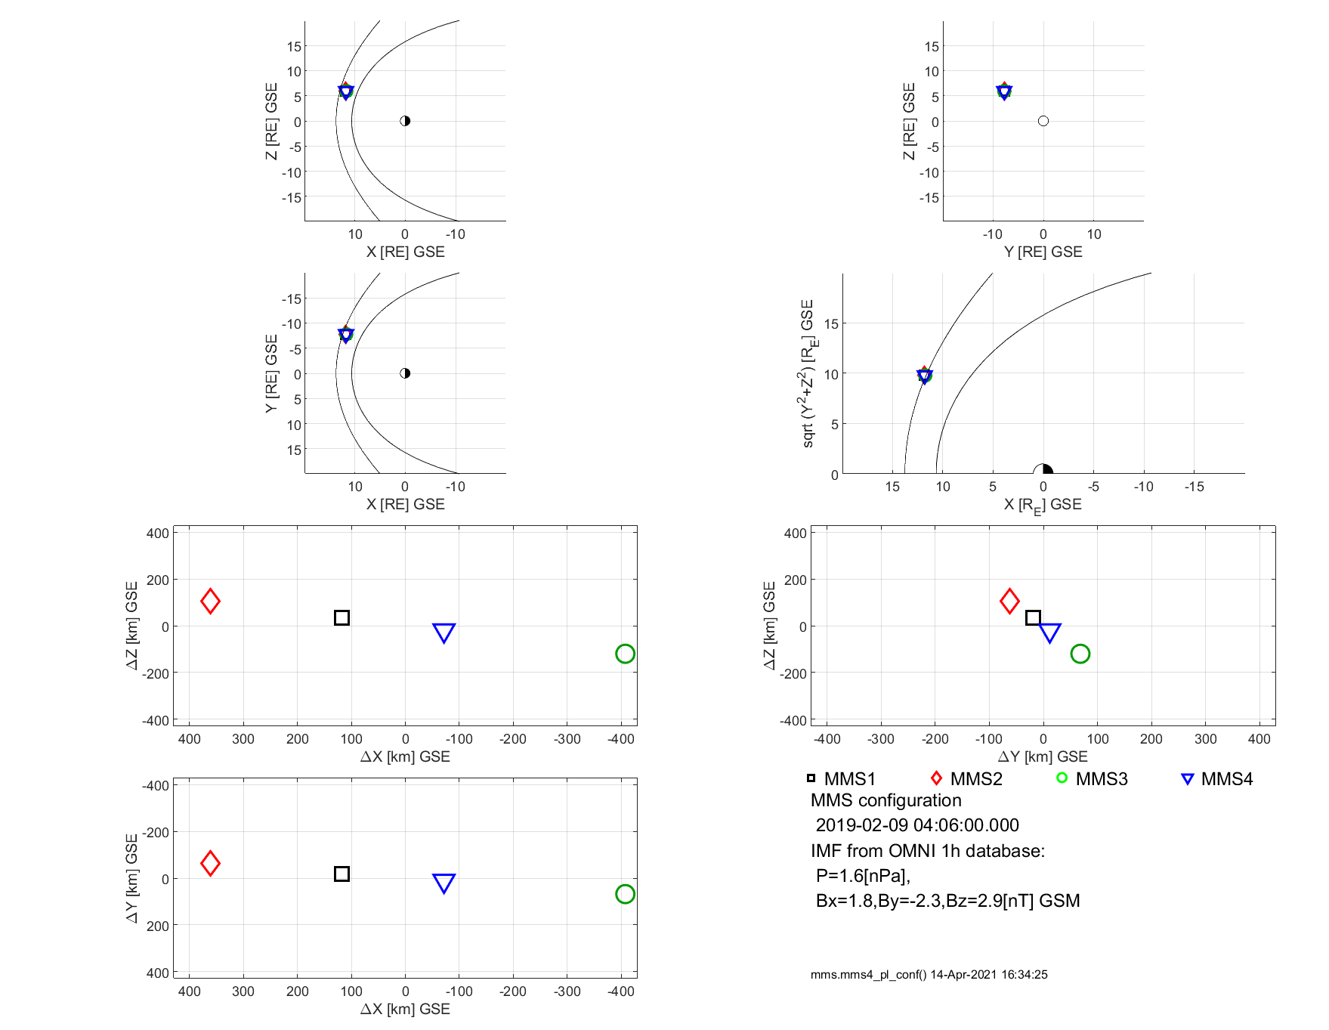
Example 2 (burst data): Close to the Bow shock jet
Raptis, Karlsson, et al. | Ongoing

Slide 16
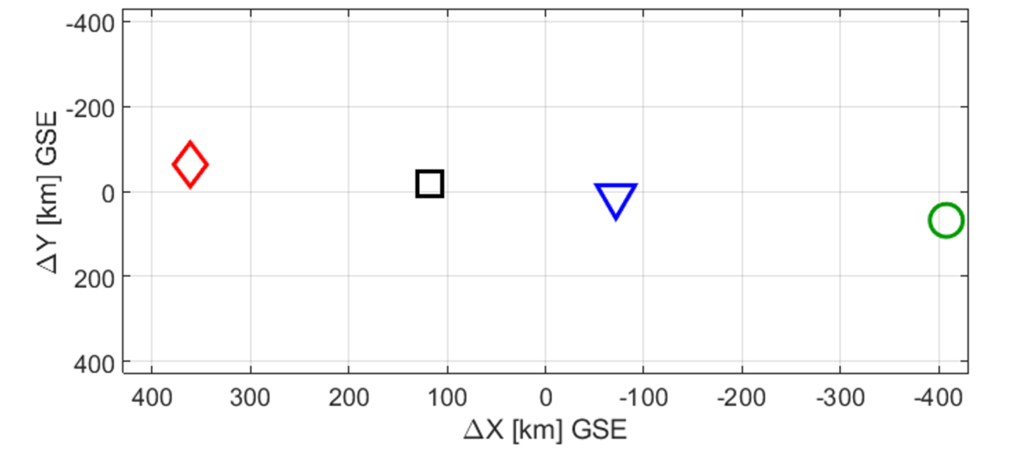
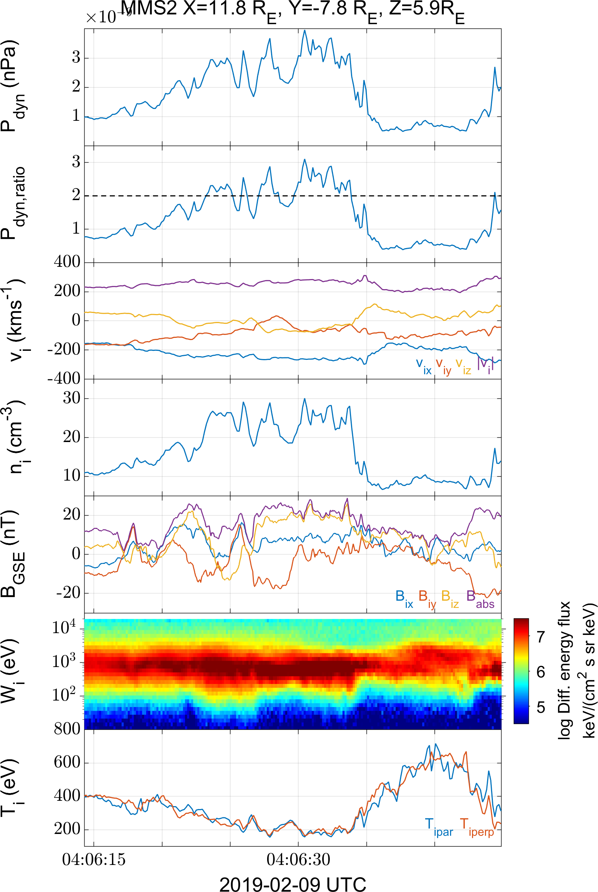
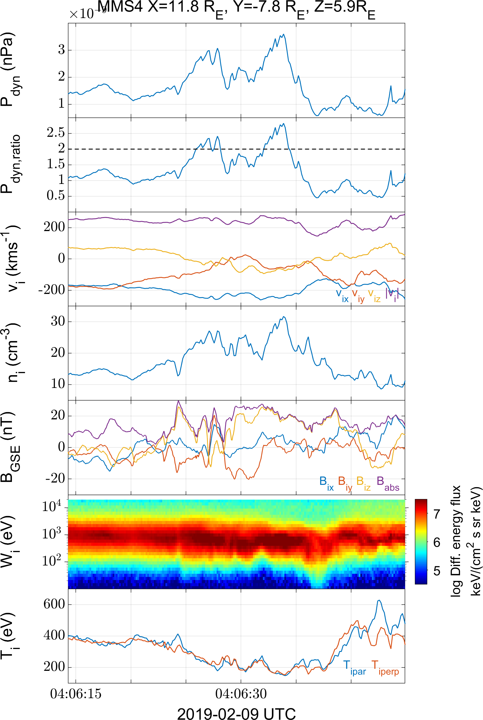
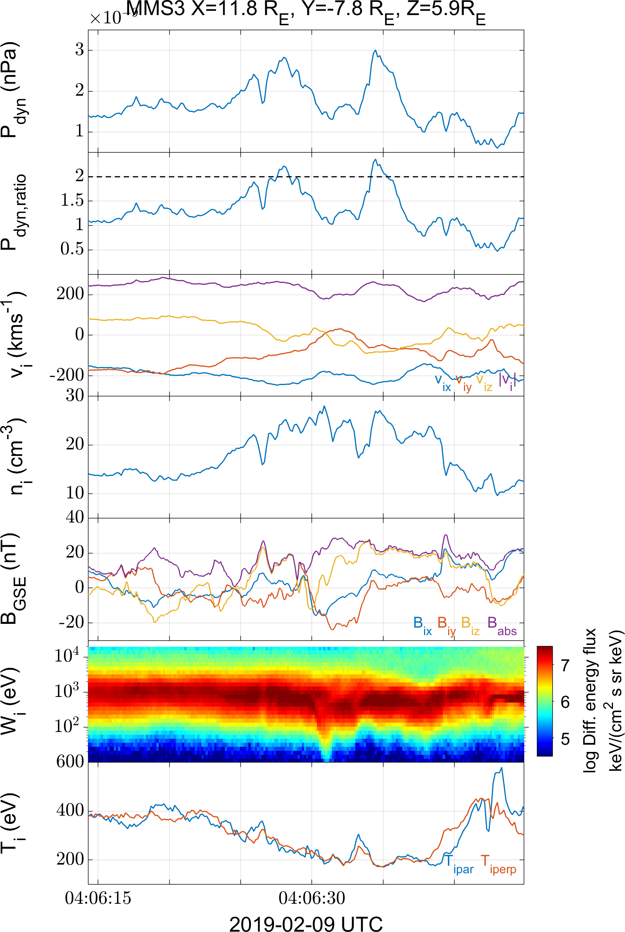
Multi point measurements (MMS 1 – 4)
Raptis, Karlsson, et al. | Ongoing

Slide 17
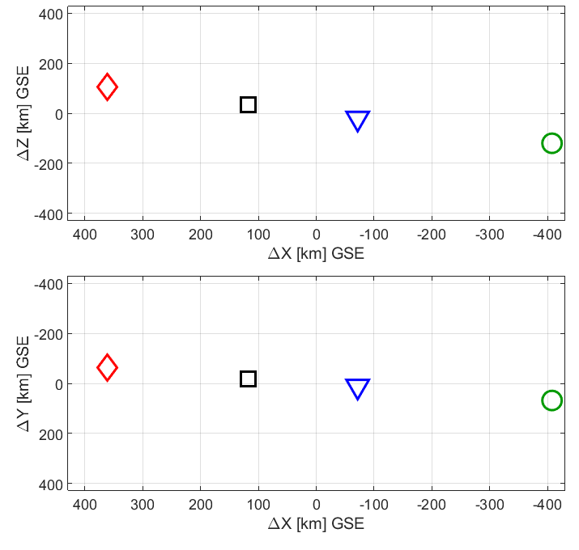
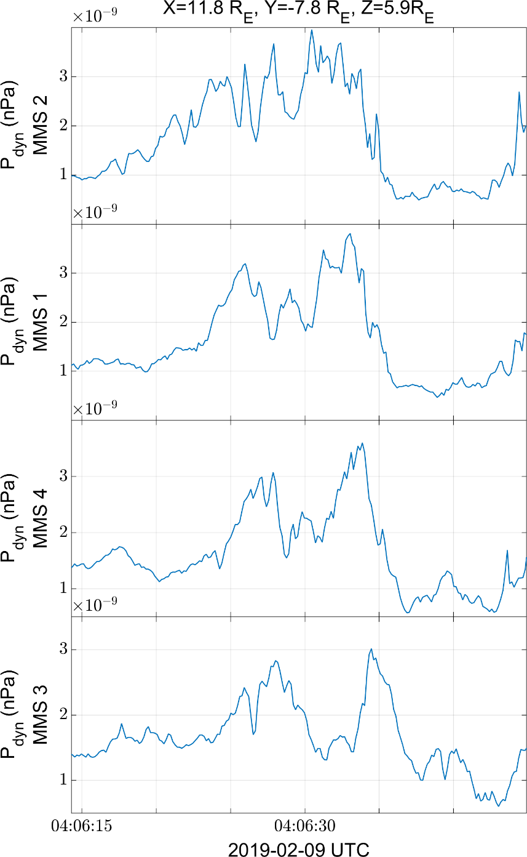
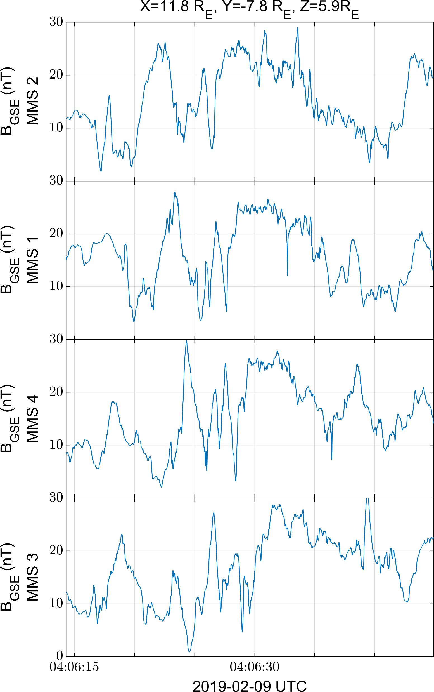

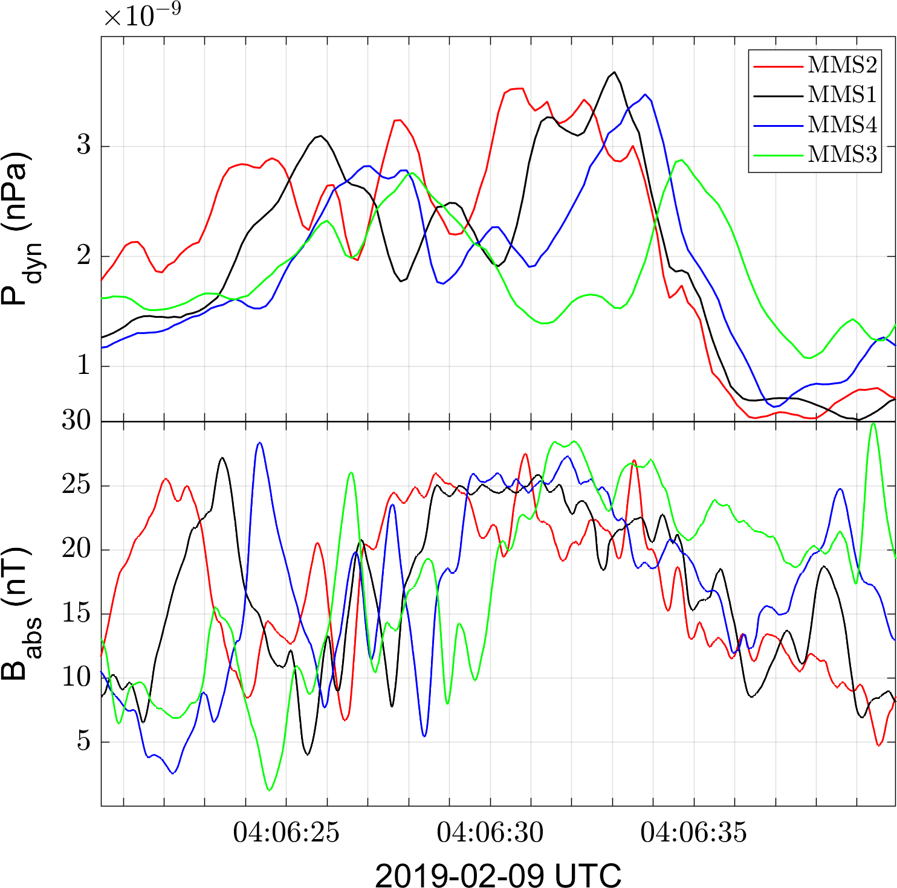
The structure is moving towards the Earth

Slide 18


Summary & Conclusion
Main points
The statistics seem to support SLAMS penetration and bow shock ripple mechanism
However, fast (*maybe even burst sometimes) data can be misleading close to the bow shock. One can confuse jets with foreshock, bow shock oscillation etc.
The case studies show similar results to statistics but also showed some false positive events that require more work.
Future work
Review each case with burst data to determine if structures are convective (jets) or nested (shock oscillation / foreshock excursions etc.)
Quantify relationship between observed parameters and compute the likelihood of each generation mechanism.
This work has been supported by Hellenic Astronomical Society (https://helas.gr)

