Slide 1

Magnetosheath Jets Close to the Bow Shock | Generation Scenarios using MMS Savvas Raptis Division of Space and Plasma Physics, KTH Royal Institute of Technology, Sweden Collisionless Shocks | mini-GEM 2021 20/01/2021

Slide 2
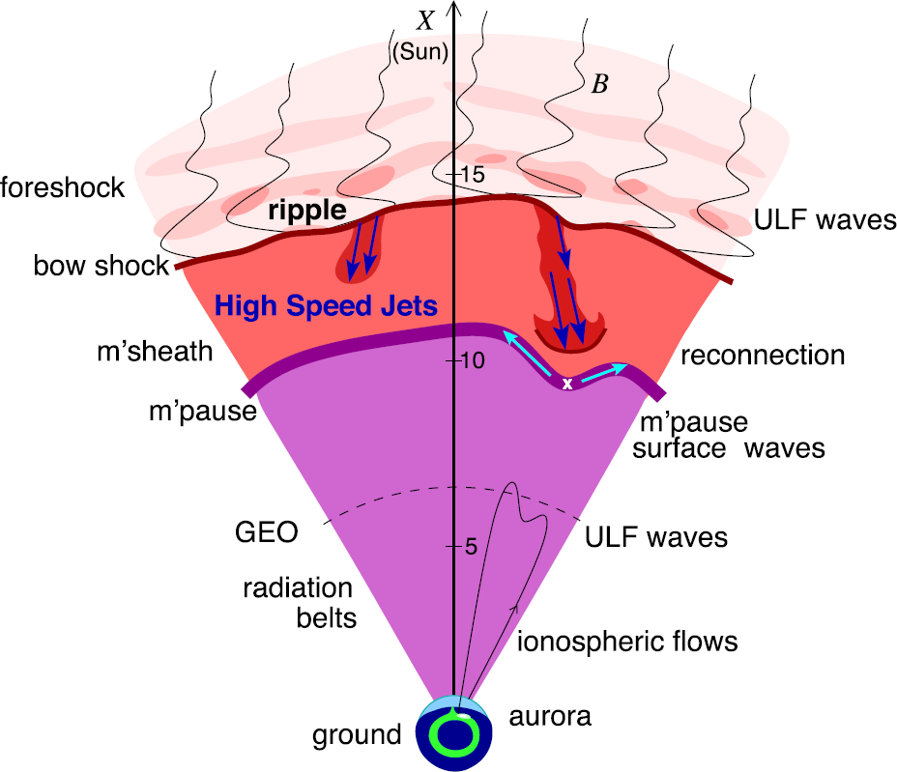
Introduction – Magnetosheath Jets
Plaschke F. et al. (2018); sketch by H. Hietala | Space Sci. Rev

Slide 3
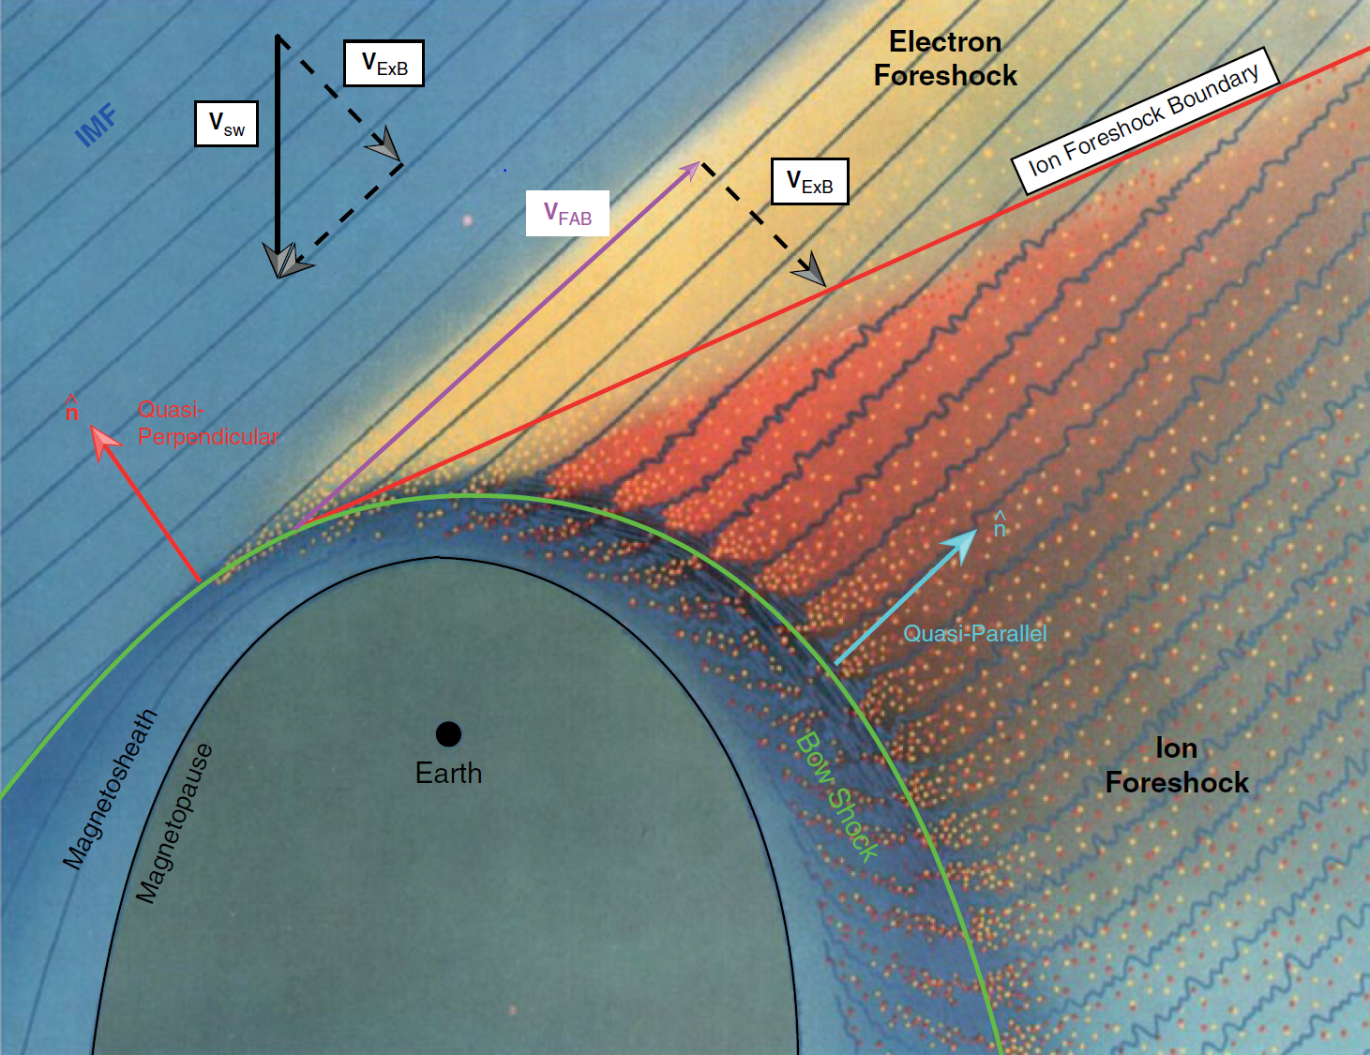
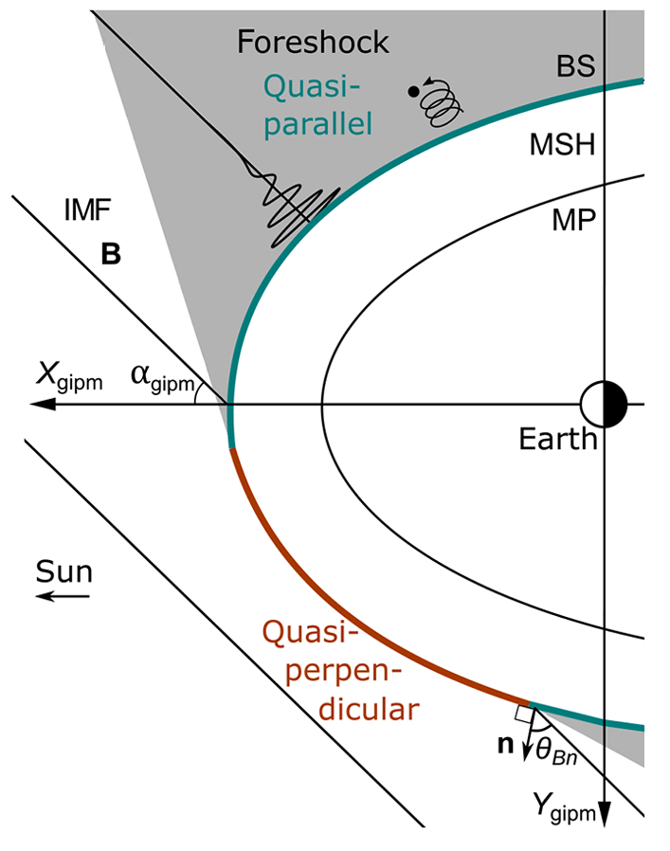

Motivation – Main Subcategories
”Found ~9 times more often behind the Qpar bow shock”
$$Q_{par}$$ | $$Q_{per}$$
L. B. Wilson (2016) | Geophysical Monograph Series
Vuorinen, et al. (2019) | Annales

Slide 4
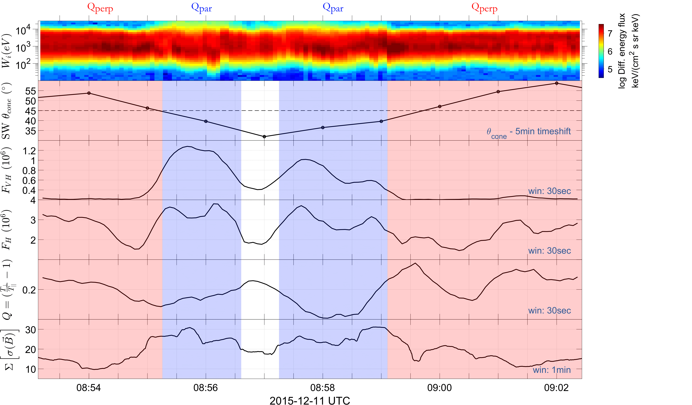
Classification Procedure in progress
Cone Angle
Very High Energy
Flux
High Energy Flux
Anisotropy
Magnetic Field
stdev
Raptis, Karlsson, et al. (2020) | JGR
Karlsson, Raptis, et al. (2020) | Ongoing

Slide 5
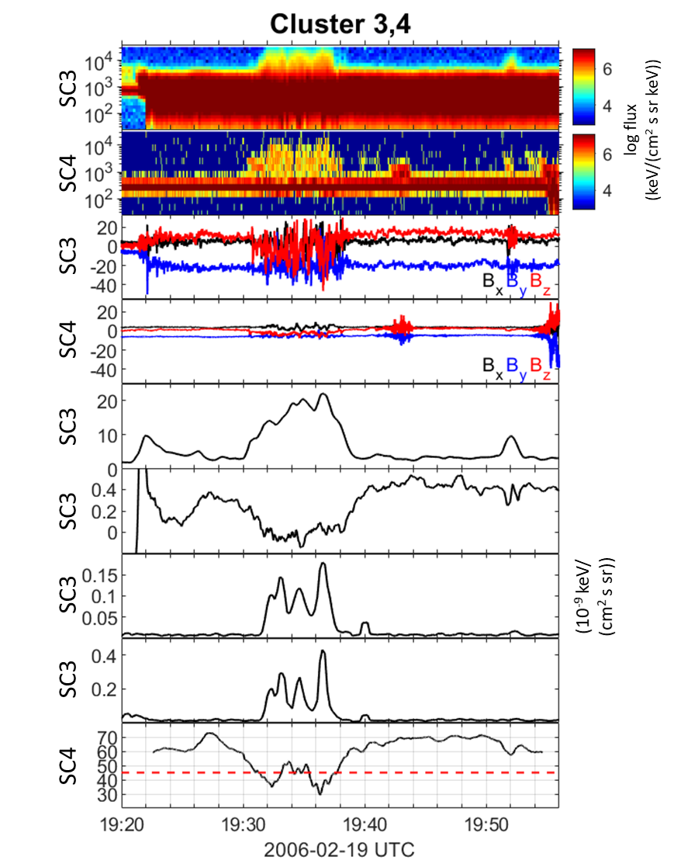
Multispacecraft Classification using Cluster
Energy Spectrum
Magnetosheath (eV)
Energy Spectrum
Solar Wind (eV)
Magnetic Field (nT)
Magnetic Field (nT)
Magnetic Field
Stdev (nT)
Anisotropy(Q)
High Energy Flux
Energy Flux Ratio
Theta Bn
Karlsson, Raptis, et al. (2020) | Ongoing

Slide 6
Main Categories of Jets
Qpar Jet
Qperp Jet
Boundary Jet
Encapsulated Jet
Jets found in $Q_{∥}$ MSH
Jets found in $Q_{∥}$ MSH
Jets found in the boundary between $Q_{∥}$ and $Q_{⊥}$ MSH
Jets corresponding to $Q_{∥}$-like MSH plasma enclosed in $Q_{⊥}$ MSH
Raptis S., Karlsson T., et al. (2020) | JGR
Raptis S., Aminalragia-Giamini S., et al. (2020) | Frontiers

Slide 7
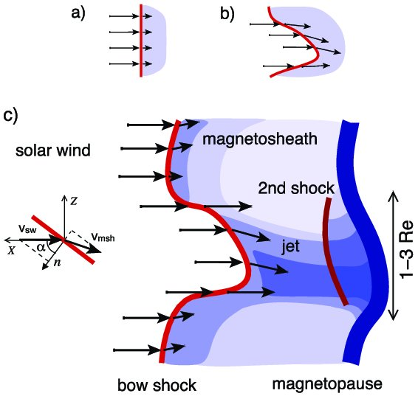

Connecting to existent mechanisms
Bow shock ripples
SLAMS penetration
Fast plasmoid
Embedded plasmoid
SLAMS
BS
v
SLAMS
v
v
Faster flow ($ΔV$) → Less heated ($ΔT$)
Steepened wave ($ΔB$) → Density enhancement ($Δn$)
Qpar : Hietala et al., (2009,2012) | Qperp : Johlander et al. (2016)
Hietala et al., (2009,2012), Karlsson et al. (2015)

Slide 8
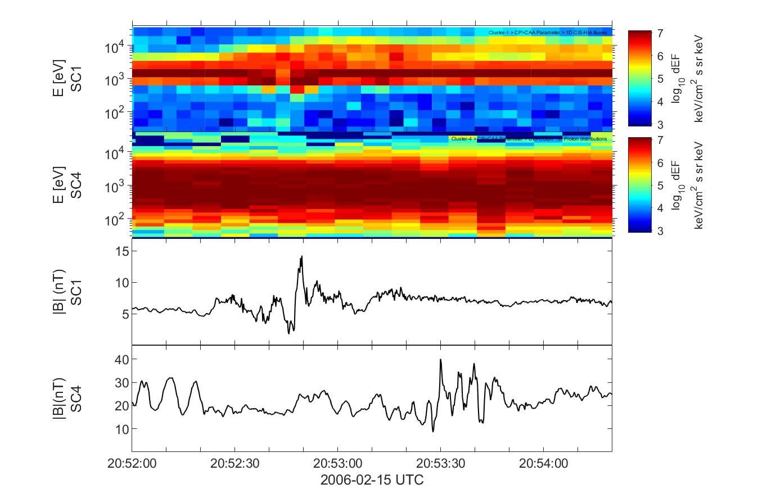
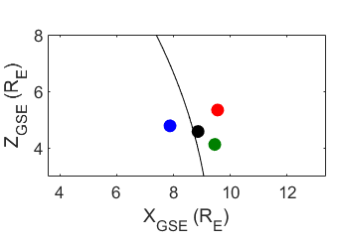
Can SLAMS go through the Shock ?
Karlsson, et al. | Ongoing

Slide 9
Recent Results
Raptis S., Karlsson T., et al. (2020) | JGR
Raptis S., Aminalragia-Giamini S., et al. (2020) | Frontiers
Palmroth M., Raptis S., et al. (2020) | Annales (under review)

Slide 10
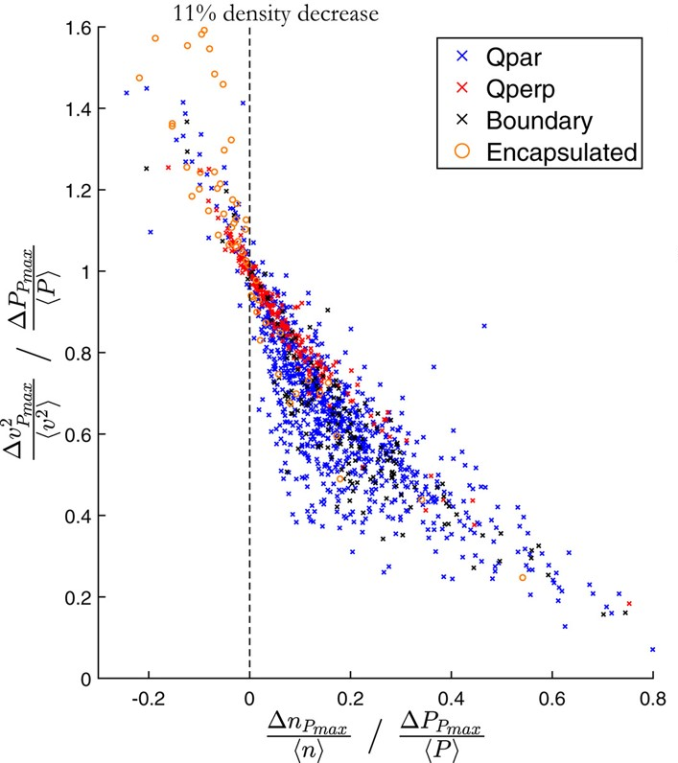
Current main results (1)
Raptis S., Karlsson T., et al. (2020) | JGR
Raptis S., Aminalragia-Giamini S., et al. (2020) | Frontiers

Slide 11
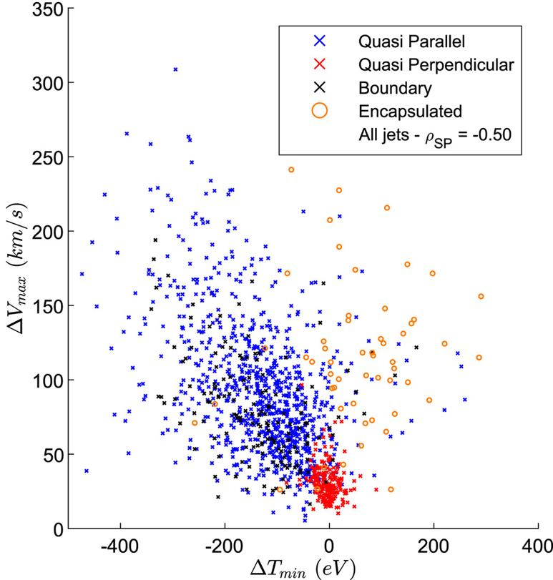
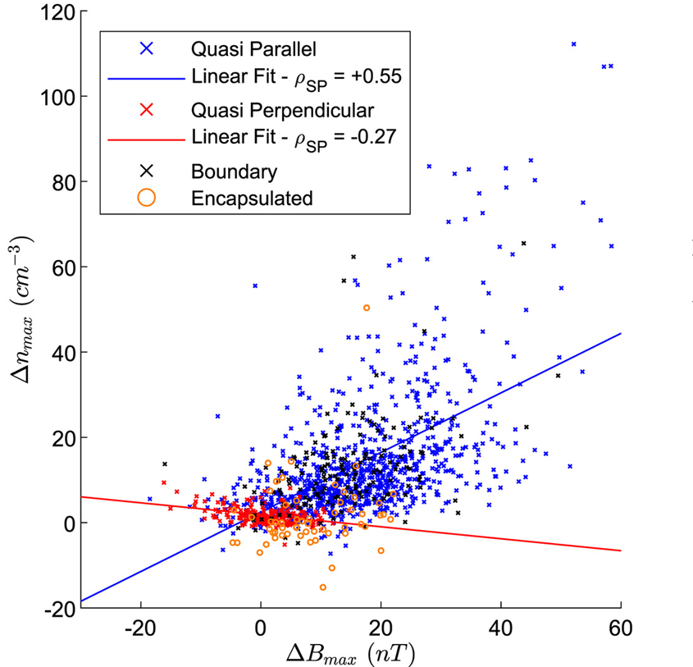

Current main results (2)
“Ripples”
$$ΔX = Χ_{jet}−{\left\langle Χ_{BG}\right\rangle }_{5min}$$
“SLAMS”
Raptis S., Karlsson T., et al. (2020) | JGR

Slide 12
Ongoing Work
Raptis, Karlsson, et al. | Ongoing

Slide 13
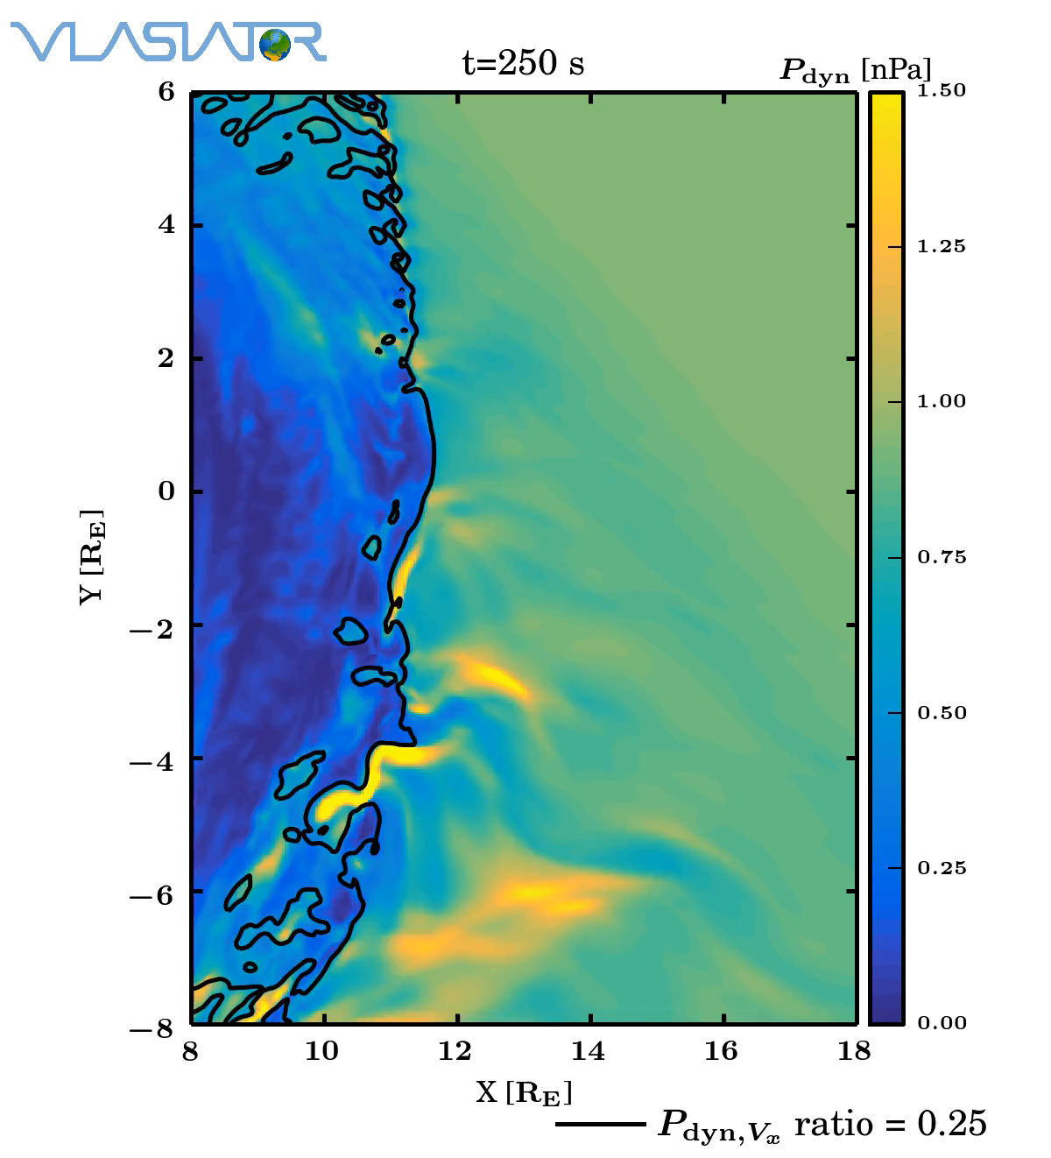
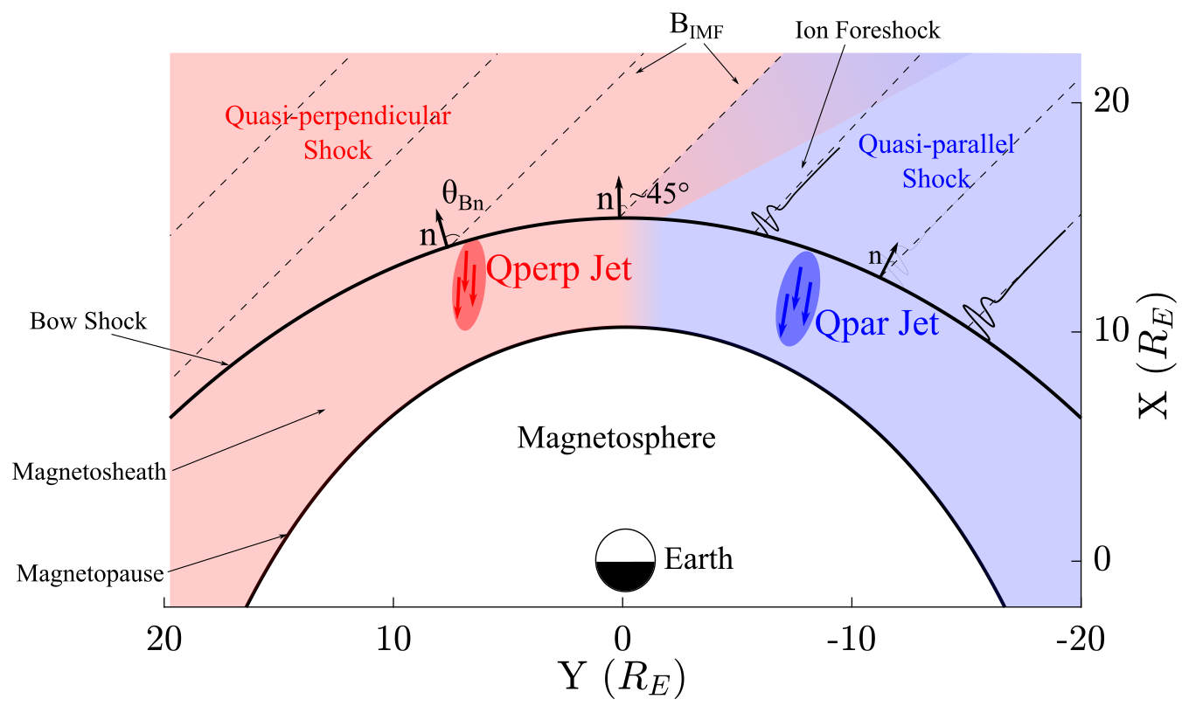
Ongoing work – Approaching the shock
Palmroth M., Raptis S., et al. (2020) | Annales (under review)
Palmroth M., et al. (2018) | Annales
Raptis S., Aminalragia-Giamini S., et al. (2020) | Frontiers

Slide 14
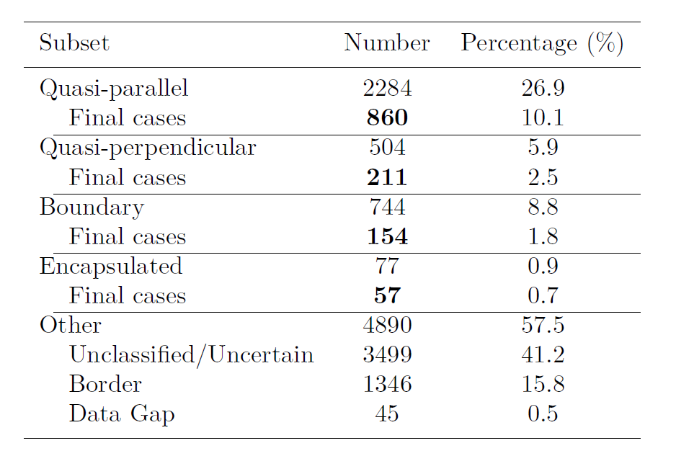
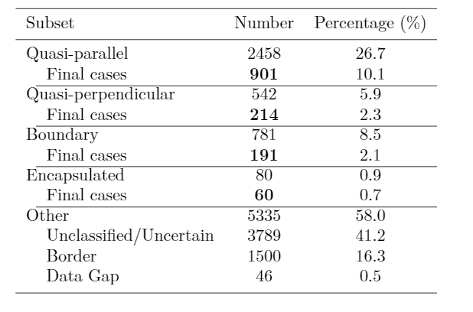
Updated database of jets
Initial: N = 8499
Updated: N = 9196
09/2015 - 04/2019
9/2015 - 9/2020
~300 close to the bow shock
Raptis S., Karlsson T., et al. (2020) | JGR
Raptis S., Aminalragia-Giamini S., et al. (2020) | Frontiers
Palmroth M., Raptis S., et al. (2020) | Annales (under review)
Raptis, Karlsson, et al. | Ongoing

Slide 15
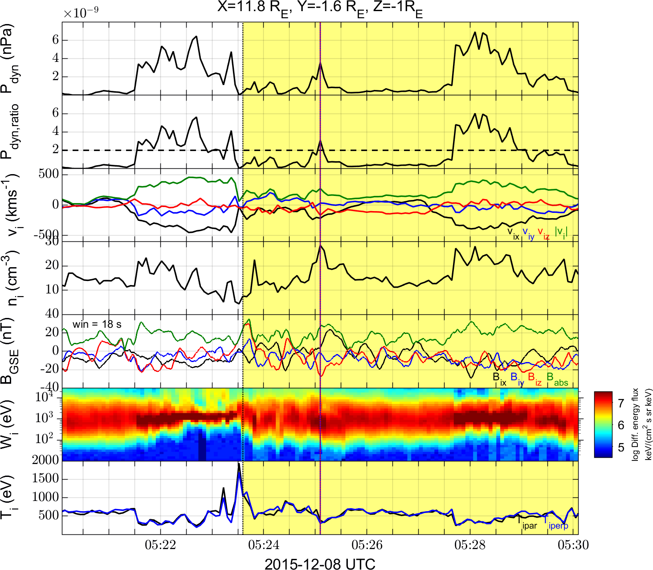
Example: close to the bow shock jet
Raptis, Karlsson, et al. | Ongoing

Slide 16
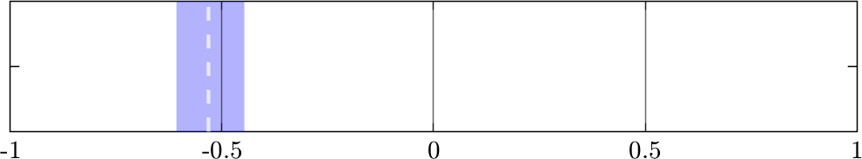
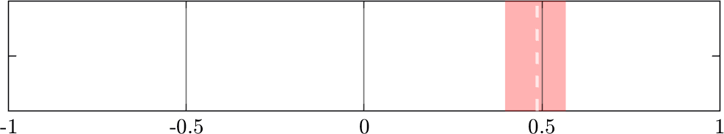
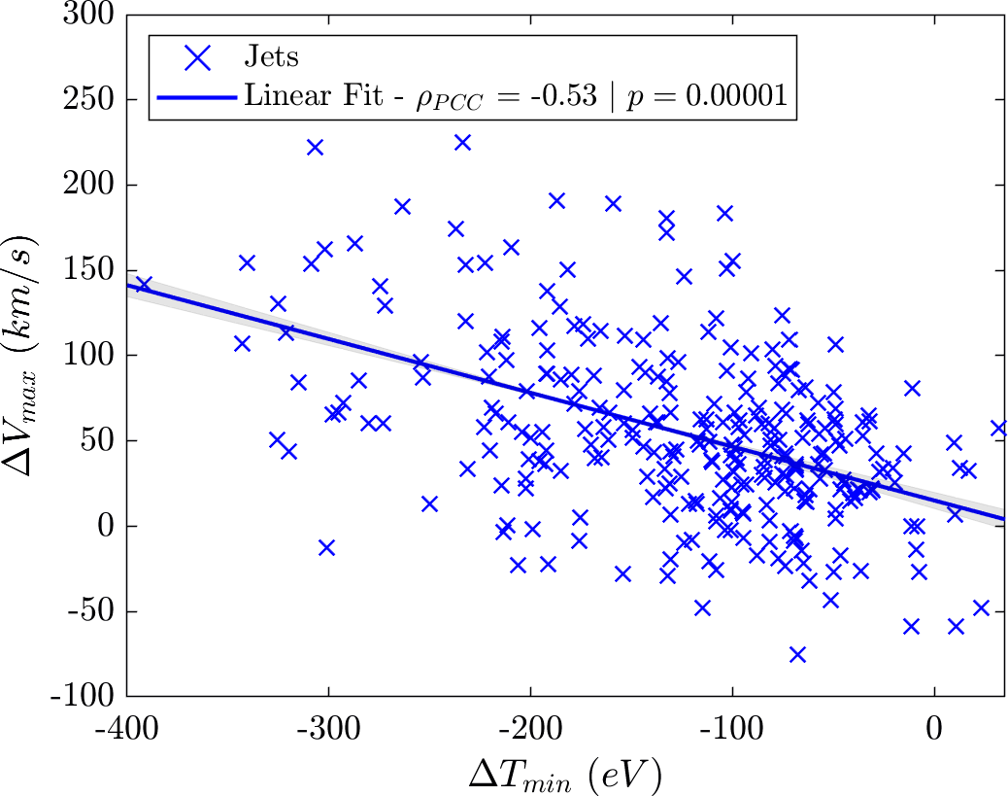
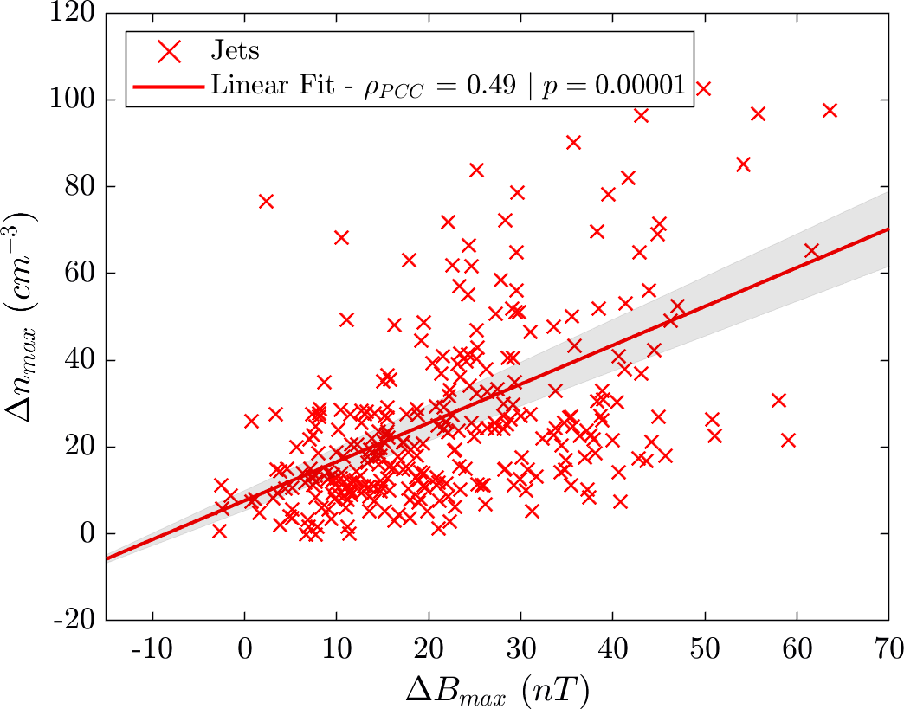



Ongoing Correlation Results
“Ripples”
$$n=310$$
“SLAMS”
$95\% CI:[−0.61 , −0.45$]
$95\% CI:[0.39 , 0.56$]
Raptis, Karlsson, et al. | Ongoing

Slide 17
Summary & Conclusion
Good indication that existent mechanism are at least partially responsible for what we see.
Quite a few things to be done:
See class specific correlations close to the bow shock.
Check burst data availability and see if this provides new insight.
Check other tools of connecting mechanisms (time series analysis, mutual information (MI), prediction power scores (PPS), machine learning (ML), analytical prediction etc.)
Quantification of other possible mechanisms (e.g. reconnection “plasmoids”, Preisser et. al. 2020 | ApJL).
Inspect for statistical artifacts (e.g. partial shock crossings, foreshock, other irregularities etc.)
Other ongoing projects with jets : Interaction of jets with ambient plasma in the magnetosheath.

Slide 18
Extra
Raptis, Karlsson, et al. | Ongoing

Slide 19
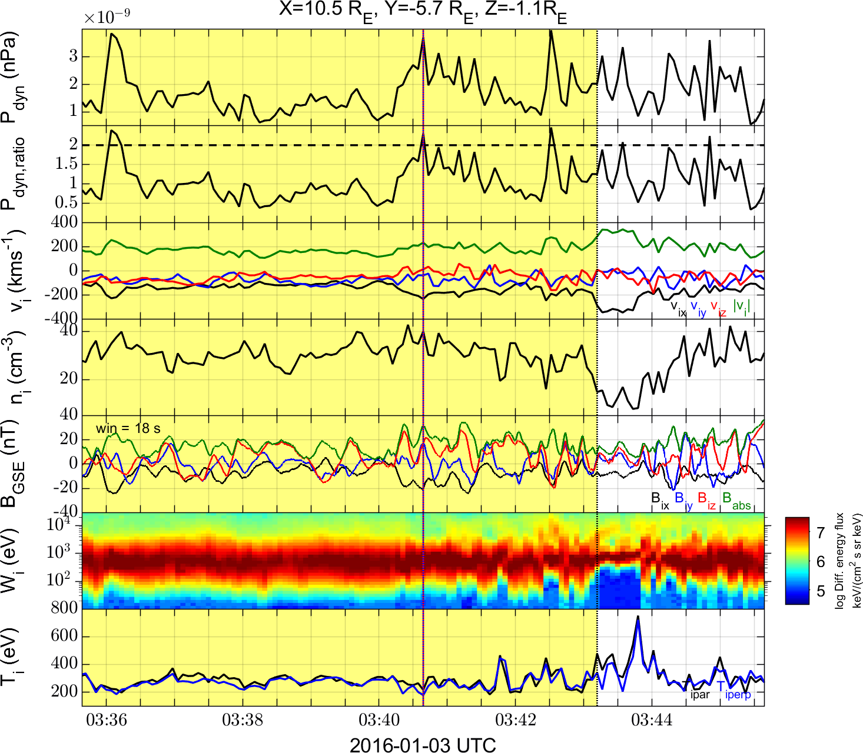
Background – Fully automated
Raptis, Karlsson, et al. | Ongoing

Slide 20
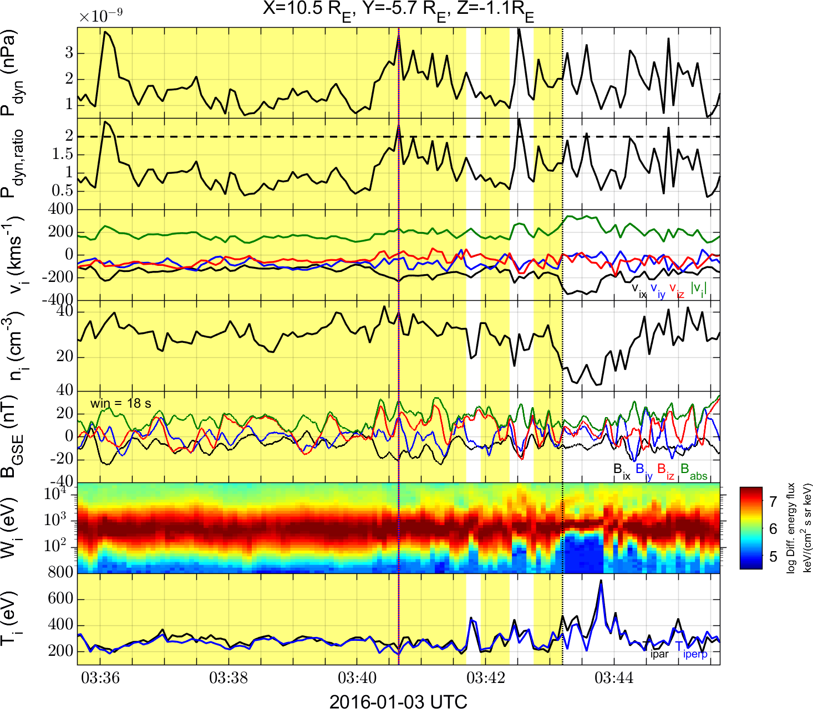
Background – Manual Addition
Raptis, Karlsson, et al. | Ongoing

Slide 21
SLAMS Penetration example
plot(B₄(t))
plot(αB₁(β t - γ ))
α = 3.0
β = 1.7
γ = 7 s
S/C 1 (SW)
S/C 4 (MSh)
Karlsson, et al. | Ongoing

Slide 22
How SLAMS get compressed ?
Δt
Δt
v_{SW}
v_{MSh}
Δt_{SLAMS}
v_{SLAMS}
v_{MSh}
v_{SLAMS} = v_{SW}/1.7 = 0.6v_{SW}
Karlsson, et al. | Ongoing

