Slide 1

On the discrepancies of magnetosheath jet identification and statistical properties due to different temporal resolution and plasma moment derivation Savvas Raptis Division of Space and Plasma Physics KTH Royal Institute of Technology, Stockholm, Sweden COSPAR 2022 – Athens, Greece 27/05/2022

Slide 2
On the discrepancies of magnetosheath jet identification and statistical properties due to different temporal resolution and plasma moment derivation & distribution functions Savvas Raptis Division of Space and Plasma Physics KTH Royal Institute of Technology, Stockholm, Sweden COSPAR 2022 – Athens, Greece 27/05/2022

Slide 3

On the discrepancies of magnetosheath jet identification and statistical properties due to different temporal resolution and plasma moment derivation & distribution functions with MMS Savvas Raptis Division of Space and Plasma Physics KTH Royal Institute of Technology, Stockholm, Sweden COSPAR 2022 – Athens, Greece 27/05/2022

Slide 4
Introduction
Jets

Slide 5
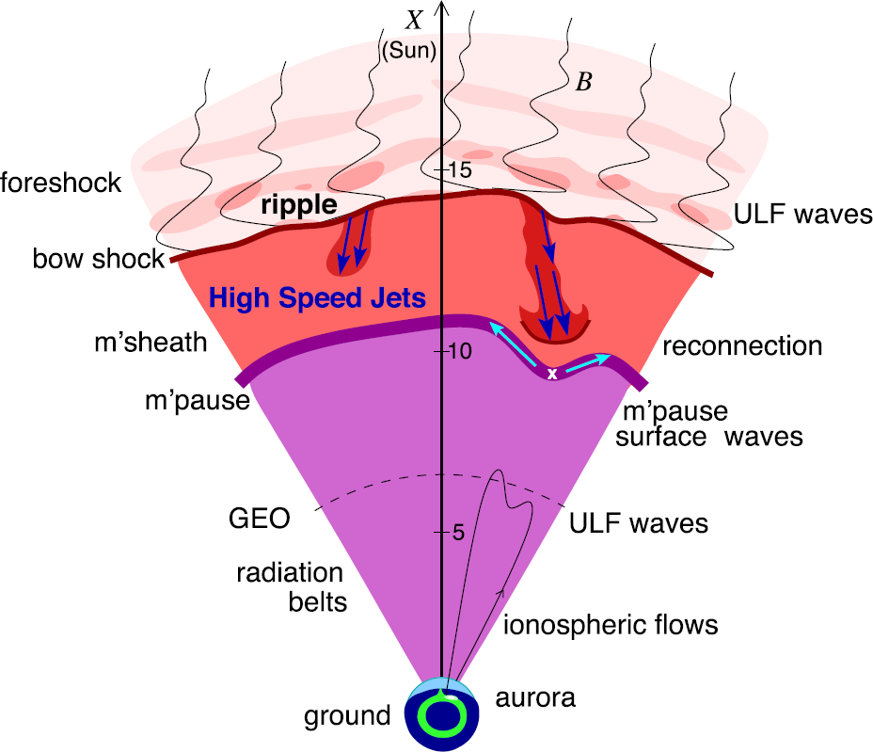
Magnetosheath Jets – Definition
Definition
Magnetosheath jets are transient localized enhancements of dynamic pressure (density and/or velocity increase)
e.g., 200% dynamic pressure enhancement compared to background magnetosheath
Related phenomena
Radiation belts
Throat aurora
Magnetopause reconnection
Magnetopause penetration
Shock acceleration
Magnetopause surface eigenmodes
ULF waves
Plaschke F. et al. (2018); sketch by H. Hietala | Space Sci. Rev

Slide 6
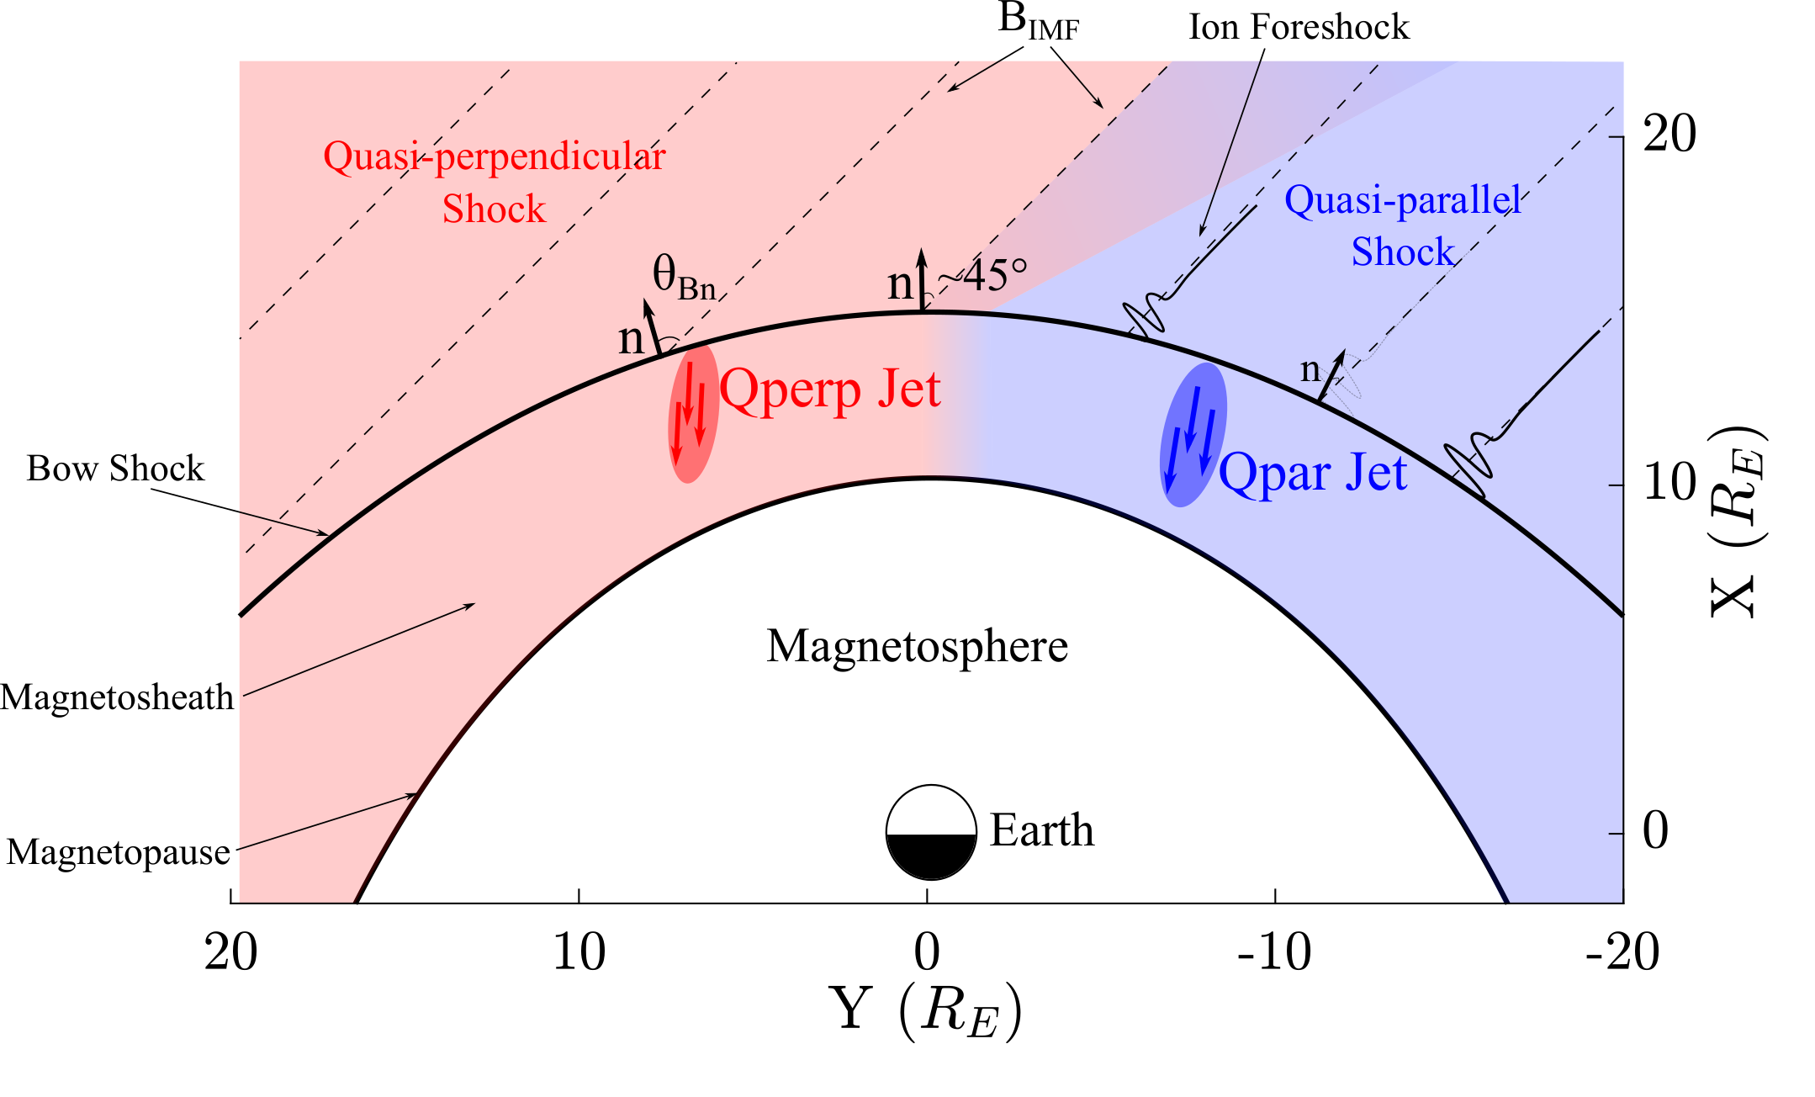
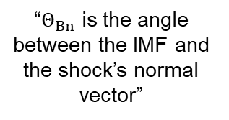
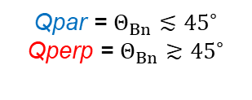
Shock, Magnetosheath & Jet classification
“$Θ_{Βn}$ is the angle between the IMF and the shock’s normal vector”
Qpar = $Θ_{Βn}≲{45}^{∘}$
Qperp = $Θ_{Βn}≳{45}^{∘}$
”Jets found ~9 times more often in the Qpar MSH”
Vuorinen et al. (2019)
Raptis, Karlsson, et al. (2020) | JGR
Raptis, Aminalragia-Giamini et al. (2020) | Front. Astron. Space Sci
Karlsson, Raptis et al. (2021) | JGR
Kajdič, Raptis et al. (2021) | GRL

Slide 7
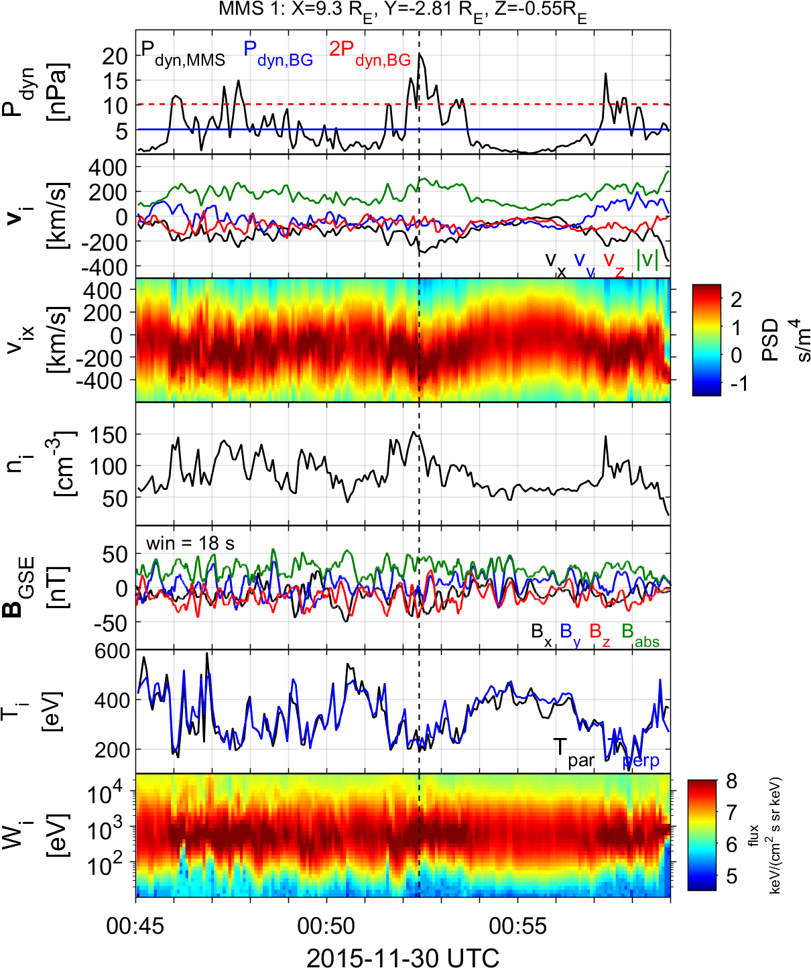
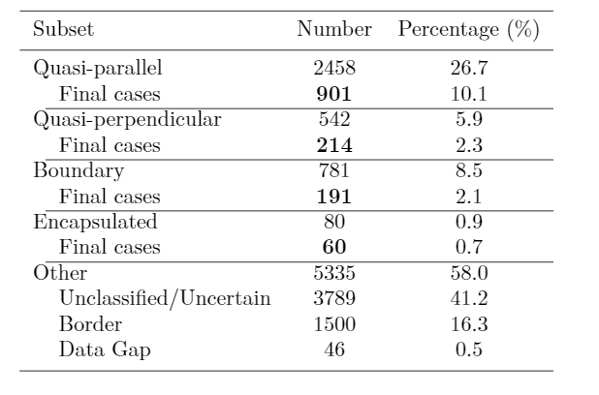

Summarized properties – Quasi Parallel
Most common
High dynamic pressure
Primarily Earthward
Associated with low temperature (ΔΤ)
Associated with high |B| & ΔΒ
High |B| variance
Relevant to magnetospheric effects
Qpar Jet
Jets found in $Q_{∥}$ MSH
Raptis S., Karlsson T., et al. (2020) | JGR

Slide 8
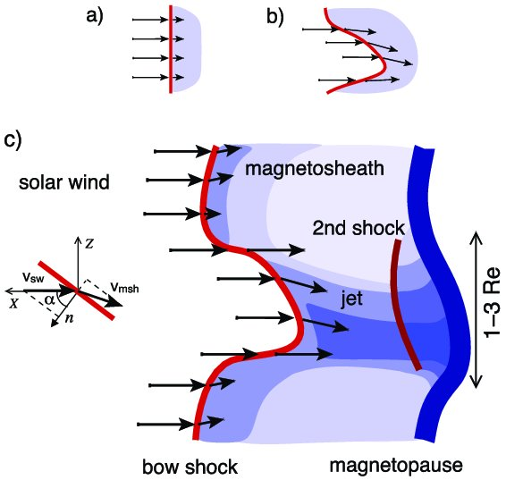
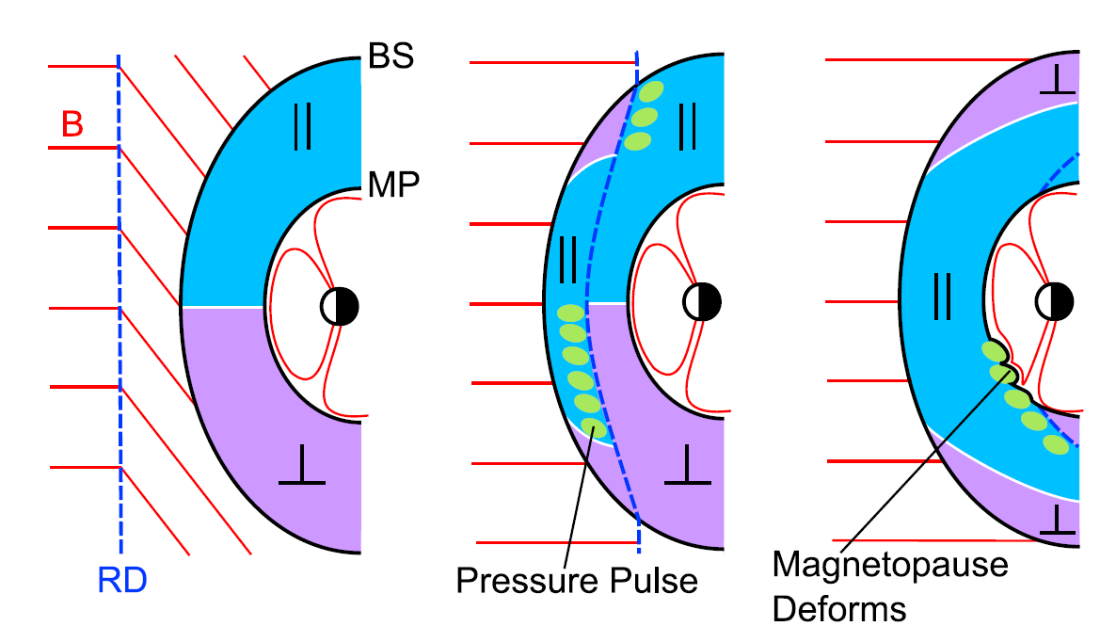
How are these jets created (Qpar) ?
Shock ripples
SW discontinuities
Foreshock Structures & Reformation
SW → locally inclined part of the bow shock → less deceleration and heating
RD → Change in Foreshock position → Pressure pulses
Hietala et al. (2009,2012)
Archer et al. (2012)
Karlsson et al.(2015), Suni et al. (2021), Raptis et al. (2022)

Slide 9
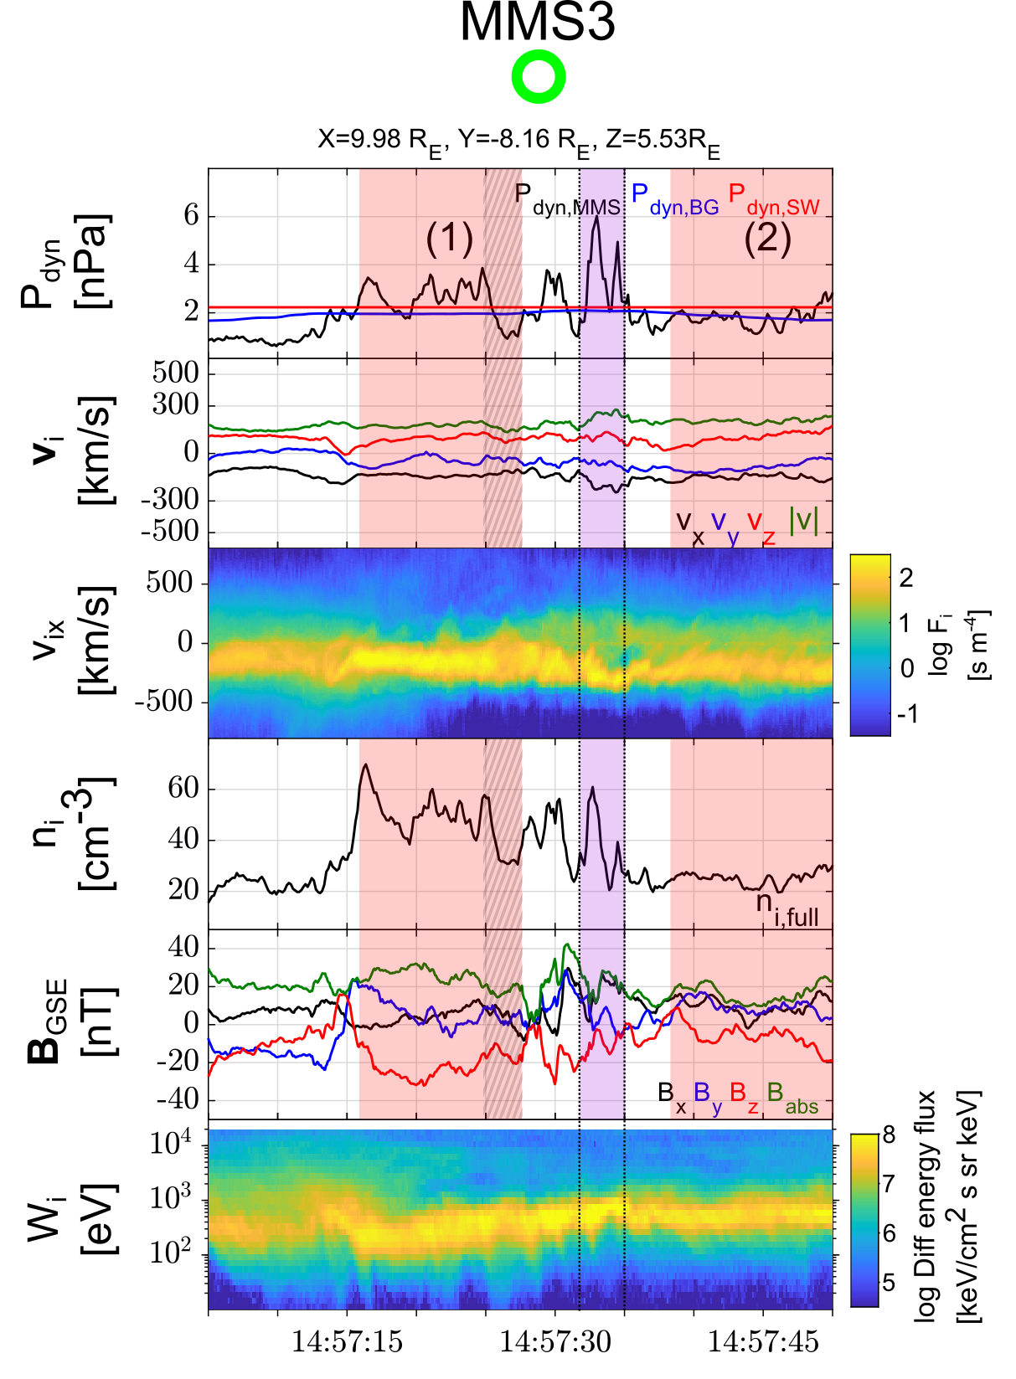
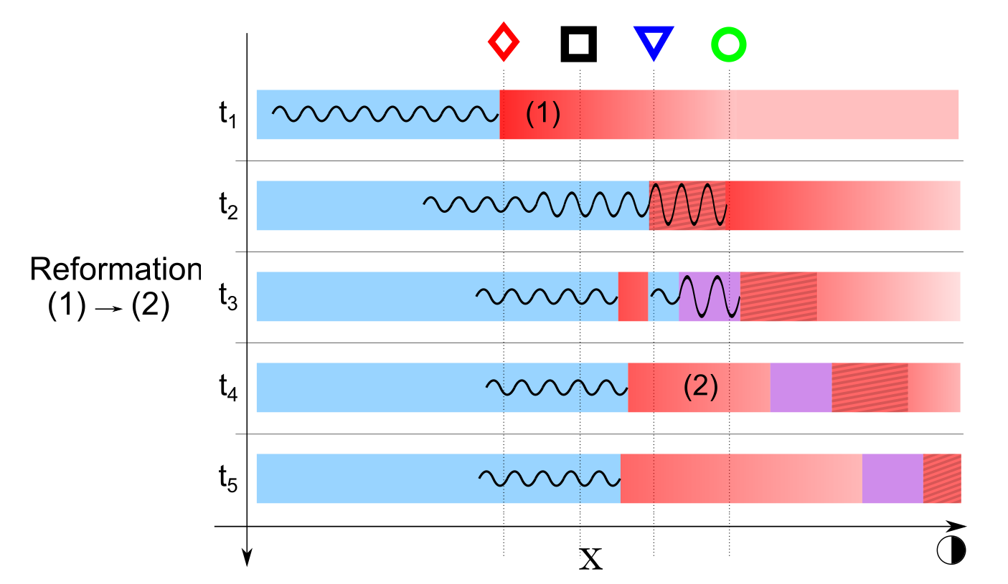
Shock Reformation & Magnetosheath Jets
Raptis, S., Karlsson, T., Vaivads, A. et al. Downstream high-speed plasma jet generation as a direct consequence of shock reformation. Nature Communications 13, 598 (2022). https://doi.org/10.1038/s41467-022-28110-4

Slide 10
Results
Raptis, Karlsson, et al,. 2022 | (Under Review)

Slide 11
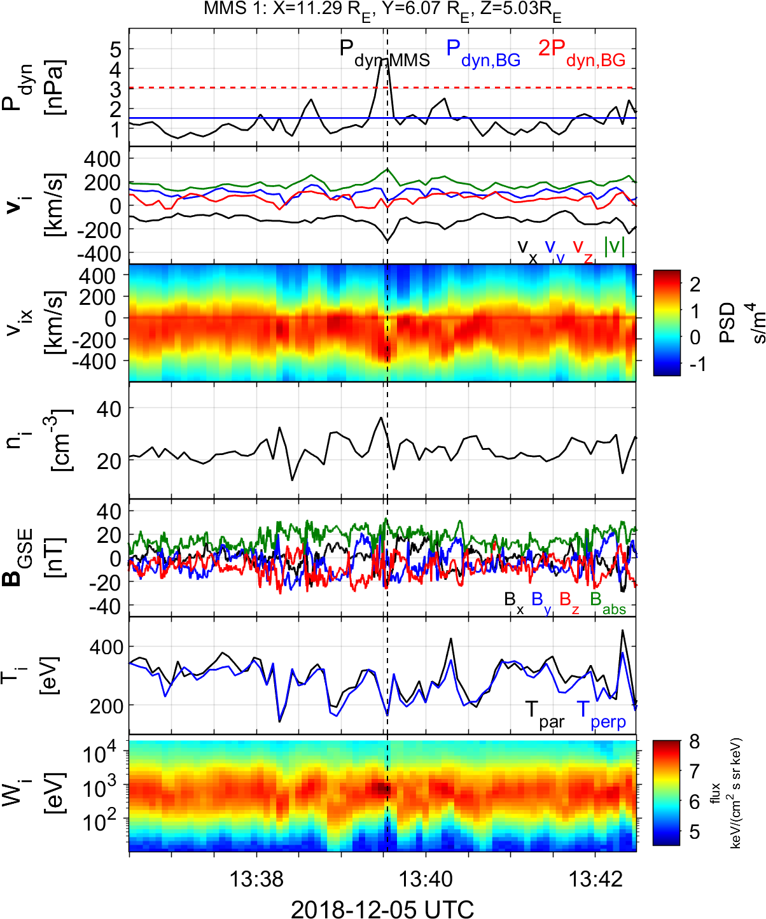
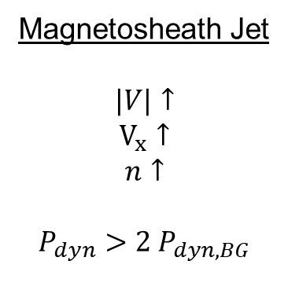
Qpar Magnetosheath jet – Fast data
Qpar Magnetosheath:
High energy ions
Low temperature anisotropy
High B Variance
Magnetosheath Jet
$$|V|↑$$
$$V_{x}↑$$
$$n↑$$
$$P_{dyn}>2 P_{dyn,BG}$$
Raptis S, et al,. 2022 | (Ongoing)

Slide 12
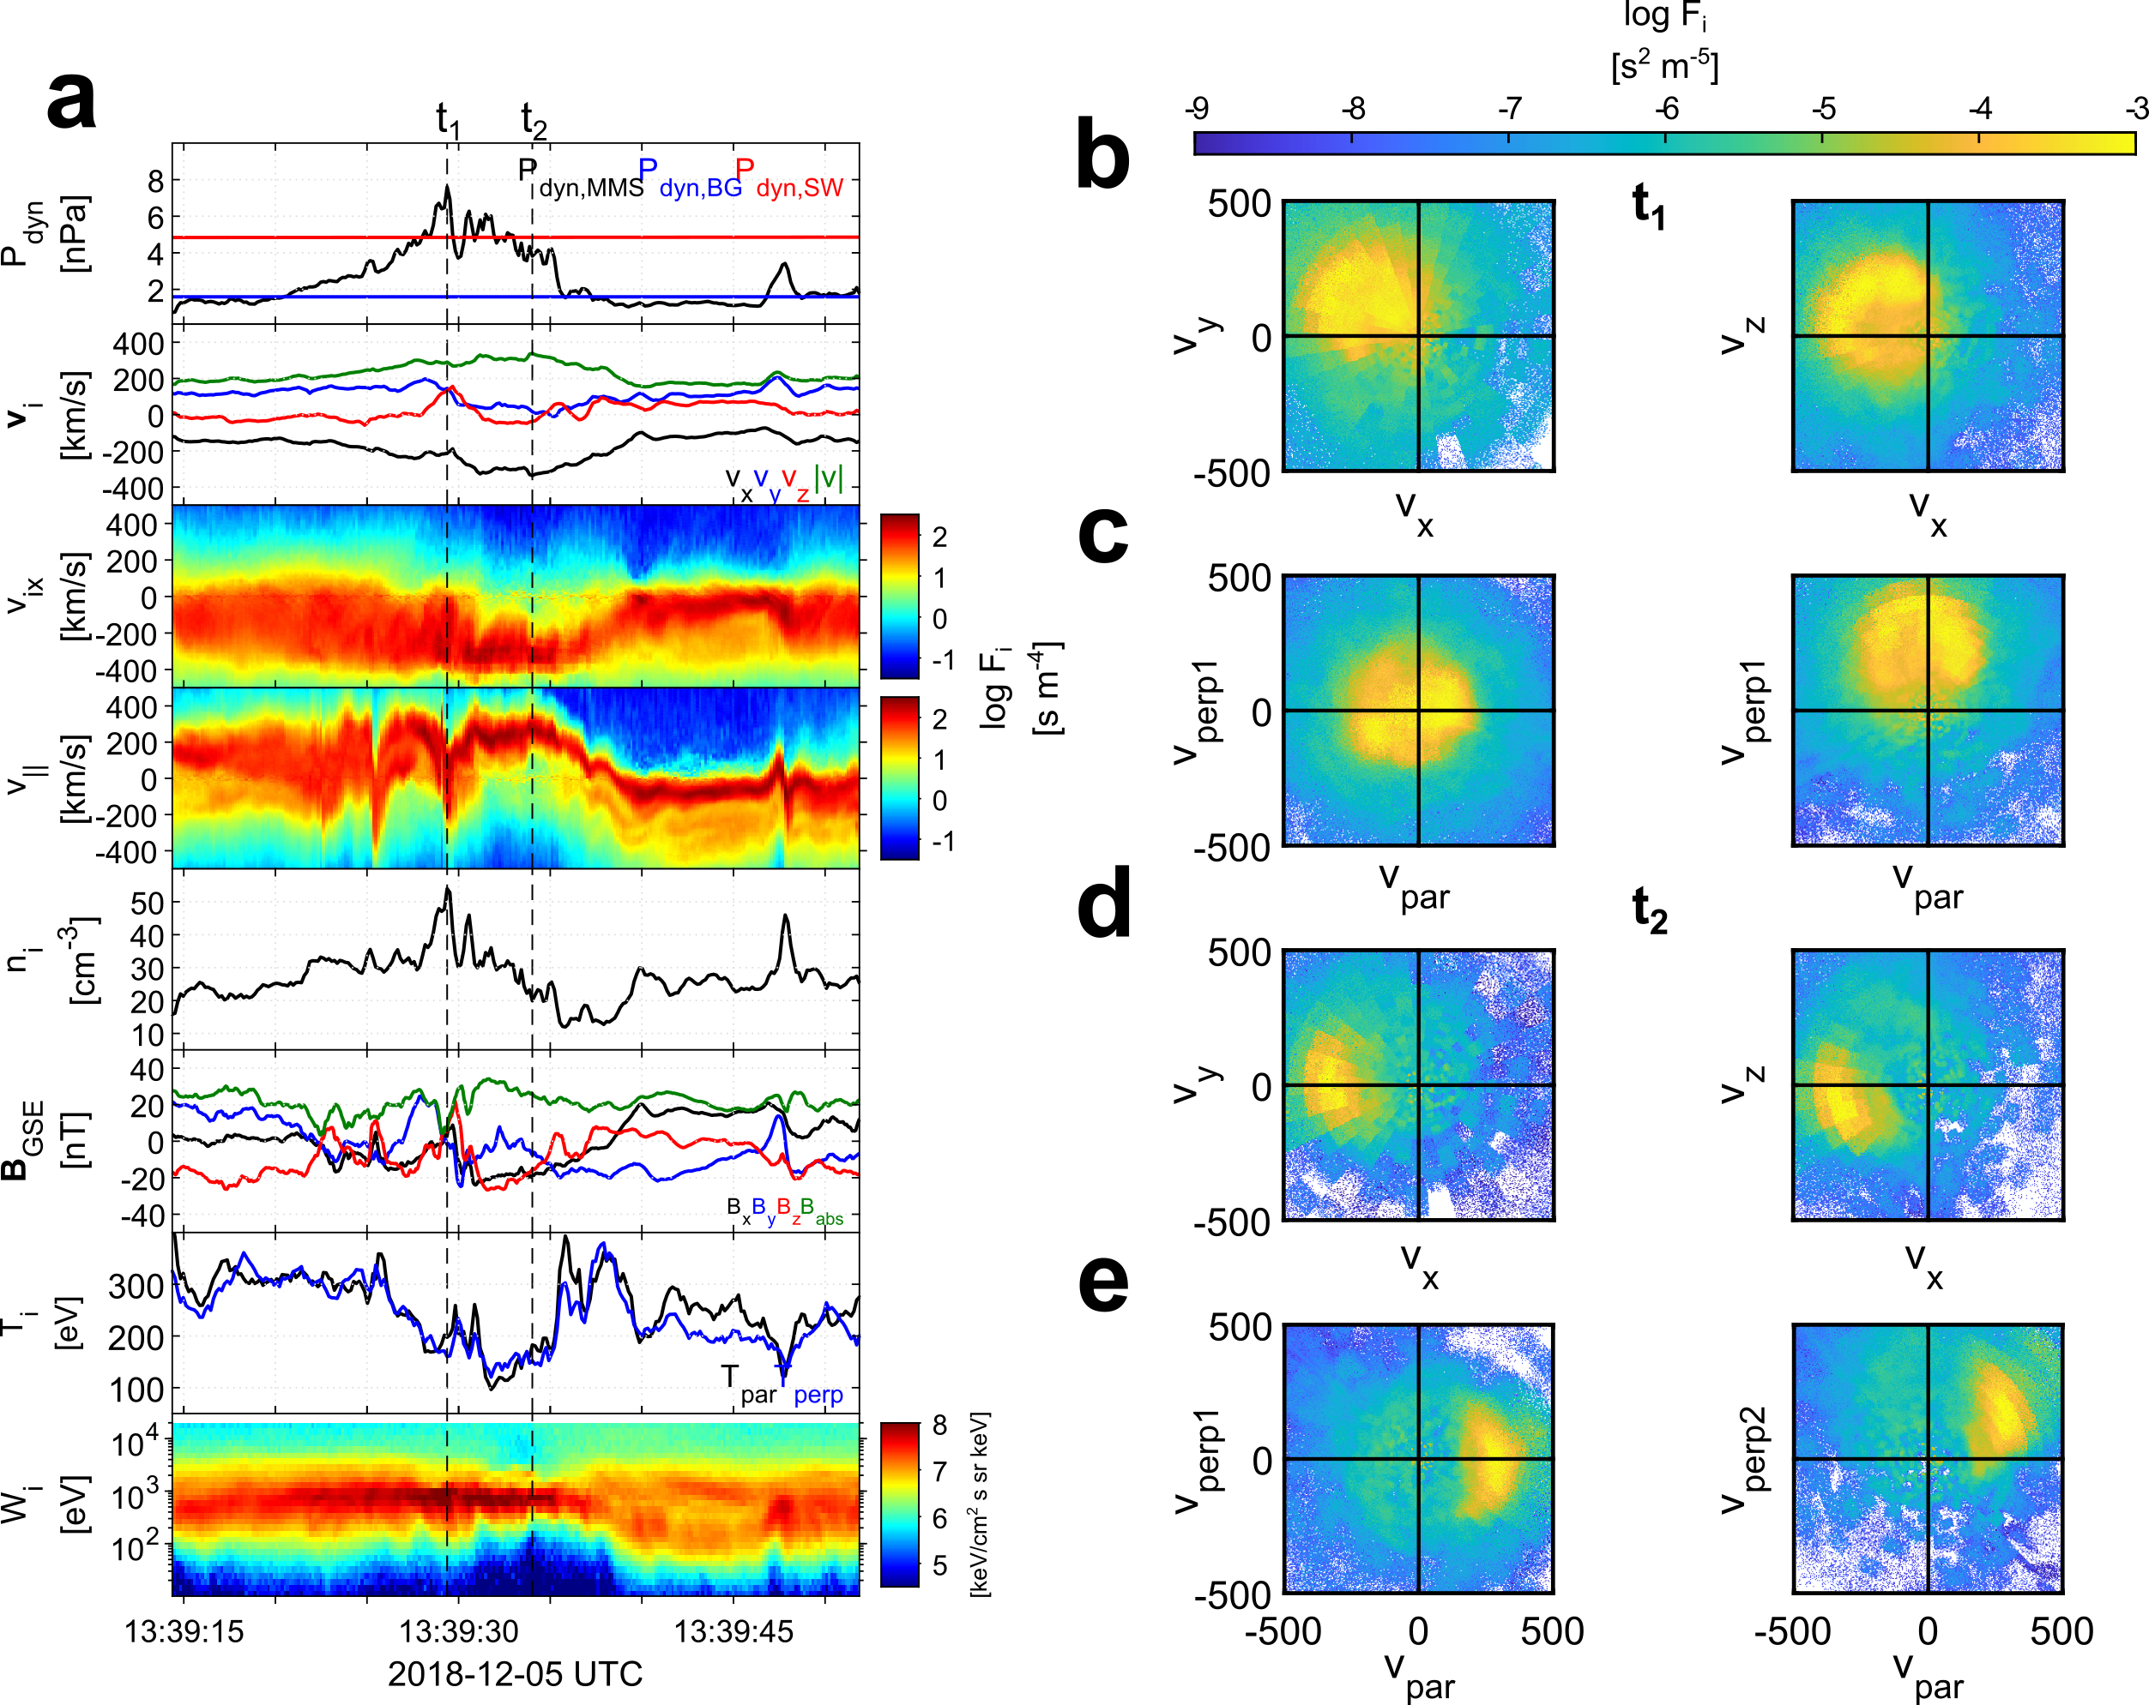
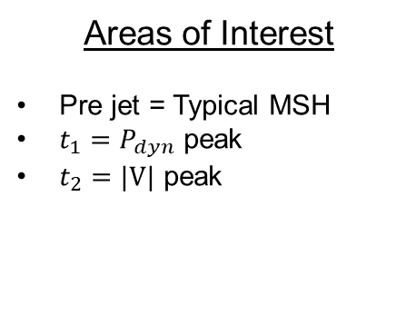
Qpar Magnetosheath jet – MMS Burst data
Areas of Interest
Pre jet = Typical MSH
$t_{1}=P_{dyn}$ peak
$t_{2}=|V|$ peak
Raptis S, et al,. 2022 | (Ongoing)

Slide 13
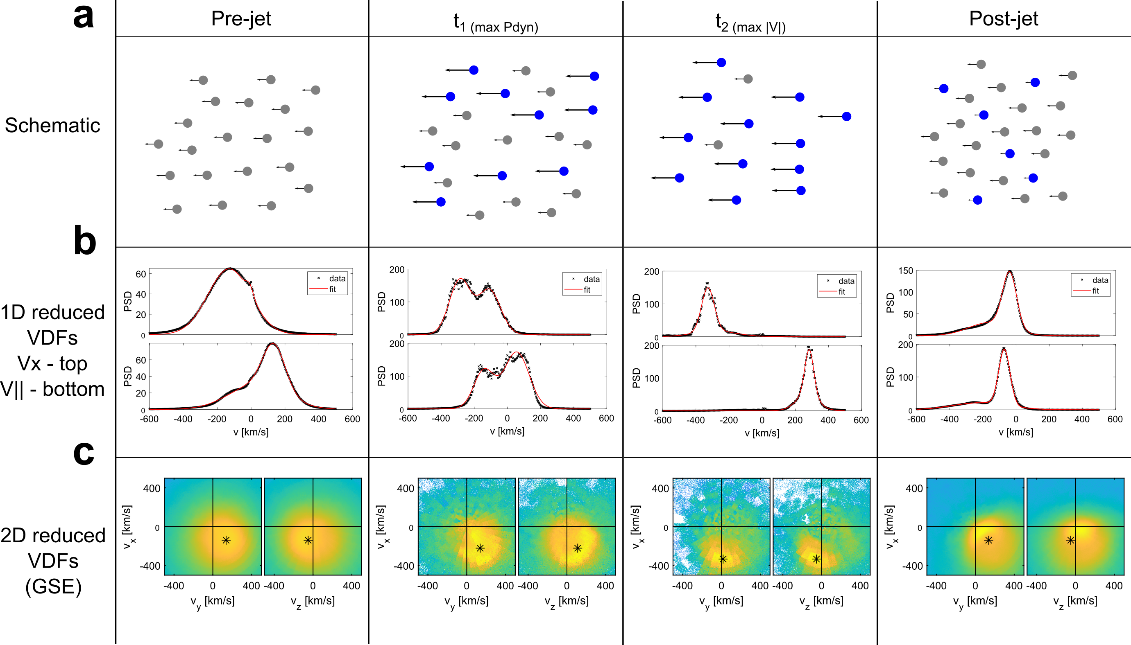
Jet evolution in Qpar Magnetosheath
Raptis S, et al,. 2022 | (Ongoing)

Slide 14
Jet evolution in Qpar Magnetosheath
Raptis S, et al,. 2022 | (Ongoing)

Slide 15
Jet evolution in Qpar Magnetosheath
Raptis S, et al,. 2022 | (Ongoing)

Slide 16
Jet evolution in Qpar Magnetosheath
Raptis S, et al,. 2022 | (Ongoing)

Slide 17
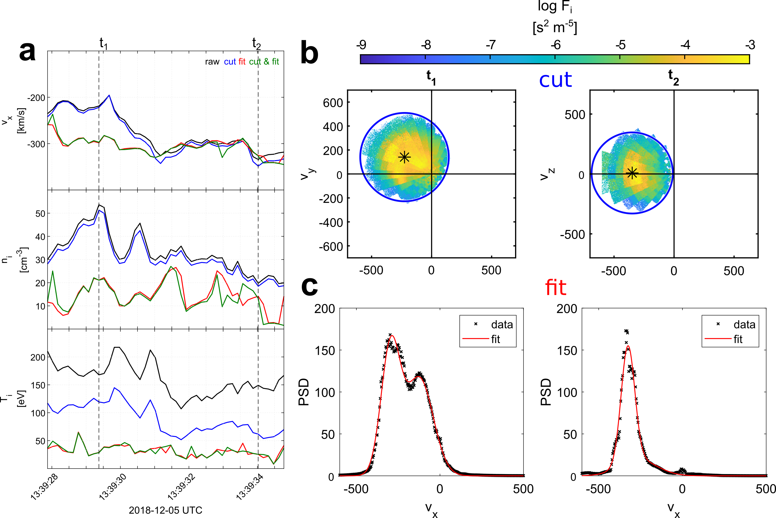
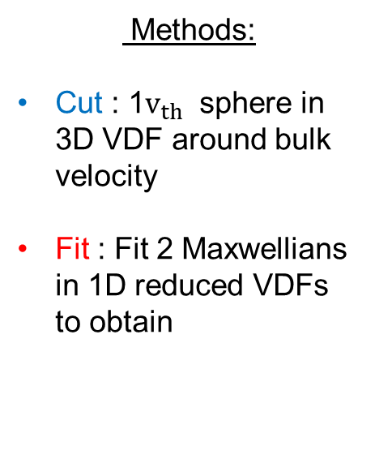
Partial Moment Derivation
Methods:
Cut : 1$v_{th}$ sphere in 3D VDF around bulk velocity
Fit : Fit 2 Maxwellians in 1D reduced VDFs to obtain
Raptis S, et al,. 2022 | (Ongoing)

Slide 18

Summary & Conclusion
Main points
Jets are inherently kinetic structures with complicated VDFs throughout their life
They interact with background plasma (magnetic structures), evolving as they propagate.
Their plasma moments are not well captured by the full particle moments since at least for part of their lifetime.
Future work
Evaluate previous statistics (done with low-resolution full particle moments).
More events to see how properties change on different environments/stages
Simulations : (TBD – Quite some interesting results already though)
Investigation of wave generation
Thank you for listening and enjoy your time in Greece ☺

Slide 19
Extras

Slide 20

Fast/Survey MMS data
Burst MMS data
Resolution (samples/s)
Resolution (samples/s)
FGM (magnetic field):
FPI (plasma moments | ions):
EDP (electric field):
0.0625
4.5
0.0313
0.0078
0.15
0.00012218
Pros
Always available
Decent resolution
Can be good for statistics due to availability
Pros
Very high resolution
Able to resolve smaller scale structures close to boundary surfaces (e.g. mix of plasma close to magnetopause, bow shock, foreshock etc.)
Cons
Not available all the time, mostly available close to vital mission objectives (magnetopause, diffusion regions, shock transitions etc.)
Hard to do proper large-scale statistics due to biases generated from specific availability and manual choice of intervals
Cons
Not suitable for small scale studies especially these related to electron moments
Could be misleading close to boundary surfaces (Magnetopause, Bow shock etc.) due to very similar observational signatures
More information: Baker, et al. (2016) | Space Sci Rev 19

Slide 21
MMS – Jet Database
Fast/Survey
Burst
9/2015 - 9/2020
Jets with full burst data
Qpar | 423
Qperp | 34
Boundary | 35
Encapsulated | 31
Close to BS / MP | 495
Others | 428
Raptis S., Karlsson T., et al. (2020) | JGR
Raptis S., Aminalragia-Giamini S., et al. (2020) | Frontiers
Palmroth M., Raptis S., et al. (2021) | Annales
Kajdic P., Raptis S., et al. (2021) | GRL
Raptis S., Karlsson T., et al. (2022) | Nat. Commun
Raptis S., Karlsson T., et al. (2022) | Under Review

Slide 22
Jets – references update (>2019)
Associated phenomena & effects
Excitation of surface eigenmodes at magnetopause: Archer et al. (2019, 2021)
Mirror mode waves and jets : Bianco-Cano et al. (2020)
Bursty magnetic reconnection at the Earth's magnetopause : Ng et al. (2021)
Ground-based magnetometer response : Norenius et al. (2021)
Generation of Pi2 pulsations : Katsavrias et al. (2021)
B in jets, Bz variations near magnetopause : Vuorinen et al. (2021)
Modeling & formation
Velocity & magnetic field alignment in jets : Plaschke et al. (2020)
Classification of jets using MMS & Neural Networks : Raptis et al. (2020a,2020b)
Comparison MMS vs simulations : Palmroth et al. (2021)
Solar wind effect on jet formation : LaMoury et al. (2021)
Magnetosheath Jets and Plasmoids - Hybrid Simulations : Preisser et al. (2020)
Formation of jets in Quasi-perpendicular magnetosheath : Primoz et al. (2021)
Jets Downstream of Collisionless Shocks
Plaschke et al. (2018)
https://link.springer.com/article/10.1007/s11214-018-0516-3
And more : Liu et al. (2020a,2020b), Omelchenko et al (2021), Sibeck et al. (2021), Suni et al. (2021), Tinoco-Arenas et al. (2022) … etc. etc.

Slide 23
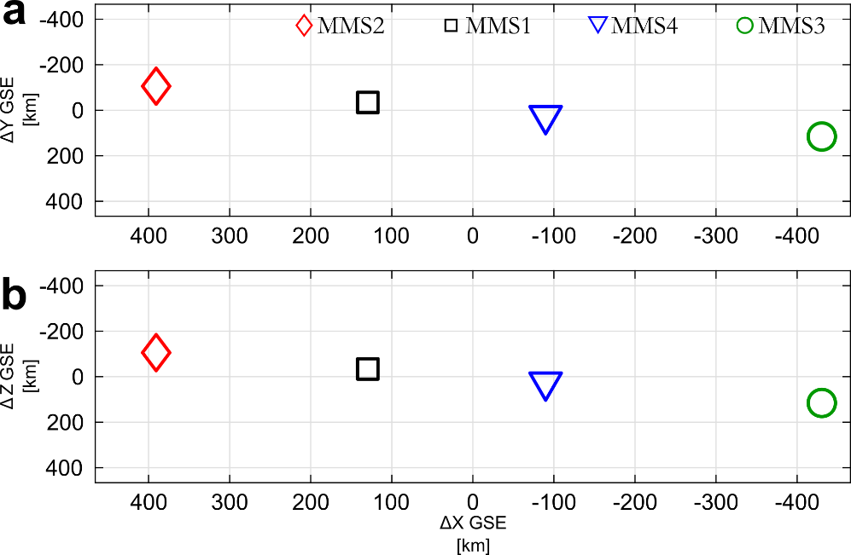
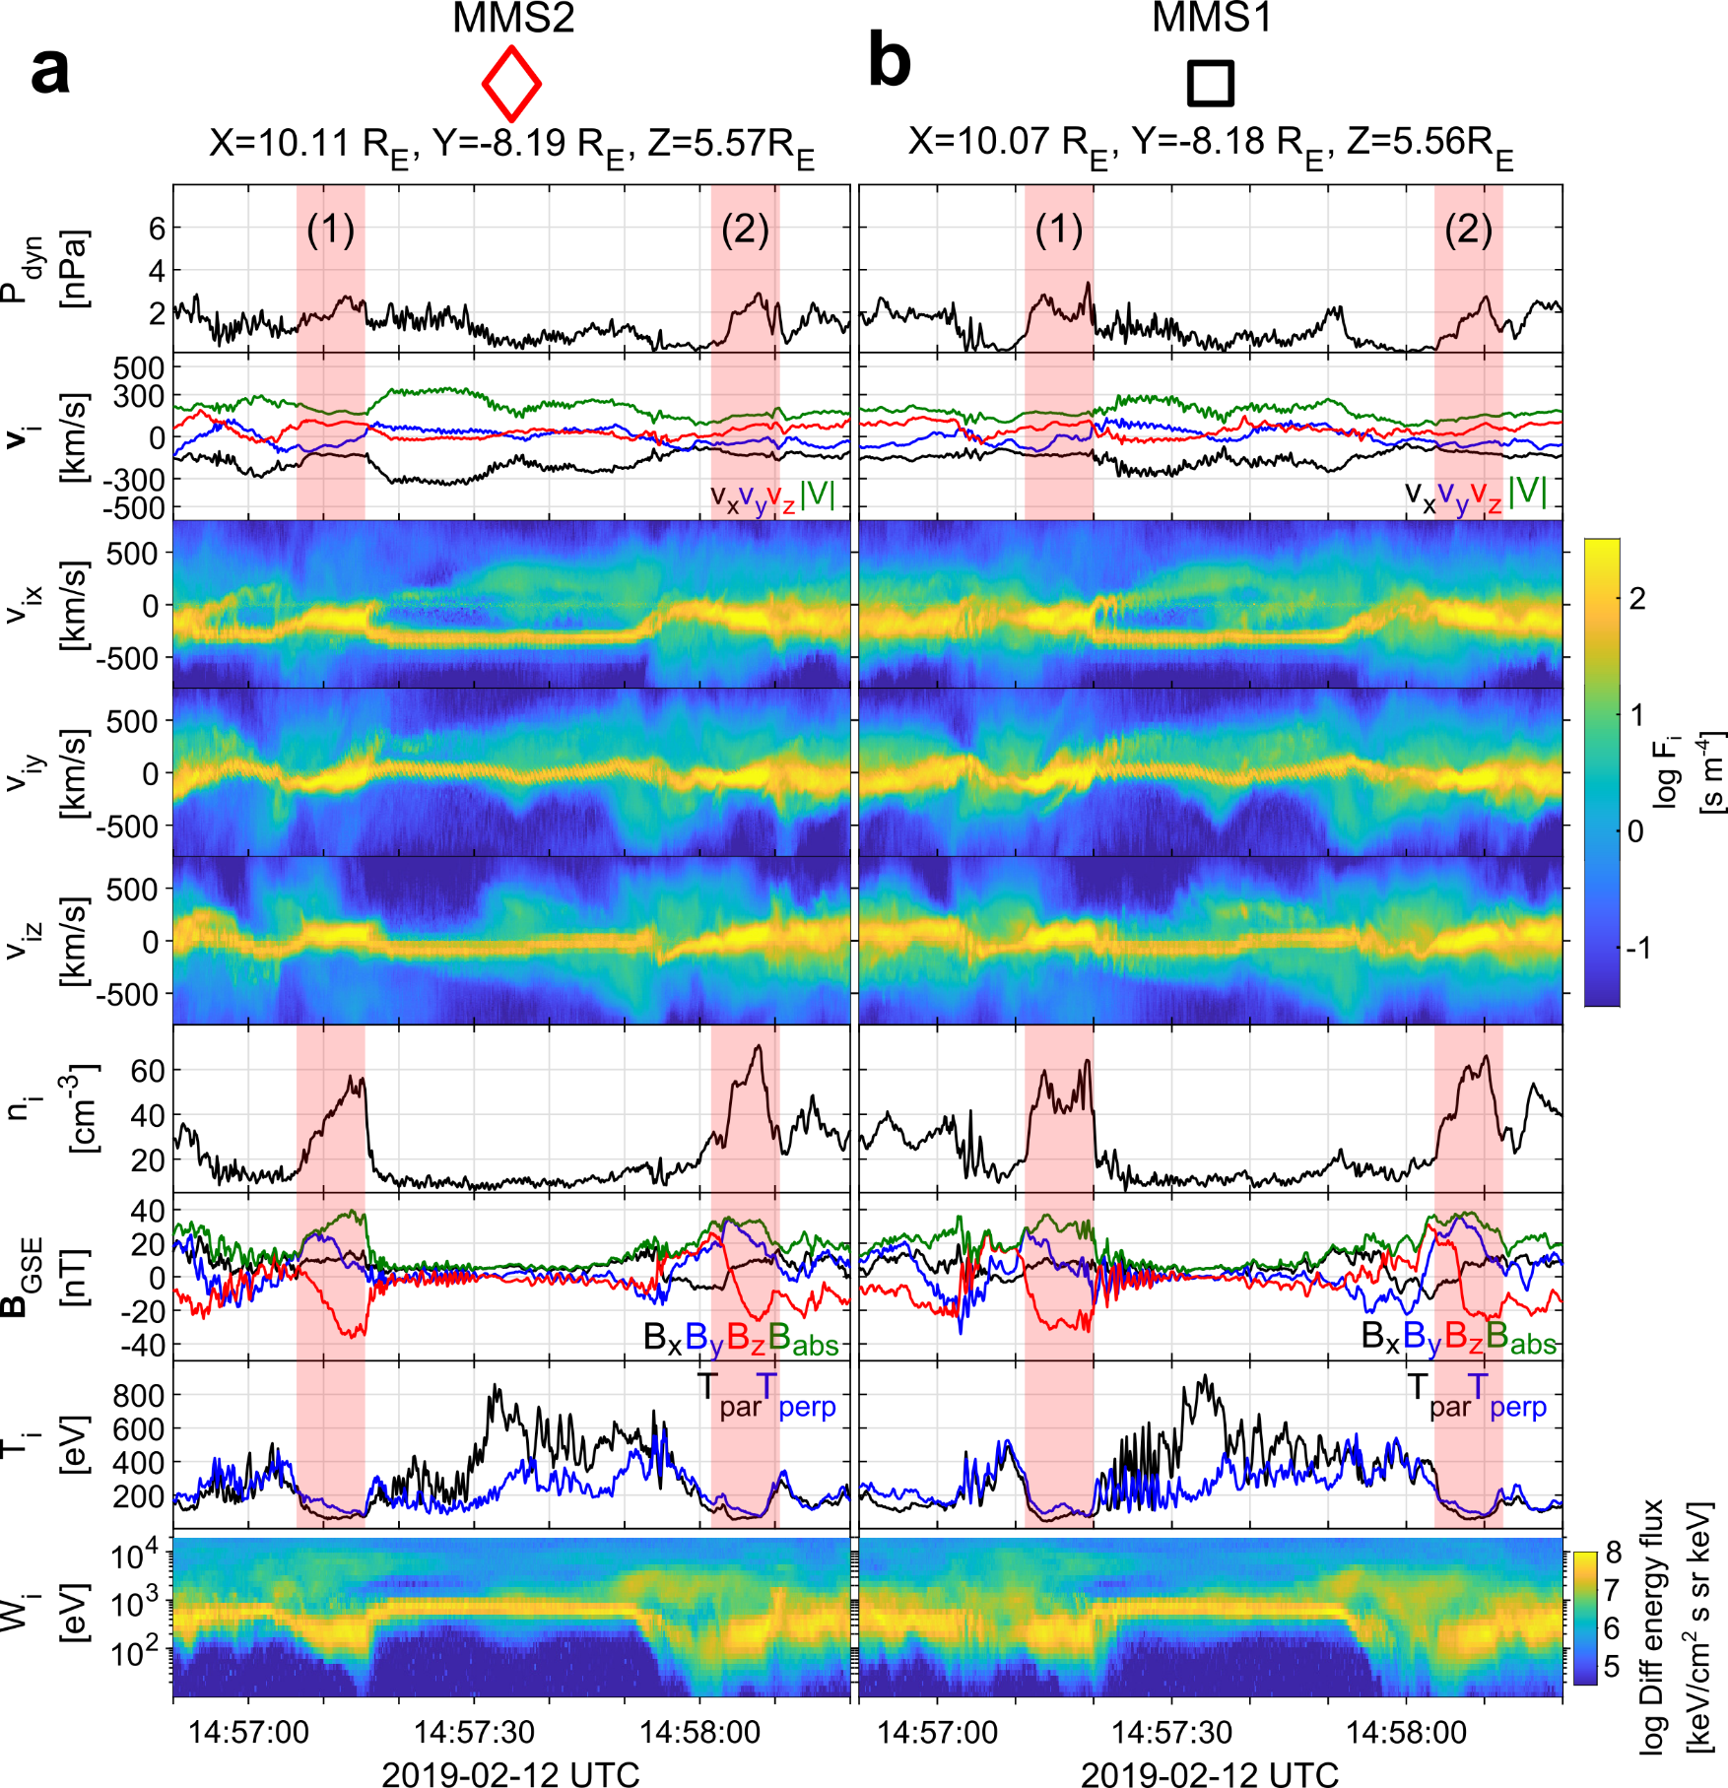
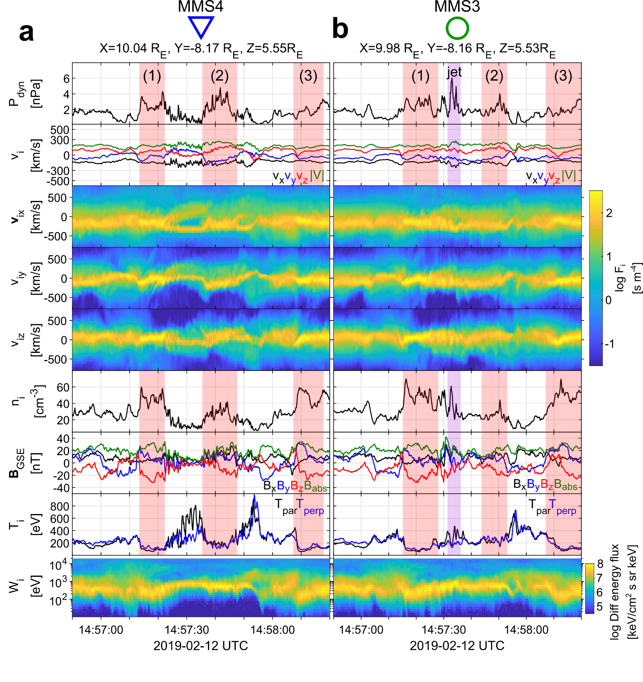
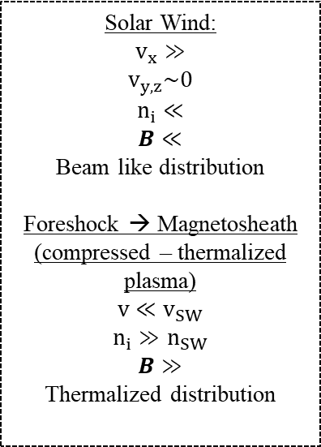
General Observations of MMS
u
d
Solar Wind:
$$v_{x}≫$$
$$v_{y,z}\sim 0$$
$$n_{i}≪$$
$$B≪$$
Beam like distribution
Foreshock → Magnetosheath
(compressed – thermalized plasma)
$$v≪v_{SW}$$
$$n_{i}≫n_{SW}$$
$$B≫$$
Thermalized distribution

Slide 24
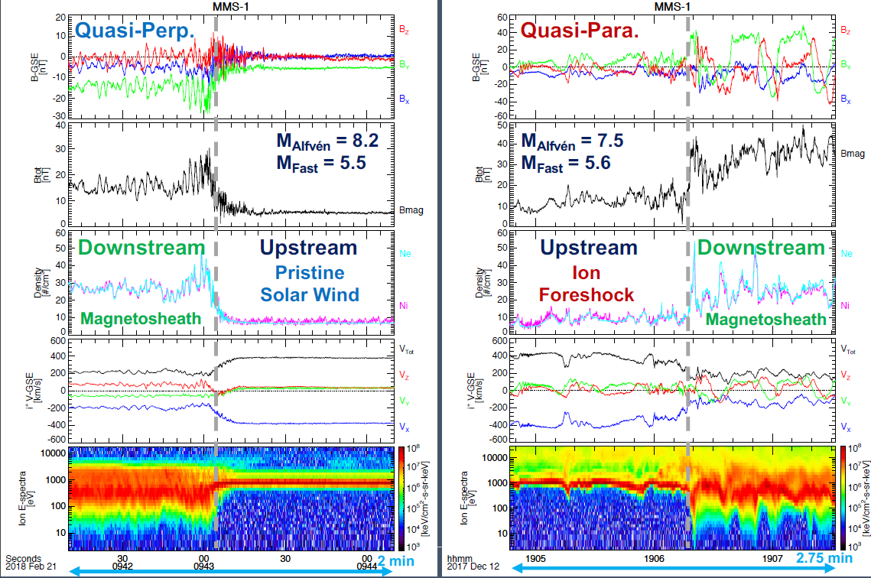
Shock transitions with MMS
Notice difference in the downstream plasma ?
Figure taken from : Drew Turner’s talk | SWSG2021

Slide 25
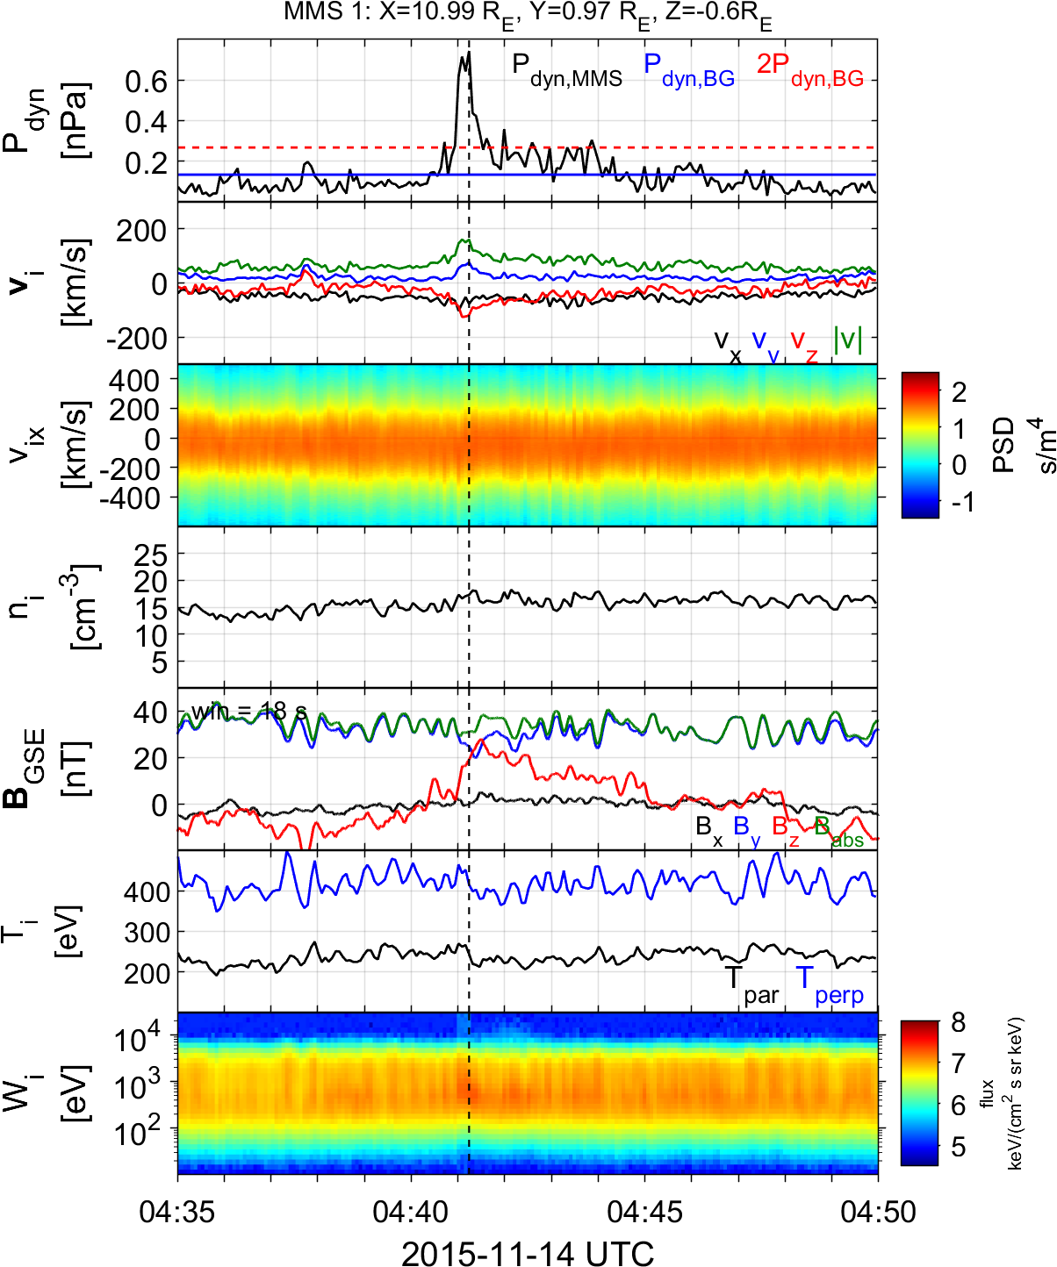

Summarized properties – Quasi Perpendicular
Less common
Less Energetic
Mainly velocity driven
Very small duration (~4 sec)
Could be connected to MSH reconnection or FTEs
Connection mirror mode waves
Qperp Jet
Jets found in $Q_{⊥}$MSH
Raptis S., Karlsson T., et al. (2020) | JGR

Slide 26
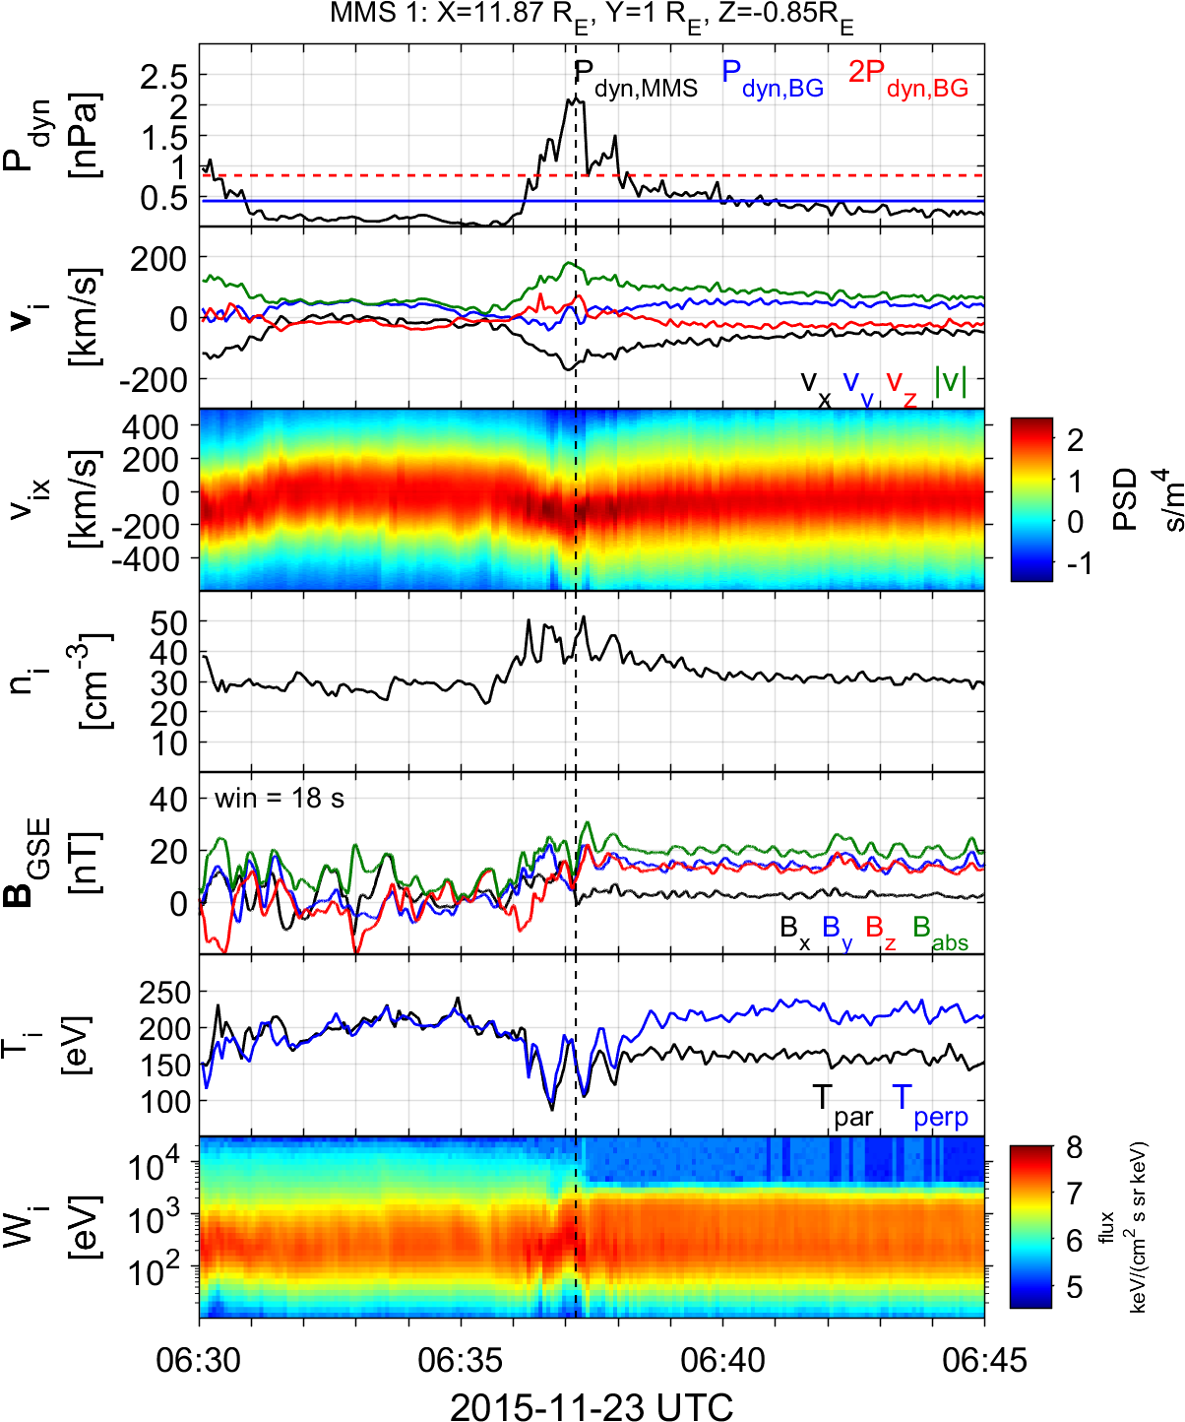
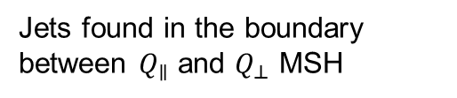
Summarized properties – Boundary
Hard to estimate their occurrence rate
Quite energetic and long duration
Similar properties to Qpar jets
Could be geoeffective (GMAGs) [Norenius et al. 2021]
Maybe associated to pressure pulses of SW [Archer et al. 2012]
Boundary Jet
Jets found in the boundary between $Q_{∥}$ and $Q_{⊥}$ MSH
Raptis S., Karlsson T., et al. (2020) | JGR

