Slide 1

Magnetosheath Jets using MMS Savvas Raptis Division of Space and Plasma Physics KTH Royal Institute of Technology, Stockholm, Sweden Swedish Space Plasma Meeting 2022 Umea, Sweden 09/06/2022

Slide 2
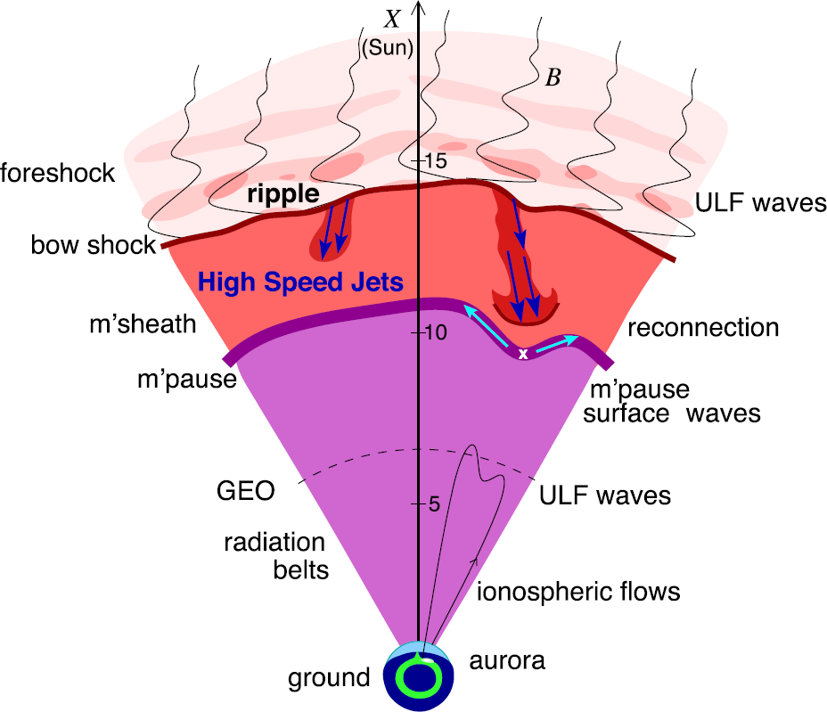
Magnetosheath Jets
Definition
Magnetosheath jets are transient localized enhancements of dynamic pressure (density and/or velocity increase)
Related phenomena
Radiation belts
Throat aurora
Magnetopause reconnection
Magnetopause penetration
Shock acceleration
Magnetopause surface eigenmodes
ULF waves
Plaschke F. et al. (2018); sketch by H. Hietala | Space Sci. Rev

Slide 3
Jets
Classes & Properties | Formation & Evolution

Slide 4
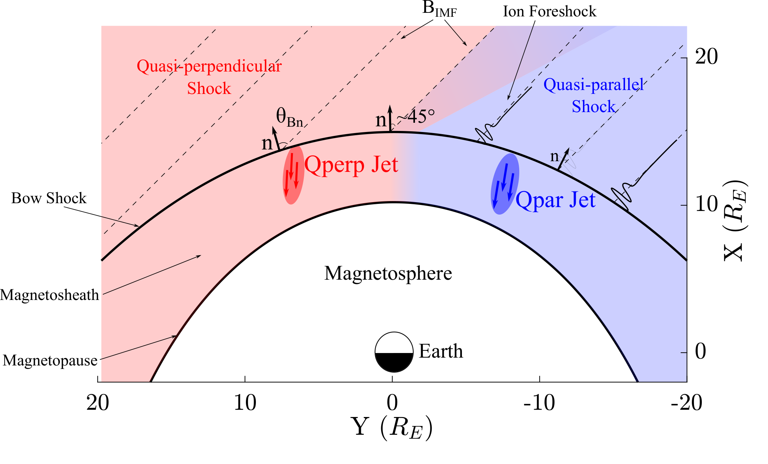
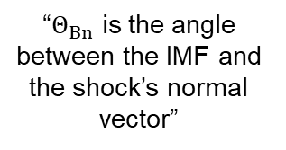
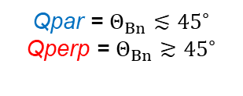
Shock, Magnetosheath & Jet classification
“$Θ_{Βn}$ is the angle between the IMF and the shock’s normal vector”
Qpar = $Θ_{Βn}≲{45}^{∘}$
Qperp = $Θ_{Βn}≳{45}^{∘}$
”Jets found ~9 times more often in the Qpar MSH”
Vuorinen et al. (2019)
Raptis, Karlsson, et al. (2020) | JGR
Raptis, Aminalragia-Giamini et al. (2020) | Front. Astron. Space Sci
Karlsson, Raptis et al. (2021) | JGR
Kajdič, Raptis et al. (2021) | GRL

Slide 5
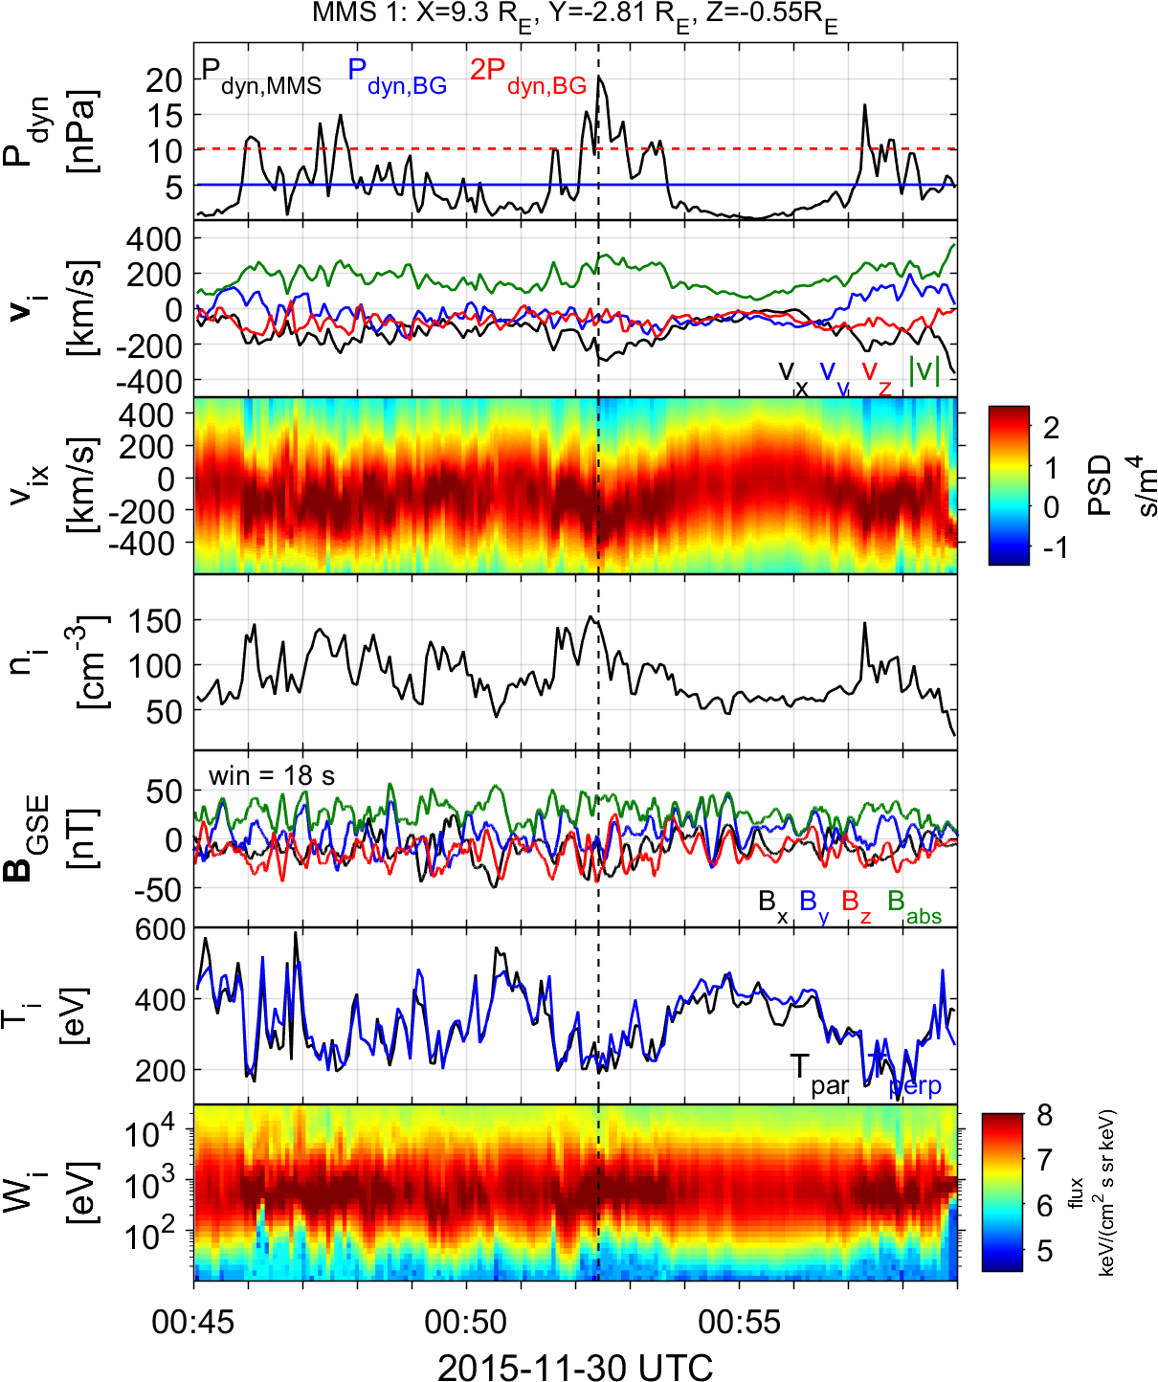
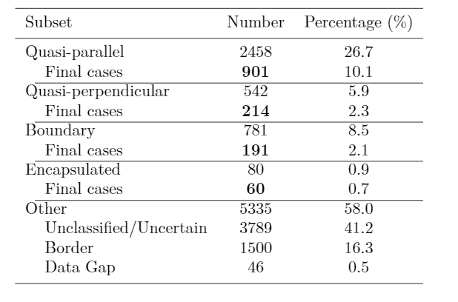

Summarized properties – Quasi Parallel
Most common
High dynamic pressure
Primarily Earthward
Associated with low temperature (ΔΤ)
Associated with high |B| & ΔΒ
High |B| variance
Relevant to magnetospheric effects
Qpar Jet
Jets found in $Q_{∥}$ MSH
Raptis S., Karlsson T., et al. (2020) | JGR

Slide 6
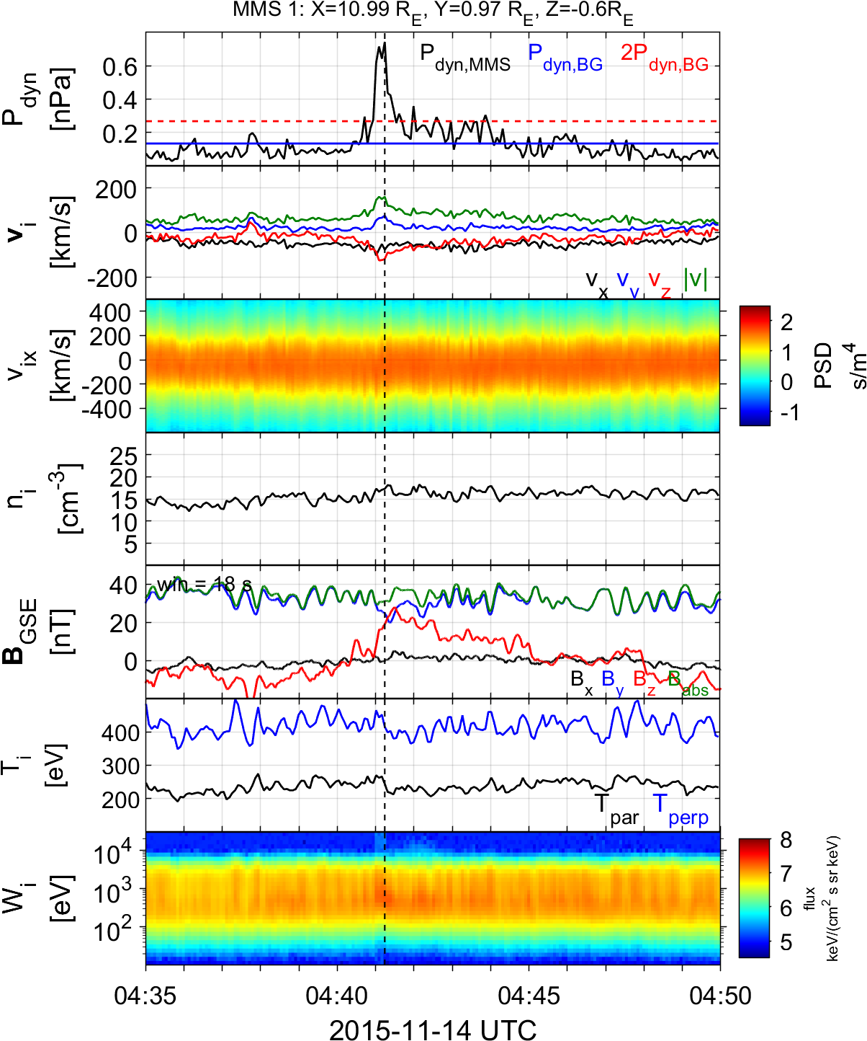

Summarized properties – Quasi Perpendicular
Less common
Less Energetic
Mainly velocity driven
Very small duration (~4 sec)
Could be connected to MSH reconnection or FTEs
Connection mirror mode waves
Qperp Jet
Jets found in $Q_{⊥}$MSH
Raptis S., Karlsson T., et al. (2020) | JGR

Slide 7
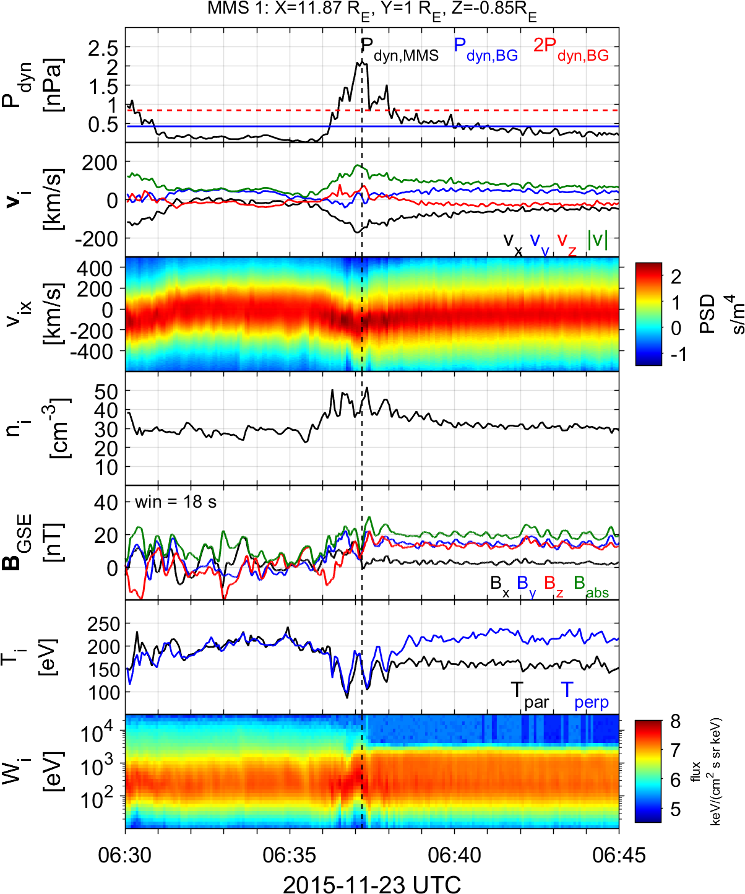
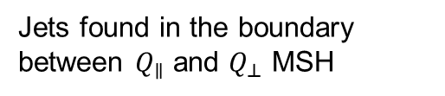
Summarized properties – Boundary
Hard to estimate their occurrence rate
Quite energetic and long duration
Similar properties to Qpar jets
Could be geoeffective (GMAGs) [Norenius et al. 2021]
Maybe associated to pressure pulses of SW [Archer et al. 2012]
Boundary Jet
Jets found in the boundary between $Q_{∥}$ and $Q_{⊥}$ MSH
Raptis S., Karlsson T., et al. (2020) | JGR

Slide 8
MMS – Jet Database
Fast/Survey (low res)
Burst (high res)
9/2015 - 9/2020
Jets with full burst data
Qpar | 423
Qperp | 34
Boundary | 35
Encapsulated | 31
Close to BS / MP | 495
Others | 428
Raptis S., Karlsson T., et al. (2020) | JGR
Raptis S., Aminalragia-Giamini S., et al. (2020) | Frontiers
Palmroth M., Raptis S., et al. (2021) | Annales
Kajdic P., Raptis S., et al. (2021) | GRL
Raptis S., Karlsson T., et al. (2022) | Nat. Commun
Raptis S., Karlsson T,, et al. (2022) | Ongoing

Slide 9
Jets
Classes & Properties | Formation & Evolution

Slide 10
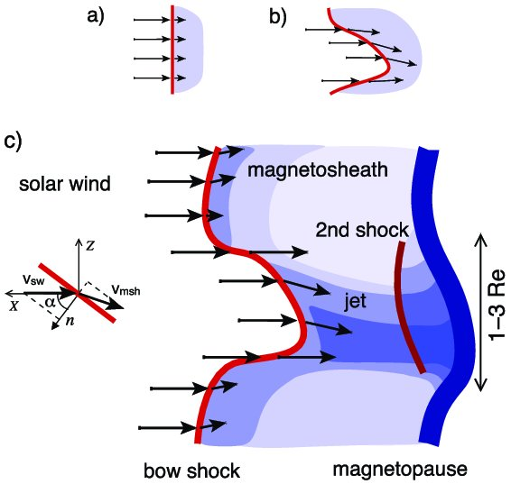
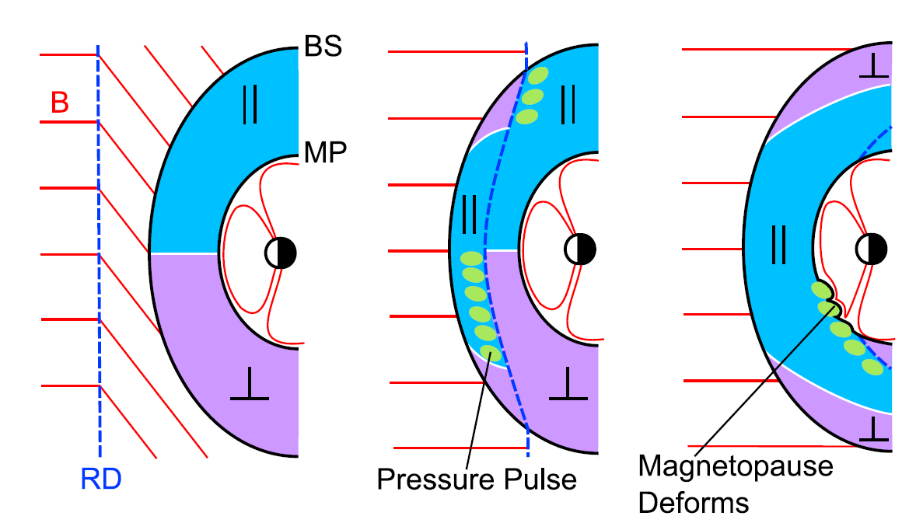
How are these jets created (Qpar/Boundary) ?
Shock ripples
SW discontinuities
Foreshock Structures & Reformation
SW → locally inclined part of the bow shock → less deceleration and heating
RD → Change in Foreshock position → Pressure pulses
Hietala et al. (2009,2012)
Archer et al. (2012)
Karlsson et al.(2015), Suni et al. (2021), Raptis et al. (2022)

Slide 11
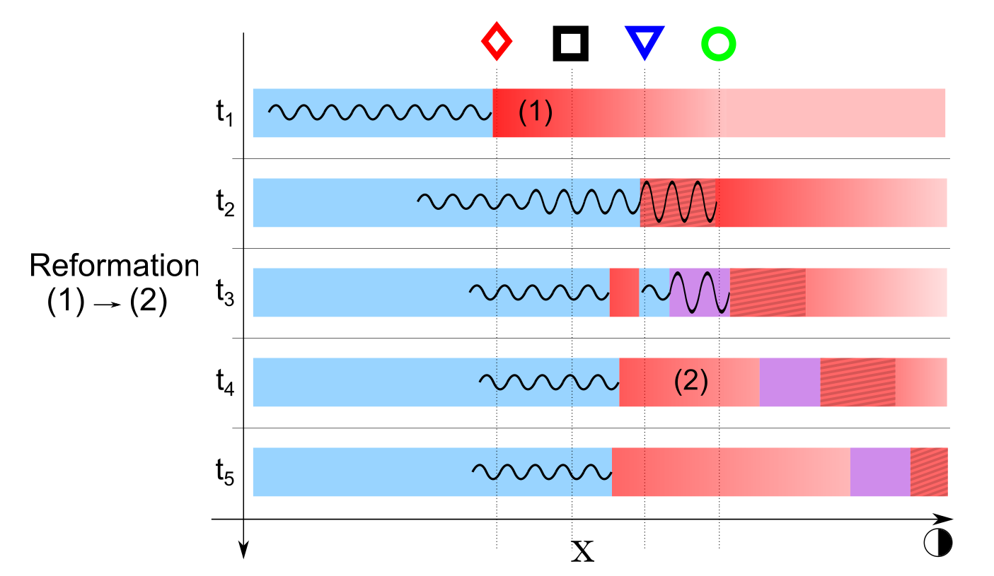
Shock Reformation & Magnetosheath Jets
Raptis, S., Karlsson, T., Vaivads, A. et al. Downstream high-speed plasma jet generation as a direct consequence of shock reformation. Nature Communications 13, 598 (2022). https://doi.org/10.1038/s41467-022-28110-4

Slide 12
Recent Results
MMS | Schematic
Raptis, Karlsson, et al,. 2022 | (Ongoing)

Slide 13
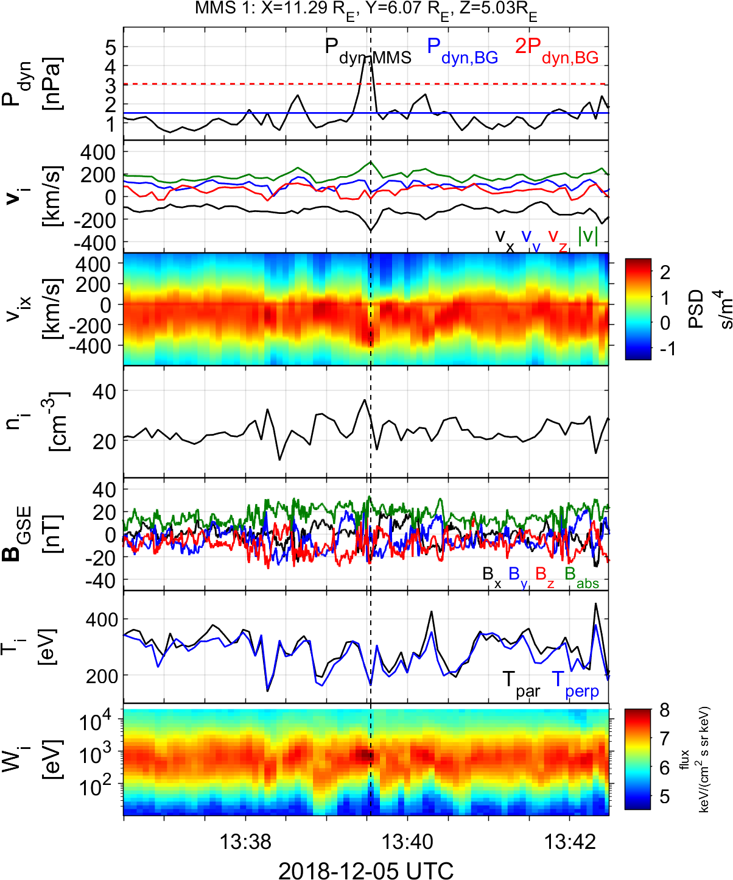
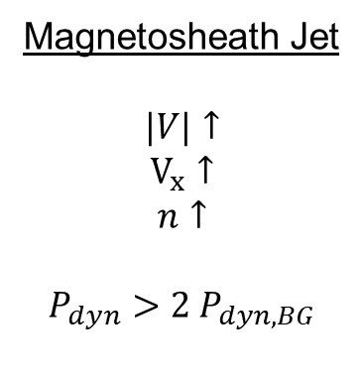
Qpar Magnetosheath jet – Fast data
Qpar Magnetosheath:
High energy ions
Low temperature anisotropy
High B Variance
Magnetosheath Jet
$$|V|↑$$
$$V_{x}↑$$
$$n↑$$
$$P_{dyn}>2 P_{dyn,BG}$$
Raptis, Karlsson, et al,. 2022 | (Ongoing)

Slide 14
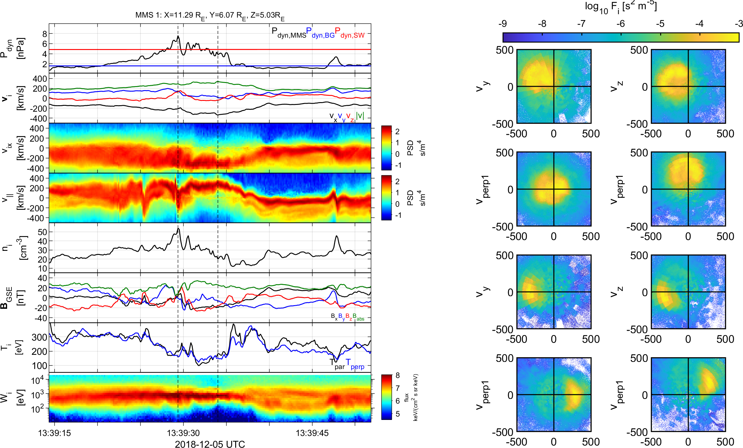




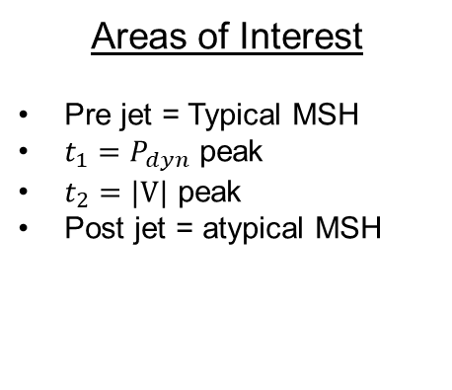
Qpar Magnetosheath jet – Burst data
$$t_{1}$$
$$t_{2}$$
Areas of Interest
Pre jet = Typical MSH
$t_{1}=P_{dyn}$ peak
$t_{2}=|V|$ peak
Post jet = atypical MSH
$$t_{1}$$
$$t_{2}$$
Raptis, Karlsson, et al,. 2022 | (Ongoing)

Slide 15
Recent Results
MMS | Schematic
Raptis, Karlsson, et al,. 2022 | (Ongoing)

Slide 16
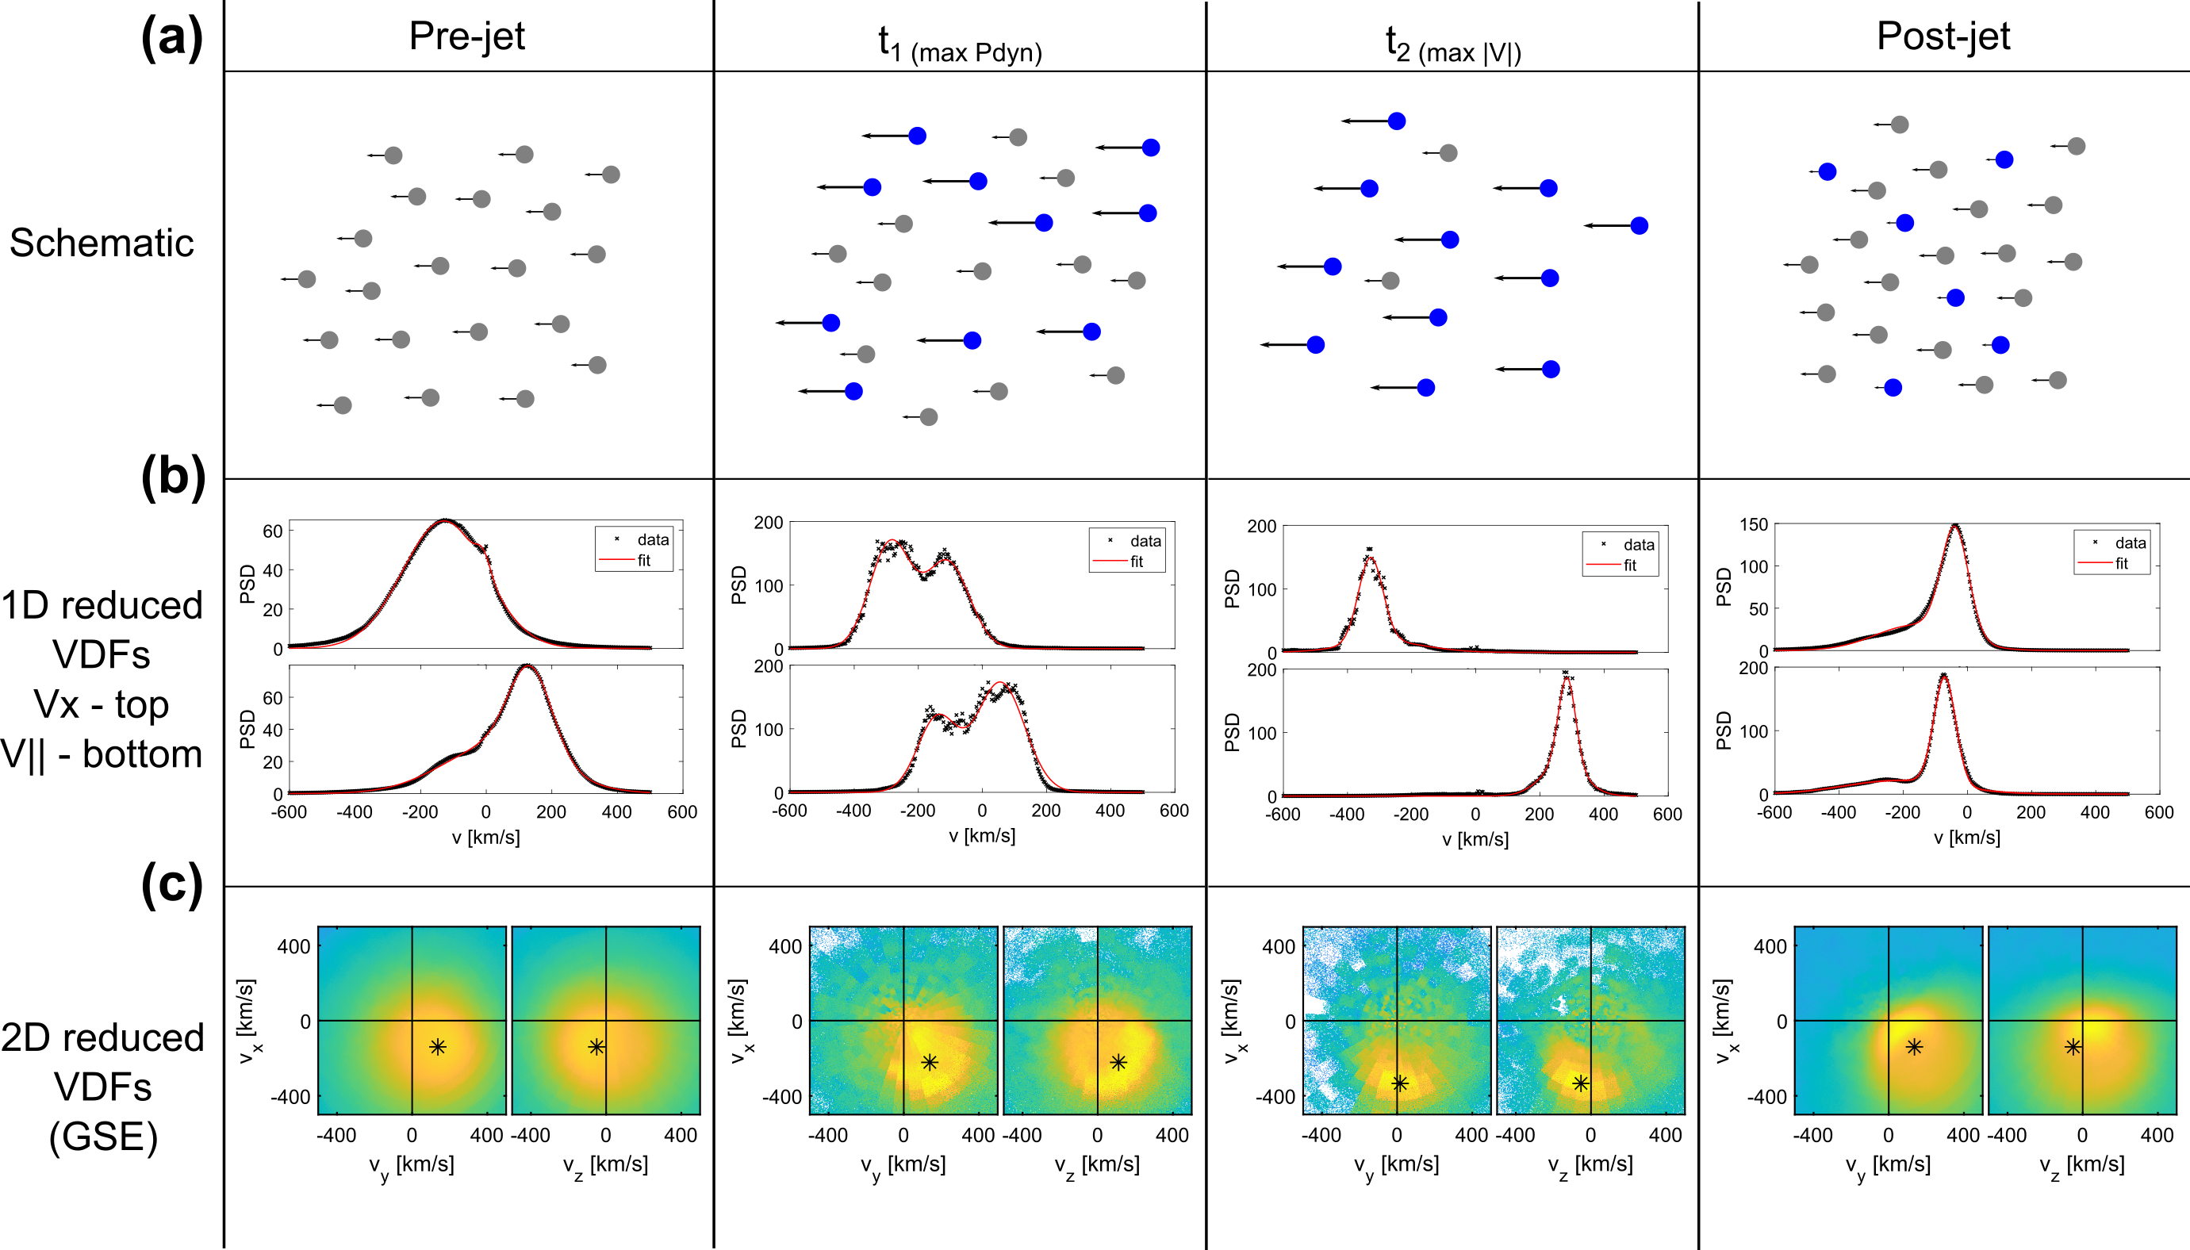
Jet evolution in Qpar Magnetosheath
Raptis, Karlsson, et al,. 2022 | (Ongoing)

Slide 17

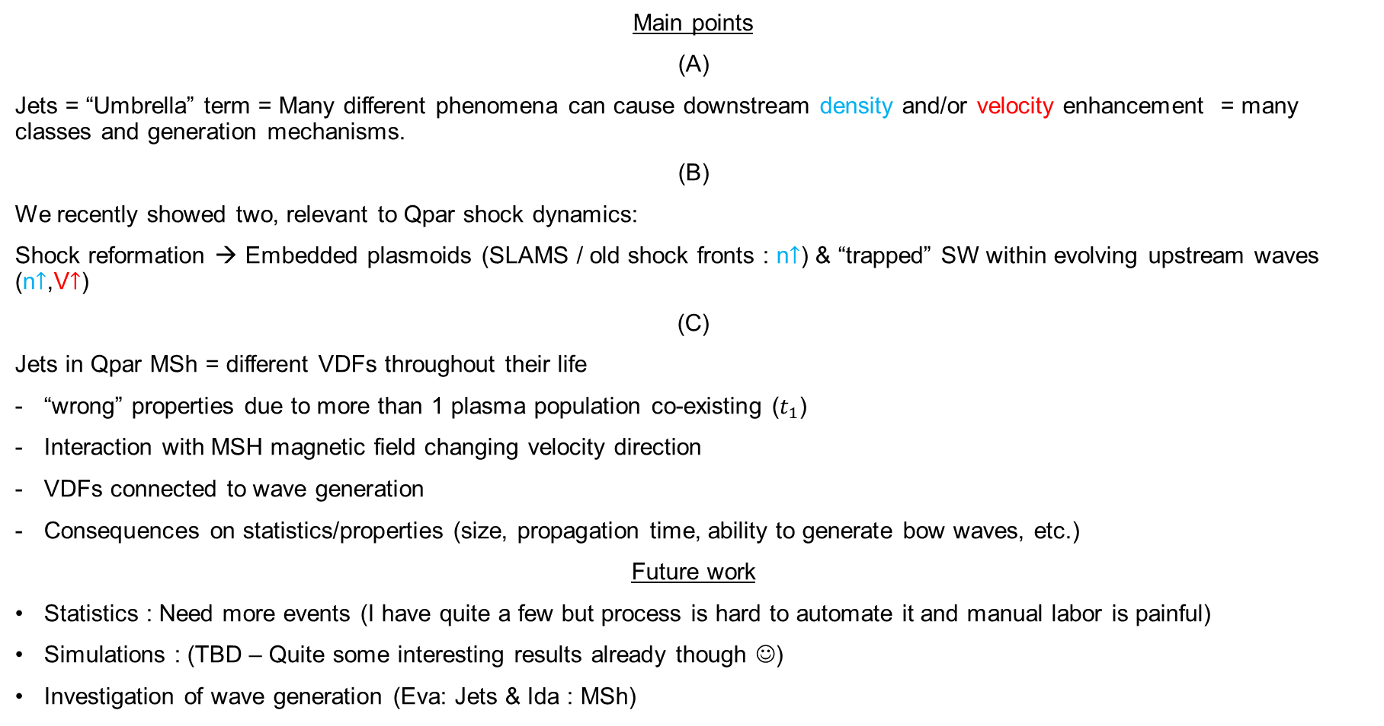
Summary & Conclusion
Main points
(A)
Jets = “Umbrella” term = Many different phenomena can cause downstream density and/or velocity enhancement = many classes and generation mechanisms.
(B)
We recently showed two, relevant to Qpar shock dynamics:
Shock reformation → Embedded plasmoids (SLAMS / old shock fronts : n$↑$) & “trapped” SW within evolving upstream waves (n$↑$,V$↑$)
(C)
Jets in Qpar MSh = different VDFs throughout their life
“wrong” properties due to more than 1 plasma population co-existing ($t_{1}$)
Interaction with MSH magnetic field changing velocity direction
VDFs connected to wave generation
Consequences on statistics/properties (size, propagation time, ability to generate bow waves, etc.)
Future work
Statistics : Need more events (I have quite a few but process is hard to automate it and manual labor is painful)
Simulations : (TBD – Quite some interesting results already though ☺)
Investigation of wave generation (Eva: Jets & Ida : MSh)

Slide 18
Extras

Slide 19
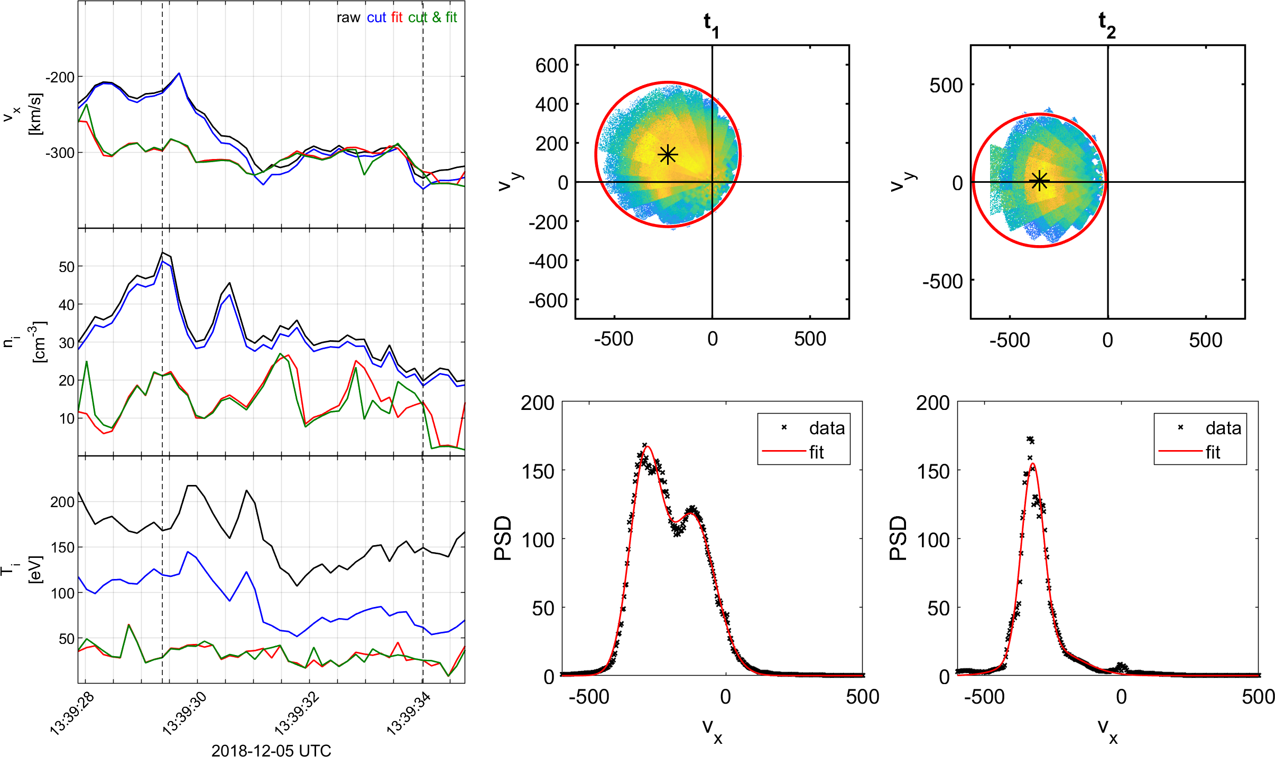
Partial moments
Raptis, Karlsson, et al,. 2022 | (Ongoing)

Slide 20
Jets – references update (>2019)
Associated phenomena & effects
Excitation of surface eigenmodes at magnetopause: Archer et al. (2019, 2021)
Mirror mode waves and jets : Bianco-Cano et al. (2020)
Bursty magnetic reconnection at the Earth's magnetopause : Ng et al. (2021)
Ground-based magnetometer response : Norenius et al. (2021)
Generation of Pi2 pulsations : Katsavrias et al. (2021)
B in jets, Bz variations near magnetopause : Vuorinen et al. (2021)
Modeling & formation
Velocity & magnetic field alignment in jets : Plaschke et al. (2020)
Classification of jets using MMS & Neural Networks : Raptis et al. (2020a,2020b)
Comparison MMS vs simulations : Palmroth et al. (2021)
Solar wind effect on jet formation : LaMoury et al. (2021)
Magnetosheath Jets and Plasmoids - Hybrid Simulations : Preisser et al. (2020)
Formation of jets in Quasi-perpendicular magnetosheath : Primoz et al. (2021)
Jets Downstream of Collisionless Shocks
Plaschke et al. (2018)
https://link.springer.com/article/10.1007/s11214-018-0516-3
And more : Liu et al. (2020a,2020b), Omelchenko et al (2021), Sibeck et al. (2021), Suni et al. (2021), Tinoco-Arenas et al. (2022) … etc. etc.

Slide 21

Fast/Survey MMS data
Burst MMS data
Resolution (samples/s)
Resolution (samples/s)
FGM (magnetic field):
FPI (plasma moments | ions):
EDP (electric field):
0.0625
4.5
0.0313
0.0078
0.15
0.00012218
Pros
Always available
Decent resolution
Can be good for statistics due to availability
Pros
Very high resolution
Able to resolve structures close to boundary surfaces (e.g. mix of plasma close to magnetopause, bow shock, foreshock etc.)
Cons
Not available all the time, mostly available close to vital mission objectives (magnetopause, diffusion regions, shock transitions etc.)
Hard to do proper large scale statistics due to biases generated from specific availability and manual choice of intervals
Cons
Not suitable for small scale studies
Could be misleading close to boundary surfaces (Magnetopause, Bow shock etc.)
More information: Baker, et al. (2016) | Space Sci Rev 19

Slide 22
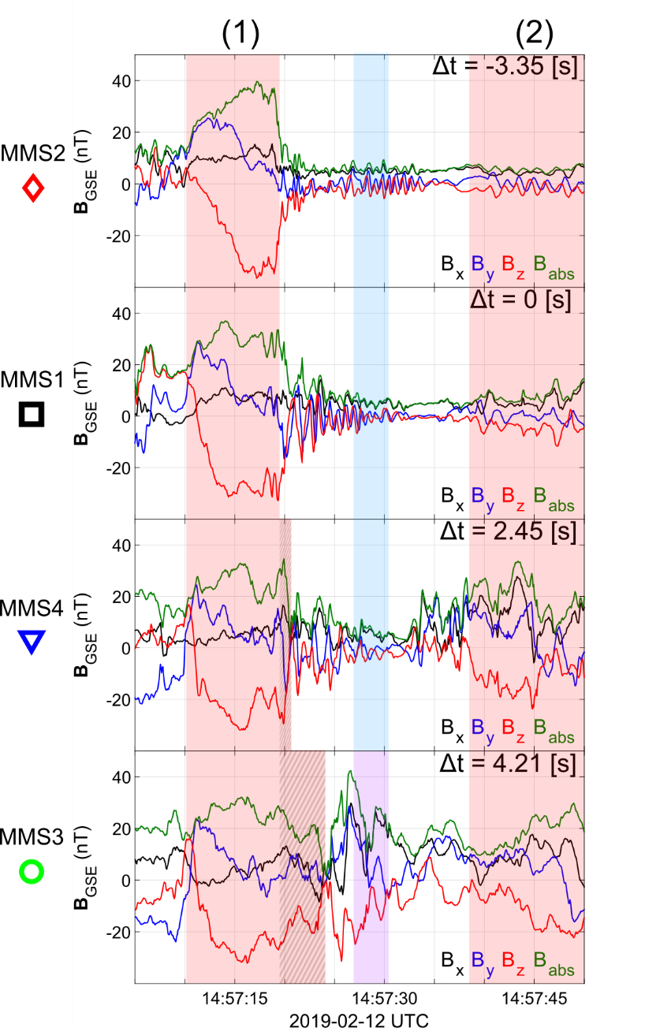
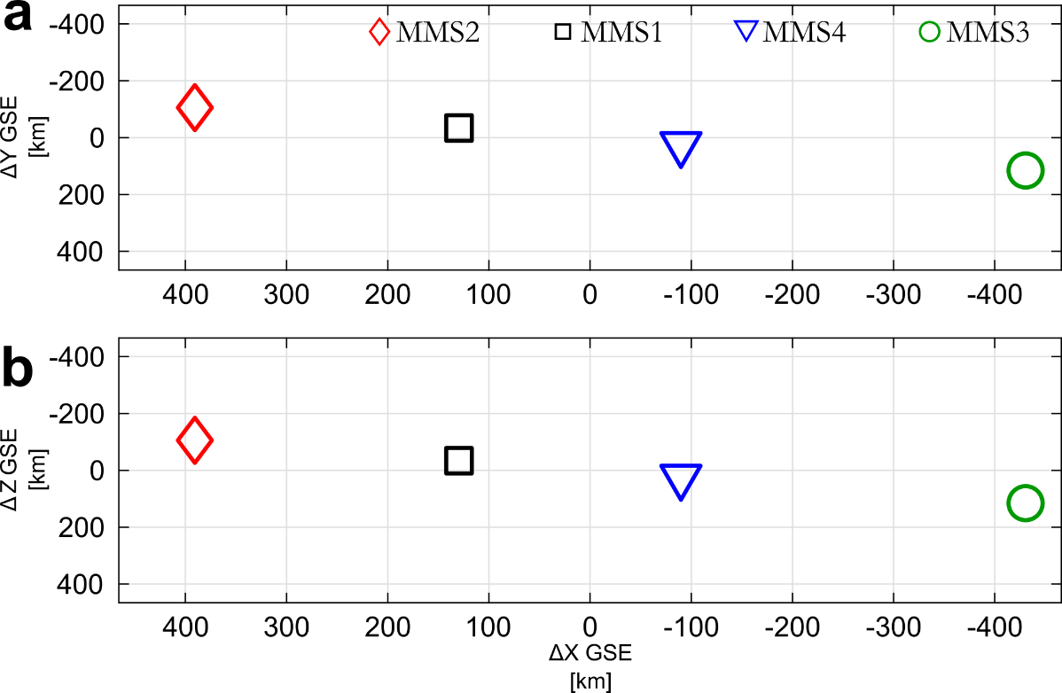
SLAMS & wave activity co-moving picture
Evolution of SLAMS
Interaction with upstream whistler
New peak /evolution*
Formation of embedded plasmoid (downstream density enhancement)**
* See similar examples by Turner et al. (2021), Chen et al. (2021)
** See similar example by Liu et al. (2021)

Slide 23

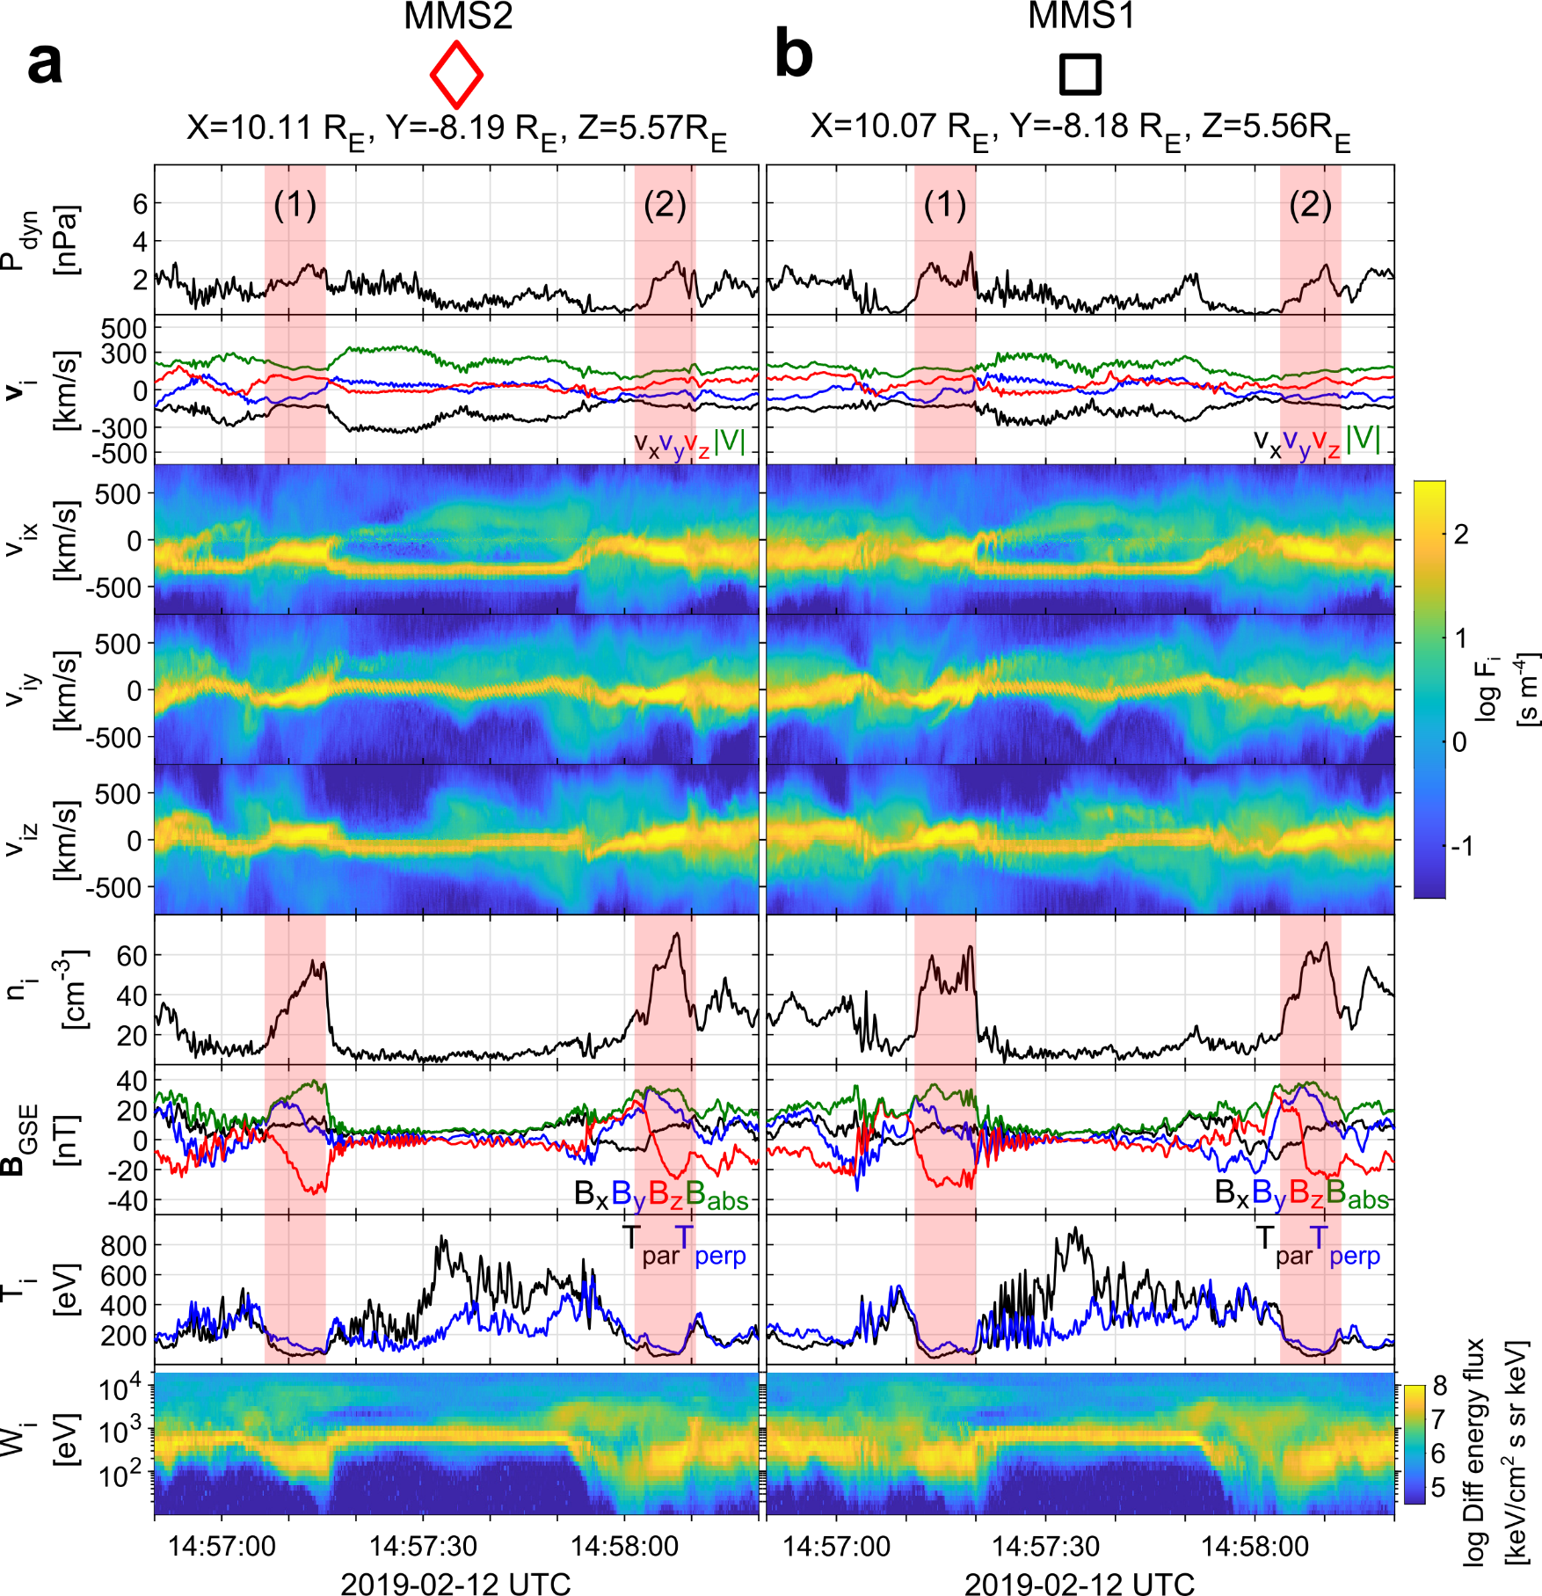
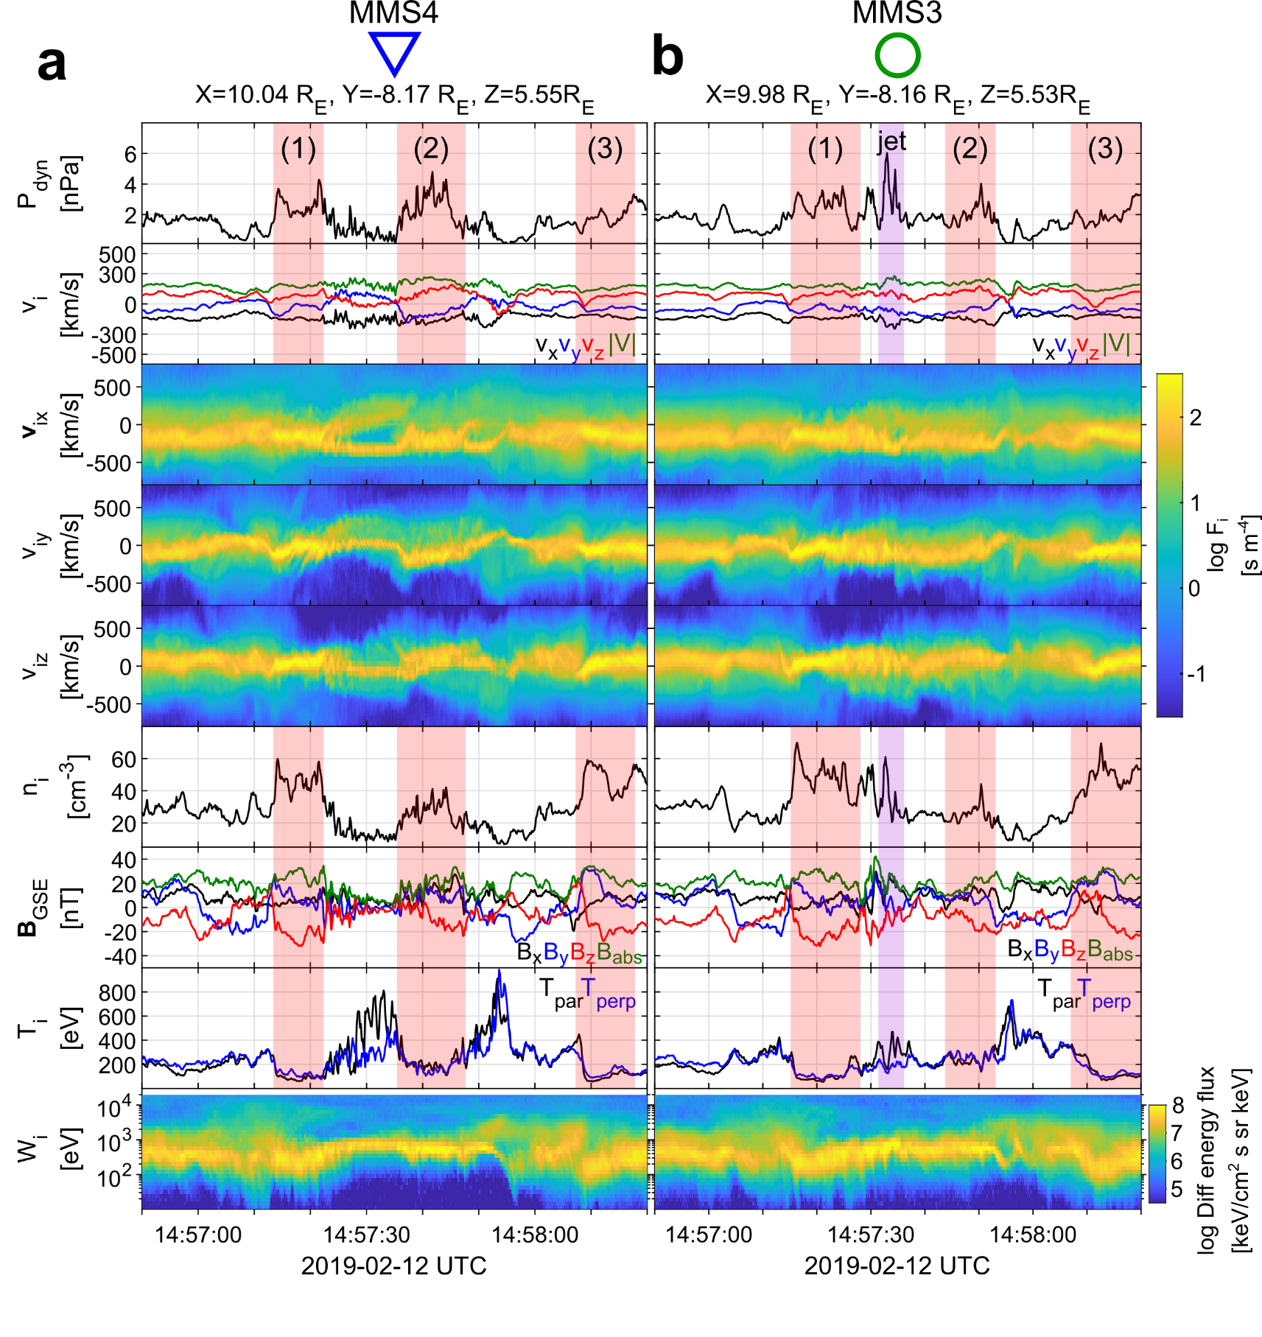
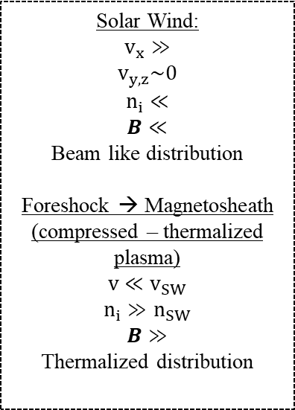
General Observations of MMS
u
d
Solar Wind:
$$v_{x}≫$$
$$v_{y,z}\sim 0$$
$$n_{i}≪$$
$$B≪$$
Beam like distribution
Foreshock → Magnetosheath
(compressed – thermalized plasma)
$$v≪v_{SW}$$
$$n_{i}≫n_{SW}$$
$$B≫$$
Thermalized distribution

Slide 24
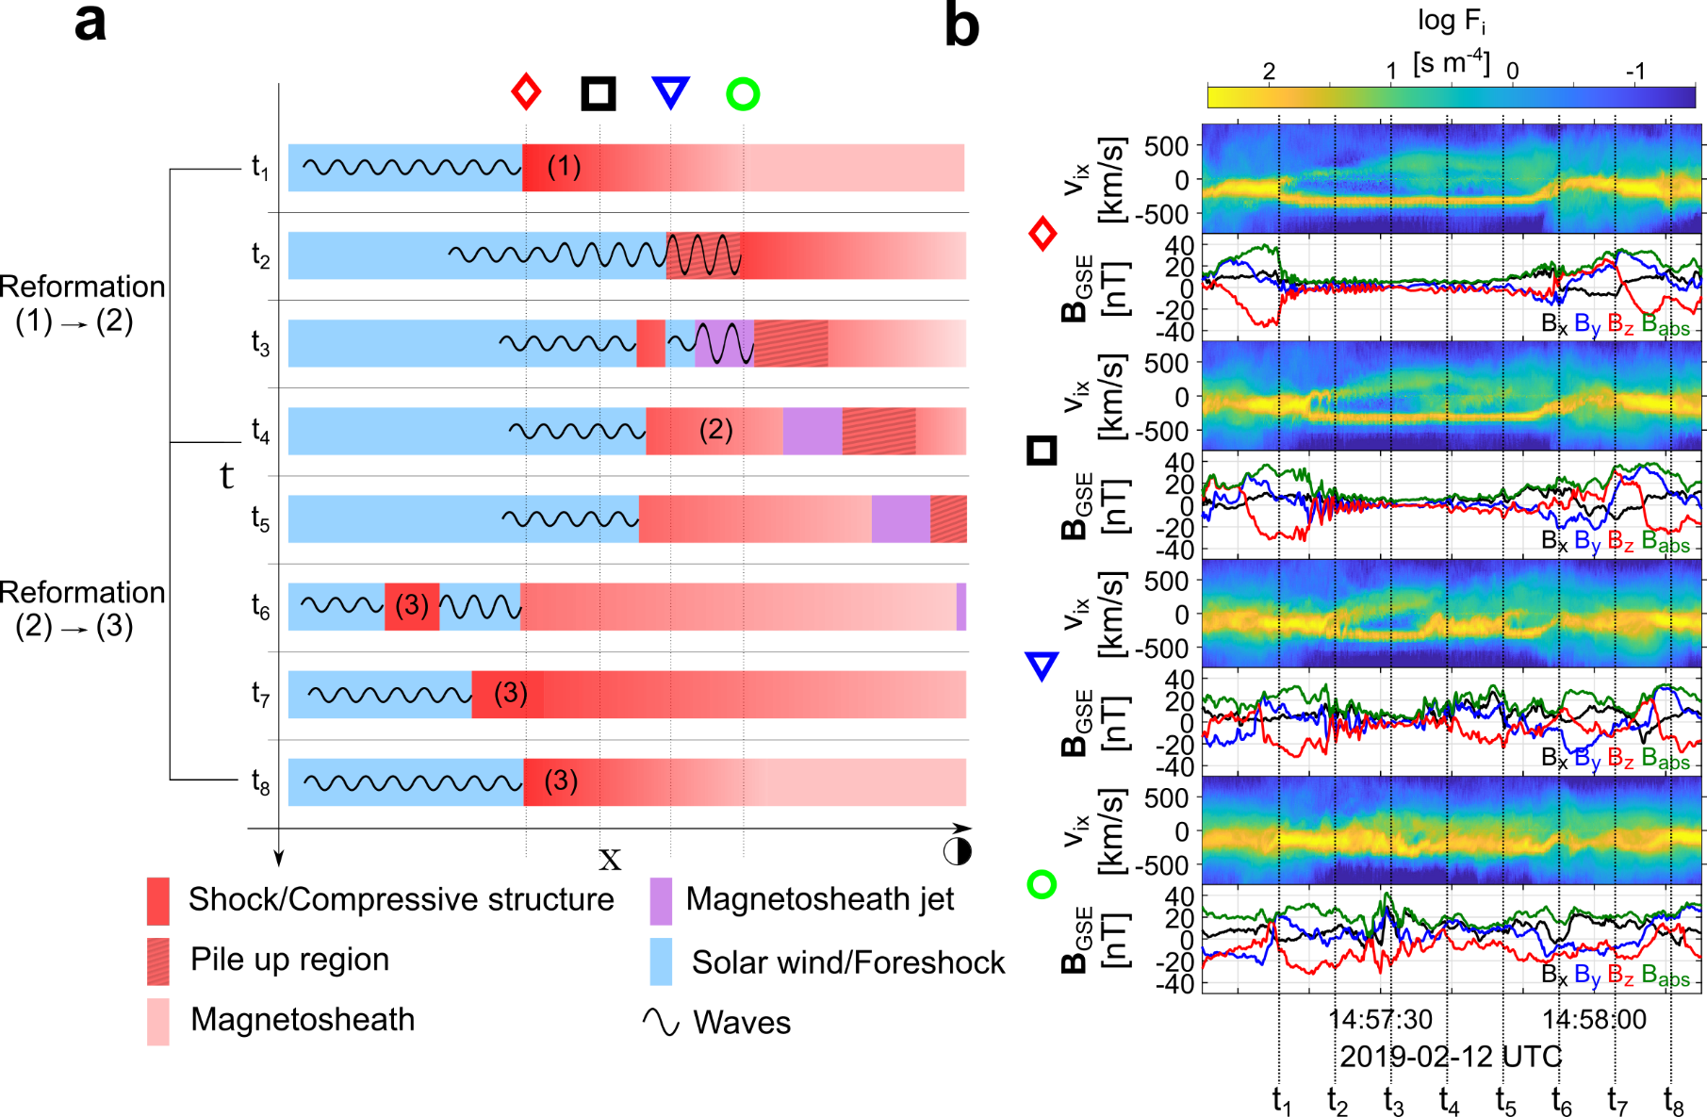
Formation mechanism

Slide 25
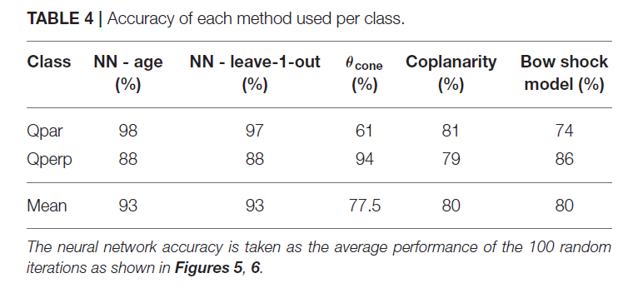
Why in-situ classification with MMS?
Not simultaneously upstream & downstream measurements = Huge errors when using our only SW monitor
Raptis, Aminalragia-Giamini et al. (2020) | Front. Astron. Space Sci

Slide 26
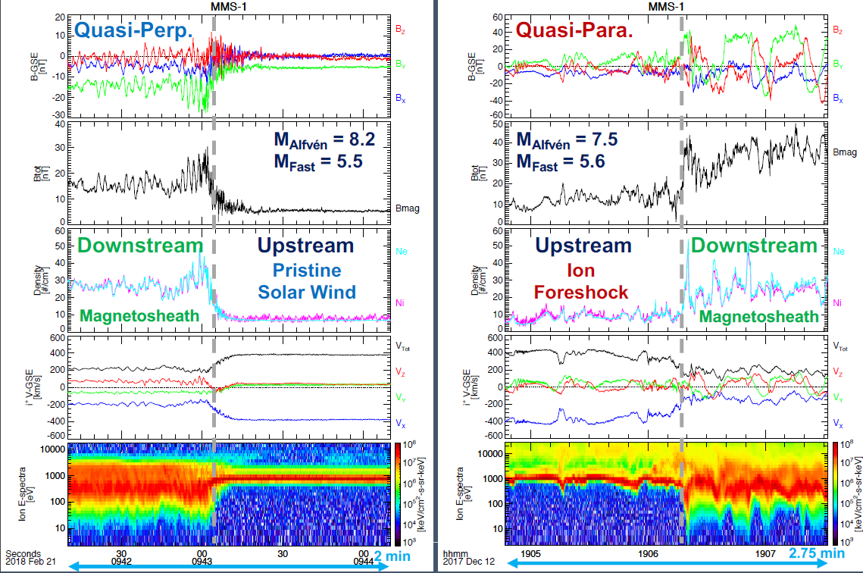
Shock transitions with MMS
Notice difference in the downstream plasma ?
Figure taken from : Drew Turner’s talk | SWSG2021

Slide 27
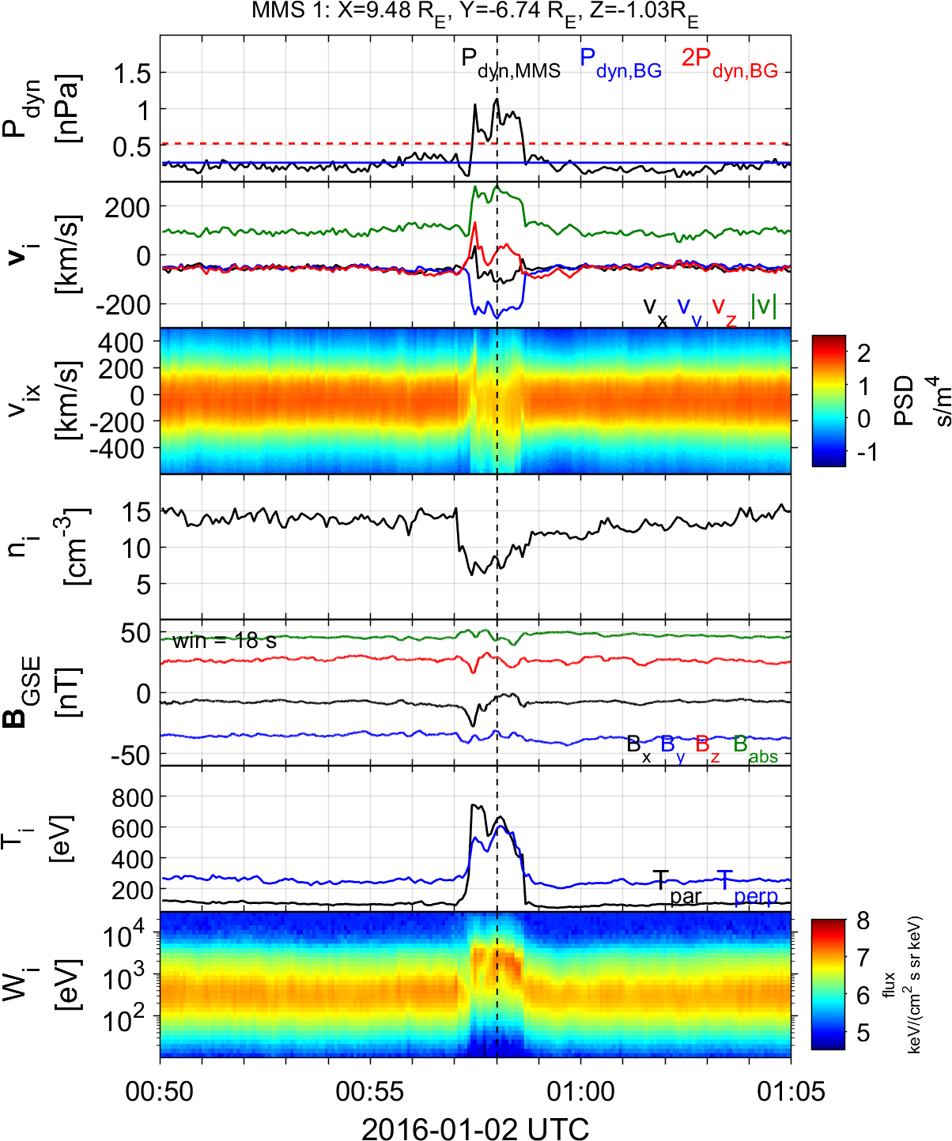
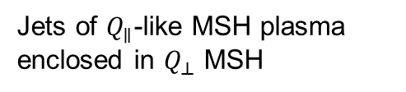
Summarized properties – Encapsulated
Possibly of magnetospheric origin (Vortices, KH)
Maybe connected to flank Qpar shock (High By,Bz IMF)
Foreshock transient & reconnection association [Kajdič et al 2021]
Mainly velocity driven
Typically density reduction
Encapsulated Jet
Jets of $Q_{∥}$-like MSH plasma enclosed in $Q_{⊥}$ MSH
Raptis S., Karlsson T., et al. (2020) | JGR

