Slide 1


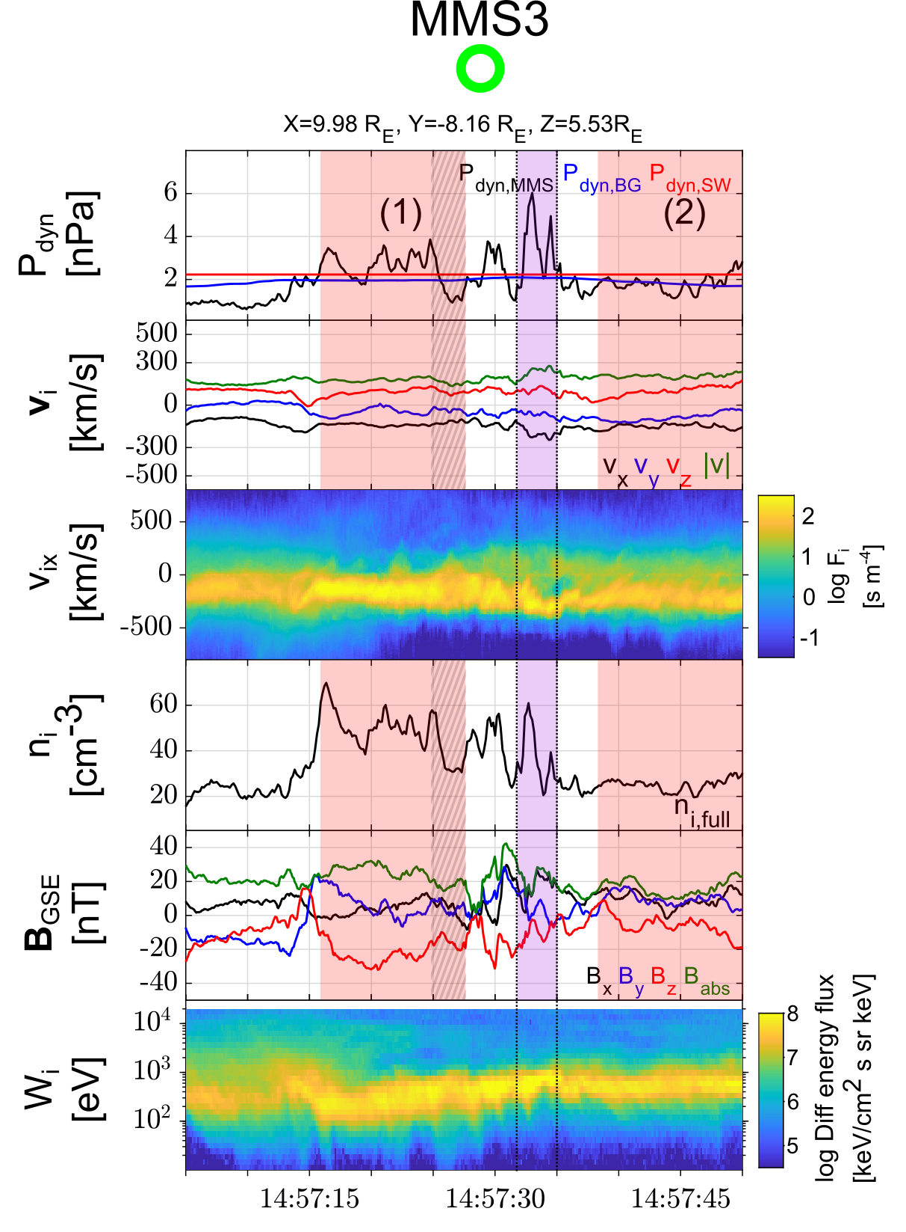
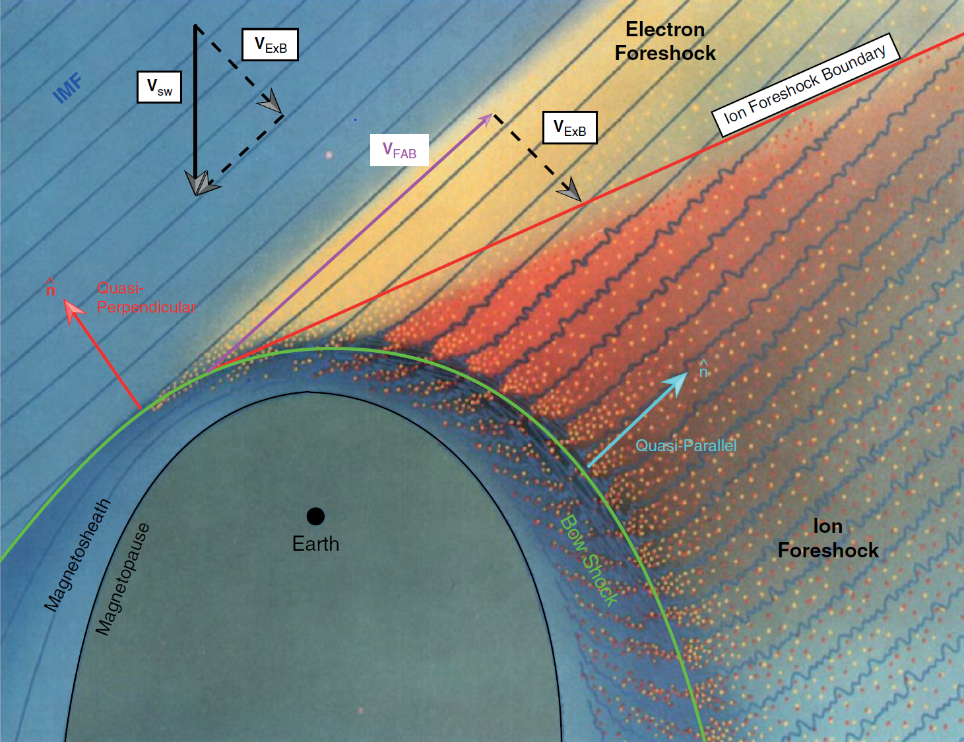
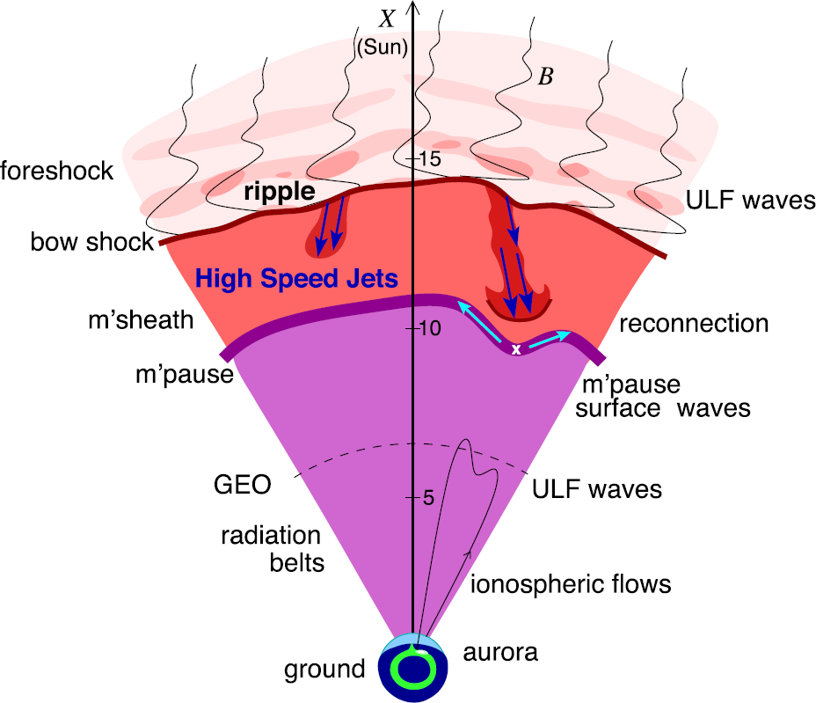
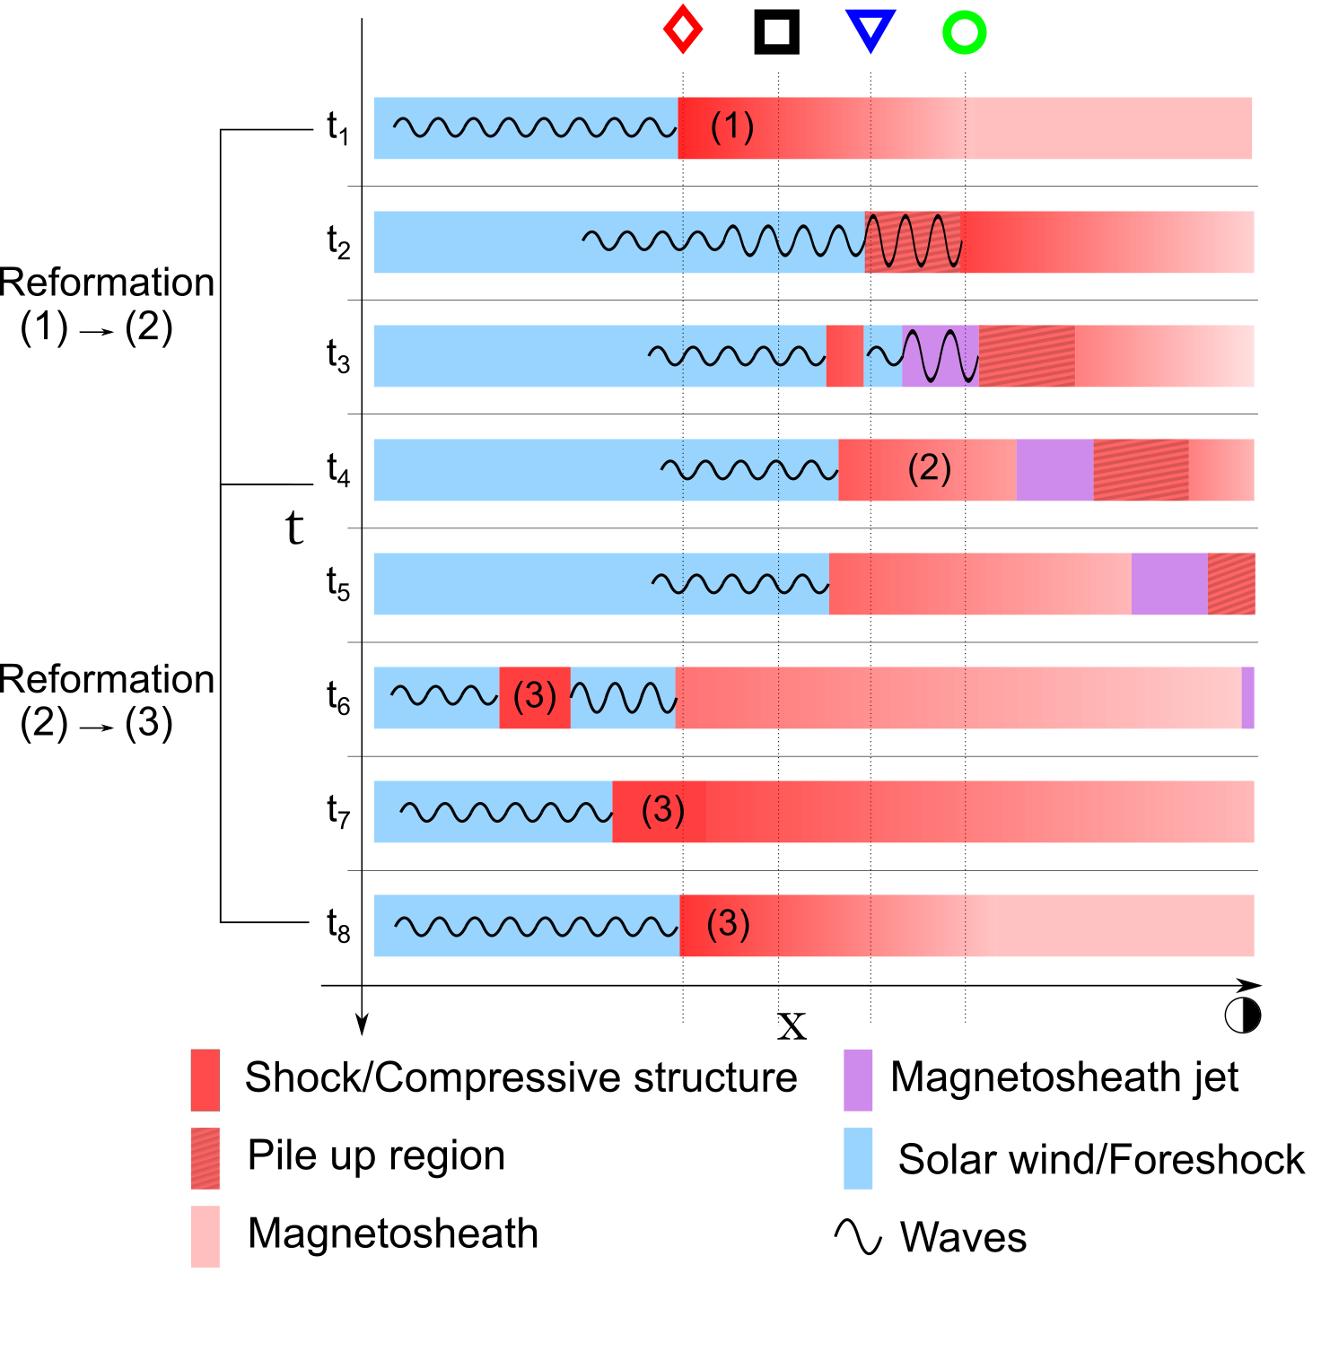
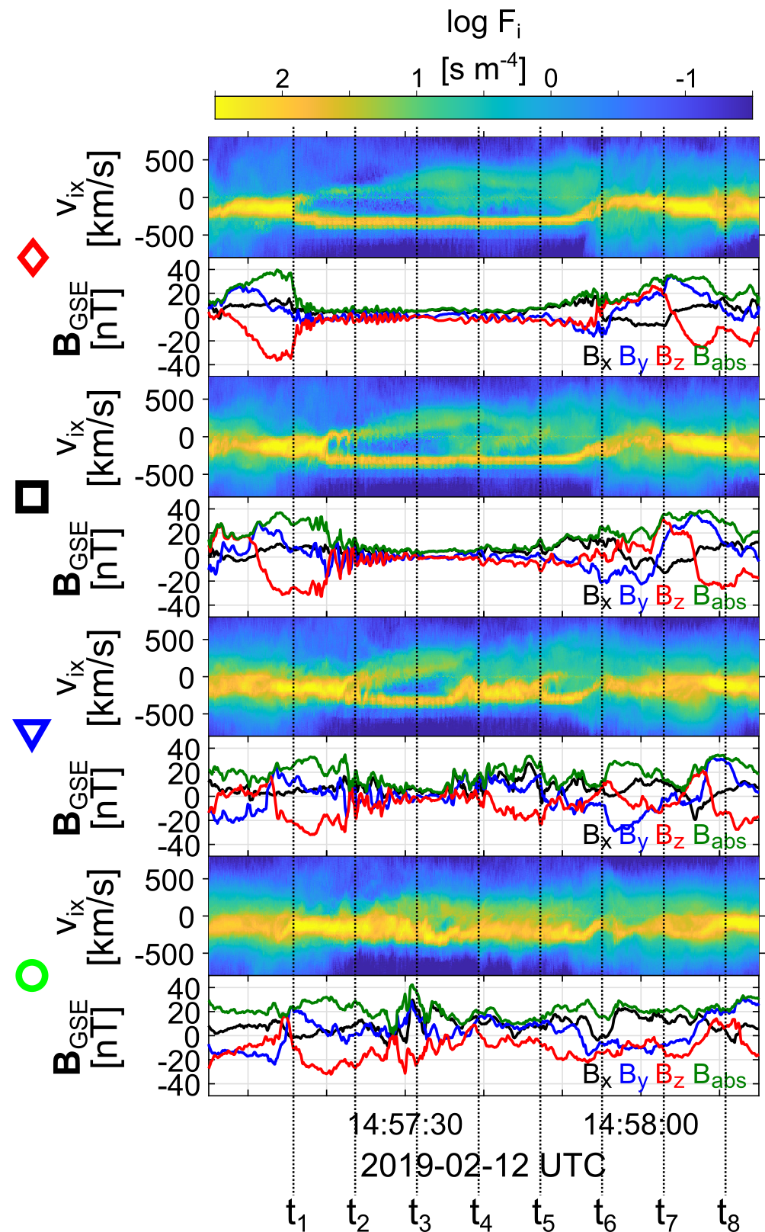
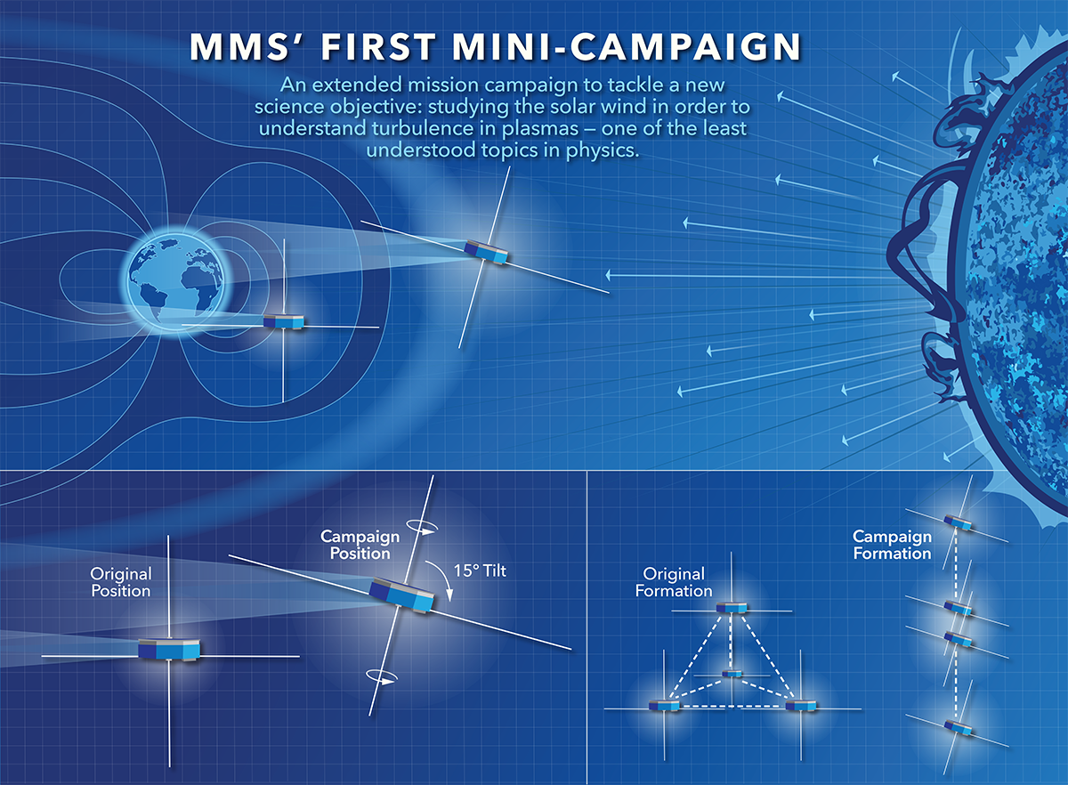


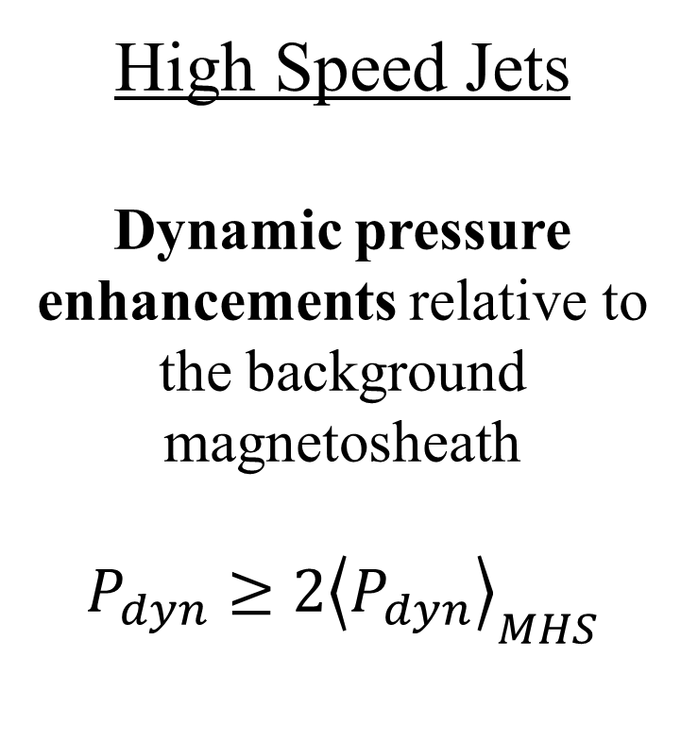

Results
High-speed plasma jets generated by the cyclic behavior of the Earth's bow shock
Introduction
Jet Properties:
Bow shock
Solar wind is braked, thermalized & compressed, forming the magnetosheath, downstream of the shock
Shocks are one of nature’s most powerful accelerations
Savvas Raptis¹, Tomas Karlsson¹, Andris Vaivads¹, Craig Pollock², Ferdinand Plaschke³, Andreas Johlander⁴, Henriette Trollvik¹, Per-Arne Lindqvist¹
¹Space and Plasma Physics, KTH Royal Institute of Technology, Stockholm, Sweden, ²Denali Scientific, Fairbanks, AK, 99709, USA, ³Institute of Geophysics and Extraterrestrial Physics, Technische Universitat Braunschweig, Germany, ⁴Swedish institute of Space Physics, Uppsala, Sweden
“Plasma jets forming by the evolution of upstream waves & bow shock’s reformation”
L. B. Wilson (2016) | Geophysical Monograph Series
High Speed Jets
Dynamic pressure enhancements relative to the background magnetosheath
$$P_{dyn}≥2{\left\langle P_{dyn}\right\rangle }_{MHS}$$
Supermagnetosonic: $M_{MS}≈1.1 − 1.4$
Anti-sunward: $V_{x}≈350 km/s$
$\frac{P_{dyn,jet}}{P_{dyn, MSH}}≈\frac{P_{dyn,jet}}{P_{dyn, SW}}≈3$
Plaschke F. et al. (2018); sketch by H. Hietala | Space Sci. Rev
Methods
Compressive Structure - Shock
Upstream waves
NASA’s Magnetospheric Multiscale (MMS) Mission, consisting of 4 satellites (MMS 1 – 4)
Credits: NASA's Goddard Space Flight Center/Mary Pat Hrybyk-Keith
Turbulence campaign (large separation)
Spacecraft aligned in Sun-Earth line
Burst data (high resolution) available
Conclusion & Discussion
Embedded plasmoids (downstream density enhancements) originate from non-linearly evolved upstream waves (“shock remnants”)
High-speed jets are generated from the evolution of the upstream waves and the reformation process
Results could be fundamental and exist in other shock environments (laboratories, planets, and astrophysical objects)
Embedded
plasmoid
Jet
Read the full article here and the popular science version here
More info: 📧 savvra@kth.se | 🔗 savvasraptis.github.io

