Slide 1

Characterizing Earth’s Magnetosheath and High-Speed Downstream Jets using Machine Learning
Savvas Raptis¹, Tomas Karlsson², Sigiava Aminalragia-Giamini³ + (many others)
¹APL ²KTH ³SPARC
SR acknowledges the support by John Hopkins University Applied Physics Laboratory independent R&D fund
savvas.raptis@jhuapl.edu

Slide 2
Introduction
(Neural Networks)

Slide 3
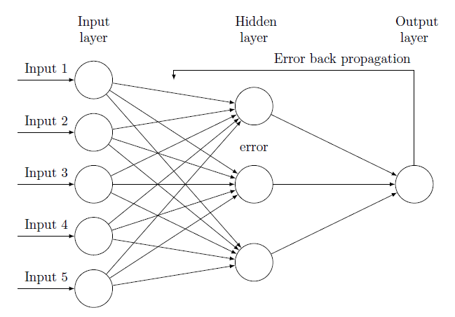
Neural Networks & Backpropagation
Supervised Learning
Labeled data
Known input/output
Unknown map/relationship
Output

Slide 4
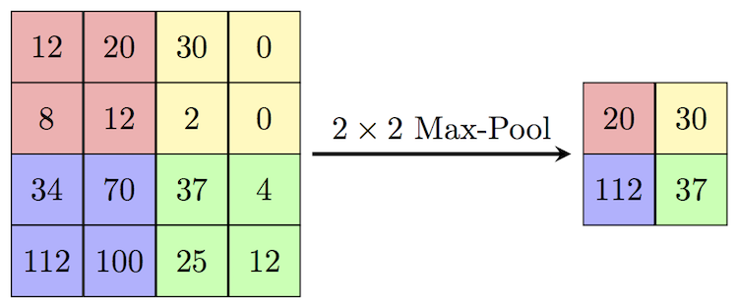
Convolutional Neural Network (CNN) Layers
Convolution
Extract features & keep spatial relationship
Pooling/Subsampling
Reduce dimensionality & retain information
*Figure Courtesy: Erik Reppel
*Figure Courtesy: Cambridge Spark Ltd

Slide 5
Introduction
(Earth’s Shock & Magnetosheath)

Slide 6
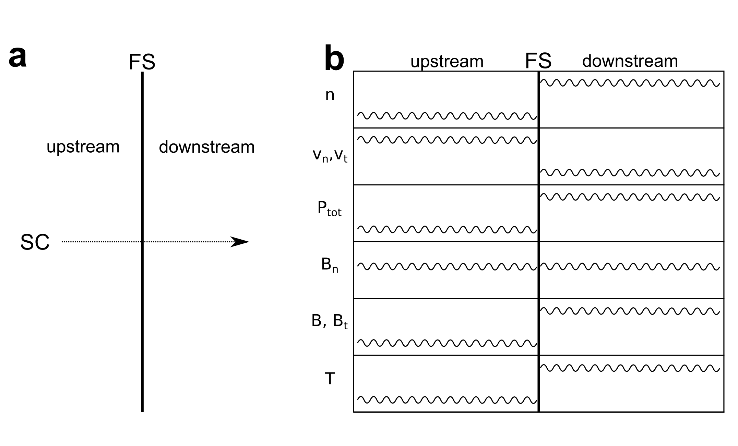
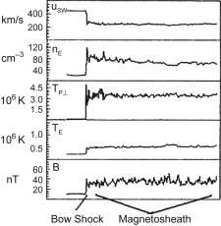
Shock transition (Theory & “initial” data)
Rankine Hugoniot relations / Jump Conditions
Thermalization, Compression, Breaking
1D Isotropic and adiabatic one fluid plasma shock transitions
1964. Initial results of IMP-1 magnetic field experiment.

Slide 7
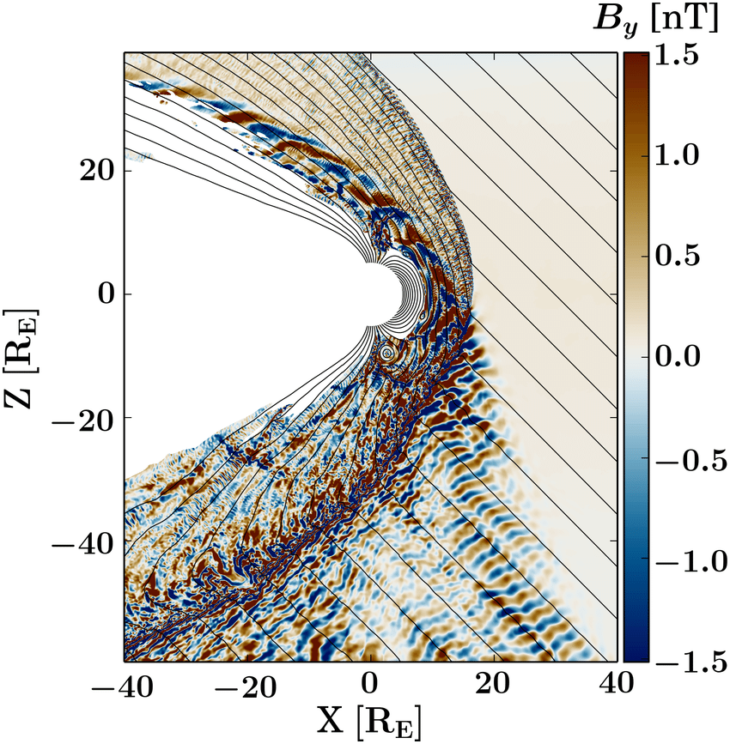
Bow shock transition (reality)
Reality though is more complicated (as expected…):
3D & kinetic effects
Foreshock
Turbulence
Reconnection
Non linear effects
Evolution of plasma waves
SLAMS, Shocklets, Magnetosheath Jets etc.
Solar wind condition variability
Transient phenomena (e.g. CMEs)
Credits: VLASIATOR team

Slide 8
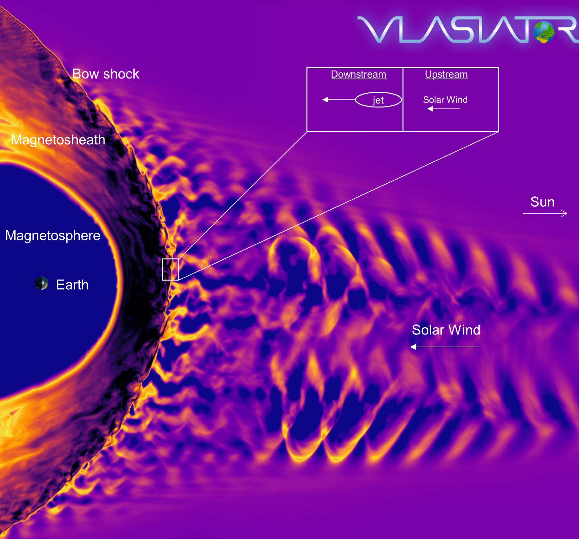
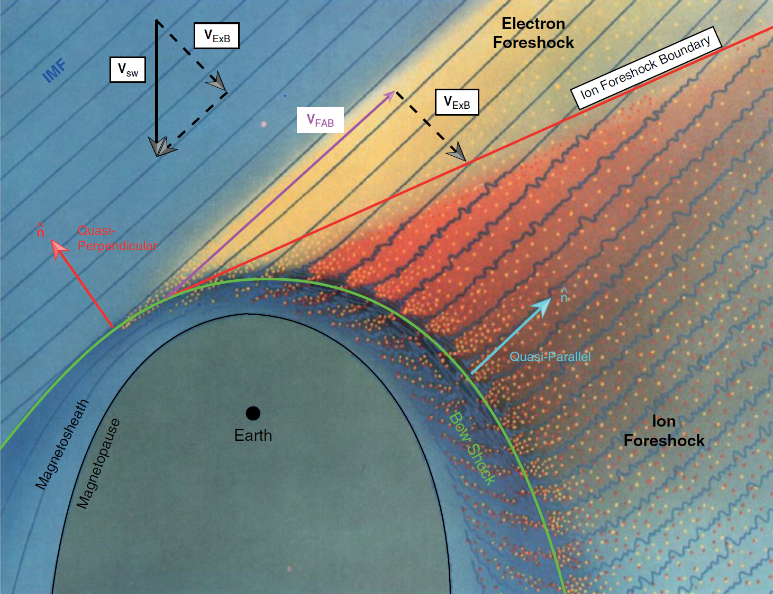
Earth’s shock and magnetosphere
Courtesy of M. Palmroth, U Helsinki / Edited by S. Raptis
L. B. Wilson (2016)

Slide 9
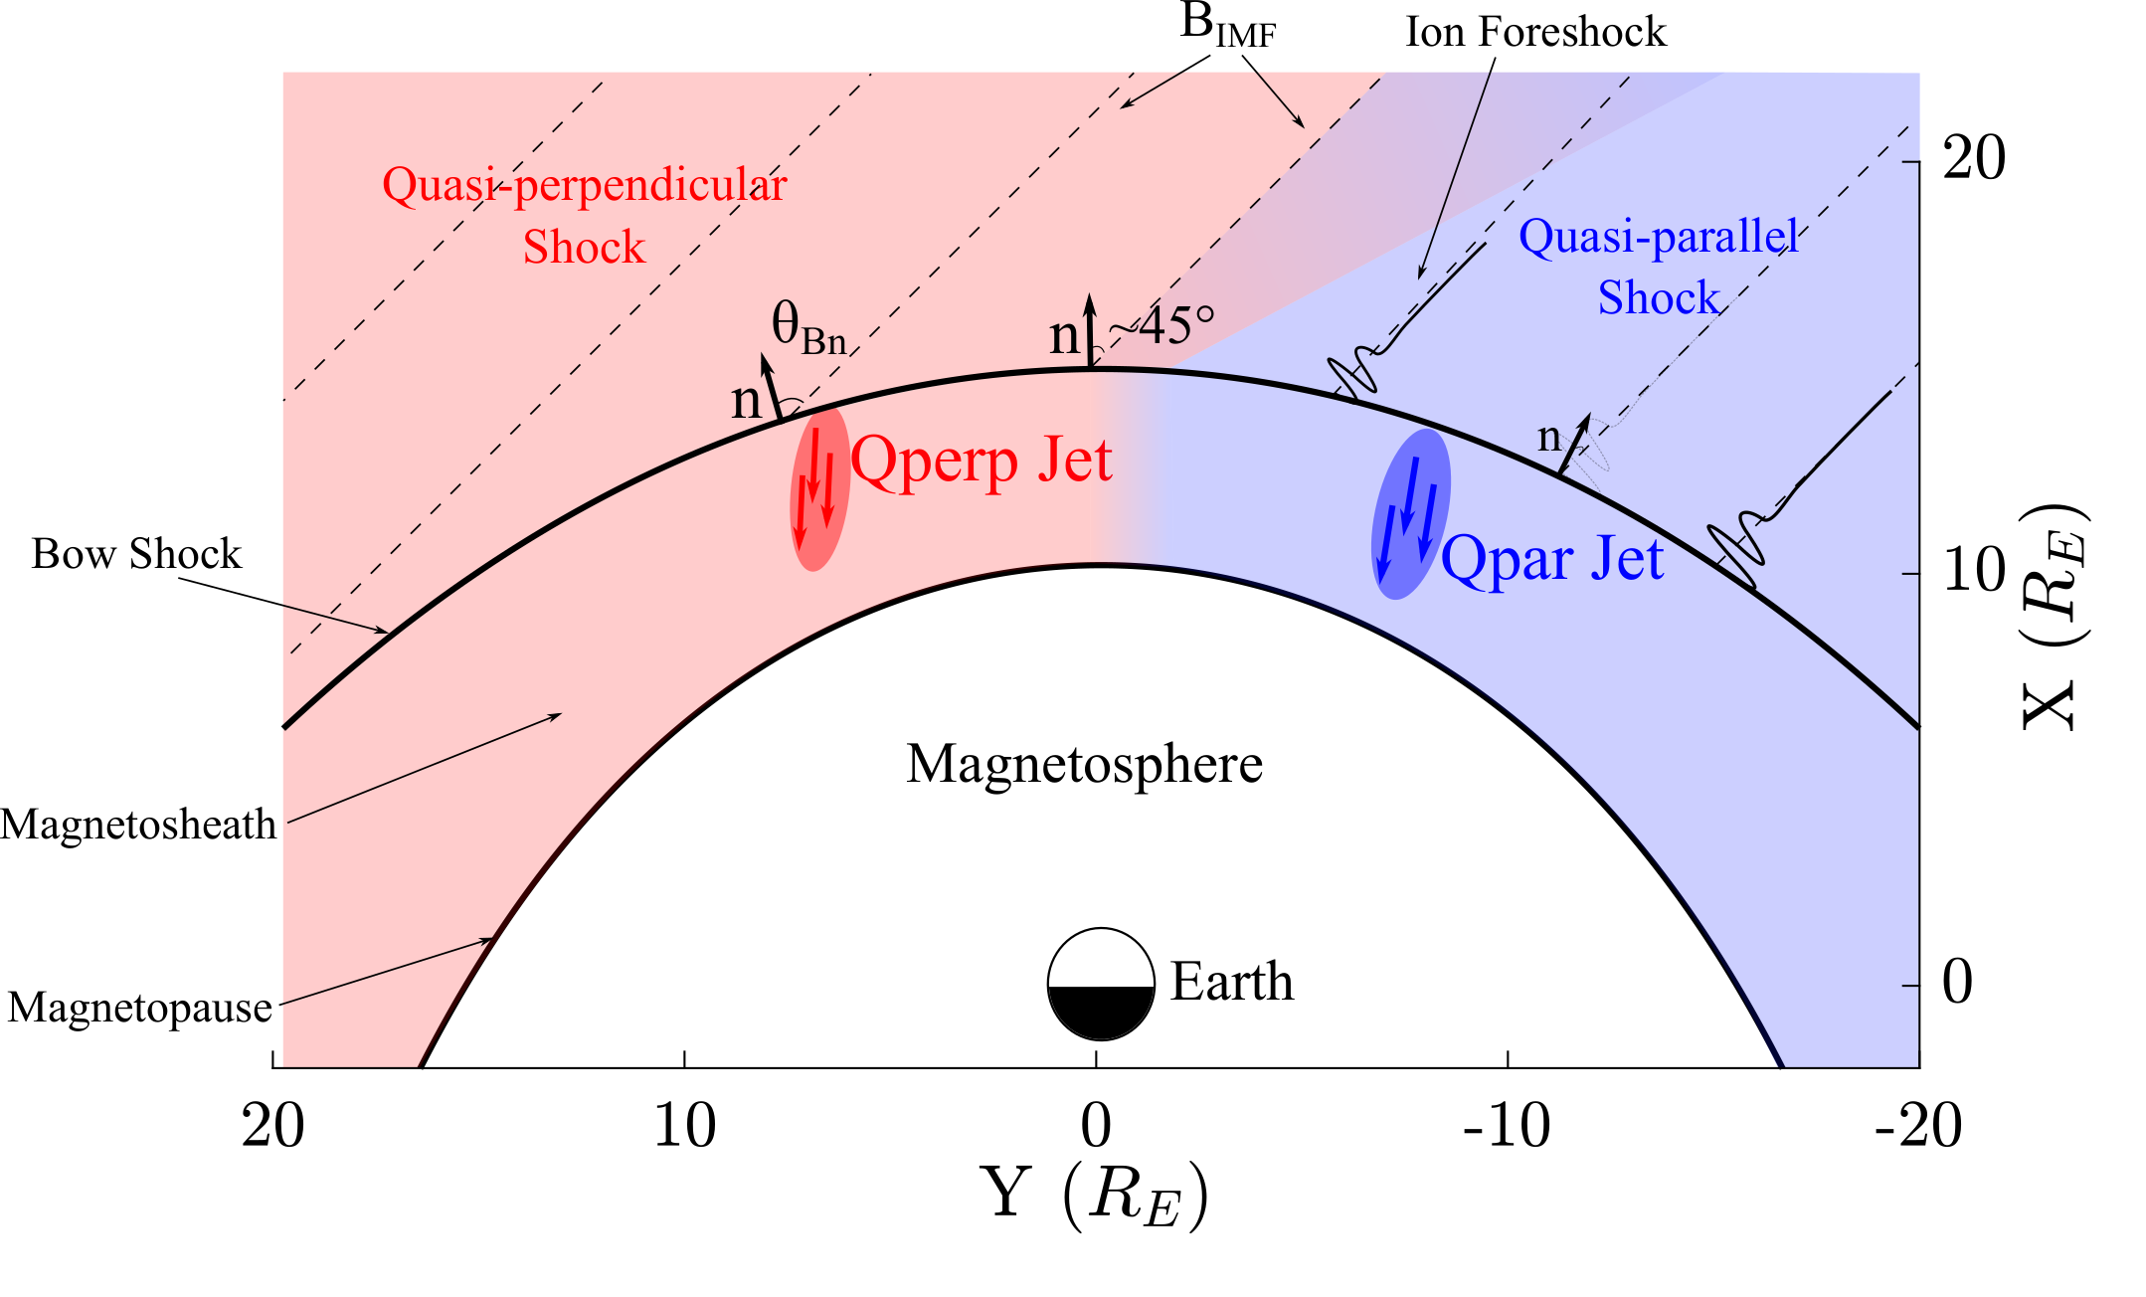
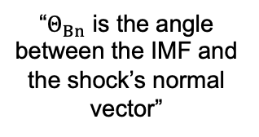
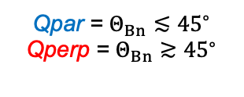
Qpar & Qperp shocks
“$Θ_{Βn}$ is the angle between the IMF and the shock’s normal vector”
Qpar = $Θ_{Βn}≲{45}^{∘}$
Qperp = $Θ_{Βn}≳{45}^{∘}$
Raptis, Aminalragia-Giamini et al. (2020) | Front. Astron. Space Sci

Slide 10
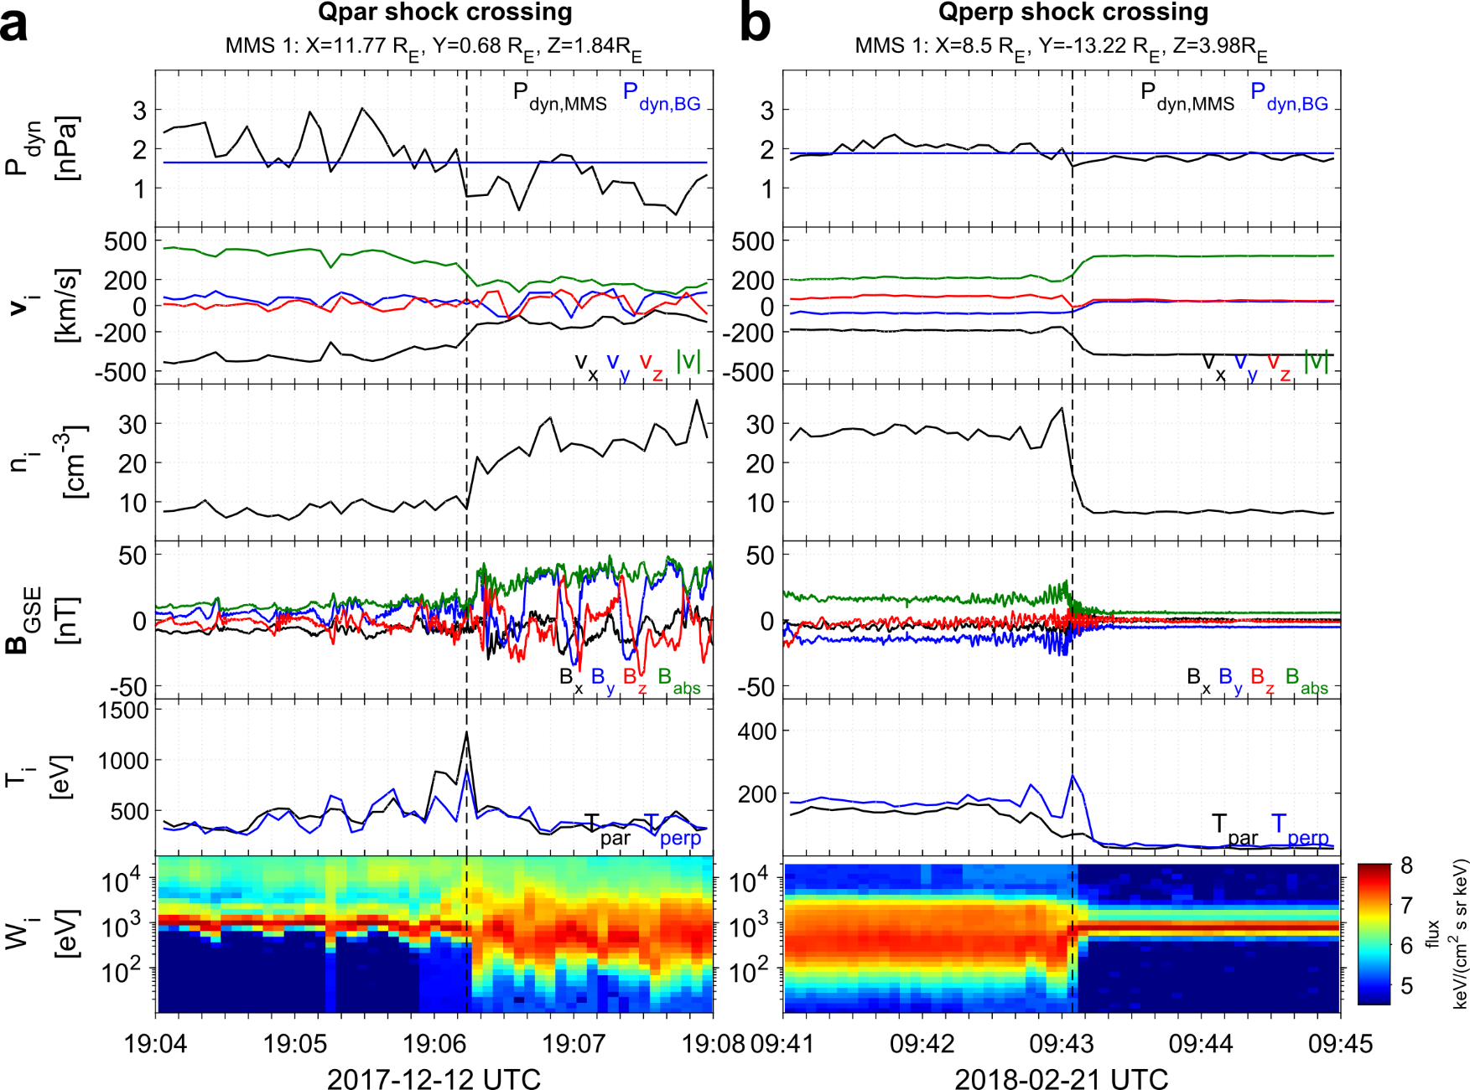
Shock transitions with MMS
high-energy ions

Slide 11
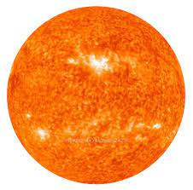
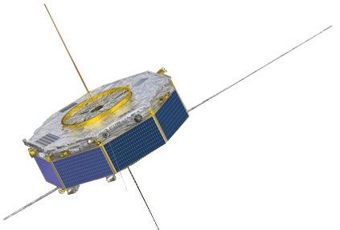










A common problem
Bow Shock
$$θ_{Bn}$$
$$\hat{B}$$
Magnetopause
solar wind
$$\hat{B}$$
$$\hat{n}$$
OMNI
(L1)
Earth
200$R_{E}$
15$R_{E}$
10$R_{E}$
1$R_{E}$
$$R_{E}=6371.2 \left[km\right]$$

Slide 12
Previous Results

Slide 13
Big picture
Paper #1
Quasi-Parallel
Quasi-Perpendicular
Bow Shock
Magnetopause
MMS
Jets
Earth
Raptis S., Karlsson T., et al. (2020) | JGR

Slide 14
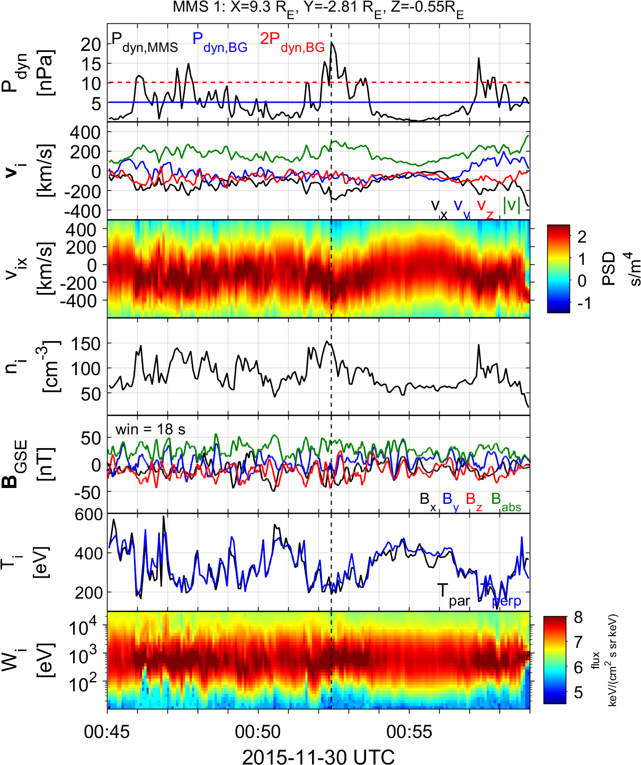
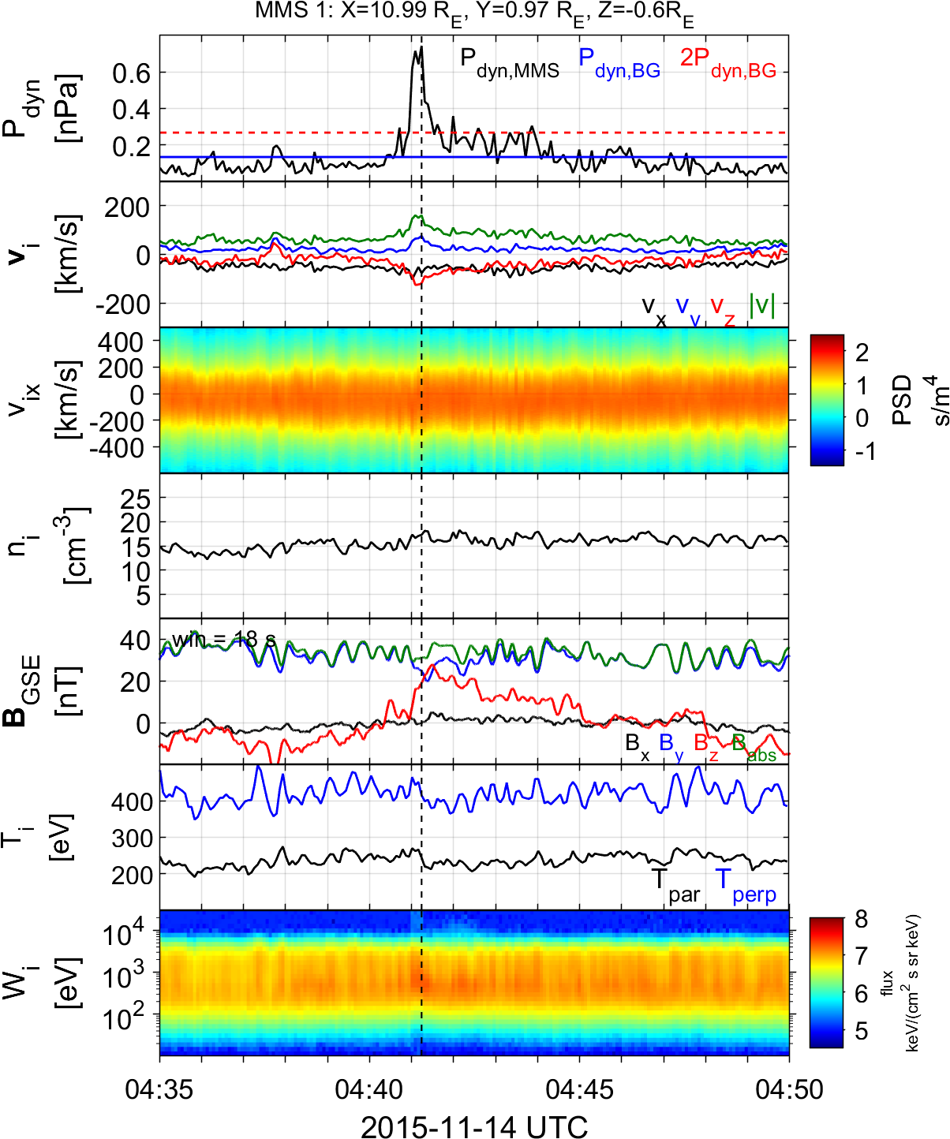
Relevant Paper #1
Classify jets with in-situ data
Magnetic field variance
Temperature anisotropy
High-energy flux
Qpar jet
Qperp Jet
Raptis S., Karlsson T., et al. (2020) | JGR

Slide 15

Big picture
Paper #1
Paper #2
Quasi-Parallel
Quasi-Parallel
Quasi-Perpendicular
Bow Shock
Quasi-Perpendicular
Bow Shock
Magnetopause
Neural Networks
Magnetopause
MMS
MMS
Jets
Jets
Earth
$$L_{1}$$
Earth
Raptis S., Karlsson T., et al. (2020) | JGR
Raptis S., Aminalragia-Giamini et al. (2020) | Front. Astron. Space Sci

Slide 16
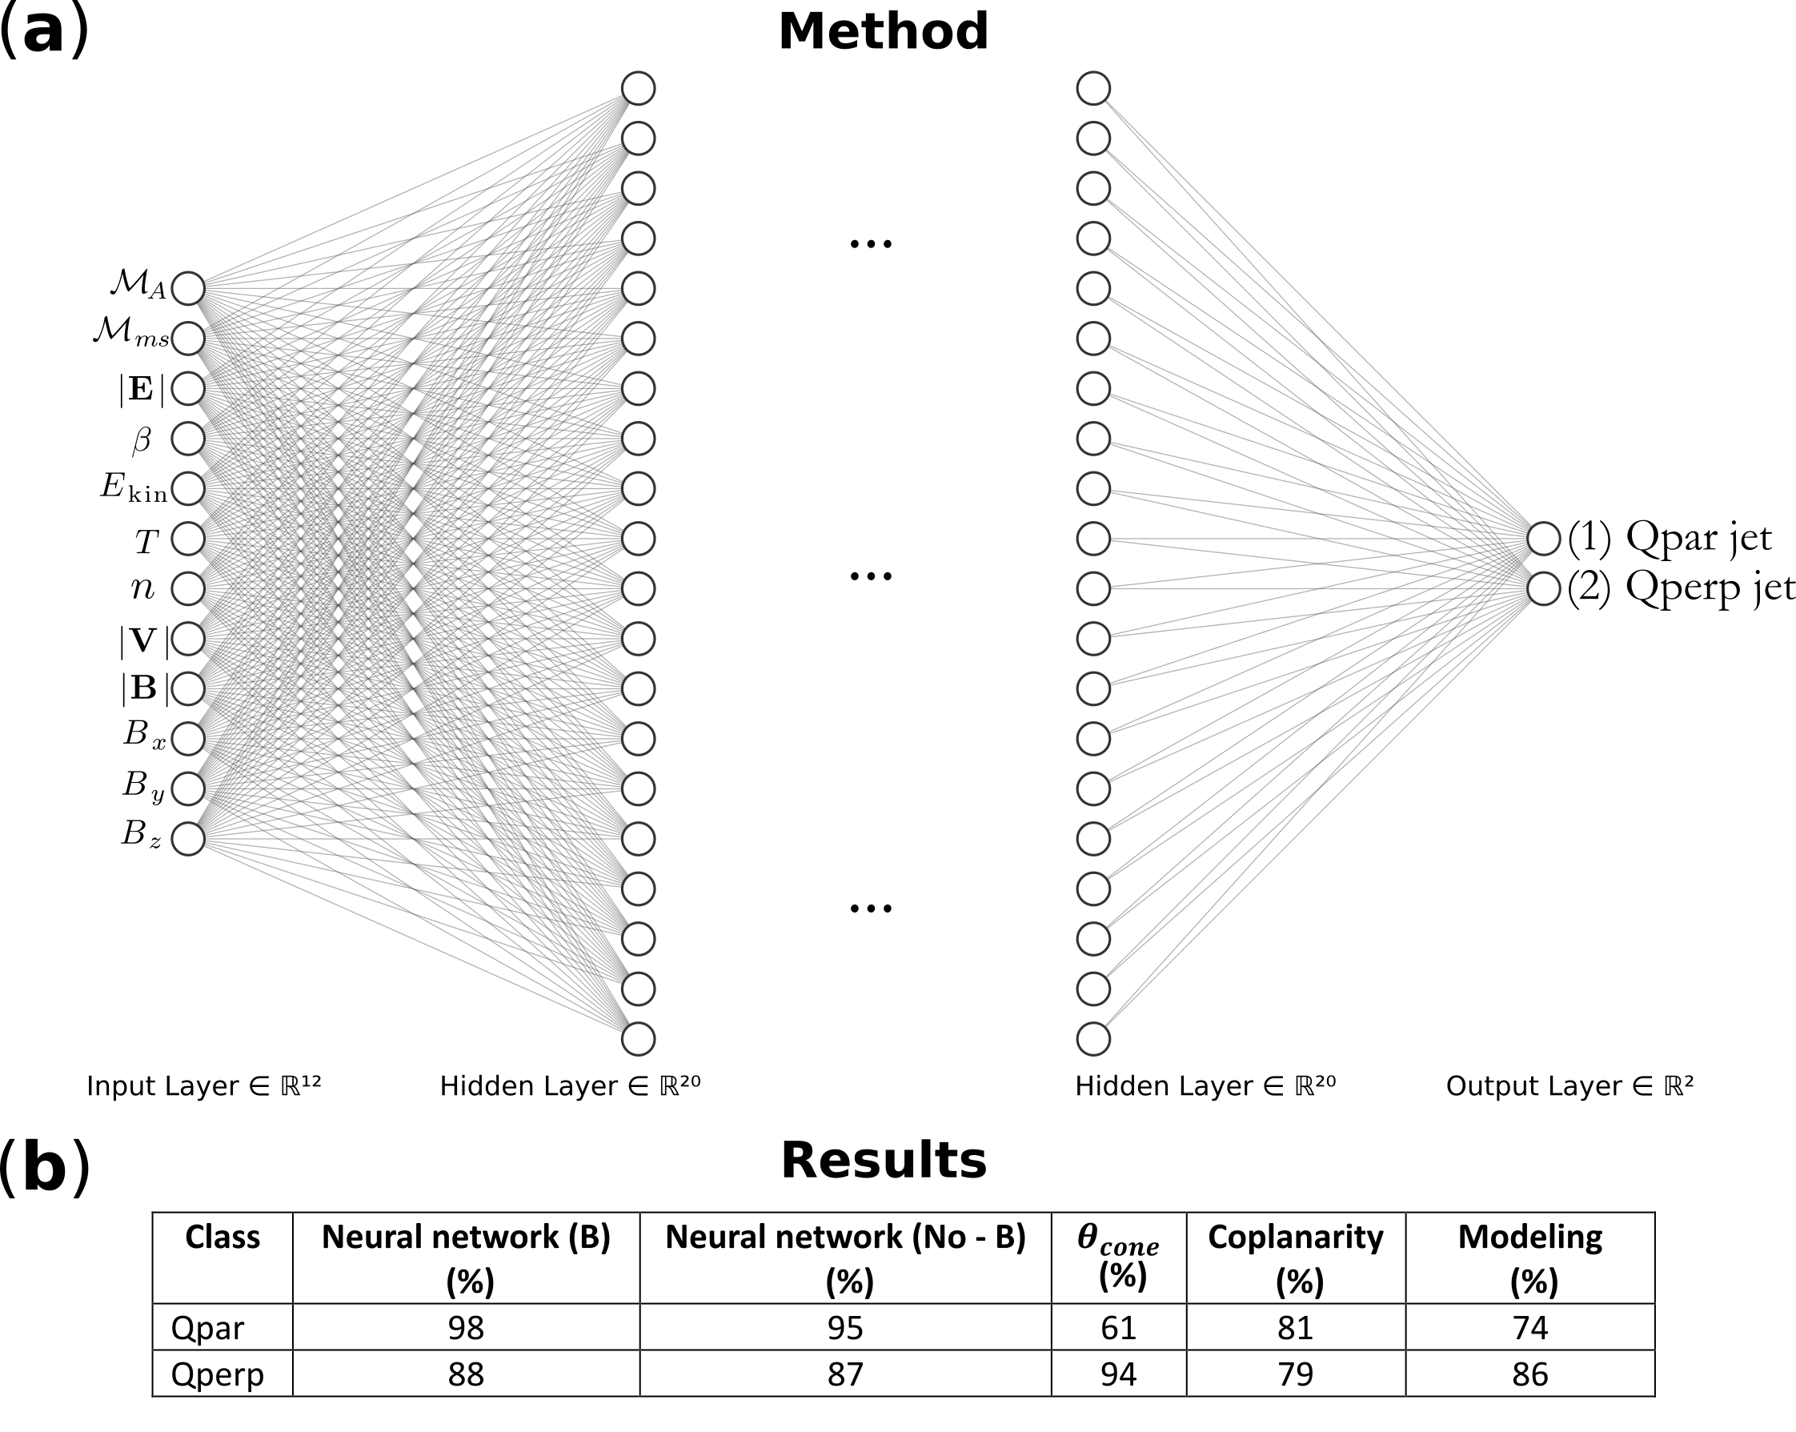
Relevant Paper #2
Upstream
SW
L1 OMNI
Downstream
MSH
MMS
* www.imbalanced-learn.org
Raptis, Aminalragia-Giamini et al. (2020) | Front. Astron. Space Sci

Slide 17
Relevant Paper #2
Classify with NN & OMNI
NNs > classic methods
Still in-situ better (?)
Information upstream
Upstream
SW
L1 OMNI
Downstream
MSH
MMS
ML
Standard
Raptis, Aminalragia-Giamini et al. (2020) | Front. Astron. Space Sci

Slide 18
Big picture
Paper #1
Paper #2
Paper #3
Quasi-Parallel
Quasi-Parallel
Quasi-Perpendicular
Bow Shock
Quasi-Perpendicular
Bow Shock
Bow Shock
Magnetopause
Neural Networks
Magnetopause
Magnetopause
MMS
MMS
Jets
Jets
Earth
$$L_{1}$$
Earth
Earth
Cluster
SW
MSH
Raptis S., Karlsson T., et al. (2020) | JGR
Raptis S., Aminalragia-Giamini et al. (2020) | Front. Astron. Space Sci
Karlsson T., Raptis S., et al. (2021) | JGR

Slide 19
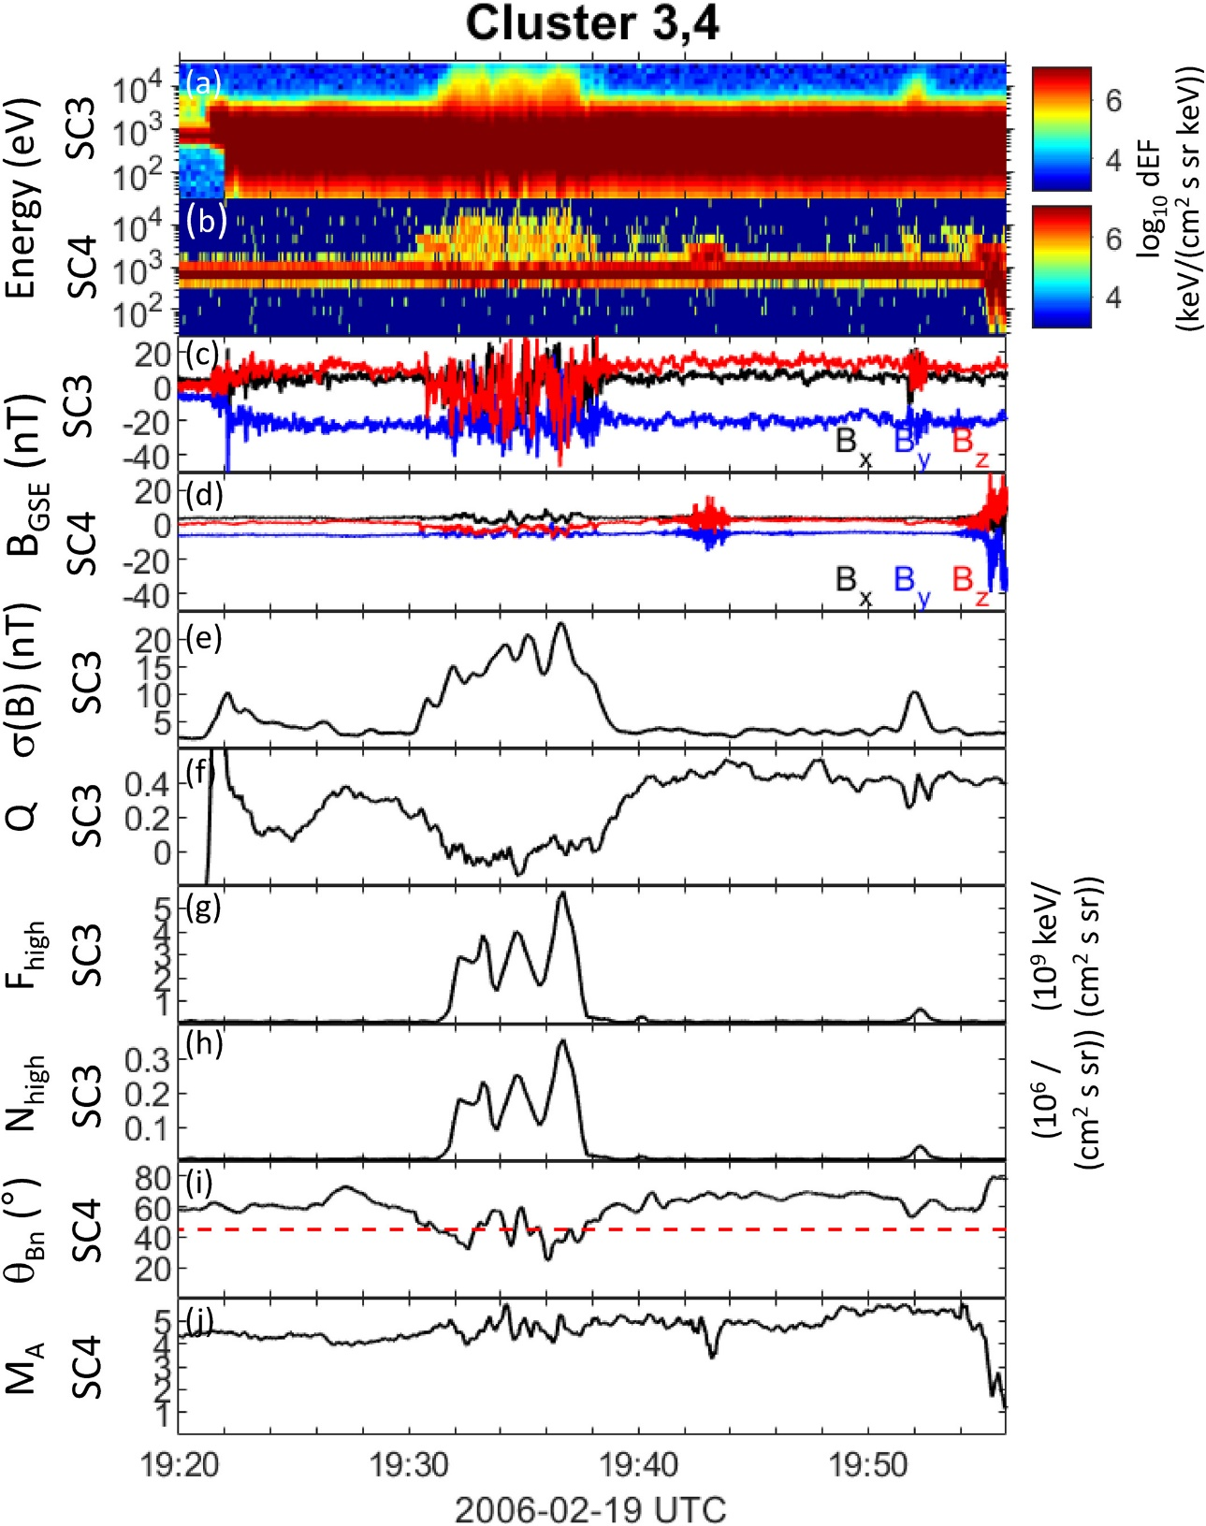
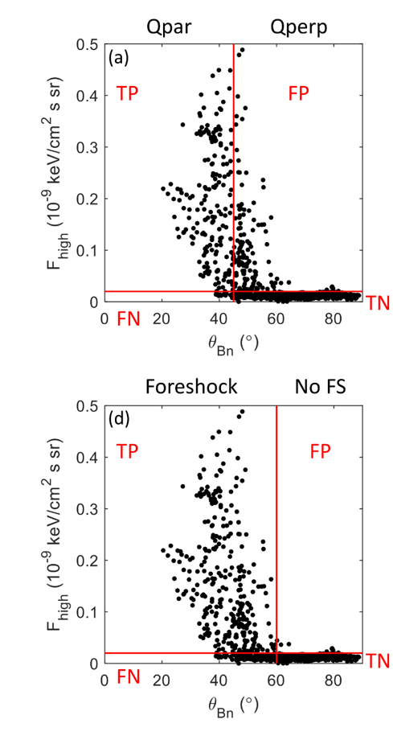
Relevant Paper #3
SC3 = Downstream satellite
SC1 = Upstream satellite
Confirm Paper #1 with CL
Confirmed*
Relation energetic ions
Flux & B variance > Q
Karlsson T., Raptis S., et al. (2021) | JGR

Slide 20
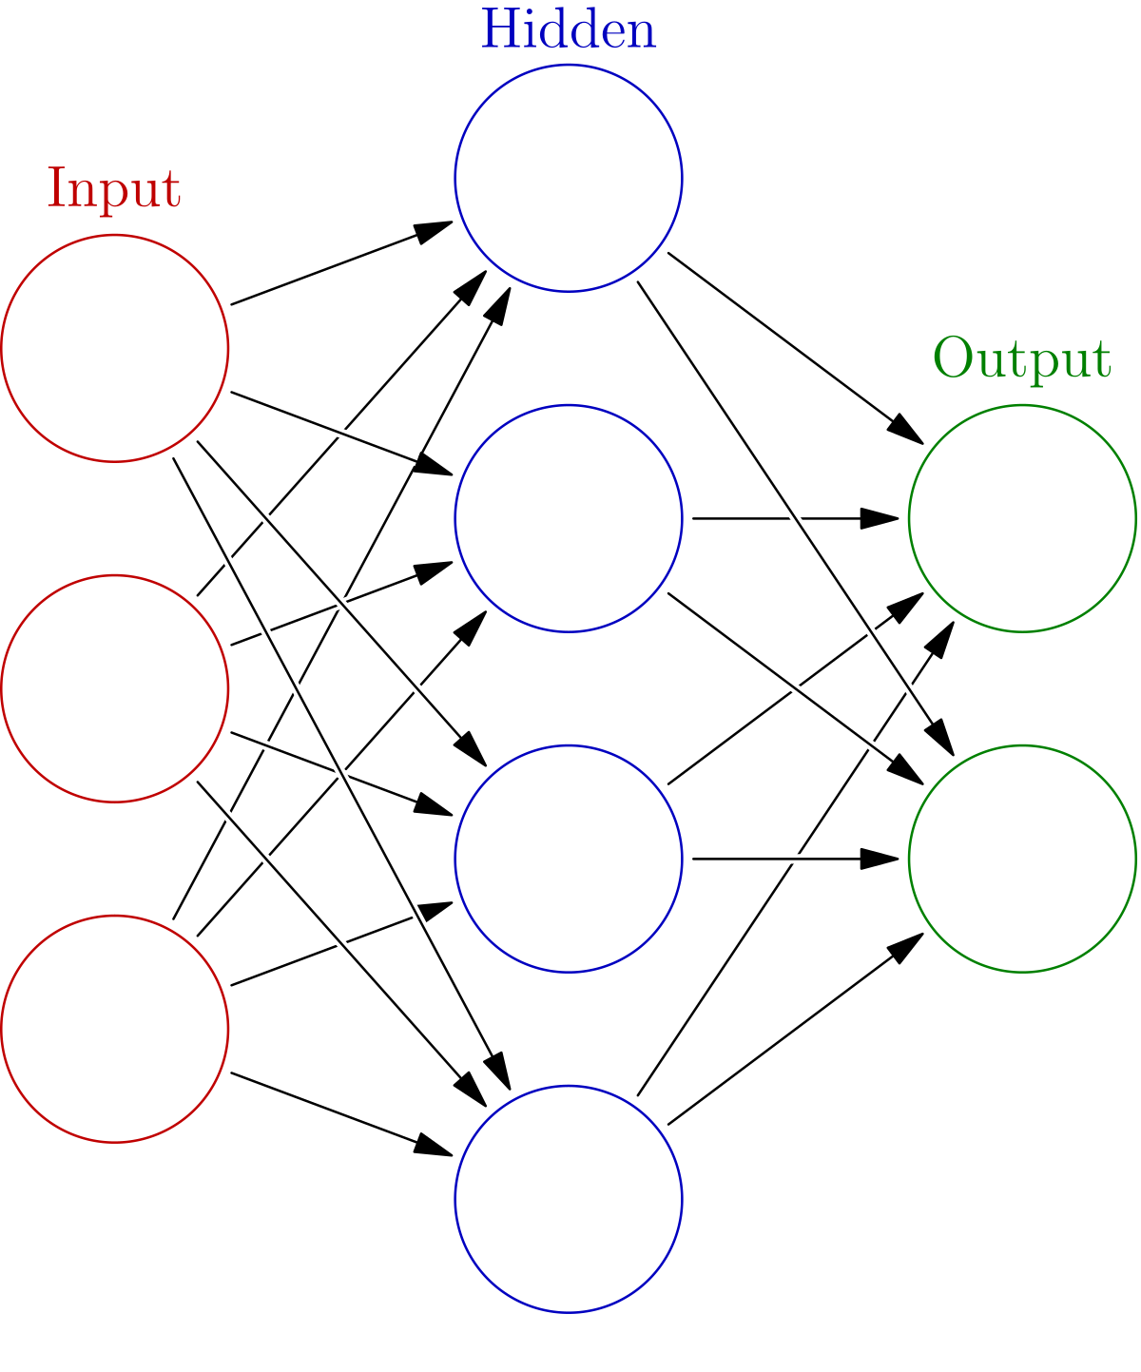
New Results
Bow Shock
Magnetopause
Cluster + (MMS)
SW
MSH
Earth

Slide 21
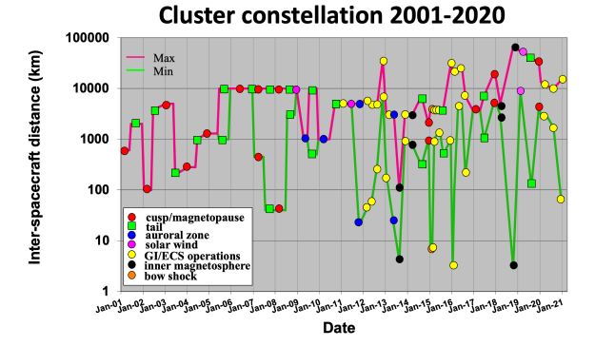
Dataset & caveats
CLUSTER
Dataset
2000 – now
Varying separation, multi-spacecraft analysis (i.e., timing, curlometer etc.
~10k points (~10s res)
2 instruments
Hot Ion Analyzer (HIA)
Composition Distribution Function (CODIF) analyzer
Time lag (upstream – downstream) ~10s – 2min
Transient localized events (e.g., MSH jets, shocklets, SLAMS, etc.)
GOAL: Can we use info from SC3 to characterize SC4 & create a synthetic energy spectrum ?
Relevant campaigns
near solar wind monitor campaign (2019)

Slide 22
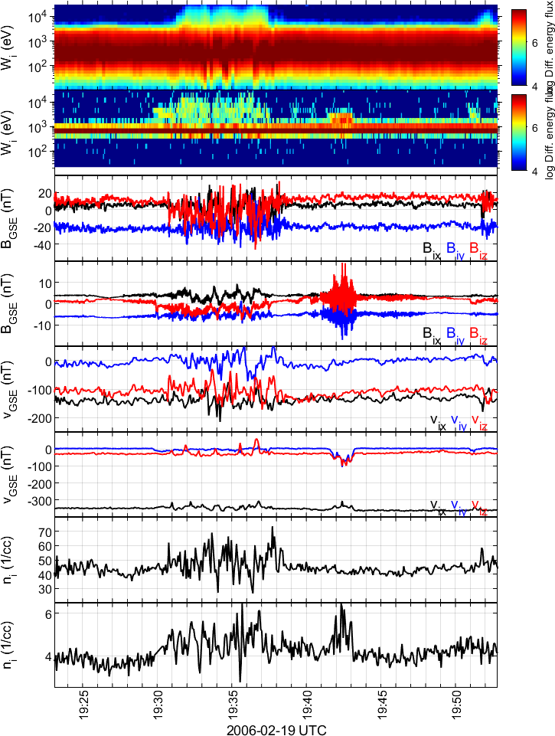
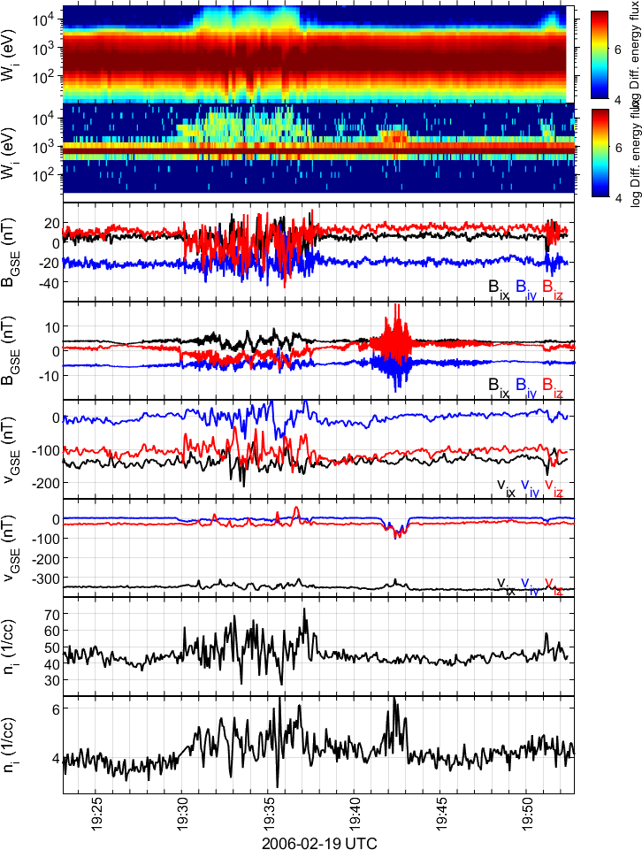
Pre-process steps
(1)
(2)
Steps
Raw Data
Time-Shift (cross-corr normalized B)

Slide 23
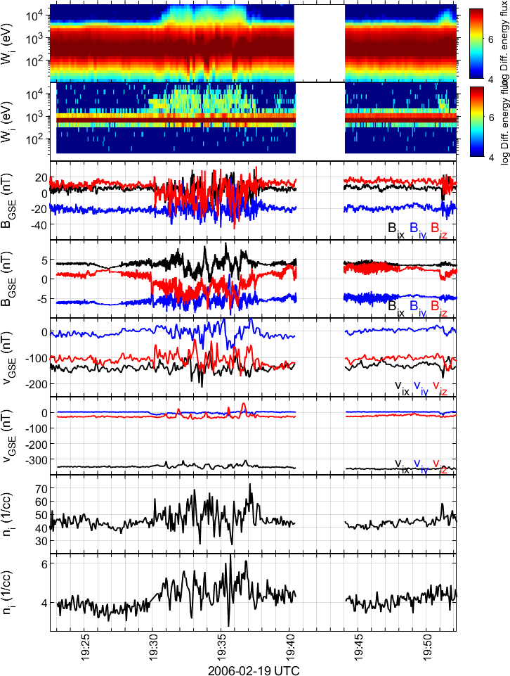
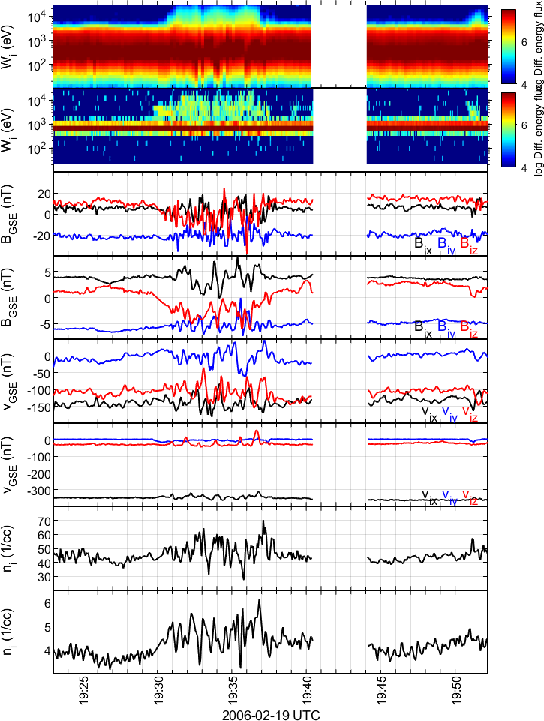
Pre-process steps
(3)
(4)
Steps
Raw Data
Time-Shift (cross-corr normalized B)
Remove transients
Resample & Rebin

Slide 24
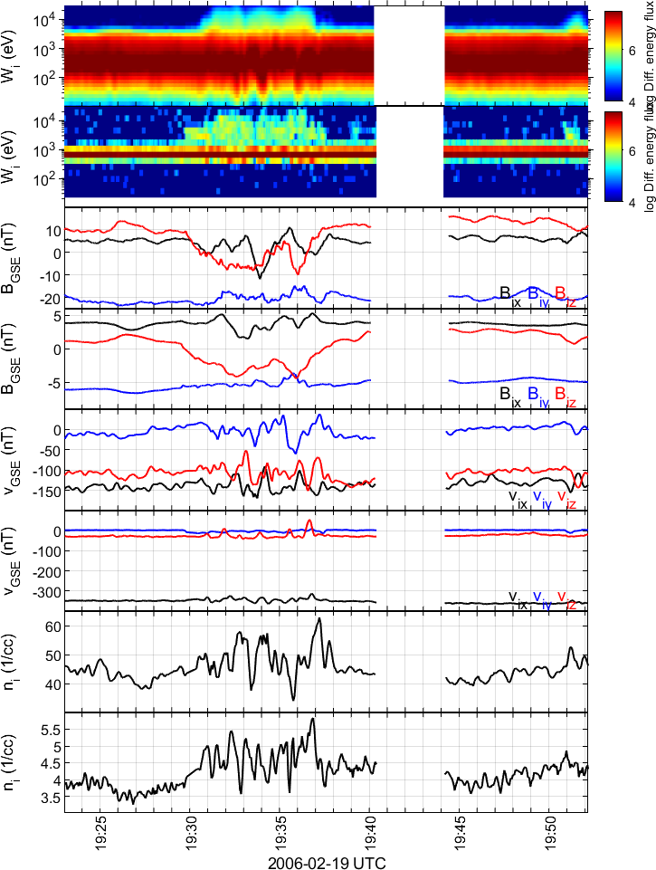
Pre-process steps
(5)
Steps
Raw Data
Time-Shift (cross-corr normalized B)
Remove transients
Resample & Rebin
Filter (optional)

Slide 25
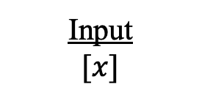



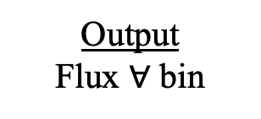
Basic idea (NN)
Input
$$[x]$$
Dense Neural Network
Regression
Output
Flux $∀$ bin
$$v$$
$$B$$
$$n$$
$$\begin{matrix}F_{d,1} \\ ⋮ \\ \begin{aligned}F_{d,32} \\ x,y,z\end{aligned}\end{matrix}$$
$$\begin{matrix}F_{u,1} \\ ⋮ \\ F_{u,32}\end{matrix}$$
x
$$…$$
Input:
x: Different downstream features (e.g., n, B, etc.)

Slide 26
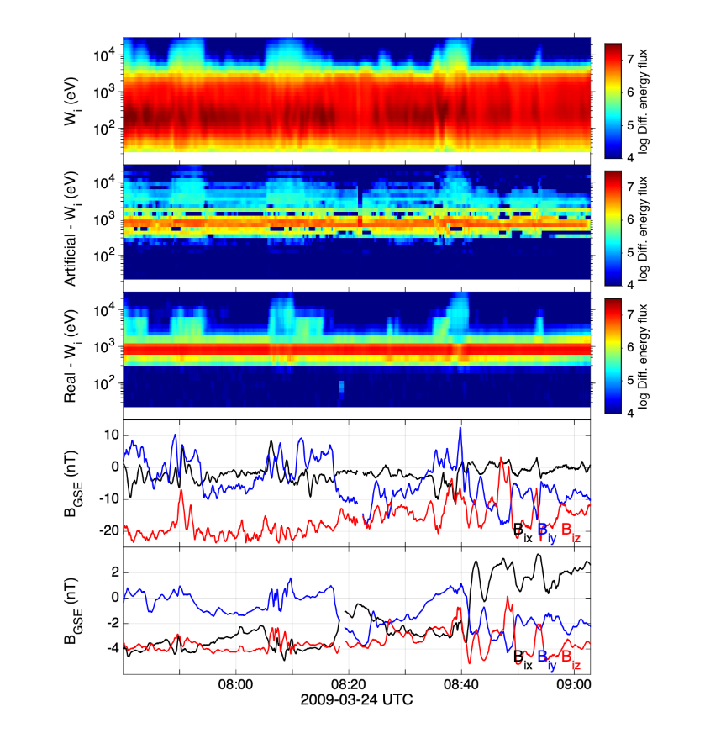
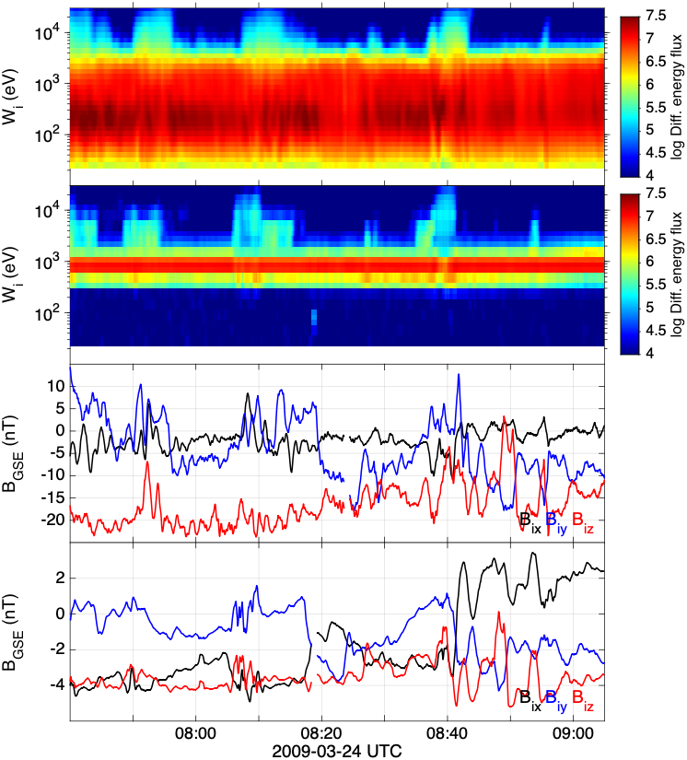
Preliminary results (test set)
Karlsson T., Raptis S., et al. (2021) | JGR

Slide 27
Basic idea (NN)
Input
$$[x]$$
Dense Neural Network
Regression
Output
Flux $∀$ bin
$$v$$
$$B$$
$$n$$
$$\begin{matrix}F_{d,1} \\ ⋮ \\ \begin{aligned}F_{d,32} \\ x,y,z\end{aligned}\end{matrix}$$
$$\begin{matrix}F_{u,1} \\ ⋮ \\ F_{u,32}\end{matrix}$$
x
$$…$$
Input:
x: Different downstream features (e.g., n, B, etc.)

Slide 28
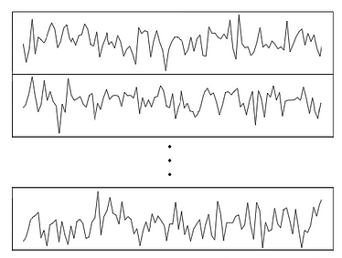
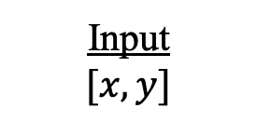



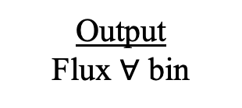
Basic idea (CNN)
Input
$$[x,y]$$
Convolution Neural Network
Feature Extraction
Dense Neural Network
Regression
Output
Flux $∀$ bin
Conv
Conv
Pool
Conv
Conv
$$\begin{matrix}F_{u,1} \\ ⋮ \\ F_{u,32}\end{matrix}$$
$$…$$
$$…$$
x
y
Input:
x: Different downstream features (e.g., n, B, etc.)
y: Information forward in time (e.g., +10 points with 10 sec resolution) – Skip cross-correlating signals

Slide 29
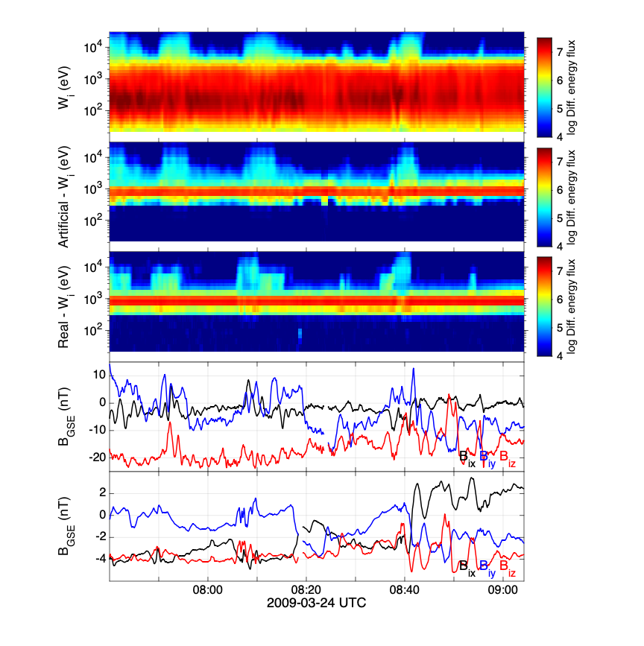
Preliminary results (test set)
Karlsson T., Raptis S., et al. (2021) | JGR
Raptis et al. (ongoing)

Slide 30
Discussion & Conclusion
Preliminary results: generate upstream data by training a ML model with downstream (the same applies for upstream to downstream).
Future
More data are needed (hard to get, manual labor involved)
Many things to be done (data cleaning, better architectures, better validation, metrics etc. etc.)
Smarter problem definition (not produce whole spectra but parts of it, specific bins using multiple models etc.)
Can we combine our knowledge of shocks to generate synthetic data (e.g., using Physics-informed machine learning)
Include other missions/objectives (THEMIS, MMS, etc.)

Slide 31
Extra

Slide 32
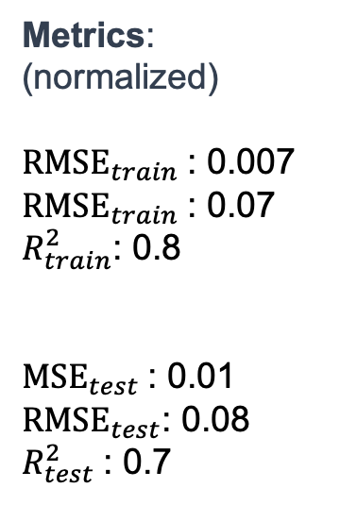
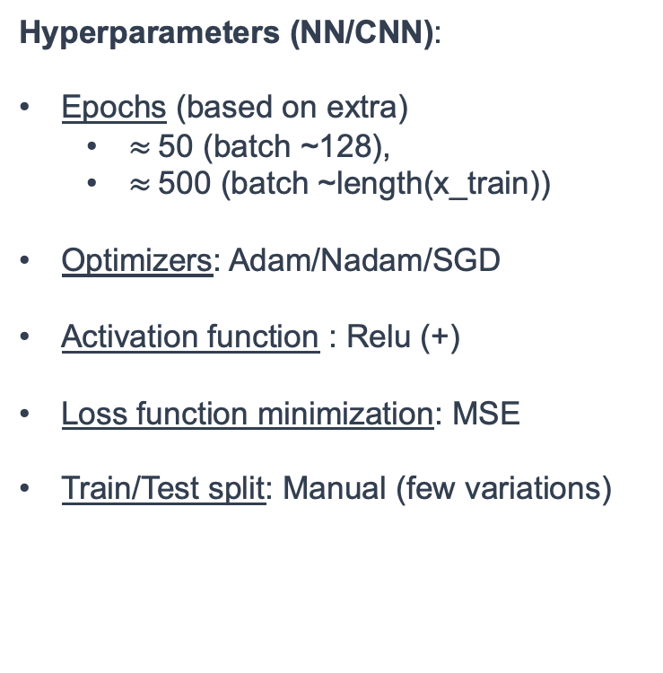
Model Basic Properties
Basic Architectures:
- Neural Network (60-80-100-80-60-1)
- CNN (16/[4,4] – 8/[2,2]–400–200–100–1)
- XGBoost (various variations)
Extras:
early-stopping based on training loss.
Metrics:
(normalized)
${RMSE}_{train}$: 0.007
${RMSE}_{train}$: 0.07
$R_{train}^{2}$: 0.8
${MSE}_{test}$: 0.01
${RMSE}_{test}$: 0.08
$R_{test}^{2}$: 0.7
Hyperparameters (NN/CNN):
Epochs (based on extra)
$≈$50 (batch ~128),
$≈$500 (batch ~length(x_train))
Optimizers: Adam/Nadam/SGD
Activation function : Relu (+)
Loss function minimization: MSE
Train/Test split: Manual (few variations)

Slide 33
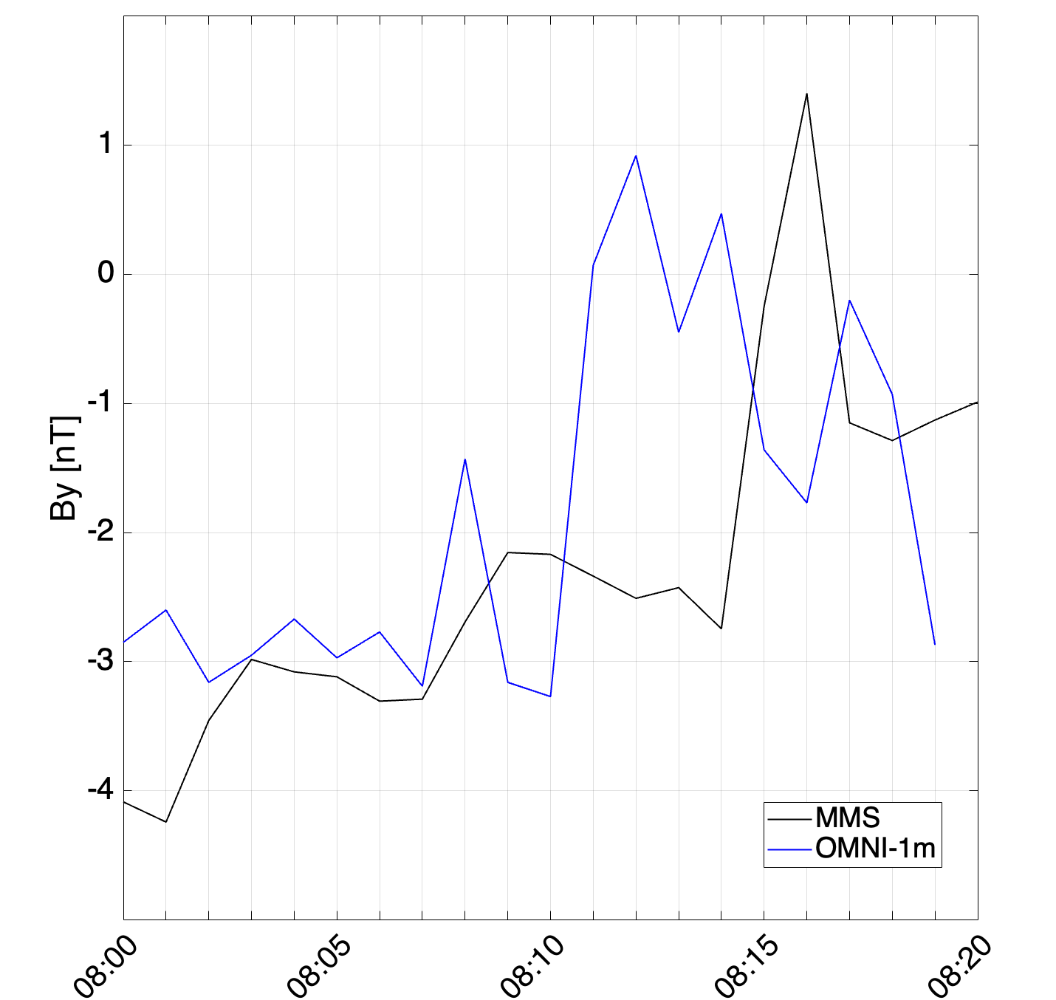
Example of OMNI miss-match
Bow Shock
MMS
~[17,2,2] Re
Magnetopause
OMNI
Earth
ΔΤ ~4-5 mins

Slide 34
Preliminary results (moments)
Density:
Real = 3.92
NN = 4.039

Slide 35
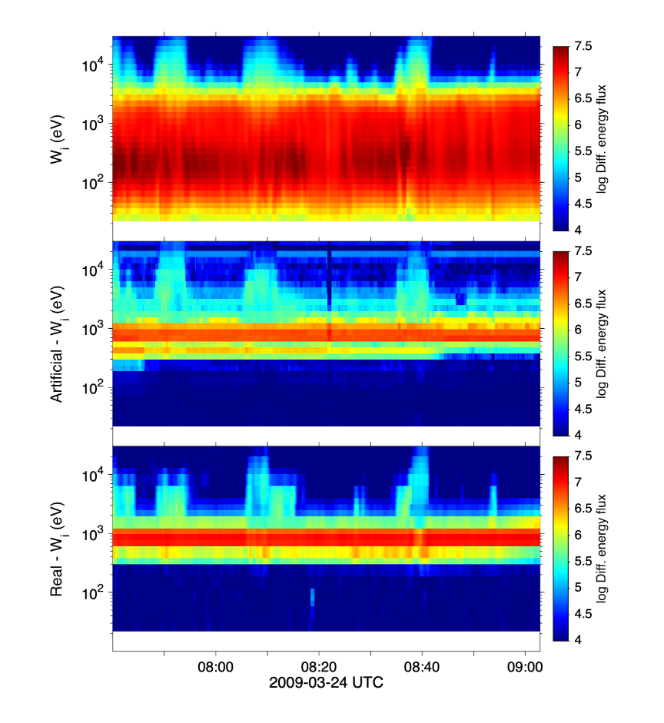
Interesting results with XGboost
CNN
XGboost

