Slide 1

Modeling Earth’s Plasma Sheet using Machine Learning
Savvas Raptis¹, Connor O’ Brien³, Louis Richard²,Slava Merkin¹, Kareem Sorathia¹, Eric Winter¹, Simon Wing¹
¹ APL/JHU, Laurel, MD, US
² Swedish Institute of Space Physics, Uppsala, Sweden
³ Center for Space Physics, Boston University, Boston, MA, USA
Supported by John Hopkins University Applied Physics Laboratory independent R&D fund
savvas.raptis@jhuapl.edu
https://savvasraptis.github.io

Slide 2
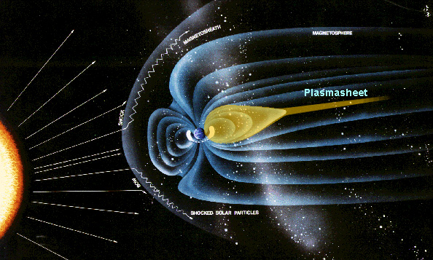
Earth’s plasma sheet
Magnetotail reconnection
Bursty Bulk Flows (BBFs)
Global Convection Patterns
Ring current
Modeling PS is useful for:
Understanding storm/substorm dynamics
Explain ring current configuration
Facilitate space weather modeling
Understand inner magnetosphere
Source for radiation belts

Slide 3
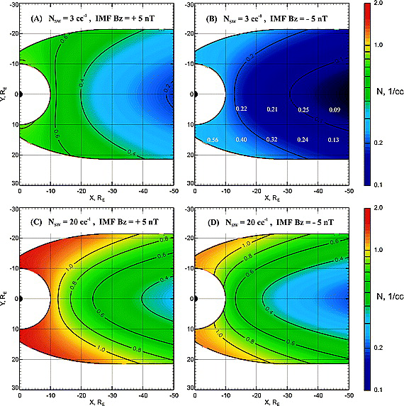
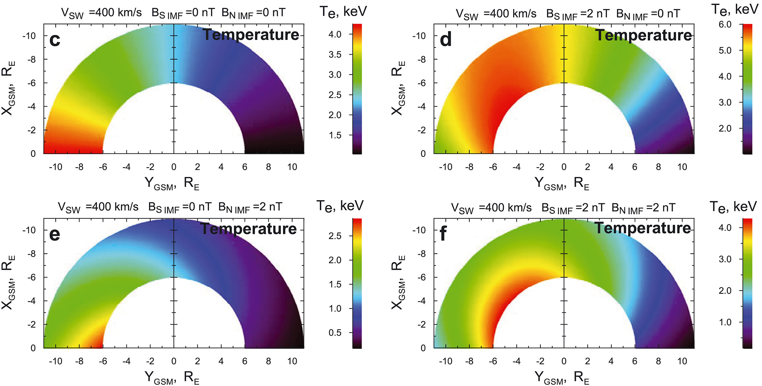
Baseline empirical models
Modelled with Geotail
Modelled with THEMIS
Dubyagin+ 2016
Why then work on this?
Many more data points covering different conditions
MMS was not used and it can provide further information/validation
These models don’t include time history which may be important
ML methods can use non-linear relationship to produce better results.
Tsyganenko & Mukai 2003

Slide 4
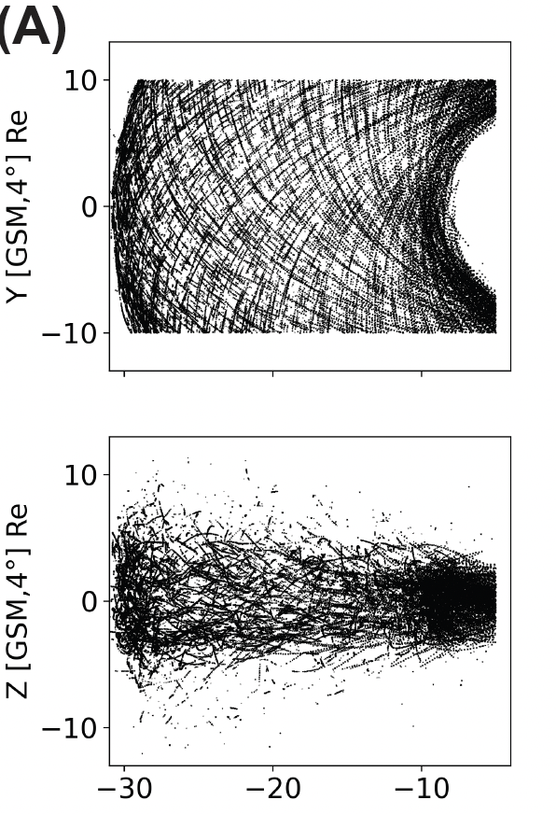
The dataset (i.e, output – Central Plasma Sheet)
Geotail (1994 - 2022)
>1 million points
(B) MMS (2015 – 2024)
~ 250k points
Output: plasma moments and magnetometer data.
Raptis+ 2024 (under review)
Presentation at MESO 15:30+

Slide 5
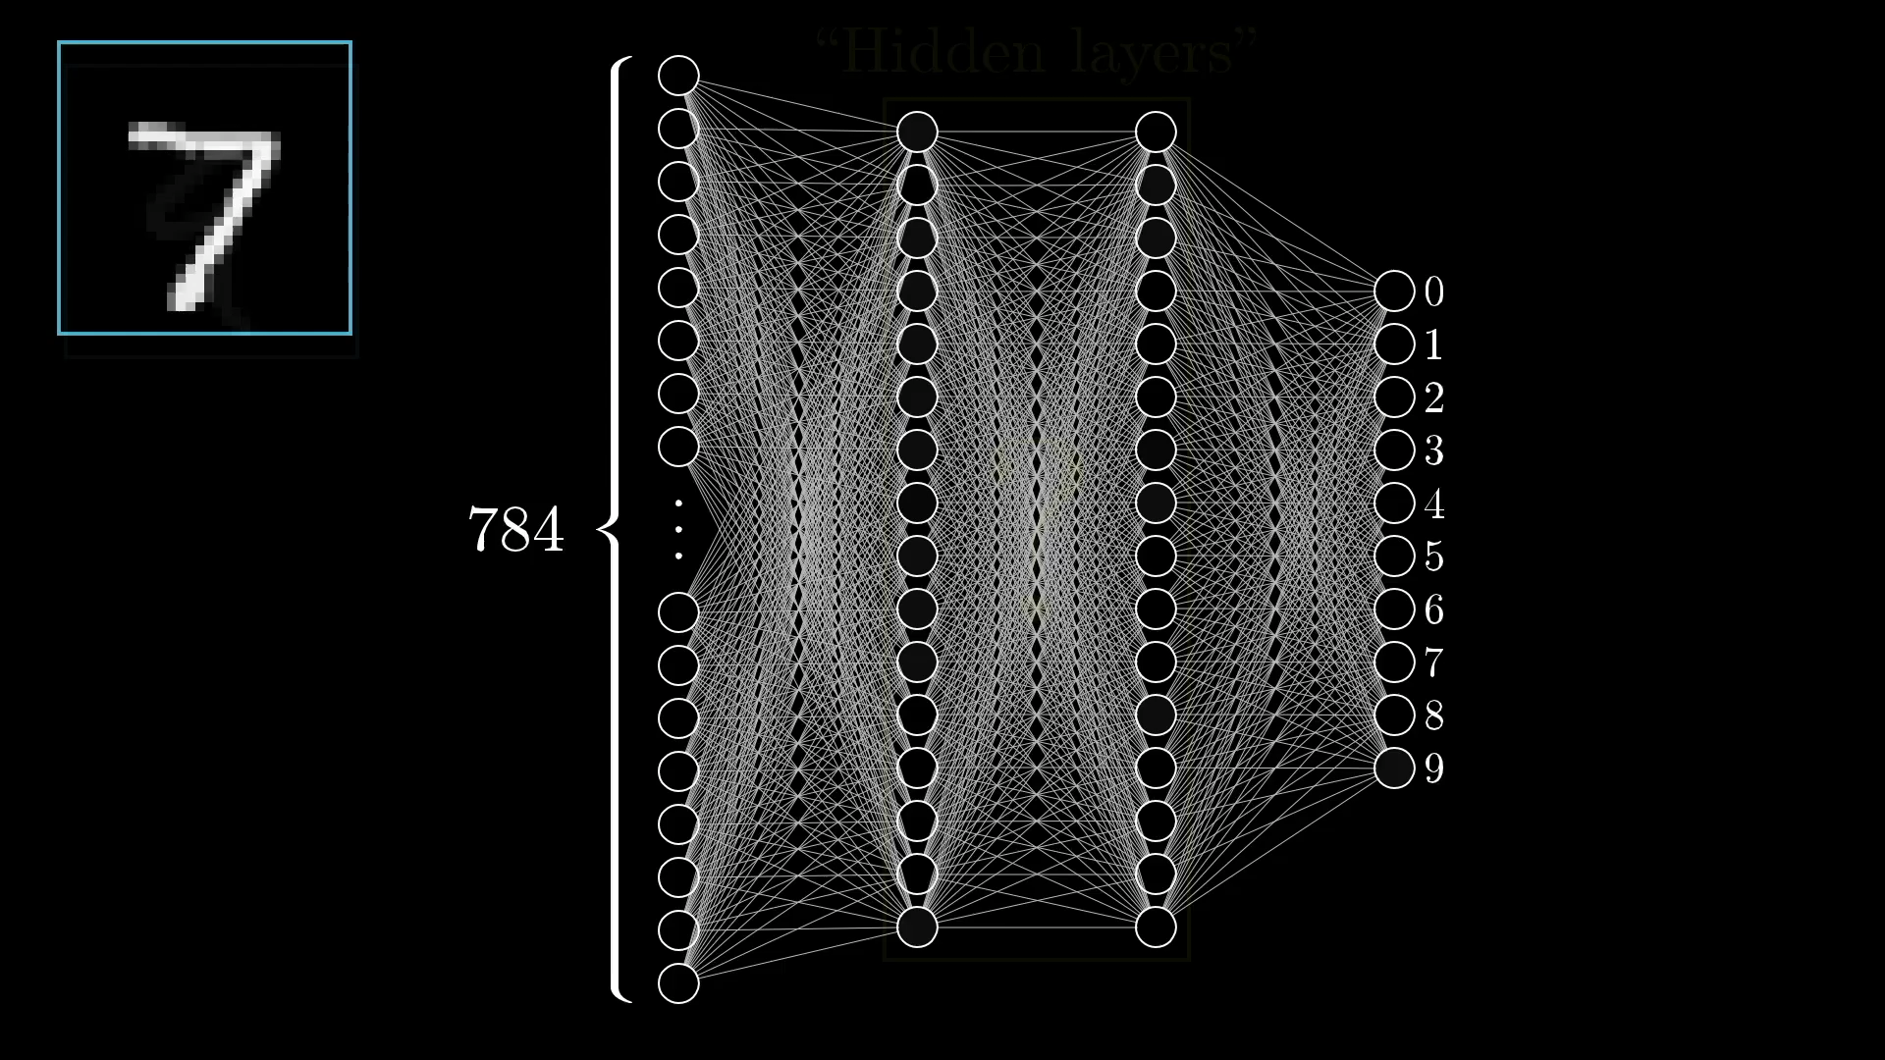
Methods - Neural Networks
www.3blue1brown.com
Also tried Gradient boosting which works great, but remember folks: trees can’t extrapolate...

Slide 6



Data Scientist POV (i.e., Input and output)
Input
Solar wind properties
Output
Plasma Sheet
Quantity
Dense Neural Network
Regression
$$\begin{matrix}x_{+5} \\ ⋮ \\ \begin{aligned}x_{−365} \\ r_{x},r_{y},r_{z}\end{aligned}\end{matrix}$$
$$…$$
$$y_{0}$$
Input:
x: Different solar wind features (e.g., n, B, etc.) + geomagnetic indices including time history up to 6h
r: Location of SC measuring output
Output:
y: Different quantities at plasma sheet (e.g., n, B, T etc.)
Currently using OMNIweb -5min (averaged over 30 mins)
More options such as using WIND data directly are to be tested
Results here shown for 5min averaged quantities for output

Slide 7
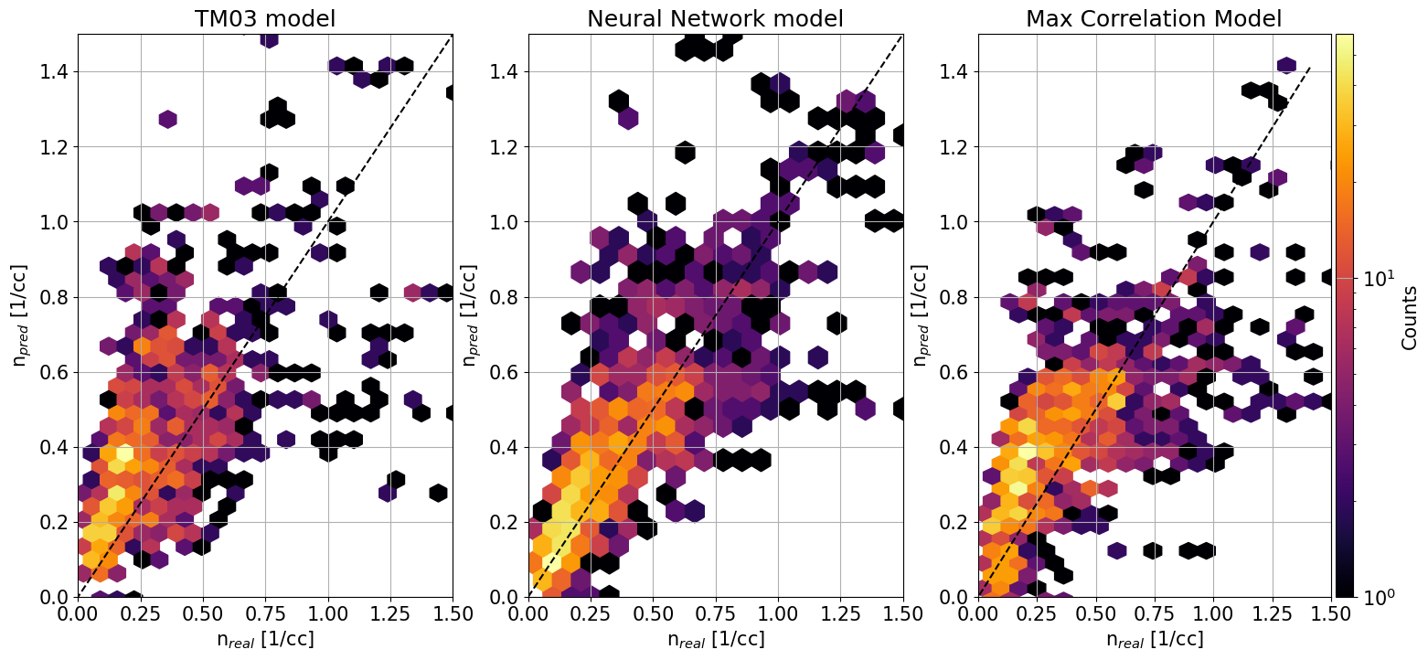
Modeling Density | Predictions vs Observations
Model that maximizes correlation for input and output
 | TM03 | NN | Base
R2 | 0.17 | 0.68 | 0.32
MAE | 0.19 | 0.11 | 0.18
RMSE | 0.27 | 0.2 | 0.27
r (cor) | 0.58 | 0.83 | 0.57
Geotail data
Presented Testing of NN → Prone to data leakage
Harder test set (i.e., 5 years of out of sample test data) gives R2 ~0.5
Raptis+ 2024 (ongoing)
Disclaimer: not exactly same input of original empirical models

Slide 8
Data Scientist POV (i.e., Input and output)
Input
Solar wind properties
Output
Plasma Sheet
Quantity
Dense Neural Network
Regression
$$\begin{matrix}x_{+5} \\ ⋮ \\ \begin{aligned}x_{−365} \\ r_{x},r_{y},r_{z}\end{aligned}\end{matrix}$$
$$…$$
$$y_{0}$$
Input:
x: Different solar wind features (e.g., n, B, etc.) + geomagnetic indices including time history up to 6h
r: Location of SC measuring output
Output:
y: Different quantities at plasma sheet (e.g., n, B, T etc.)
Currently using OMNIweb -5min (averaged over 30 mins)
More options such as using WIND data directly are to be tested
Results here shown for 5min averaged quantities for output

Slide 9

Next step: 2D modeling
Input
Solar wind properties
Output
Plasma Sheet
Quantity
Dense Neural Network
Regression
grid in x,y
To get 2D maps
Output across 2D
$$\begin{matrix}x_{+5} \\ ⋮ \\ \begin{aligned}x_{−365} \\ r_{x},r_{y},r_{z}\end{aligned}\end{matrix}$$
$$…$$
$$y_{0}$$
Input:
x: Different solar wind features (e.g., n, B, etc.) + geomagnetic indices including time history up to 6h
r: Location of SC measuring output
Output:
y: Different quantities at plasma sheet (e.g., n, B, T etc.)
Currently using OMNIweb -5min (averaged over 30 mins)
More options such as using WIND data directly are to be tested
Results here shown for 5min averaged quantities for output

Slide 10
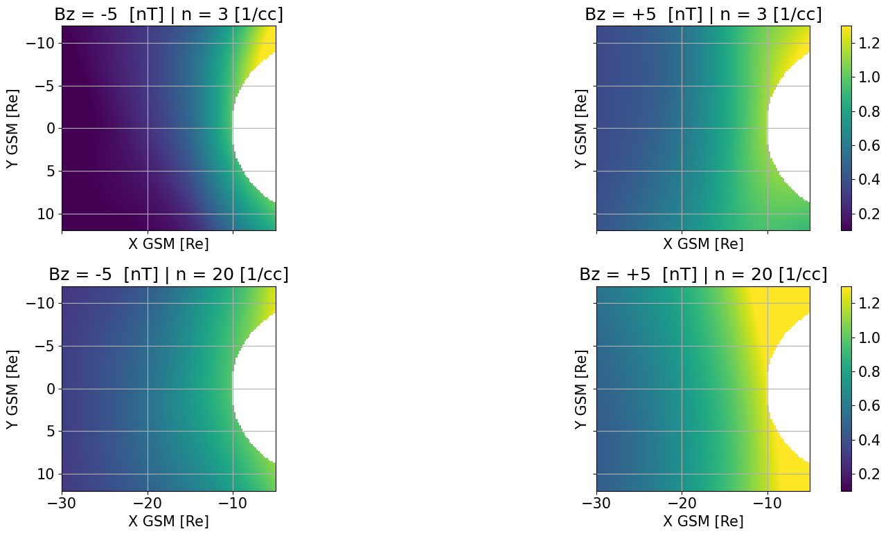
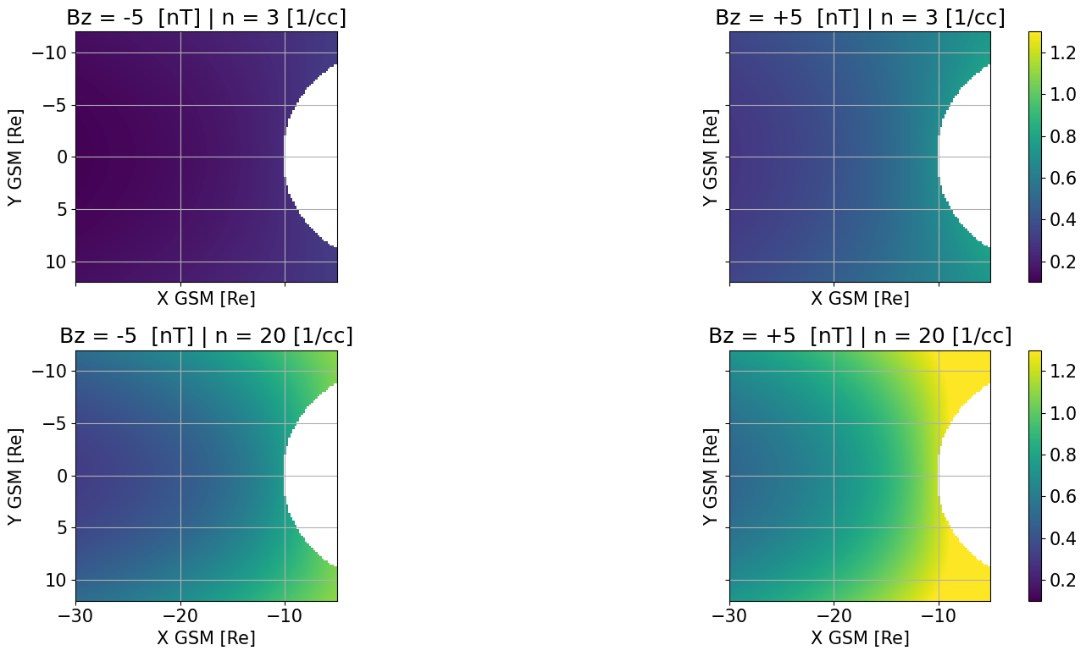
Modeling Density | 2D Maps
N [1/cc]
N [1/cc]
Neural Networks modeling
Empirical modeling (TM03)
Raptis+ 2024 (ongoing)

Slide 11
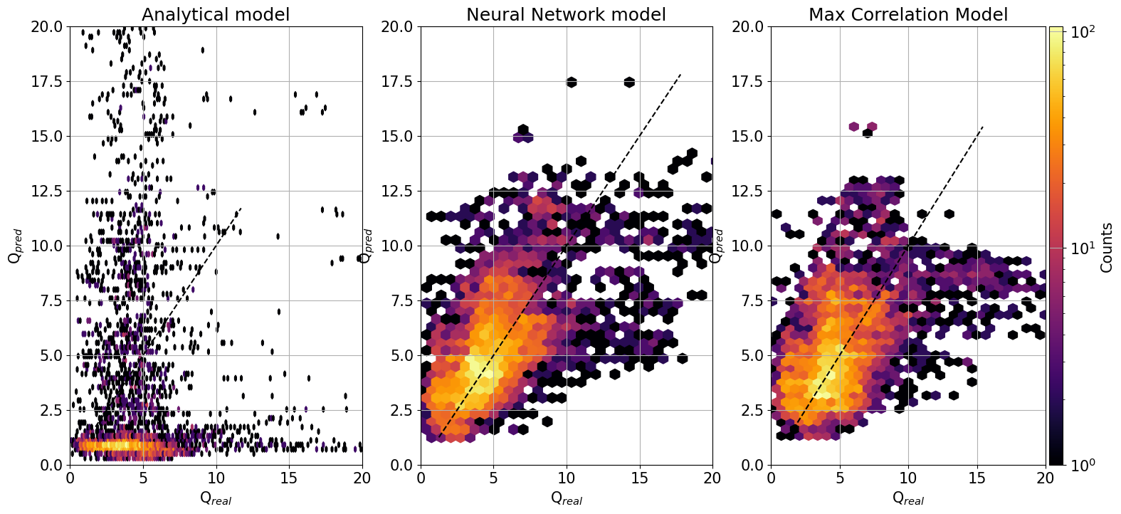
Modeling Temperature Ratios | Predictions vs Observations
An interesting quantity to see is Ti/Te both physically and for modeling
TM03 was fitted on Geotail data, while DGSR16 on THEMIS. Let’s test them on MMS by looking at the ratio
 | NN | Base
R2 | 0.32 | 0.12
MAE | 1.8 | 2.1
RMSE | 2.5 | 2.9
r (cor) | 0.6 | 0.45
Why ?
I messed up with the empirical models
Models are valid on different spatial distances (orbits of Geotail and THEMIS)
Intercalibration issues and instrumental effect are very important
ML model targeting directly an objective is simply more efficient
Disclaimer: not exactly same input of original empirical models

Slide 12
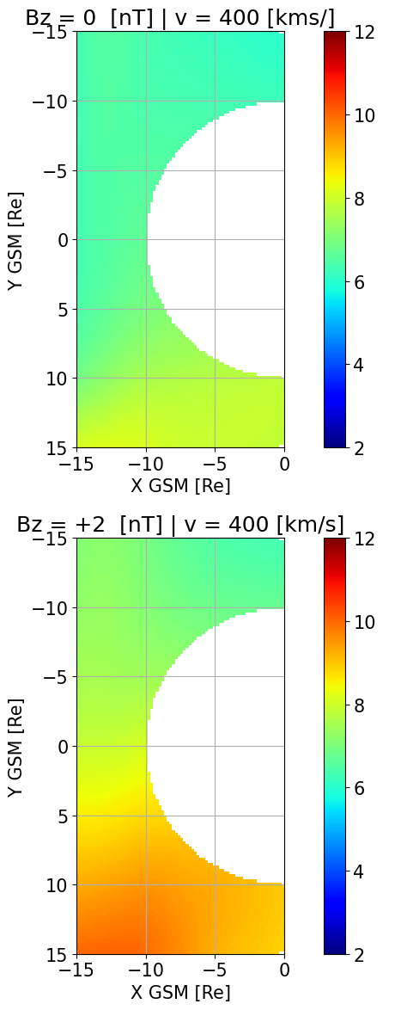
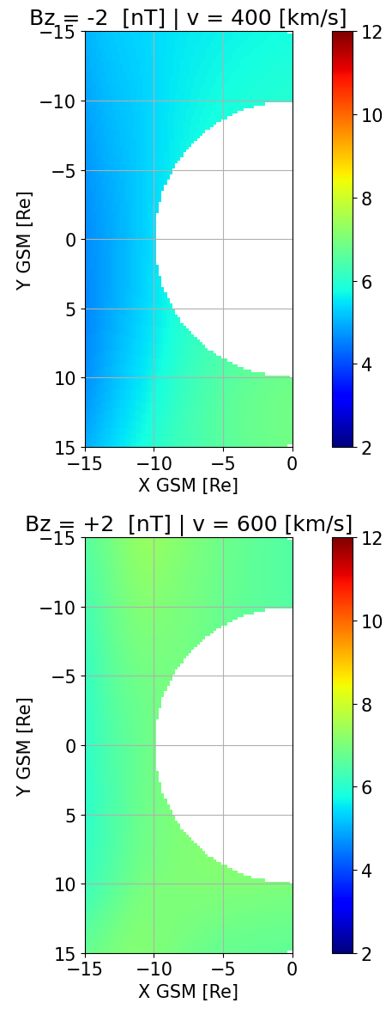
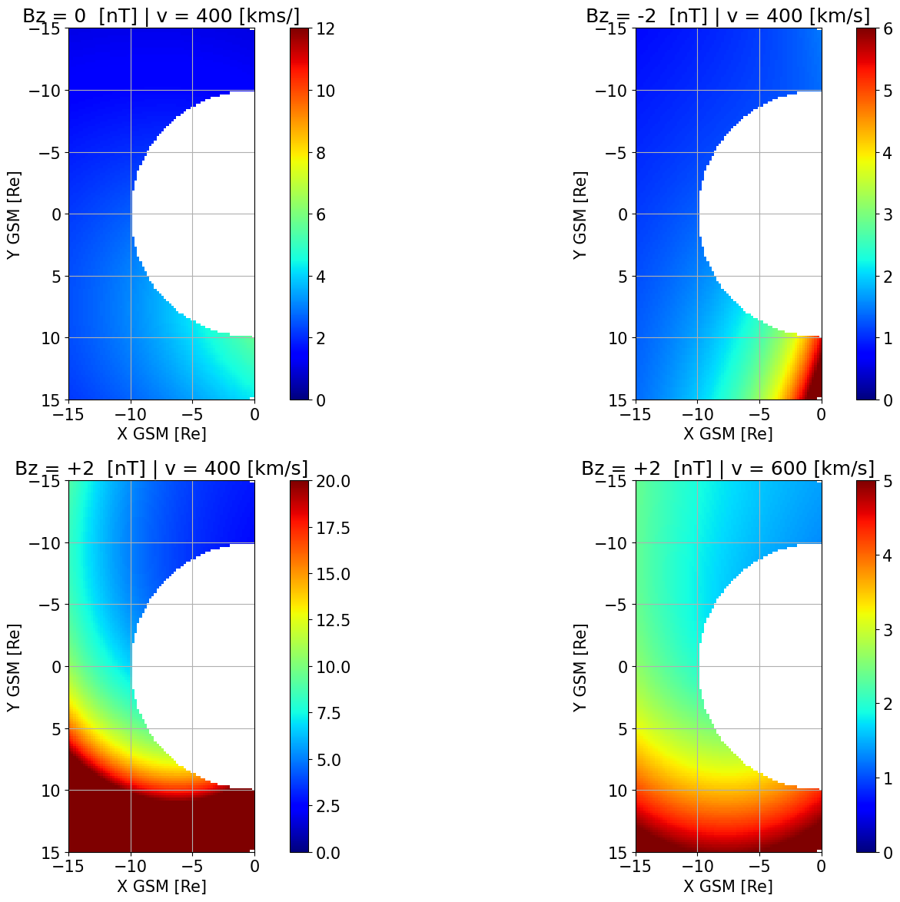
Modeling Temperature Ratios | 2D Maps
Note: here that this dataset I used from MMS are (a) not classified properly (on purpose) (b) trained with little optimization and (c) not pre-processed. Still, NN provide reasonable results.
No extreme values
Neural Networks modeling
Empirical modeling (TM03/DSGR16)

Slide 13
Summary & Discussion
Results:
Simple machine learning methods (ANNs) outperform empirical models when modeling bulk properties of plasma sheet
Models introduce data-driven asymmetries to the picture not typically captured by analytical modeling efforts
Examine physical consequences of what models shown in terms of plasma sheet dynamics (Future work)
Discussion point:
There are many biases/instrumental effects in datasets. Be careful and always consult people that know the instrumentation and the caveats of each mission.
Also don’t assume that a model that is fitted on one mission is applicable on another.

Slide 14
Extras

Slide 15
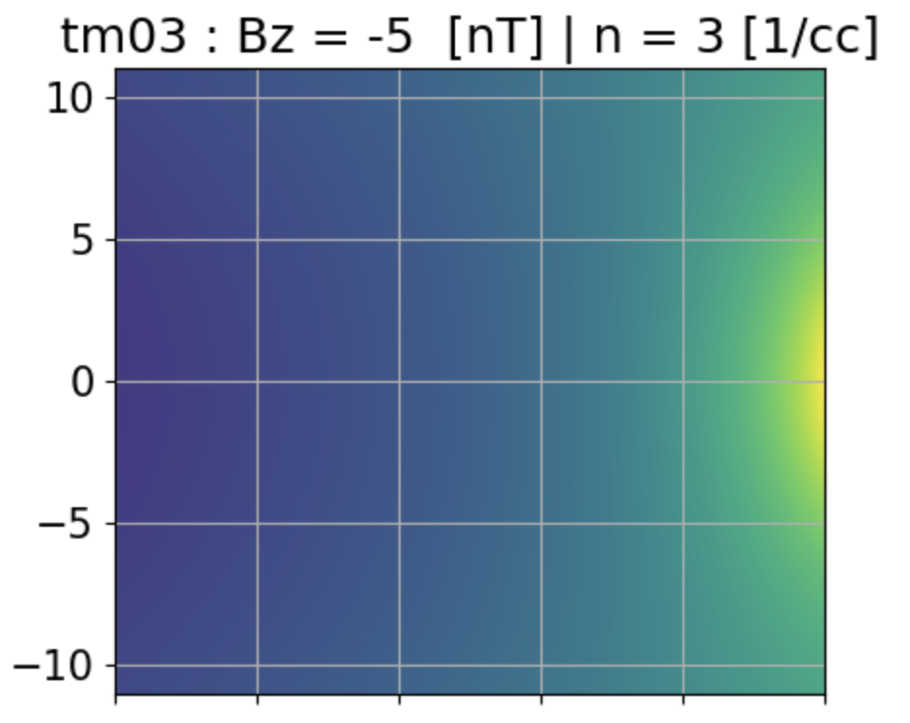
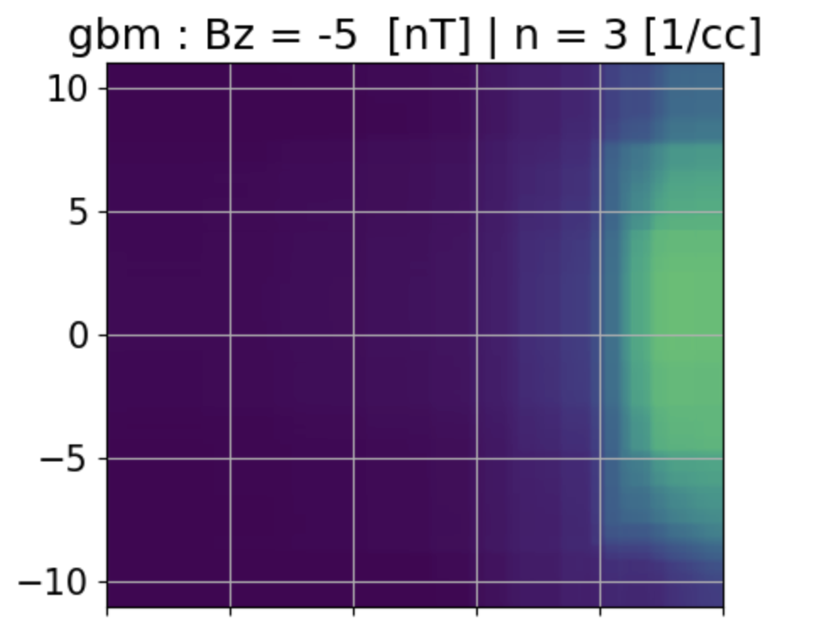
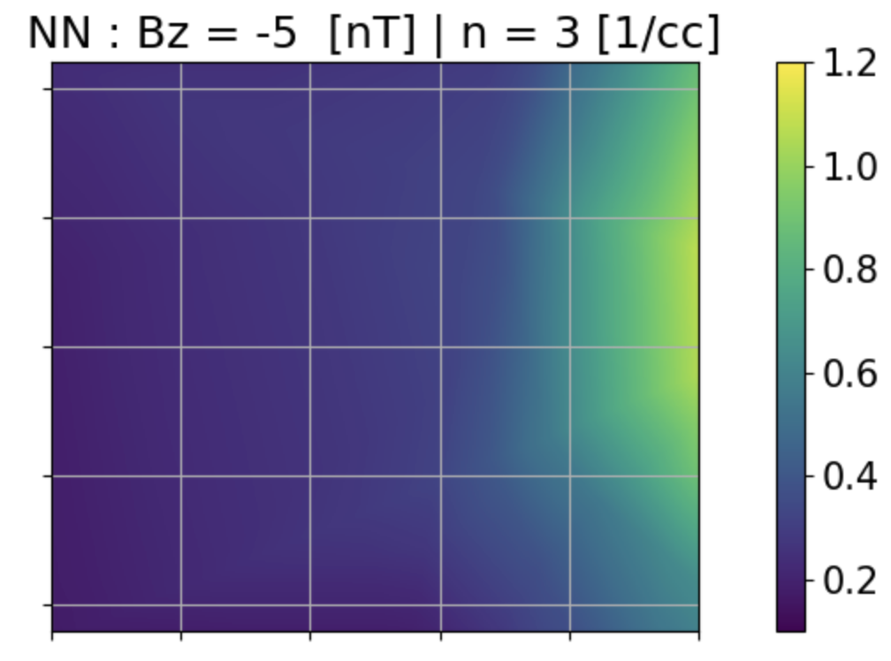
Modeling Bz in XY plane
Gradient boosting is great as a tool, but is a bad “extrapolator”.
It’s based on decision trees, so it finds mostly the “nearest” value rather than a new one, like a NN

Slide 16
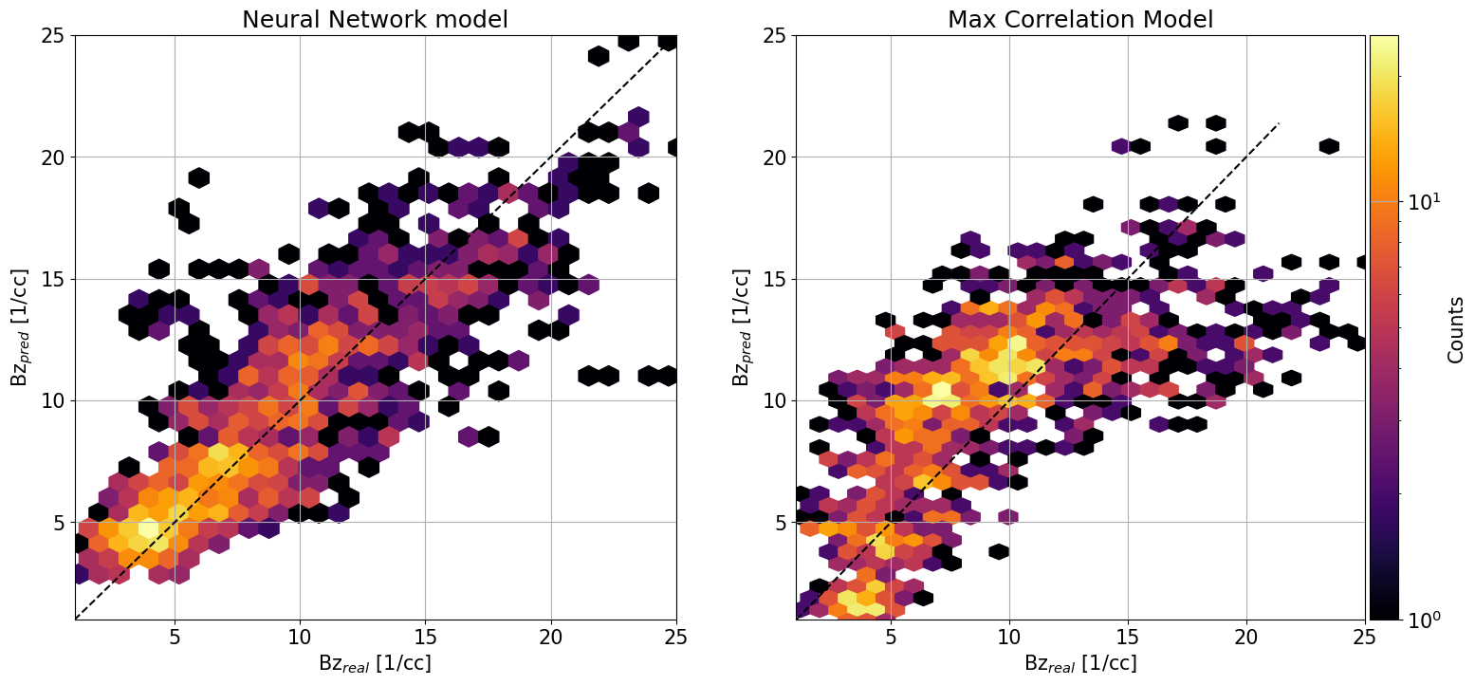
Modeling Bz | Predictions vs Observations
 | NN | CCA
R2 | 0.7 | 0.46
MAE | 1.9 | 2.9
RMSE | 2.67 | 3.635
r (cor) | 0.84 | 0.7
Presented Testing of NN → Very prone to data leakage
Harder test set (i.e., 5 years of test data) gives R2 ~0.5

