Slide 1

Plasma Sheet Magnetic Flux Transport During Geomagnetic Storms
Savvas Raptis¹, Slava Merkin¹, Shin Ohtani¹, Matina Gkioulidou¹, Leonardo Regoli¹
¹ APL/JHU, Laurel, MD, US
Supported by NASA DRIVE Science Center for Geospace Storms (CGS) - 80NSSC22M0163
savvas.raptis@jhuapl.edu
https://savvasraptis.github.io

Slide 2

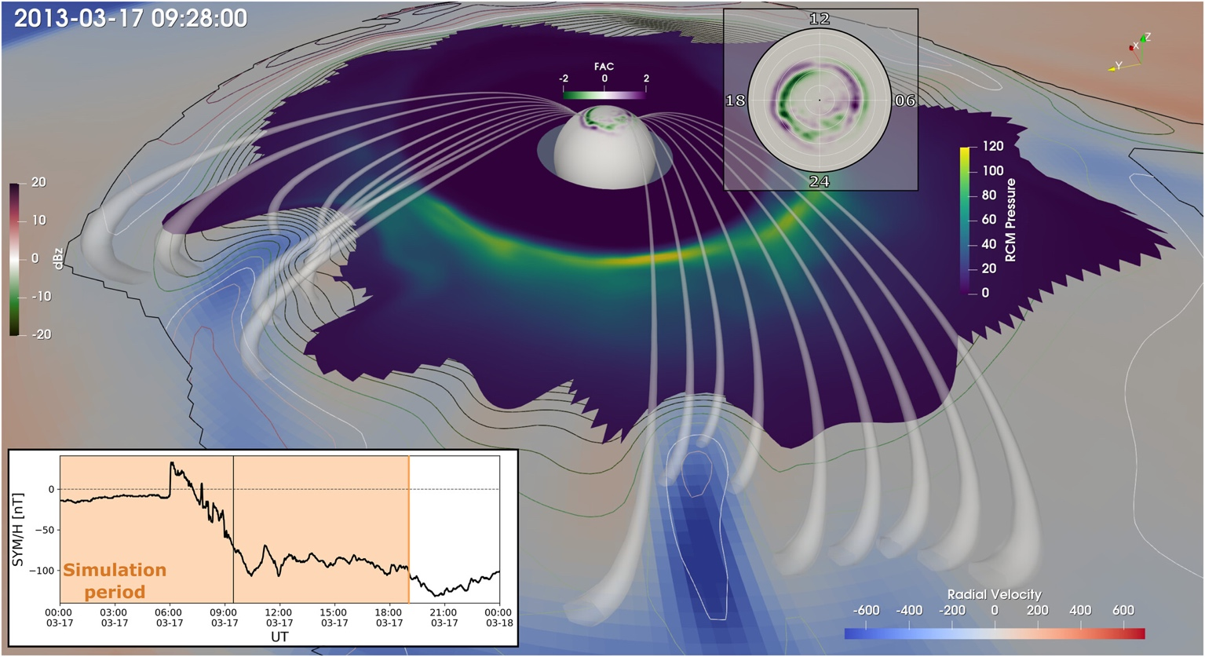
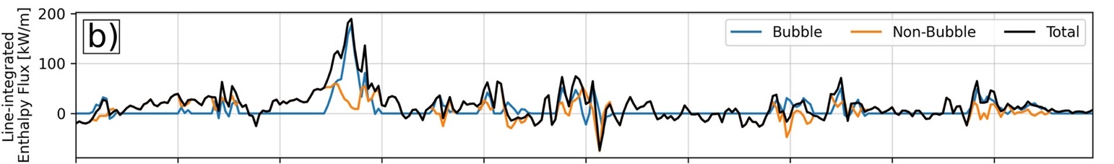
General Context - Motivation
One of CGS objectives:
The role of mesoscale plasma sheet transport in the ring current build-up
To tackle this we need to establish a clear understanding of the overall plasmasheet transport during quiet and storm times.
This work:
Focus on magnetic flux transport during storms
Building towards a holistic multi-spacecraft evaluation including mass and energy transport
50% of total energy flux transported into the inner magnetosphere by mesoscale structures
Sciola+ 2023
https://cgs.jhuapl.edu

Slide 3

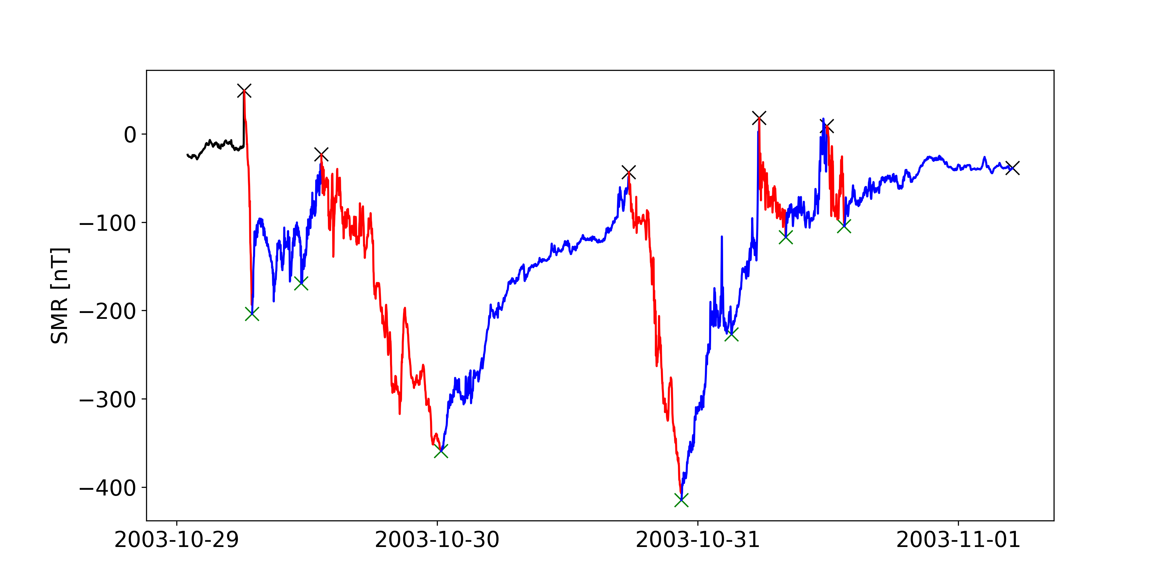
Storm phases classification
2003 Halloween Storm
Recovery | Main
Verified with methodology of Ohtani 2021

Slide 4


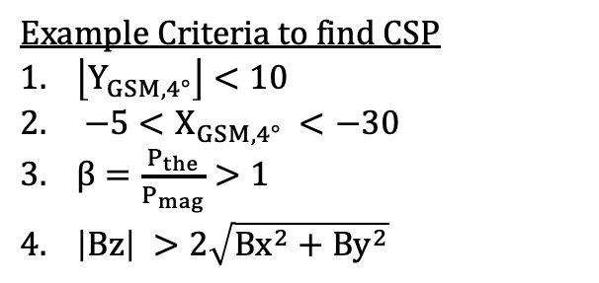
Plasmasheet Coverage per mission
Example Criteria to find CSP
$\left\lfloor Y_{GSM,4°}\right\rfloor <10$
$−5<X_{GSM,4°} <−30$
$β=\frac{P_{the}}{P_{mag}}>1$
$\left|Βz\right| >2\sqrt{Bx^{2}+By^{2}}$
See e.g., Ohtani+ 2008, Guild+ 2008, Roziers+ 2009, Vo+ 2023
Geotail > 1 million points ~250 storms
MMS ~ 250k points ~25 storms
MMS have limited observations during storm times (especially main phase)
Main phase contains data from about 6 storms for MMS
Slightly more Dawn data during main phase for Geotail
Disclaimer: absolute numbers can be sensitive to criteria
Raptis+ 2024 (under review)

Slide 5



Plasma Sheet Convection – Geotail
Storm Ey $↑$
Outer
Inner
Main V⊥x $↑$
Storm Bz $↑$
Towards Earth
Raptis+ 2024 (under review)

Slide 6
Plasma Sheet Convection – MMS
Storm Ey $↑$
Outer
Inner
Main V⊥x $↑$
Storm Bz $↑$
Towards Earth
Raptis+ 2024 (under review)

Slide 7




Storm - Main Phase Behavior
Ey $↑$
V⊥x $↓$
(1)
(1)
Bz $↑$
Dusk
Dawn
(2)
(2)
Outer
Inner
V⊥x $↑$
Ey
V⊥x
Bz
Raptis+ 2024 (under review)

Slide 8
Discussion & Conclusion
Summary
During storm times:
Plasmasheet during storm times has elevated Ey associated with increased Bz, and limited enhancement of V⊥x throughout the whole magnetotail.
During Storm times:
Dusk observations showing more dipolar magnetic fields
Dawn are associated to relatively faster flows
Future Work
Evaluate mass and energy flux transport
Create similar datasets and evaluate THEMIS dataset
Quantify contribution of mesoscale transient phenomena across different missions
Supported by NASA DRIVE Science Center for Geospace Storms (CGS) - 80NSSC22M0163

Slide 9
Backup

Slide 10
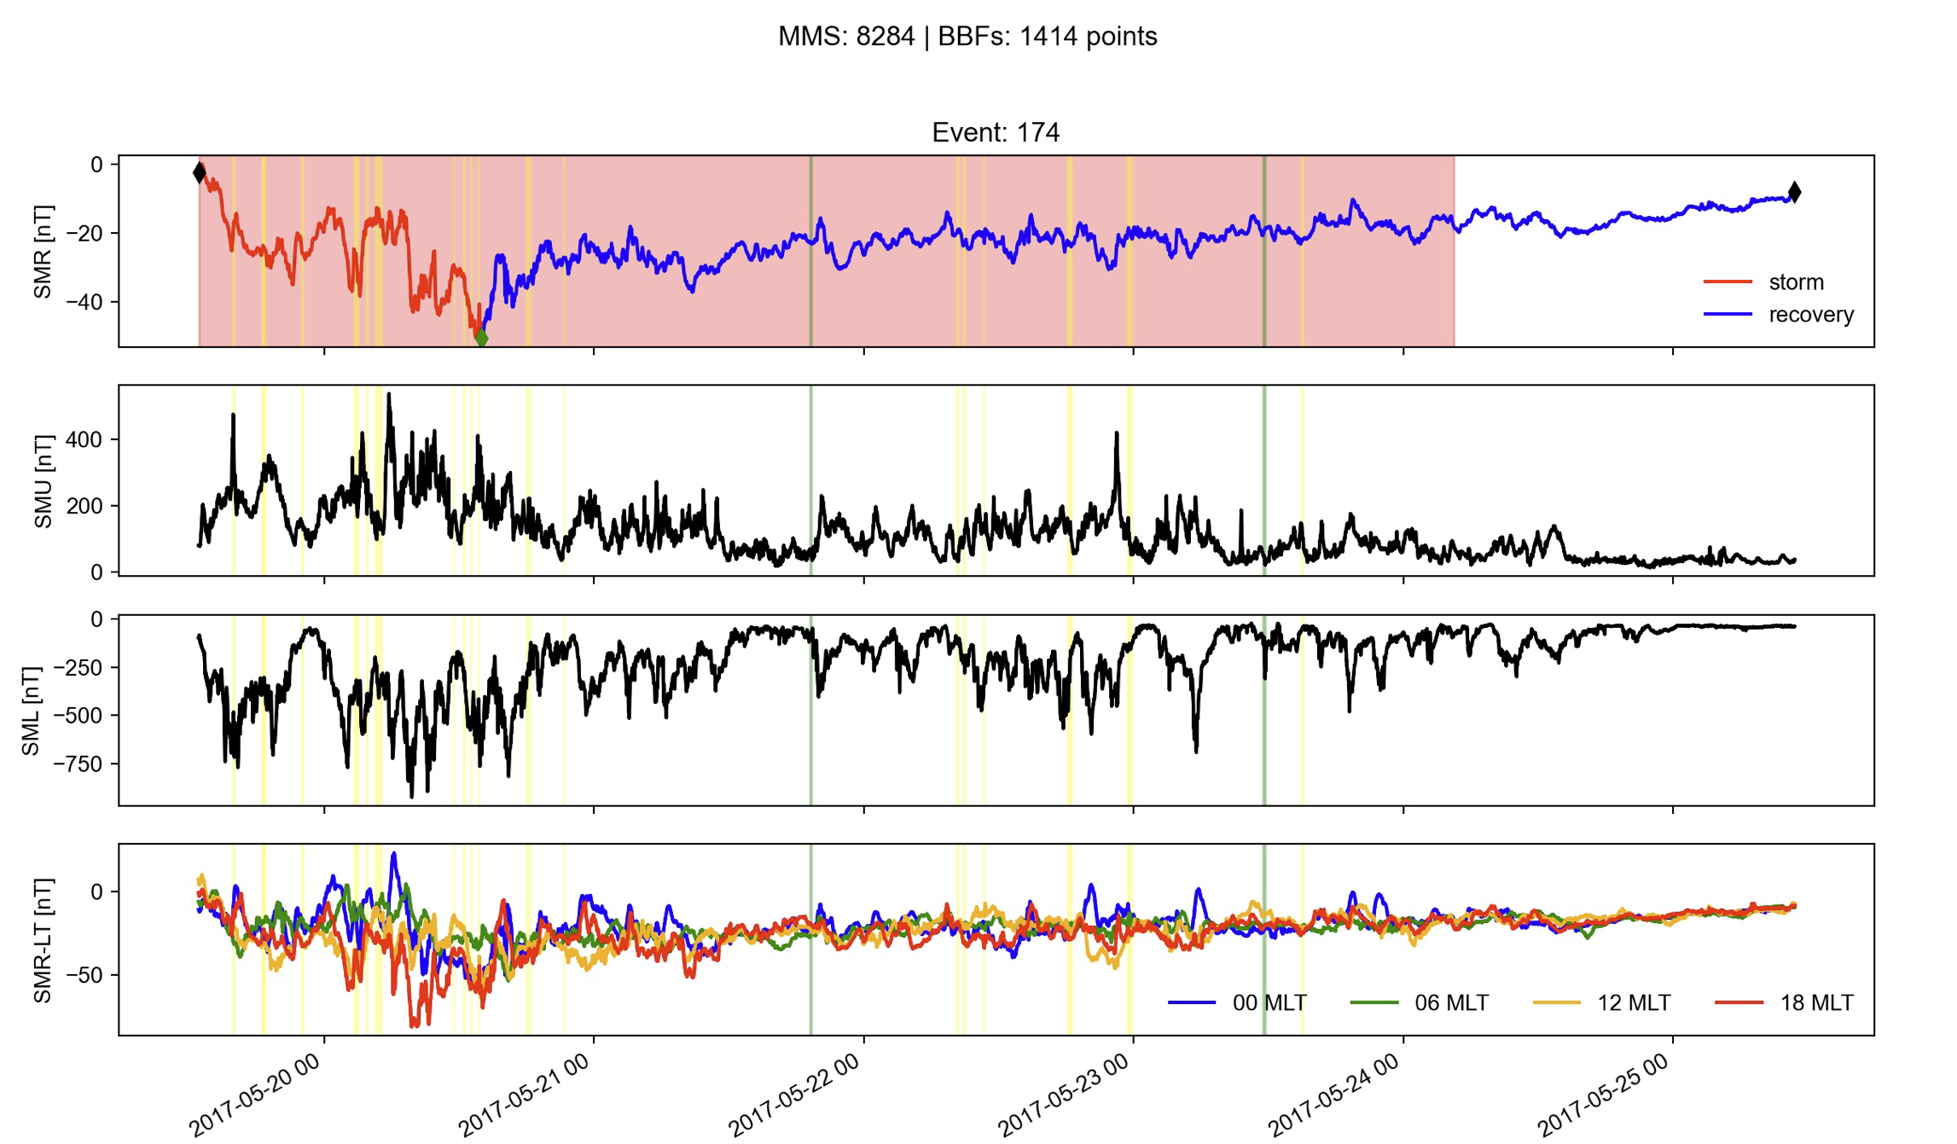
Future work: Connecting storms to SC coverage & to transients
Red = MMS coverage
Green = IP shocks
Yellow = BBFs

Slide 11
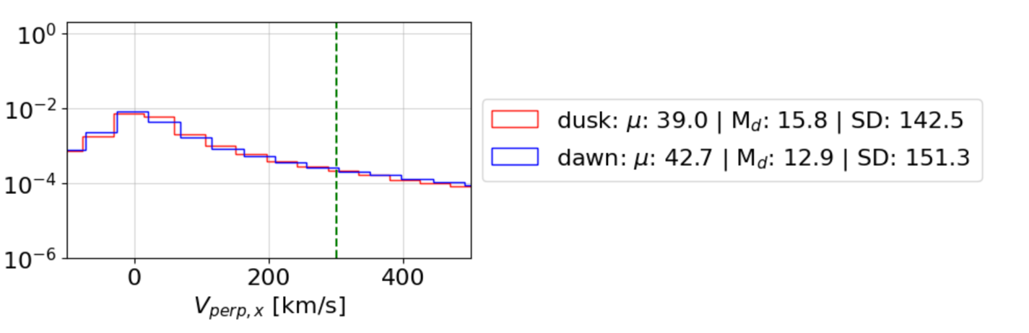
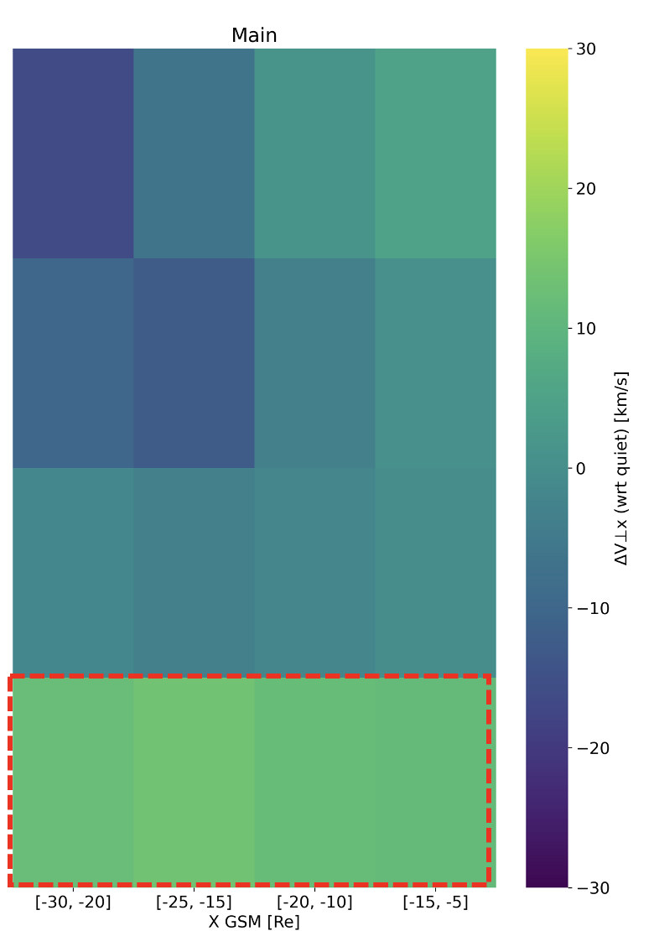
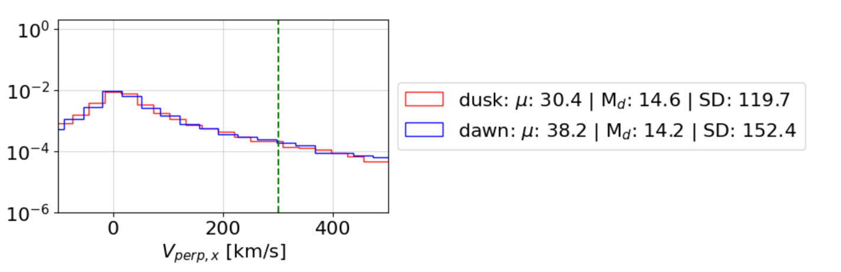

Dusk – Dawn Asymmetry Velocity
Quiet
Dusk
Recovery
Dawn
Main

Slide 12
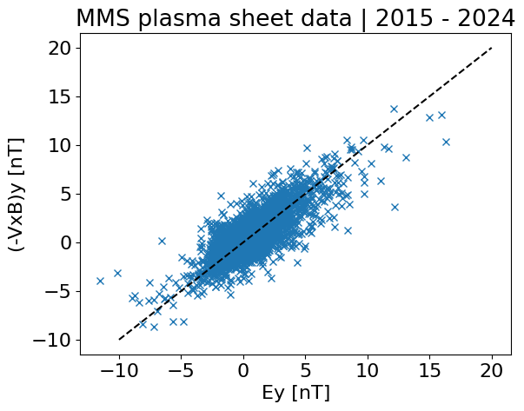
Can we use VxBy as a proxy of Ey?

Slide 13
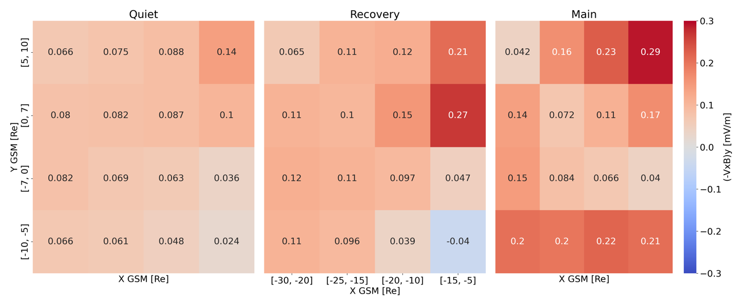
Spatial distribution - Ey

Slide 14
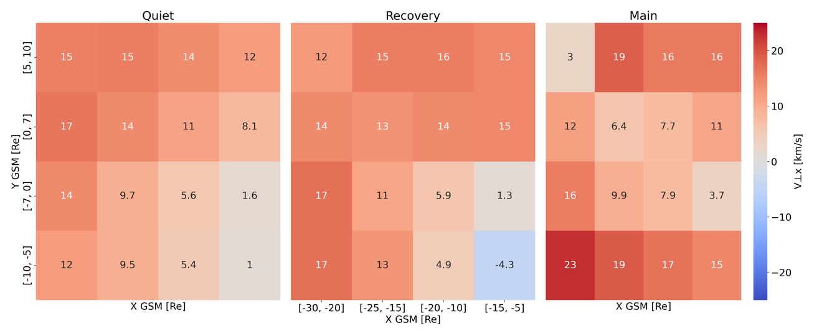
Spatial distribution - V⊥x

Slide 15
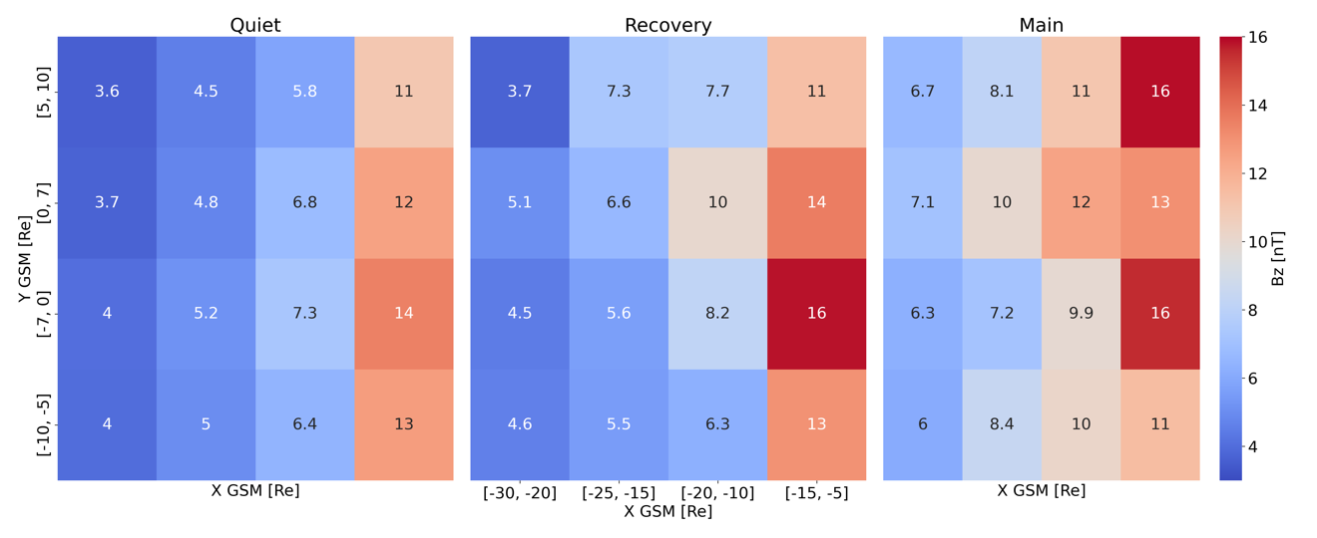
Spatial distribution - Bz

