Slide 1
Shock Kinetic Processes and Particle Energization
Savvas Raptis
Collaborators: Ahmad Lalti, Martin Lindberg, Drew L. Turner, Damiano Caprioli, James L. Burch, Primoz Kajdic, Ian Cohen, Athanasios Kouloumvakos, Tomas Karlsson, Ian Cohen, Adnane Osmane, Adam Michael, Mike Shumko, Eva Krämer, Xóchitl Blanco-Cano, Lynn B. Wilson III , Hadi Madanian, Lucille Turc, Yufei Zhou, Christos Katsavrias, Terry Liu, Laura Vuorinen, Philippe Escoubet, David G. Sibeck+ +
Supported by Johns Hopkins University Applied Physics Laboratory independent R&D fund.
savvas.raptis@jhuapl.edu / https://savvasraptis.github.io

Slide 2
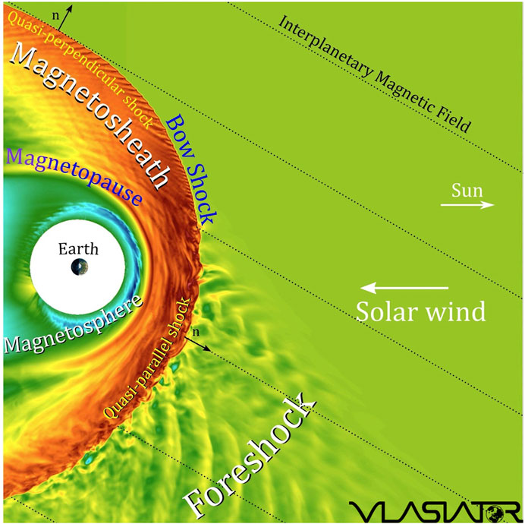
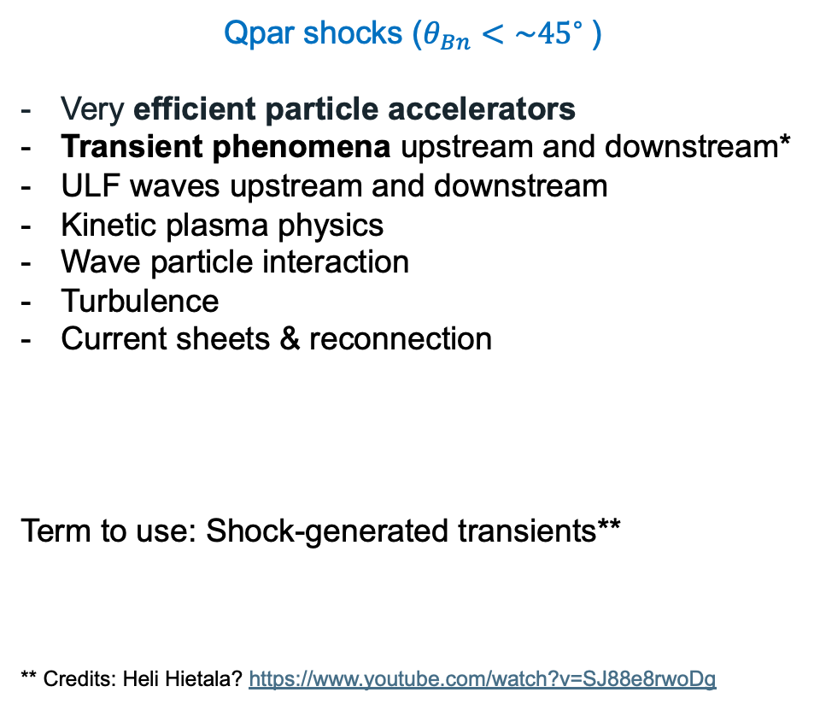
Earth’s Qpar bow shock and foreshock
Qpar shocks ($θ_{Bn}<\sim {45}^{∘}⁡$)
Very efficient particle accelerators
Transient phenomena upstream and downstream*
ULF waves upstream and downstream
Kinetic plasma physics
Wave particle interaction
Turbulence
Current sheets & reconnection
Term to use: Shock-generated transients**
** Credits: Heli Hietala? https://www.youtube.com/watch?v=SJ88e8rwoDg

Slide 3
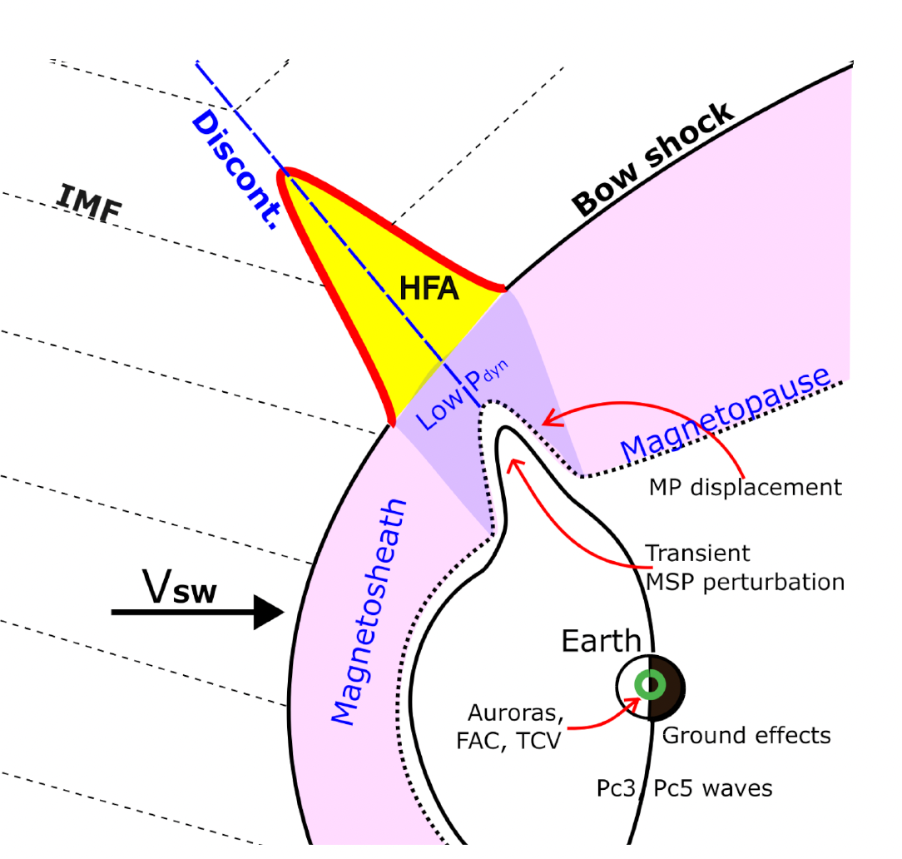
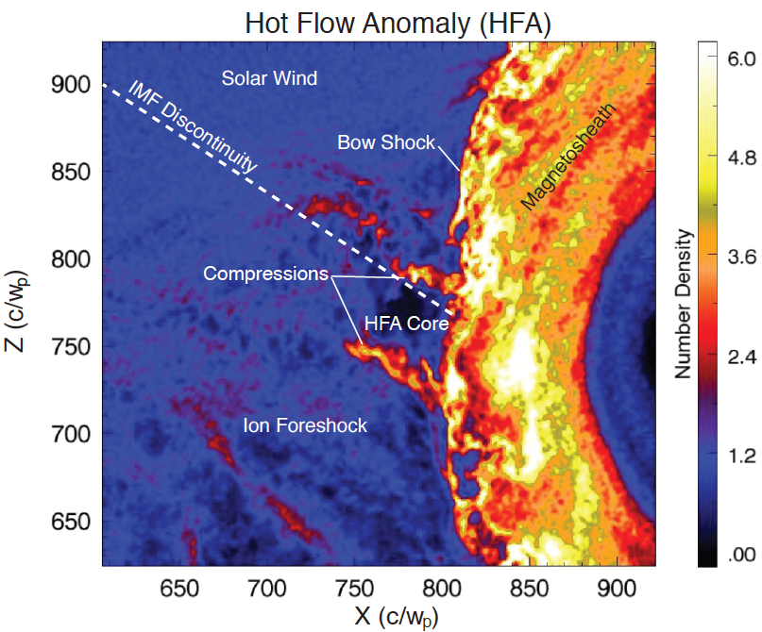
The anatomy of an HFA
How many: ~several per day!
How big: ~10s of Re
Crater-like B-field and IMF discontinuity
Upstream
shock
Solar wind beam disrupted
Density compressions and cavity
Upstream
shock
Strong plasma flow
deflections in core
Hot Flow Anomalies (HFA)
Figure by Nick Omidi
Kajdič+ (2024)
Superheated core plasma
Discontinuity intersects the bow shock and the convection electric field
(−V X B) points towards the sheet on at least one side.
Figure by Drew Turner

Slide 4
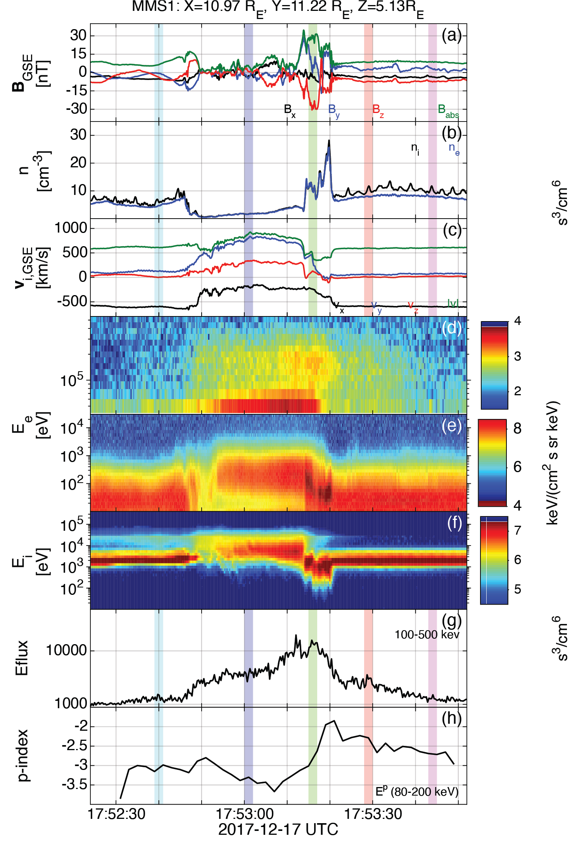
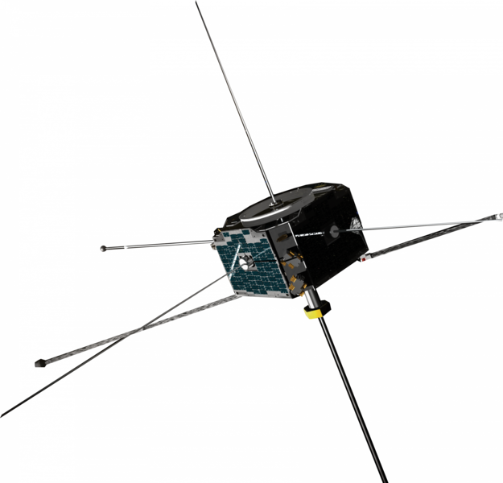
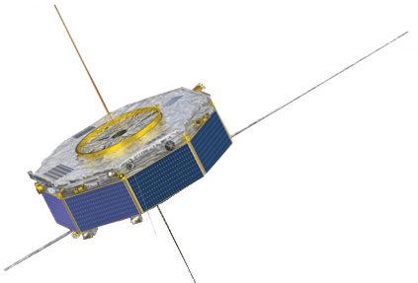

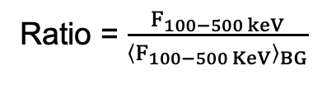
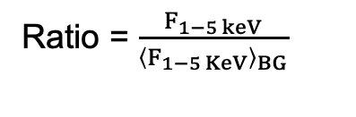
Reinforced Shock Acceleration of Relativistic Electrons
Most energetic electrons observed (500+keV) at foreshock transients by MMS showing:
Seed population from fast solar wind at suprathermal energy range (1-5 KeV)
Shock acceleration (SDA/DSA) + Wave particle interaction (high frequency “chorus” waves)
Efficiency factors (Trapping and scattering – geometry with bow shock)
Ratio = $\frac{F_{100−500 keV}}{{\left\langle F_{100−500 KeV}\right\rangle }_{BG}}$
Ratio = $\frac{F_{1−5 keV}}{{\left\langle F_{1−5 KeV}\right\rangle }_{BG}}$
Max flux ratio
Max flux ratio
Discontinuity ARTEMIS
Key-point:
Seed + Foreshock’s Shock + Waves + Efficiency factors = ~MeV electrons before reaching the bow shock.
Transient MMS
Earth
~ 30 Re
Raptis+ 2024 (Revealing an Unexpectedly Low Electron Injection Threshold via Reinforced Shock Acceleration – Accepted)

Slide 5
Reinforced Shock Acceleration of Relativistic Electrons
Raptis+ 2024 (Revealing an Unexpectedly Low Electron Injection Threshold via Reinforced Shock Acceleration – Accepted)

Slide 6
What happens when we move downstream?
Raptis+ 2024/2025 (to be submitted next week)
Multi-Mission Observations of Relativistic Electrons and High-Speed Jets Linked to Shock Generated Transients

Slide 7
Cluster upstream showing foreshock transients
700 km/s Solar Wind!
Fast coronal hole plasma consistent with our previous work ✓
Several Foreshock Transients
~200 keV electrons
Raptis+ (under preparation)

Slide 8
MMS downstream shows the transmission
Series of flow anomalies similar to upstream
Localized jets at edges (both density and velocity peaks)
Extended ~300+ KeV electron interval confined (~ 30 mins)
Raptis+ (under preparation)

Slide 9
Electron energization upstream to downstream
Cluster | Upstream
MMS | Downstream
Similar model* to Liu et al., 2019
*Betatron in strong scattering → $\frac{ΔΕ}{Ε_{0}}=\frac{2}{3}\frac{ΔΒ}{Β_{0}} ,where ΔΧ=X_{down}−X_{up}$
Raptis+ (under preparation)

Slide 10

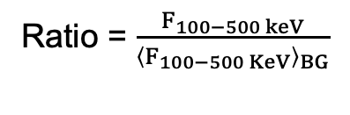
Summary: Electron Multiscale Acceleration
(A)
Discontinuity (SW) ARTEMIS
Transient (FS) MMS
(B)
Transient (FS) Cluster
Transient (MSH) MMS
Coronal Hole SW
V> 500 km/s
200 → 300 keV
~1 keV
>500 keV
Ratio = $\frac{F_{100−500 keV}}{{\left\langle F_{100−500 KeV}\right\rangle }_{BG}}$
Ratio = $\frac{F_{1−5 keV}}{{\left\langle F_{1−5 KeV}\right\rangle }_{BG}}$
Max flux ratio
Max flux ratio
SW - THEMIS
Foreshock - MMS
Magnetosheath – CL/MMS
: Raptis+ 2024 (“Accepted”) - Revealing an Unexpectedly Low Electron Injection Threshold via Reinforced Shock Acceleration
: Raptis+ 2025 (to be submitted) - Multi-Mission Observations of Relativistic Electrons and High-Speed Jets Linked to Shock Generated Transients

Slide 11
Key take away
: Raptis+ 2024 (Accepted) - Revealing an Unexpectedly Low Electron Injection Threshold via Reinforced Shock Acceleration
: Raptis+ 2025 (Ongoing) - Multi-Mission Observations of Relativistic Electrons and High-Speed Jets Linked to Shock Generated Transients
(A) Raptis+ 2024 (“Accepted”)
Revealed that electron injection threshold to obtain relativistic electrons (> 500 keV) at Earth’s foreshock can be at the low suprathermal range of ~1-5 KeV
This seed population is a systematic feature of the fast coronal hole solar wind plasma.
(B) Raptis+ 2025 (Ongoing)
Energized electrons (~200 keV) get further accelerated as transients get transmitted (~300 keV)
Transmitted Shock-Generated transients produce localized high-speed jets
Strongest electron acceleration may not happen at the shock transition
Transient phenomena are making shocks much more efficient accelerators

Slide 12

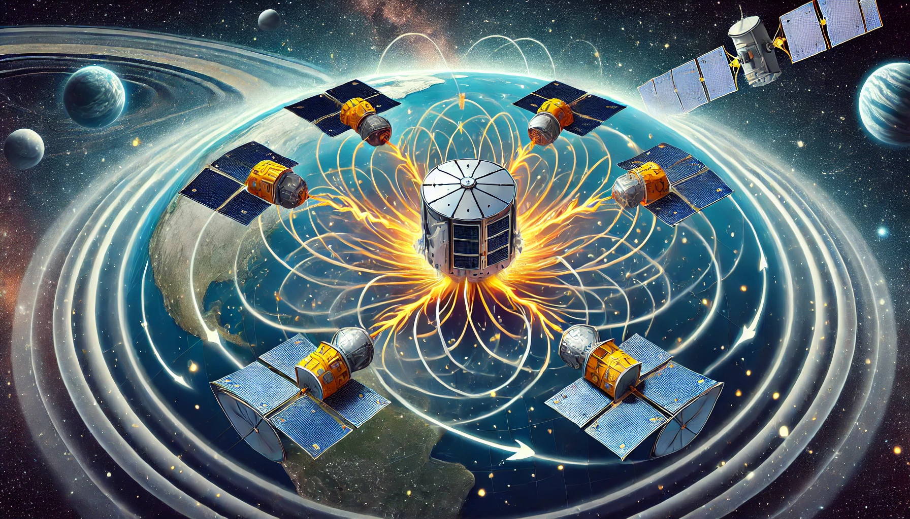
Final words
Plasma Observatory
As written on our latest ongoing draft:
“The multi-mission observations presented here emphasize the importance of adopting a multi-scale approach to address shock-related phenomena and reinforce the necessity of obtaining such data…. proposed missions such as the Plasma Observatory (PO) mission will be critical to advance our understanding of collisionless shock physics and associated particle energization. “
What ChatGPT thinks PO will do →

Slide 13
Extras

Slide 14
Reinforced Shock Acceleration of Relativistic Electrons
Electron acceleration at Foreshock Transient
Shock Acceleration
Wave particle interactions
Ratio = $\frac{F_{100−500 KeV}}{{\left\langle F_{100−500 KeV}\right\rangle }_{BG}}$
Injection Threshold
“Seeding”
Seed from
CH plasma
(~1-5 keV)
+
Max flux ratio
Efficient PA scattering & confinement:
- LF whistler waves (Shock Transition)
- Wavefield of HFA’s core (ΔB>>B)
- ”Magnetic bottle” between edges of HFA and Earth’s bow shock (geometry)
- Betatron (electron acceleration, temperature anisotropy)
Key-point:
Seed + Foreshock’s Shock + Waves + Efficiency factors = ~MeV electrons before reaching the bow shock.
Raptis+ 2024 (Revealing an Unexpectedly Low Electron Injection Threshold via Reinforced Shock Acceleration – Accepted)

Slide 15
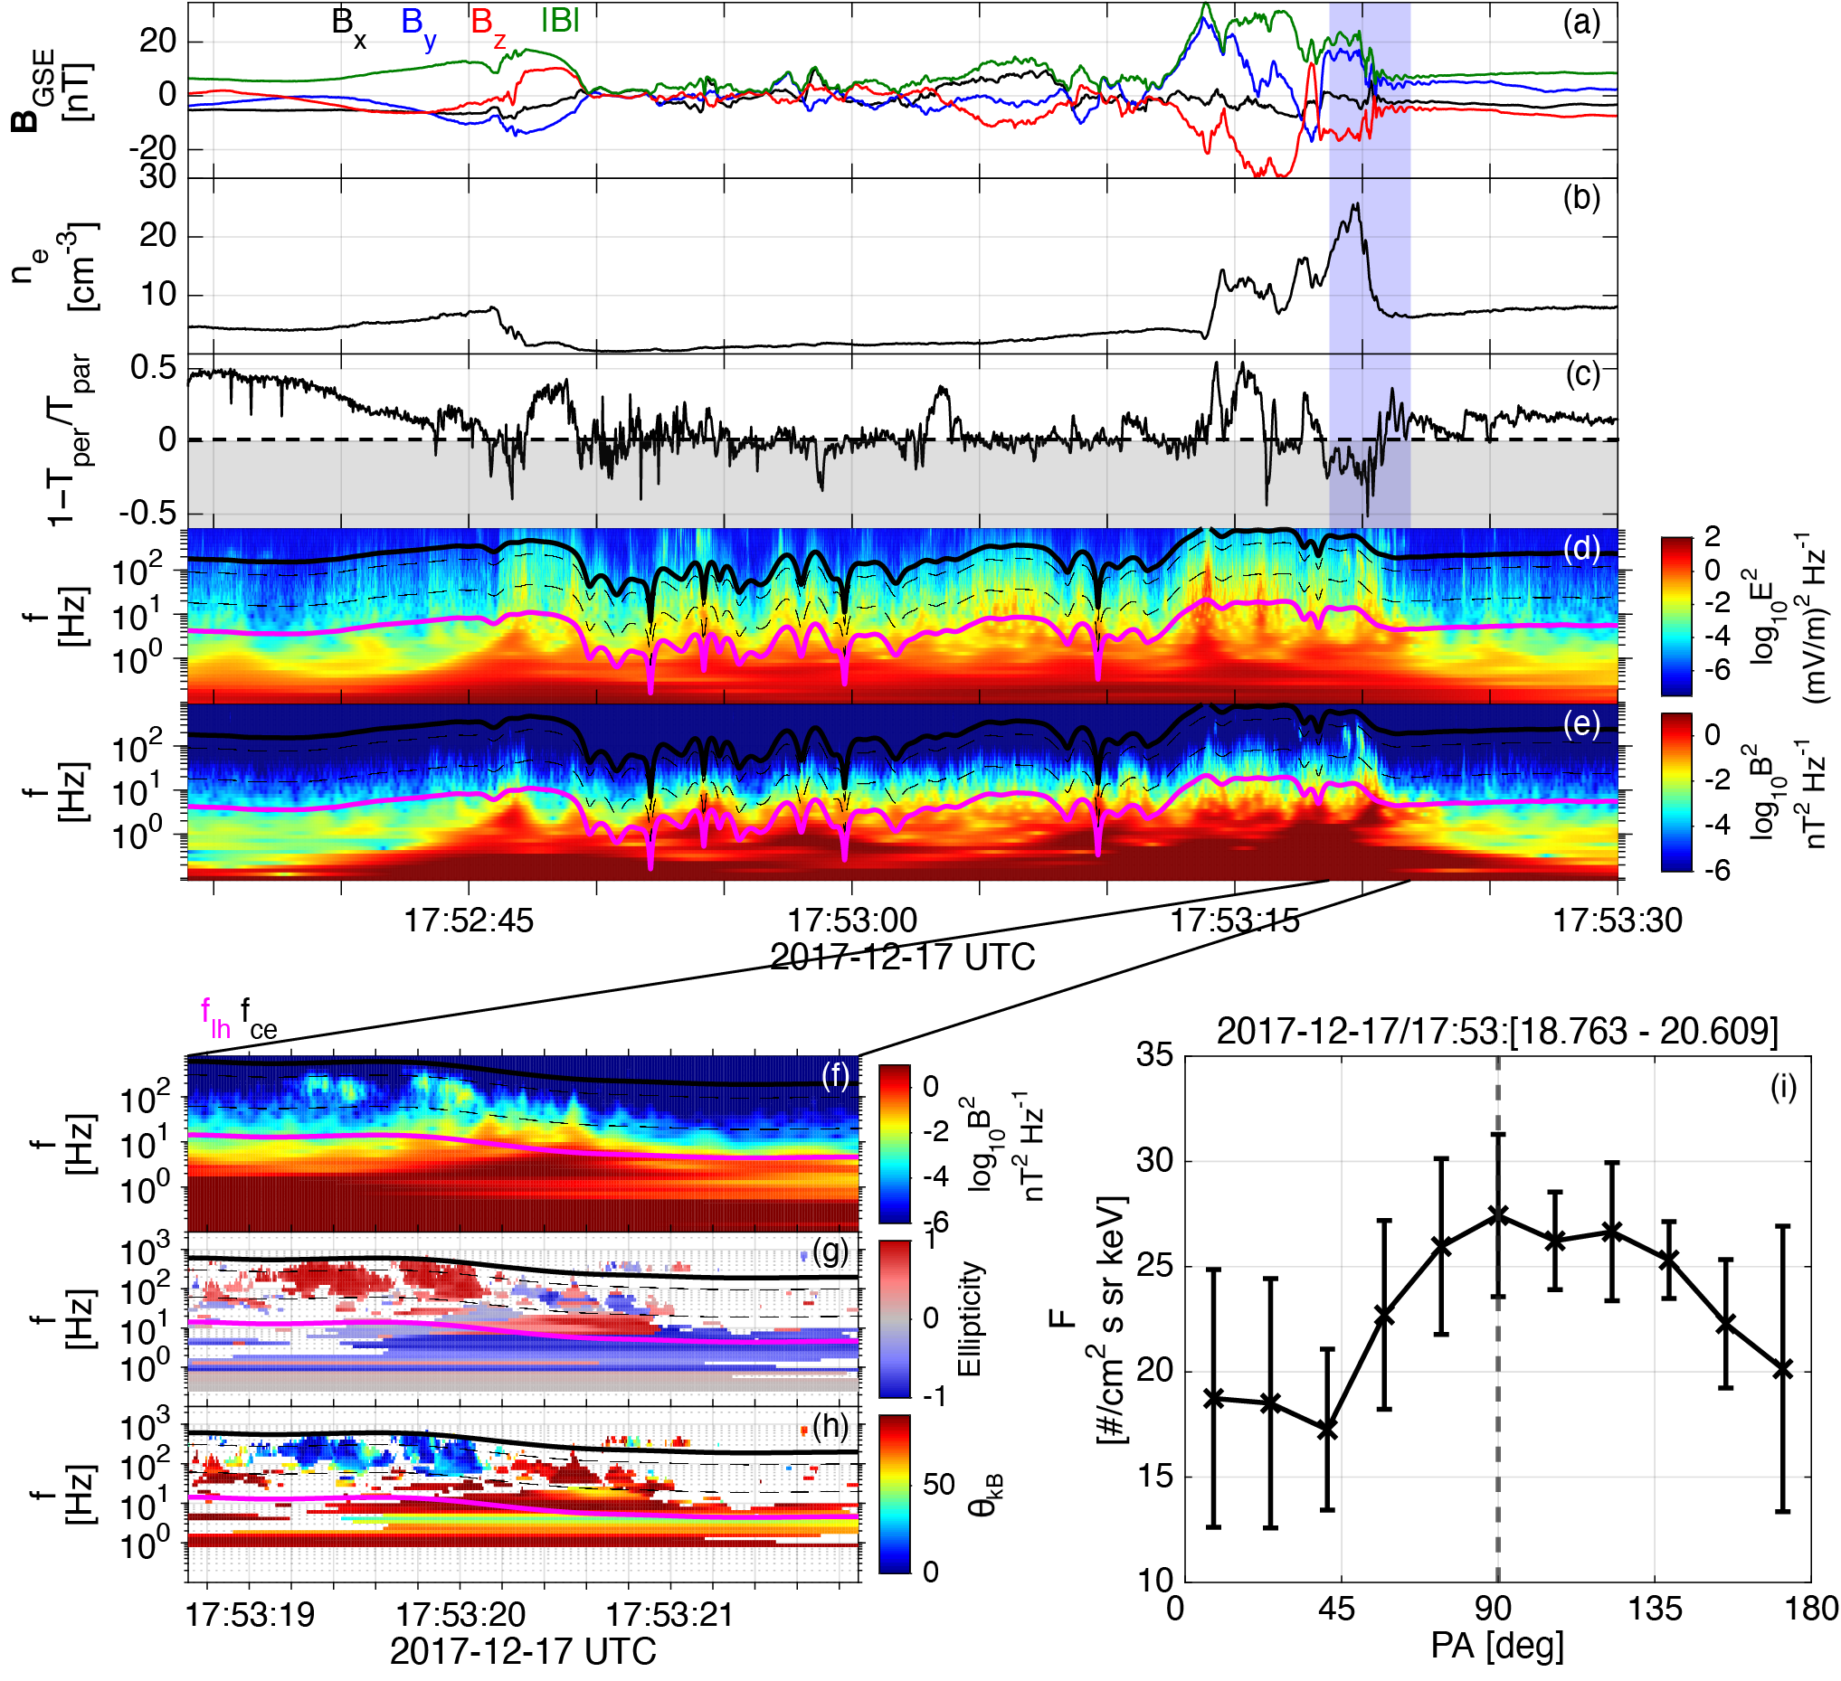
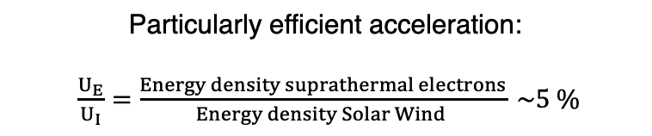
Wave analysis of event
Acceleration:
Shock Acceleration
Betatron → Temperature anisotropy
High amplitude electron whistler waves (Chorus) resonance
Scattering & Trapping:
- LF whistler waves (Shock)
- Wavefield of HFA’s core
- Geometry of HFA with respect to Earth’s bow shock
Particularly efficient acceleration:
$\frac{U_{E}}{U_{I}}=\frac{Energy density suprathermal electrons}{Energy density Solar Wind } \sim 5 \%$
Raptis+ 2024 (Revealing an Unexpectedly Low Electron Injection Threshold via Reinforced Shock Acceleration – Accepted)
See Artemyev+, Xiaofei+, Vargas + Tonoian+ (2022 – 2024)

Slide 16
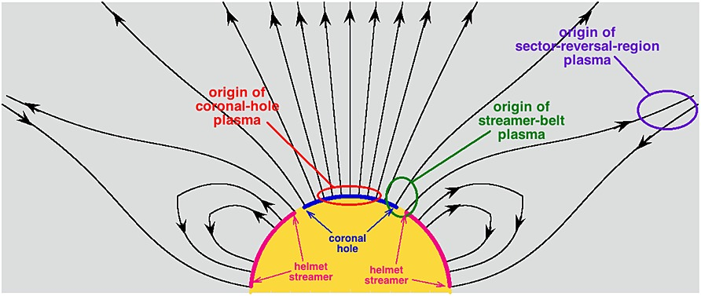

Statistics for seed and acceleration
Seed events (FEEPS > 100 KeV)
CH (78%), CH (40%), CH(79%), CH (39%), CH(77%), CH(79%)
No-seed (FEEPS = Noise)
SB (80%), SB(42%), EJ (55%) SB (44%), SR(63%), SB (46%)
Using: [Xu and Borosvky 2014, Camporeale+ 2017] methodology
Ratio = $\frac{F_{1−5 KeV}}{{\left\langle F_{1−5 KeV}\right\rangle }_{BG}}$
Raptis+ 2024 (Revealing an Unexpectedly Low Electron Injection Threshold via Reinforced Shock Acceleration – Accepted)
Terry Liu+ ( 2017) noticed similar trends

Slide 17
Location of SCs and IMF conditions
(A)
Cluster: Upstream
MMS : Downstream
(B)
L1 monitors apart
(C)
Temporal & spatial Variability ++
Discontinuities ++

Slide 18
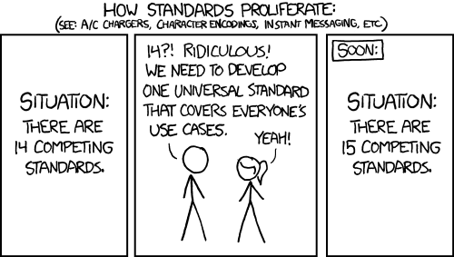
Discussing new models
*
*In our case models, mechanisms, explanations etc.

