Slide 1

Modeling Earth’s Plasma Sheet using Machine Learning
Savvas Raptis¹, Connor O’ Brien³, Louis Richard²,Slava Merkin¹, Kareem Sorathia¹, Simon Wing¹
¹ APL/JHU, Laurel, MD, US
² Swedish Institute of Space Physics, Uppsala, Sweden
³ Center for Space Physics, Boston University, Boston, MA, USA
Supported by John Hopkins University Applied Physics Laboratory independent R&D fund
savvas.raptis@jhuapl.edu
https://savvasraptis.github.io

Slide 2
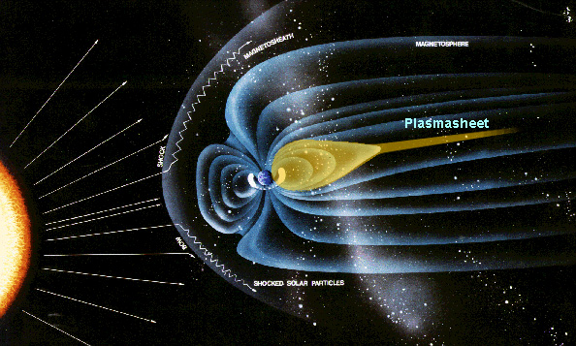
Earth’s plasma sheet
Magnetotail reconnection
Bursty Bulk Flows (BBFs)
Global Convection Patterns
Ring current
Modeling PS is useful for:
Understanding storm/substorm dynamics
Explain ring current configuration
Facilitate space weather modeling
Understand inner magnetosphere
Source for radiation belts

Slide 3
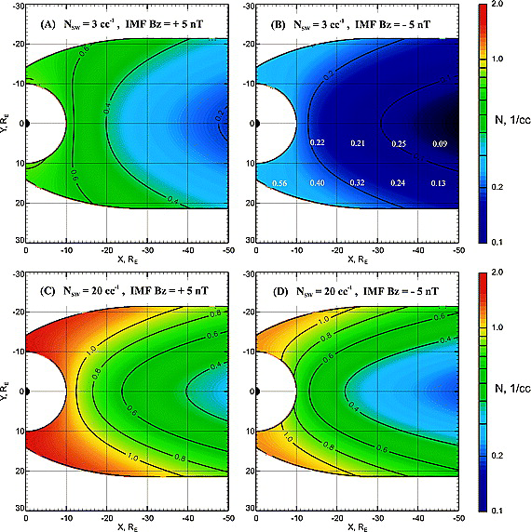
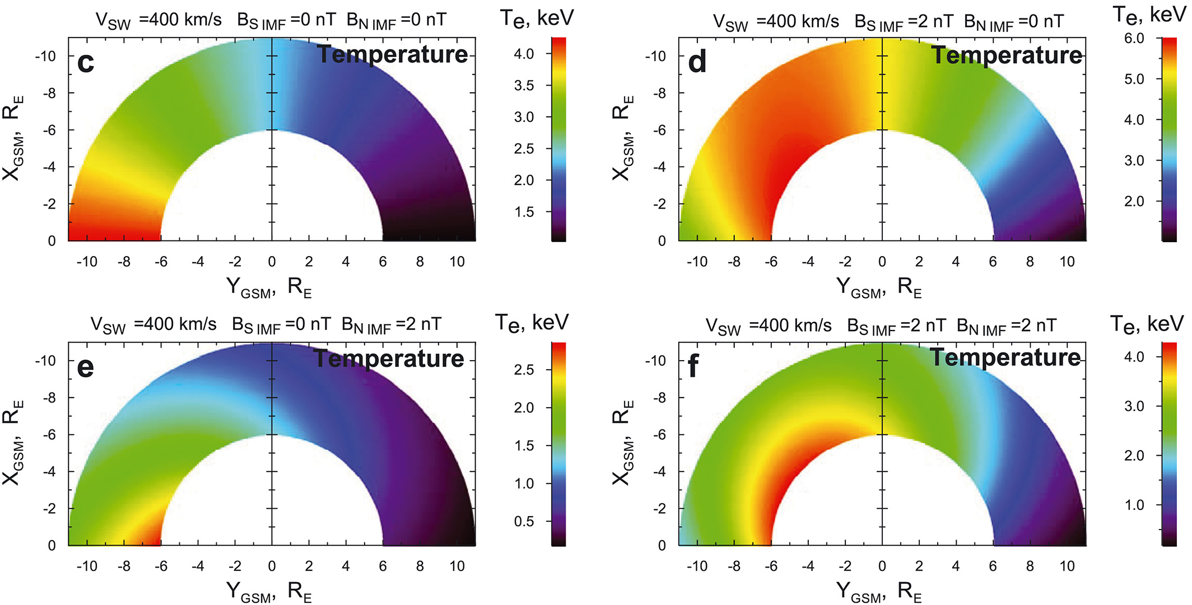
Baseline empirical models
Modelled with Geotail
Modelled with THEMIS
Dubyagin+ 2016
Why then work on this?
More data under different conditions
MMS was never used with its state of the art instrumentation
These models don’t include time history
ML methods can reveal non-linear relationships easily
Tsyganenko & Mukai 2003

Slide 4
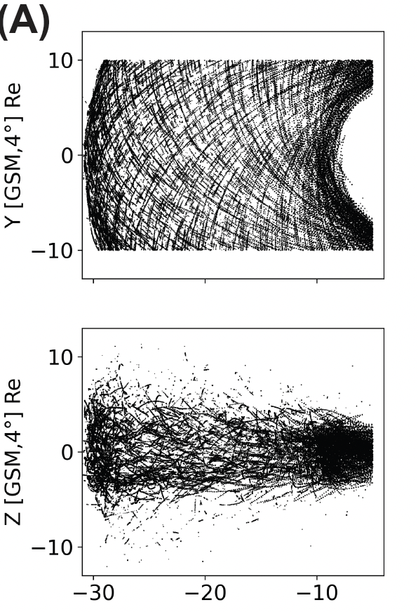
The dataset (output – Central Plasma Sheet)
Geotail (1994 - 2022)
>1 million points (~12s res)
(B) MMS (2015 – 2024)
~ 250k points (~12s res)
Output:
Anything locally measured
(In this example plasma moments)
Raptis+ 2024 (GRL)

Slide 5



Data Scientist POV (i.e., Input, output & regression)
Input
SW properties + Geo conditions
Output
Plasma Sheet
Quantity
Dense Neural Network
Regression
$$\begin{matrix}x_{+5} \\ ⋮ \\ \begin{aligned}x_{−365} \\ r_{x},r_{y},r_{z}\end{aligned}\end{matrix}$$
$$…$$
$$y_{0}$$
Input:
x: Different solar wind features (e.g., n, B, etc.) + geomagnetic indices including time history up to 6h
r: Location of SC measuring output
Output:
y: Different quantities at plasma sheet (e.g., n, B, T etc.)
SW Input tried: Wind (1min res) – OMNIweb (1/5 min res)
Results here shown for 1min averaged quantities for output

Slide 6
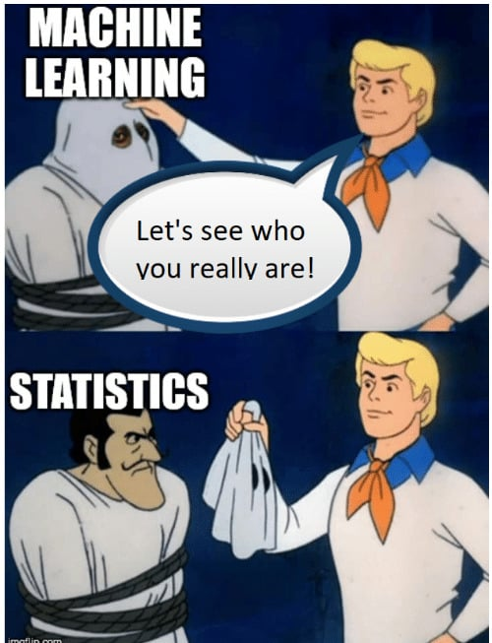
Statistical Results
Notes:
20 minutes mark

Slide 7
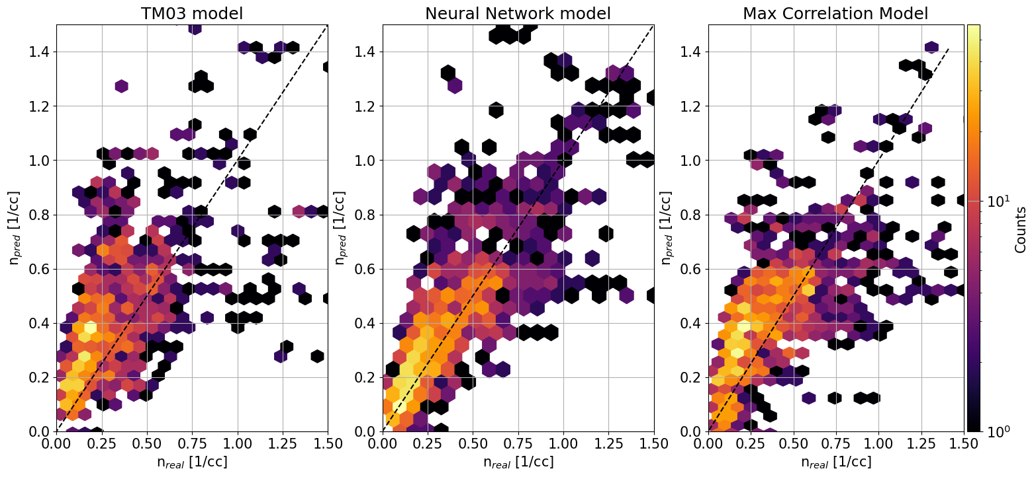
Modeling Density | Predictions vs Observations
Model maximizing correlation for input and output (replace for linear regression)
Results from Last GEM
Key Message: NN > Baseline> TM03
 | TM03 | NN | Base
R2 | 0.17 | 0.68 | 0.32
MAE | 0.19 | 0.11 | 0.18
RMSE | 0.27 | 0.2 | 0.27
r (cor) | 0.58 | 0.83 | 0.57
Geotail data
Presented Testing of NN → Prone to data leakage
Harder test set (i.e., 5 years of out of sample test data) gives R2 ~0.3-0.4
Raptis, O’Brien et al., 2024 (under prep.)
Disclaimer: not exactly same input of original empirical models

Slide 8
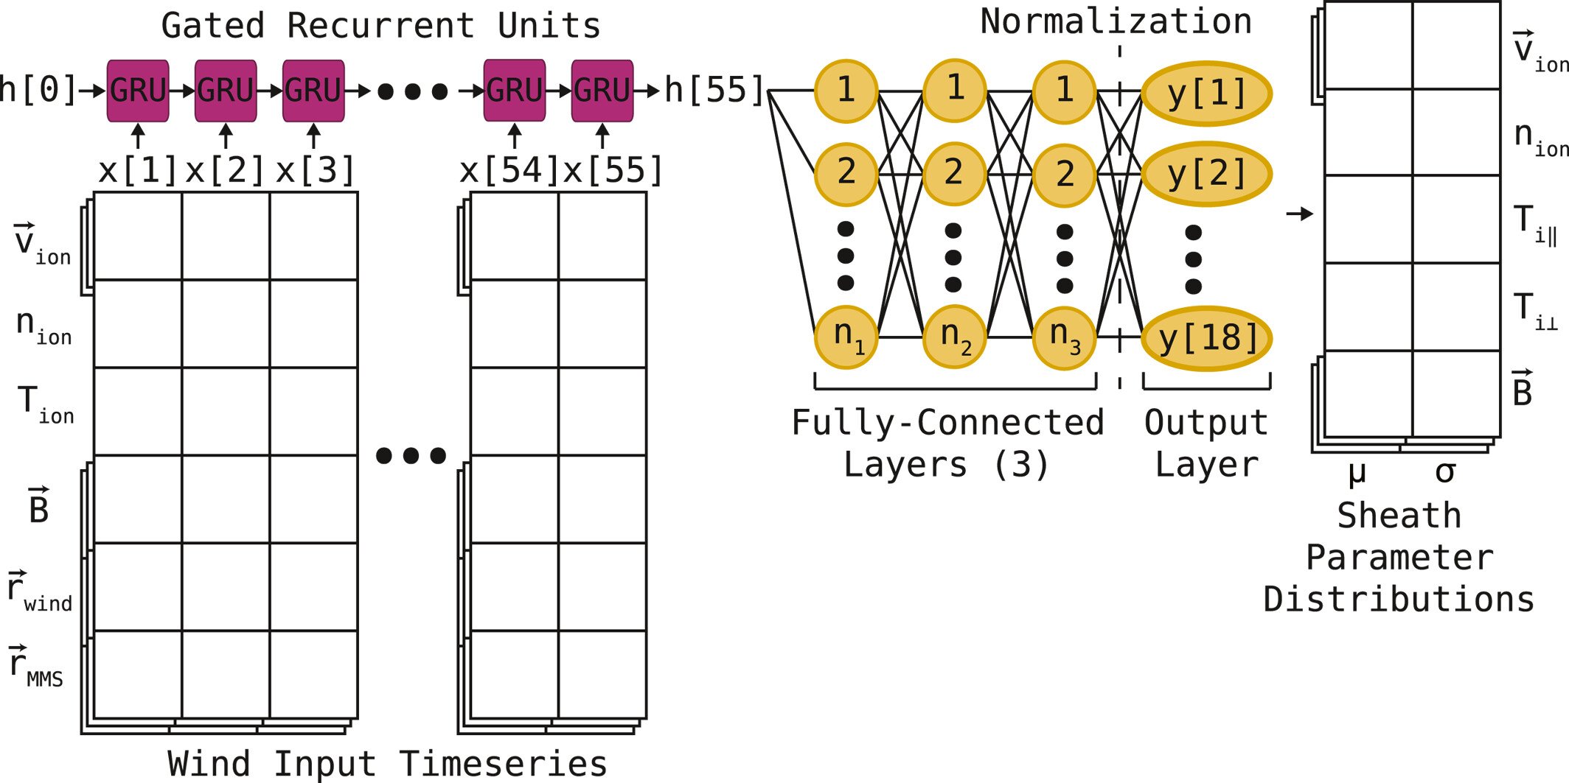
More methodologies & input space
PRIME: GRU architecture, non-propagated Wind values tried up to several hours of history time
Time History | Type of Input | Architectures
1-10h | Wind (L1) | Linear Reg
 | OMNIweb | Gradient Boosting
 |  | Neural Network
 |  | RNN/LSTM/GRU (PRIME-PS)
O’Brien et al., 2024
Also tried different error functions, optimizers, hyperparameters etc.
TODO some different imbalanced techniques
Key Takeaway:
To quantify our method's impact, we tested diverse variations of the problem.
Raptis, O’Brien et al., 2024 (under prep.)

Slide 9
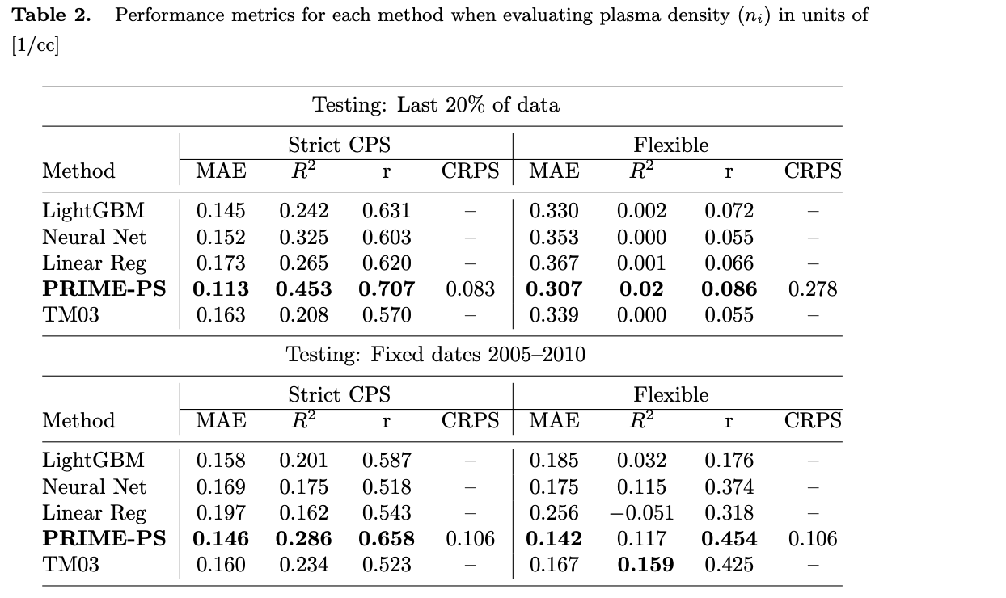
Updated results (Test set, last 20% of data)
Key Results:
PRIME-PS demonstrates a performance edge (~30% MAE from TM03 and ~15% from other ML).
This advantage can get quite low (from cross-validation | not shown).
Different input, method, time-history, and hyperparameter tuning etc. had overall a statistically marginal effect.
Why is this the case?
Raptis, O’Brien et al., 2024 (under prep.)

Slide 10
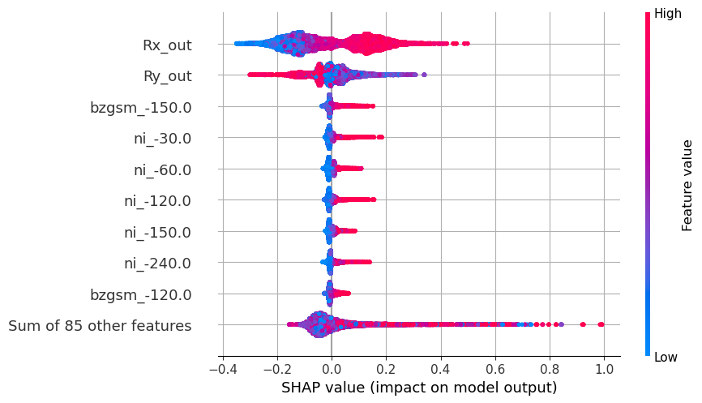
Preliminary feature Importance Analysis
More density close to earth and at dawn
X GSM
Y GSM
Answer: In most cases (statistically):
Model is predominantly driven by spacecraft location
Solar wind input only marginally affects performance
SHAP Values explain why a model made a specific prediction, by showing each feature's impact.

Slide 11
Modeling Efforts
Notes:
20 minutes mark

Slide 12
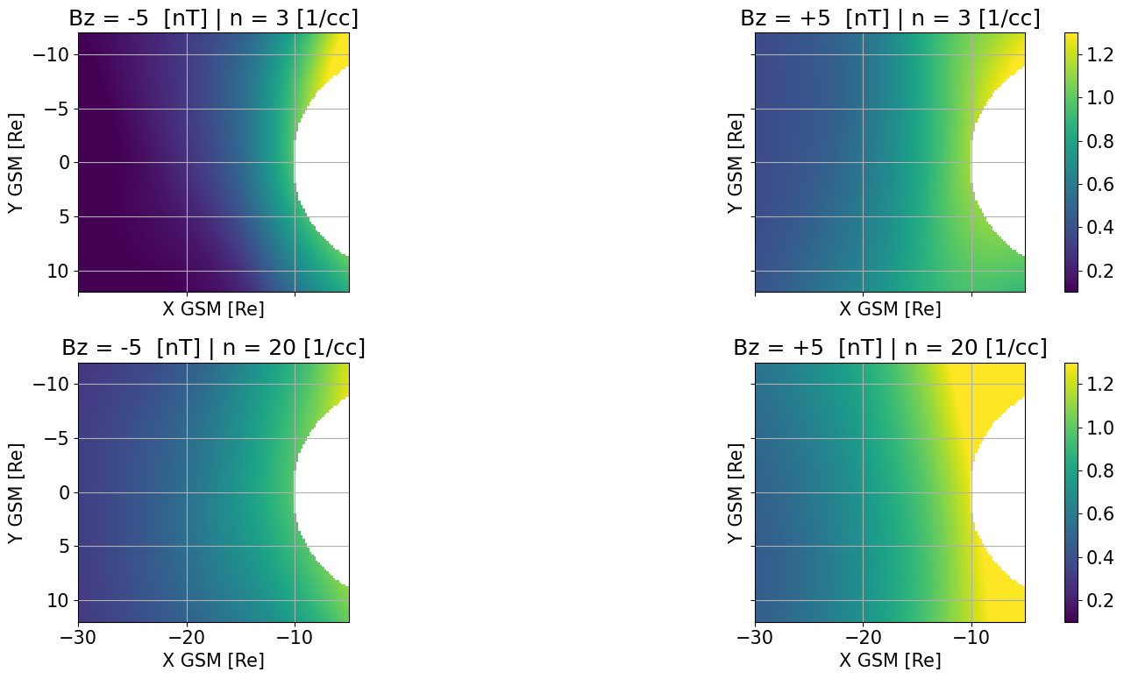
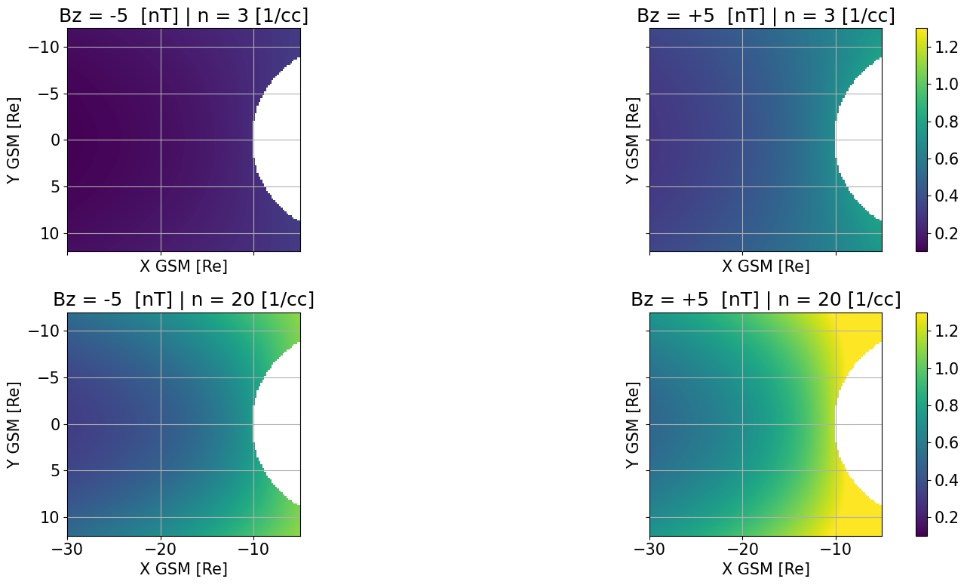
Modeling Density | 2D Maps
Asymmetries introduced
N [1/cc]
N [1/cc]
Neural Networks modeling
Empirical modeling (TM03)
Raptis, O’Brien et al., 2024 (under prep.)

Slide 13
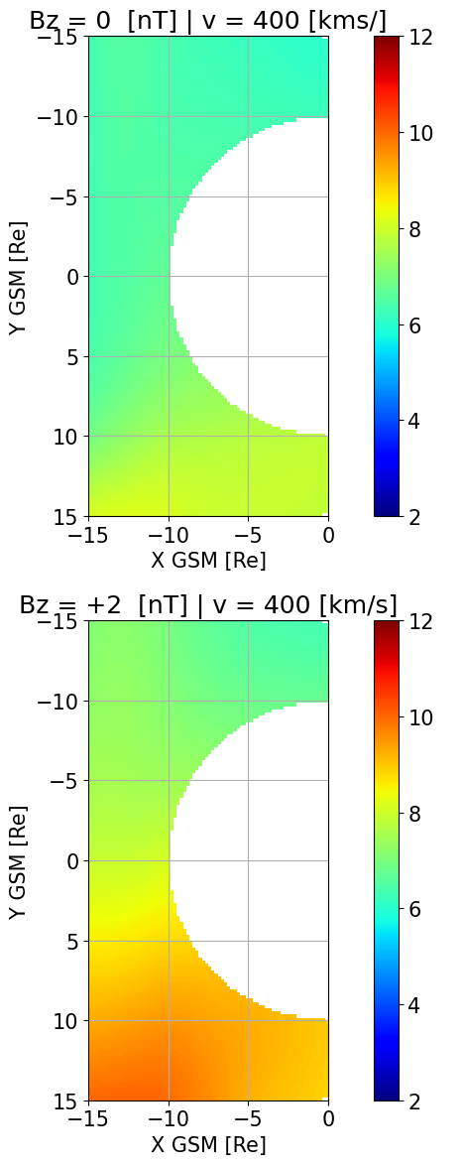
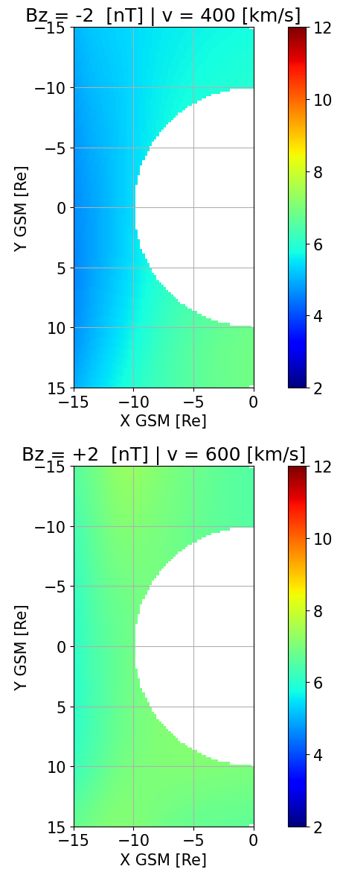
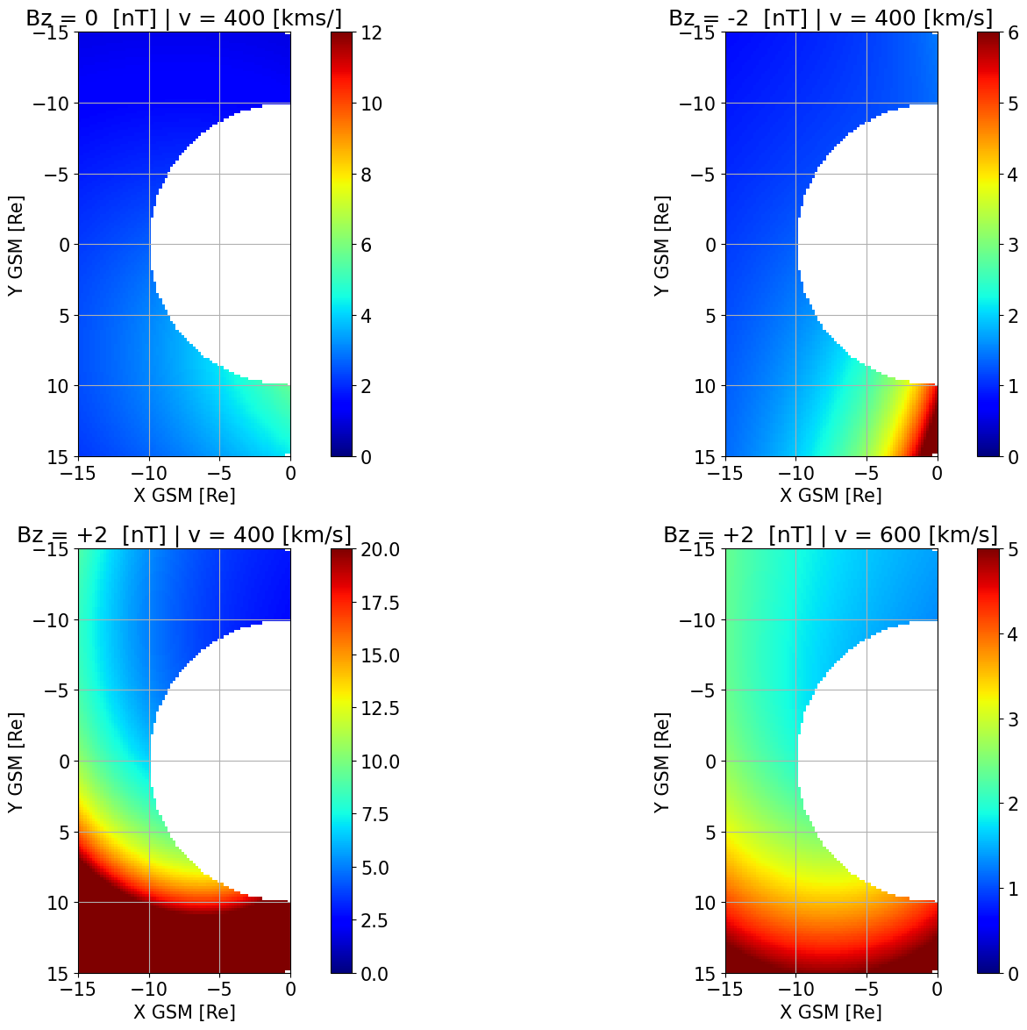
Modeling Temperature Ratios with MMS | 2D Maps
Reproducing: Wang et al., 2009 with dusk Ti/Te much higher than dawn
+No extreme values
+Asymmetries are shown
+ Coherent physical picture
Neural Networks modeling
Empirical modeling (TM03/DSGR16)

Slide 14
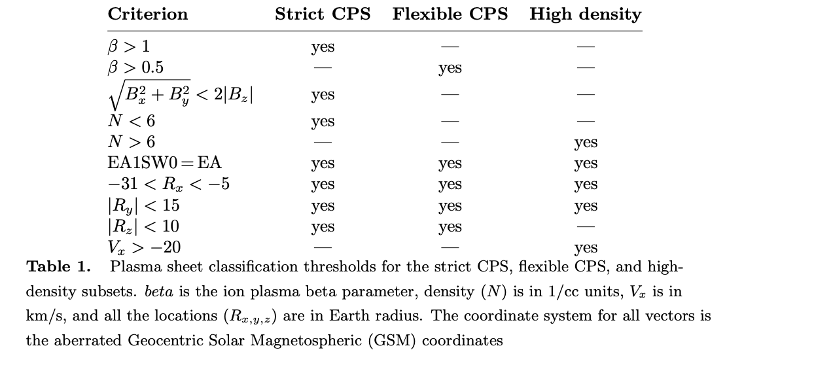
Storm Time Behavior and Importance of Outliers
The Problem: We use static thresholds for dynamic environents.
The Risk: Therefore we can mistakenly remove the crucial "stormtime plasmasheet.”
The "Solution": Manually find the missing data and add it to the dataset.
Strict CPS (e.g., Ohtani et al., 2008 Raptis et al., 2024) & Flexible CPS (e.g., Richard et al., 2022)
Notes:
20 minutes mark

Slide 15
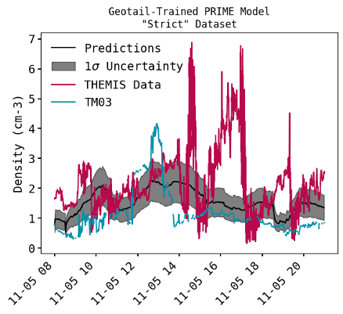
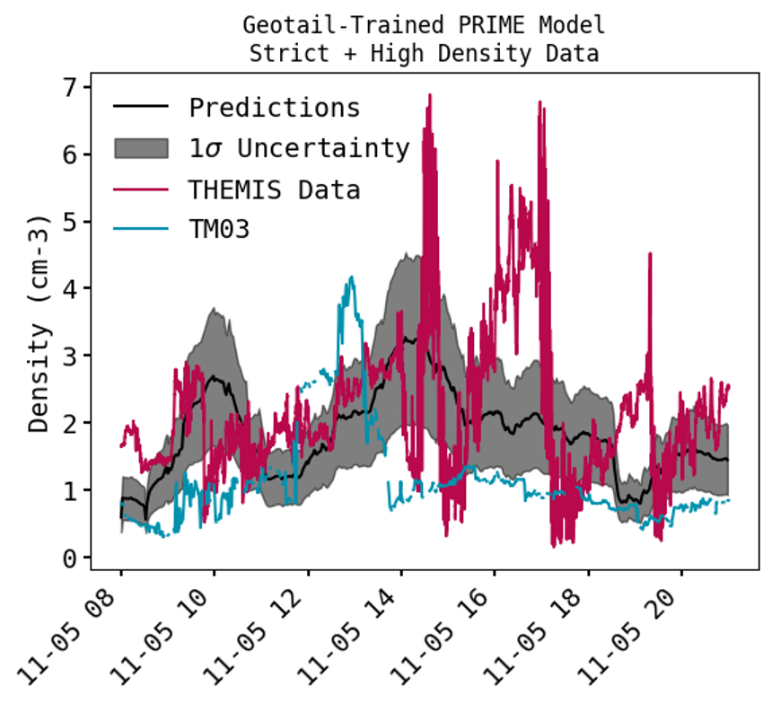
Test case of a storm (05 Nov 2023)
MAE (>40% improvement)
ML model: 0.7 [1/cc]
TM03: 1.22 [1/cc]
Note: values <1 cm⁻³, are transitions to the lobe/BL (will filter them out).

Slide 16
Summary & Discussion
Results
✅ Marginal Gains: ML models overall outperform analytical methods and show hidden asymmetries.
❌ Mediocre Predictability: We only capture "boring" conditions, not the critical rare events.
🧠 Core Problem: Our training data is biased. Extreme events, which are not captured by simple thresholds, must be included, but even then, they are very rare...
Future Work
Understand the output: How can we use these output to understand more about the physical processes?
Simulations to the Rescue (?): Try use simulations to generate extreme event data that in-situ observations struggle to provide.

Slide 17


Advertisement: LMAG25 (13 – 17 OCT 2025 JHU/APL)
When: 13–17 October 2025
Where: JHU/APL, Laurel, MD (primarily in-person)
Remote access: Zoom participation available
Format: ~20 minute talks plus short Q&A. Emphasis on interaction and collaborative problem-solving
Topics: See the LMAG2025 site for science themes; topic suggestions and ideas welcome
Audience: Heliophysics and geospace researchers, data scientists and computer scientists experts
No registration fee
RSVP today!

Slide 18
Extras

Slide 19

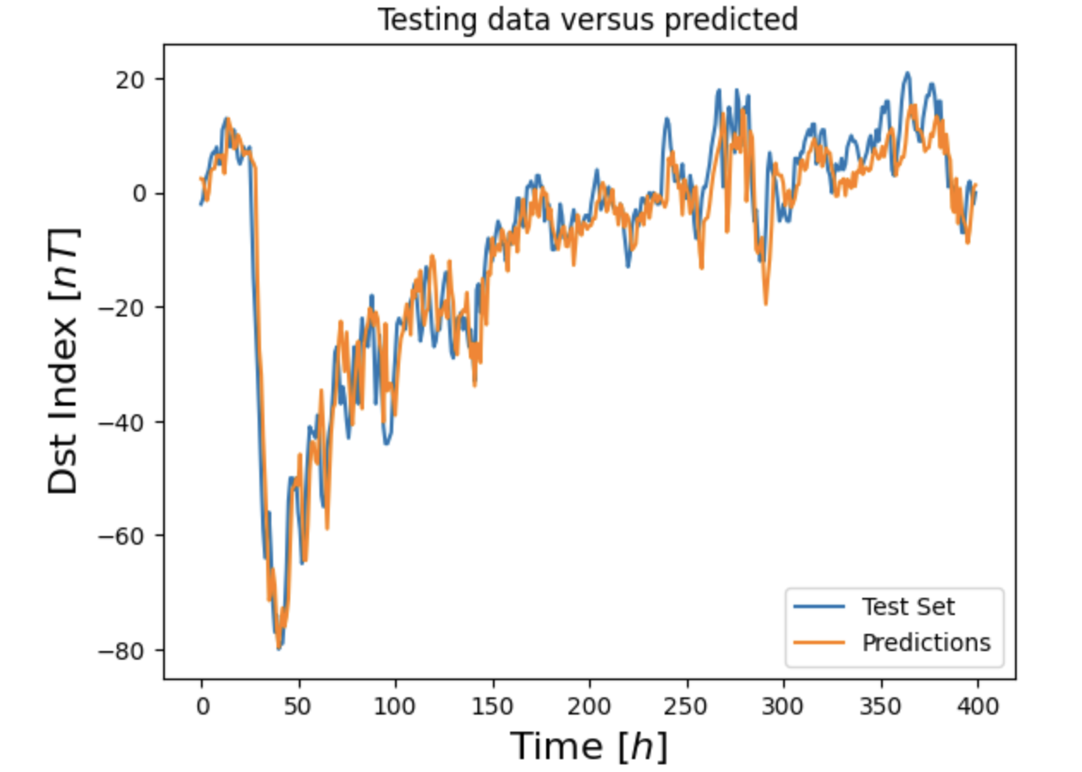

Forecasting DST index 3h in advance
explained_variance: 0.849
median absolute error: 3.758
r2: 0.848
MAE: 5.183
RMSE: 7.472
https://mybinder.org/v2/gh/SavvasRaptis/machine-learning-examples/HEAD

Slide 20
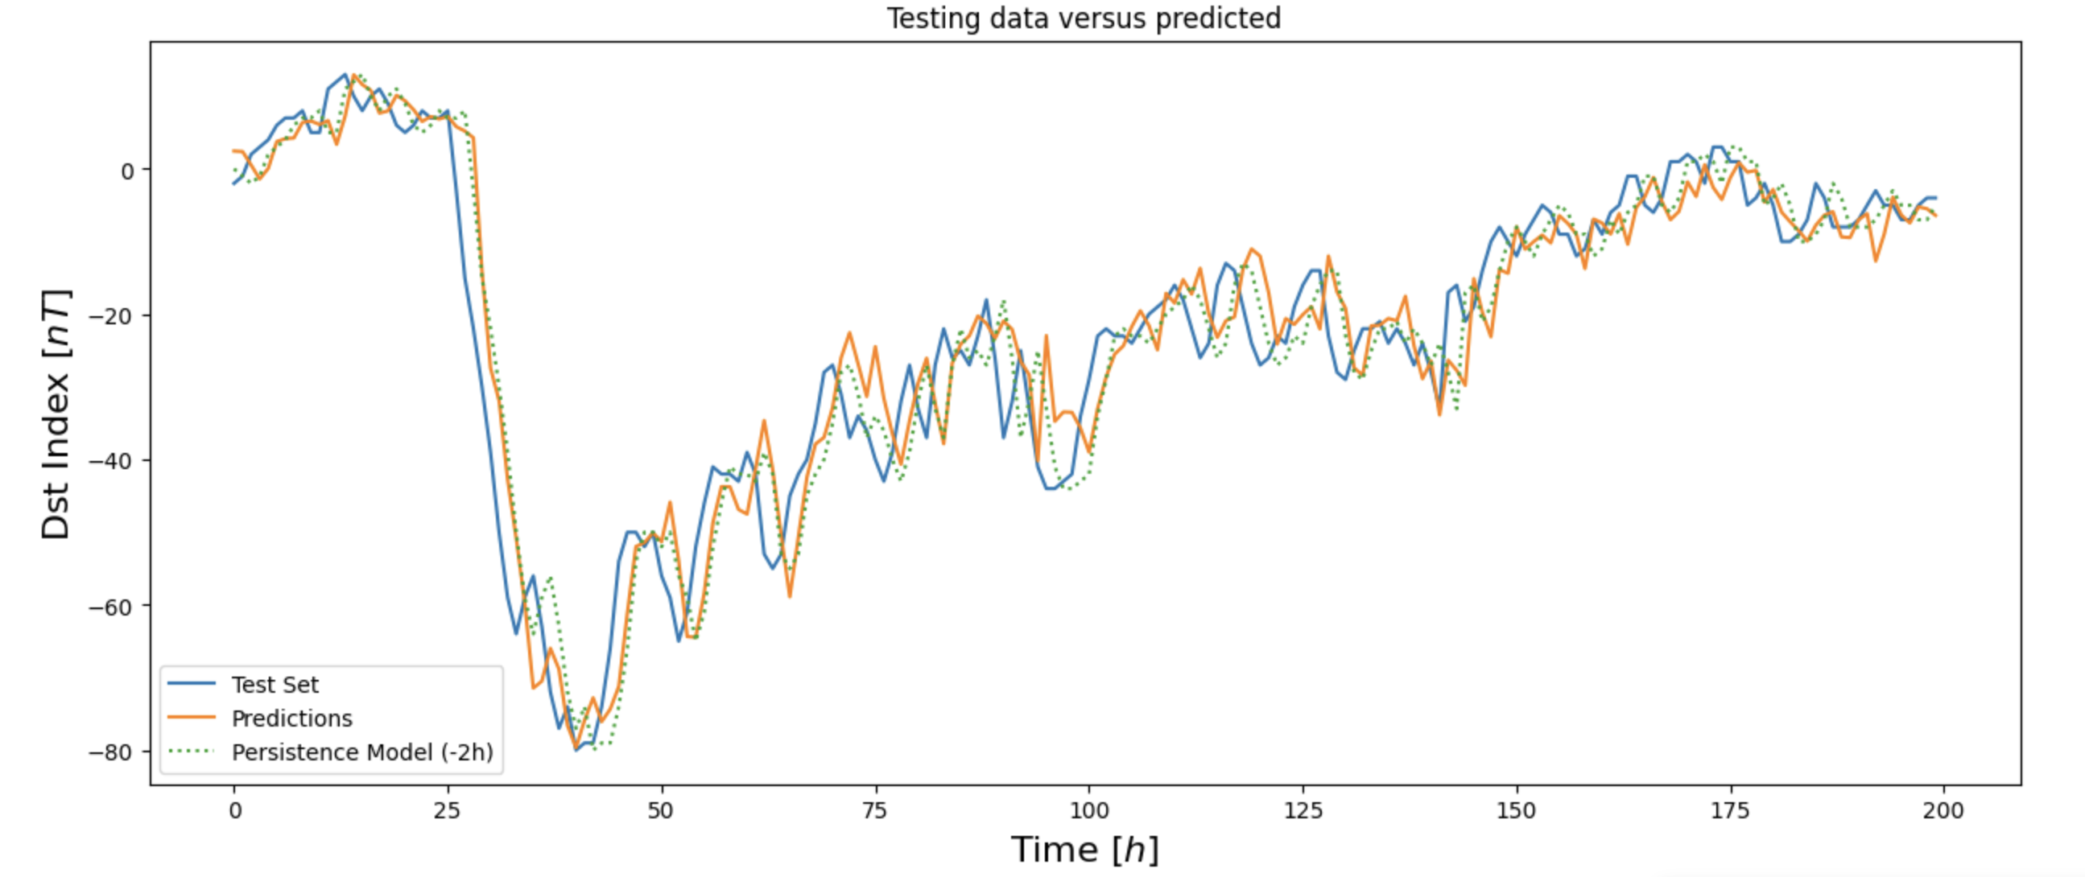
Forecasting DST index (3h) vs baseline model (2h)
Predictions (3h)
explained_variance: 0.849
median absolute error: 3.758
r2: 0.848
MAE: 5.183
RMSE: 7.472
Persistance model (2h)
explained_variance: 0.864
median absolute error: 3.0
r2: 0.864
MAE: 4.71
RMSE: 7.076
https://mybinder.org/v2/gh/SavvasRaptis/machine-learning-examples/HEAD

Slide 21
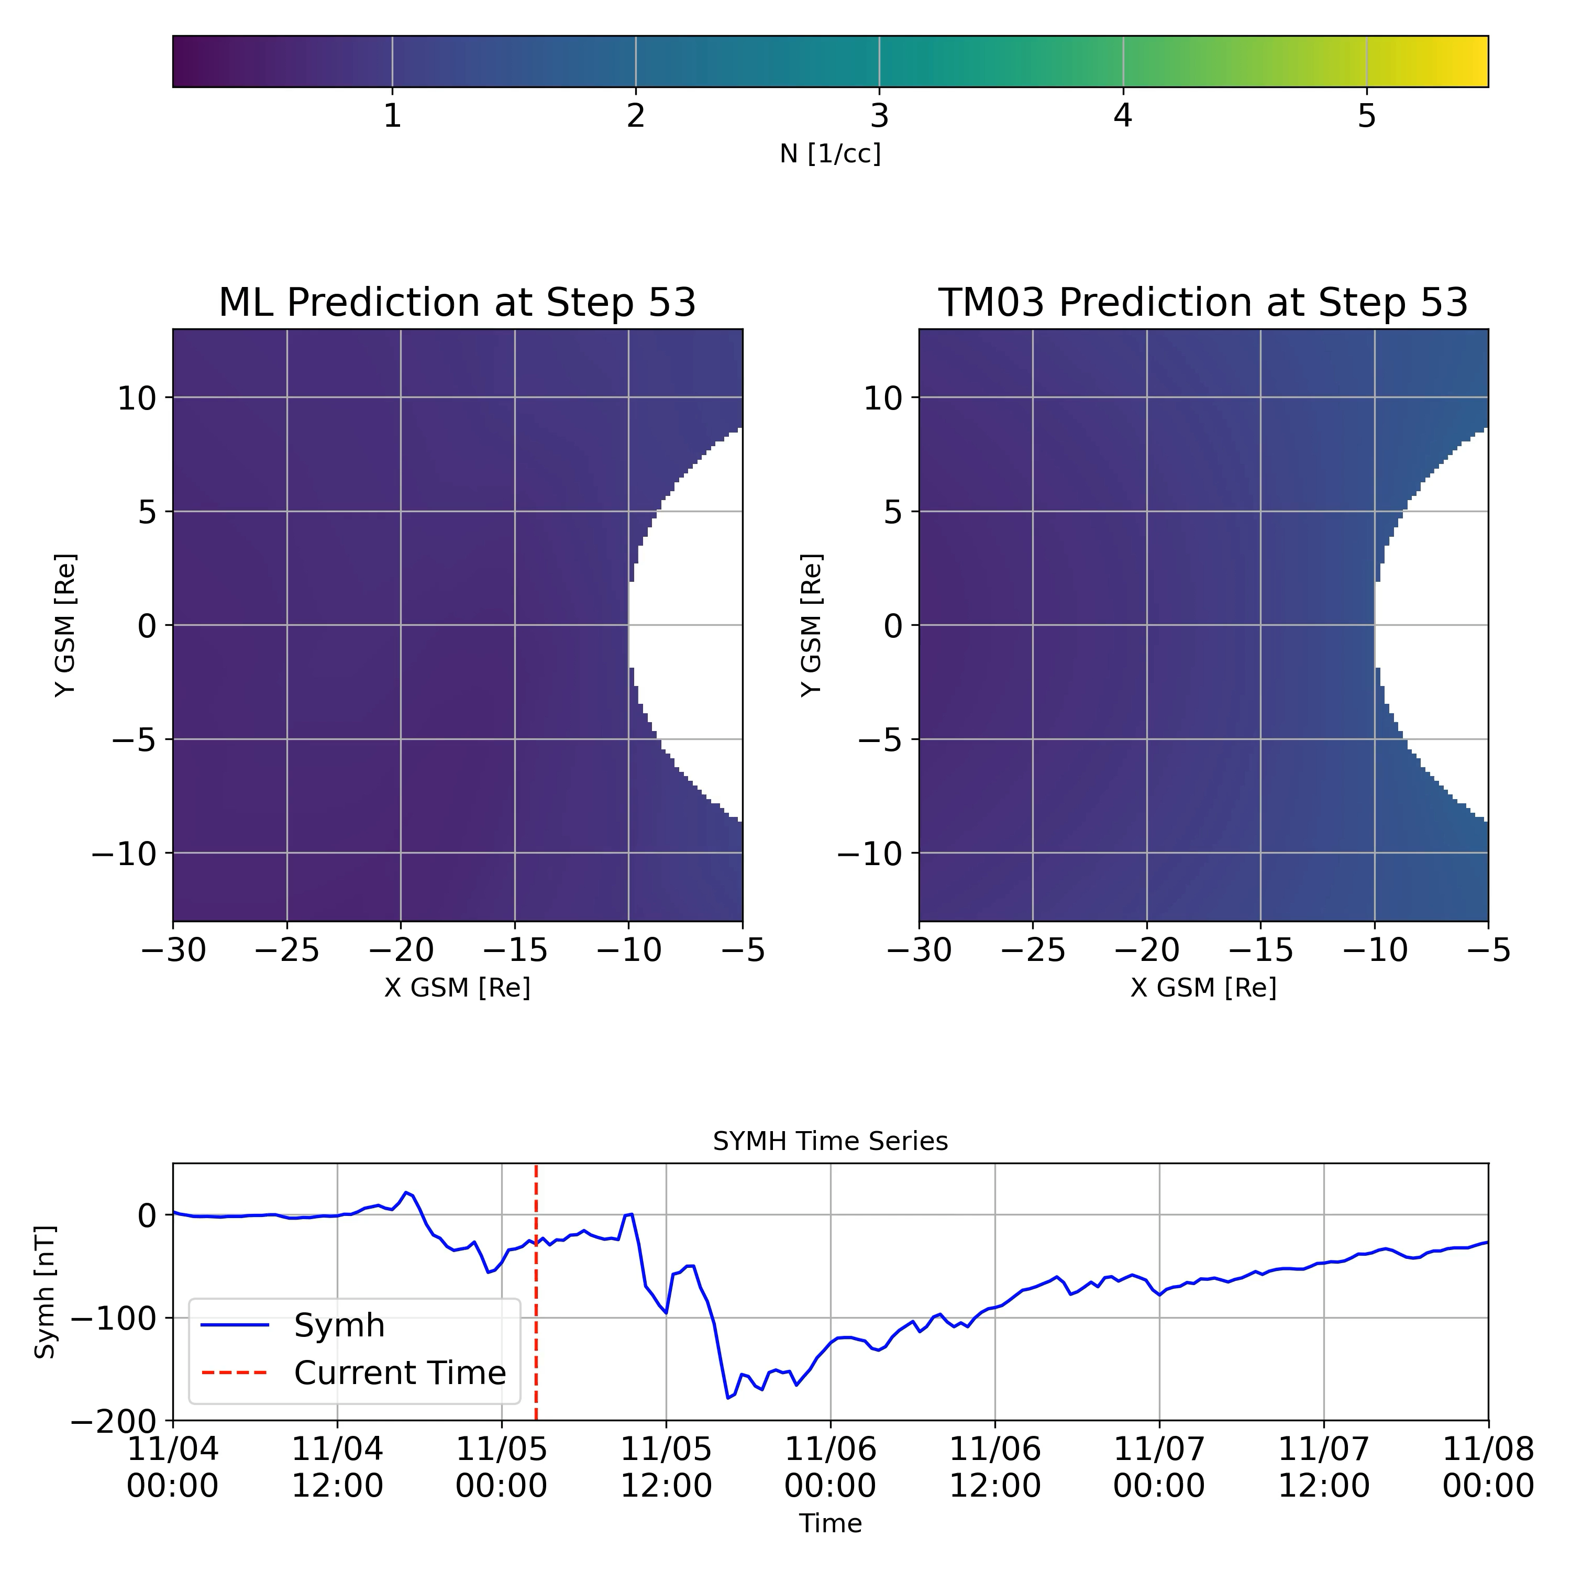
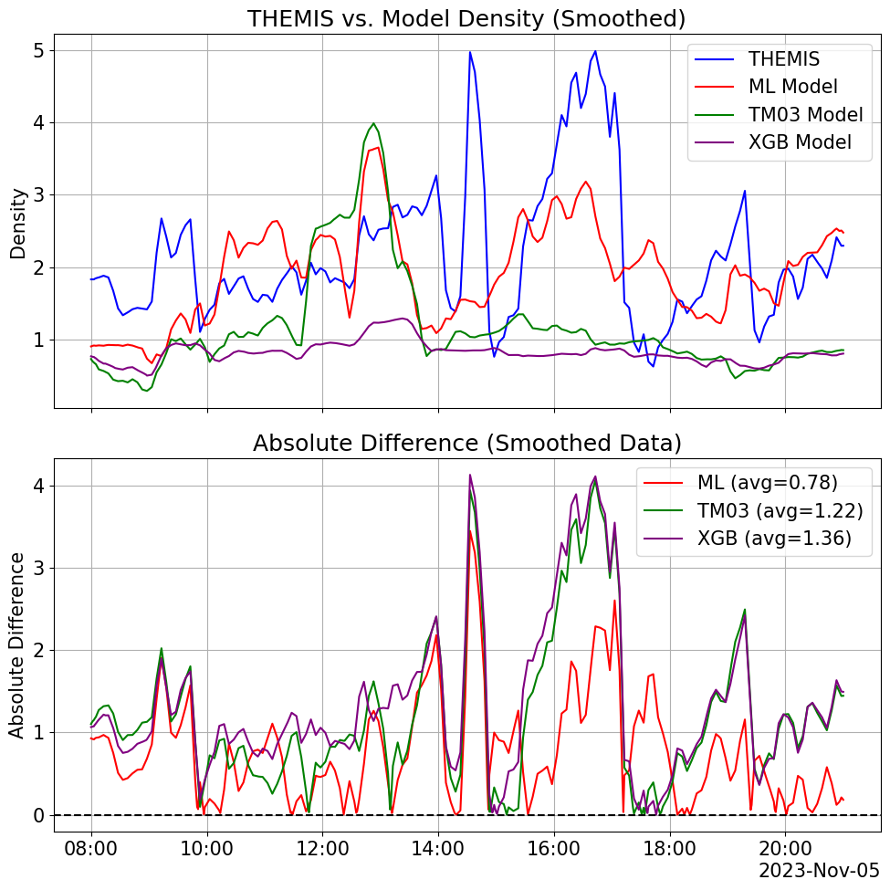
ML storm time density modeling

Slide 22
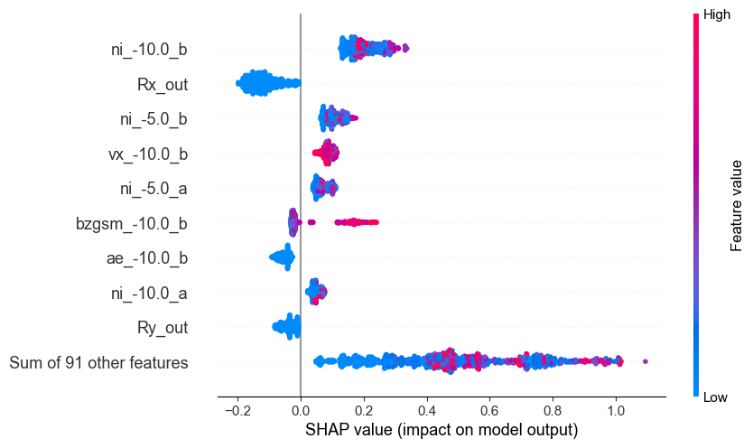
Model Feature importance storm vs quiet
In other words, the increased upstream density had a greater impact during the storm than the SC location.
X_test_storm
X_test_total

Slide 23
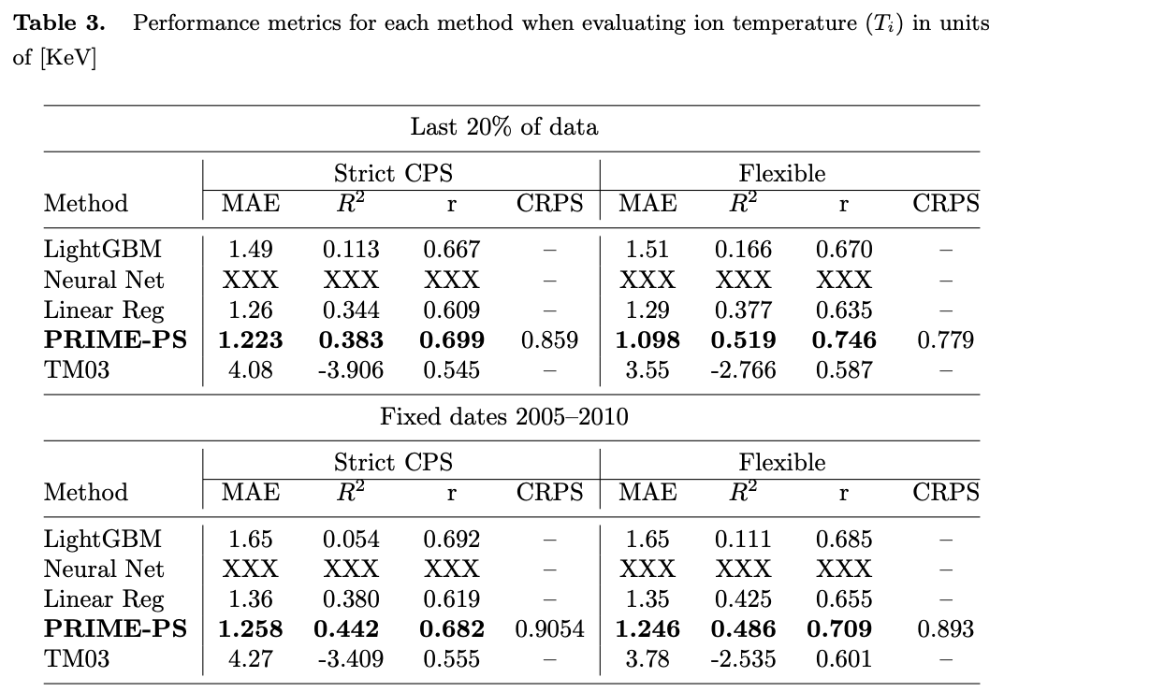
Updated results
Two different tests: (20% last data) – fixed dates 2005-2010 (after TM03 was published)
Key Results:
PRIME-PS demonstrates a performance edge (~30% MAE from TM03 and ~10% from NN).
This advantage is relatively low (from cross-validation).
Different input, method, history, etc. had a marginal effect.
Why is this the case?

Slide 24

Next step: 2D modeling
Input
SW properties + Geo conditions
Output
Plasma Sheet
Quantity
Dense Neural Network
Regression
grid in x,y
To get 2D maps
Output across 2D
$$\begin{matrix}x_{+5} \\ ⋮ \\ \begin{aligned}x_{−365} \\ r_{x},r_{y},r_{z}\end{aligned}\end{matrix}$$
$$…$$
$$y_{0}$$
Input:
x: Different solar wind features (e.g., n, B, etc.) + geomagnetic indices including time history up to 6h
r: Location of SC measuring output
Output:
y: Different quantities at plasma sheet (e.g., n, B, T etc.)
SW Input tried: Wind (1min res) – OMNIweb (1/5 min res)
Results here shown for 1min averaged quantities for output

Slide 25
(a)
Neural Network
Empirical (TM03)
(b)
 | TM03 | NN
R2 | 0.17 | 0.68
MAE | 0.19 | 0.11
RMSE | 0.27 | 0.2
r (cor) | 0.58 | 0.83

Slide 26
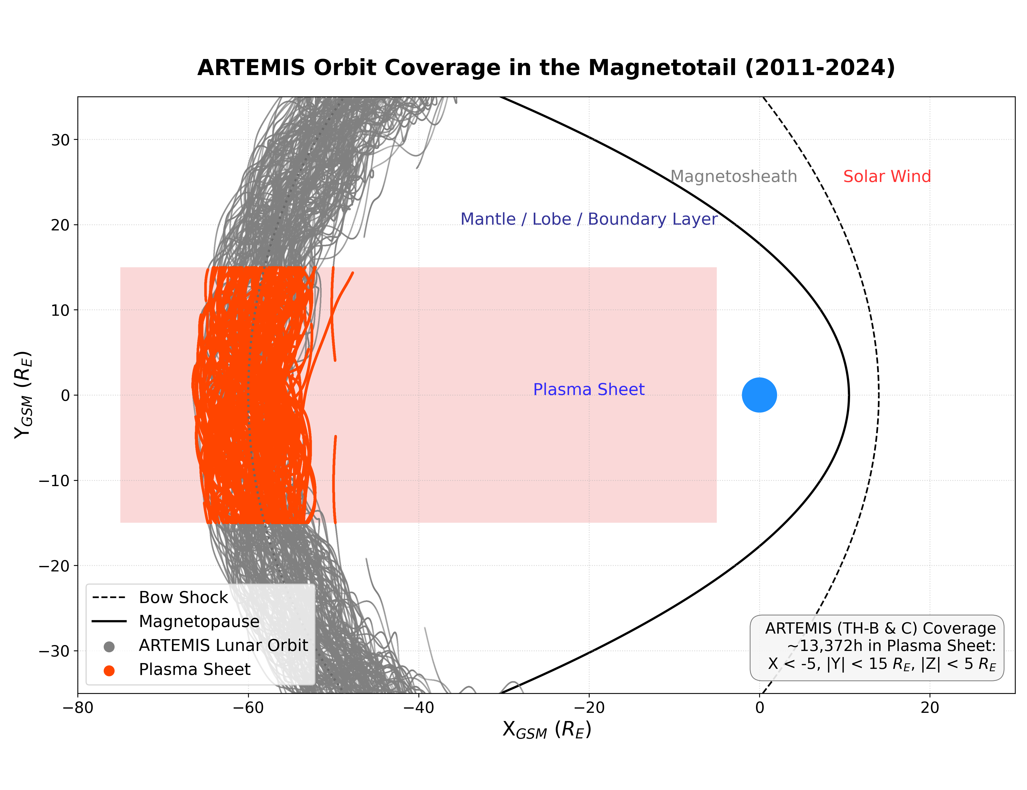
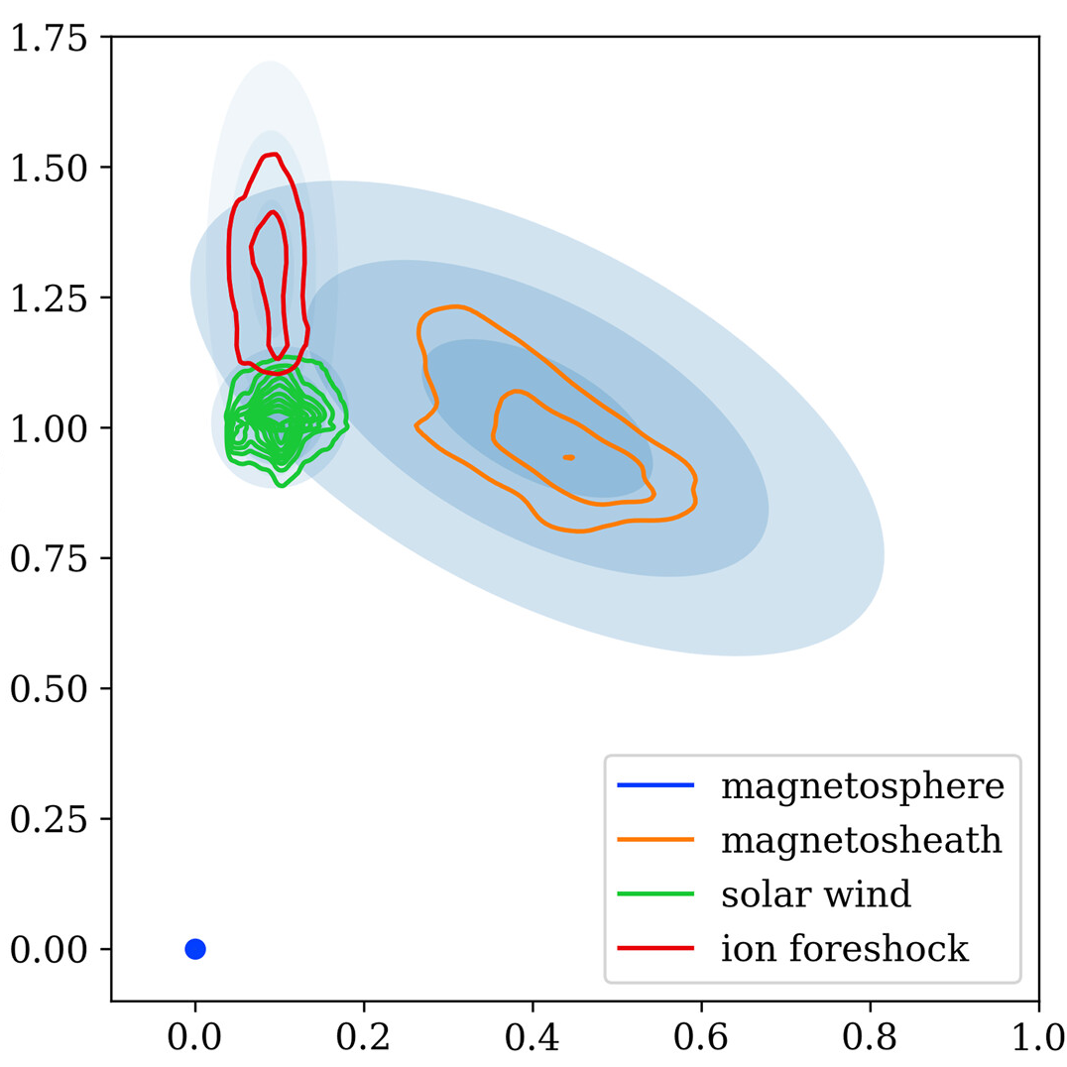
(a)
(b)
In-situ Clustering
Feature #2
Feature #1

